Slide 1
WEEK 3 – NETWORK SECURITY ASSESSMENT
Nmap & Wireshark Practical Lab
DG INTERNS HUB CYBER SECURITY INTERNSHIP • Ethical Hacking Track
Complete assessment cycle: Discovery → Enumeration → Traffic Analysis → Vulnerability Assessment → Hardening → Verification
Mah Noor | Kali Linux ↔ Metasploitable2 | VMware Host-Only Lab

Slide 2
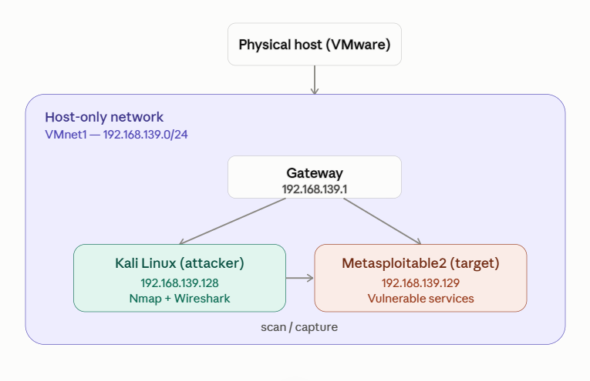
1. Objectives & Network Topology
Authorized host-only lab environment used for the assessment
• Discover active hosts and identify the target using Nmap.
• Identify exposed ports, services, and versions.
• Capture and analyze live traffic with Wireshark.
• Correlate Nmap results with packet-level evidence.
• Assess vulnerabilities and document risk.
• Apply hardening and verify the changes with after-scans.
VMware Host-Only Network: VMnet1 — 192.168.139.0/24
All scanning, testing, and packet capture were performed only on this private authorized lab.
2

Slide 3
2. Task 7 – Network Discovery & Basic Nmap
Discovering live hosts before examining their services
Command used nmap -sn 192.168.139.0/24
Result 5 active hosts were found in the /24 subnet. The key target was Metasploitable2 at 192.168.139.129.
IP Address | Role | Vendor
192.168.139.128 | Kali Linux – Attacker/Analyst | VMware
192.168.139.129 | Metasploitable2 – Target | VMware
192.168.139.1 | Gateway | VMware
192.168.139.254 | VMware DHCP/NAT | VMware
Next: nmap -sV 192.168.139.129 This moved the assessment from host discovery to service/version enumeration.
3

Slide 4
3. Task 8 – Advanced Nmap: Port & Service Assessment
Required structured summary of exposed services
Command: nmap -sV 192.168.139.129 | Additional scan: nmap -A 192.168.139.129 | SYN scan: sudo nmap -sS 192.168.139.129
IP | Port | Protocol | Service | Version | Risk | Observation
192.168.139.129 | 21 | TCP | FTP | vsFTPd 2.3.4 | CRITICAL | Known backdoor; anonymous login
192.168.139.129 | 22 | TCP | SSH | OpenSSH 4.7p1 | Medium | Old remote-access service
192.168.139.129 | 23 | TCP | Telnet | Linux telnetd | High | Credentials in plain text
192.168.139.129 | 80 | TCP | HTTP | Apache 2.2.8 | High | Old web server / CVEs
192.168.139.129 | 139/445 | TCP | Samba | Samba 3.x–4.x | High | Old file-sharing service
192.168.139.129 | 1524 | TCP | Bindshell | Metasploitable shell | CRITICAL | Root shell backdoor
192.168.139.129 | 3306 | TCP | MySQL | 5.0.51a | High | Outdated DB exposed
192.168.139.129 | 5432 | TCP | PostgreSQL | 8.3.x | High | Old DB exposed
192.168.139.129 | 6667 | TCP | IRC | UnrealIRCd | CRITICAL | Known backdoor risk
192.168.139.129 | 8009 | TCP | AJP | Apache Jserv | High | Ghostcat risk
192.168.139.129 | 8180 | TCP | HTTP | Tomcat/Coyote | High | Default-credential risk
4

Slide 5
4. Task 9 – Wireshark Network Traffic Capture
Capturing live traffic on eth0 and analyzing protocol behavior
Capture file wireshark_eth0RW77U3.pcapng
DNS Filter: dns Kali generated DNS queries, including google.com and metasploitable.localdomain.
TCP / HTTP Filter: tcp Observed SYN → SYN/ACK → ACK, followed by GET / and 200 OK.
ICMP Filter: icmp Echo requests/replies confirmed the target was alive and reachable.
SYN packets Filter: tcp.flags.syn == 1 Isolated new TCP connection attempts.
Conversation statistics Statistics → Conversations showed 1,027 packets / 60 KB in the major Ethernet conversation out of 2,072 total packets.
What I learned: Wireshark made the network activity visible at packet level instead of relying only on scanner output.
5

Slide 6
5. Task 10 – Nmap + Wireshark Investigation
Comparing scanner results with packet-level evidence
Nmap Result | Wireshark Evidence | Interpretation
Port 80 — Open | SYN → SYN/ACK | Web server is running and accepting connections
Port 22 — Open | SYN → SYN/ACK | SSH service is active and responding
Port 143 — Closed | SYN → RST | IMAP is not in use; target rejects connection
Port 995 — Closed | SYN → RST | POP3S is closed; no service running
Port 8888 — Closed | SYN → RST | No service on port 8888
Port 21 — Open | SYN → SYN/ACK | FTP service/backdoor is active
Port 1524 — Open | SYN → SYN/ACK | Root bindshell is active and responding
Key conclusion: an open port produced SYN/ACK; a closed port produced RST. Wireshark verified the Nmap results at packet level.
6

Slide 7
6. Task 11 – Advanced Network Traffic Investigation
Top communicating hosts + interesting events identified from the capture
Top communicating hosts 192.168.139.128 — Kali: source of most scans 192.168.139.129 — Metasploitable2: scan destination 8.8.8.8 — DNS destination
Interesting events observed in the pcapng
Time (s) | Source IP | Destination IP | Port | Protocol | Observation | Security Significance
2.575 | 192.168.139.128 | 192.168.139.129 | 80 | TCP | SYN port-scan probe | Start of Nmap reconnaissance
148.396 | 192.168.139.128 | 192.168.139.129 | 143,995,8888 | TCP | SYNs to closed ports | Range scan; ~1,002 SYN packets
148.396 | 192.168.139.129 | 192.168.139.128 | 143 | TCP | RST/ACK | Target rejected closed port
2.635 | 192.168.139.128 | 8.8.8.8 | 53 | DNS | Query for google.com | Normal DNS resolution
2.576 | 192.168.139.128 | 192.168.139.129 | 80 | HTTP | GET / HTTP/1.1 | Web request to Apache
2.594 | 192.168.139.129 | 192.168.139.128 | 80 | HTTP | 200 OK | Apache returned page
0.000 | 192.168.139.128 | 192.168.139.129 | ICMP | ICMP | Echo request | Host discovery / reachability check
148.402 | 192.168.139.128 | 192.168.139.129 | 445 | TCP | SYN to Samba | Potential SMB enumeration
7

Slide 8
7. Task 12 – Vulnerability Assessment
Nmap NSE evidence, risk classification, impact, and remediation
Finding | Risk | Reasoning / Evidence | Recommendation
vsFTPd 2.3.4 backdoor (CVE-2011-2523) | CRITICAL | Port 21 + NSE vuln result; remote root-shell risk | Disable/remove vsftpd 2.3.4; replace with SFTP
Bindshell on port 1524 | CRITICAL | Open root shell; no authentication | Kill process; block 1524; audit backdoors
UnrealIRCd backdoor (6667) | CRITICAL | Known backdoor / remote command execution risk | Disable/remove IRC; block 6667
Telnet exposed (23) | HIGH | Plain-text credentials visible in Wireshark | Disable Telnet; use SSH
r-services (512–514) | CRITICAL | Unencrypted legacy remote services; lateral-movement risk | Disable rexec/rlogin/rsh; use SSH
Anonymous FTP | HIGH | Anonymous access can expose or alter files | Disable anonymous login; use SFTP
Outdated MySQL/PostgreSQL | HIGH | Old database versions directly network-exposed | Update; restrict to required hosts/firewall
SSL POODLE (CVE-2014-3566) | HIGH | NSE confirmed SSLv3 weakness | Disable SSLv3; TLS 1.2+; update OpenSSL
VNC 5900 / NFS 2049 | HIGH | Remote desktop / file-share exposure | Restrict access; firewall/VPN; audit exports
8

Slide 9
8. Task 13 – Security Hardening & Before/After Verification
Fixes were applied on Metasploitable2 and verified from Kali
Security Issue | Before | Action Taken | After | Result
vsFTPd 2.3.4 — Port 21 | OPEN / CRITICAL | Killed xinetd process (PID 5019) managing vsftpd | CLOSED | Backdoor eliminated
Telnet — Port 23 | OPEN / HIGH | Same xinetd process stopped | CLOSED | Unencrypted remote access eliminated
Java RMI — Port 1099 | OPEN / HIGH | Killed rmiregistry process (PID 5152) | CLOSED | RCE vector removed
• Used netstat to identify listening processes before terminating them.
• Ran a fresh nmap -sV scan after the changes.
• Final verification confirmed ports 21, 23, and 1099 were closed.
Outcome: 3 high-risk attack vectors were removed and verified with after-scans.
9

Slide 10
9. Task 14 – Five Professional Security Recommendations
Recommendations stated in the report
1. Apply least privilege for network services Disable every service that is not absolutely necessary; minimize exposed ports.
2. Replace unencrypted protocols Replace Telnet with SSH, FTP with SFTP/SCP, and disable r-services.
3. Keep software updated and patched Maintain current versions and monitor CVE/security advisories.
4. Implement segmentation and firewall rules Restrict databases, NFS/Samba, VNC, and SSH to trusted hosts/management networks.
5. Deploy IDS and perform regular scanning Use IDS such as Snort/Suricata and regularly scan owned systems for exposure.
10

Slide 11
10. Final Assessment & Key Takeaways
The complete Week 3 security-assessment cycle
1. Discovery Active hosts found
2. Enumeration Ports/services identified
3. Analysis Traffic inspected
4. Assessment Risks documented
5. Hardening 3 ports closed
6. Verification Fixes re-scanned
Major findings: 3 critical backdoors (vsftpd, bindshell, UnrealIRCd), confirmed POODLE, multiple outdated services, Telnet, anonymous FTP, and exposed databases.
Hardening result: Ports 21, 23, and 1099 moved from OPEN → CLOSED and were verified with after-scans.
Main learning: professional security work is not only running tools — it is interpreting evidence, prioritizing risk, fixing weaknesses, and proving the fix worked.
11

Slide 12
References & Assessment Scope
Key resources cited in the report
Resource | Use
Nmap Official Website / Reference Guide | Nmap commands and documentation
Nmap NSE Documentation | Vulnerability detection scripts
Wireshark Official Website / User's Guide | Packet capture and traffic analysis
Wireshark Display Filter Reference | Display filters used in investigation
MITRE ATT&CK Framework | Security / adversary-technique reference
CVE Program | CVE references and vulnerability identifiers
CVE-2011-2523 / CVE-2014-3566 | vsFTPd backdoor / SSL POODLE evidence
Metasploitable2 Documentation | Target lab environment reference
Scope statement: all scanning, testing, and packet capture were performed exclusively on the authorized VMware host-only lab environment.
12

