Slide 1
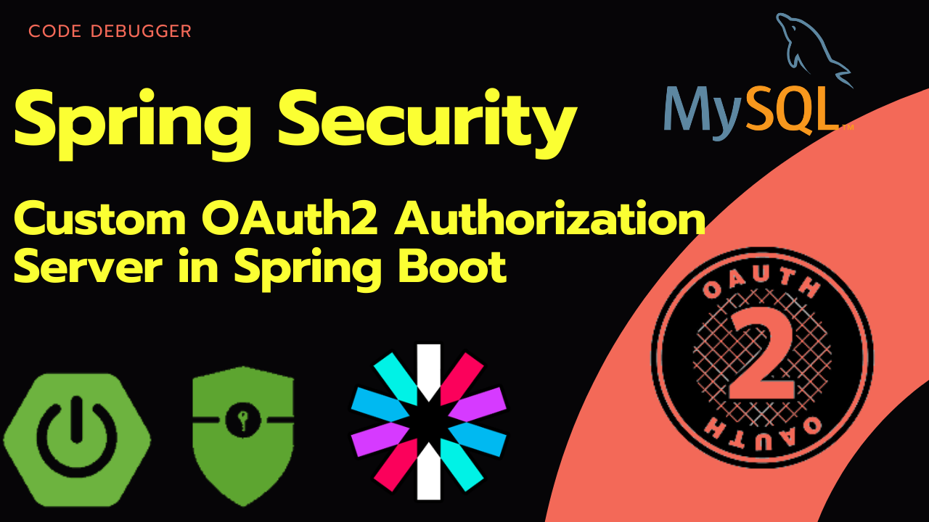

Slide 2

What is OAuth ?
OAuth is known as secure, third-party, user-agent, delegated authorization service.
OAuth is an open-standard authorization protocol or framework that describes how unrelated servers and services can safely allow authenticated access to their services without sharing user details.

Slide 3
How it works ?
OAuth doesn't share password data but instead uses authorization tokens to prove an identity between consumers and service providers.
OAuth is an authentication protocol that allows you to approve one application interacting with another on your behalf without giving away your password

Slide 4
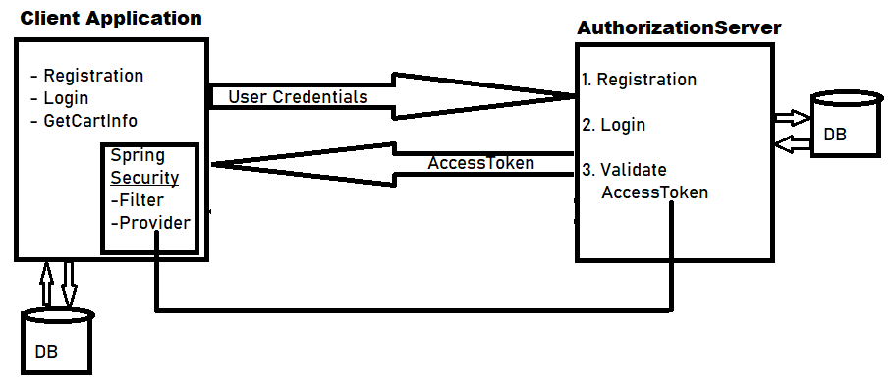
Custom Oauth Implementation Diagram

Slide 5
Tables required for OAuth
oauth_access_token
oauth_refresh_token
oauth_code
oauth_approvals
ClientDetails
oauth_client_details
oauth_client_token
user_role

