Slide 1
Reproduction of 1/z expansion method on LiHoF₄
Yikai Yang
2026.08.02

Slide 2
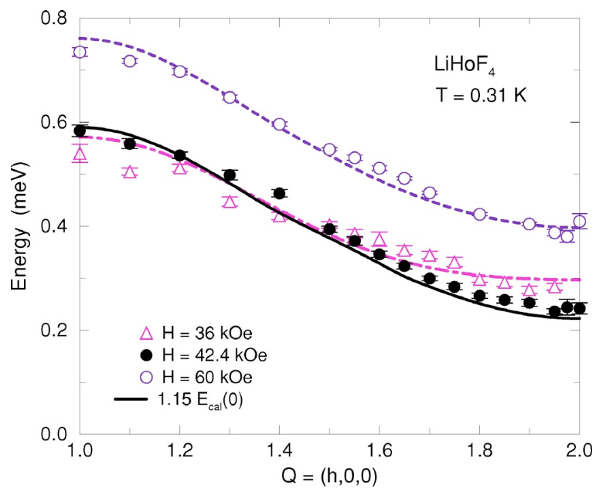
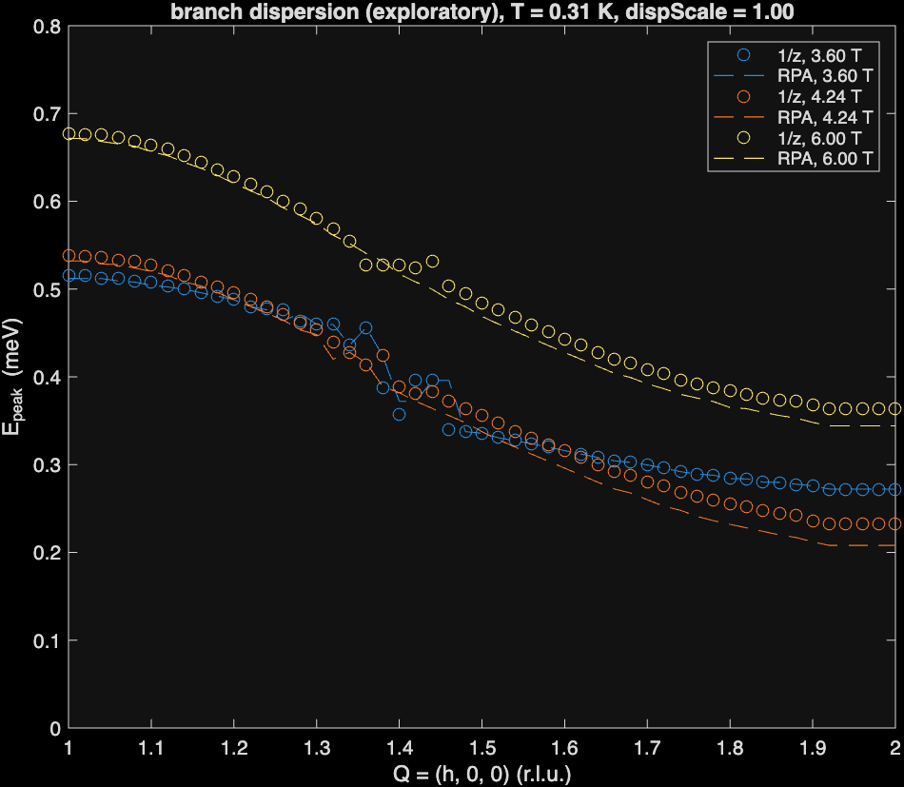
Reproduction of PRB 75, 054426 (2007)
H. Ronnow, et al. Phys. Rev. B 75, 054426 (2007)
Reproduction

Slide 3
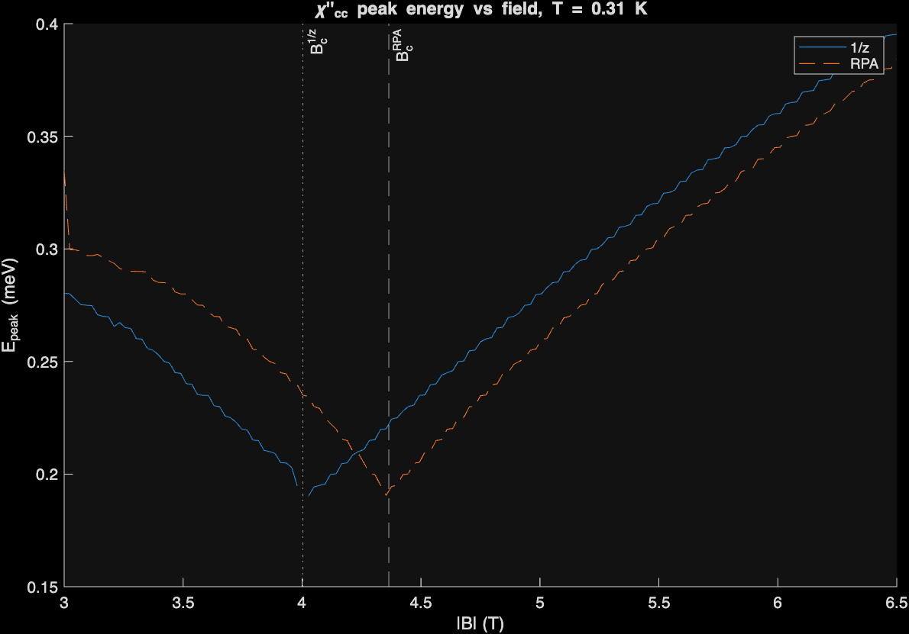
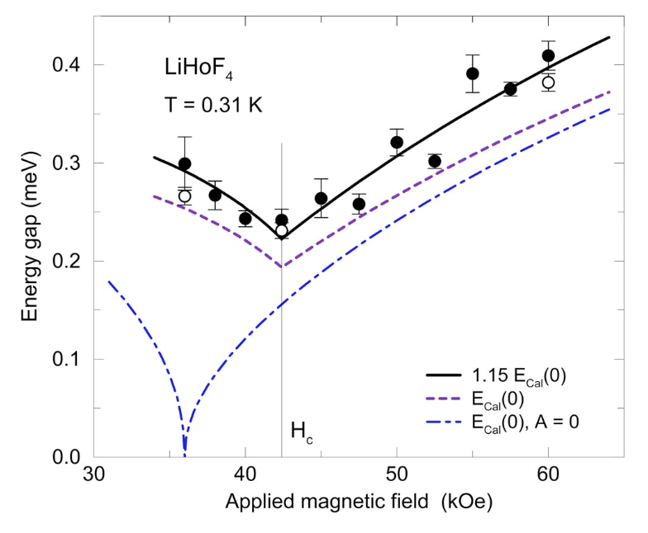
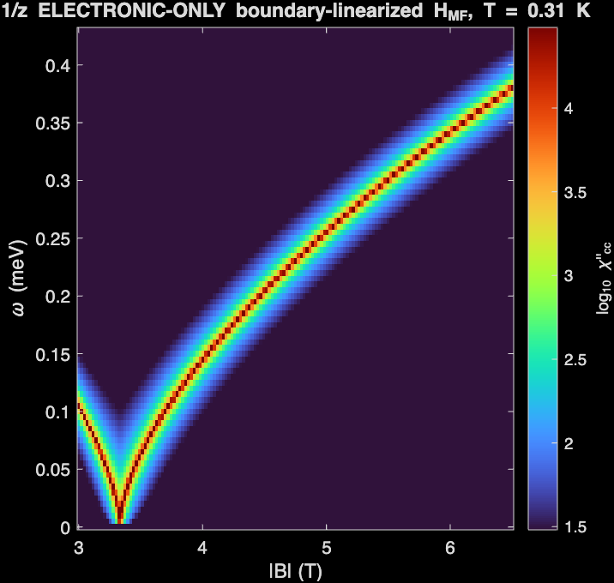
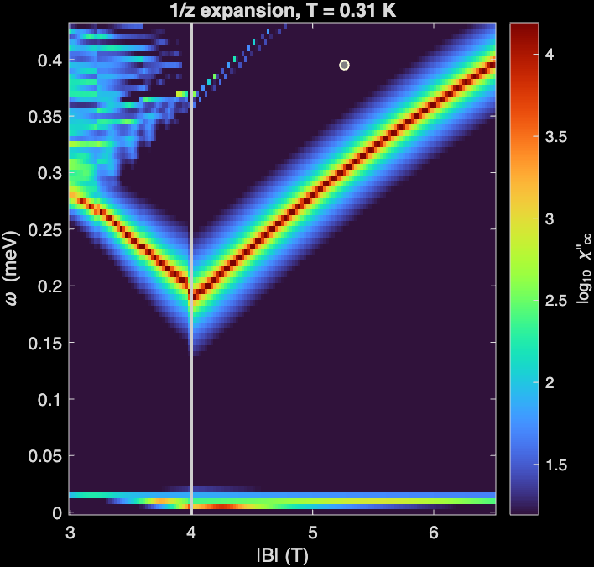
Reproduction of PRB 75, 054426 (2007)
E_{cal}(0), A = 0
E_{cal}(0), A > 0
H. Ronnow, et al. Phys. Rev. B 75, 054426 (2007)
Reproduction

Slide 4
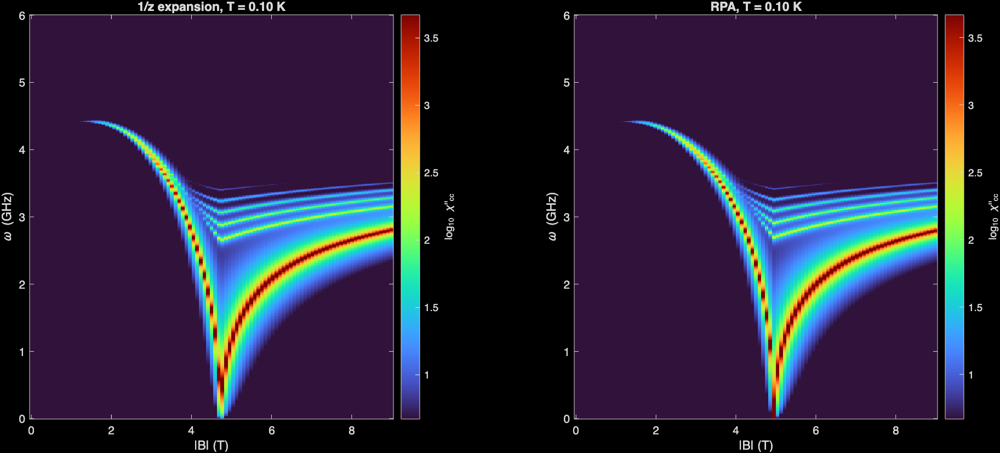
1/z expansion
RPA calculation

Slide 5
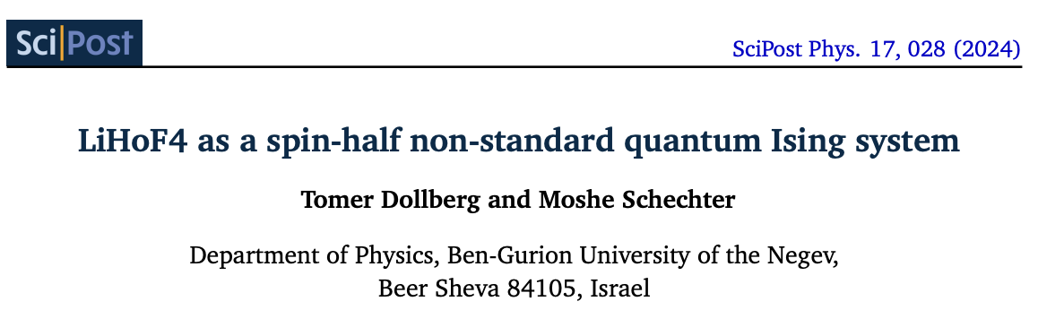
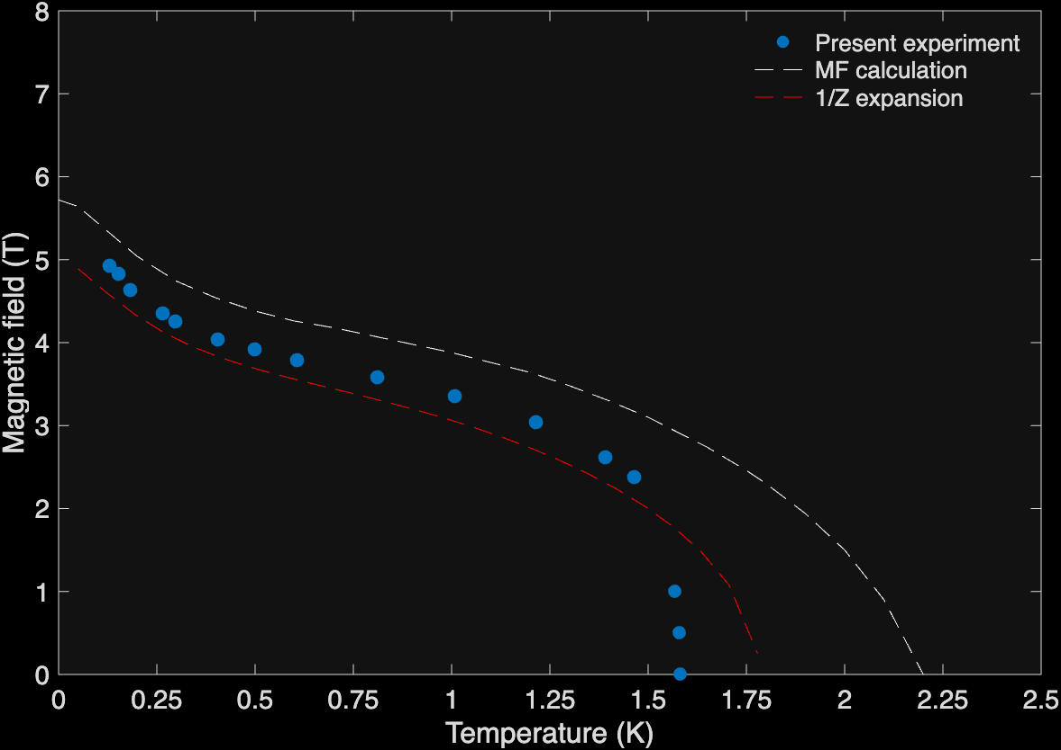
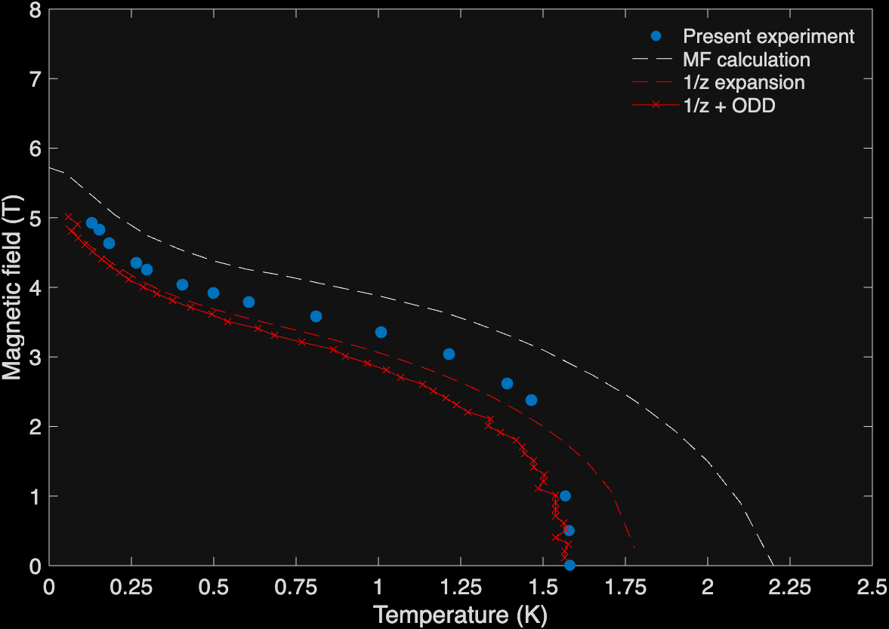
New ingredient beyond 1/z expansion
MF vs 1/z expansion
MF vs 1/z expansion vs 1/z + ODD

Slide 6
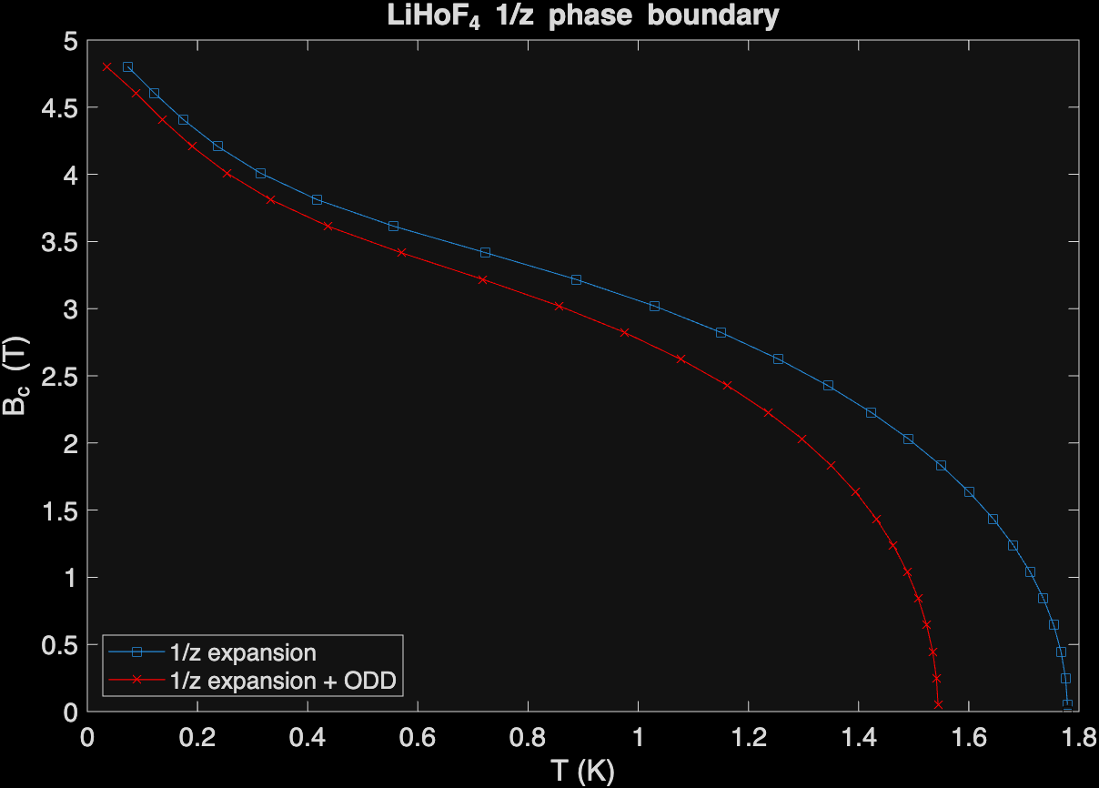
MF vs 1/z expansion vs 1/z + ODD
1/z expansion vs 1/z + ODD

Slide 7
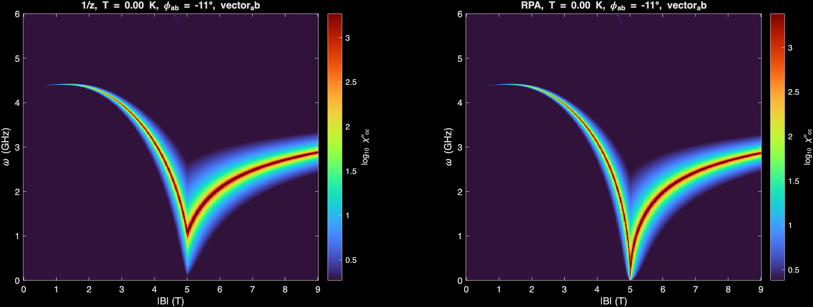
1/z expansion
RPA
Artifact

