Slide 1
Reservations API

Slide 2
First, let’s talk about some stories of my friends.

Slide 3
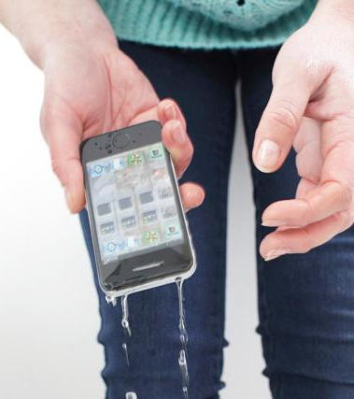
Bob’s busy morning
Bob checked his calendar before bed and realized he had a early meeting at 7 AM in the next morning.
Bob set up an alarm to wake up at 6 AM.
Of course, Bob snoozed and didn’t woke up until 6:15 AM. He rushed to shower and realized he forgot to request his Uber yet.
Now here it is Bob with his hands wet trying to unlock his phone, open the Uber app and request a ride.

Slide 4

Cindy – busy business traveler
Cindy had a flight leaving SFO right after her meeting.
Cindy checked-in her flight yesterday on the Delta app.
Cindy was in the meeting and can’t really book the ride on her phone.
Now here it is Cindy standing around worriedly booking and then waiting for her ride.

Slide 5
This happens to not just Bob or Cindy. This happens almost to Everyone of us, and almost everyday!

Slide 6
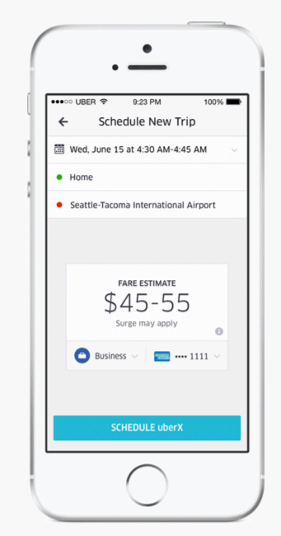
Wouldn’t it be AWESOME
Wouldn’t it be AWESOME If Cindy can reserve a ride right after she checked in her flight within the same app?
Wouldn’t it be AWESOME If David can simply reserve a ride for the next morning right within his calendar app?
If we can Schedule it right in the app when we realize we need a ride and you don’t need to ever worry about it!

Slide 7
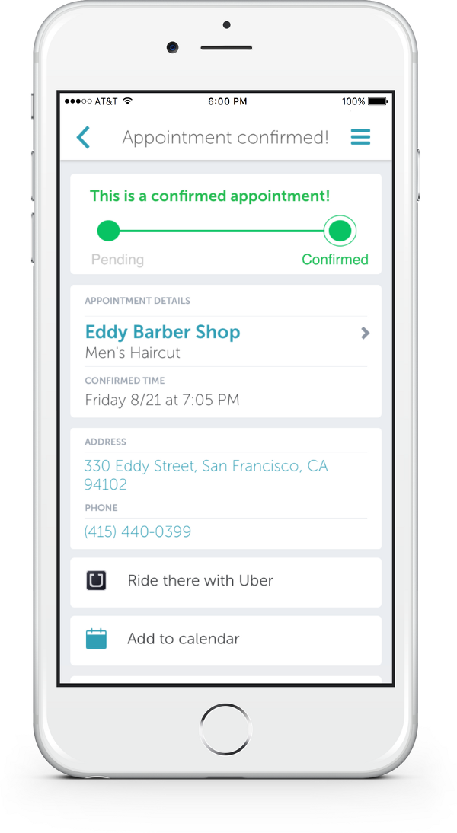
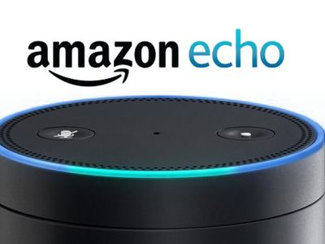
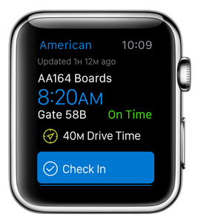
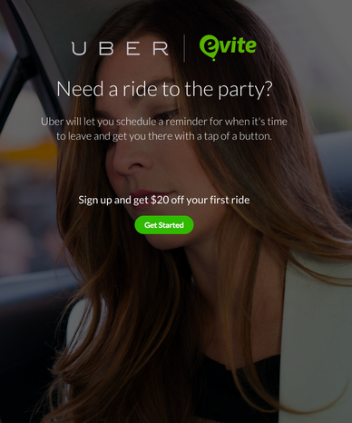
Peace of Mind + Convenience + Simplicity = Reservation API
Schedule a ride from
Anything with a reservation, dining, events, flight, movies.
Social networking, conversations with friends.
Calendar
Smart home/personal assistant
Event organizing app. ( Organizer can reserve rides for you!)
And many more!

Slide 8
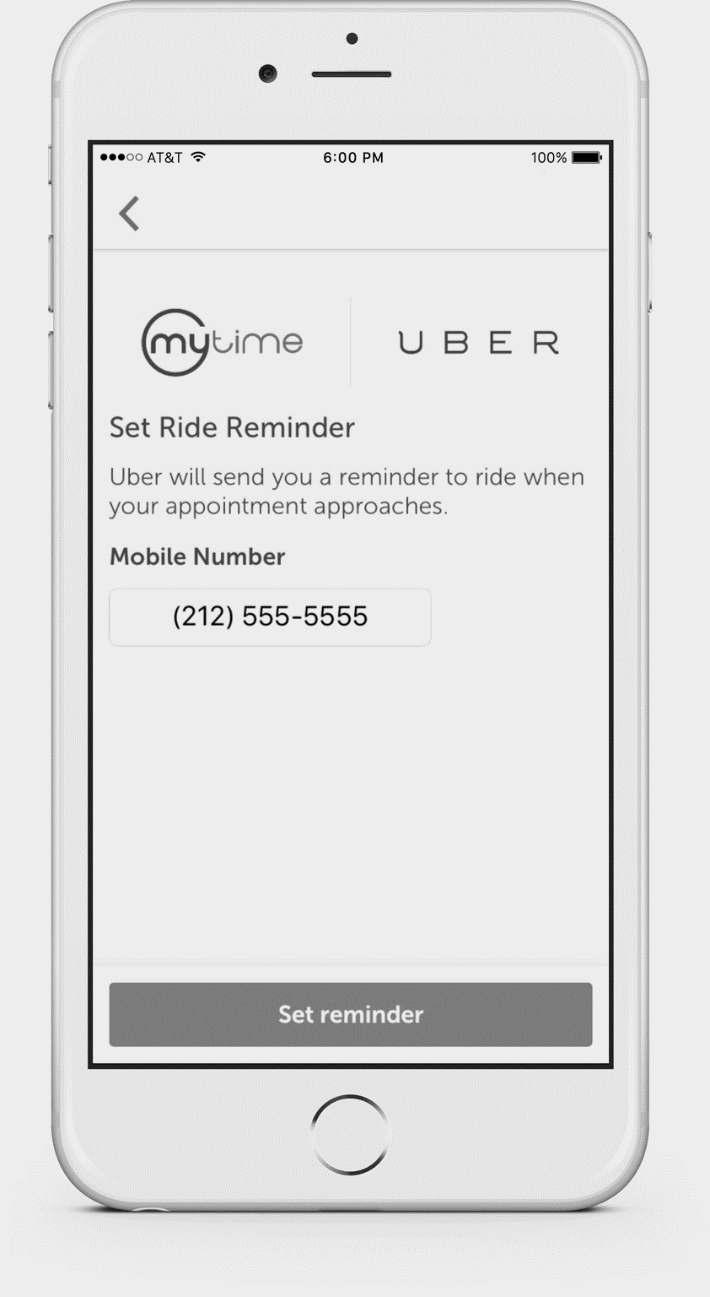
Also much simpler compared to reminder

Slide 9
For riders
At the scale of Uber… Everyday
Convenience
Peace of mind
Simple, Fast and Easy
100K+ airport drop off
$3+million in revenue related to airport transportation.
50K reminders are sent.
25% our rides are for a reserved destination.
For Uber
Engage users
Increase revenue
Not a chance for users to switch to Lyft
Better predict demand and allocate resource

Slide 10
Now let’s bring reservations APIs to users and developers and change the way of people getting around once again!

