Slide 1
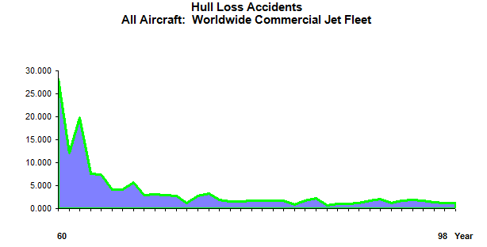
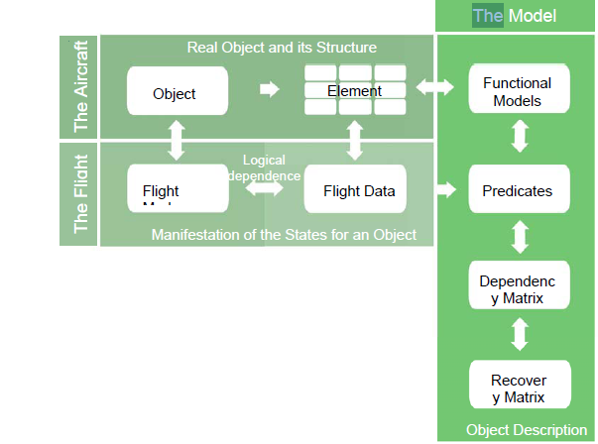
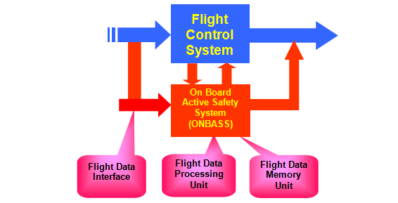
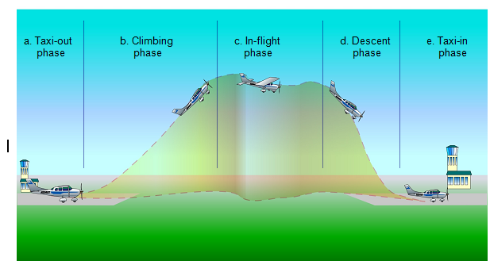
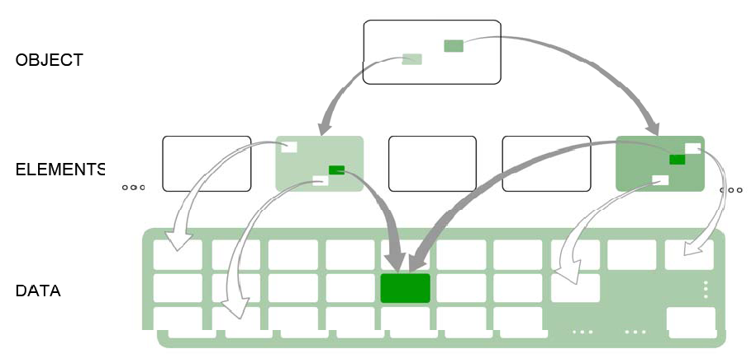
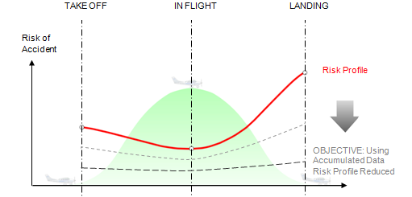
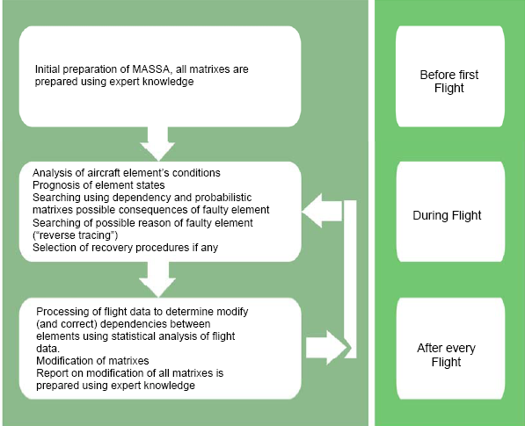
PROTOTYPE DEVELOPMENT OF ACTIVE CONDITIONAL MONITORING SYSTEM
ADEYEMI ADEKUNLE (M.Sc Computing)
LONDON METROPOLITAN UNIVERSITY
INTRODUCTION
FIG 1
FIG 4
FIG 7
Active conditional monitoring system is a system that monitors the elements of an object (aircraft) before and during take-off, during flights, and landing in real time. This system, not only monitor the aircraft but also alert the right authority e.g the pilot, control tower, e.t.c, of any potential damage and/or accident in terms of the elements or the equipments of the aircraft. The system also records the condition of the aircraft at any particular point in time putting into consideration data recorded from previous flights and the different states of the elements or components and determining normal and abnormal states for further analysis. This system was developed as part of the Principle of Active Safety Systems (PASS).
The system (PASS) was proposed as part of a way of increasing the safety regulation of the aviation sector and reducing the accidents and incidents rates in this industry.
The aviation sector is divided into different sectors considering different factors which include the flights mission, the mode or method of operation, the technical specification and the state of development of the aircraft [1]. But generally it can be divided into two; military and civil aviation. The military aviation safety procedure has been adapted to the function of the hardware and software of the planes basically because it contains at most two pilots and has been modified for combats and other special functions and also contains some sensitive information.
The civil aviation sector further divided into two, namely general aviation (GA) and commercial aviation (CA) [1] but the risk and safety in this sector still poses a great threat to aviation sector in general (Fig 1)[2]. During the analysis of these risks a reduction level was proposed as shown in fig 3 and on further analysis it was found out that the highest accidents and/or incidents occur in the climbing and the landing phases of the flight (fig 2)[3]. to reduce this mortality rate a project called ONBASS which modelled the PASS with the present system of objective checking (SOC) was proposed (fig 7)[3].
The structure of PASS was developed too (fig 4)[4]. This structure showed the relationship between the flight model, the flight data, the objects and elements with the other parts of PASS which predicts occurrence of incidents or accidents and initiating possible sequence of reaction to avert it. The algorithm for the PASS was modelled too (Fig 6)[2]
The active conditional monitoring system uses this structure of PASS to determine the states of the elements from the recorded data during the phases of flights and analyse it to get the normal and abnormal states of the elements (fig 5)[4]
Accident statistics per million departures (Source [2])
Overview of the ONBASS System [3]
FIG 2
conclusion
THE MASSA STRUCTURE [ source 4]
With the development of these safety systems, the mortality rate in the aviation sector can and will brought to the nearest minimum. And also it give the manufacturers of these element a better understanding of their products making them produce fault tolerant products.
FIG 5
REFERENCE
ONBASS project, Deliverable 1.2 ONBASS Consortium, 2005,
United states GAO (General Accounting Office), GAO-01-96, “General Aviation Status of the Industry, Related Infrastructure, and safety Issues”, Report to Congressional Requester, August 2001.
PASS
Weener E., “Aviation Safety for the 21st century”, Invited Lecture 1998 ISSSC, Seattle.
Annex 1 – “Description of work”, Version 3.1, dd 12/11/2004, for ONBASS. Contract of the 6th European Framework Program: “Integrating and Strengthening the European Research Area, Thematic Priority” : Aeronautics and Space, Contract No: AST4-CT-2004-51
Igor Schagaev., “Concept Of Dynamic Safety for Aviation” , 16th ISSC 1998, Seattle
Schagaev I., Concept of Active System Safety. In Proc. 15th IFAC Symp. On Automatic Control in Aerospace Bologna/ Forli, Italy September 2001
Bukov V.N., Systems Embedding. Analysis and Design of Matrix Systems: An analytical approach. Kaluga: N Bochkareva Publishing house, 2006
Earl F. Weener 98 Commercial aviation Safety Challenges for the 21st Century, Presentation to Systems safety Conference September 16, 1998
. Typical flight phases [ source 3]
FIG 3
Dependency of data and elements [source 4]
FIG 6
. Propose Level of Risk Reduction[7]
The on- board and on-ground phases of PASS algorithms [2]

