Slide 1
Group Meeting
Presenters : You-Ran Nai
Advisor : Prof. K.C.Chang
Notes:
老師學長姐大家好

Slide 2
Stability of Elastomeric Isolation Bearings: Experimental Study
JOURNAL OF STRUCTURAL ENGINEERING / JANUARY 2002
Ian Buckle, Satish Nagarajaiah, Keith Ferrell
Notes:
放期刊名稱
今天我要來簡報我讀的 paper 給大家參考。
這篇 paper 是在研究 彈性隔震支承的穩定度 並以實驗驗證
2002 年 1 月的期刊
作者是這三個人

Slide 3
Punchline of your project in a few words
Here is the subline, explain your project in 2-3 lines so that we clearly understand the value proposal.

Slide 4
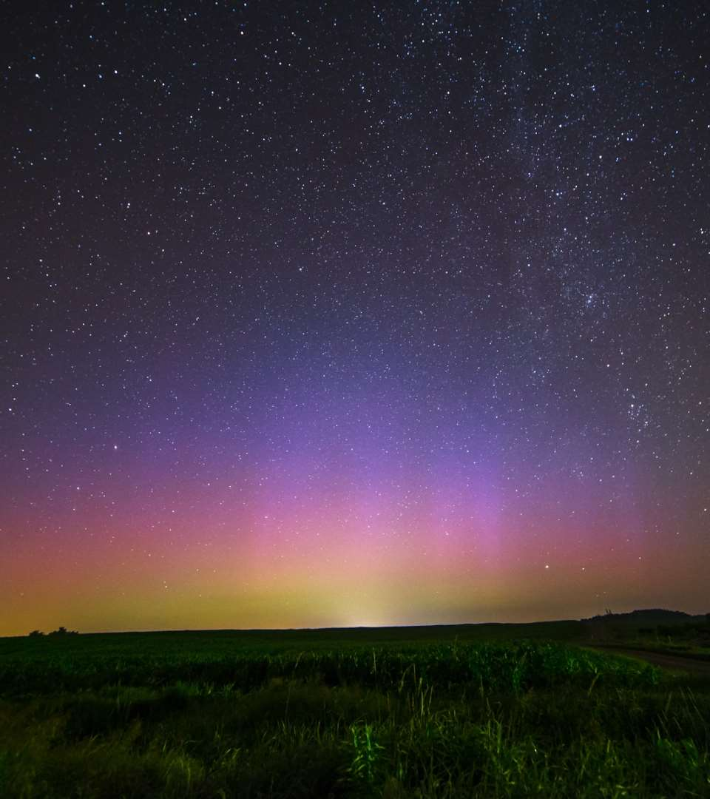
The problem you want to solve
Notes:
首先是遇到的問題

Slide 5
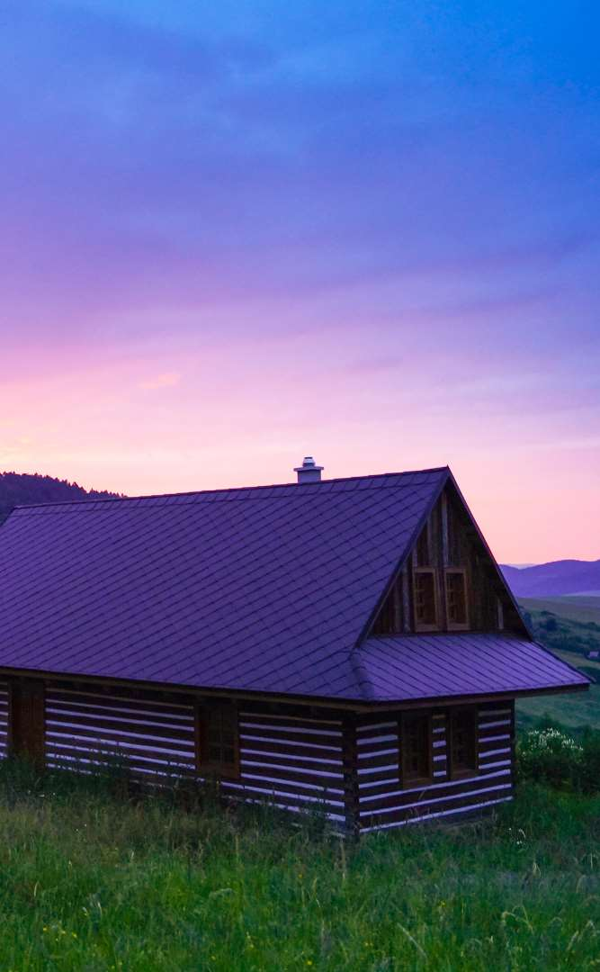
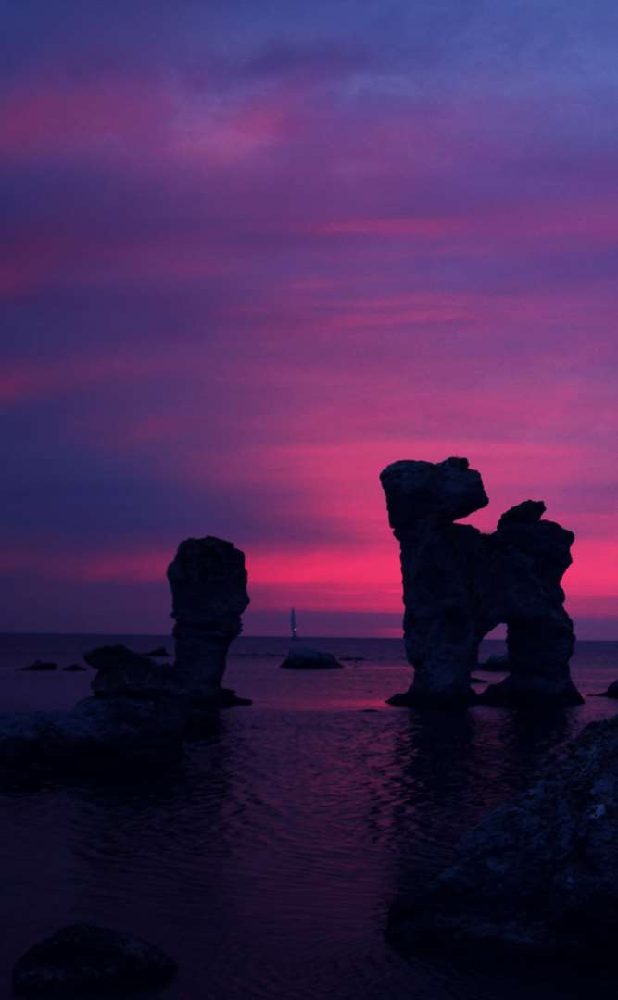

Today’s solutions
Notes:
現在的解決辦法

Slide 6
Why it doesn’t work
Difficult to implement
Expensive for small businesses
Zero customization

Slide 7
Your solution

Slide 8
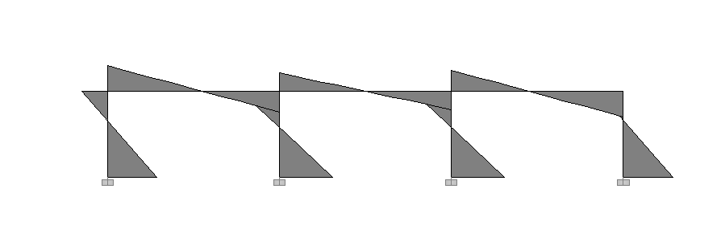
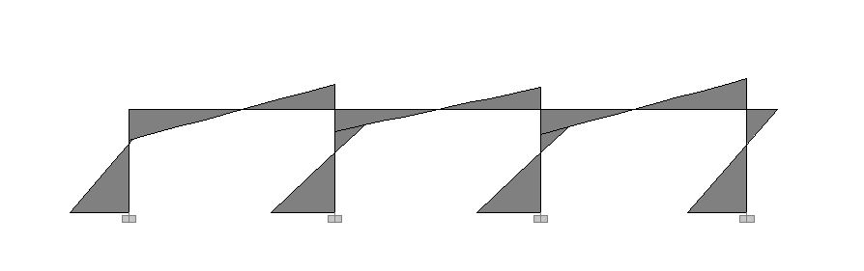
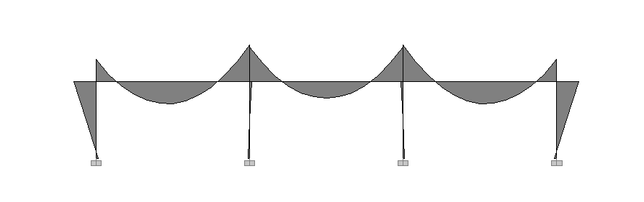

Slide 9
Notes:
大梁
假設重力、地震力的實際需求如右圖

Slide 10
Notes:
線性疊加
這裡也包含了載重組合的概念
取一組載重組合為例
1.4DL + E
取包絡線

Slide 11
Notes:
依據需求所得出的左中右的配筋
左端為 0~1/3 的最大值
中央是 1/4~3/4 的最大值
右端是 2/3~1 的最大值
實際配筋應該會再大一點
而且最少會有兩支的限制
這裡取最 critical 的情況

Slide 12
Notes:
再來就是依據現有配筋依據需求曲線做優化
首先是上層筋的部分
中間沒有需求
兩端主要由耐震控制
我們就直接拉直

Slide 13
Notes:
接下來是下層筋的部分
這部分就比較複雜了
左右兩端由耐震控制
中央我們原本預估是由重力控制
後來真的下去做的時候發現會有地震力的因素參雜進來了
如果中間依照重力，兩端依據地震力取大值會如右方藍色的線

Slide 14
Notes:
可以發現綠色圈圈的部分多估了
紅色部分的不保守

Slide 15
Notes:
而如果我們直接拉直線
效益會下降
從整體 11% 的效益下降到 7.5% 這個數字是考慮了延伸長度的
搭接長度：8.5% 5.5%
延伸長度：11% 7.5%
沒有延伸：22% 17%

Slide 16
Notes:
所以如果想要從現有配筋就有很好的效果的話 ( 如果已經產生配筋表格了)
那我們就會需要更多的資料

Slide 17
Notes:
像是 如果我們知道這條重力曲線的話
再加上六個配筋點
那其實很多曲線就可以逆推出來了
但只僅僅知道這條紅色的重力曲線還不夠
還需要做載重組合
1.4D
1.2D +1.6L
1.2D + 0.5L ± E
0.9D ± E
忽略風力
所以需要使用者輸入更多的資訊
DL LL 版厚 帶寬 梁長

Slide 19
Awesome features
Awesome map feature
Awesome like feature
Awesome battery feature

Slide 20
Use case
1
2
3
4
5
Very Easy Step 1
Very Easy Step 2
Very Easy Step 3
Very Easy Step 4
Very Easy Step 5

Slide 21
Value Proposal
Make things really change
Make the world a better place
Offer one perfect answer
This is how we are going to make this happen in a beautiful way.
This is how we are going to make this happen in a beautiful way.
This is how we are going to make this happen in a beautiful way.

Slide 22
Market Sizing
$36b
$12b
$2b
Total World Market
Total US Market
Total FR Market
Source : source.io
Source : source.io
Source : source.io

Slide 23
Market Size over Time
Market Sizing (in €billions)

Slide 24
Market on Map
$1b
$2b

Slide 25
Why Now ?
Mobile Internet Usage

Slide 26


Customer Profiles
Young adults
25-35 years old
Students
15-20 years old

Slide 27
Competitors

Slide 28
AXIS 2
Your company
competitor
competitor
AXIS 1
AXIS 1
competitor
competitor
competitor
competitor
AXIS 2

Slide 29
 | YOUR COMPANY | COMPETITOR 1 | COMPETITOR 2 | COMPETITOR 3
feature 1
feature 2
feature 3
feature 4
feature 5
feature 6

Slide 30
Metrics
800
97%
94%
Paying users
Margin
Recurring users
$150,000
85,000
54
Monthly Recurring
Revenue
Users growing 45% per month
API Integrations

Slide 31
Conversion Rate
0,27%

Slide 32
Split Budget

Slide 33
Split Budget
75%
69%
30%
29%
29%
Marketing
Research
Sales
Design
Hiring

Slide 34
Forecast

Slide 35
Financial Table
 | 2016 | 2017 | 2018 | 2019 | 2020
Sales | 0 | 50 | 400 | 1000 | 3000
Revenue | - | $100 000 | $800 000 | $2 000 000 | $6 000 000
Gross Margin (%) | - | 49% | 51% | 53% | 58%
Expenses | - | $128 000 | $450 000 | $800 000 | $1 200 000
Net Profit | - | $-28,000 | $350 000 | $1 200 000 | $4 800 000
Profit Margin (%) | - | -28% | 44% | 60% | 80%

Slide 36
Outstanding Founders
Dave Lopper CTO
Come Mertial CEO
Tran Zition
CPO
Google
Facebook
Stanford
Microsoft
SalesForce
HEC Paris
Uber
Awwwards
MIT Media Lab

Slide 37
Advisors and Directors
Jérémy Vestiaire
Financial Advisor
Goldman Sachs
Jey Bestelgram
Product Advisor
Amazon
Oudam Dadam
Machine Learning Enthousiast
SpaceX
Tomy Lamousse
PR Advisor
Mashable
Lam Ontarelle
UX Contributor
Slidor
Renaude Yorella
Board Member
Sequoia Capital
Laurence Marc
Board Member
Accel Partners
Vince Lacluze
UI Director
Snapchat

Slide 38
Roadmap
02/2016
04/2016
06/2016
Market Overview
Pre-Release
Launch
01/2016
03/2016
05/2016
Introduction
Partnerships
Beta

Slide 39
Say you want to make the world a better place

Slide 40
Icons

Slide 41
Icons

Slide 42
Social

Slide 43
Red
Pink
Purple
Deep Purple
Indigo
Blue
Light Blue
Cyan
Teal
Green
Light Green
Lime
Yellow
Amber
Orange
Deep Orange
50
50
50
50
50
50
50
50
50
50
50
50
50
50
50
50
100
100
100
100
100
100
100
100
100
100
100
100
100
100
100
100
200
200
200
200
200
200
200
200
200
200
200
200
200
200
200
200
300
300
300
300
300
300
300
300
300
300
300
300
300
300
300
300
400
400
400
400
400
400
400
400
400
400
400
400
400
400
400
400
500
500
500
500
500
500
500
500
500
500
500
500
500
500
500
500
600
600
600
600
600
600
600
600
600
600
600
600
600
600
600
600
700
700
700
700
700
700
700
700
700
700
700
700
700
700
700
700
800
800
800
800
800
800
800
800
800
800
800
800
800
800
800
800
900
900
900
900
900
900
900
900
900
900
900
900
900
900
900
900
A100
A100
A100
A100
A100
A100
A100
A100
A100
A100
A100
A100
A100
A100
A100
A100
A200
A200
A200
A200
A200
A200
A200
A200
A200
A200
A200
A200
A200
A200
A200
A200
A400
A400
A400
A400
A400
A400
A400
A400
A400
A400
A400
A400
A400
A400
A400
A400
A700
A700
A700
A700
A700
A700
A700
A700
A700
A700
A700
A700
A700
A700
A700
A700

