Slide 2
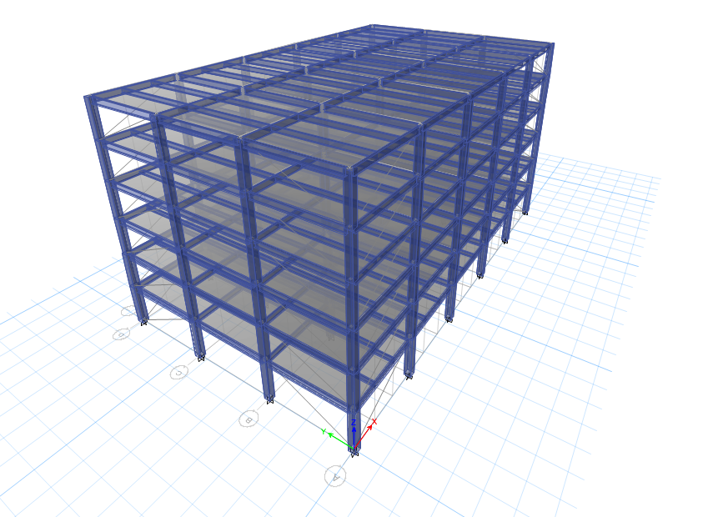
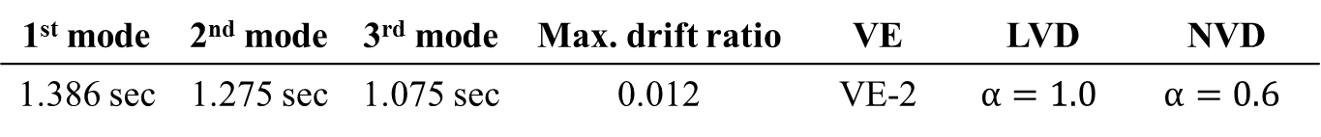
Introduction
Model information
Chia-Yi City
Type II Soil
2F~6F @ 4m
1F @ 4.5m
45m
27m
1st mode | 2nd mode | 3rd mode | Max. drift ratio | VE | LVD | NVD
1.386 sec | 1.275 sec | 1.075 sec | 0.012 | VE-2 | $$α=1.0$$ | $$α=0.6$$

Slide 3







Design of dampers
Design procedure
Decide control earthquake
Preliminary design
Decide control story drift
Displacement spectrum & acceleration spectrum
Decide $ξ$
Define $φ , m , cosθ$
Define $φ , m , cosθ , A , λ , α$
Define $\frac{A}{t}, k_{d}, C_{d}, ω_{sr}$
Calculate $c , k$
Calculate $c , k$
Check $ξ$
LVD design
NVD design
VE design

Slide 4
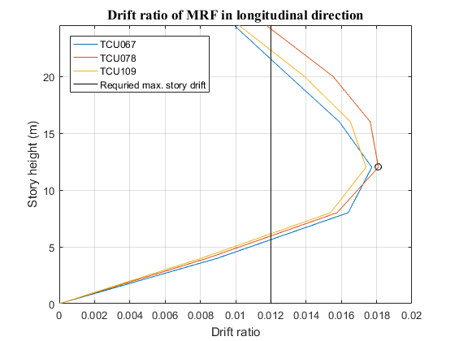
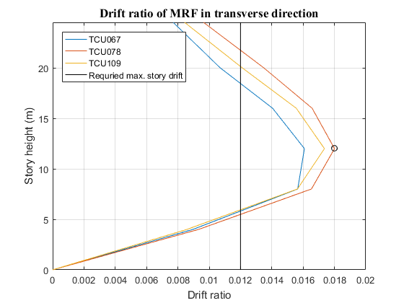
Design of dampers
Preliminary design
Decide control earthquake
Decide control story drift

Slide 5
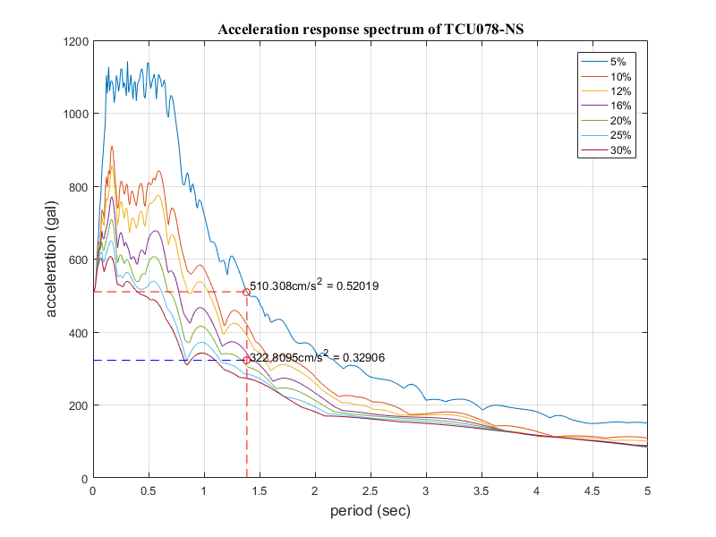
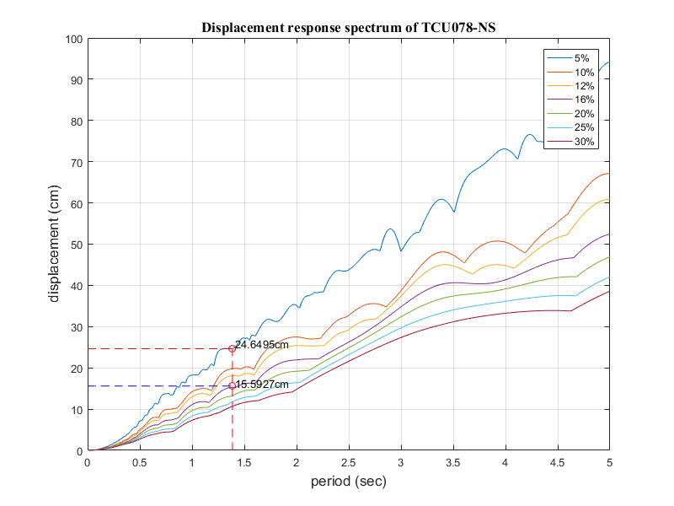

Design of dampers
Preliminary design
Displacement spectrum & acceleration spectrum
Decide $ξ$
$ξ_{d}=14\%$

Slide 6
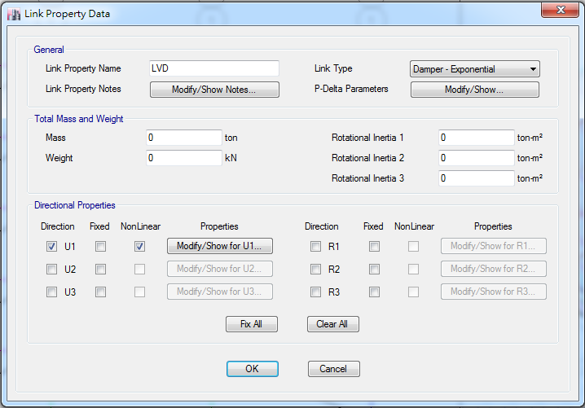
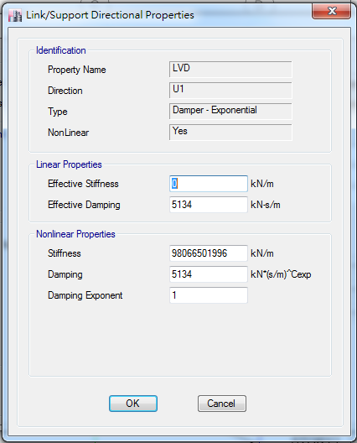
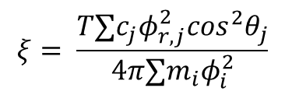

Design of dampers
Linear viscous damper design
$$ξ= \frac{T∑c_{j}φ_{r,j}^{2}cos^{2}θ_{j}}{4π∑m_{i}φ_{i}^{2}}$$
$$c=5134.4KN−sec/m$$

Slide 7
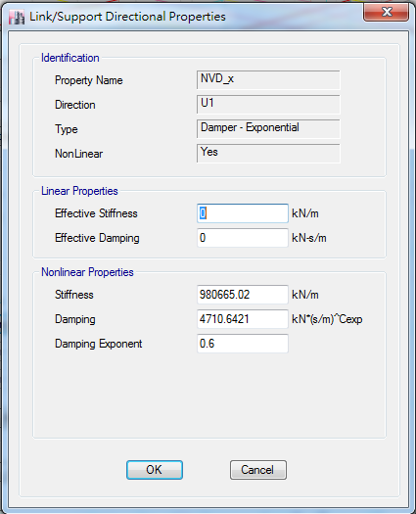

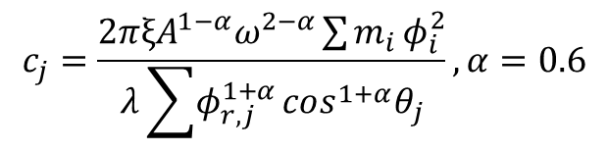
Design of dampers
Nonlinear viscous damper design
$$c_{j}=\frac{2π{ξA}^{1−α}ω^{2−α}\sum{m_{i}}φ_{i}^{2}}{λ\sum{φ_{r,j}^{1+α}}cos^{1+α}θ_{j}}, α=0.6$$
$$\left\{\begin{matrix}longitudinal direction , ξ=10\% , c=4710.64 KN−sec/m \\ transverse driection, ξ=10\% , c=5374.77 KN−sec/m\end{matrix}\right.$$

Slide 8
Design of dampers
Viscoelastic damper design

Slide 9
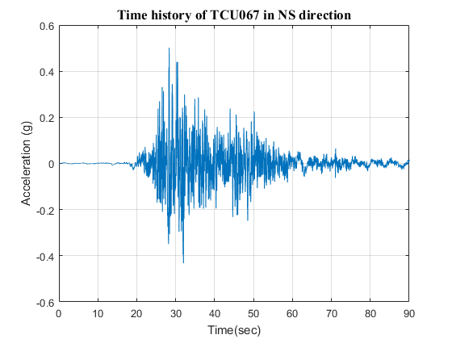
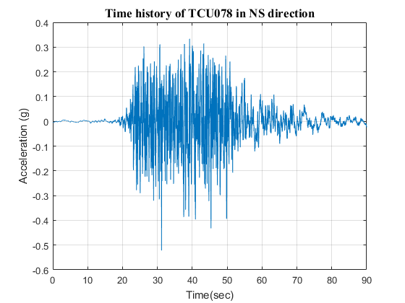
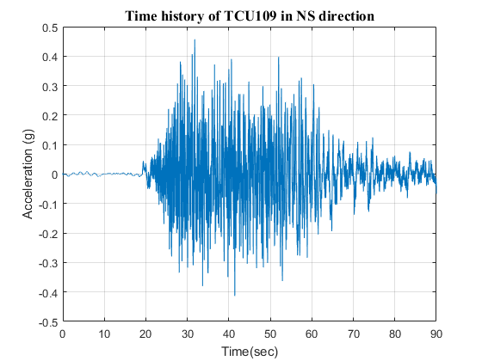
Analysis results
Design earthquake

Slide 10
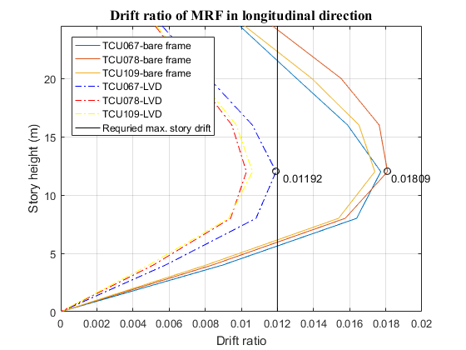
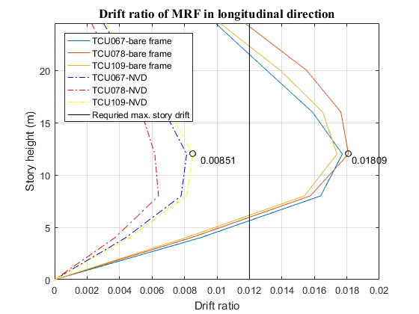
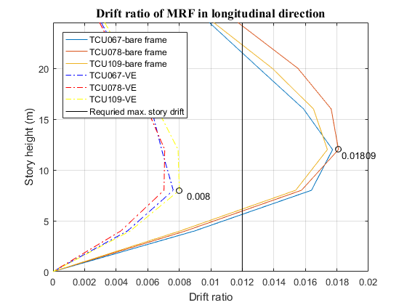
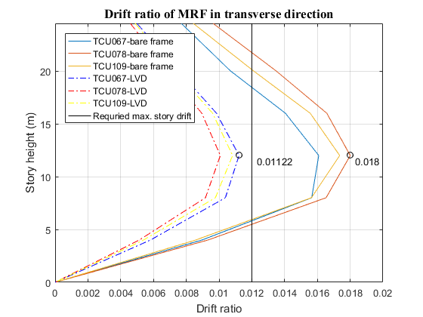
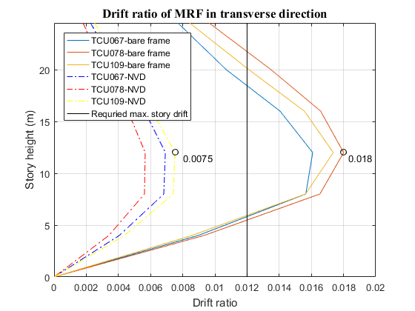
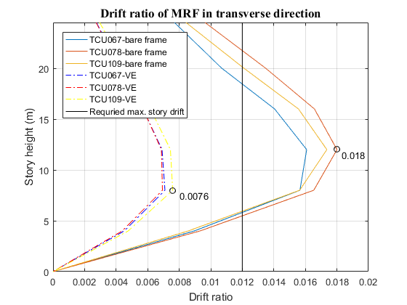
Analysis results
Story drift
X-direction
Story drift
Y-direction

Slide 11
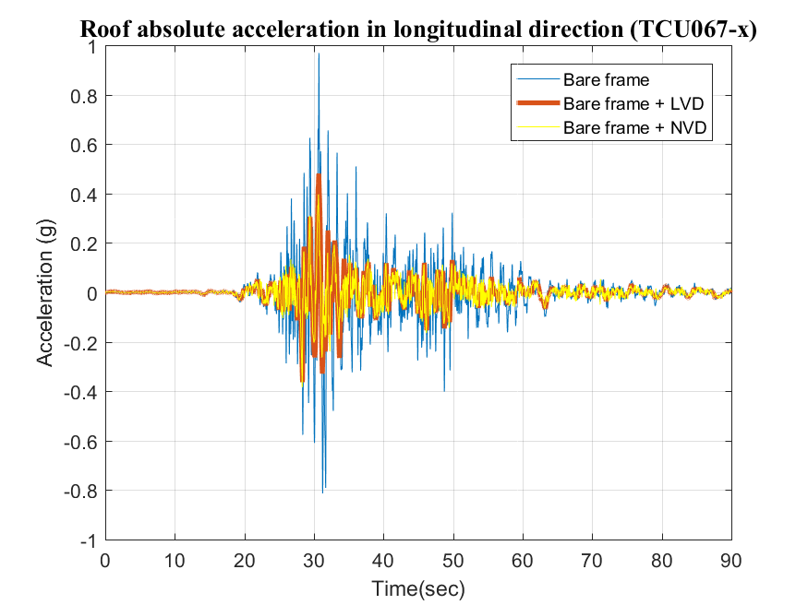
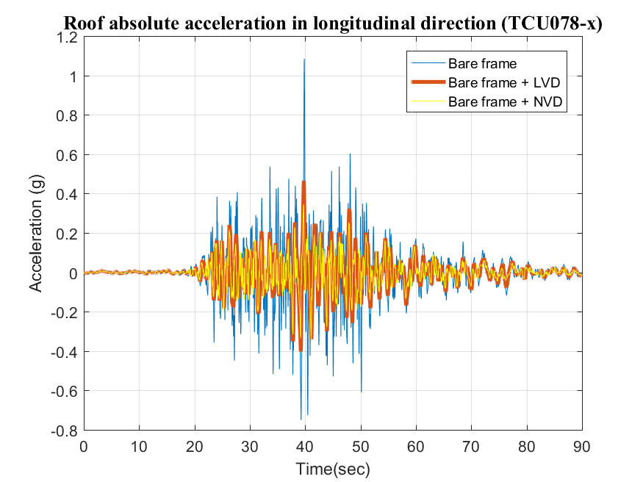
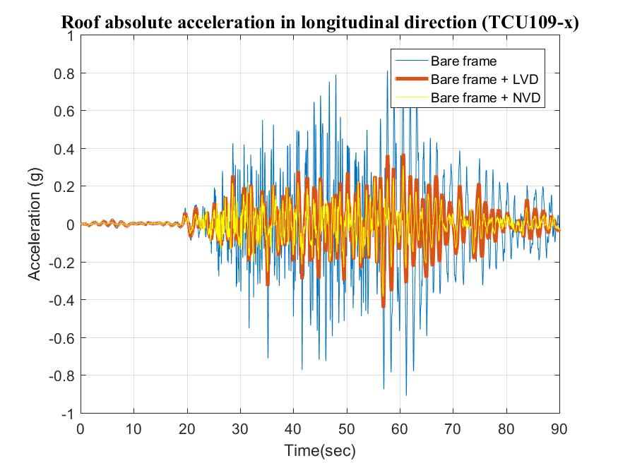
Analysis results
Roof acceleration response
X-direction
Linear VD | Relative Displacement |  | Ratio | Relative Velocity |  | Ratio | Absolute Acceleration |  | Ratio
 | Bare frame | VD | % | Bare frame | VD | % | Bare frame | VE | %
067 | 0.2700 | 0.1253 | 46.41 | 1.6367 | 1.0035 | 61.31 | 9.502 | 4.717 | 49.64
078 | 0.2662 | 0.1758 | 66.04 | 1.3923 | 0.8552 | 61.42 | 10.647 | 4.561 | 42.84
109 | 0.3214 | 0.1885 | 58.65 | 1.6144 | 0.8445 | 52.31 | 7.973 | 3.629 | 45.52
Nonlinear VD | Relative Displacement |  | Ratio | Relative Velocity |  | Ratio | Absolute Acceleration |  | Ratio
 | Bare frame | NVD | % | Bare frame | NVD | % | Bare frame | NVD | %
067 | 0.2700 | 0.1409 | 52.19 | 1.6367 | 0.6483 | 39.61 | 9.502 | 3.8886 | 40.92
078 | 0.2662 | 0.1087 | 40.83 | 1.3923 | 0.5405 | 38.82 | 10.647 | 3.4059 | 31.99
109 | 0.3214 | 0.1447 | 45.02 | 1.6144 | 0.5675 | 35.15 | 7.973 | 3.7857 | 47.48

Slide 12
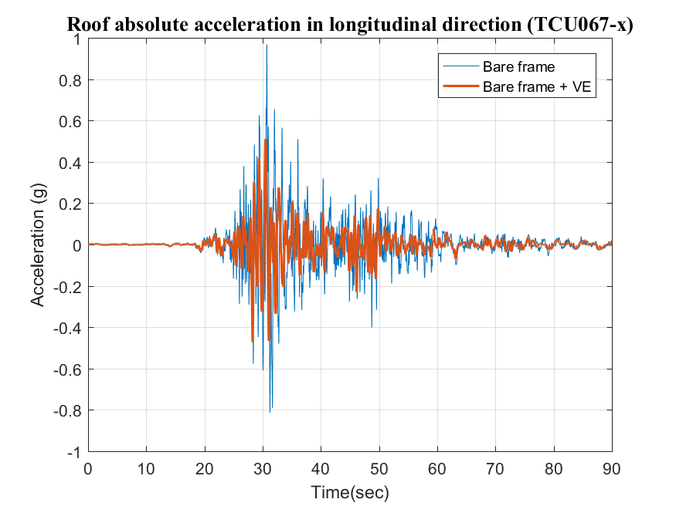
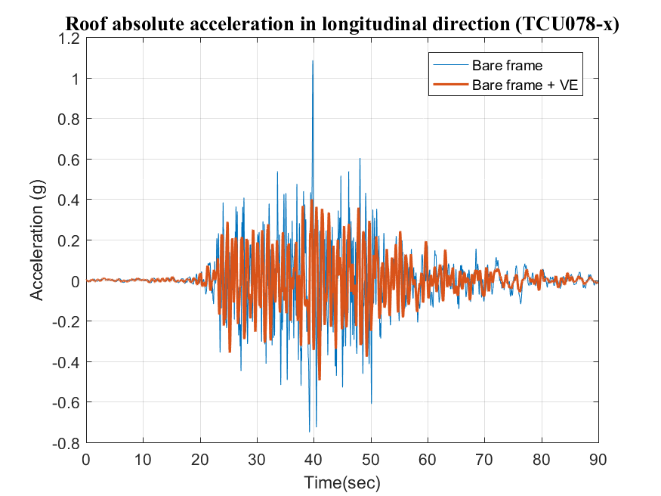
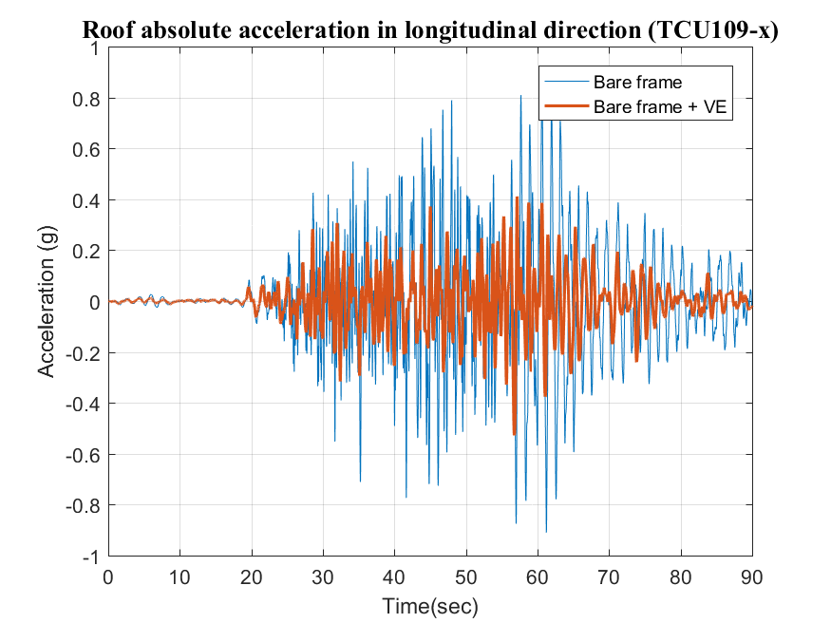
Analysis results
Roof acceleration response
X-direction
VE | Relative Displacement |  | Ratio | Relative Velocity |  | Ratio | Absolute Acceleration |  | Ratio
 | Bare frame | VE | % | Bare frame | VE | % | Bare frame | VE | %
067 | 0.2700 | 0.1367 | 50.63 | 1.6367 | 0.7831 | 47.85 | 9.502 | 5.013 | 52.76
078 | 0.2662 | 0.1274 | 47.86 | 1.3923 | 0.7224 | 51.89 | 10.647 | 4.851 | 45.56
109 | 0.3214 | 0.1444 | 44.93 | 1.6144 | 0.9575 | 59.31 | 7.973 | 5.179 | 64.96
Notes:
有效降低峰值

Slide 13
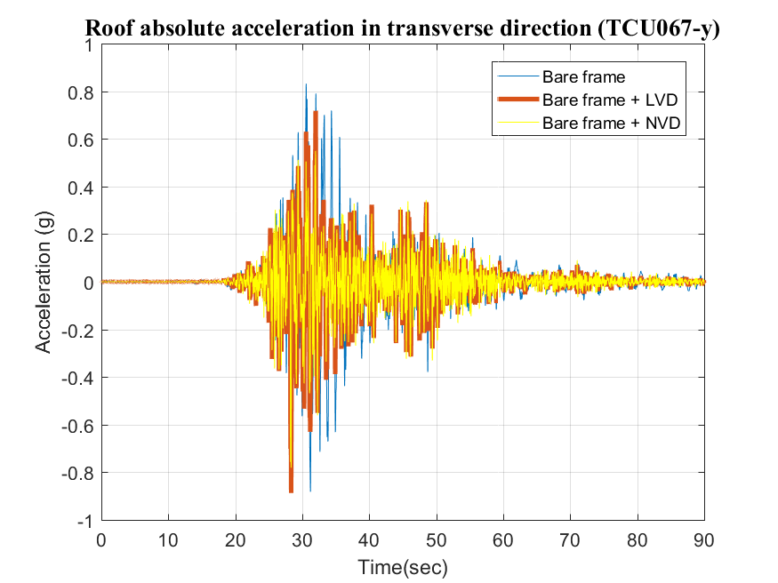
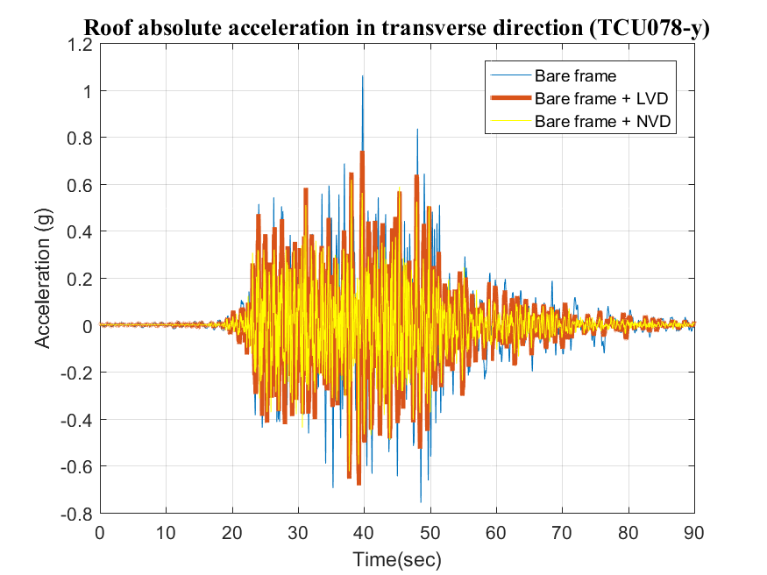
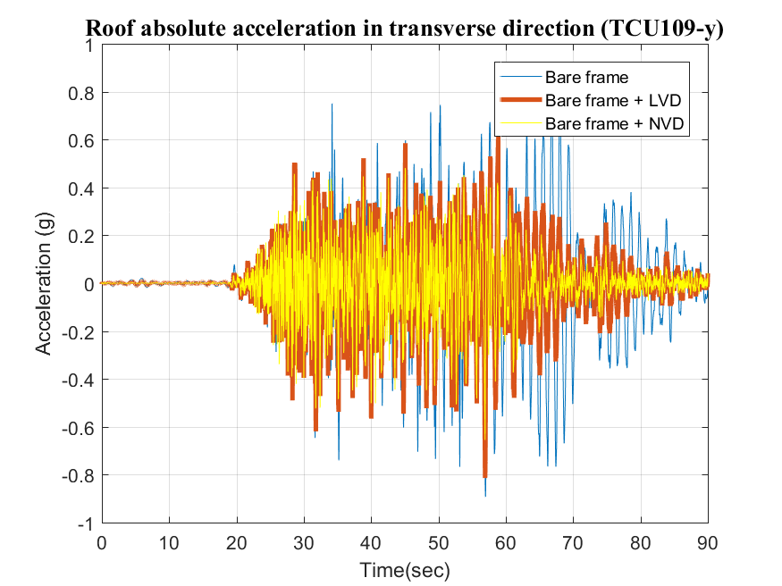
Analysis results
Roof acceleration response
Y-direction
Linear VD | Relative Displacement |  | Ratio | Relative Velocity |  | Ratio | Absolute Acceleration |  | Ratio
 | Bare frame | VD | % | Bare frame | VD | % | Bare frame | VE | %
067 | 0.2518 | 0.1263 | 50.16 | 1.7387 | 1.0438 | 60.03 | 8.161 | 7.040 | 86.26
078 | 0.2412 | 0.1483 | 61.48 | 1.6896 | 0.8049 | 47.64 | 10.426 | 7.269 | 69.72
109 | 0.2907 | 0.1911 | 65.74 | 1.6535 | 0.8736 | 52.83 | 8.818 | 6.233 | 70.68
Nonlinear VD | Relative Displacement |  | Ratio | Relative Velocity |  | Ratio | Absolute Acceleration |  | Ratio
 | Bare frame | NVD | % | Bare frame | NVD | % | Bare frame | NVD | %
067 | 0.2518 | 0.1197 | 47.54 | 1.7387 | 0.6125 | 35.23 | 8.161 | 7.6632 | 93.90
078 | 0.2412 | 0.0955 | 39.59 | 1.6896 | 0.5424 | 32.10 | 10.426 | 6.1153 | 58.65
109 | 0.2907 | 0.1282 | 44.10 | 1.6535 | 0.6119 | 37.01 | 8.818 | 6.4271 | 72.89
Notes:
有效降低峰值

Slide 14
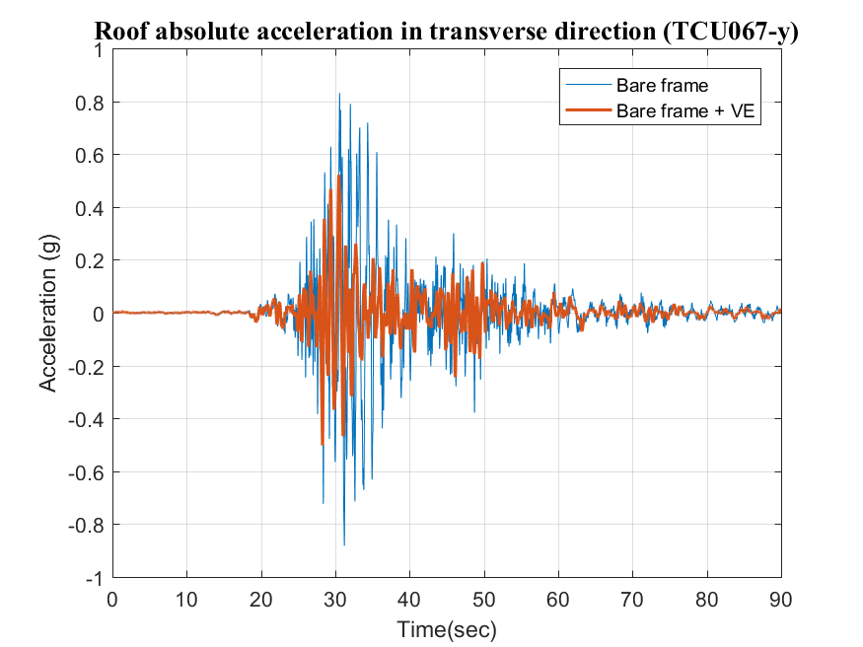
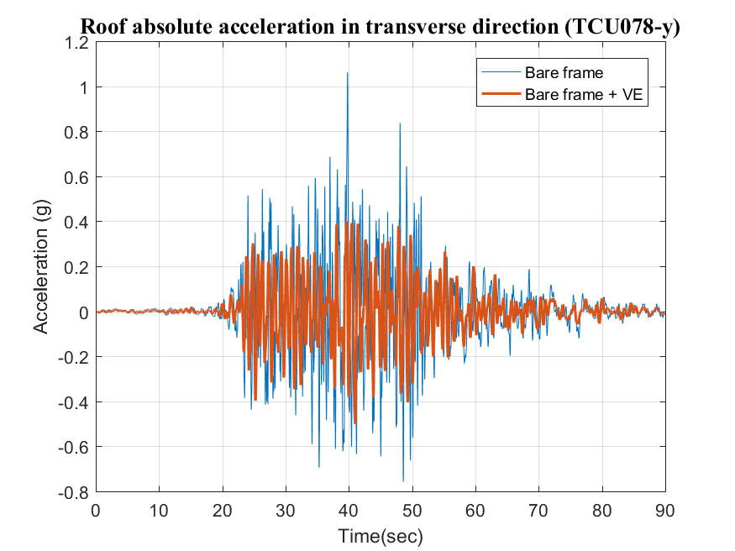
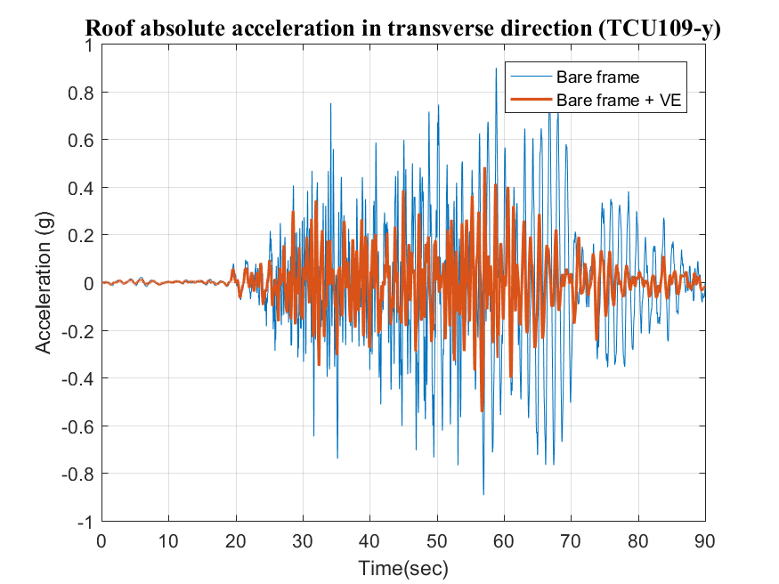
Analysis results
Roof acceleration response
Y-direction
VE | Relative Displacement |  | Ratio | Relative Velocity |  | Ratio | Absolute Acceleration |  | Ratio
 | Bare frame | VE | % | Bare frame | VE | % | Bare frame | VE | %
067 | 0.2518 | 0.1269 | 50.40 | 1.7387 | 0.835 | 48.02 | 8.161 | 5.115 | 62.68
078 | 0.2412 | 0.1239 | 51.37 | 1.6896 | 0.7295 | 43.18 | 10.426 | 4.917 | 47.16
109 | 0.2907 | 0.1363 | 46.89 | 1.6535 | 0.9738 | 58.89 | 8.818 | 5.343 | 60.59
Notes:
有效降低峰值

Slide 15
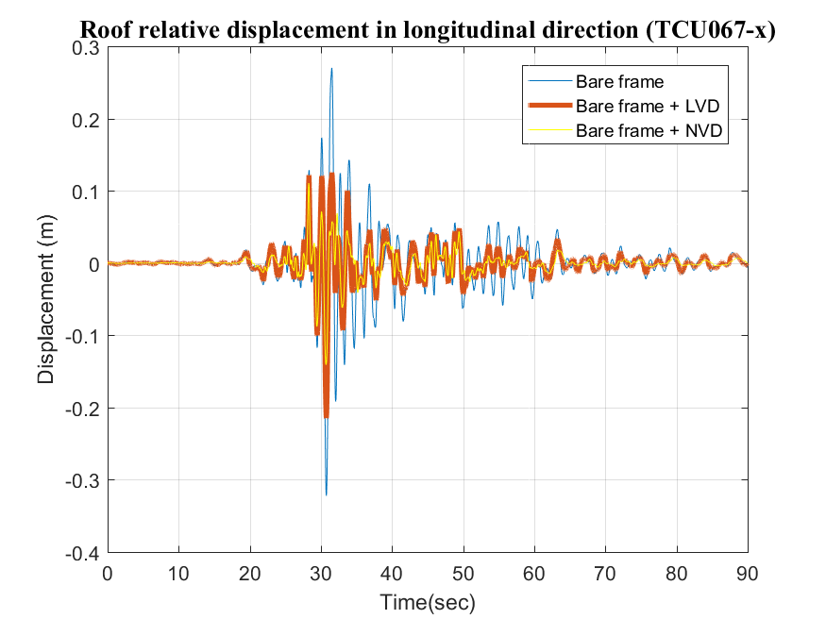
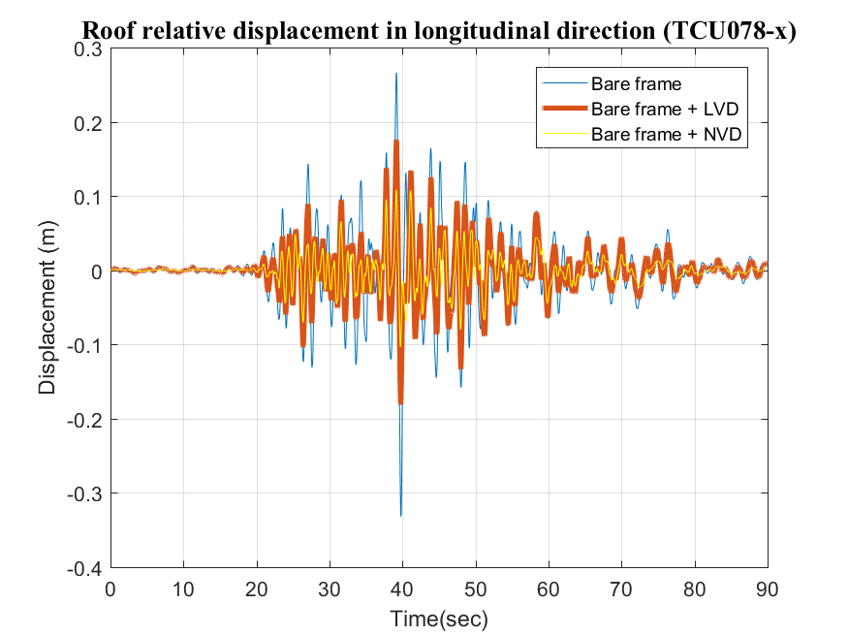
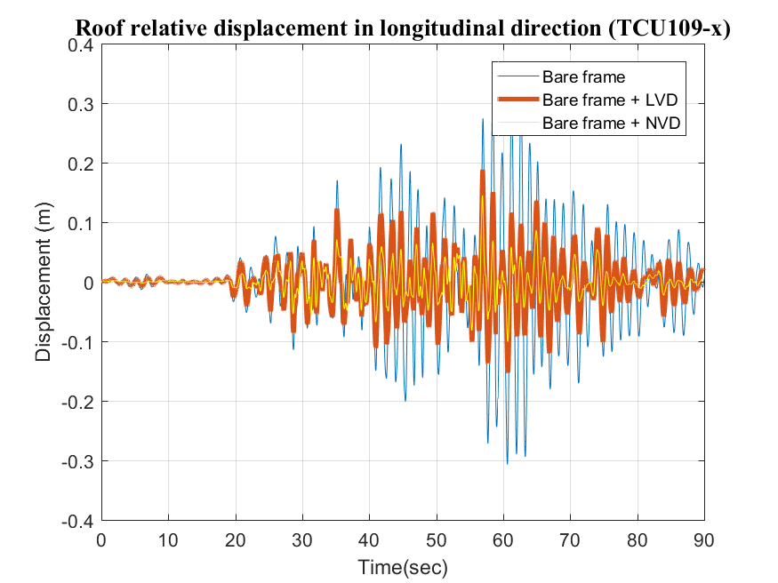
Analysis results
Roof displacement response
X-direction
Linear VD | Relative Displacement |  | Ratio | Relative Velocity |  | Ratio | Absolute Acceleration |  | Ratio
 | Bare frame | VD | % | Bare frame | VD | % | Bare frame | VE | %
067 | 0.2700 | 0.1253 | 46.41 | 1.6367 | 1.0035 | 61.31 | 9.502 | 4.717 | 49.64
078 | 0.2662 | 0.1758 | 66.04 | 1.3923 | 0.8552 | 61.42 | 10.647 | 4.561 | 42.84
109 | 0.3214 | 0.1885 | 58.65 | 1.6144 | 0.8445 | 52.31 | 7.973 | 3.629 | 45.52
Nonlinear VD | Relative Displacement |  | Ratio | Relative Velocity |  | Ratio | Absolute Acceleration |  | Ratio
 | Bare frame | NVD | % | Bare frame | NVD | % | Bare frame | NVD | %
067 | 0.2700 | 0.1409 | 52.19 | 1.6367 | 0.6483 | 39.61 | 9.502 | 3.8886 | 40.92
078 | 0.2662 | 0.1087 | 40.83 | 1.3923 | 0.5405 | 38.82 | 10.647 | 3.4059 | 31.99
109 | 0.3214 | 0.1447 | 45.02 | 1.6144 | 0.5675 | 35.15 | 7.973 | 3.7857 | 47.48

Slide 16
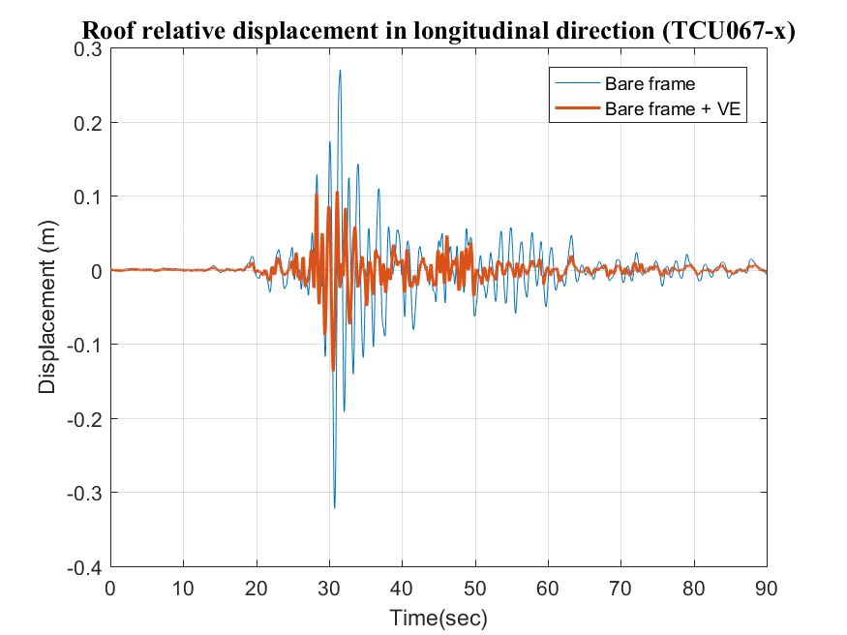
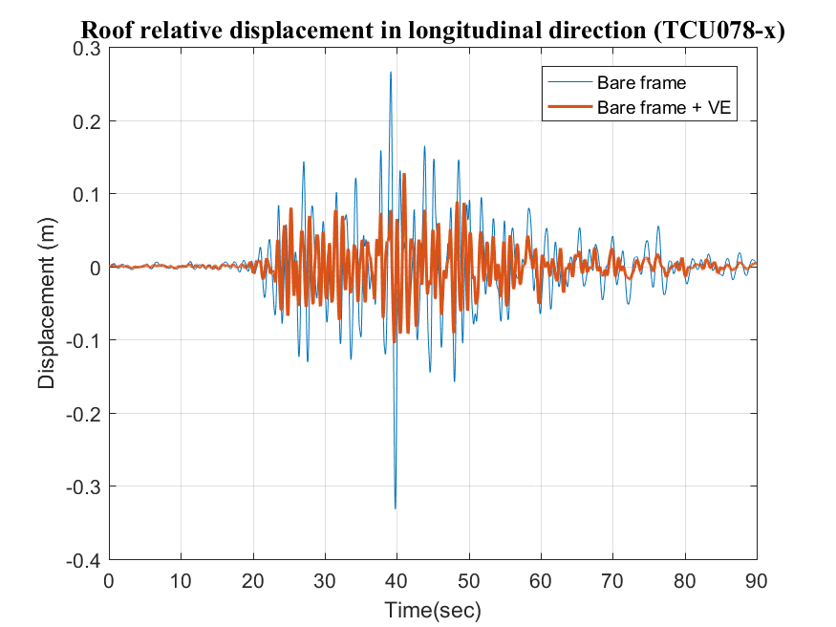
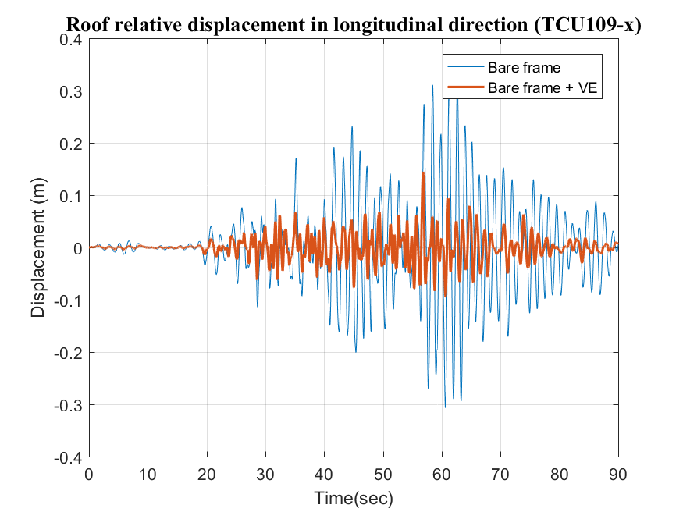
Analysis results
Roof displacement response
X-direction
VE | Relative Displacement |  | Ratio | Relative Velocity |  | Ratio | Absolute Acceleration |  | Ratio
 | Bare frame | VE | % | Bare frame | VE | % | Bare frame | VE | %
067 | 0.2700 | 0.1367 | 50.63 | 1.6367 | 0.7831 | 47.85 | 9.502 | 5.013 | 52.76
078 | 0.2662 | 0.1274 | 47.86 | 1.3923 | 0.7224 | 51.89 | 10.647 | 4.851 | 45.56
109 | 0.3214 | 0.1444 | 44.93 | 1.6144 | 0.9575 | 59.31 | 7.973 | 5.179 | 64.96

Slide 17
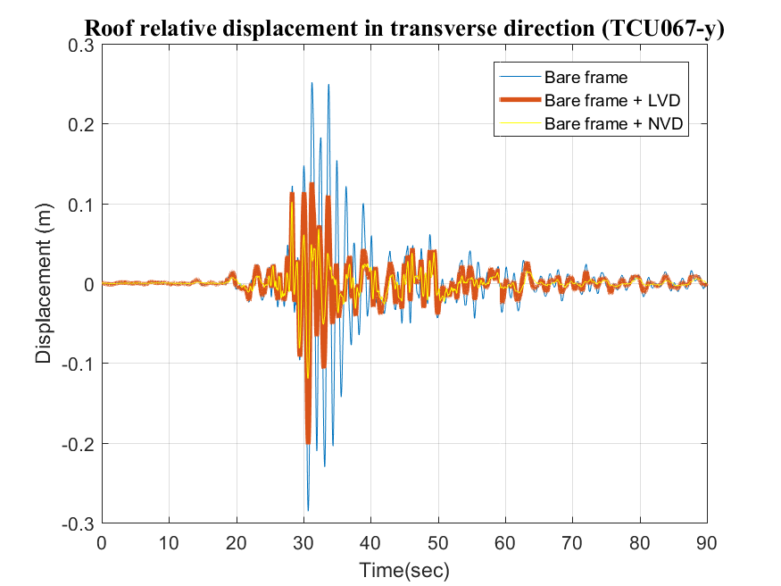
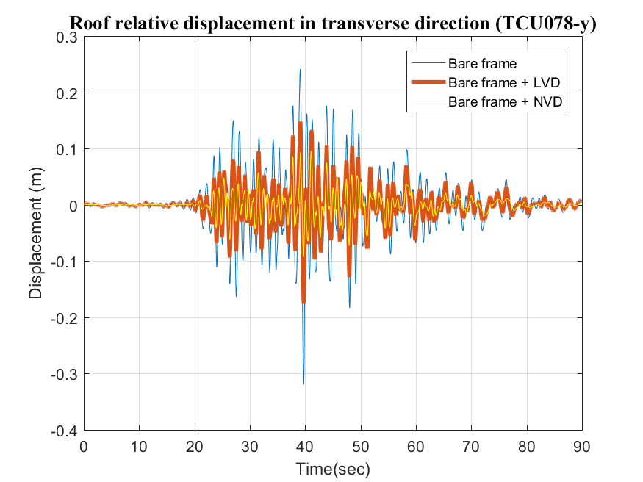
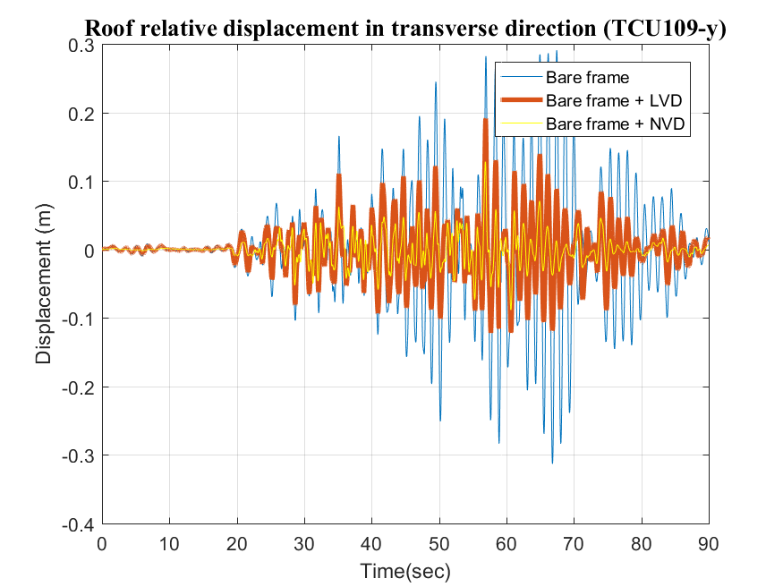
Analysis results
Roof displacement response
Y-direction
Linear VD | Relative Displacement |  | Ratio | Relative Velocity |  | Ratio | Absolute Acceleration |  | Ratio
 | Bare frame | VD | % | Bare frame | VD | % | Bare frame | VE | %
067 | 0.2518 | 0.1263 | 50.16 | 1.7387 | 1.0438 | 60.03 | 8.161 | 7.040 | 86.26
078 | 0.2412 | 0.1483 | 61.48 | 1.6896 | 0.8049 | 47.64 | 10.426 | 7.269 | 69.72
109 | 0.2907 | 0.1911 | 65.74 | 1.6535 | 0.8736 | 52.83 | 8.818 | 6.233 | 70.68
Nonlinear VD | Relative Displacement |  | Ratio | Relative Velocity |  | Ratio | Absolute Acceleration |  | Ratio
 | Bare frame | NVD | % | Bare frame | NVD | % | Bare frame | NVD | %
067 | 0.2518 | 0.1197 | 47.54 | 1.7387 | 0.6125 | 35.23 | 8.161 | 7.6632 | 93.90
078 | 0.2412 | 0.0955 | 39.59 | 1.6896 | 0.5424 | 32.10 | 10.426 | 6.1153 | 58.65
109 | 0.2907 | 0.1282 | 44.10 | 1.6535 | 0.6119 | 37.01 | 8.818 | 6.4271 | 72.89

Slide 18
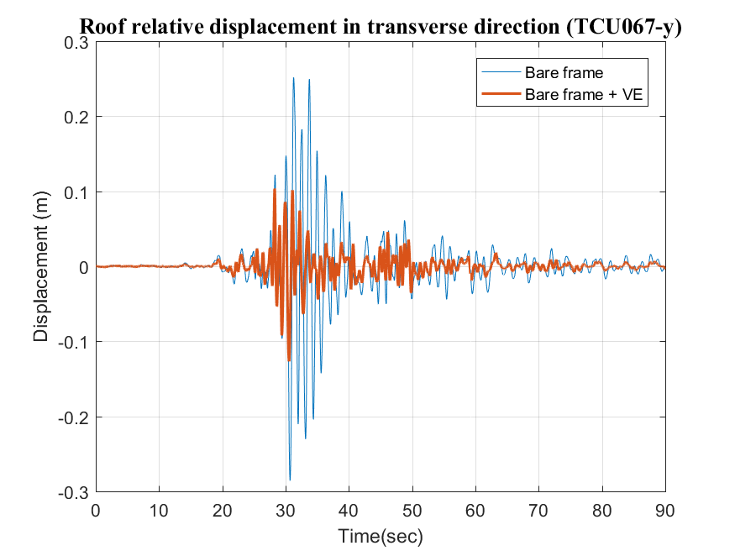
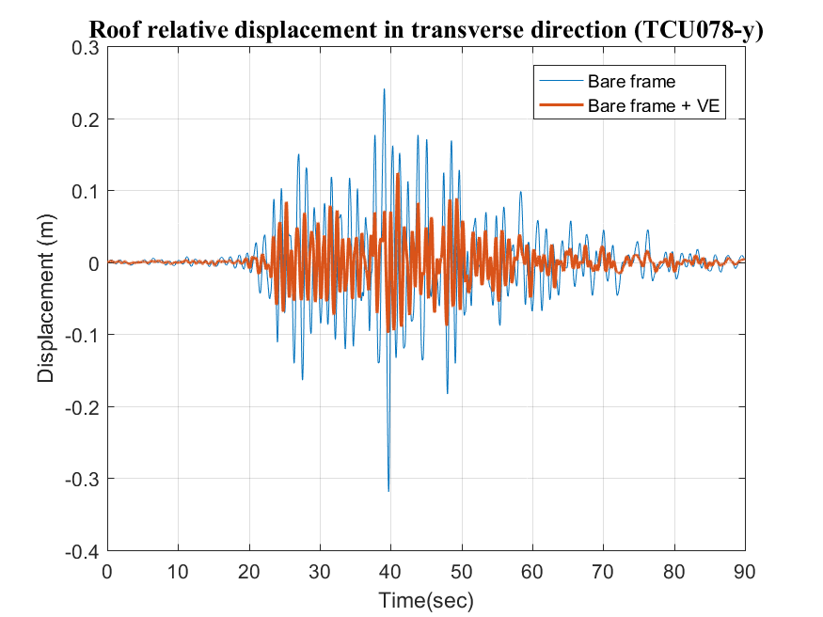
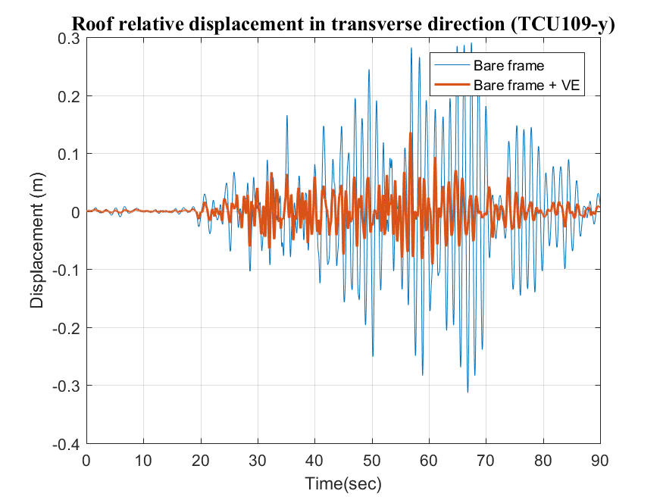
Analysis results
Roof displacement response
Y-direction
VE | Relative Displacement |  | Ratio | Relative Velocity |  | Ratio | Absolute Acceleration |  | Ratio
 | Bare frame | VE | % | Bare frame | VE | % | Bare frame | VE | %
067 | 0.2518 | 0.1269 | 50.40 | 1.7387 | 0.835 | 48.02 | 8.161 | 5.115 | 62.68
078 | 0.2412 | 0.1239 | 51.37 | 1.6896 | 0.7295 | 43.18 | 10.426 | 4.917 | 47.16
109 | 0.2907 | 0.1363 | 46.89 | 1.6535 | 0.9738 | 58.89 | 8.818 | 5.343 | 60.59

Slide 19
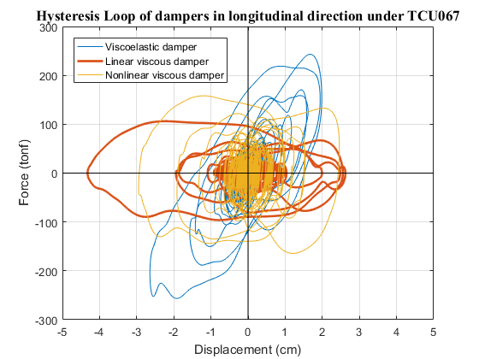
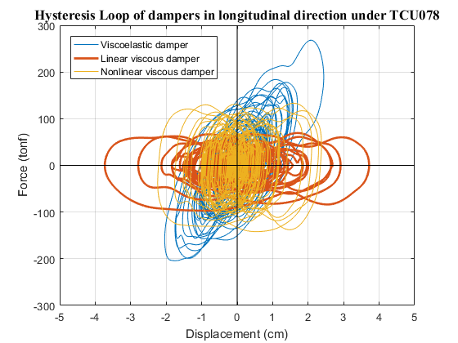
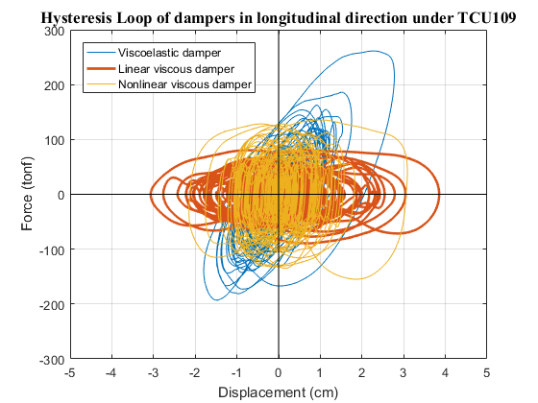



Analysis results
Hysteresis loop
X-direction
Hysteresis loop
Y-direction

Slide 20
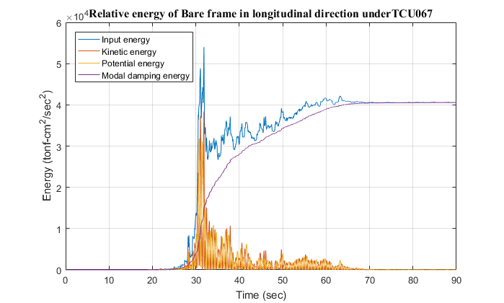
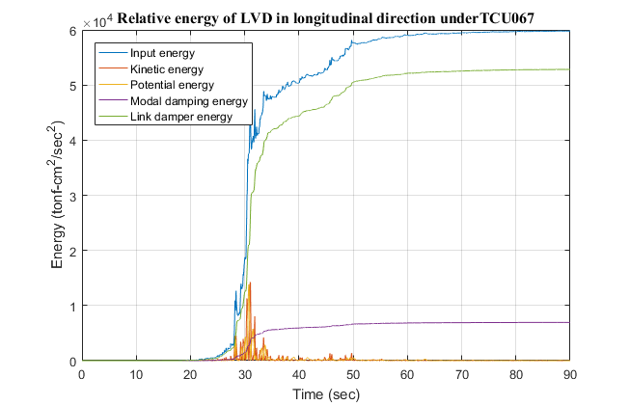
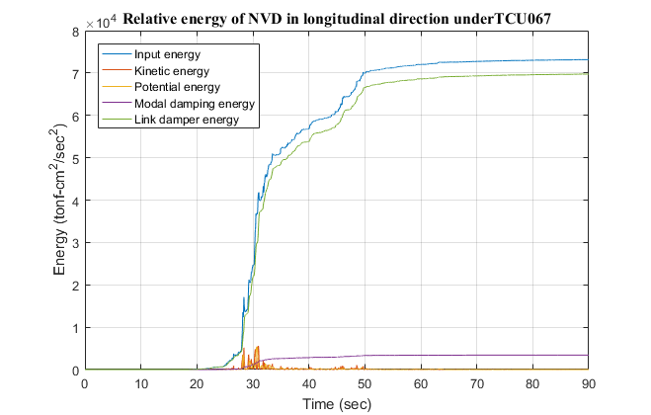






Analysis results
Energy dissipation
X-direction

Slide 21









Analysis results
Energy dissipation
Y-direction

Slide 22

Nonlinear Time History Analysis
Modified PISA3D model

Slide 23


Nonlinear Time History Analysis
Modified PISA3D model

Slide 24
Nonlinear Time History Analysis
Test earthquake

Slide 25
Nonlinear Time History Analysis
Story drift
X-direction

Slide 26
Nonlinear Time History Analysis

Slide 27

Design of FPS

Slide 28













Design of FPS
$$R=4.3812$$
$$K_{eff}=\frac{W}{R}+\frac{μW}{D}$$
$$K_{eff}=38, 74, 147$$
$$W=88, 171, 341tonf$$
$$T=3s$$
$$K_{H}=\frac{W}{R}$$
$$K_{h}=20, 39, 78$$
$$B_{eff}=30\%$$
$$μ=0.05$$
$$K_{1}=51K_{H}$$
$$K_{1}=1020, 1991, 3975$$

Slide 29
Design of FPS
$$R=4.3812$$
$$K_{eff}=\frac{W}{R}+\frac{μW}{D}$$
$$K_{eff}=38, 74, 147$$
$$W=88, 171, 341tonf$$
$$T=3s$$
$$K_{H}=\frac{W}{R}$$
$$K_{h}=20, 39, 78$$
$$B_{eff}=30\%$$
$$μ=0.05$$
$$K_{1}=51K_{H}$$
$$K_{1}=1020, 1991, 3975$$

