Slide 1
Plastic Analysis and Design
Final term project 2018
2019.01.02
Advisor : Kuo-Chun Chang
Group 3
R06521212 Dong-Hua Tsai
R06521217

Slide 2
Introduction
Etabs
TEASPA
Xtract
Upper bound
Summary

Slide 3
Introduction
Etabs
TEASPA
Xtract
Upper bound
Summary

Slide 4
Introduction
Purposes
1. After the 921 earthquake, many school buildings collapsed. The lack of seismic design building code in the past was discovered. So that the seismic design of the school buildings began to be carried out with today’s norms.
2. Focus on the collapsed Chiayi Minxung factory, we investigate the defects in the structure and the reasons for the collapse.
3. Using Etabs, TEASPA, and Xtract structural analysis model with ATC-40 and FEMA273 building code to investigate the damage of the structure.

Slide 5
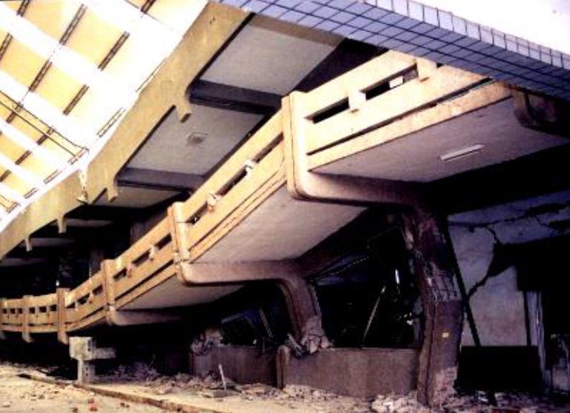
Introduction
Basic information
Building name
Soil type
Building function
Structure system
Structure size
Materials
loadings
:
:
:
:
:
:
:
Chiayi Minxung factory
Type 2
School building
RC MRF
2 floor without basement
Concrete strength 280 kg/cm² , Rebar strength 2800 kg/cm²
Dead load 850 kg/m² , live load 250 kg/m²

Slide 6
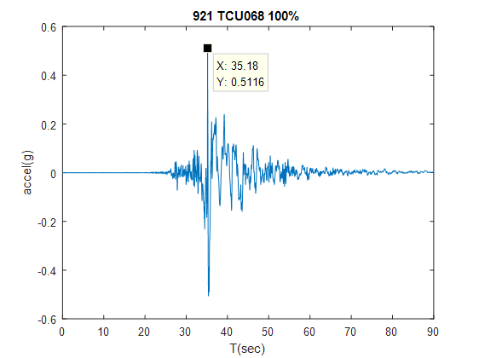
Introduction
Seismic records

Slide 7
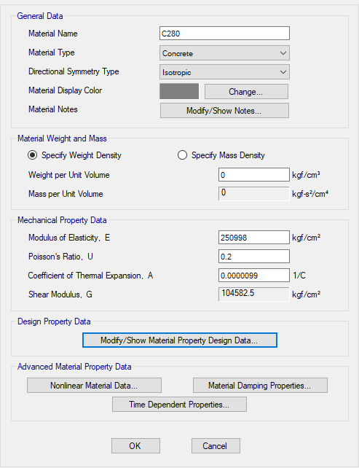
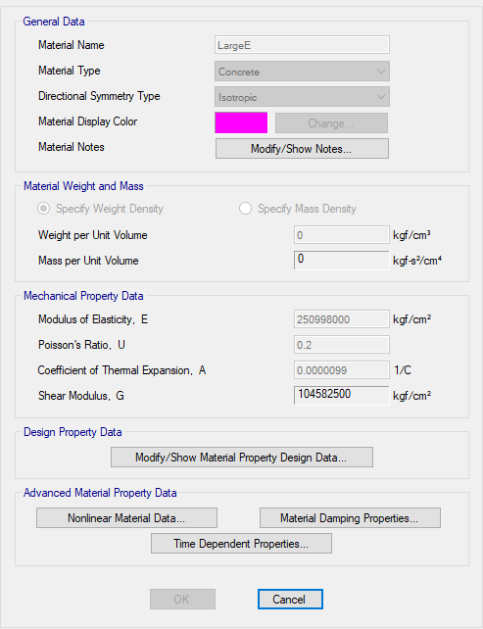
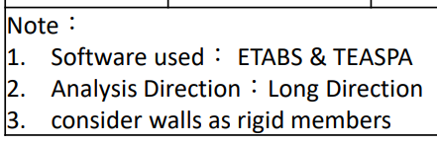
Etabs model
Material
1000 times
Concrete
Brace

Slide 8
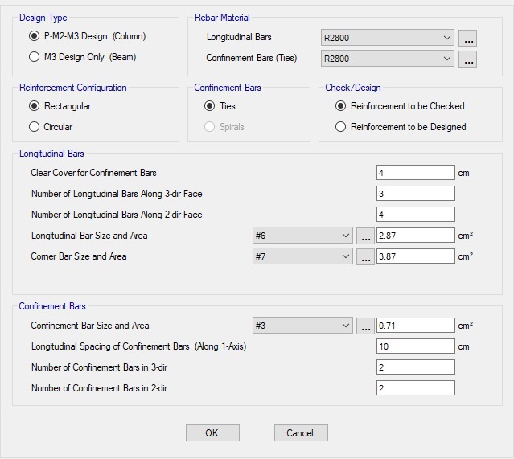
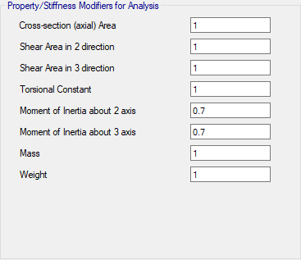
Etabs model
Section – Column Beam Slab

Slide 9
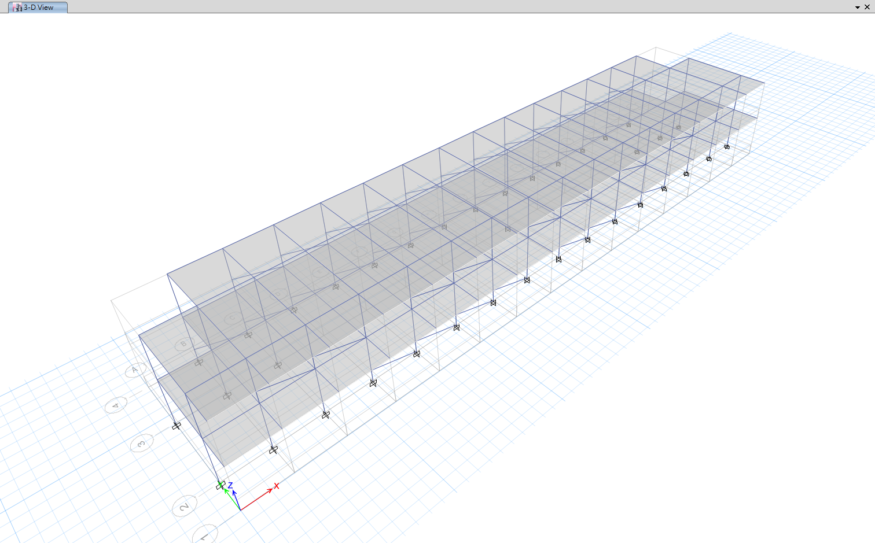
Etabs model
Model

Slide 10
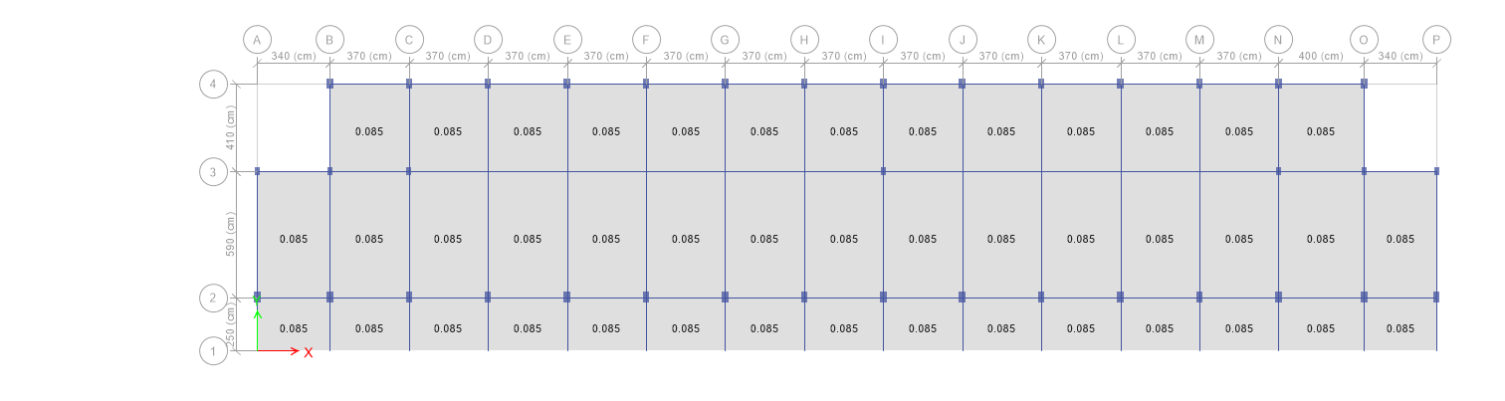
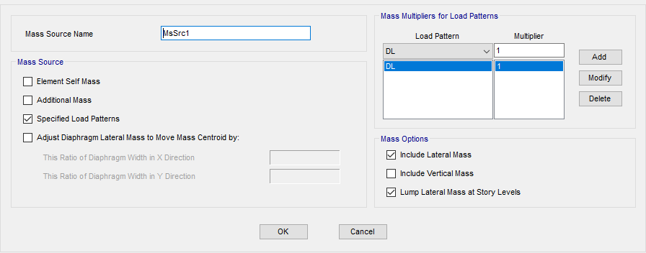
Etabs model
Loading
DL, LL
No Consider Self Weight

Slide 11
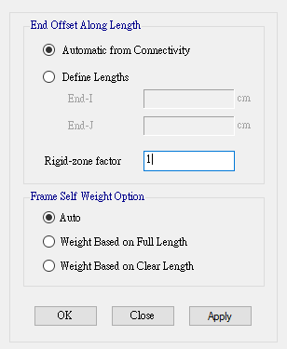
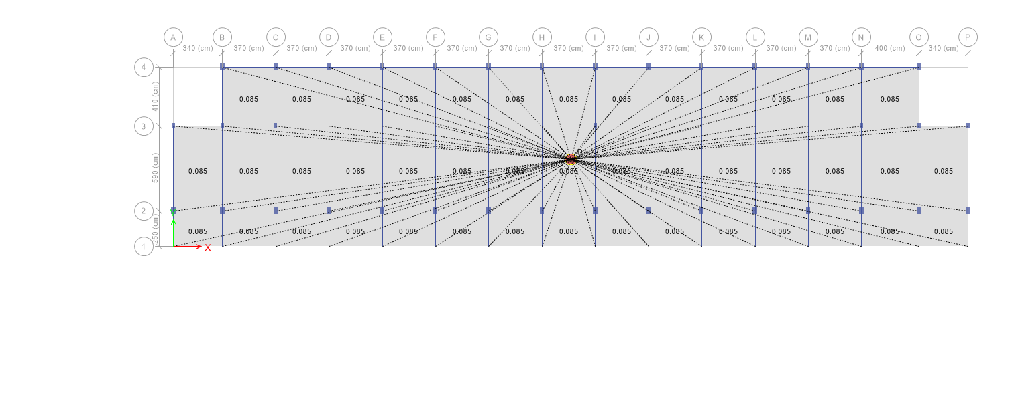
Etabs model
Rigid Zone Factor and Rigid Diaphragm

Slide 12
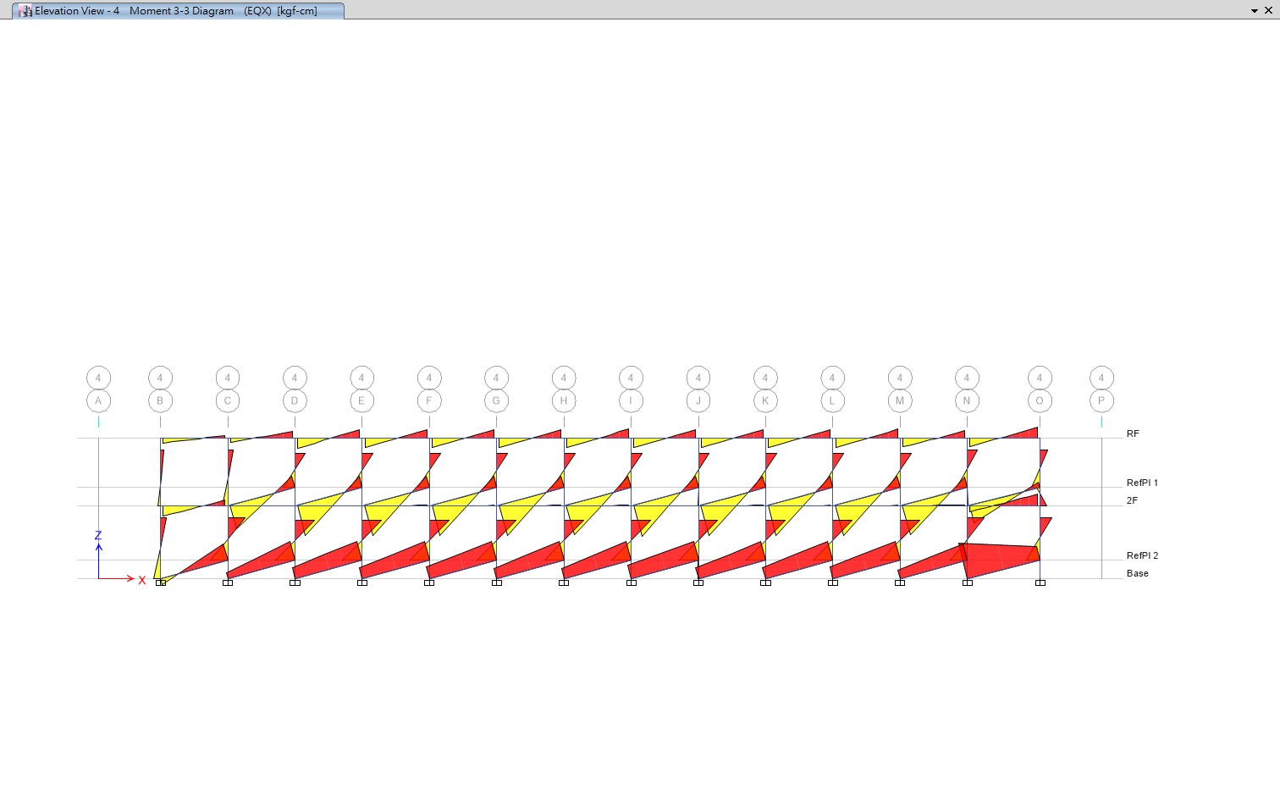
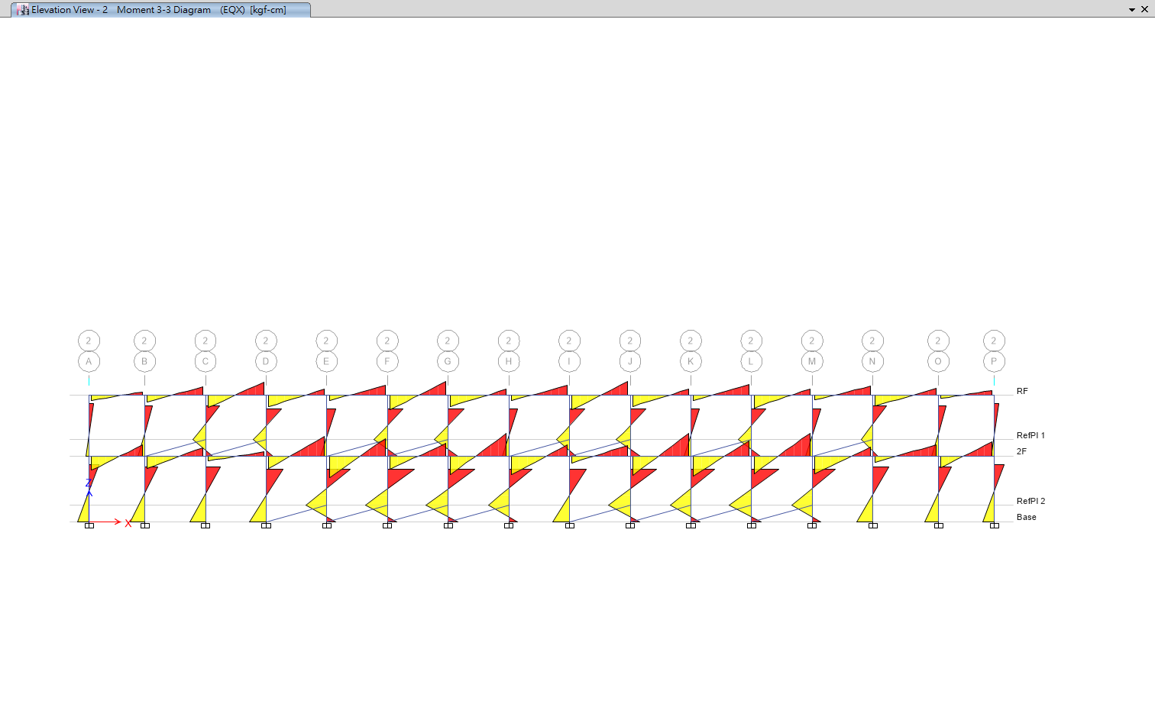
Etabs model
Brace Release
Brace Resist Moment
Column Resist Moment
No Release
Release M3

Slide 13
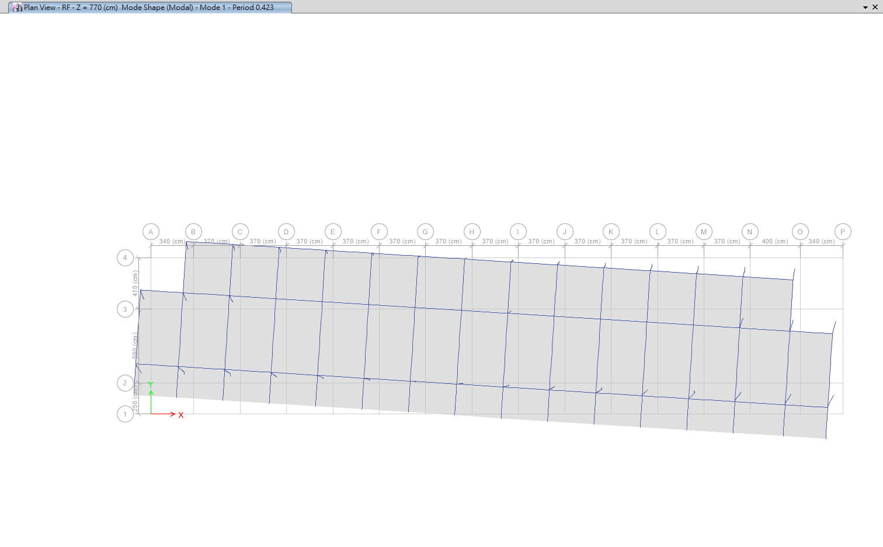
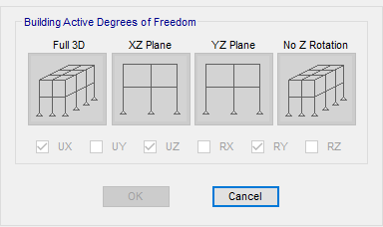
Etabs model
Degrees of Freedom
Torsion Control

Slide 14
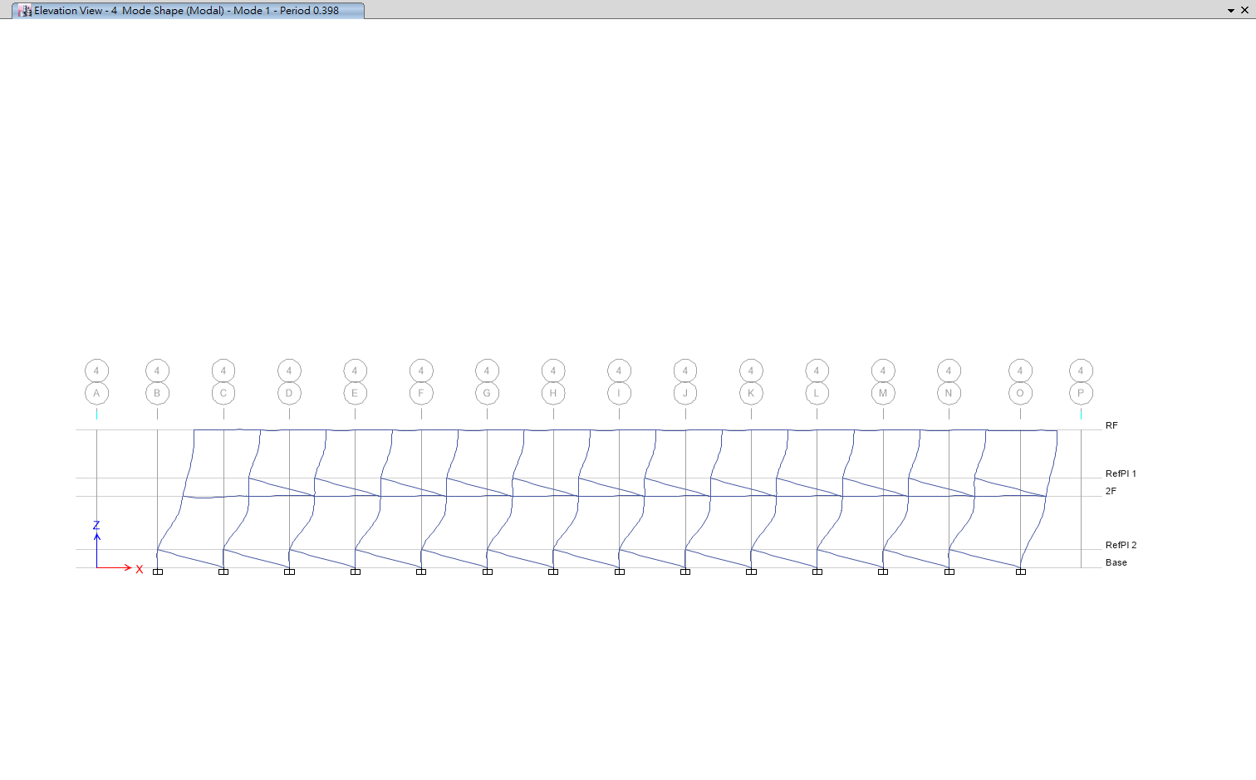
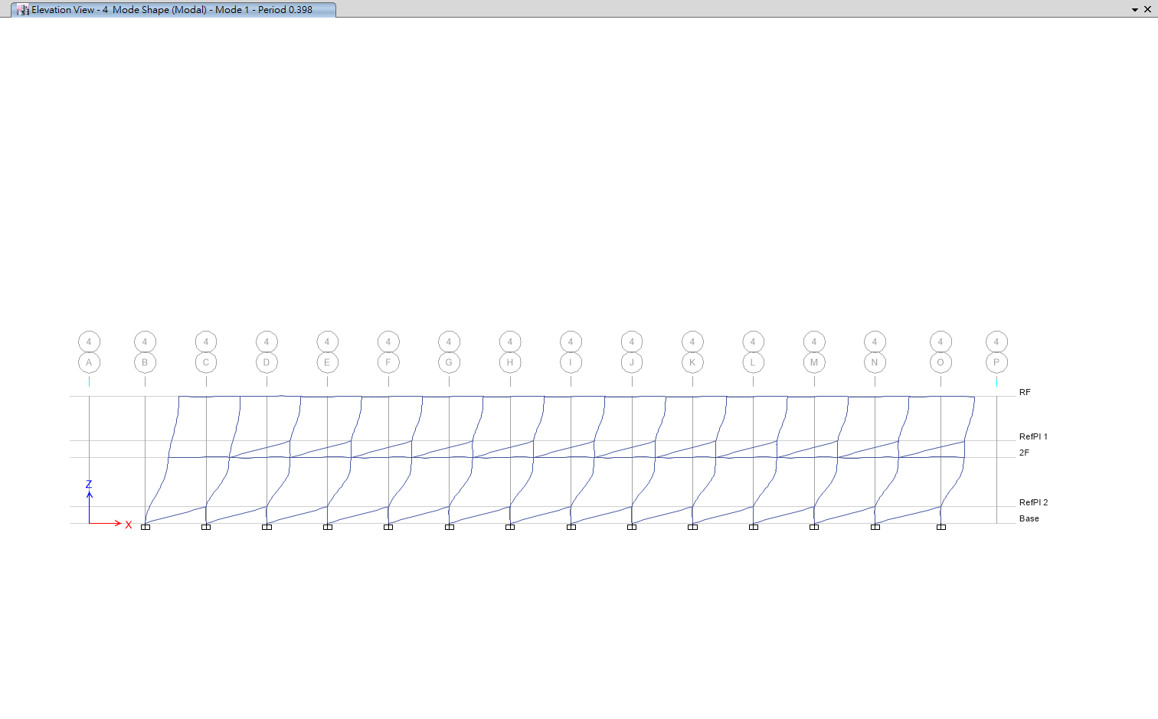
Etabs model
Modal Analysis
T1: 0.398
Modal Participating Mass Ratio: 96.6%
First Mode Shape: 0.0344, 0.0236
XP
XN

Slide 15
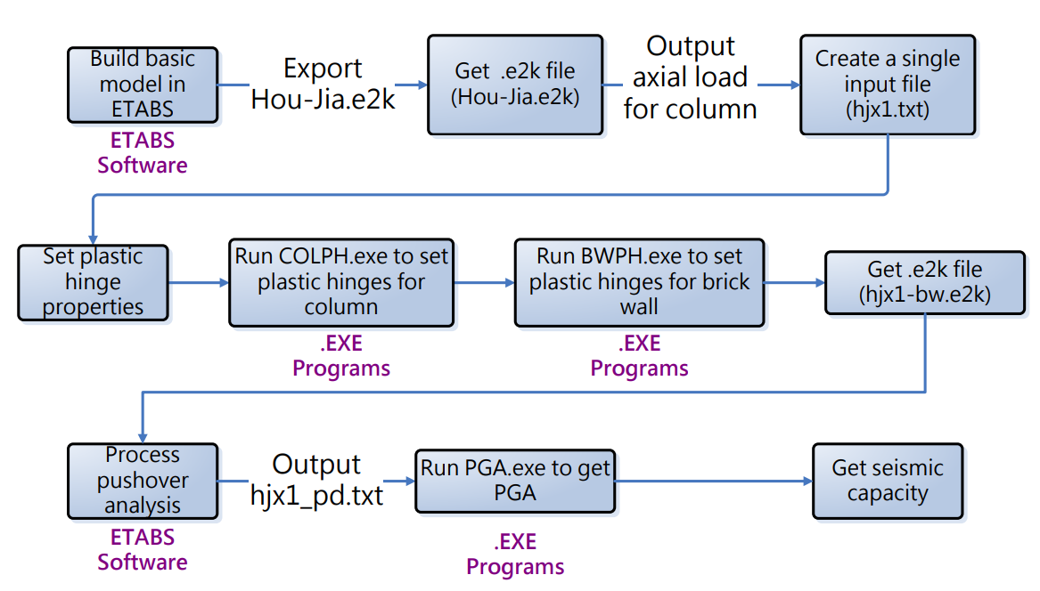
TEASPA
Work Flow

Slide 16
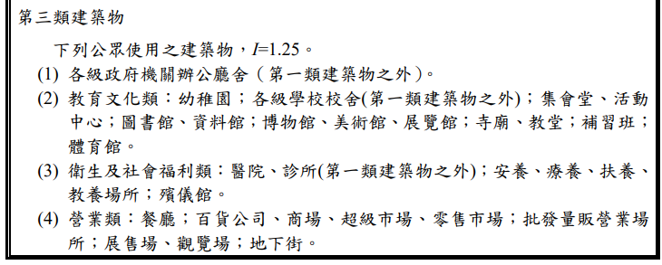
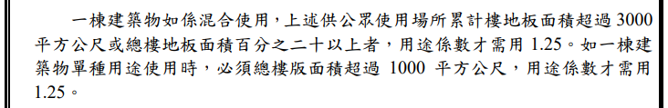
TEASPA
Site Parameter

Slide 17
TEASPA
Build Input File
$ BUILDING PROPERTIES
$ Weight Height
562802 400
562802 770
$ SITE SPECTRUM PARAMETER
$S_DS S_D1
1.096 0.778
$ BRICK WALL PROPERTIES
$ Name width height thick f_mc f_bc P Bond Confinement
D370 370 100 24 210 150 0 3 2
D400 400 100 24 210 150 0 3 2
$ COLUMN PROPERTIES
$Name f_cp f_yl f_yt cover hoop spacing num_hoop TR
1C1 280 2800 2800 4 3 10 2 0
1C2 280 2800 2800 4 3 10 2 0
梁不同跨距與單雙翼視為不同分開建立
$ BEAM PROPERTIES
$Name Lc f_cp f_yl f_yt cover hoop spacing num_hoop TR

Slide 18
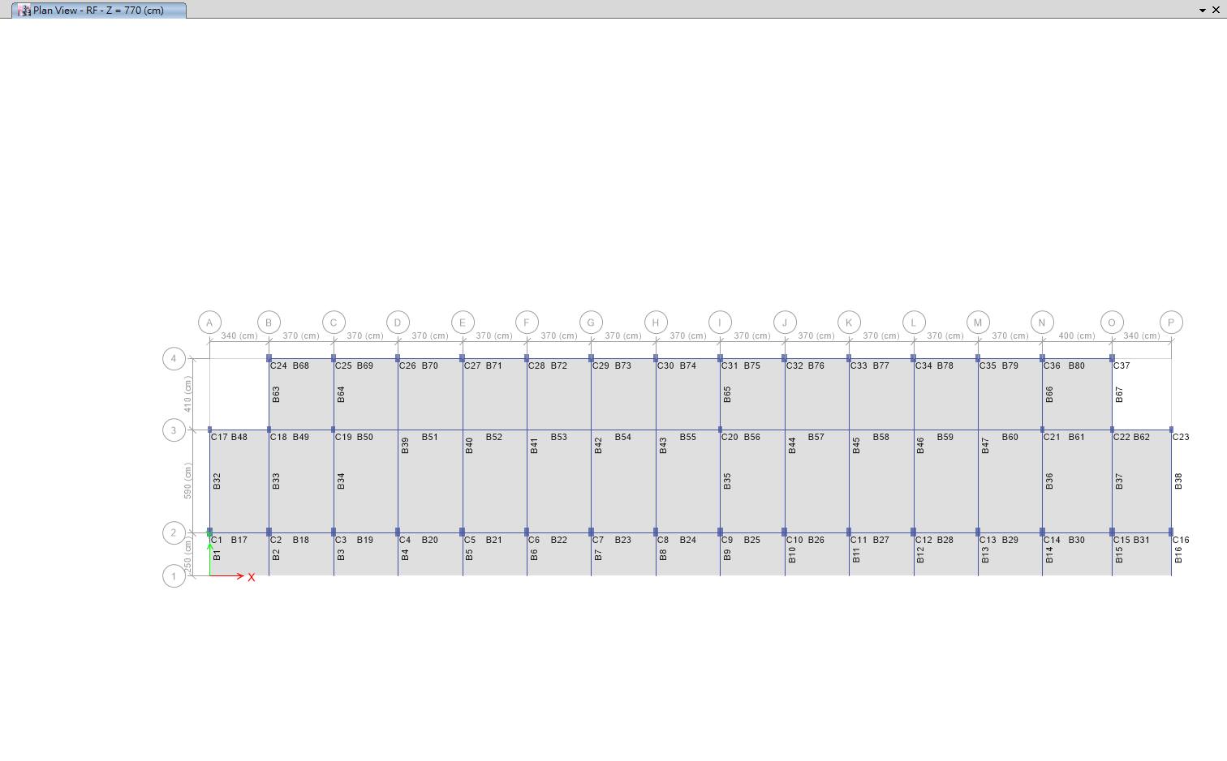
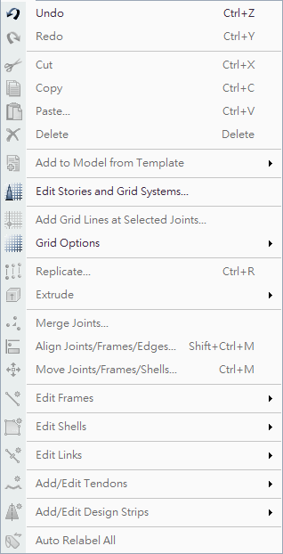
TEASPA
Relabel

Slide 19
TEASPA
Build Input File
$ COLUMN DATA
$Name story section shape Height L fromBtm
One by One
$ BEAM DATA
$Name story section
$ AXIAL LOAD
$ Story Column Loc P
From ETABS
$ COLUMN SECTION PROPERTIES
2B4D_400
15 100 40 25
2.5 2800 3 3 3 3 3 3
5.95 2800 6 6
12.5 2800 3 3 3 3 3 3
34 2800 6 6
T Beam

Slide 20
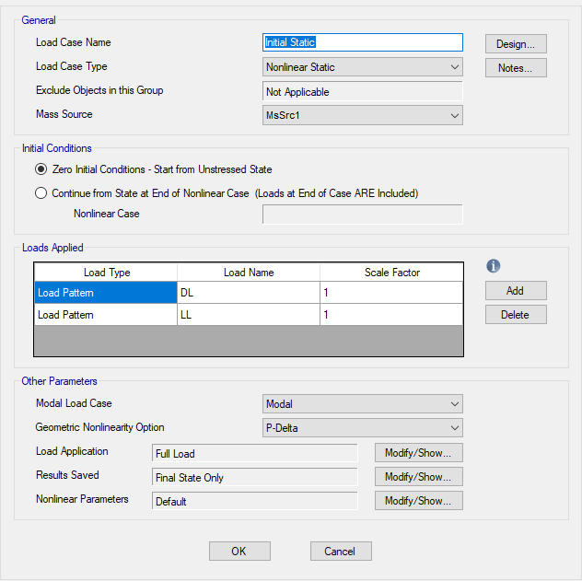
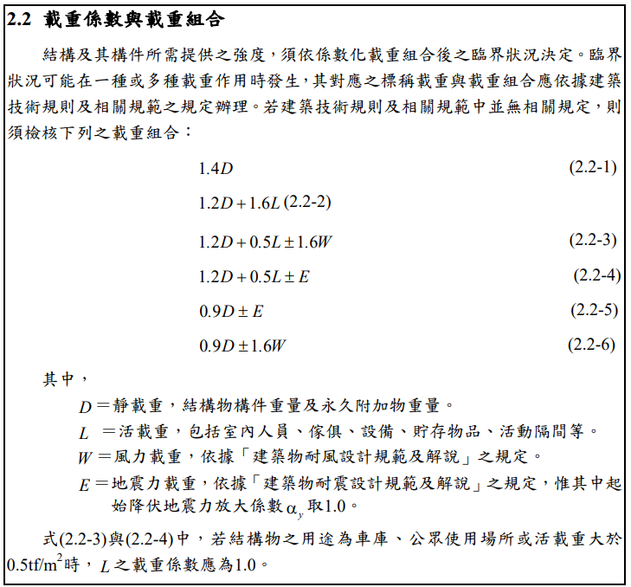
TEASPA
Pushover

Slide 21
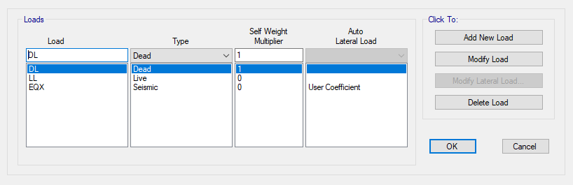
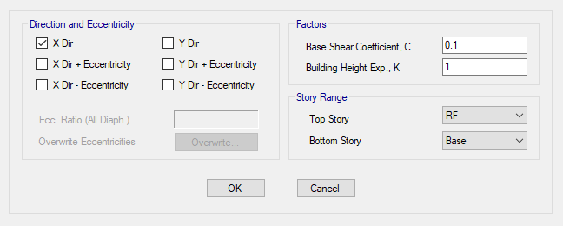
TEASPA
Load Pattern
No Consider Eccentricities

Slide 22
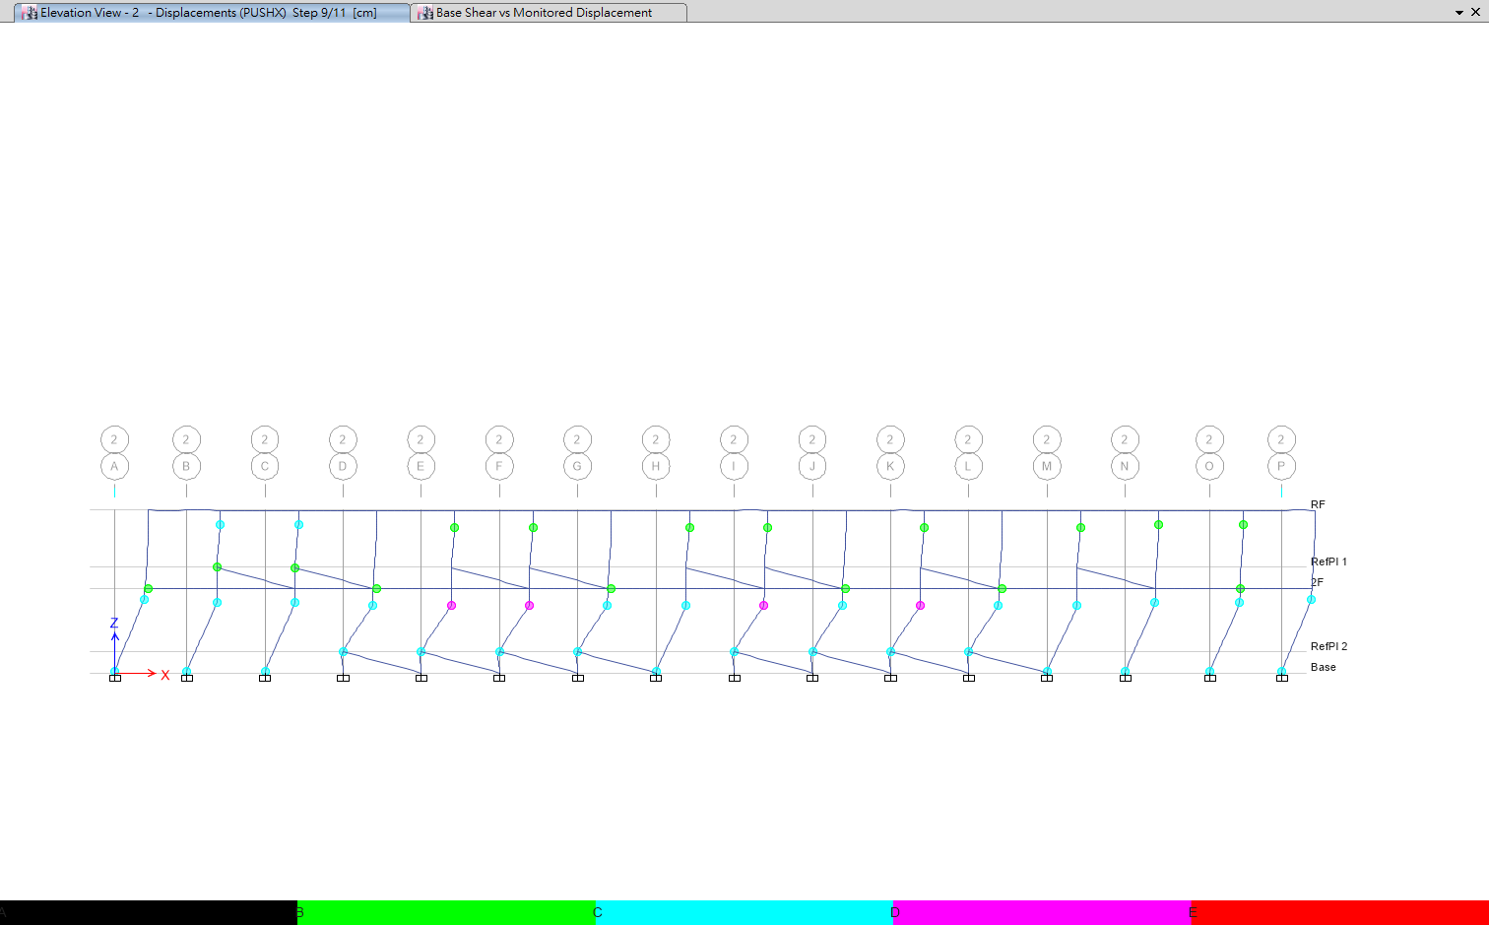
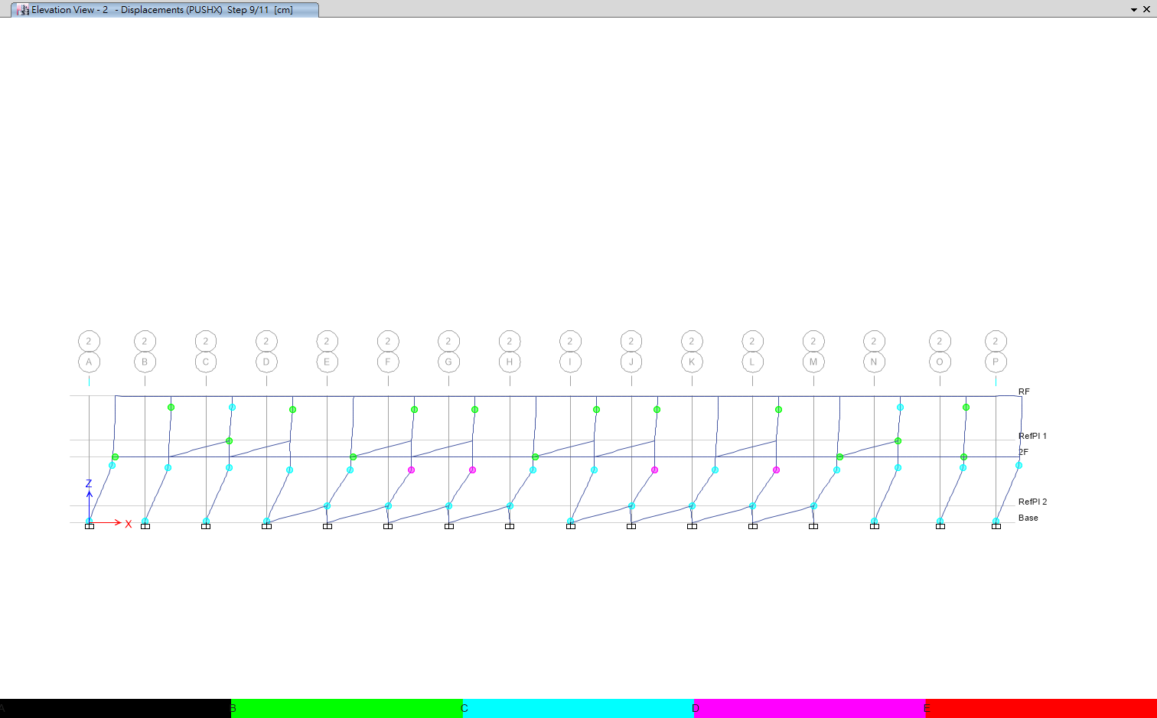
TEASPA
Nonlinear Hinge
XP
XN

Slide 23
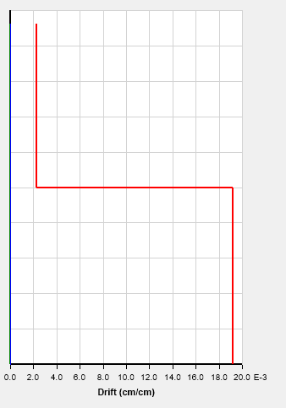
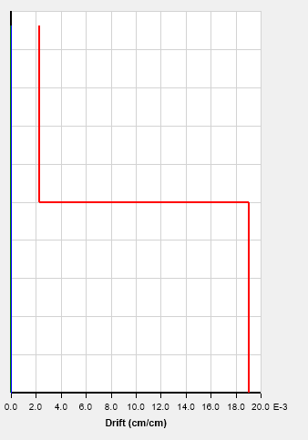
TEASPA
DM Performance
Smaller than 2% => OK
XP
XN

Slide 24
TEASPA
IM Performance
AT: 0.4 * SDS * I=0.548
XP: Ap=0.2897 < AT => NG
XN: Ap=0.2883 < AT => NG

Slide 25
Xtract
Cross section info.
kN-m | 1B1 | 1B2,2B2 | 1B3,2B3 | 2B1 | 2B4 | 1B4 | CB
Mux+ | 639.9 | 152.1 | 176.5 | 471.5 | 51.8 | 75.3 | 227.5
Mux- | 295.6 | 66.1 | 96.9 | 288.3 | 51.8 | 75.3 | 90.7
 | 1C1 | 1C2 | 1C3 | 2C1 | 2C2 | 2C3
Muy | 118.1 | 101.8 | 41.6 | 108.6 | 75.2 | 43.9

Slide 26
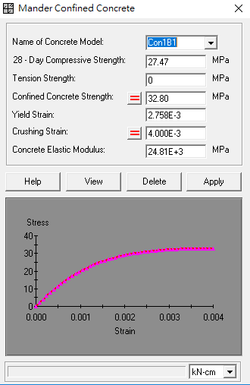
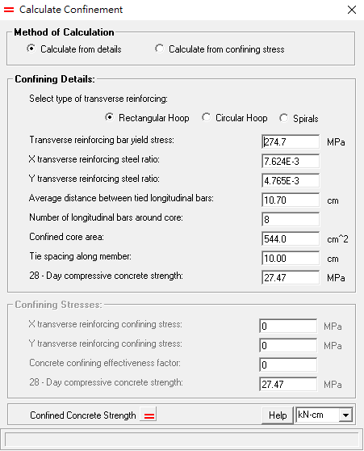
Xtract
Detail design

Slide 27
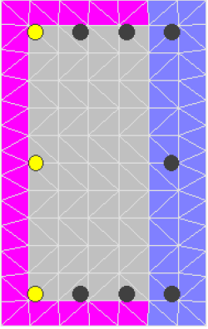
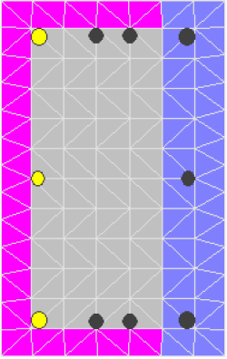
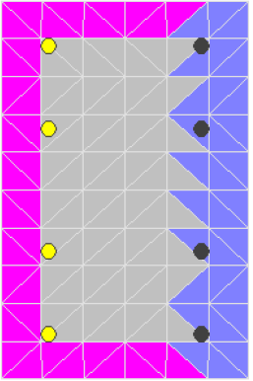
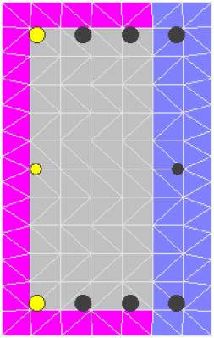
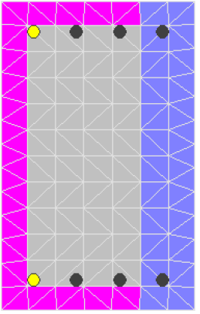
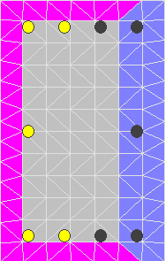
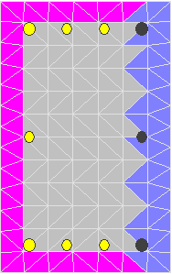
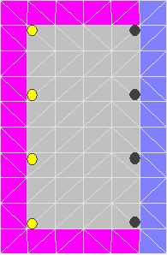
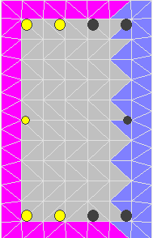
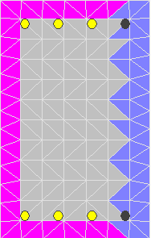
Xtract
Comparison
 | 1C1 | 1C2 | 1C3,2C3 | 2C1 | 2C2
Rough design
Detail design

Slide 28
Upper bound method
Assumption
1. The story drift on 2F is small enough to be neglected.
2. Neglect the effect on plastic hinge from 2F beam and column.
3. Only 1F panel mechanism.
4. Using Xtract to define the Mp and using TEASPA to define location of plastic hinge.

Slide 29
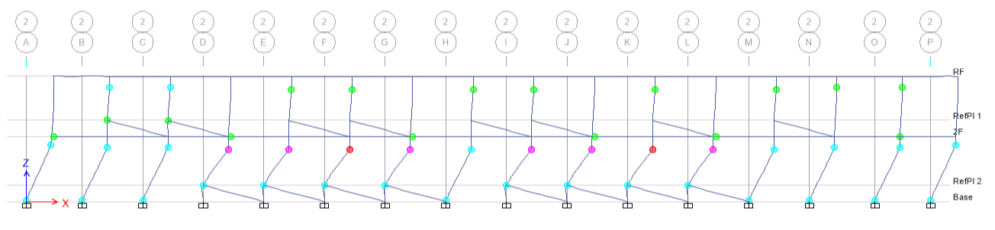
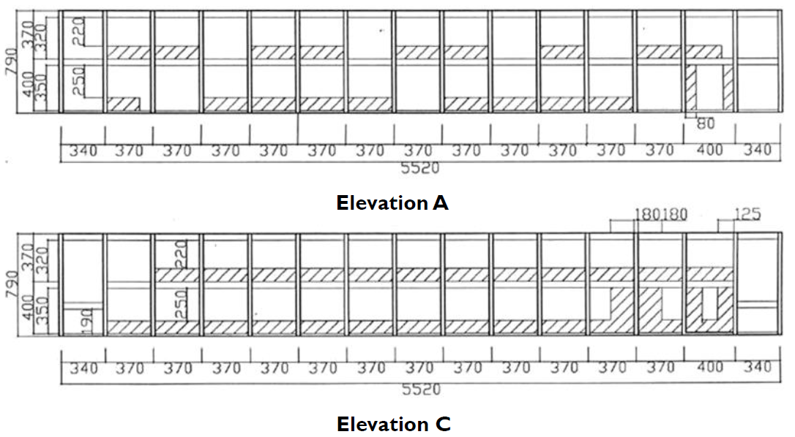
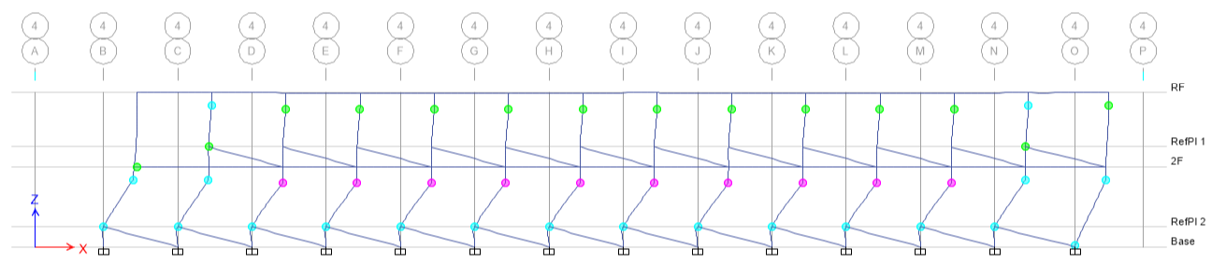
Upper bound method
Location of plastic hinge

Slide 30



Upper bound method
Calculation
P
0.519P
$$θ_{S}$$
$$θ_{L}$$
Mp | kN-m
1C1 | 118.1
1C2 | 101.8
1C3 | 41.6
Lc
100
$$θ_{S}×L_{C}=θ_{L}×(L_{C}+100)$$

Slide 31
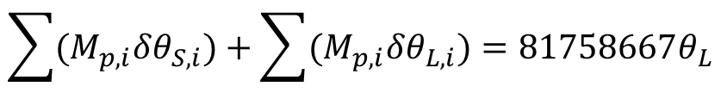
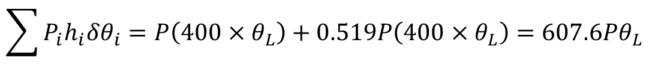

Upper bound method
Calculation
$$\sum{P_{i}h_{i}δθ_{i}}=P\left(400×θ_{L}\right)+0.519P\left(400×θ_{L}\right)=607.6Pθ_{L}$$
$$\sum{(M_{p,i}δθ_{S,i})}+\sum{(M_{p,i}δθ_{L,i})}=81758667θ_{L}$$
$$V_{upperbound}=\left(1+0.519\right)P=1.519×134560.02=204396.7 kg$$
$$V_{pushover}=456065kg$$

Slide 32
Summary

