Slide 1
Plastic Analysis and Design
Final term project 2018
2019.01.02
Advisor : Kuo-Chun Chang
Group 3
R06521212 Dong-Hua Tsai
R06521217

Slide 2
Introduction
Etabs
TEASPA
Xtract
Upper bound
Summary

Slide 3
Introduction
Etabs
TEASPA
Xtract
Upper bound
Summary

Slide 4
Introduction
Purposes
1. After the 921 earthquake, many school buildings collapsed. The lack of seismic design building code in the past was discovered. So that the seismic design of the school buildings began to be carried out with today’s norms.
2. Focus on the collapsed Chiayi Minxung factory, we investigate the defects in the structure and the reasons for the collapse.
3. Using Etabs, TEASPA, and Xtract structural analysis model with ATC-40 and FEMA273 building code to investigate the damage of the structure.

Slide 5
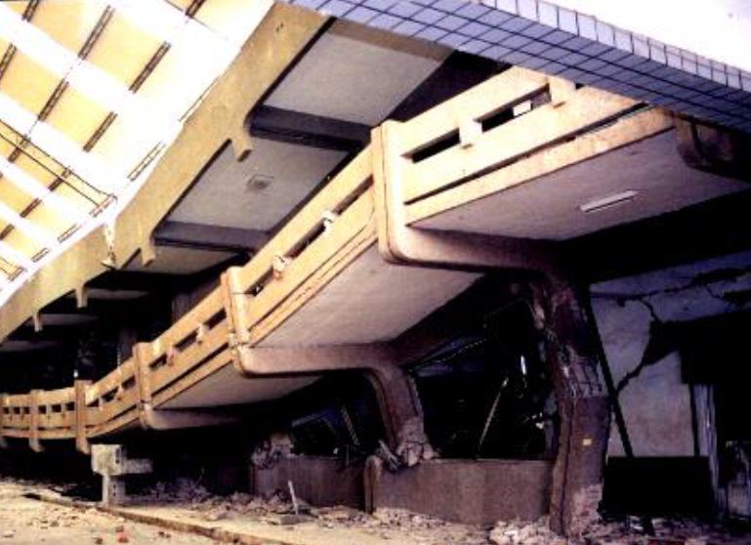
Introduction
Basic information
Building name
Soil type
Building function
Structure system
Structure size
Materials
loadings
:
:
:
:
:
:
:
Chiayi Minxung factory
Type 2
School building
RC MRF
2 floor without basement
Concrete strength 280 kg/cm² , Rebar strength 2800 kg/cm²
Dead load 850 kg/m² , live load 250 kg/m²

Slide 6
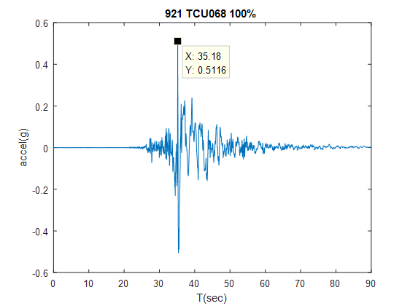
Introduction
Seismic records

Slide 7
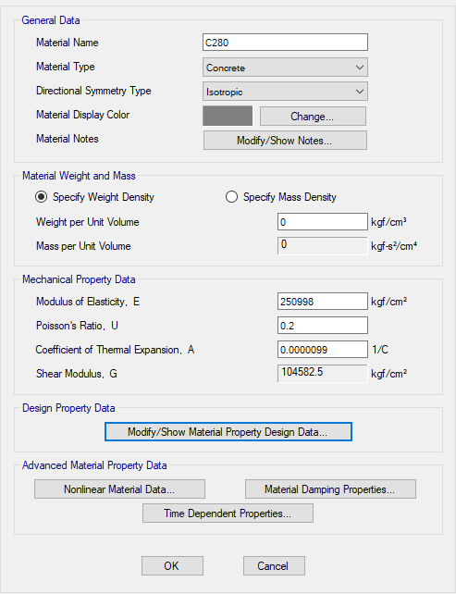
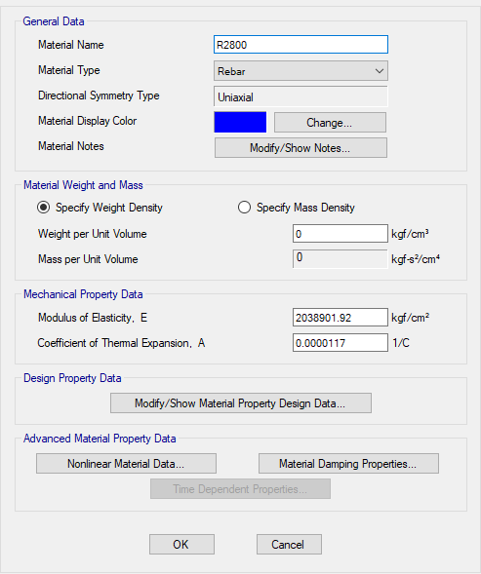
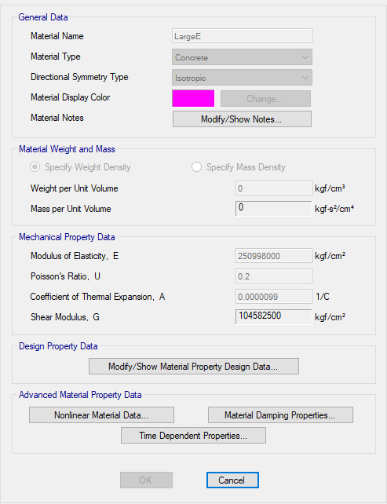
Etabs model
Material
Concrete
Rebar
Brace

Slide 8
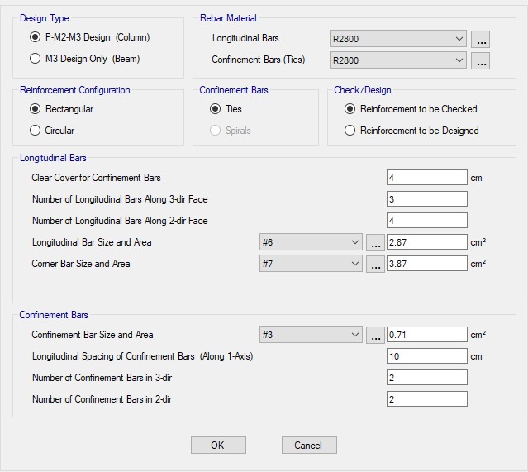
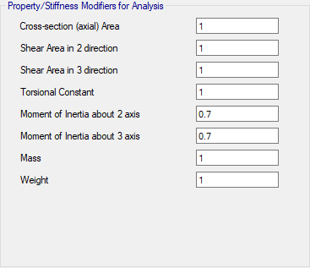
Etabs model
Section

Slide 9
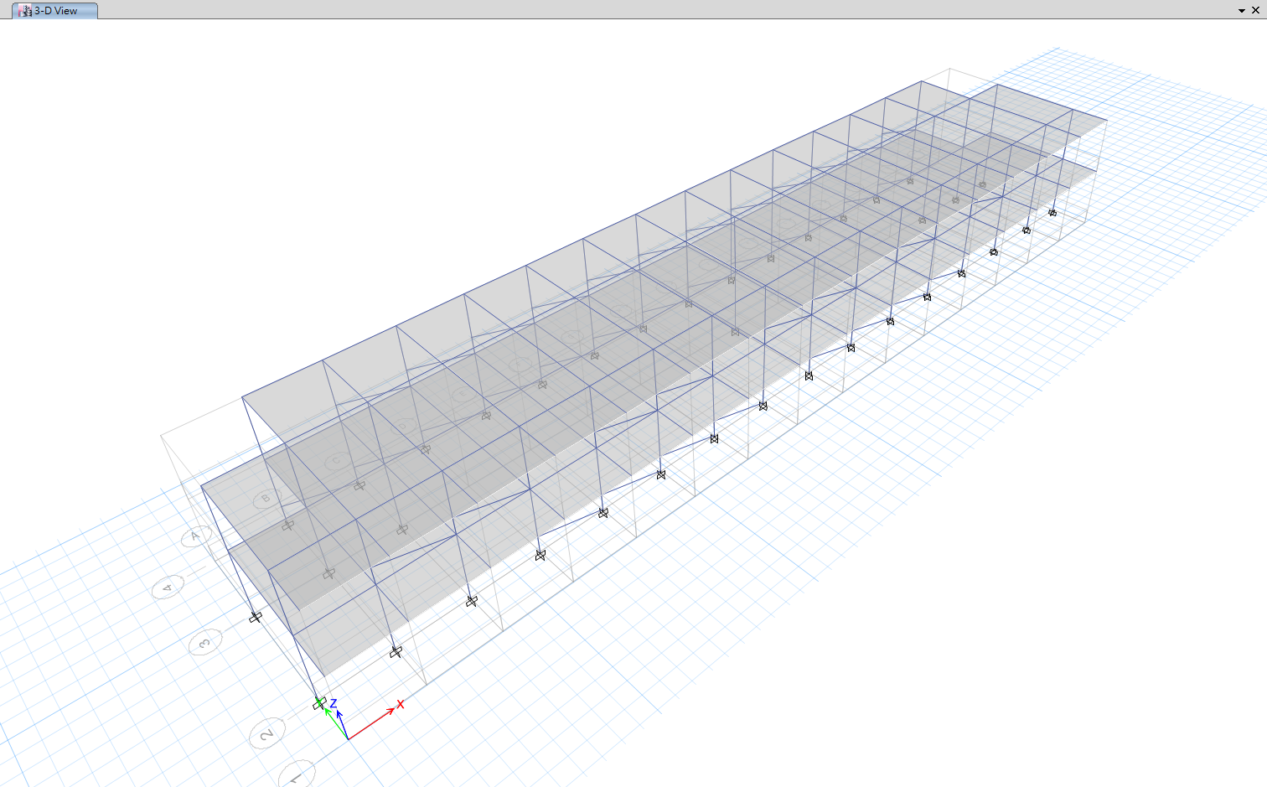
Etabs model
Model

Slide 10
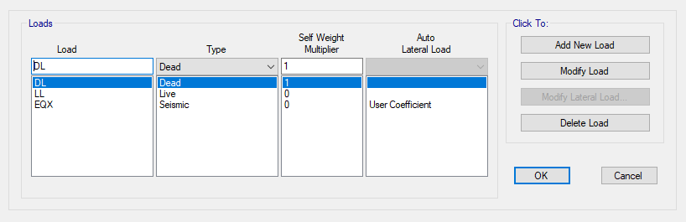
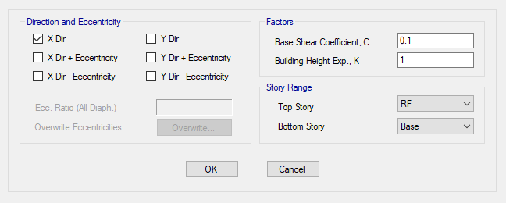
Etabs model
Load Pattern

Slide 11
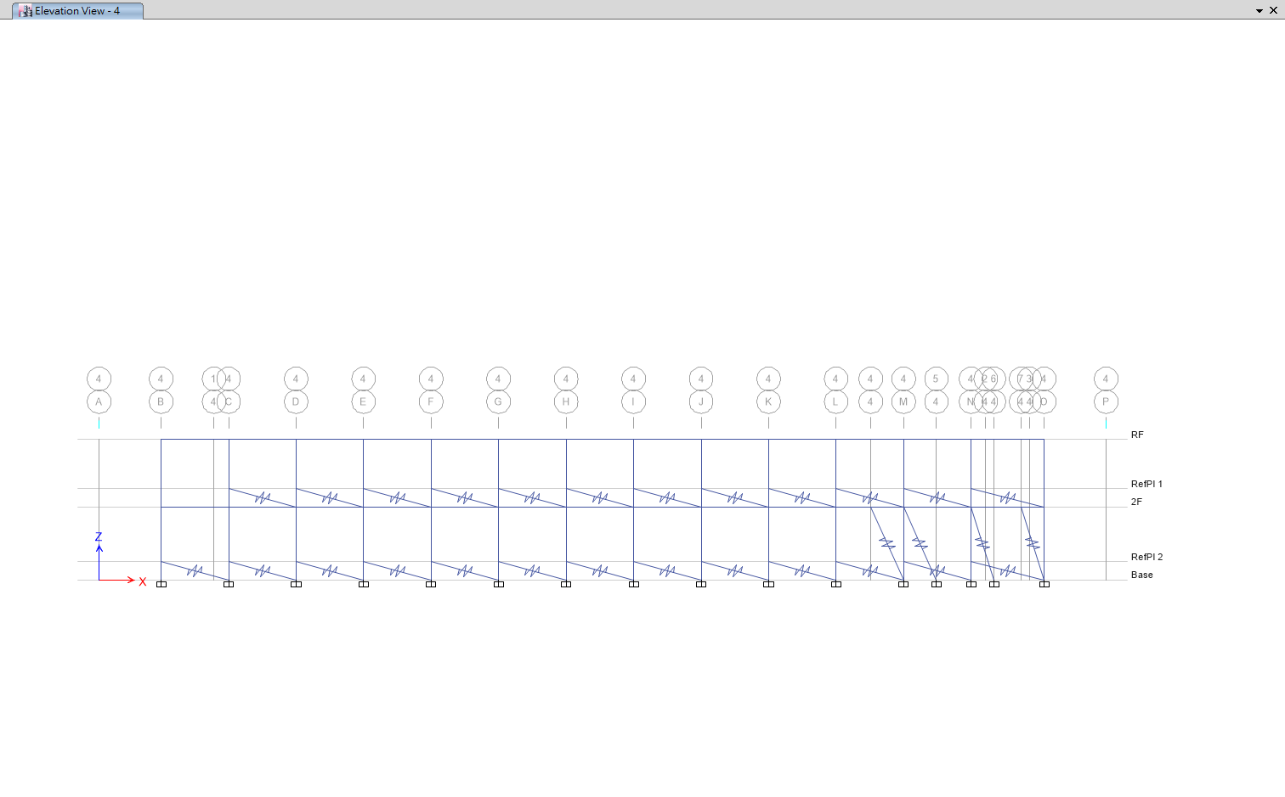
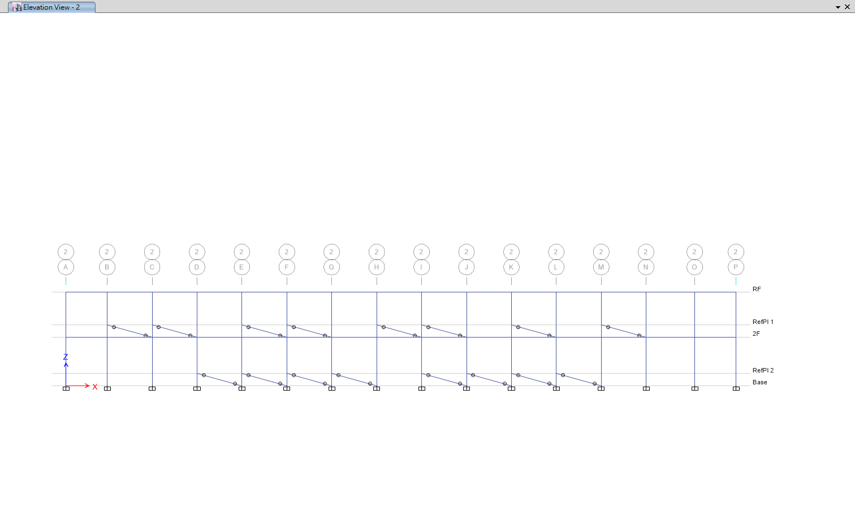
Etabs model
Brace
Link
Section

Slide 12
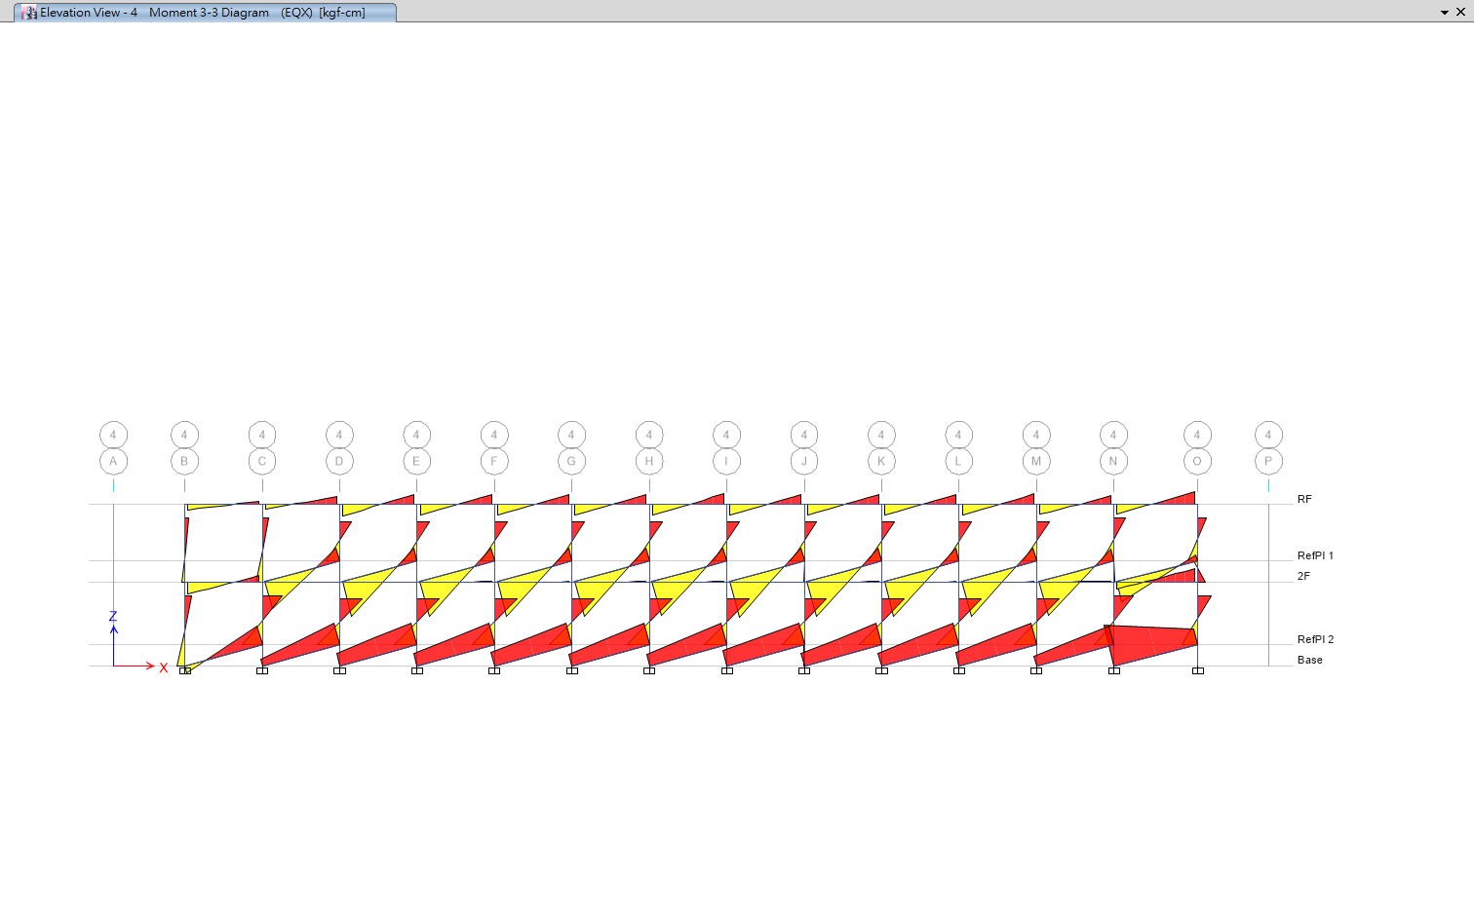
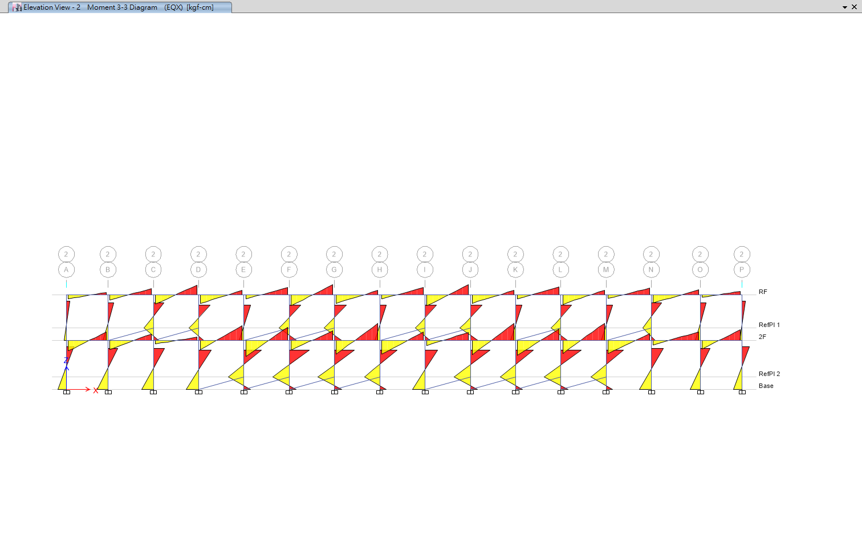
Etabs model
Brace Release
No Release
Release M3

Slide 13
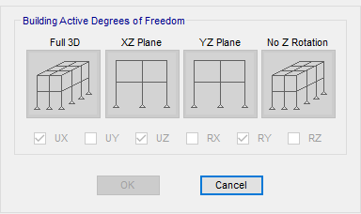
Etabs model
Degrees of Freedom

Slide 14
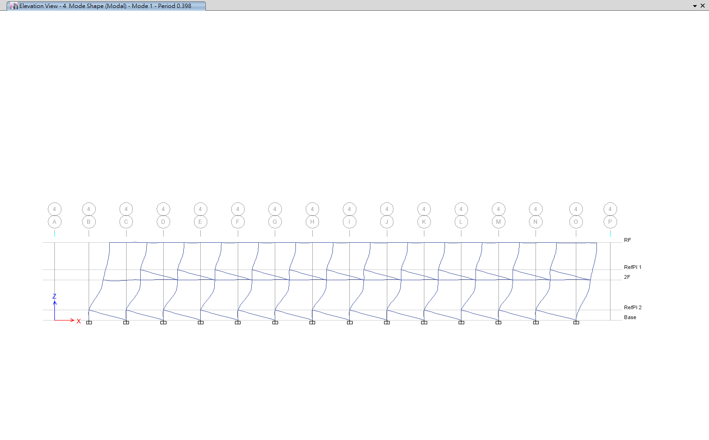
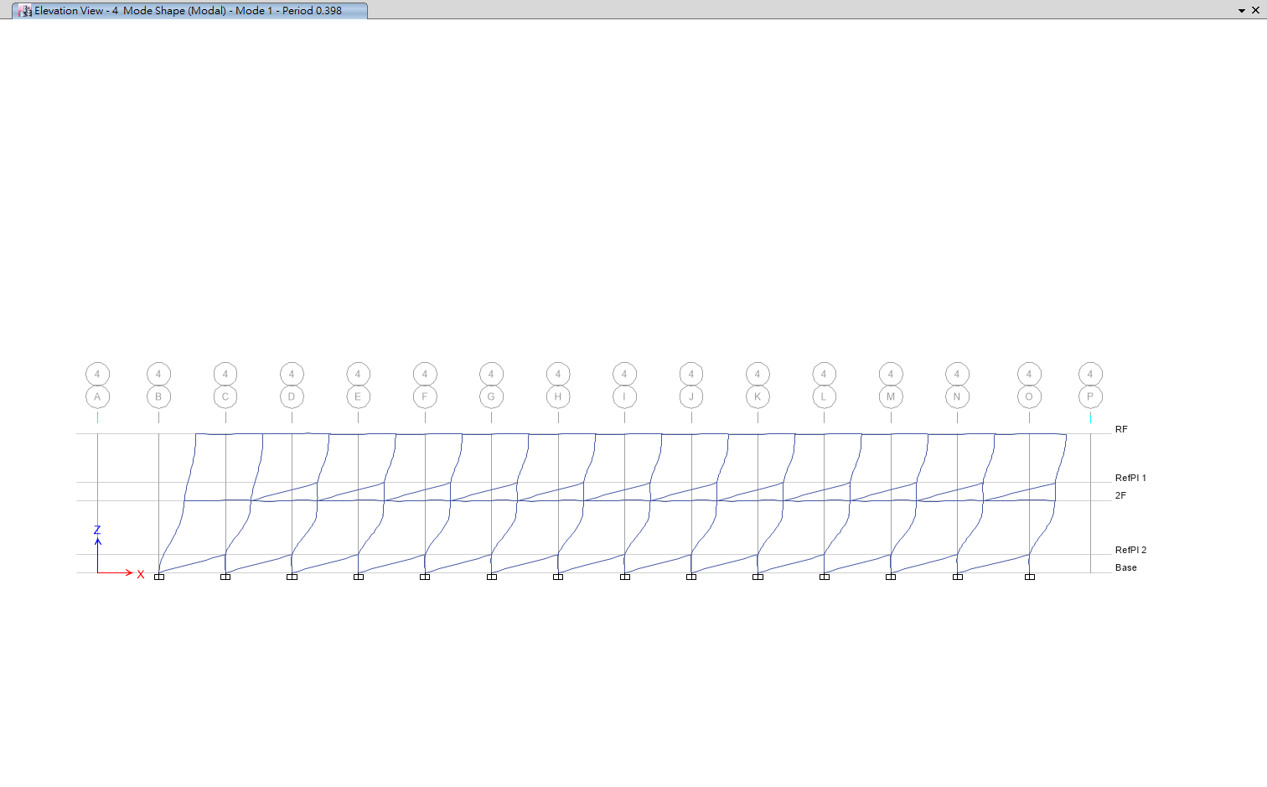
Etabs model
Modal Analysis
T1: 0.398
Modal Participating Mass Ratio: 96.6%
First Mode Shape: 0.0344, 0.0236
XP
XN

Slide 15
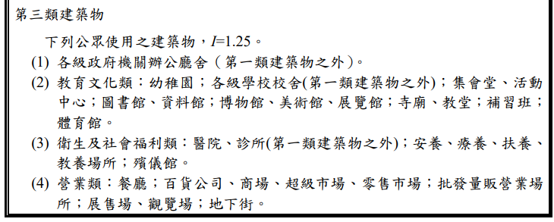
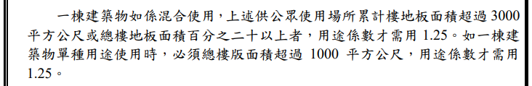
TEASPA
Site Parameter

Slide 16
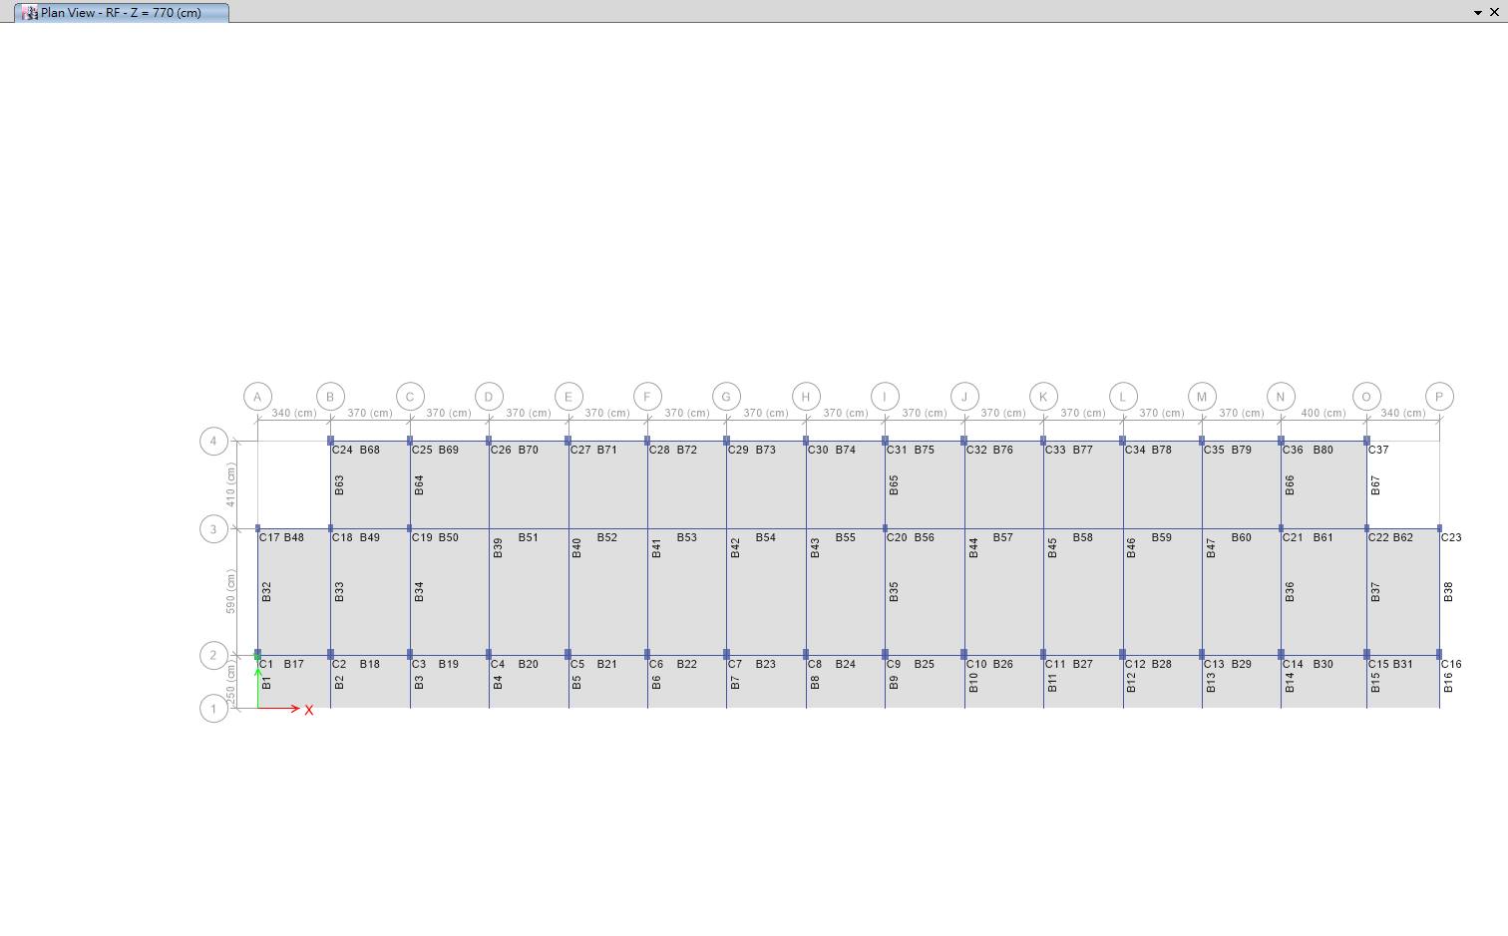
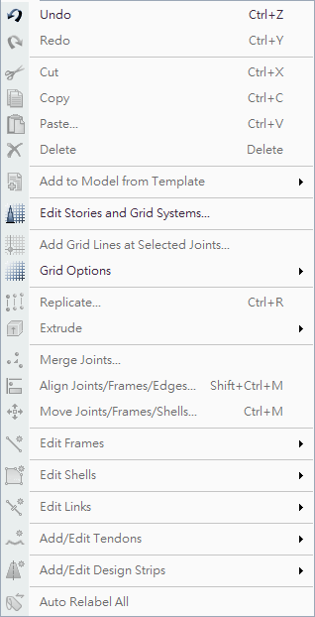
TEASPA
Relabel

Slide 17
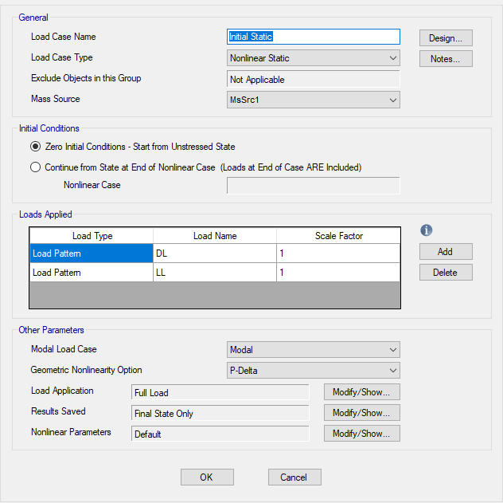
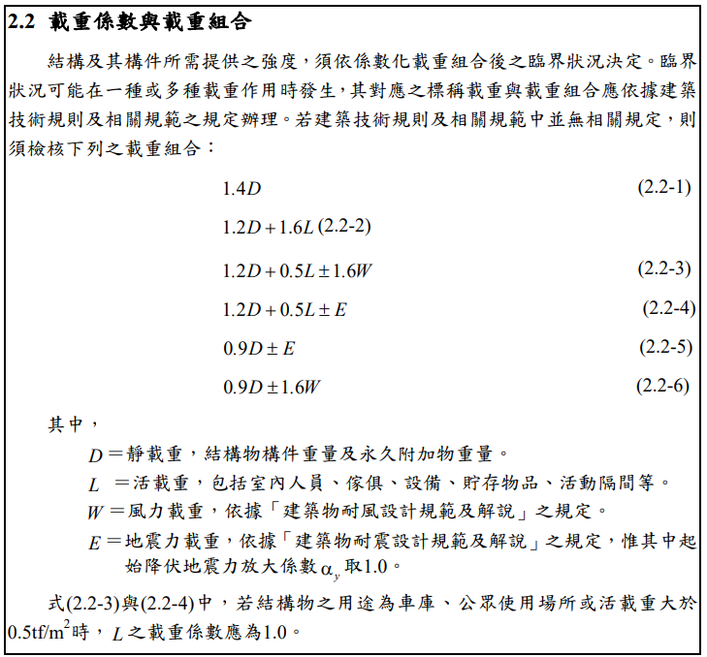
TEASPA
Pushover

Slide 18
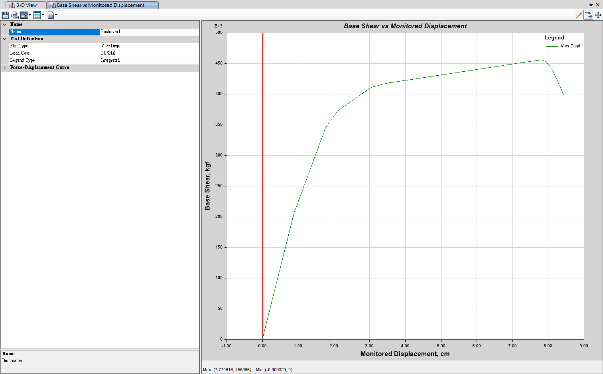
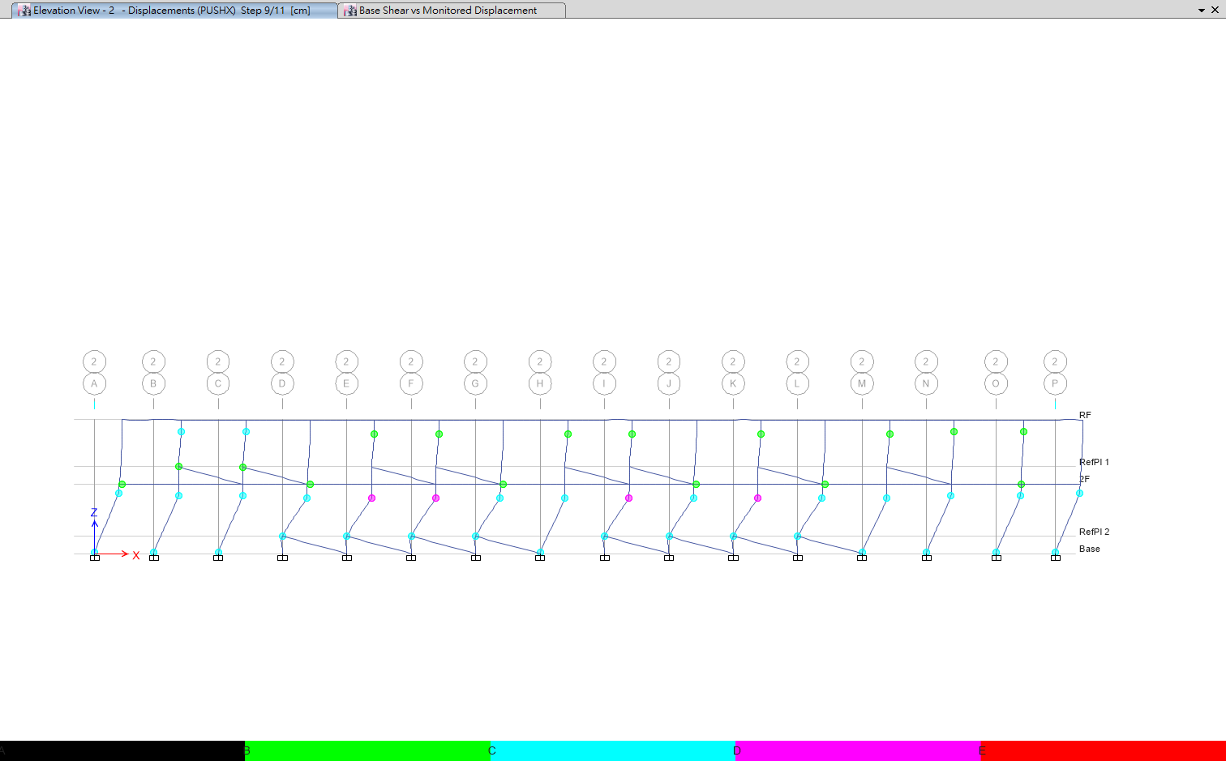
TEASPA
Site Parameter

Slide 19
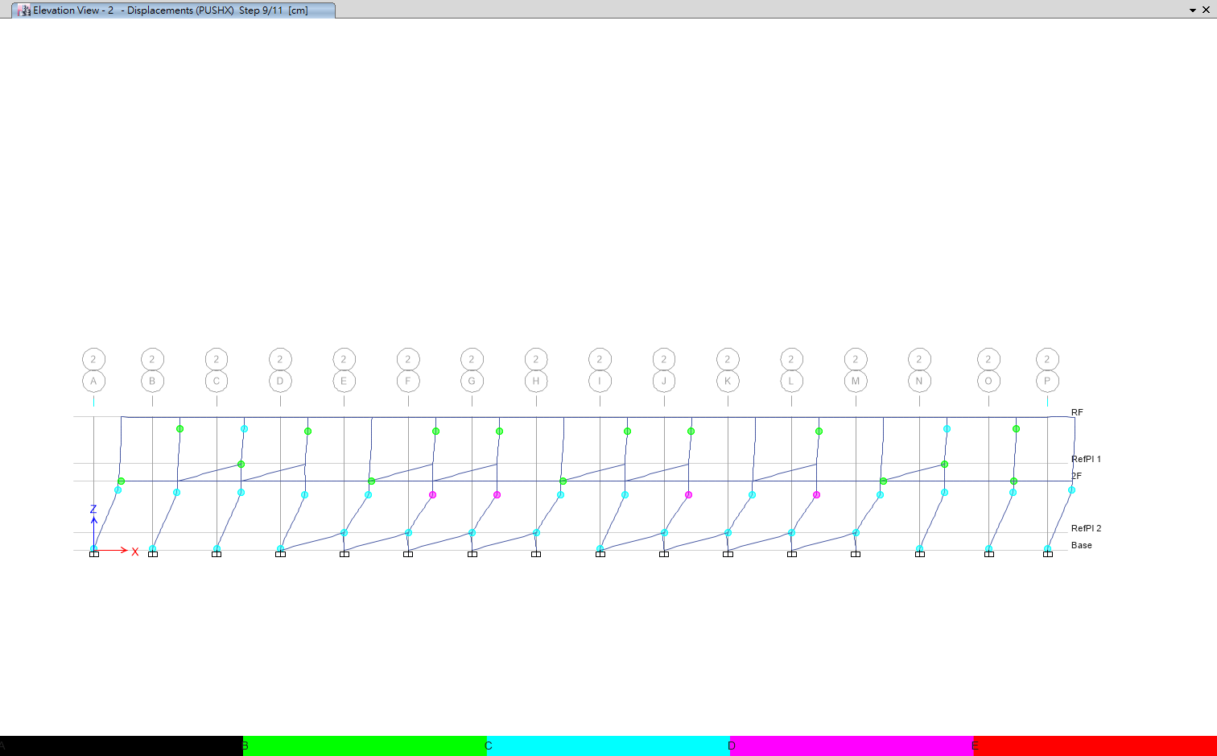
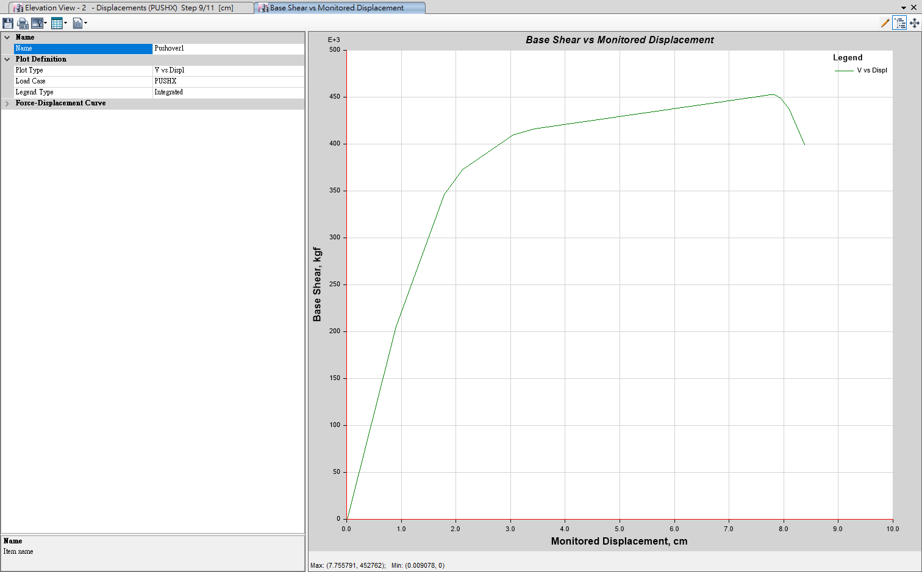
TEASPA
Site Parameter

Slide 20
TEASPA
Site Parameter

Slide 21
TEASPA
Site Parameter

Slide 22
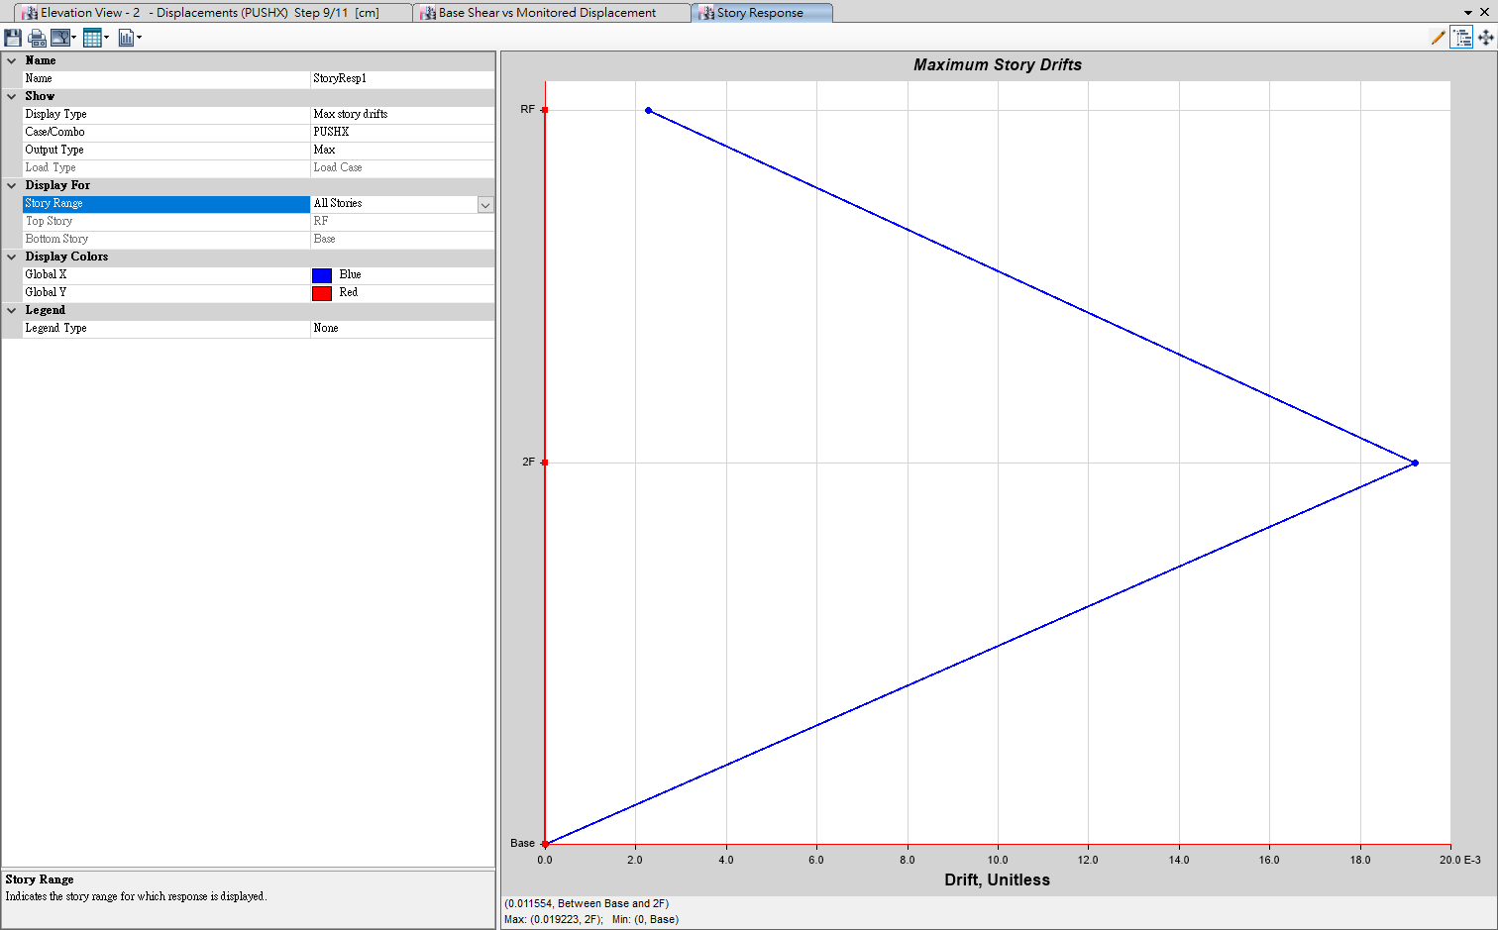
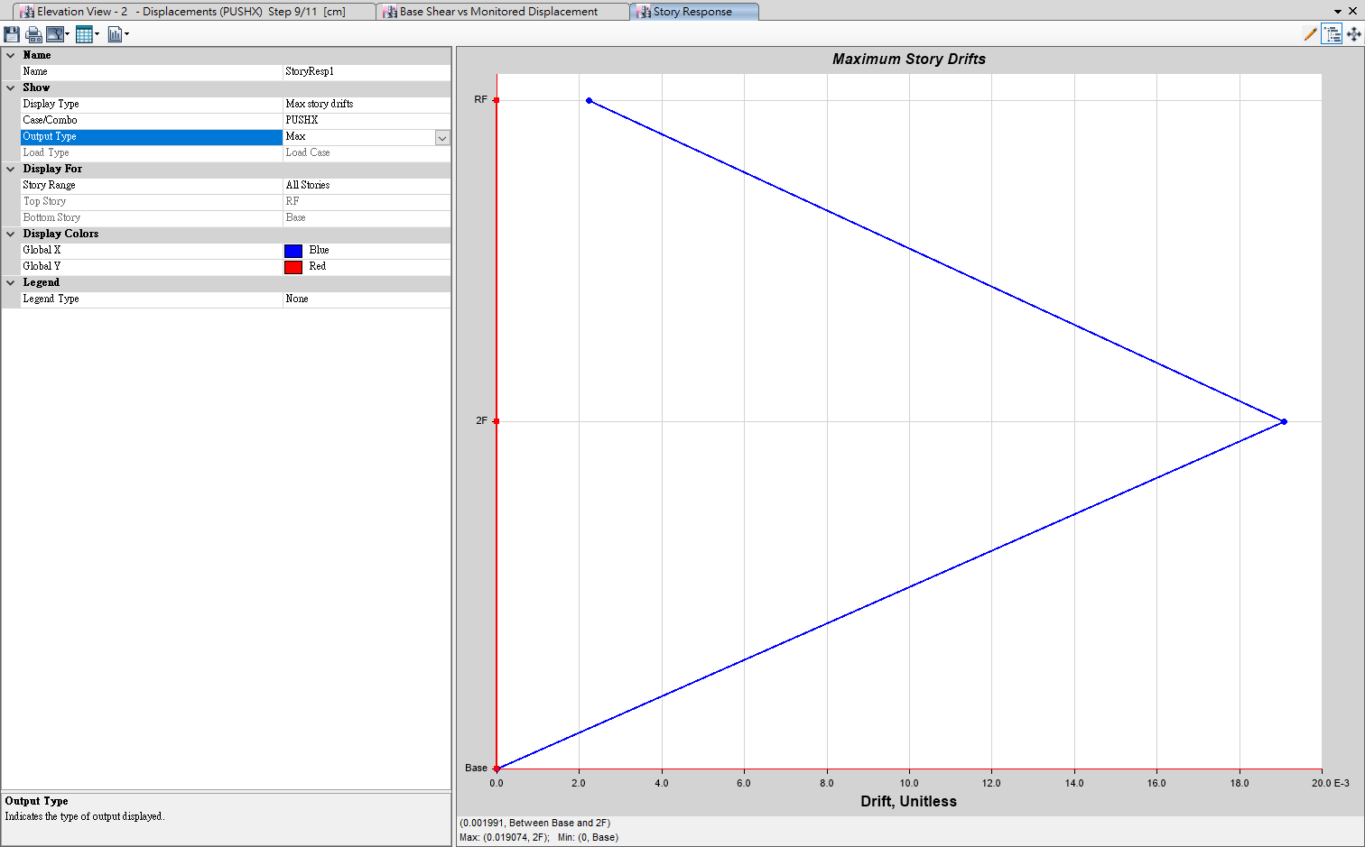
TEASPA
Site Parameter

Slide 23
TEASPA
Site Parameter

Slide 24
Xtract
Cross section info.
kN-m | 1B1 | 1B2,2B2 | 1B3,2B3 | 2B1 | 2B4 | 1B4 | CB
Mux+ | 639.9 | 152.1 | 176.5 | 471.5 | 51.8 | 75.3 | 227.5
Mux- | 295.6 | 66.1 | 96.9 | 288.3 | 51.8 | 75.3 | 90.7
 | 1C1 | 1C2 | 1C3 | 2C1 | 2C2 | 2C3
Muy | 118.1 | 101.8 | 41.6 | 108.6 | 75.2 | 43.9

Slide 25
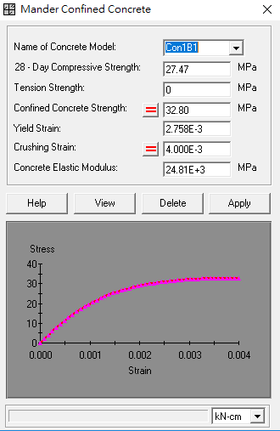
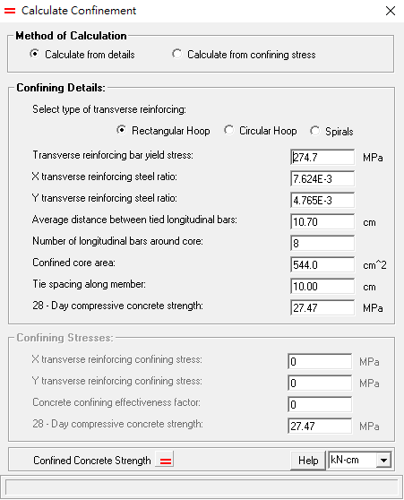
Xtract
Detail design

Slide 26
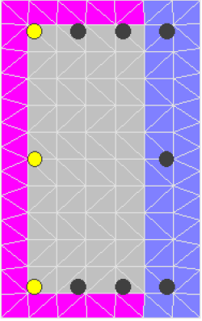
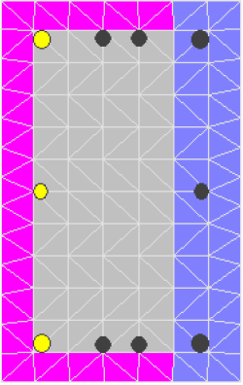
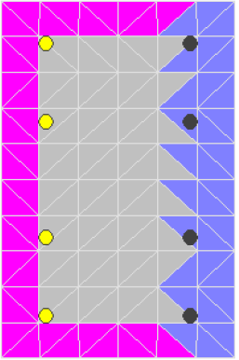
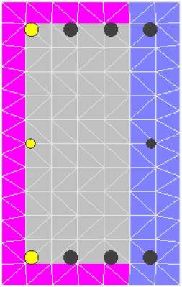
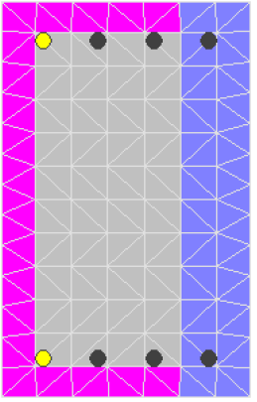
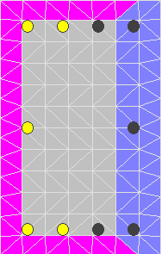
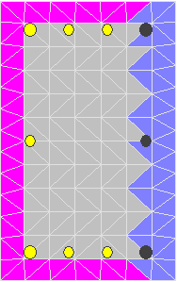
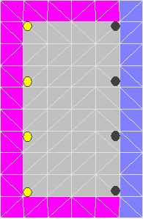
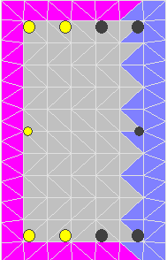
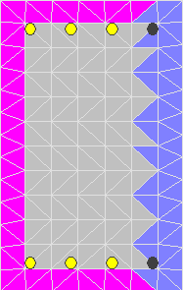
Xtract
Comparison
 | 1C1 | 1C2 | 1C3,2C3 | 2C1 | 2C2
Rough design
Detail design

Slide 27
Upper bound method
Assumption
1. The story drift on 2F is small enough to be neglected.
2. Neglect the effect on plastic hinge from 2F beam and column.
3. Only 1F panel mechanism.
4. Using Xtract to define the Mp and using TEASPA to define location of plastic hinge.

Slide 28
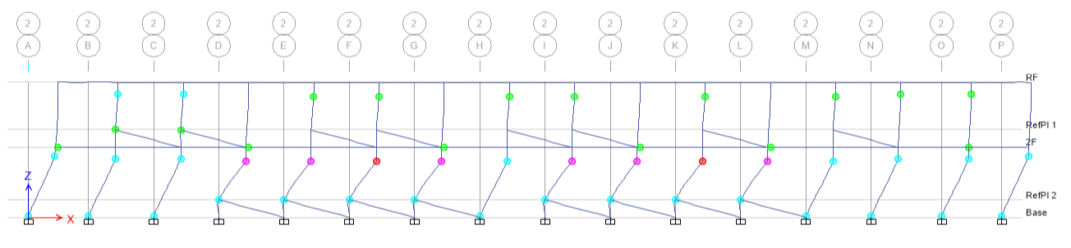
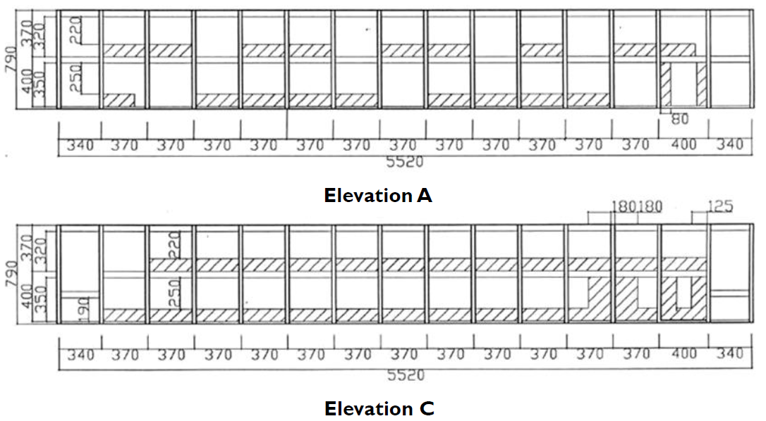
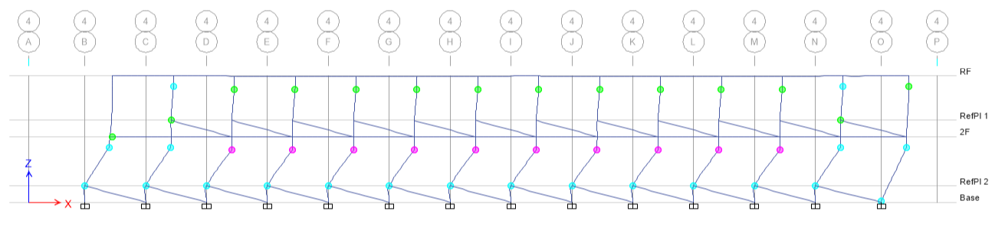
Upper bound method
Location of plastic hinge

Slide 29



Upper bound method
Calculation
P
0.519P
$$θ_{S}$$
$$θ_{L}$$
Mp | kN-m
1C1 | 118.1
1C2 | 101.8
1C3 | 41.6
Lc
100
$$θ_{S}×L_{C}=θ_{L}×(L_{C}+100)$$

Slide 30
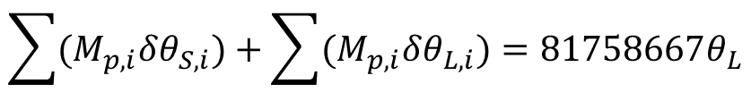
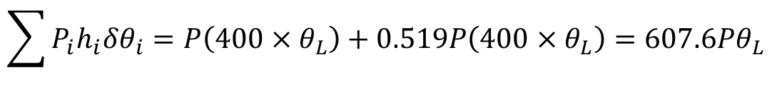

Upper bound method
Calculation
$$\sum{P_{i}h_{i}δθ_{i}}=P\left(400×θ_{L}\right)+0.519P\left(400×θ_{L}\right)=607.6Pθ_{L}$$
$$\sum{(M_{p,i}δθ_{S,i})}+\sum{(M_{p,i}δθ_{L,i})}=81758667θ_{L}$$
$$V_{upperbound}=\left(1+0.519\right)P=1.519×134560.02=204396.7 kg$$
$$V_{pushover}=456065kg$$

Slide 31
Summary

