Slide 1
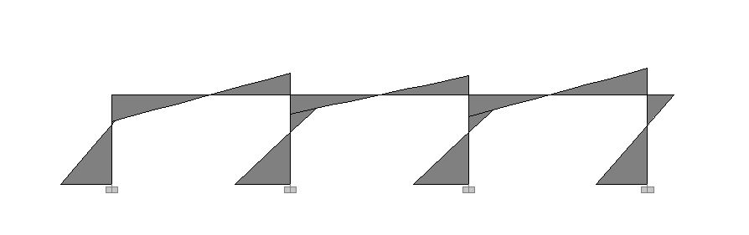
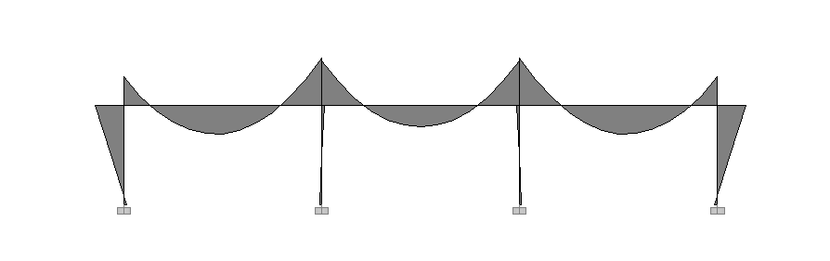

Tradition
Lateral Load
Lateral
Force
Moment Diagram
$$A_{s}(cm^{2})$$
Gravity Load
Gravity Load
Beam Length(cm)

Slide 2
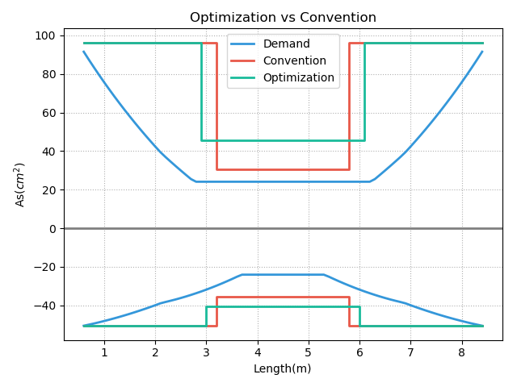
76cm<d=90cm

Slide 3
Notes:
Tradition MMC Pushover

Slide 4
Notes:
Tradition Mode1 Mode2

Slide 5
Notes:
Multi MMC Pushover

Slide 6
Notes:
Multi Mode1 Mode2

Slide 7
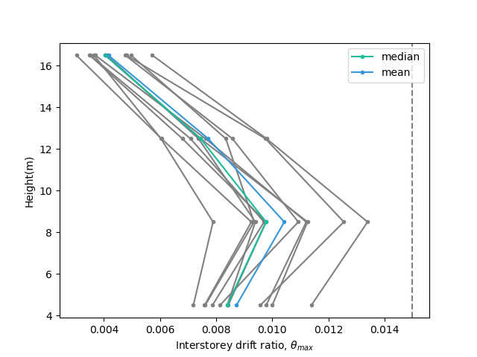
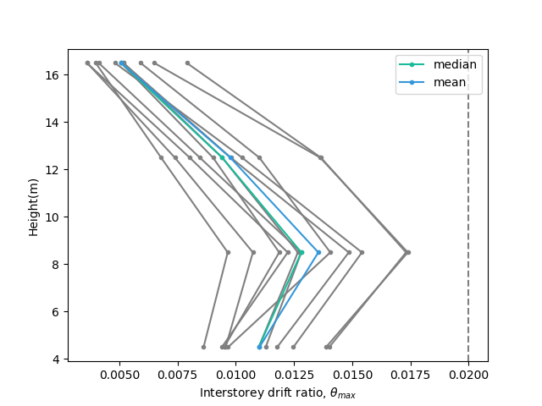
Notes:
Tradition DBE MCE

Slide 8

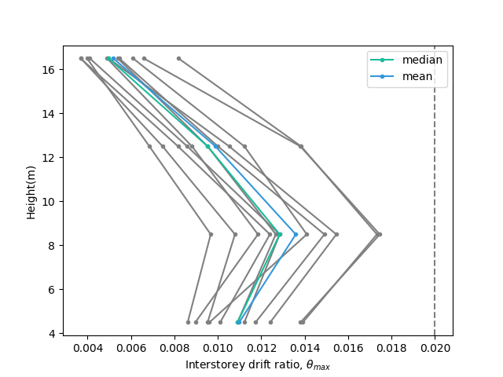
Notes:
Multi DBE MCE

Slide 9
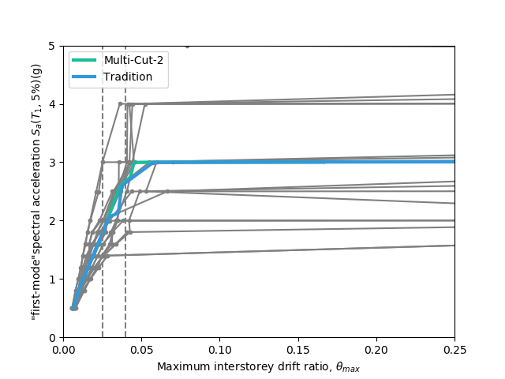
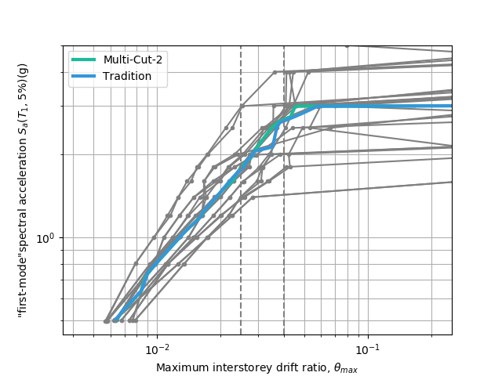
Notes:
IDA LOG

Slide 10
Notes:
Tradition MMC Pushover

Slide 11
Notes:
Tradition Mode1 Mode2

Slide 12
Notes:
Multi MMC Pushover

Slide 13
Notes:
Multi Mode1 Mode2

Slide 14
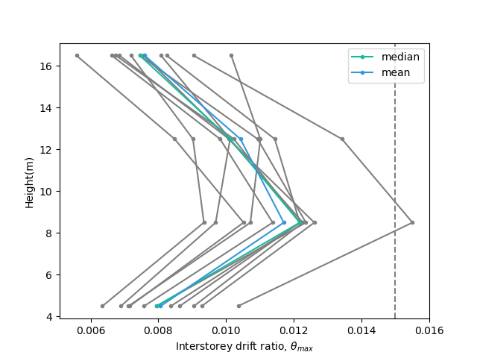
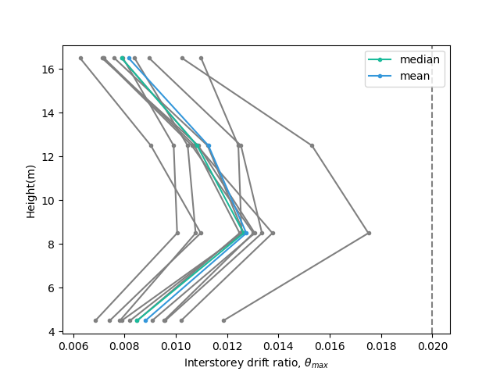
Notes:
Tradition DBE MCE

Slide 15
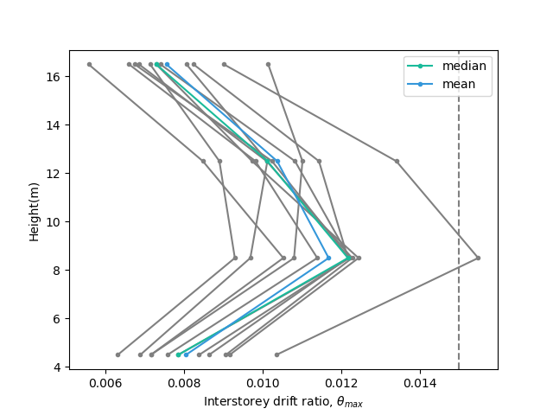

Notes:
Multi DBE MCE

Slide 16
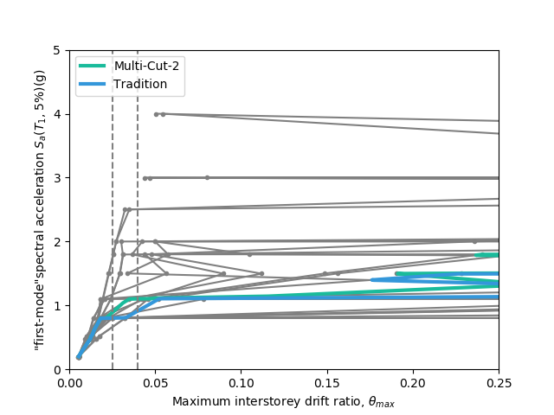
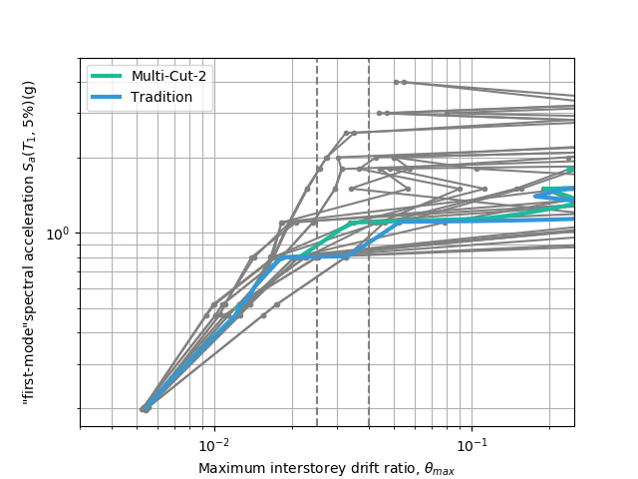
Notes:
IDA LOG

Slide 17
Notes:
Tradition MMC Pushover

Slide 18
Notes:
Tradition Mode1 Mode2

Slide 19
Notes:
Multi MMC Pushover

Slide 20
Notes:
Multi Mode1 Mode2

Slide 21
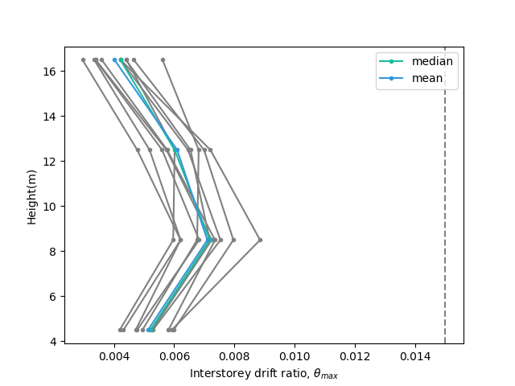
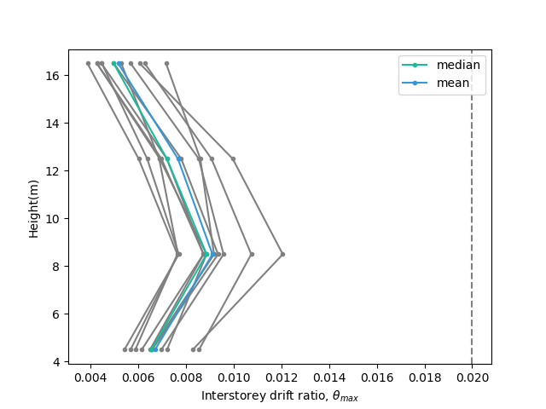
Notes:
Tradition DBE MCE

Slide 22
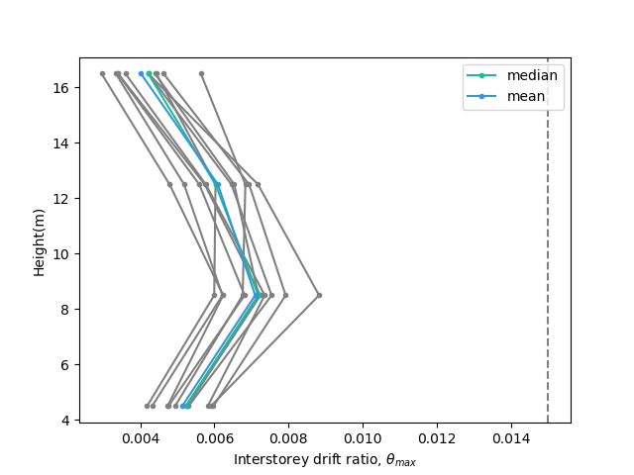
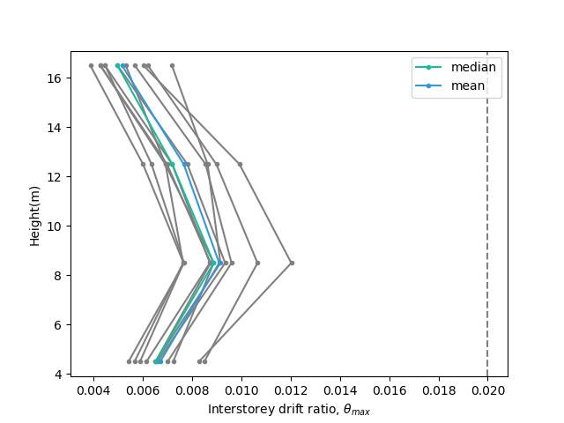
Notes:
Multi DBE MCE

Slide 23
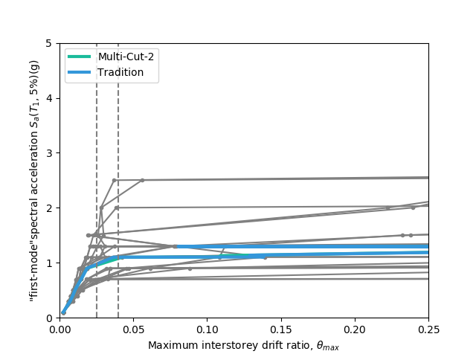
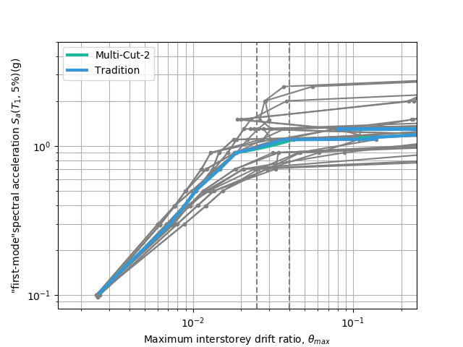
Notes:
IDA LOG

Slide 24
Notes:
Tradition MMC Pushover

Slide 25
Notes:
Tradition Mode1 Mode2

Slide 26
Notes:
Multi MMC Pushover

Slide 27
Notes:
Multi Mode1 Mode2

Slide 28
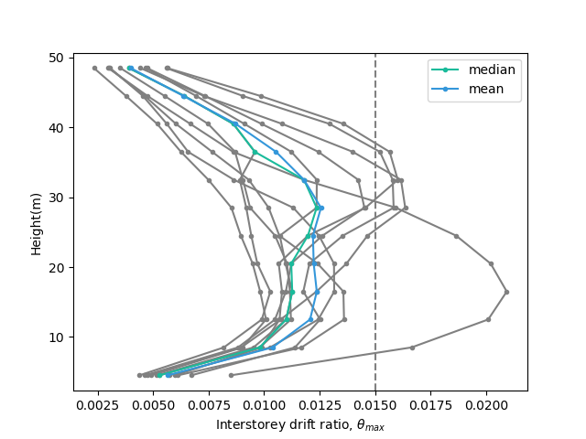
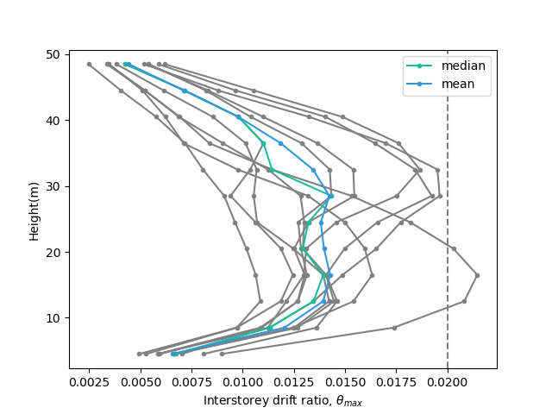
Notes:
Tradition DBE MCE

Slide 29
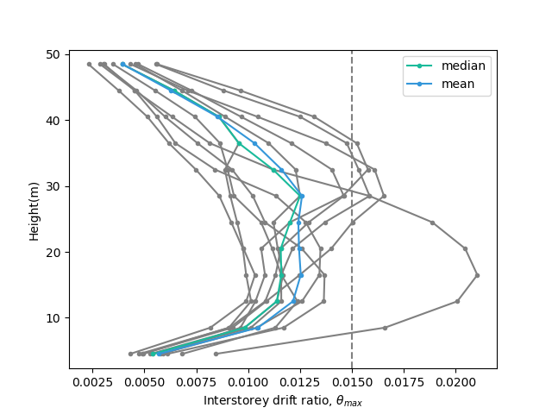
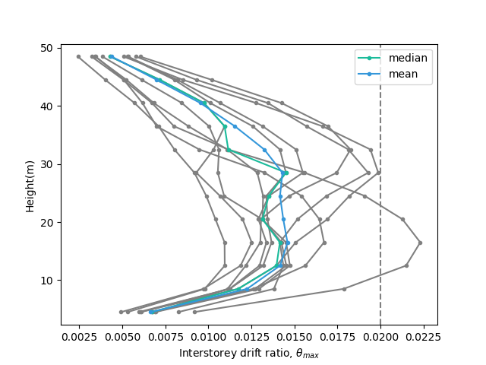
Notes:
Multi DBE MCE

Slide 30
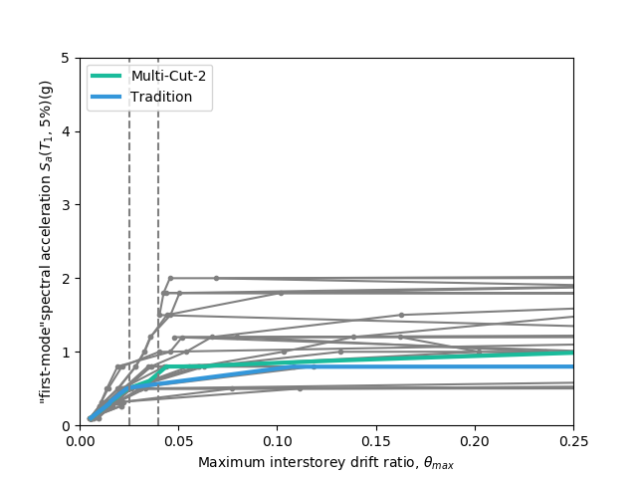
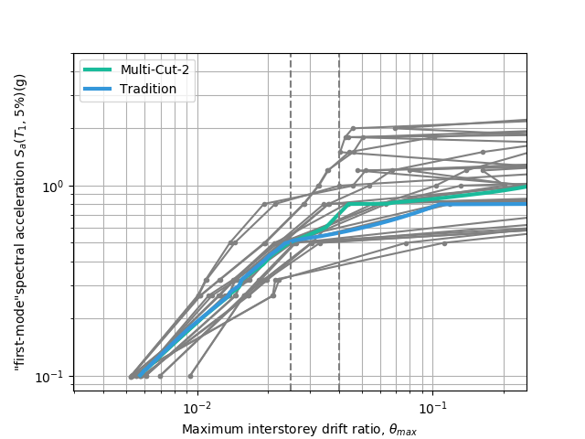
Notes:
IDA LOG

Slide 31
Notes:
Tradition MMC Pushover

Slide 32
Notes:
Tradition Mode1 Mode2

Slide 33
Notes:
Multi MMC Pushover

Slide 34
Notes:
Multi Mode1 Mode2

Slide 35
Notes:
Tradition DBE MCE

Slide 36
Notes:
Multi DBE MCE

Slide 37
Notes:
IDA LOG

