Slide 1
Lecture 2, basic C

Slide 2
Getting Started
Log in using diskless (if you’re on Windows)
Make sure you know how to do the following:
  Open a new shell window
  Open a browser - browser is now installed
  Read a pdf file (go to the class web site and download the pdf slides for this lecture) – pdf viewer is now installed
  Use gedit to edit programs
  Go to your home directory (using the folders and using “cd” command) – e.g., /user/yourname

Slide 3
Example 0
(All examples can be downloaded from the class web page)

Slide 4
hello world
This is your first C program
#include <stdio.h>
/*
hi mom
*/
int main () {
printf(“hello world\n”);
}

Slide 5
hello world
#include <stdio.h>
/*
hi mom
*/
int main () {
printf(“hello world\n”);
}
#include statement

Slide 6
hello world
#include <stdio.h>
/*
hi mom
*/
int main () {
printf(“hello world\n”);
}
#include statement
comments

Slide 7
hello world
#include <stdio.h>
/*
hi mom
*/
int main () {
printf(“hello world\n”);
}
#include statement
comments
Main program

Slide 8
#include statement
Provides definitions for libraries
  library contains the “built-in” functions for various tasks (printing, reading input, etc) and definitions of “built-in” variables (e.g., M_PI)
  Built-in libraries are mostly found in /usr/include (their filenames end in *.h, i.e., a header file)
    Try opening the stdio.h and math.h files
  “definitions” mean that the “form” of the functions and variables provided by the libraries, but not the actual code itself

Slide 9
Comments
standard C comments are bracketed between the symbols /* and the symbols */
Anything in between (spacing, tabs, newlines, punctuation, code, etc.) is ignored
/*
hi mom
*/
“hi mom” is a comment

Slide 10
the main function
Every C program that can be run must have a main function.
When the system starts the executable, it runs that function by default
int main () {
/* your code goes here */
}

Slide 11
The { } symbols
In python, a “suite” was a set of statements grouped together, also called a block.
A “block” is indicated here by the beginning and end of the { } symbols

Slide 12
;
The ; character is used to indicate the end “of a statement”
The end of a statement is not necessarily the end of a line. Statement is logical, line is layout

Slide 13
hello world
#include <stdio.h>
/*
hi mom
*/
int main () {
printf(“hello world\n”);
}
No semicolon here
Don’t care whether there are semicolons or not
Main program
Each statement should be terminated with a semicolon unless it defines a block of statements {…}

Slide 14
printf
printf is the function that takes a string as input and prints it as indicated
Strings are listed between “ “.
Remember that to get a newline, you must explicitly include \n
  Example:
    printf(“hello world\n”);

Slide 15
Escape characters
Characters that are hard to express:
\n newline
\t tab
\’ print a single quote
\\ print a backslash
many others

Slide 16
Example 1
A more complex C program

Slide 17
#include <stdio.h>
#include "simpleCalc.h”
int main(){
int
installations; // number of installations
float
yardsOfPipe, // yards of pipe used during installations
feetOfPipe, // feet of pipe used during installations
revenue; // revenue generated
printf("Please enter the number of installations: ");
scanf("%d",&installations);
printf("Please enter the yards of pipe used: ");
scanf(”%f",&yardsOfPipe);
feetOfPipe = 3 * yardsOfPipe;
revenue = installations * INSTALLATION_FEE + feetOfPipe * COST_PER_FOOT; // cap values from include
printf("The revenue generated = $%f\n\n",revenue);
return 0;
}
What’s New?

Slide 18
#include <stdio.h>
#include "simpleCalc.h”
int main(){
int
installations; // number of installations
float
yardsOfPipe, // yards of pipe used during installations
feetOfPipe, // feet of pipe used during installations
revenue; // revenue generated
printf("Please enter the number of installations: ");
scanf("%d",&installations);
printf("Please enter the yards of pipe used: ");
scanf(”%f",&yardsOfPipe);
feetOfPipe = 3 * yardsOfPipe;
revenue = installations * INSTALLATION_FEE + feetOfPipe * COST_PER_FOOT; // cap values from include
printf("The revenue generated = $%f\n\n",revenue);
return 0;
}
Another type of include statement

Slide 19
#include <stdio.h>
#include "simpleCalc.h”
int main(){
int
installations; // number of installations
float
yardsOfPipe, // yards of pipe used during installations
feetOfPipe, // feet of pipe used during installations
revenue; // revenue generated
printf("Please enter the number of installations: ");
scanf("%d",&installations);
printf("Please enter the yards of pipe used: ");
scanf(”%f",&yardsOfPipe);
feetOfPipe = 3 * yardsOfPipe;
revenue = installations * INSTALLATION_FEE + feetOfPipe * COST_PER_FOOT; // cap values from include
printf("The revenue generated = $%f\n\n",revenue);
return 0;
}
Another type of include statement
C++ style comments

Slide 20
#include <stdio.h>
#include "simpleCalc.h”
int main(){
int
installations; // number of installations
float
yardsOfPipe, // yards of pipe used during installations
feetOfPipe, // feet of pipe used during installations
revenue; // revenue generated
printf("Please enter the number of installations: ");
scanf("%d",&installations);
printf("Please enter the yards of pipe used: ");
scanf(”%f",&yardsOfPipe);
feetOfPipe = 3 * yardsOfPipe;
revenue = installations * INSTALLATION_FEE + feetOfPipe * COST_PER_FOOT; // cap values from include
printf("The revenue generated = $%f\n\n",revenue);
return 0;
}
Another type of include statement
C++ style comments
Variable
Declaration

Slide 21
#include <stdio.h>
#include "simpleCalc.h”
int main(){
int
installations; // number of installations
float
yardsOfPipe, // yards of pipe used during installations
feetOfPipe, // feet of pipe used during installations
revenue; // revenue generated
printf("Please enter the number of installations: ");
scanf("%d",&installations);
printf("Please enter the yards of pipe used: ");
scanf(”%f",&yardsOfPipe);
feetOfPipe = 3 * yardsOfPipe;
revenue = installations * INSTALLATION_FEE + feetOfPipe * COST_PER_FOOT; // cap values from include
printf("The revenue generated = $%f\n\n",revenue);
return 0;
}
Another type of include statement
C++ style comments
Variable
Declaration
Another built-in function

Slide 22
#include <stdio.h>
#include "simpleCalc.h”
int main(){
int
installations; // number of installations
float
yardsOfPipe, // yards of pipe used during installations
feetOfPipe, // feet of pipe used during installations
revenue; // revenue generated
printf("Please enter the number of installations: ");
scanf("%d",&installations);
printf("Please enter the yards of pipe used: ");
scanf(”%f",&yardsOfPipe);
feetOfPipe = 3 * yardsOfPipe;
revenue = installations * INSTALLATION_FEE + feetOfPipe * COST_PER_FOOT; // cap values from include
printf("The revenue generated = $%f\n\n",revenue);
return 0;
}
Another type of include statement
C++ style comments
Variable
Declaration
Another built-in function
Arithmetic expression

Slide 23
#include <stdio.h>
#include "simpleCalc.h”
int main(){
int
installations; // number of installations
float
yardsOfPipe, // yards of pipe used during installations
feetOfPipe, // feet of pipe used during installations
revenue; // revenue generated
printf("Please enter the number of installations: ");
scanf("%d",&installations);
printf("Please enter the yards of pipe used: ");
scanf(”%f",&yardsOfPipe);
feetOfPipe = 3 * yardsOfPipe;
revenue = installations * INSTALLATION_FEE + feetOfPipe * COST_PER_FOOT; // cap values from include
printf("The revenue generated = $%f\n\n",revenue);
return 0;
}
Another type of include statement
C++ style comments
Variable
Declaration
Another built-in function
Arithmetic expression
Return an exit code

Slide 24
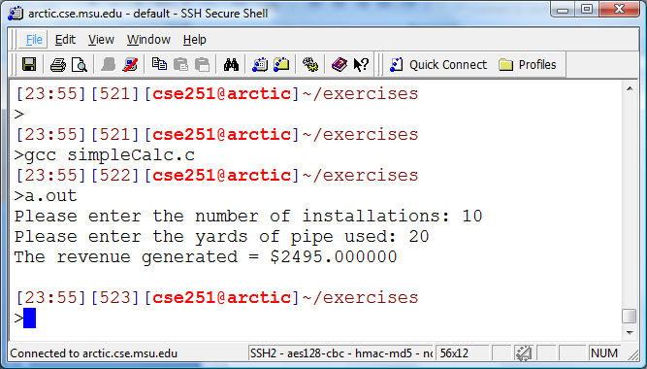

Slide 25
#include: < > versus “ “
#include <stdio.h>
#include "simpleCalc.h”
< > means get the built-in variable/function definitions from “the standard place” (usually /usr/include)
“ “ means get them from the current directory, ie, your own variable/function definitions

Slide 26
simplecalc.h (Header file)
double
INSTALLATION_FEE = 230.00, // installation fee
COST_PER_FOOT = 3.25; // pipe cost per foot

Slide 27
Single-line comment: //
in C99 you can use // as a comment
Ignore everything from // to the end of the line
double
INSTALLATION_FEE = 230.00; // installation fee
This is the comment part

Slide 28
variables

Slide 29
Why do we need variable declaration? Answer: memory
Here is how C deals with memory
Imagine the system memory as a nice, flat stretch of beach
You want a variable, you need to dig a hole in the sand and dump the value in
How big a hole?

Slide 30
Declare variable before use
When you declare a variable, you are telling the compiler the size of value the variable may hold (its type)
You cannot change the type of value a variable can hold once declared (well, pretty much anyway)
In fact, everything needs a type in C and it must be declared before use!

Slide 31
Common types, “regular” C
int : an integer, usually 4 bytes
float: float, usually 4 bytes
double : float, usually 8 bytes
char : single char, value in single quotes

Slide 32
Must declare before use
Every variable must be declared before it can be used (its type must be indicated)
Syntax:
<variable_type> <variable_name> [ =<initial_value> ];
Example: int length, width = 5, height = 10;

Slide 33
Rules for Variable Names
Must begin with a letter
any combination of letters, digits and underscore
at least as long as 31 chars, C99 at least 63
cannot match with a C keyword
  E.g., int int; int long;

Slide 34
C Keywords
auto double int struct
break else long switch
case enum register typedef
char extern return union
const float short unsigned
continue for signed void
default goto sizeof volatile
do if static while

Slide 35
printf, more detail

Slide 36
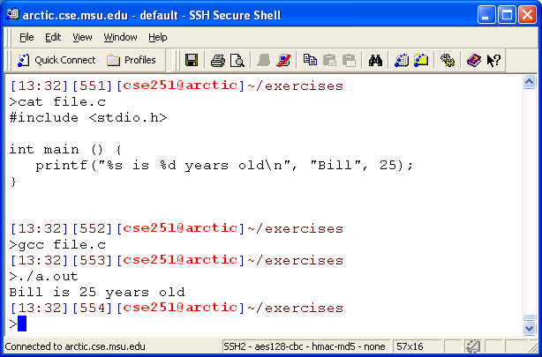
Example of String Formatting

Slide 37
Many descriptors
%s string
%d decimal
%e floating point exponent
%f floating point decimal
%u unsigned integer
and others

Slide 38
Full Format string
The format string contains a set of format descriptors that describe how an object is to be printed
% -#0 12 .4 h d
Conversion
Type
(d for decimal)
size
modifier
(h for short int)
start
specification
Width
Precision
Flags

Slide 39
Examples
printf(“%f\n”,M_PI);
  3.141593
printf(“%.4f\n”,M_PI);
  3.1416 (4 decimal points of precision, with rounding)
printf(“%10.2f\n”,M_PI);
  3.14 (10 spaces in total including the number and the decimal point)
printf(“%10.2f is PI\n”,M_PI);
  3.14 is PI

Slide 40
Input

Slide 41
scanf
printf("Please enter the yards of pipe used: ");
scanf(”%f",&yardsOfPipe);
Scanf is an input routine
useful for reading in string input and doing conversion to the correct type, all at once
syntax is “kind of like” printf
beware the use of the & operator!!!

Slide 42
Basic form
To understand input, it is probably better to start with an example.
scanf(“%d, %f”, &myInt, &myFloat);
is waiting for input of the exact form
25, 3.14159

Slide 43
format string the same
What is typed in the format string is the same as what the input expects, in this case:
  a decimal number
  a comma
  a floating point number

Slide 44
The &
Hard to explain at the moment, but any variable that gets read in needs that ampersand character
It is the address of the variable
more on that later

Slide 45
Arithmetic Expression

Slide 46
Types determine results
For integers: +,-,*,/ all yield integers. Thus division can lead to truncation (2/3 has value 0). % gives the remainder
For floats: +,-,*,/ all work as advertised. No remainder.

Slide 47
Mixed computation
As with most languages, C expects to work with like types. 1 + 1, 3.14. + 4.56
When mixing, usually errors except where C can “help”
It will promote a value to a more “detailed” type when required
1 + 3.14 yields a float (1 promoted to 1.0)

Slide 48
coercion, cast
Explicit type conversion:
(double) 3
  convert int 3 to double 3.0. Note the parens!
(int) 3.14
  convert 3.14 to int. No rounding!
Makes a new value, does not affect the old one!

Slide 49
Example 2

Slide 50
#include <stdio.h>
int main(){
// const means the variable value cannot be changed from this initial setting
const int A = 3, B = 4, C = 7;
const double X = 6.5, Y = 3.5;
printf("\n*** Integer computations ***\n\n");
printf("%d + %d equals %d\n",A,B,A+B);
printf("%d - %d equals %d\n",A,B,A-B);
printf("%d * %d equals %d\n",A,B,A*B);
printf("%d / %d equals %d with remainder %d\n",A,B,A/B,A%B);
printf("\n");
printf("\n*** Real computations ***\n\n");
printf("%f + %f equals %f\n",X,Y,X+Y);
printf("%f - %f equals %f\n",X,Y,X-Y);
printf("%f * %f equals %f\n",X,Y,X*Y);
printf("%f / %f equals %f\n",X,Y,X/Y);

Slide 51
printf("\n*** Mixed-type computations ***\n\n");
printf("%f + %d equals %f\n",X,A,X+A);
printf("%f - %d equals %f\n",X,A,X-A);
printf("%f * %d equals %f\n",X,A,X*A);
printf("%f / %d equals %f\n",X,A,X/A);
printf("\n*** Compound computations ***\n\n");
printf("%d + %d / %d equals %d\n",C,B,A,C+B/A);
printf("(%d + %d) / %d equals %d\n",C,B,A,(C+B)/A);
printf("\n");
printf("%d / %d * %d equals %d\n",C,B,A,C/B*A);
printf("%d / (%d * %d) equals %d\n",C,B,A,C/(B*A));
printf("\n*** Type conversions ***\n\n");
printf("Value of A: %d\n",A);
printf("Value of (double)A: %f\n",(double)A);
printf("Value of X: %f\n",X);
printf("Value of (int)X: %d\n",(int)X);
return 0;
}
Try it out on your own

Slide 52
Assignment

Slide 53
= does not mean equal to
the “=“ means assignment, not equalty.
Assignment means:
  do everything on the lhs of the =, get a value
  dump the value into the memory indicated by the variable on the rhs
  variable now associated with a value
declare first, assign second!

Slide 54
example
int val1, val2;
val1 = 7 * 2 + 5; // 19 now in val1
val2 = val1 + 5; // 24 in val2
val2 = val2 + 10; // calc lhs (34), // reassign to val2

Slide 55
rules
rhs must yield a value to be assigned
lhs must be a legal name
type of the value and the variable must either match or there be a way for a conversion to take place automatically

