Slide 1

Functions

Slide 2
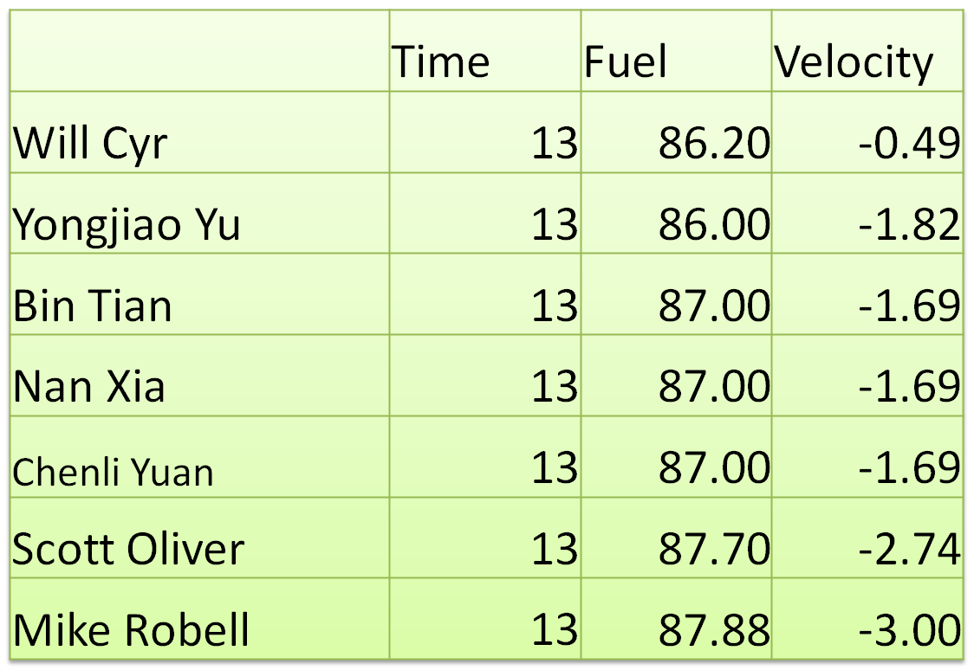
Moon Landings

Slide 3
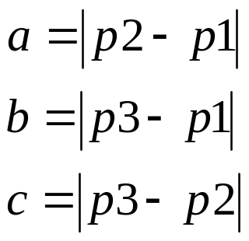
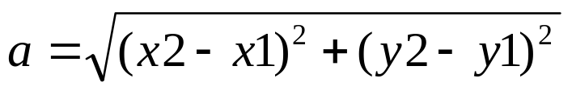
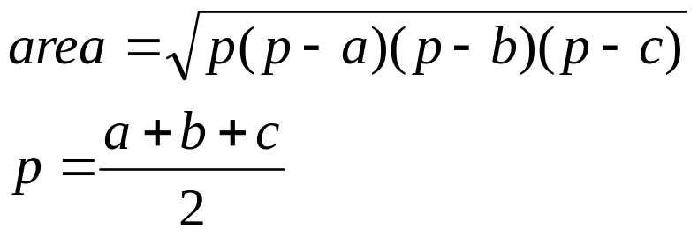
Triangle Area Computation
p3=(x3,y3)
c
p2=(x2,y2)
b
a
p1=(x1,y1)
How would you write this program?

Slide 4
Variables
int main()
{
double x1=0, y1=0;
double x2=17, y2=10.3;
double x3=-5.2, y3=5.1;
double a, b, c; /* Triangle side lengths */
double p; /* For Heron's formula */
double area;

Slide 5
Lengths of Edges
a = sqrt((x1 - x2) * (x1 - x2) + (y1 - y2) * (y1 - y2));
b = sqrt((x1 - x3) * (x1 - x3) + (y1 - y3) * (y1 - y3));
c = sqrt((x2 - x3) * (x2 - x3) + (y2 - y3) * (y2 - y3));
p3=(x3,y3)
c
p2=(x2,y2)
b
a
p1=(x1,y1)

Slide 6
Area
p = (a + b + c) / 2;
area = sqrt(p * (p - a) * (p - b) * (p - c));
printf("%f\n", area);

Slide 7
Whole Program
int main()
{
double x1=0, y1=0;
double x2=17, y2=10.3;
double x3=-5.2, y3=5.1;
double a, b, c; /* Triangle side lengths */
double p; /* For Heron's formula */
double area;
a = sqrt((x1 - x2) * (x1 - x2) + (y1 - y2) * (y1 - y2));
b = sqrt((x1 - x3) * (x1 - x3) + (y1 - y3) * (y1 - y3));
c = sqrt((x2 - x3) * (x2 - x3) + (y2 - y3) * (y2 - y3));
p = (a + b + c) / 2;
area = sqrt(p * (p - a) * (p - b) * (p - c));
printf("%f\n", area);
}
What if I made a mistake on the edge length equation?

Slide 8
Functions
Functions are subprograms that perform some operation and return one value
They “encapsulate” some particular operation, so it can be re-used by others (for example, the abs() or sqrt() function)

Slide 9
Characteristics
Reusable code
  code in sqrt() is reused often
Encapsulated code
  implementation of sqrt() is hidden
Can be stored in libraries
  sqrt() is a built-in function found in the math library

Slide 10
Writing Your Own Functions
Consider a function that converts temperatures in Celsius to temperatures in Fahrenheit.
  Mathematical Formula:
  F = C * 1.8 + 32.0
  We want to write a C function called CtoF

Slide 11
Convert Function in C
double CtoF ( double paramCel )
{
return paramCel*1.8 + 32.0;
}
This function takes an input parameter called paramCel (temp in degree Celsius) and returns a value that corresponds to the temp in degree Fahrenheit

Slide 12
How to use a function?
#include <stdio.h>
double CtoF( double );
/************************************************************************
* Purpose: to convert temperature from Celsius to Fahrenheit
************************************************************************/
int main()
{
double c, f;
printf(“Enter the degree (in Celsius): “);
scanf(“%lf”, &c);
f = CtoF(c);
printf(“Temperature (in Fahrenheit) is %lf\n”, f);
}
double CtoF ( double paramCel)
{
return paramCel * 1.8 + 32.0;
}

Slide 13
Terminology
Declaration: double CtoF( double );
Invocation (Call): Fahr = CtoF(Cel);
Definition:
double CtoF( double paramCel )
{
return paramCel*1.8 + 32.0;
}

Slide 14
Function Declaration
Also called function prototype:
Declarations describe the function:
  the return type and function name
  the type and number of parameters
return_type function_name (parameter_list)
double CtoF(double)

Slide 15
Function Definition
return_type function_name (parameter_list)
{
….
function body
….
}
double CtoF(double paramCel)
{
return paramCel*1.8 + 32.0;
}

Slide 16
Function Invocation
1. Call copies argument c to parameter paramCel
int main()
{ …
f = CtoF(c);
}
2. Control transfers to function “CtoF”
double CtoF ( double paramCel )
{
return paramCel*1.8 + 32.0;
}

Slide 17
Invocation (cont)
int main()
{ …
f = CtoF(c);
}
3. Expression in “CtoF” is evaluated
4. Value of expression is returned to “main”
double CtoF ( double paramCel )
{
return paramCel*1.8 + 32.0;
}

Slide 18
Local Objects
The parameter “paramCel” is a local object which is defined only while the function is executing. Any attempt to use “paramCel” outside the function is an error.
The name of the parameter need not be the same as the name of the argument. Types must agree.

Slide 19
Can we do better than this?
int main()
{
double x1=0, y1=0;
double x2=17, y2=10.3;
double x3=-5.2, y3=5.1;
double a, b, c; /* Triangle side lengths */
double p; /* For Heron's formula */
double area;
a = sqrt((x1 - x2) * (x1 - x2) + (y1 - y2) * (y1 - y2));
b = sqrt((x1 - x3) * (x1 - x3) + (y1 - y3) * (y1 - y3));
c = sqrt((x2 - x3) * (x2 - x3) + (y2 - y3) * (y2 - y3));
p = (a + b + c) / 2;
area = sqrt(p * (p - a) * (p - b) * (p - c));
printf("%f\n", area);
}

Slide 20
What should we name our function?
a = sqrt((x1 - x2) * (x1 - x2) + (y1 - y2) * (y1 - y2));
“Length” sounds like a good idea.
??? Length( ??? )
{
}

Slide 21
What does our function need to know?
a = sqrt((x1 - x2) * (x1 - x2) + (y1 - y2) * (y1 - y2));
(x, y) for two different points:
??? Length(double x1, double y1,
double x2, double y2)
{
}

Slide 22
What does our function return?
a = sqrt((x1 - x2) * (x1 - x2) + (y1 - y2) * (y1 - y2));
A computed value which is of type double
double Length(double x1, double y1,
double x2, double y2)
{
}

Slide 23
How does it compute it?
a = sqrt((x1 - x2) * (x1 - x2) + (y1 - y2) * (y1 - y2));
A computed value which is of type double
double Length(double x1, double y1,
double x2, double y2)
{
double len;
len = sqrt((x1 - x2) * (x1 - x2) + (y1 - y2) * (y1 - y2));
return(len);
}

Slide 24







Using This
#include <stdio.h>
#include <math.h>
/* Declaration */
double Length(double x1, double y1, double x2, double y2);
/*
* Program to determine the area of a triangle
*/
int main()
{
double x1=0, y1=0;
double x2=17, y2=10.3;
double x3=-5.2, y3=5.1;
double a, b, c; /* Triangle side lengths */
double p; /* For Heron's formula */
double area;
a = Length(x1, y1, x2, y2);
b = Length(x1, y1, x3, y3);
c = Length(x2, y2, x3, y3);
p = (a + b + c) / 2;
area = sqrt(p * (p - a) * (p - b) * (p - c));
printf("%f\n", area);
}
/* Definition */
double Length(double x1, double y1, double x2, double y2)
{
double len;
len = sqrt((x1 - x2) * (x1 - x2) + (y1 - y2) * (y1 - y2));
return(len);
}
Declaration
Invocations
Definition
1

Slide 25


Potential Errors
#include <stdio.h>
double convert( double );
int main()
{
double c, f;
printf(“Enter the degree (in Celsius): “);
scanf(“%lf”, &c);
f= convert(c);
printf(“Temp (in Fahrenheit) for %lf Celsius is %lf”, paramCel, f);
}
double CtoF( double paramCel)
{
return c * 1.8 + 32.0;
}
Error! paramCel is not defined
Scope – Where a variable is known to exist.
No variable is known outside of the curly braces that contain it, even if the same name is used!
Error! C is not defined

Slide 26




Another
Example
#include <stdio.h>
double GetTemperature();
double CelsiusToFahrenheit( double );
void DisplayResult( double, double );
int main()
{
double
TempC, // Temperature in degrees Celsius
TempF; // Temperature in degrees Fahrenheit
TempC = GetTemperature();
TempF = CelsiusToFahrenheit(TempC);
DisplayResult(TempC, TempF);
return 0;
}
Declarations
Invocations

Slide 27
Function:
GetTemperature
double GetTemperature()
{
double Temp;
printf("\nPlease enter a temperature in degrees Celsius: ");
scanf("%lf", &Temp);
return Temp;
}

Slide 28
Function: CelsiusToFahrenheit
double CelsiusToFahrenheit(double Temp)
{
return (Temp * 1.8 + 32.0);
}

Slide 29
Function: DisplayResult
void DisplayResult(double CTemp, double FTemp)
{
printf("Original: %5.2f C\n", CTemp);
printf("Equivalent: %5.2f F\n", FTemp);
return;
}

Slide 30
Declarations (Prototypes)
double GetTemp( );
double CelsiusToFahrenheit( double );
void Display( double, double );
void means “nothing”. If a function doesn’t return a value, its return type is void

Slide 31
Abstraction
Get Temperature
Convert Temperature
Display Temperature
int main()
{
double
TempC, // Temperature in degrees Celsius
TempF; // Temperature in degrees Fahrenheit
TempC = GetTemperature();
TempF = CelsiusToFahrenheit(TempC);
DisplayResult(TempC, TempF);
return 0;
}
We are hiding details on how something is done in the function implementation.

Slide 32
Another Way to Compute Factorial
Pseudocode for factorial(n)
if n == 0 then
result = 1
else
result = n * factorial(n – 1)
After all, 5! = 5 * 4 * 3 * 2 * 1 = 5 * 4!

Slide 33
Recursive Functions
Factorial function contains an invocation of itself.
We call this a: recursive call.
int Factorial(int n)
{
if(n == 0)
return 1;
else
return n * Factorial(n-1);
}
Recursive functions must have a base case
(if n == 0): why?
This works much like proof by induction.
if n == 0 then
result = 1
else
result = n * factorial(n – 1)

Slide 34
Infinite Recursion
What if I omit the “base case”?
This leads to infinite recursion!
int Factorial(int n)
{
return n * Factorial(n-1);
}
cbowen@ubuntu:~/cse251$ ./combi1
Input n: 5
Input k: 3
Segmentation fault
Factorial(3)=
3 * Factorial(2) =
3 * 2 * Factorial(1) =
3 * 2 * 1 * Factorial(0) =
3 * 2 * 1 * 0 * Factorial(-1) =
…

Slide 35


Psuedocode and Function
if n == 0 then
result = 1
else
result = n * factorial(n – 1)
int Factorial(int n)
{
if(n == 0)
return 1;
else
return n * Factorial(n-1);
}
Base Case
Declaration: int Factorial(int n);
Invocation: f = Factorial(7);
Definition:
int Factorial(int n)
{
if(n == 0)
return 1;
else
return n * Factorial(n-1);
}
2

