Slide 1

Pointers and Reference parameters

Slide 2






Today’s Lecture
Address | Variable | Value
0x4520 | B | 181
0x4524 | pB | 0x4520
Pointers are variables that store memory addresses
Memory Address
Before we learn about pointers, we must learn more about addresses
Address | Variable | Value
0x4520 | B | 181
0x4524 | pB | 0x4520
Pointer
Value

Slide 3
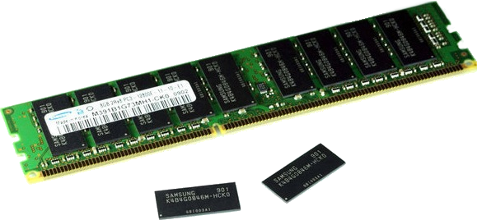

Computer Memory
Memory is just a long list of numbers one after the other
My laptop has over 4 Billion of these numbers
Each number is 8 bits (BYTE)
We combine them to make integers and floating point values

Slide 4
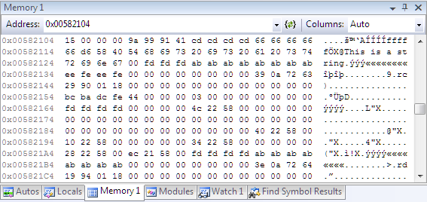





Computer
Memory
int (21)
float (18.2)

Slide 5
Memory Addresses
Memory addresses in computers are often 32 bits (or nowadays, 64-bits) long, e.g.
01111111111111111111101010001100
Another way to represent an address is to use hexadecimal:
0x 7ffffa8c

Slide 6
Hexadecimal (Base-16)
0000 = 0 1000 = 8
0001 = 1 1001 = 9
0010 = 2 1010 = 10 = a
0011 = 3 1011 = 11 = b
0100 = 4 1100 = 12 = c
0101 = 5 1101 = 13 = d
0110 = 6 1110 = 14 = e
0111 = 7 1111 = 15 = f
I have included this chart on your worksheet so you can refer to it.

Slide 7
Addresses
32-bit address (Binary):
0111 1111 1111 1111 1111 1010 1000 1100
7 f f f f a 8 c
32-bit address (Hex): 0x 7 f f f f a 8 c
Notes:
  In C “0x” indicates a Hexadecimal number
  Convert every four bits to a hex digit

Slide 8
Arithmetic (in Hex)
0000 = 0 1000 = 8
0001 = 1 1001 = 9
0010 = 2 1010 = 10 = a
0011 = 3 1011 = 11 = b
0100 = 4 1100 = 12 = c
0101 = 5 1101 = 13 = d
0110 = 6 1110 = 14 = e
0111 = 7 1111 = 15 = f
Sum: 0x 90
+ 0x 04
0x 94

Slide 9
Arithmetic (in Hex)
0000 = 0 1000 = 8
0001 = 1 1001 = 9
0010 = 2 1010 = 10 = a
0011 = 3 1011 = 11 = b
0100 = 4 1100 = 12 = c
0101 = 5 1101 = 13 = d
0110 = 6 1110 = 14 = e
0111 = 7 1111 = 15 = f
Sum with carry: 0x 8c
+ 0x 04
0x ??

Slide 10
Arithmetic (in Hex)
Sum with carry: 0x 8c
+ 0x 04
0x ??
  What is “c + 4”?
  In decimal it is “12 + 4 = 16”
  which is Hex “10” (0 and carry 1)

Slide 11
Arithmetic (in Hex)
1
Sum with carry: 0x 8c
+ 0x 04
0x ??
  What is “c + 4”?
  In decimal it is “12 + 4 = 16”
  which is Hex “10” (0 and carry 1)

Slide 12
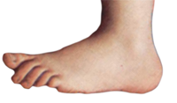
Arithmetic (in Hex)
1
Sum with carry: 0x 8c
+ 0x 04
0x 90
  What is “c + 4”?
  In decimal it is “12 + 4 = 16”
  which is Hex “10” (0 and carry 1)
1

Slide 13





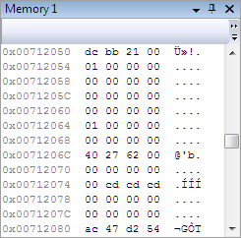
Bytes and Words
byte
word
Remember
  8 bits = 1 byte
  32 bits = 4 bytes = 1 word.
32-bit address machines are addressed by bytes so consecutive words have addresses that differ by four

Slide 14
32-bit Addresses
Here are three consecutive 32-bit addresses (in Hex) of words:
0x00712050 dc bb 21 00
0x00712054 01 00 00 00
0x00712058 00 00 00 00

Slide 15
Pointers
Pointers are variables that contain addresses
  Just like other variables, they must be declared before being used
Declaration:
int *p; /* instead of int p for integers */
  int * means p is a pointer variable that stores the address of an integer variable
Pointers and Ref parameters

Slide 16
Pointer Initialization
Declaration:
int a = 2; /* a is an integer */
int *pA = &a; /* pA is a pointer containing
the address of a */
  “&” operator means “address of”
  Read it as “at”

Slide 17





The Address Game
int a = 2;
int *pA = &a;
a
pA
An Intel processor is called a little endian processor because it stores values with the least significant byte first. You read it in reverse order.
0x00602104 in memory will be: 04 21 60 00

Slide 18
Example Program
“%x” prints the hexadecimal value
Operators:
& “address of”
* “dereference”
int a = 21;
int *pA = &a;
printf("%d\n", a);
printf("%x\n", a);
printf("%x\n", &a);
printf("%x\n", pA);
printf("%d\n", *pA);
printf("%x\n", &pA);
Output
21
15
bfee861c
bfee861c
21
bfee8618

Slide 19
#include<stdio.h>
int main()
{
  int a = 15, b = 38;
  int *c = &a;
  printf("%x : %d\n", &a, a);
  printf("%x : %d\n", &b ,b);
  printf("%x : %x : %d\n", &c, c, *c);
  a = 49;
  printf("%x : %d\n", &a, a);
  printf("%x : %d\n", &b ,b);
  printf("%x : %x : %d\n", &c, c, *c);
  c = &b;
  printf("%x : %d\n", &a, a);
  printf("%x : %d\n", &b ,b);
  printf("%x : %x : %d\n", &c, c, *c);
}

Slide 20
#include<stdio.h>
int main()
{
  int a = 15, b = 38;
  int *c = &a;
  printf("%x : %d\n", &a, a);
  printf("%x : %d\n", &b ,b);
  printf("%x : %x : %d\n", &c, c, *c);
  a = 49;
  printf("%x : %d\n", &a, a);
  printf("%x : %d\n", &b ,b);
  printf("%x : %x : %d\n", &c, c, *c);
  c = &b;
  printf("%x : %d\n", &a, a);
  printf("%x : %d\n", &b ,b);
  printf("%x : %x : %d\n", &c, c, *c);
}

Slide 21
First Section
Declares a and b as integers
Declares c as a pointer that contains the address of a (“points to a”)
Address
Memory
Name
  int a = 15, b = 38;
  int *c = &a;
  printf("%x : %d\n", &a, a);
  printf("%x : %d\n", &b ,b);
  printf("%x : %x : %d\n", &c, c, *c);
0xeffffa94
15
a
0xeffffa90
38
b
0xeffffa8c
0xeffffa94
c

Slide 22
First Section
Declares a and b as integers
Declares c as a pointer that contains the address of a (“points to a”)
Address
Memory
Name
  int a = 15, b = 38;
  int *c = &a;
  printf("%x : %d\n", &a, a);
  printf("%x : %d\n", &b ,b);
  printf("%x : %x : %d\n", &c, c, *c);
0xeffffa94
15
a
0xeffffa90
38
b
0xeffffa8c
0xeffffa94
c
Output:
effffa94 15
effffa90 38
effffa8c effffa94 15

Slide 23
First Section
Declares a and b as integers
Declares c as a pointer that contains the address of a (“points to a”)
  int a = 15, b = 38;
  int *c = &a;
  printf("%x : %d\n", &a, a);
  printf("%x : %d\n", &b ,b);
  printf("%x : %x : %d\n", &c, c, *c);
Note the difference between
*C in variable declaration
and *C in printf
Output:
effffa94 15
effffa90 38
effffa8c effffa94 15

Slide 24
#include<stdio.h>
int main()
{
  int a = 15, b = 38;
  int *c = &a;
  printf("%x : %d\n", &a, a);
  printf("%x : %d\n", &b ,b);
  printf("%x : %x : %d\n", &c, c, *c);
  a = 49;
  printf("%x : %d\n", &a, a);
  printf("%x : %d\n", &b ,b);
  printf("%x : %x : %d\n", &c, c, *c);
  c = &b;
  printf("%x : %d\n", &a, a);
  printf("%x : %d\n", &b ,b);
  printf("%x : %x : %d\n", &c, c, *c);
}

Slide 25
Second Section
Address
Memory
Name
  a = 49;
  printf("%x : %d\n", &a, a);
  printf("%x : %d\n", &b ,b);
  printf("%x : %x : %d\n", &c, c, *c);
0xeffffa94
15 49
A
0xeffffa90
38
B
0xeffffa8c
0xeffffa94
C

Slide 26
Second Example
Address
Memory
Name
  a = 49;
  printf("%x : %d\n", &a, a);
  printf("%x : %d\n", &b ,b);
  printf("%x : %x : %d\n", &c, c, *c);
0xeffffa94
15 49
A
0xeffffa90
38
B
0xeffffa8c
0xeffffa94
C
Output:
effffa94 49
effffa90 38
effffa8c effffa94 49

Slide 27
#include<stdio.h>
int main()
{
  int a = 15, b = 38;
  int *c = &a;
  printf("%x : %d\n", &a, a);
  printf("%x : %d\n", &b ,b);
  printf("%x : %x : %d\n", &c, c, *c);
  a = 49;
  printf("%x : %d\n", &a, a);
  printf("%x : %d\n", &b ,b);
  printf("%x : %x : %d\n", &c, c, *c);
  c = &b;
  printf("%x : %d\n", &a, a);
  printf("%x : %d\n", &b ,b);
  printf("%x : %x : %d\n", &c, c, *c);
}

Slide 28
Third Section
Address
Memory
Name
  c = &b; /* c now points to b */
  printf("%x : %d\n", &a, a);
  printf("%x : %d\n", &b ,b);
  printf("%x : %x : %d\n", &c, c, *c);
0xeffffa94
49
A
0xeffffa90
38
B
0xeffffa8c
0xeffffa90
C

Slide 29
Third Section
Address
Memory
Name
  c = &b; /* c now points to b */
  printf("%x : %d\n", &a, a);
  printf("%x : %d\n", &b ,b);
  printf("%x : %x : %d\n", &c, c, *c);
0xeffffa94
49
A
0xeffffa90
38
B
0xeffffa8c
0xeffffa90
C
Output:
effffa94 49
effffa90 38
effffa8c effffa90 38
2

Slide 30
Reference parameters
A valuable use for pointers:
Passing addresses to a function

Slide 31
Argument & Returned Value
Consider a function call y=f(x).
  The value x is passed to the function f
  A value is returned and assigned to y.
  By passed we mean that the value of argument x is copied to the parameter in the function. Some calculation is performed and the result is returned and assigned to y.

Slide 32
Example
int x, y;
x = 5;
y = Square(x);
int Square(int t)
{
return t*t
}
Address
Memory
Name
0xeffffa94
…
x
0xeffffa98
…
y
…
…
…

Slide 33
Example
int x, y;
x = 5;
y = Square(x);
int Square(int t)
{
return t*t
}
Address
Memory
Name
0xeffffa94
5
x
0xeffffa98
…
y
…
…
…

Slide 34
Example
The call Square(x) :
creates a variable t
copies the value of x to t
int x, y;
x = 5;
y = Square(x);
int Square(int t)
{
return t*t
}
Address
Memory
Name
0xeffffa94
5
x
0xeffffa98
…
y
…
…
0xeffffc8c
5
t

Slide 35
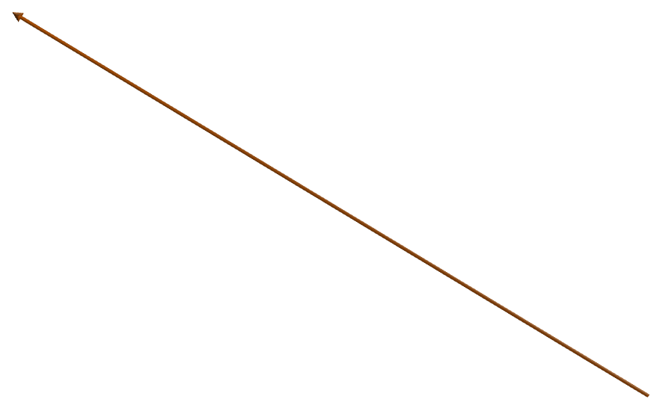
Example
The call Square(x) :
creates a variable t
copies the value of x to t
calculates t * t
returns t
int x, y;
x = 5;
y = Square(x);
int Square(int t)
{
return t*t
}
Address
Memory
Name
0xeffffa94
5
x
0xeffffa98
…
y
…
…
0xeffffc8c
5
t
0xeffffc90
25
temp

Slide 36
y=f(x)
Only one valued returned
What if we want to return more than one value?
  Solution is to use pointers to variables in the calling function

Slide 37
How to do this in C
The approach is to pass the address (using the & operator) of the value to be modified.
We call such a parameter a reference parameter.
Use the * operator to change the reference parameter value

Slide 38
Function Reference Params
Name | Address | Value
val | 0xeffffa90 | 10
int val = 10;
MyFun(&val);
printf(“%d”,val);
void MyFun(int *param)
{
*param = 27;
}

Slide 39
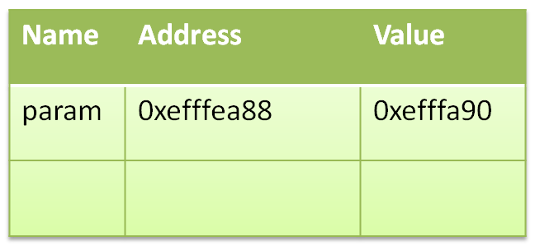
Function Reference Params
Name | Address | Value
val | 0xeffffa90 | 10
int val = 10;
MyFun(&val);
printf(“%d”,val);
void MyFun(int *param)
{
*param = 27;
}

Slide 40
Function Reference Params
Name | Address | Value
val | 0xeffffa90 | 27
int val = 10;
MyFun(&val);
printf(“%d”,val);
void MyFun(int *param)
{
*param = 27;
}

Slide 41
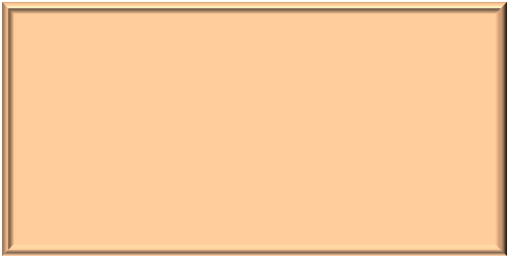
Function Reference Params
Name | Address | Value
val | 0xeffffa90 | 27
int val = 10;
MyFun(&val);
printf(“%d”,val);
Prints: 27
void MyFun(int *param)
{
*param = 27;
}
The memory used by the function is destroyed when it returns.

Slide 42
What will this do different?
Name | Address | Value
val | 0xeffffa90 | 10
int val = 10;
MyFun2(val);
printf(“%d”,val);
void MyFun2(int param)
{
param = 27;
}

Slide 43
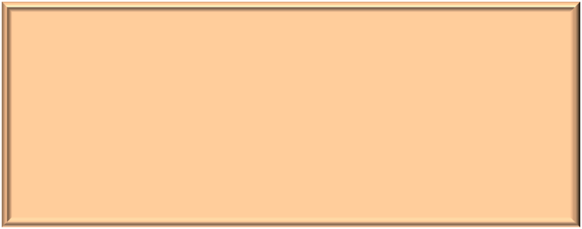
Cards program
/* Create a random card and suit */
/* This will compute a random number from 0 to 3 */
suit1 = rand() % 4;
/* This will compute a random number from 1 to 13 */
card1 = rand() % 13 + 1;
do
{
/* Create a random card and suit */
/* This will compute a random number from 0 to 3 */
suit2 = rand() % 4;
/* This will compute a random number from 1 to 13 */
card2 = rand() % 13 + 1;
} while(card1 == card2 && suit1 == suit2);
This program repeats code. We don’t like to do that. But, we could not put the card draw into a function because a function can only return one value, or so we thought!

Slide 44
Solution, pass by reference using pointers
/* Create a random card and suit */
DrawCard(&card1, &suit1);
do
{
DrawCard(&card2, &suit2);
} while(card1 == card2 && suit1 == suit2);
Don’t forget:
*suit ← to set the value
&card1 ← to get the address
Pass with &
Set with *
void DrawCard(int *card, int *suit)
{
/* This will compute a
random number from 0 to 3 */
*suit = rand() % 4;
/* This will compute a random
number from 1 to 13 */
*card = rand() % 13 + 1;
}
3

