Slide 1
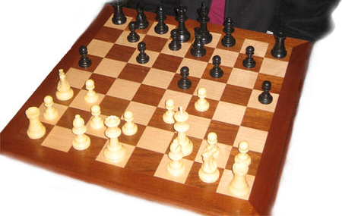
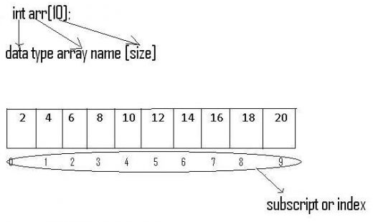
Intro to Arrays
Storing List of Data

Slide 2

Why Arrays
Suppose we want to store the grade for each student in a class
/* Need a variable for each? */
int bob, mary, tom, …;
Wow, cumbersome…
Easier to have a variable that stores the grades for all students

Slide 3
An array is a “Chunk of memory”
An array is a contiguous piece of memory that can contain multiple values
The values within the contiguous chunk can be addressed individually
Address in memory
0xeffffa00
0xeffffa04
0xeffffa08
0xeffffa0c
0xeffffa10
0xeffffa14
0xeffffa18
0xeffffa1c
0xeffffa20
grades
74
59
95
85
71
45
99
82
76

Slide 4
Array: “Chunk of memory”
Physical address
0xeffffa00
0xeffffa04
0xeffffa08
0xeffffa0c
0xeffffa10
0xeffffa14
0xeffffa18
0xeffffa1c
0xeffffa20
grades
74
59
95
85
71
45
99
82
76
index
0
1
2
3
4
5
6
7
8
Use an index to access individual elements of the array:
grades[0] is 74, grades[1] is 59, grades[2] is 95, and so on

Slide 5
Array Declaration
Syntax for declaring array variable:
type array_name[capacity];
  type can be any type (int, float, char, …)
  array_name is an identifier
  capacity is the number of values it can store (indexing starts at 0)

Slide 6


Example
Notice: The first location is location 0 (zero)!
int x[3]; // an array of 3 integers
double y[7]; // an array of 7 doubles
Storage, e.g. 4-bytes per int
X
0
1
2
First Location

Slide 7
Operations with Arrays
Assignment:
  x[0] = 6; /* Assign 6 to element x[0] */
  y[2] = 3.1; /* Assign 3.1 to element y[2] */
Access
  m = x[2];
  p = y[0];
Input/Output:
  the elements are handled as their types, e.g.
  scanf(“%d %lf”, &x[2], &y[3]);
  printf(“%d %lf\n”,x[0], y[2]); /* output 6 and 3.1 */

Slide 8
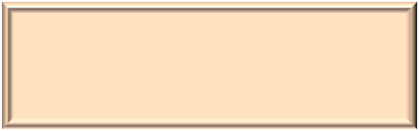

Arithmetic Operations
int main()
{
double x[5];
x[0] = 1;
x[1] = 2;
x[2] = x[0] + x[1]; /* X[2] = 3 */
x[3] = x[2] / 3; /* X[3] = 1 */
x[4] = x[3] * x[2]; /* X[4] = 3 */
}
Variable Declaration
for the array

Slide 9
for loops
“for” loops are ideal for processing elements in the array.
int main()
{
int i;
double values[4] = {3.14, 1.0, 2.61, 5.3};
double sumValues = 0.0;
for (i=0; i<4; i++)
{
sumValues = sumValues + values[i];
}
printf(“Sum = %lf\n”, sumValues);
}

Slide 10

for loops
“for” loops are ideal for processing elements in the array.
int main()
{
int i;
double values[4] = {3.14, 1.0, 2.61, 5.3};
double sumValues = 0.0;
for (i=0; i<=4; i++)
{
sumValues = sumValues + values[i];
}
printf(“Sum = %lf\n”, sumValues);
}
ERROR!
Out of bound

Slide 11
Initialization
Syntax: int X[4] = {2, 4, 7, 9};
Behavior: initialize elements starting with leftmost, i.e. element 0. Remaining elements are initialized to zero.
Initialize all to 0: int X[4]={0};
X
2
4
7
9
0
1
2
3
Notes:
Note that initializing all elements of an array using a simple “={0}” causes the compiler to insert a for loop which loops through the whole array assigning each element a value of zero. If the array is large, this simple looking initialization operation can take a significant amount of time.

Slide 12
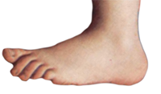
Example
int main()
{
double grades[5] = {90, 87, 65, 92, 100};
double sum;
int i;
printf("The first grade is: %.1f\n", grades[0]);
sum = 0;
for(i=0; i<5; i++)
{
sum += grades[i];
}
printf("The average grade is: %.1f\n", sum / 5);
grades[2] = 70; /* Replaces 65 */
grades[3] = grades[4]; /* Replaces 92 with 100 */
}
1

Slide 13
Constants for capacity
Good programming practice:
use #define for constants in your program
For example:
#define MaxLimit 25
int grades[MaxLimit]; for(int i; i<MaxLimit; i++){ };
If size needs to be changed, only the capacity “MaxLimit” needs to be changed.

Slide 14

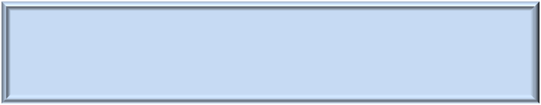
Arrays as parameters of functions
int main()
{
double values[4] = {3.14, 1.0, 2.61, 5.3};
printf(“Sum = %lf\n”, SumValues( values, 4));
}
Suppose we want a function that sums up values of the array

Slide 15
Arrays as parameters of functions
double SumValues(double x[], int numElements)
{
int i;
double result = 0;
  for (i=0; i < numElements; i++)
  result = result + x[i];
  return result;
  }
“[]” flags the parameter as an array.
  ALWAYS passed by reference
Array size is passed separately (as numElements)

Slide 16
Example
Program Behavior
  Create an array of random numbers
  Print unsorted array
  Sort the array
  Print sorted array

Slide 17
Array before sorting
Element 0 : 58.7000
Element 1 : 8.0100
Element 2 : 72.3700
Element 3 : 4.6500
Element 4 : 58.3000
Element 5 : 92.1700
Element 6 : 95.3100
Element 7 : 4.3100
Element 8 : 68.0200
Element 9 : 72.5400
Array after sorting
Element 0 : 4.3100
Element 1 : 4.6500
Element 2 : 8.0100
Element 3 : 58.3000
Element 4 : 58.7000
Element 5 : 68.0200
Element 6 : 72.3700
Element 7 : 72.5400
Element 8 : 92.1700
Element 9 : 95.3100
Sample output
The array elements are randomly generated

Slide 18
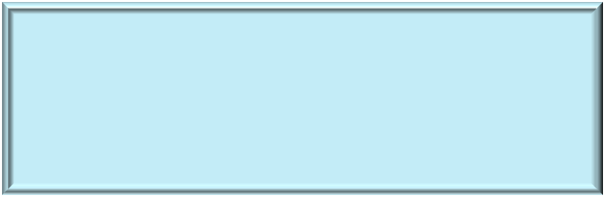
#include <stdio.h>
#include <stdlib.h>
void PrintArray( double [], int );
void SortArray( double [], int );
void Swap (double *, double *);
Functions are your friends! Make them work and then use them to do work!

Slide 19
#define NumElements 10
int main()
{
int i;
double values[NumElements]; /* The array of real numbers */
srand(time(NULL));
for (i=0; i < NumElements; i++)
{
values[i] = (double)(rand() % 10000) / 100.0;
}
printf("\nArray before sorting\n");
PrintArray( values, NumElements );
SortArray( values, NumElements );
printf("\nArray after sorting\n");
PrintArray( values, NumElements );
return 0;
}

Slide 20
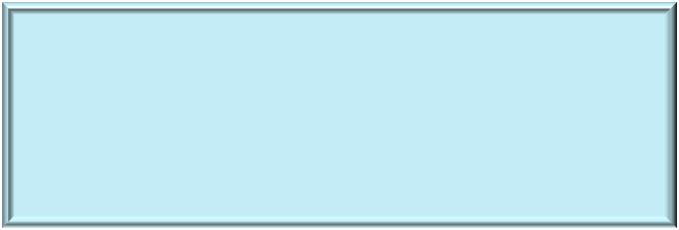
#define NumElements 10
int main()
{
int i;
double values[NumElements]; /* The array of real numbers */
srand(time(NULL));
for (i=0; i < NumElements; i++)
{
values[i] = (double)(rand() % 10000) / 100.0;
}
printf("\nArray before sorting\n");
PrintArray( values, NumElements );
SortArray( values, NumElements );
printf("\nArray after sorting\n");
PrintArray( values, NumElements );
return 0;
}
Array declaration
Declare an array of 10 doubles
The indices range from 0 to 9, i.e. Value[0] to Value[9]

Slide 21
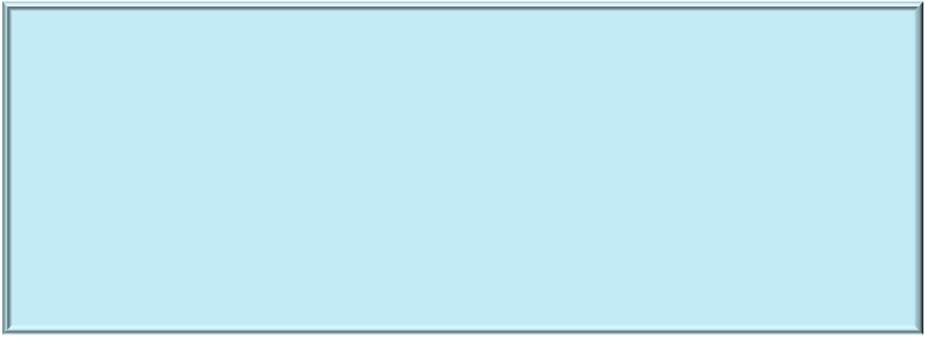
#define NumElements 10
int main()
{
int i;
double values[NumElements]; /* The array of real numbers */
srand(time(NULL));
for (i=0; i < NumElements; i++)
{
values[i] = (double)(rand() % 10000) / 100.0;
}
printf("\nArray before sorting\n");
PrintArray( values, NumElements );
SortArray( values, NumElements );
printf("\nArray after sorting\n");
PrintArray( values, NumElements );
return 0;
}
Initialize the array with random values
rand() returns a pseudo random number between 0 and RAND_MAX
rand()%10000 yields a four-digit integer remainder
/100.0 moves the decimal point left 2 places
So, Values is an array of randomly generated 2-decimal digit numbers between 0.00 and 99.99

Slide 22
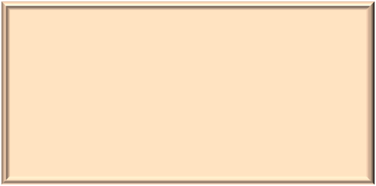
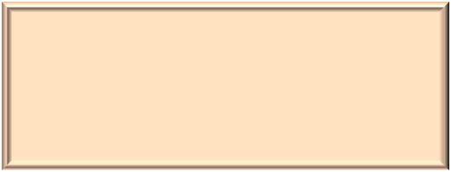
printf("\nArray before sorting\n");
PrintArray( values, NumElements );
SortArray( values, NumElements );
printf("\nArray after sorting\n");
PrintArray( values, NumElements );
PrintArray prints the elements of the array in the order they are given to it
SortArray sorts the elements into ascending order

Slide 23
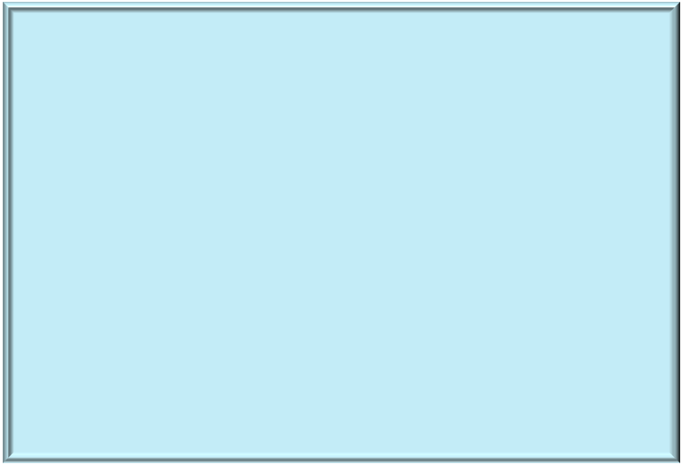
Parameter Passing
void PrintArray( double array[], int size )
{
}
array is a C array of doubles
array is passed by reference, i.e. any changes to parameter array in the function would change the argument values
The array size is passed as “size”

Slide 24
void PrintArray( double array[], int size )
{
int i;
for (i=0; i<size; i++)
printf(" Element %5d : %8.4lf\n",i, array[i]);
}
array[i] is a double so the output needs to be “%f”
The range of the “for” statement walks through the whole array from element 0 to element N-1.

Slide 25
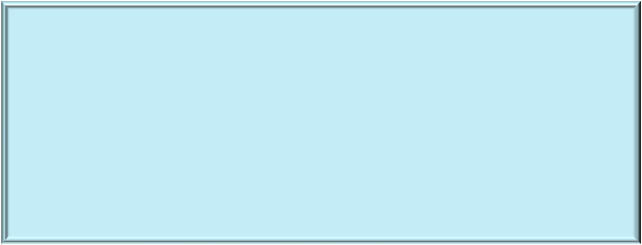
Sorting Array
void SortArray( double array[], int size)
{
}
array is an array of doubles.
array is passed by reference, i.e. changes to parameter array change the argument values
There is no size restriction on array so the size is passed as “size”.

Slide 26
Selection Sort
array
8
2
6
4
0
1
2
3

Slide 27
Selection Sort
array
8
2
6
4
Search from array[0] to array[3]
to find the smallest number
0
1
2
3

Slide 28
Selection Sort
Search from array[0] to array[3]
to find the smallest number and
swap it with array[0]
array
8
2
6
4
0
1
2
3
2
8
6
4
0
1
2
3

Slide 29
Selection Sort
array
8
2
6
4
0
1
2
3
Search from array[1] to array[3]
to find the smallest number
2
8
6
4
0
1
2
3

Slide 30
Selection Sort
array
8
2
6
4
0
1
2
3
Search from array[1] to array[3]
to find the smallest number and
swap it with array[1]
2
8
6
4
0
1
2
3
2
4
6
8
0
1
2
3

Slide 31
Selection Sort
array
8
2
6
4
0
1
2
3
2
8
6
4
0
1
2
3
Search from array[2] to array[3]
to find the smallest number and
swap it with array[2]
2
4
6
8
0
1
2
3

Slide 32

Selection Sort
array
8
2
6
4
0
1
2
3
2
8
6
4
0
1
2
3
Search from array[2] to array[3]
to find the smallest number and swap it with array[2]
2
4
6
8
0
1
2
3
2
4
6
8
And we are done!
0
1
2
3

Slide 33
Selection Sort
How many iterations are there?
Answer: 3 ( from i = 0 to i = 2)
More generally, if number of
elements in the array is size,
you need to iterate from
i = 0 to i = size - 2
array
8
2
6
4
0
1
2
3
2
8
6
4
0
1
2
3
2
4
6
8
0
1
2
3
2
4
6
8
0
1
2
3

Slide 34
Selection Sort
At every iteration i, you need to search
from array[i] to array[size – 1] to
find the smallest element
How to do this?
2
8
6
4
0
1
2
3

Slide 35
Selection Sort
At every iteration i, you need to search
from array[i] to array[size – 1] to
find the smallest element
How to do this?
Use a variable called min to locate
the index of the smallest element
2
8
6
4
0
1
2
3
min
3

Slide 36
Selection Sort
Assume current iteration i = 1
Initialize min = i
2
8
6
4
0
1
2
3
min
1

Slide 37
Selection
Sort
i
j
Assume current iteration i = 1
Initialize min = I
Set j = i + 1
Compare array(min) to array(j)
2
8
6
4
0
1
2
3
min
1

Slide 38
Selection
Sort
i
j
Assume current iteration i = 1
Initialize min = i
Set j = i + 1
Compare array(min) to array(j)
If array(j) < array(min)
set min to j
Because 6 < 8,
min is now set to 2
2
8
6
4
0
1
2
3
min
2

Slide 39
Selection
Sort
i
j
Increment j
Compare array(min) to array(j)
2
8
6
4
0
1
2
3
min
2

Slide 40
Selection
Sort
i
j
Increment j
Compare array(min) to array(j)
If array(j) < array(min)
set min to j
Because 4 < 6,
min is now set to 3
2
8
6
4
0
1
2
3
min
3

Slide 41
Selection
Sort
i
j
2
8
6
4
Swap array(i) with array(min)
0
1
2
3
min
3

Slide 42
SortArray
void SortArray( double array[], int size)
{
int i, j, min;
for (i=0; i < size-1; i++)
{
min = i;
for (j=i+1; j<size; j++)
{
if (array[j] < array[min])
{
min = j;
}
}
Swap(&array[i], &array[min]);
}
}

Slide 43
Swap
void Swap (double *a, double *b)
{
double temp = *a;
*a = *b;
*b = temp;
}

Slide 44
Swap
void Swap (double *a, double *b)
{
double temp = *a;
*a = *b;
*b = temp;
}
Note: We’re passing two elements of the array; not passing the entire array
So, we CANNOT declare it as
void Swap(double a, double b)
void Swap(double a[], double b[])
2

