Slide 1
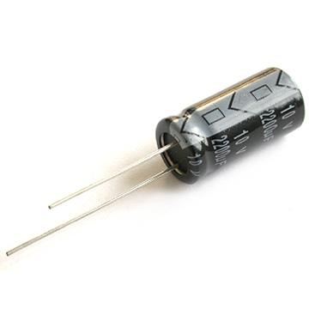
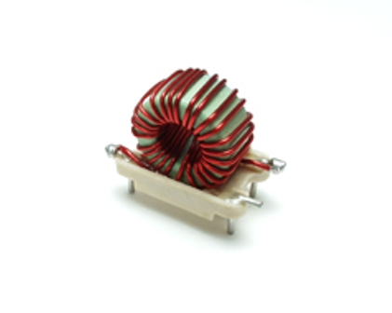
Flow Control and Booleans
1. Please get logged in.
2. Open a new terminal window Applications/Accessories/Terminal
3. Open a web browser Applications/Internet/Iceweasel Web Browser
4. Go to http://www.cse.msu.edu/~cse251
5. Open Step 3: Flow Control and Booleans

Slide 2
Today: Flow Control and Booleans
Flow Control
if, switch
Boolean Logic
<, <=, ==, >=, >, !=

Slide 3
rlc.c
#include <stdio.h>
#include <math.h>
/*
* Simple program to compute the resonant frequency of
* an RLC circuit
*/
int main()
{
double l; /* Inductance in millihenrys */
double c; /* Capacitance in microfarads */
double omega; /* Resonance frequency in radians per second */
double f; /* Resonance frequency in Hertz */
printf("Enter the inductance in millihenrys: ");
scanf("%lf", &l);
printf("Enter the capacitance in microfarads: ");
scanf("%lf", &c);
omega = 1.0 / sqrt((l / 1000) * (c / 1000000));
f = omega / (2 * M_PI);
printf("Resonant frequency: %.2f\n", f);
}

Slide 4

rlc.c
#include <stdio.h>
#include <math.h>
/*
* Simple program to compute the resonant frequency of
* an RLC circuit
*/
int main()
{
double l; /* Inductance in millihenrys */
double c; /* Capacitance in microfarads */
double omega; /* Resonance frequency in radians per second */
double f; /* Resonance frequency in Hertz */
printf("Enter the inductance in millihenrys: ");
scanf("%lf", &l);
printf("Enter the capacitance in microfarads: ");
scanf("%lf", &c);
omega = 1.0 / sqrt((l / 1000) * (c / 1000000));
f = omega / (2 * M_PI); /* Convert radians per sec to Hertz */
printf("Resonant frequency: %.2f\n", f);
}
Note the use of comments to tell: a) what the program does, b) what some lines of code do, and c) what the variables are.

Slide 5


rlc.c
#include <stdio.h>
#include <math.h>
/*
* Simple program to compute the resonant frequency of
* an RLC circuit
*/
int main()
{
double l; /* Inductance in millihenrys */
double c; /* Capacitance in microfarads */
double omega; /* Resonance frequency in radians per second */
double f; /* Resonance frequency in Hertz */
printf("Enter the inductance in millihenrys: ");
scanf("%lf", &l);
printf("Enter the capacitance in microfarads: ");
scanf("%lf", &c);
omega = 1.0 / sqrt((l / 1000) * (c / 1000000));
f = omega / (2 * M_PI);
printf("Resonant frequency: %.2f\n", f);
}
Note the use of indentation

Slide 6

rlc.c
#include <stdio.h>
#include <math.h>
/*
* Simple program to compute the resonant frequency of
* an RLC circuit
*/
int main()
{
double l; /* Inductance in millihenrys */
double c; /* Capacitance in microfarads */
double omega; /* Resonance frequency in radians per second */
double f; /* Resonance frequency in Hertz */
printf("Enter the inductance in millihenrys: ");
scanf("%lf", &l);
printf("Enter the capacitance in microfarads: ");
scanf("%lf", &c);
omega = 1.0 / sqrt((l / 1000) * (c / 1000000));
f = omega / (2 * M_PI);
printf("Resonant frequency: %.2f\n", f);
}
Indentation is necessary to make your program readable!

Slide 7
Sequential Execution
Statement 1
Statement 2
...
Statement n

Slide 8
Selective Execution
true
boolean
expression
false
statement 1
statement 2

Slide 9
if statements
The if statement
Fundamental means of flow control
How we will make decisions
if(age > 39)
printf(“You are so old!\n”);
Boolean expressions
The actual determination of the decision
age > 39
c == 0
l <= 0
(age >= 18) && (age < 65)

Slide 10
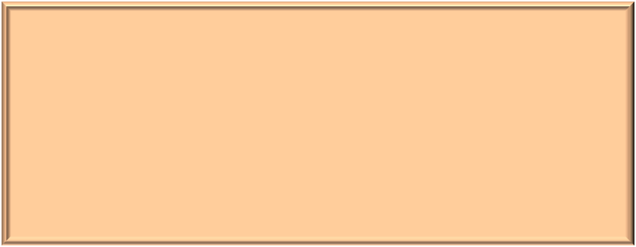

Structure of an if statement
If expression1 is true, execute statement1.
Otherwise, test to see if expression2 is true. If so, execute statement2.
Otherwise, execute statement3.
if(expression1)
statement1;
else if(expression2) /* Optional */
statement2;
else /* Optional */
statement3;
The expressions are boolean expressions that resolve to a true or a false.

Slide 11


Basic Boolean Expressions
Some operators:
< Less than
<= Less than or equal to
== Equal
!= Not equal
>= Greater than or equal to
> Greater than
true
false
age < 18
divisor == 0
size > 1000000
ch == ‘X’
Important: The test for equality is ==, not =. This is the most common error in a C program.

Slide 12



Example if statements
< Less than
<= Less than or equal to
== Equal
!= Not equal
>= Greater than or equal to
> Greater than
if(age < 18)
printf(“Too young to vote!\n”);
if(area == 0)
printf(“The plot is empty\n”);
else
printf(“The plot has an area of %.1f\n”, area);
if(val < 0)
printf(“Negative input is not allowed\n”);
else if(val == 0)
printf(“A value of zero is not allowed\n”);
else
printf(“The reciprocal is %.2f\n”, 1.0 / val);
Note the indentation
1

Slide 13




Blocks
Single Statement
printf(“This is a statement\n”);
Block
{
printf(“All items in a curly brace\n”);
printf(“as if there are one statement”);
printf(“They are executed sequentially”);
}

Slide 14

Where is this useful?
If the expression is true, all of the statements in the block are executed
if(value > 0)
{
result = 1.0 / value;
printf("Result = %f\n", result);
}

Slide 15
Where is this useful?
Will these two sections of code work differently?
if(value > 0)
{
result = 1.0 / value;
printf("Result = %f\n", result);
}
if(value > 0)
result = 1.0 / value;
printf("Result = %f\n", result);

Slide 16


Where is this useful?
Yes!
if(value > 0)
{
result = 1.0 / value;
printf("Result = %f\n", result);
}
Will always execute!
if(value > 0)
result = 1.0 / value;
printf("Result = %f\n", result);
2

Slide 17
Nested Blocks
What does this do?
if(bobsAge != suesAge) /* != means "not equal" */
{
printf("Bob and Sue are different ages\n");
if(bobsAge > suesAge)
{
printf("In fact, Bob is older than Sue\n");
if((bobsAge - 20) > suesAge)
{
printf("Wow, Bob is more than 20 years older\n");
}
}
}

Slide 18

Importance of indentation
See how much harder this is to read?
if(bobsAge != suesAge) /* != means "not equal" */
{
printf("Bob and Sue are different ages\n");
if(bobsAge > suesAge)
{
printf("In fact, Bob is older than Sue\n");
if((bobsAge - 20) > suesAge)
{
printf("Wow, Bob is more than 20 years older\n");
}
}
}

Slide 19
Boolean Expressions
An expression whose value is true or false
In C:
  integer value of 0 is “false”
  nonzero integer value is “true”
Example of Boolean expressions:
  age < 40
  graduation_year == 2010
Relational operator

Slide 20
#include <stdio.h>
#include <stdbool.h>
int main()
{
const bool trueVar = true, falseVar = false;
const int int3 = 3, int8 = 8;
printf("No 'boolean' output type\n");
printf("bool trueVar: %d\n",trueVar);
printf("bool falseVar: %d\n\n",falseVar);
printf("int int3: %d\n",int3);
printf("int int8: %d\n",int8);
}
Library that defines: bool, true, false
What does the output look like?

Slide 21
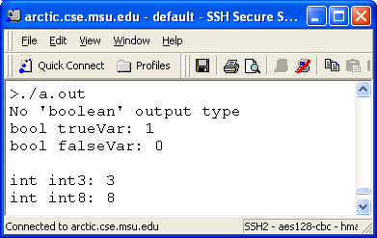
#include <stdio.h>
#include <stdbool.h>
int main()
{
const bool trueVar = true, falseVar = false;
const int int3 = 3, int8 = 8;
printf("No 'boolean' output type\n");
printf("bool trueVar: %d\n",trueVar);
printf("bool falseVar: %d\n\n",falseVar);
printf("int int3: %d\n",int3);
printf("int int8: %d\n",int8);
}
Library that defines: bool, true, false
What does the output look like?

Slide 22
// Example3 (continued…)
printf("\nint3 comparators\n");
printf("int3 == int8: %d\n",(int3 == int8));
printf("int3 != int8: %d\n",(int3!=int8));
printf("int3 < 3: %d\n",(int3 < 3));
printf("int3 <= 3: %d\n",(int3 <= 3));
printf("int3 > 3: %d\n",(int3 > 3));
printf("int3 >= 3: %d\n",(int3 >= 3));
Comparing values of two integer constants
What does the output look like?

Slide 23
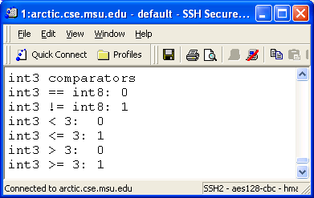
// Example3 (continued…)
printf("\nint3 comparators\n");
printf("int3 == int8: %d\n",(int3 == int8));
printf("int3 != int8: %d\n",(int3!=int8));
printf("int3 < 3: %d\n",(int3 < 3));
printf("int3 <= 3: %d\n",(int3 <= 3));
printf("int3 > 3: %d\n",(int3 > 3));
printf("int3 >= 3: %d\n",(int3 >= 3));

Slide 24
More Examples
char myChar = ‘A’;
  The value of myChar==‘Q’ is false (0)
Be careful when using floating point equality comparisons, especially with zero, e.g. myFloat==0

Slide 25
Suppose?
What if I want to know if a value is in a range?
Test for: 100 ≤ L ≤ 1000?

Slide 26

You can’t do…
This code is WRONG and will fail.
if(100 <= L <= 1000)
{
printf(“Value is in range…\n”);
}

Slide 27


Why this fails…
C Treats this code this way
if((100 <= L) <= 1000)
{
printf(“Value is in range…\n”);
}
Suppose L is 5000. Then 100 <= L is true, so (100 <= L) evaluates to true, which, in C, is a 1. Then it tests 1 <= 1000, which also returns true, even though you expected a false.

Slide 28
Compound Expressions
Want to check whether -3 <= B <= -1
  Since B = -2, answer should be True (1)
But in C, the expression is evaluated as
  ((-3 <= B) <= -1) (<= is left associative)
  (-3 <= B) is true (1)
  (1 <= -1) is false (0)
  Therefore, answer is 0!

Slide 29
Compound Expressions
Solution (not in C): (-3<=B) and (B<=-1)
In C: (-3<=B) && (B<=-1)
Logical Operators
  And: &&
  Or: ||
  Not: !

Slide 30
Compound Expressions
#include <stdio.h>
int main()
{
const int A=2, B = -2;
printf("Value of A is %d\n", A);
printf("0 <= A <= 5?: Answer=%d\n", (0<=A) && (A<=5));
printf("Value of B is %d\n", B);
printf("-3 <= B <= -1?: Answer=%d\n", (-3<=B) && (B<=-1));
}

Slide 31
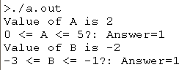
Compound Expressions
#include <stdio.h>
int main()
{
const int A=2, B = -2;
printf("Value of A is %d\n", A);
printf("0 <= A <= 5?: Answer=%d\n", (0<=A) && (A<=5));
printf("Value of B is %d\n", B);
printf("-3 <= B <= -1?: Answer=%d\n", (-3<=B) && (B<=-1));
}
Correct Answer!!!
True (1)
True (1)

Slide 32
Compound Expressions
#include <stdio.h>
int main()
{
const int A=2, B = -2;
printf("Value of A is %d\n", A);
printf("0 <= A <= 5?: Answer=%d\n", (0<=A) && (A<=5));
printf("Value of B is %d\n", B);
printf("-3 <= B <= -1?: Answer=%d\n", (-3<=B) && (B<=-1));
}
Correct Answer!!!
True (1)
True (1)
&&
True (1)

Slide 33
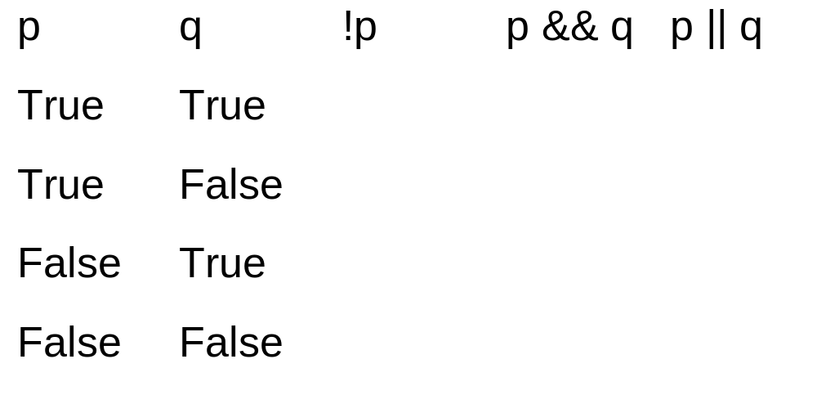
Truth Tables
Not
And
Or

Slide 34
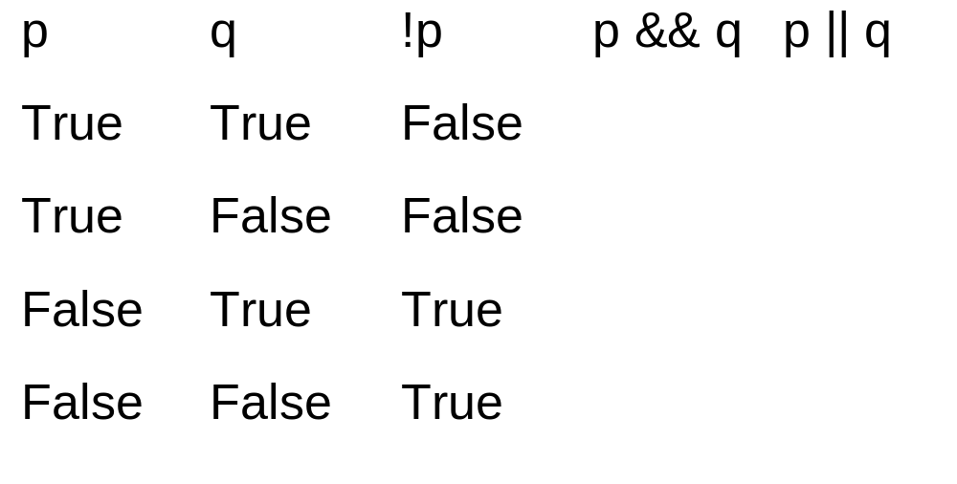
Truth Tables
Not
And
Or

Slide 35
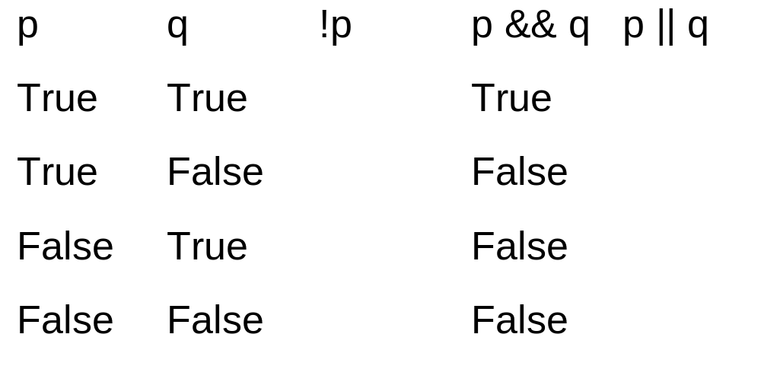
Truth Tables
Not
And
Or

Slide 36
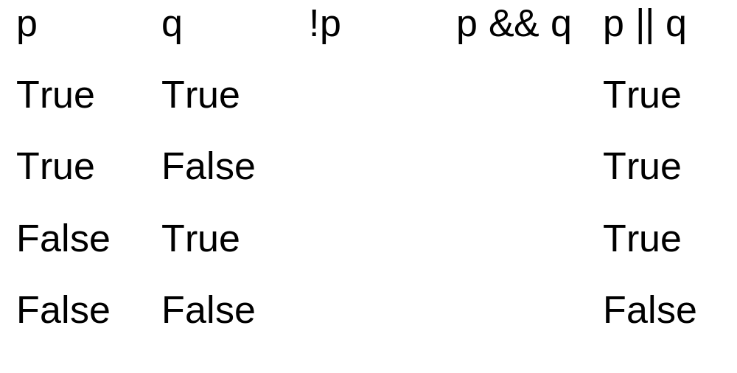
Truth Tables
Not
And
Or

Slide 37
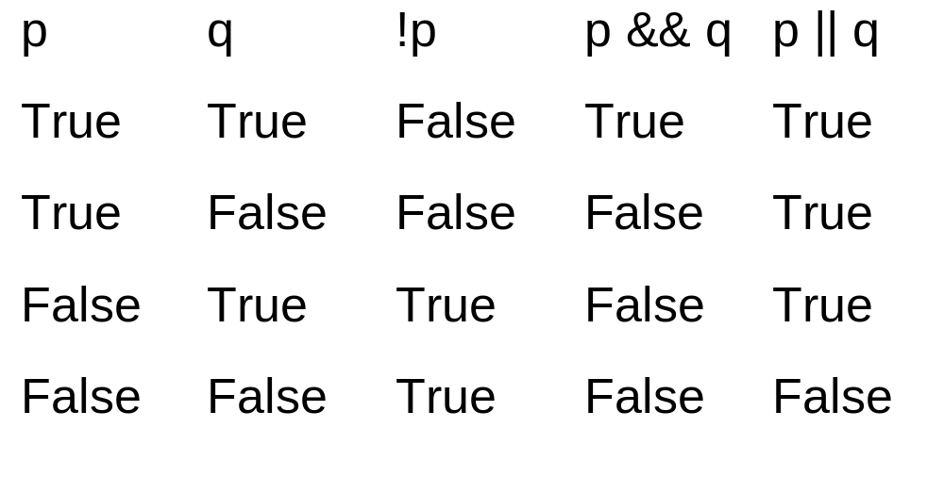
Truth Tables
Our comparison operators: < <= == != >= >
Not
And
Or
3

Slide 38
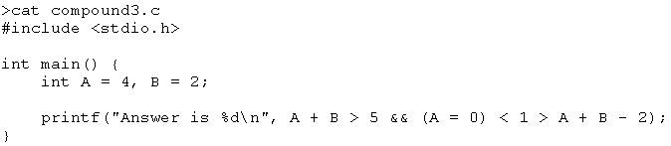
Precedence & Associativity
Can you guess what’s the answer?
Relational operators have precedence and associativity (just like arithmetic operators)
Use ( ) when in doubt

Slide 39
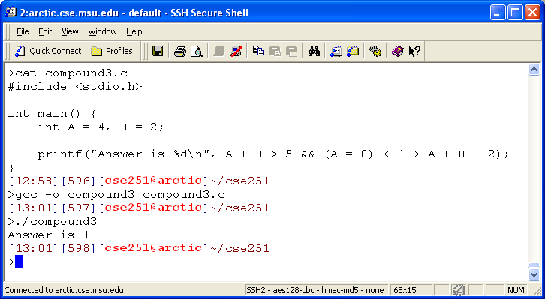
( ((A + B) > 5) && ( ((A=0) < 1) > ((A + B) – 2)) )
( (6 > 5) && ( ((A=0) < 1) > ((A + B) – 2)) )
( 1 && ( ( 0 < 1) > ((A + B) – 2)) )
( 1 && ( 1 > ( 2 – 2) ) )
( 1 && ( 1 > 0 ) )
( 1 && 1 )
Answer: 1
Precedence: +/-
> <
&&

Slide 40
Associativity
“=“ is right associative
Example: X=Y=5
  right associative: X = (Y=5)
  expression Y=5 returns value 5: X = 5

Slide 41
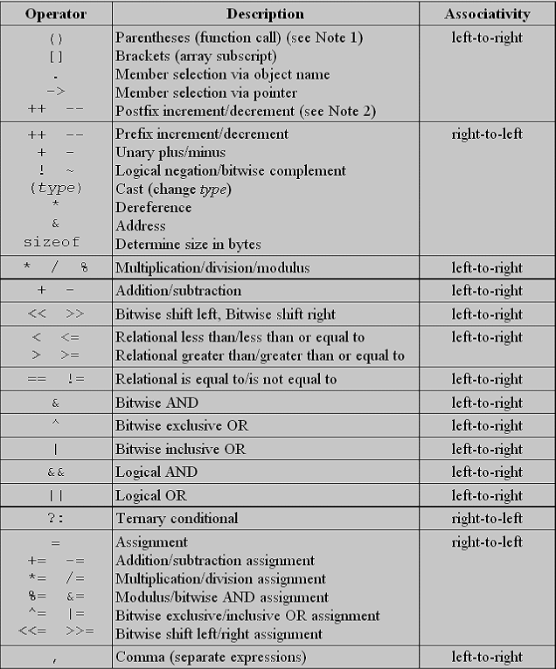
You should refer to the C operator precedence and associative table
See for example, http://www.difranco.net/cop2220/op-prec.htm
Or just use parentheses whenever you’re unsure about precedence and associativity

Slide 42
Switch Statement
A less general substitute for the multibranch if. It is used for selecting among discrete values (int), i.e. not continuous values.
switch (int_expression)
{
case_list:
statement_list;
case_list:
statement_list;
default:
statement_list;
}
Switch & Functions

Slide 43
Behavior
The int_expression is evaluated. If the value is in a case_list, execution begins at that statement_list and continues through subsequent statement_lists until: break, return, or end of switch.
Switch & Functions

Slide 44
#include <stdio.h>
void main()
{
int gender;
printf("Enter your gender (male=1, female=2): ");
scanf("%d",&gender);
switch(gender)
{
case 1:
printf("You are a male\n");
break;
case 2:
printf("you are a female\n");
break;
default:
printf("Not a valid input\n");
break;
}
}

Slide 45
switch(gender)
{
case 1:
printf("You are a male\n");
break;
case 2:
printf("you are a female\n");
break;
default:
printf("Not a valid input\n");
break;
}
4

