Slide 1
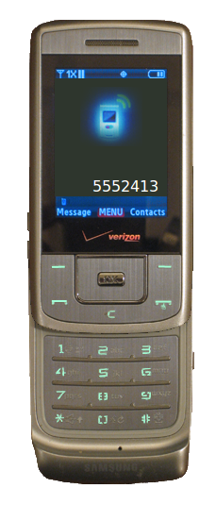
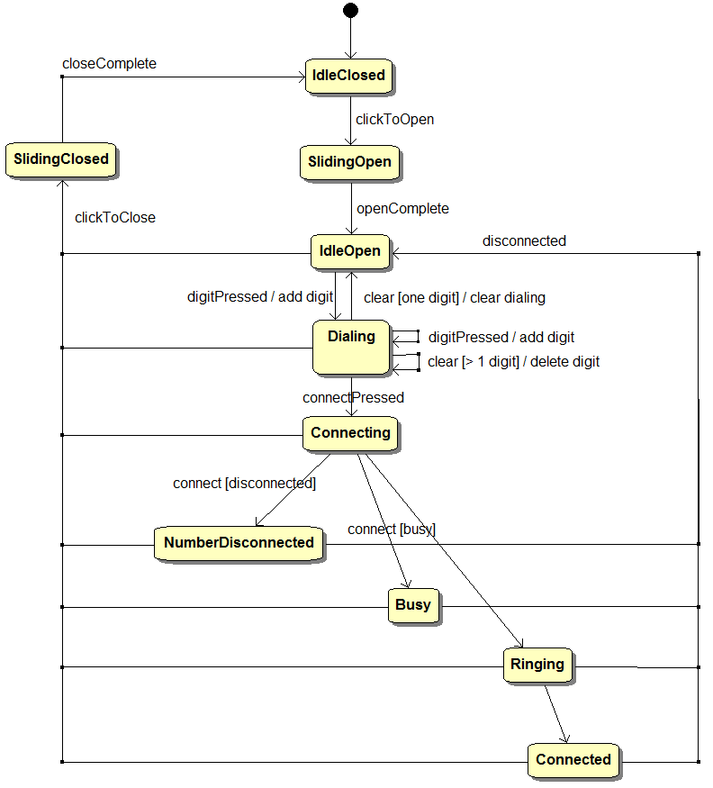
States and State Machines

Slide 2
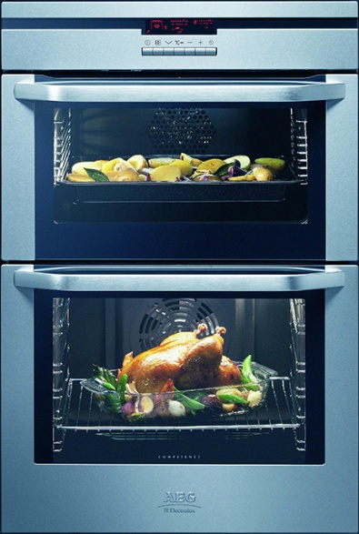
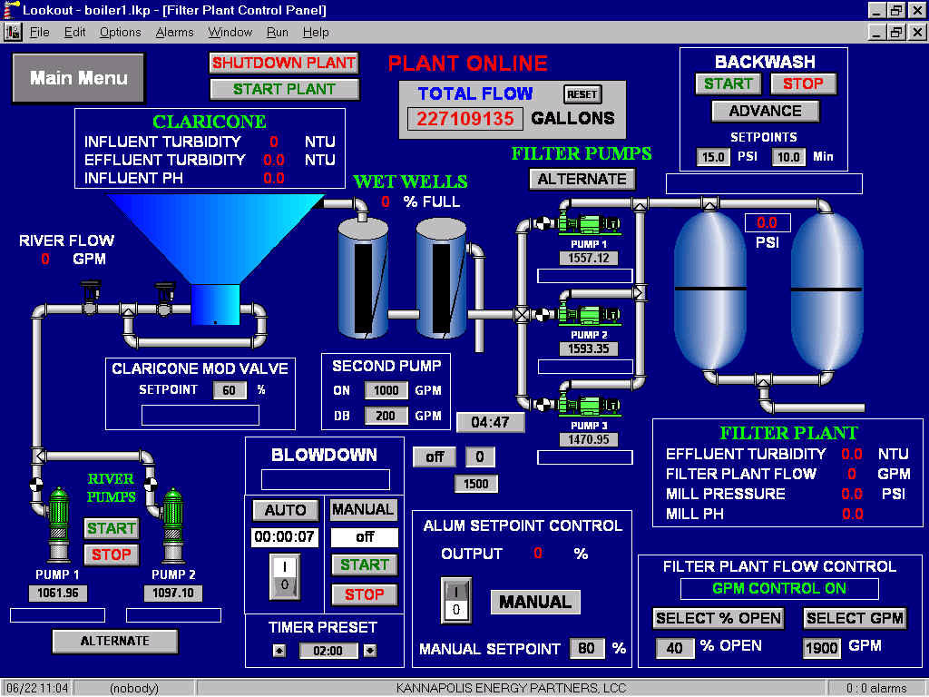
What is this for?
State machines are commonly used in…
Embedded Systems
Factory/Process Controls

Slide 3
State
State – An abstraction of the current status of a system. States are assigned names.
Waiting for a Keypress
Waiting for Elvis
Raising Firearm to Fire
Cellphone is Dialing
Door Opening
Paper Jammed
Battery is Below Limit
Power is On
Door Open
Prius Accelerator Stuck
Verbs with “ing”
Statement of condition

Slide 4
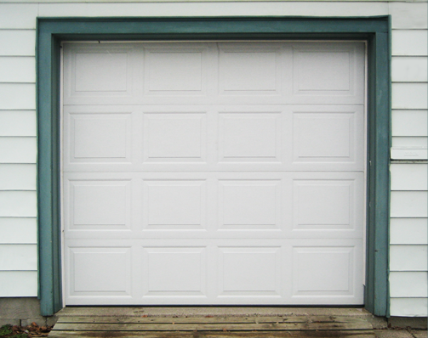
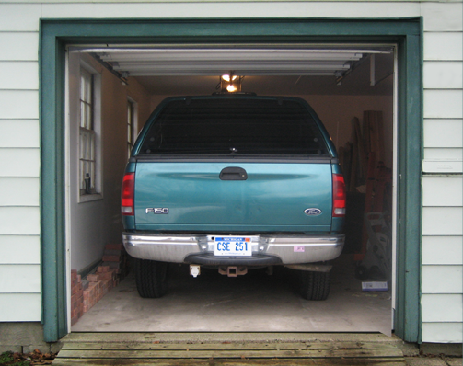

States in a Garage Door
Are there any more states?
DoorClosed
DoorOpen
A

Slide 5
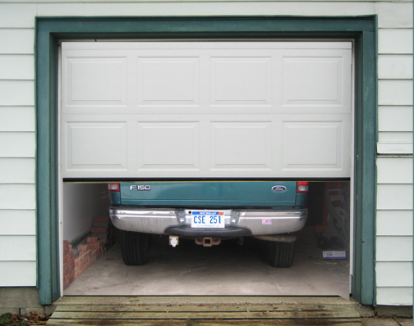


More States
DoorOpening
DoorClosing

Slide 6
How we will express this in a program
/* Our possible garage door states */
#define DoorClosed 1
#define DoorOpening 2
#define DoorOpen 3
#define DoorClosing 4
int main()
{
int state = DoorClosed;
…
In the main function
Above main in our program
Why do we care? We do different things depending on the current state. What does the button do in each state?
B

Slide 7
Naming Conventions - States
We will usually name states with camel-case and a capital first letter. We’ll use #defines in our programs for state names.
WaitingForKeypress
WaitingForElvis
RaisingFirearm
CellphoneDialing
DoorOpening
PaperJammed
BatteryBelowLimit
PowerOn
DoorOpen
PriusAccelStuck
Verbs with “ing”
Statement of condition

Slide 8
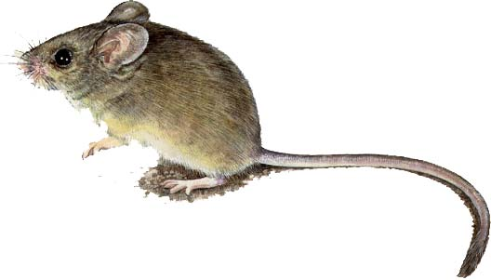
Events
An event is an occurrence in time. It is considered atomic and instantaneous.
Left mouse button pressed
Key pressed
Elvis has left the building
Flight 529 has landed
Power turned on
Paper is jammed
Message has timed out
10 seconds has elapsed
Battery is below limit
Project 2 is due
Past tense verbs
Onset of condition

Slide 9
Events vs. State
clickedOnScreen
screenSlideDone
clickedOnScreen
screenSlideDone
IdleClosed
SlidingOpen
IdleOpen
SlidingClosed
IdleClosed
An event is what causes us to change from state to state.

Slide 10
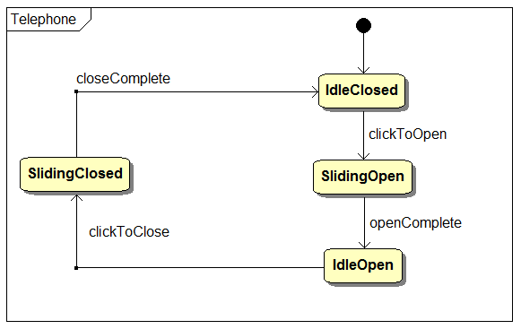
State Diagrams
State diagrams describe what we will implement in code as a state machine.

Slide 11








State Diagrams
Initial State
State
Transition
Event

Slide 12

Starting out State Machine
int main()
{
int state = DoorClosed;
…
C

Slide 13
A Control Loop
int main()
{
int state = DoorClosed;
printf("Garage Startup\n");
GarageStartup();
while(IsGarageRunning())
{
}
printf("Garage Shutdown\n");
GarageShutdown();
return 0;
}
A continuous loop in a controls application that controls the system. Right now our loop is doing nothing. We’ll want to add code to make our garage door work.

Slide 14
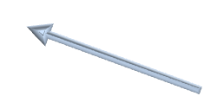

Important Idea
We do something different depending on the state we are in. It makes sense to create a function for each state.
void StateDoorClosed(int *state)
{
}
Note the pointer. We pass the state by reference. It is an in/out parameter
What should happen when we are in the DoorClosed state?

Slide 15
DoorClosed state…
If the button is pressed:
Start the motor
Go to the DoorOpening state
otherwise:
Do nothing…

Slide 16
DoorClosed state…
void StateDoorClosed(int *state)
{
if(WasButtonPressed())
{
SetMotorPower(1);
*state = DoorOpening;
}
}
If the button is pressed:
Start the motor
Go to the DoorOpening state
otherwise:
Do nothing…

Slide 17
The Control Loop – Handling States
while(IsGarageRunning())
{
switch(state)
{
case DoorClosed:
StateDoorClosed(&state);
break;
}
}
We will put a switch statement in our control loop to handle the states.

Slide 18
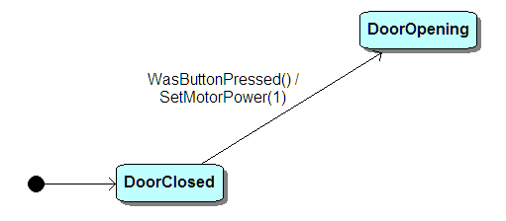
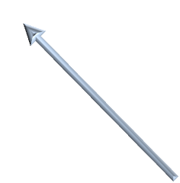

We now have this…
Trigger / Activity
Trigger is what causes the transition. Activity is something that happens when the transition occurs.
This is a simple 2-state statement.

Slide 19
What happens
while(IsGarageRunning())
{
switch(state)
{
case DoorClosed:
StateDoorClosed(&state);
break;
}
}
void StateDoorClosed(int *state)
{
if(WasButtonPressed())
{
SetMotorPower(1);
*state = DoorOpening;
}
}
Control Loop
State Function
The control loop runs continuously (1000 times per second in this program). Each time it calls a function for the current state. That state function decides if we need to change the state and does anything else we need to do while in that state.

Slide 20
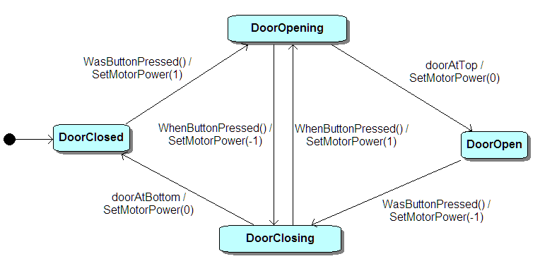

A Garage Door Opener
1

