Slide 1
Pointers, Arrays, Multidimensional Arrays
Pointers versus arrays
  Lots of similarities
How to deal with 2D, 3D, multidimensional arrays (for storing matrices and other 2D or 3D data!)

Slide 2
Review: Pointers
Address
Memory
Name
Pointers are variables that store memory addresses
  int a = 15;
  int *b = &a;
  printf(“%x %x %d\n”, b, &b, *b);
  // prints effffa94 effffa98 15
0xeffffa94
a
15
0xeffffa98
0xeffffa94
b

Slide 3
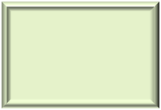
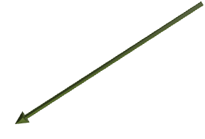
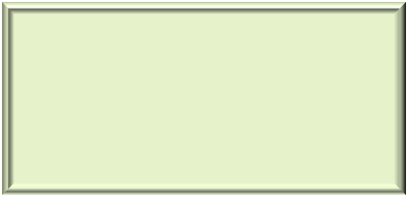


int number;
int *ptr = &number;
printf(“Enter an integer: ”);
scanf(“%d”, &number);
printf(“Enter another integer: “);
scanf(“%d”, ptr);
printf(“Number = %d, *ptr = %d\n”, number, *ptr);
Using pointers in scanf function
Read & as “at”
Don’t have to put & before ptr. It’s already an “at”.
Example output:

Slide 4
int multiply( int *, int);
int main()
{
int number = 3;
int *ptr = &number;
printf(“1: %d\n”, multiply( &number, 2 ) );
printf(“2: %d\n”, multiply( ptr, 3 ) );
}
int multiply (int *a, int factor)
{
return (*a) * factor;
}
Passing pointers (addresses) to functions

Slide 5

Review: Arrays
An array is a contiguous chunk of memory to store multiple values
  int grades[]={74,59,95,85,71,45,99,82,76};
0xeffffa00
0xeffffa04
0xeffffa08
0xeffffa0c
0xeffffa10
0xeffffa14
0xeffffa18
0xeffffa1c
0xeffffa20
grades
74
59
95
85
71
45
99
82
76
index
0
1
2
3
4
5
6
7
8
A

Slide 6
int sumArray( int [], int);
int main()
{
int list[] = {1, 2, 3, 4};
printf(“Sum = %d\n”, sumArray( list , 4 ));
}
int sumArray (int list[], int arraySize)
{
int sumvalue = 0;
for (int i=0; i<arraySize; i++)
sumvalue += list[i];
return sumvalue;
}
Passing arrays to functions

Slide 7
Array Name
The array name is a pointer to the first element of the array
ffe2de0c
ffe2de10
ffe2de14
ffe2de18
list
1
2
3
4
[0]
[1]
[2]
[3]
  int list[]={1,2,3,4};
  printf(“%x, %x, %d”, list, &list[0], *list);
Output: ffe2de0c ffe2de0c 1

Slide 8
Pointers and Arrays
p
list
1
2
3
4
int *p,
int list[]={1,2,3,4};
p = list; /* equivalent to p = &list[0] */
printf(“%d\n”, *p); /* prints the value “1” */
[0]
[1]
[2]
[3]
You can use a
pointer to access
the array

Slide 9
Pointer and []
P
Any pointer to a block of memory can use the [] syntax, even if it is not declared as an array!
List
1
2
3
4
[0]
[1]
[2]
[3]
int *p,
int list[]={1,2,3,4};
p = list;
printf(“%d\n”, p[2]); // prints 3
int *v; and int v[]; /* Mean the same thing */

Slide 10
Array indexing []
*list – Contents pointed to by list
*(list + 2) – Contents at list[2]
list
list + 2
Indexing an array is just a way of finding a particular address in that block
ffe2de0c
ffe2de10
ffe2de14
ffe2de18
1
2
3
4
[0]
[1]
[2]
[3]
int list[] = {1,2,3,4} // array of 4 ints
printf(“%d”, list[2]);
This is equivalent to
printf(“%d”,*(list+2));
B

Slide 11
Pointer Arithmetic
When we add to a pointer, such as (p + 1), we don’t literally add 1 to the pointer address
Instead we add one “address” to the pointer

Slide 12
Pointer Arithmetic
int list[] = {1, 2, 3, 4};
int *p = list; /* same as p = &list[0] */
printf(“%x”,p); /* prints ffe2de0c */
p
ffe2de0c
ffe2de10
ffe2de14
ffe2de18
1
2
3
4

Slide 13
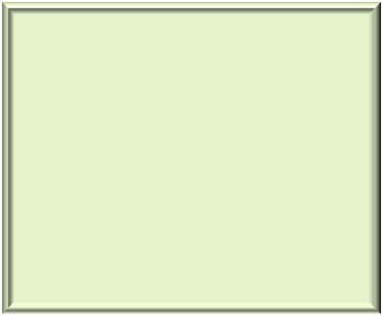
Pointer Arithmetic
int list[] = {1, 2, 3, 4};
int *p = list; /* same as p = &list[0] */
printf(“%x”,p); /* prints ffe2de0c */
p = p + 1; /* p increases by 4 */
printf(“%x”,p); /* prints ffe2de10 */
p
Think of pointer arithmetic as add 1 “location” instead of one byte or address.
ffe2de0c
ffe2de10
ffe2de14
ffe2de18
1
2
3
4

Slide 14
Pointer Arithmetic
double list2[] = {1.0, 2.0, 3.0};
double *p = list2; /* same as p = &list2[0] */
printf(“%x”, p); /* prints ffe2de0c */
p
ffe2de0c
ffe2de10
ffe2de14
ffe2de18
ffe2de1c
ffe2de20
1.0
2.0
3.0
C

Slide 15
Pointer Arithmetic
double list2[] = {1.0, 2.0, 3.0};
double *p = list2; /* same as p = &list2[0] */
printf(“%x”,p); /* prints ffe2de0c */
p = p + 1; /* P increases by 8 bytes */
printf(“%x”,p); /* prints ffe2de14 */
P
ffe2de0c
ffe2de10
ffe2de14
ffe2de18
ffe2de1c
ffe2de20
1.0
2.0
3.0

Slide 16
Pointer Arithmetic on Arrays
*(list+1) references the next element in the array (equivalent to list[1])
Be careful: *(++list) works too but now we have lost our pointer to the beginning of the array!!!
  Equivalent to: list = list + 1; *list;

Slide 17
sizeof() operator
Returns the number of bytes needed to store a variable or a data type
int i;
int *ptr4i = &i;
int IntArray[] = {1, 2, 3, 4, 5};
double j;
double *ptr4j = &j;
double doubleArray[] = {1.0, 2.0, 3.0, 4.0,5.0};
printf("Sizeof integer is %d bytes\n", sizeof(int));
printf("Sizeof double is %d bytes\n", sizeof(double));
printf("Sizeof i is %d bytes\n", sizeof(i));
printf("Sizeof pointer for i is %d bytes\n", sizeof(ptr4i));
printf("Sizeof j is %d bytes\n", sizeof(j));
printf("Sizeof pointer for j is %d bytes\n", sizeof(ptr4j));
printf("Sizeof intArray is %d bytes\n", sizeof(intArray));
printf("Sizeof doubleArray is %d bytes\n", sizeof(doubleArray));

Slide 18
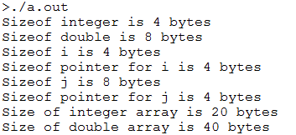
sizeof() operator

Slide 19
When we pass an array
When we pass an array, we are passing the array address
    int sumArray( int [ ], int);
    int main()
    {
    int list[] = {1, 2,3, 4);
    …
    sumArray( list , 4 );
…

Slide 20
When we pass an array
This will work too (because array name is a pointer to the beginning of the array)
    int sumArray( int *, int);
    int main()
    {
    int list[] = {1, 2,3, 4);
    …
    sumArray( list , 4 );
…

Slide 21
When we pass an array
But this DOES NOT work!
    int sumArray( int *, int);
    int main()
    {
    int *list = {1, 2, 3, 4);
    …
    sumArray( list , 4 );
…

Slide 22

Pointers
*list – Contents pointed to by list
*(list + 2) – Contents at list[2]
list
list + 2
Indexing an array is just a way of finding a particular address in that block
ffe2de0c
ffe2de10
ffe2de14
ffe2de18
1
2
3
4
[0]
[1]
[2]
[3]
int list[] = {1,2,3,4} // array of 4 ints
printf(“%d”, list[2]);
This is equivalent to
printf(“%d”,*(list+2));
1

Slide 23
2-D Arrays
int cave[ArraySize][ArraySize];
Column
0
1
2
3
0
1 | 2 | 3 | 4
5 | 6 | 7 | 8
9 | 10 | 11 | 12
13 | 14 | 15 | 16
1
Row
2
3

Slide 24

2D Arrays
  int myMatrix[3][4] = { {1,2,3,4},{5,6,7,8},{9,10,11,12} };
Column
0
1
2
3
0
1 | 2 | 3 | 4
5 | 6 | 7 | 8
9 | 10 | 11 | 12
myMatrix[0][1] → 2
Row
1
2
myMatrix[2][3] → 12
myMatrix[row][col]
Notes:
Note that the following also works for initialization:
int heat[4][4] = {0,0,0,0,0,0,0,0,…};

Slide 25
Physically, in one block of memory
int myMatrix[2][4] = { {1,2,3,4},{5,6,7,8} };
ffe2de0c
ffe2de10
ffe2de14
ffe2de18
ffe2de1c
ffe2de20
ffe2de24
ffe2de28
1 | 2 | 3 | 4 | 5 | 6 | 7 | 8
row 1
row 2
Array elements are stored in row major order
Row 1 first, followed by row2, row3, and so on

Slide 26
2D Array Name and Addresses
int myMatrix[2][4] = { {1,2,3,4},{5,6,7,8} };
ffe2de0c
ffe2de10
ffe2de14
ffe2de18
ffe2de1c
ffe2de20
ffe2de24
ffe2de28
1 | 2 | 3 | 4 | 5 | 6 | 7 | 8
myMatrix: pointer to the first element of the 2D array
myMatrix[0]: pointer to the first row of the 2D array
myMatrix[1]: pointer to the second row of the 2D array
*myMatrix[1] is the address of element myMatrix[1][0]

Slide 27
Accessing 2D Array Elements
int myMatrix[2][4] = { {1,2,3,4} , {5,6,7,8} };
1 | 2 | 3 | 4 | 5 | 6 | 7 | 8
Indexing: myMatrix[i][j] is same as
*(myMatrix[i] + j)
(*(myMatrix + i))[j]
*((*(myMatrix + i)) + j)
*(&myMatrix[0][0] + 4*i + j)

Slide 28
Declaration
#define ROWS 3
#define COLS 5
int table[ROWS][COLS];
void display (table);

Slide 29
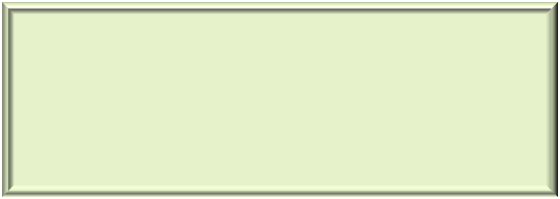
void display( int x[ROWS][COLS] )
{
for (int i=0; i < ROWS; i++)
{
for (int j=0; j < COLS; j++ )
{
printf(" x[%d][%d]: %d", i, j, x[i][j]);
}
printf("\n");
}
printf("\n");
}
2D Arrays often require nested loops – two variables

Slide 30
  Table A = { {13, 22, 9, 23},
{17, 5, 24, 31, 55},
{4, 19, 29, 41, 61} };
Table B = {1, 2, 3, 4,
5, 6, 7, 8, 9,
10, 11, 12, 13, 14 };
13 | 22 | 9 | 23 | ?
17 | 5 | 24 | 31 | 55
4 | 19 | 29 | 41 | 61
1 | 2 | 3 | 4 | 5
6 | 7 | 8 | 9 | 10
11 | 12 | 13 | 14 | ?

Slide 31
passing 2d arrays
In passing a multi-dimensional array, the first array size does not have to be specified. The second (and any subsequent) dimensions must be given!
int myFun(int list[][10]);

Slide 32
#define ROWS 3
#define COLS 5
int addMatrix( int [ ][COLS] );
int main()
{
int a[][COLS] = { {13, 22, 9, 23, 12}, {17, 5, 24, 31, 55}, {4, 19, 29, 41, 61} };
printf(“Sum = %d\n”, addMatrix( a ) );
}
int addMatrix( int t[ ][COLS] )
{
int i, j, sum = 0;
for (i=0; i<ROWS; i++)
for (j=0; j<COLS; j++)
sum += t[i][j];
return sum;
}
1

