Slide 1
Network Security: Assignment 3
RSA-based PKDA
Submitted by:
Akash Kushwaha 2021514
Suyash Kumar 2021293

Slide 2
Project Objective & Overview
Objective:
This project implements a Public Key Distribution Authority (PKDA) using RSA encryption to securely distribute public keys to clients. Two clients communicate confidentially after securely obtaining each other's public key via the PKDA.
Overview:
Key functional blocks:
PKDA Server
Client 1
Client 0

Slide 3
System Overview
PKDA Server (pkda.py): This server acts as the central authority for managing and distributing public keys. It listens for client requests, decrypts incoming messages, retrieves the requested public key, and sends it securely back to the requesting client.
Client 1 (client1.py): This client initiates a request to the PKDA to obtain the public key of another client. After retrieving the key, it engages in encrypted communication with the other client.
Client 0 (client0.py): Similar to Client 1, this client requests the PKDA for a public key and then uses it to establish secure communication with Client 1.

Slide 4
Public Key Distribution Authority
pkda.py file implements the PKDA server, which is responsible for securely distributing public keys to clients.
Loads PKDA Credentials: Reads the private (d) and public (e, n) keys from creds/pkda.json.
Establishes a Server Socket: Listens for incoming client connections on a predefined IP (HOST) and port (PORT).
Handles Client Requests:
Accepts incoming client connections.
Receives an encrypted request (encrypted by Public Key of PKDA) for a public key of another client.
Decrypts the request using the PKDA's private key.
Retrieves the requested client's public key from the respective credential file (clientX.json).
Constructs a response containing the requested public key and a nonce.
Sends the response back to the client (currently unencrypted, though it should be encrypted with the initiator's public key).

Slide 5
Client 1
client1.py file represents Client 1, which interacts with the PKDA and another client (Client 0) for secure communication.
Loads Credentials: Reads the private (d, n) and public (e, n) keys from client1.json, and also loads PKDA's public key from pkda.json.
Requests Client 0's Public Key from PKDA:
Creates a request dictionary containing, Request type, Initiator (Client 1), Requested client (Client 0), Timestamp
Encrypts the request with PKDA’s public key.
Sends the encrypted request to PKDA.
Receives and decrypts the response from PKDA, extracting Client 0's public key.
Establishes Secure Communication with Client 0:
Listens on PORT_CLIENT1 for incoming connections.
Decrypts the received message using Client 1's private key.
Displays the message and Encrypts the response using Client 0’s public key and sends it.

Slide 6
Client 0
Loads Credentials: Reads Client 0’s private (d, n) and public (e, n) keys from client0.json, and also loads PKDA’s public key.
Requests Client 1’s Public Key from PKDA:
Creates and encrypts a request to PKDA for Client 1’s public key.
Sends the request to PKDA and receives the response.
Decrypts the response to retrieve Client 1’s public key.
Initiates Secure Communication with Client 1:
Connects to Client 1’s listening port (PORT_CLIENT1).
Reads user input, encrypts it using Client 1’s public key, and sends it.
Waits for an encrypted response, decrypts it using Client 0’s private key, and displays it.

Slide 7
Running the System
Start the PKDA Server:
Open a terminal and run python pkda.py.
The server will start listening for client requests.
Run Client 1:
Open a second terminal and run python client1.py.
Client 1 will request the public key of Client 0 from the PKDA.
Run Client 0:
Open a third terminal and run python client0.py.
Client 0 will request the public key of Client 1 and then start

Slide 8
RSA Encryption & Decryption Library
encrypt(message, e, n):
Converts the message into bytes.
Encrypts the message using the RSA formula: ciphertext = (message^e) % n.
decrypt(encrypted, d, n):
Decrypts the message using: plaintext = (ciphertext^d) % n.
Converts the decrypted integer back into a string.

Slide 9
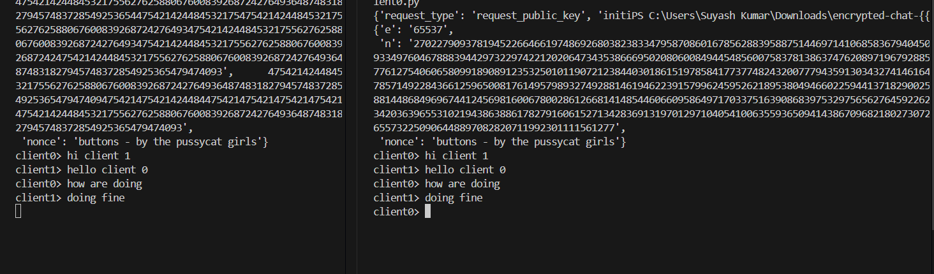
Established chat between Client 0 & Client 1

Slide 10
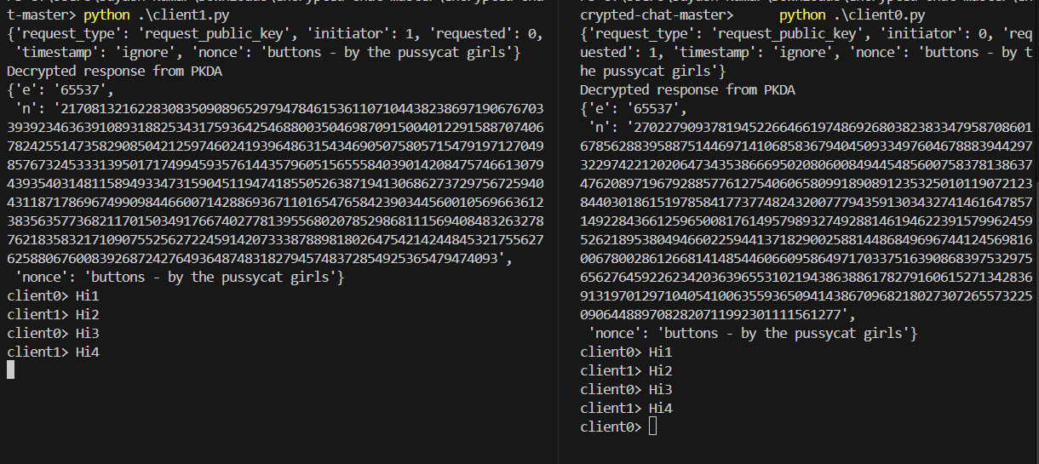
Test Case 1

