Slide 1
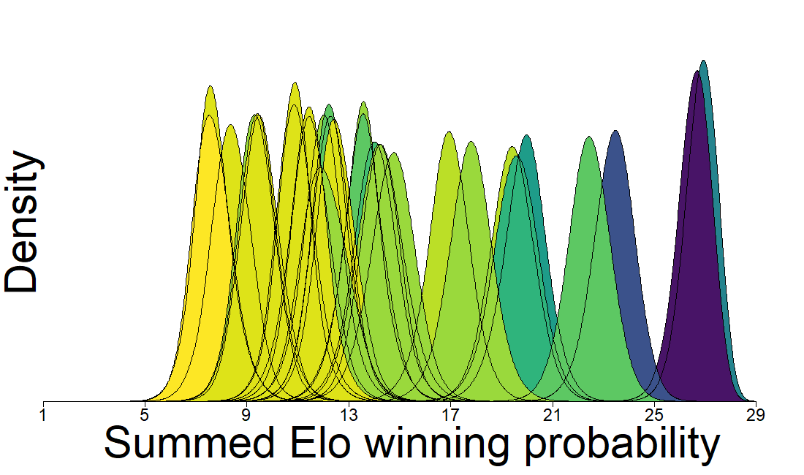
Average gait score
3.9
3.5
2.5
1.9
Density
Summed Elo winning probability

