Slide 1
Faster Matrix Completion Using Randomized SVD
Jingyi Feng, Hangtian Zhu

Slide 2

INTRODUCTION
Matrix completion, or estimating missing values in a matrix, occurs in many areas of engineering and applied science
The matrix which we wish to complete often has low rank or approximately low rank.
Thus, many existing methods formulate the matrix completion as a rank minimization problem:

Slide 3
INTRODUCTION
The problem is NP-hard in general.
Widely used nuclear norm (i.e., the sum of singular values) as a convex relaxation of the rank operator.
This results in a relaxed convex optimization, which can be solved with the singular value thresholding (SVT) algorithm
Truncated singular value decomposition (SVD) or inexact augmented Lagrange multiplier (IALM) algorithm are used to solve SVT
In experiments, IALM are several times faster than the SVT algorithm

Slide 4
INTRODUCTION
Recently, randomized matrix computation has gained significant increase in popularity, which involves the same or fewer floating-point operations (flops), and is more efficient for truly large data sets.
A lot of randomized algorithms are proposed but are not sufficient for accelerating the matrix completion.
In this paper, researchers investigate the acceleration of matrix completion for large data using the randomized SVD techniques.

Slide 5
OUTLINE
First, combining some existing acceleration skills for the basic randomized SVD (rSVD) algorithm and derive a fast randomized SVD algorithm (called rSVD-PI) and prove its correctness.
Then, utilizing these techniques and the block Krylov-subspace iteration (BKI) scheme and propose a rSVD-BKI algorithm for highly accurate SVD of sparse matrix.
Finally, choose the SVT algorithm and accelerate the matrix completion with the rSVD-BKI algorithm and a novel subspace recycling technique, proposed the fast SVT algorithm with same accuracy and reliability as the original SVT algorithm

Slide 6


PRELIMINARIES
Singular value decomposition (SVD):
Truncated SVD:
Projection Based Randomized Algorithms:
Using random projection to identify the subspace capturing the dominant actions of matrix A.

Slide 7
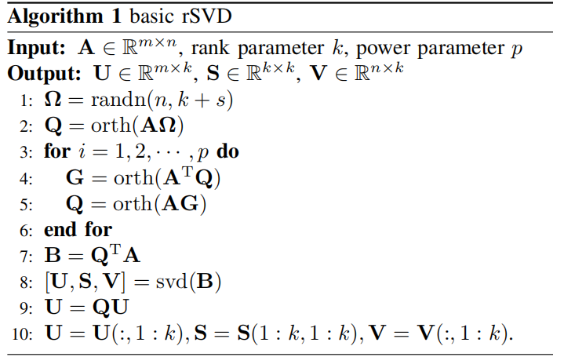
basic rSVD

Slide 8
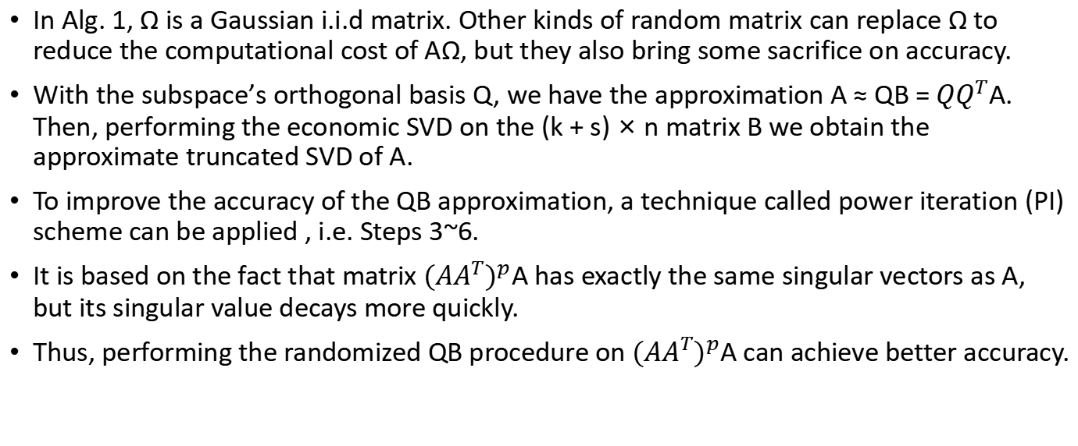
Explanation
In Alg. 1, Ω is a Gaussian i.i.d matrix. Other kinds of random matrix can replace Ω to reduce the computational cost of AΩ, but they also bring some sacrifice on accuracy.
With the subspace’s orthogonal basis Q, we have the approximation A ≈ QB = ${QQ}^{T}$A. Then, performing the economic SVD on the (k + s) × n matrix B we obtain the approximate truncated SVD of A.
To improve the accuracy of the QB approximation, a technique called power iteration (PI) scheme can be applied , i.e. Steps 3~6.
It is based on the fact that matrix ${({AA}^{T})}^{p}$A has exactly the same singular vectors as A, but its singular value decays more quickly.
Thus, performing the randomized QB procedure on ${({AA}^{T})}^{p}$A can achieve better accuracy.

Slide 9

Matrix Completion Algorithms
The matrix completion problem (1) is often relaxed to the problem minimizing the nuclear norm of matrix:
where P(·) is an orthogonal projector onto the span of
matrices vanishing outside of set Φ.

Slide 10
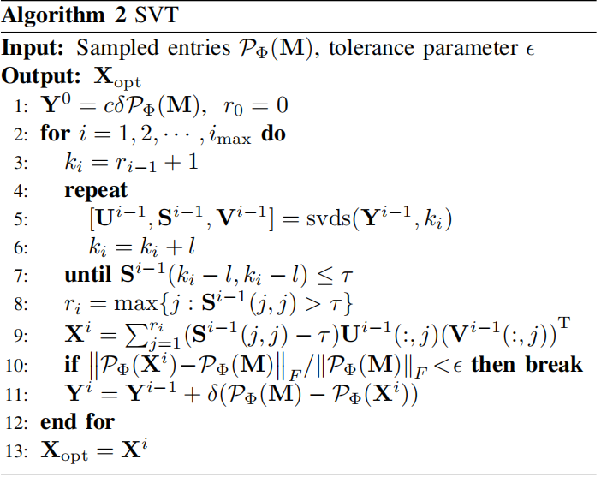
SVT

Slide 11
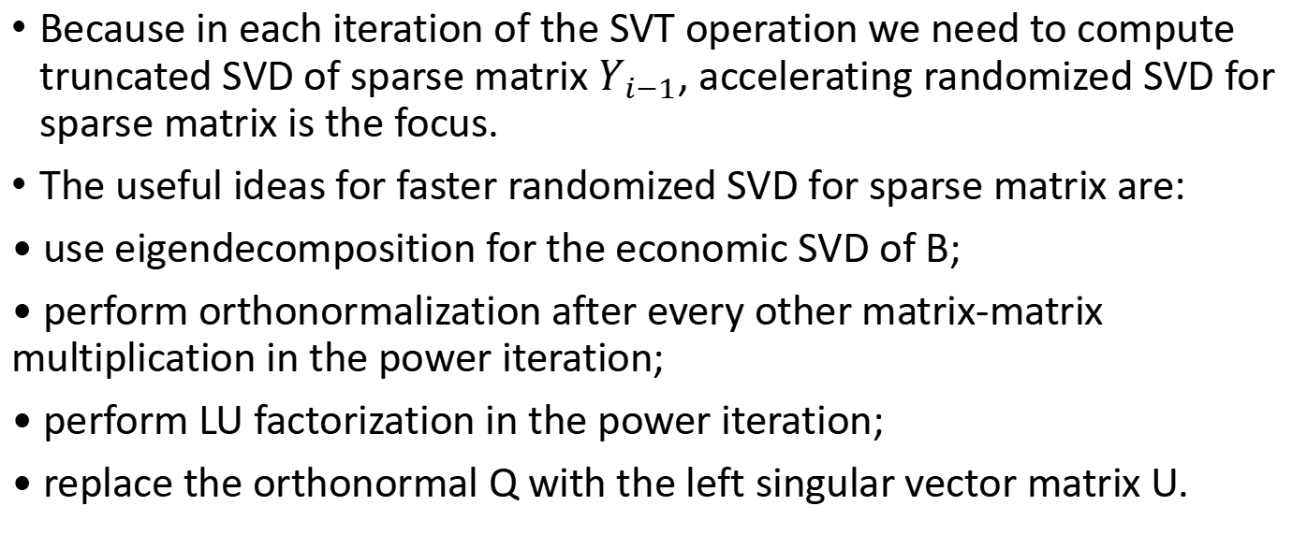
FASTER RANDOMIZED SVD FOR SPARSE MATRIX
Because in each iteration of the SVT operation we need to compute truncated SVD of sparse matrix $Y_{i−1}$, accelerating randomized SVD for sparse matrix is the focus.
The useful ideas for faster randomized SVD for sparse matrix are:
• use eigendecomposition for the economic SVD of B;
• perform orthonormalization after every other matrix-matrix multiplication in the power iteration;
• perform LU factorization in the power iteration;
• replace the orthonormal Q with the left singular vector matrix U.

Slide 12
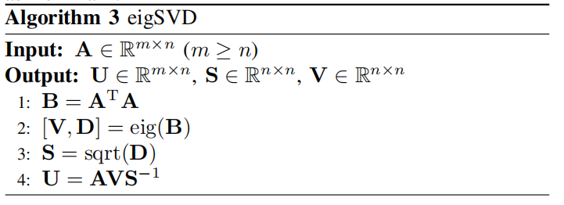
eigSVD

Slide 13

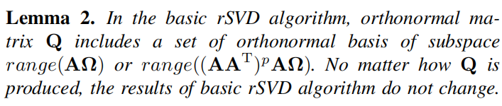
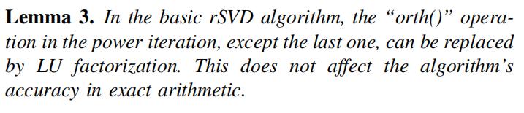
Lemma

Slide 14
Fast rSVD-PI Algorithm and rSVD-BKI Algorithm
Based on the above discussion, we find out that the eigSVD procedure can be applied to the basic rSVD to produce both the economic SVD of B and the orthonormal Q.

Slide 15
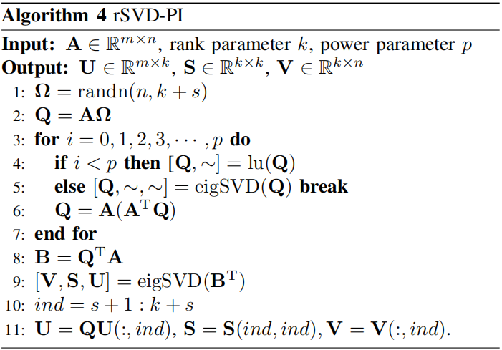
rSVD-PI

Slide 16
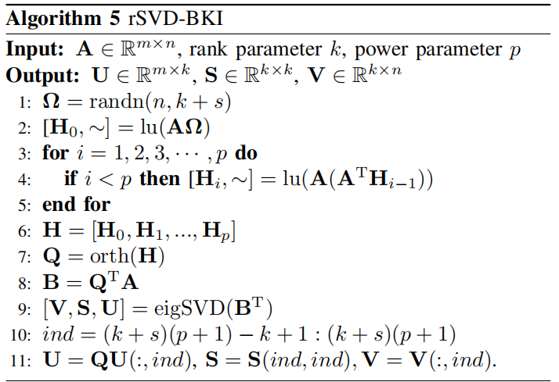
rSVD-BKI

Slide 17
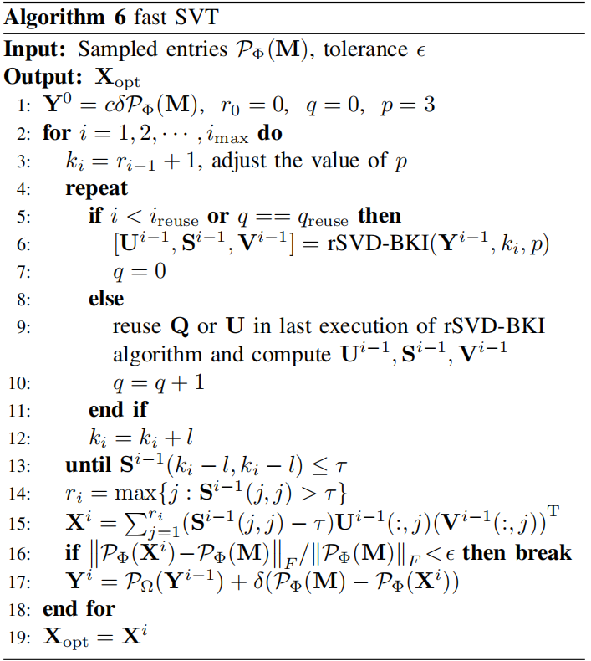
fast SVT

