Slide 1

AI-Augmented DME Fraud Detection
Human-in-the-Loop Pattern Modeling for Medicare Program Integrity

Slide 2
The Problem: $60B+ Lost Annually
Traditional detection stops at the generic threshold. Modern organized fraud is fragmented across coordinated networks.

Slide 3
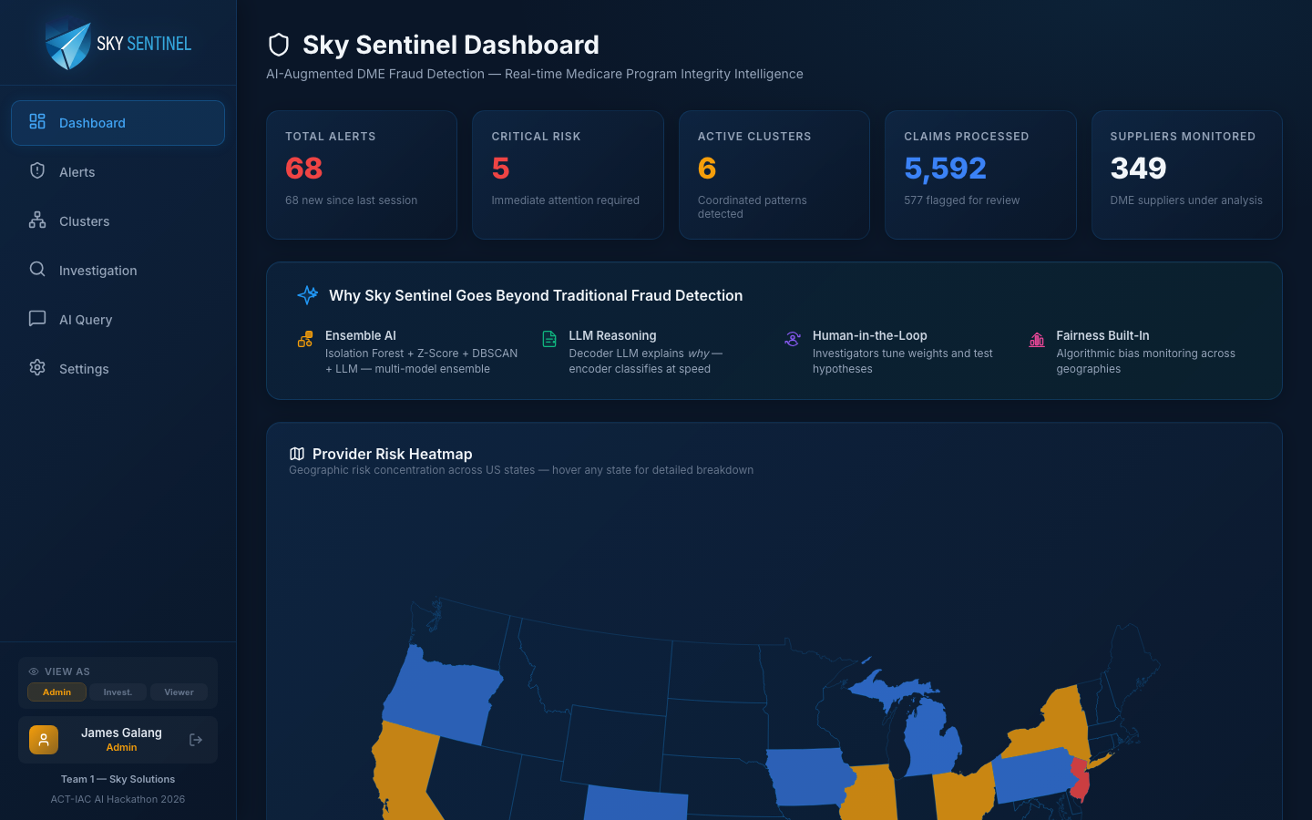
Command Center: Global Risk Intelligence

Slide 4
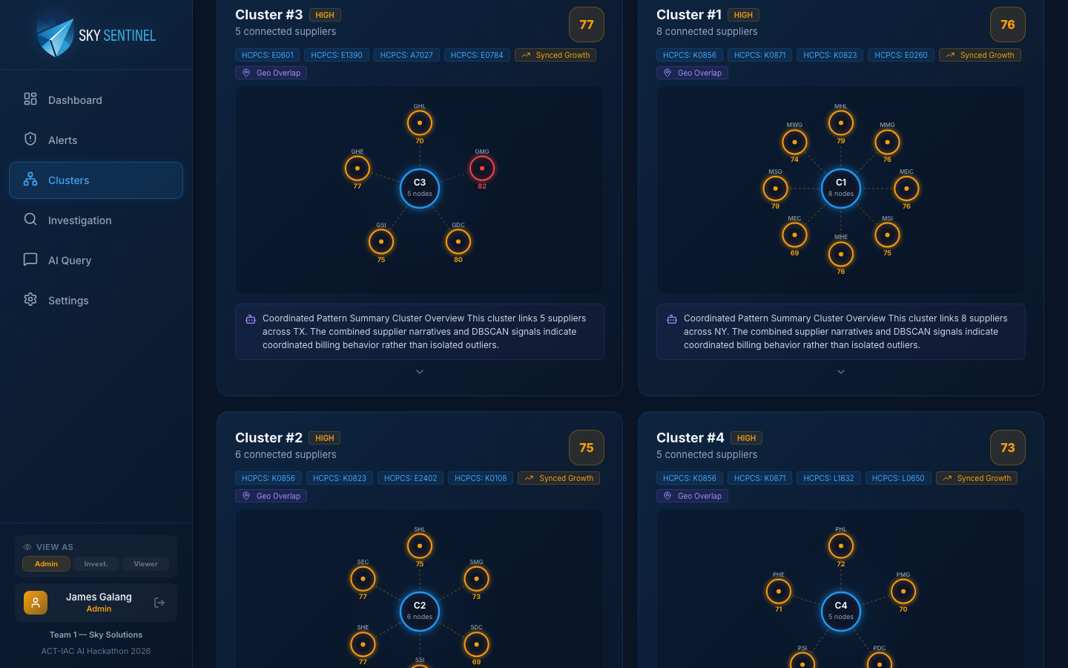
Behavioral Clustering: Catching the Network

Slide 5
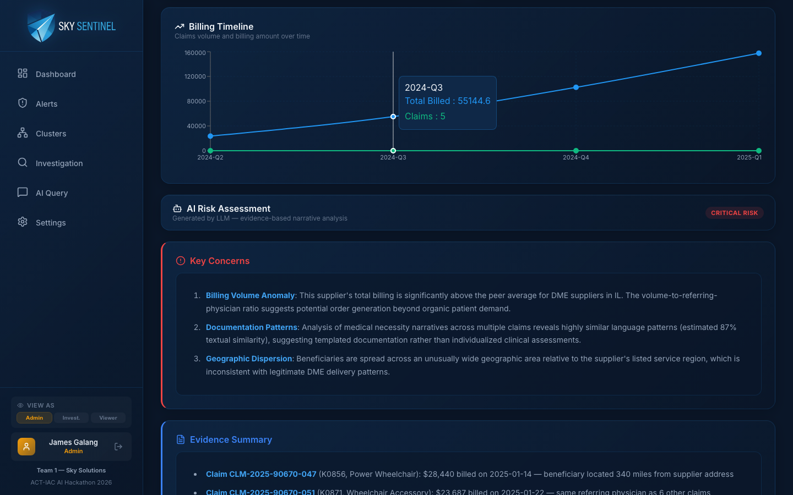
Explainable AI: Contextual Justifications

Slide 6
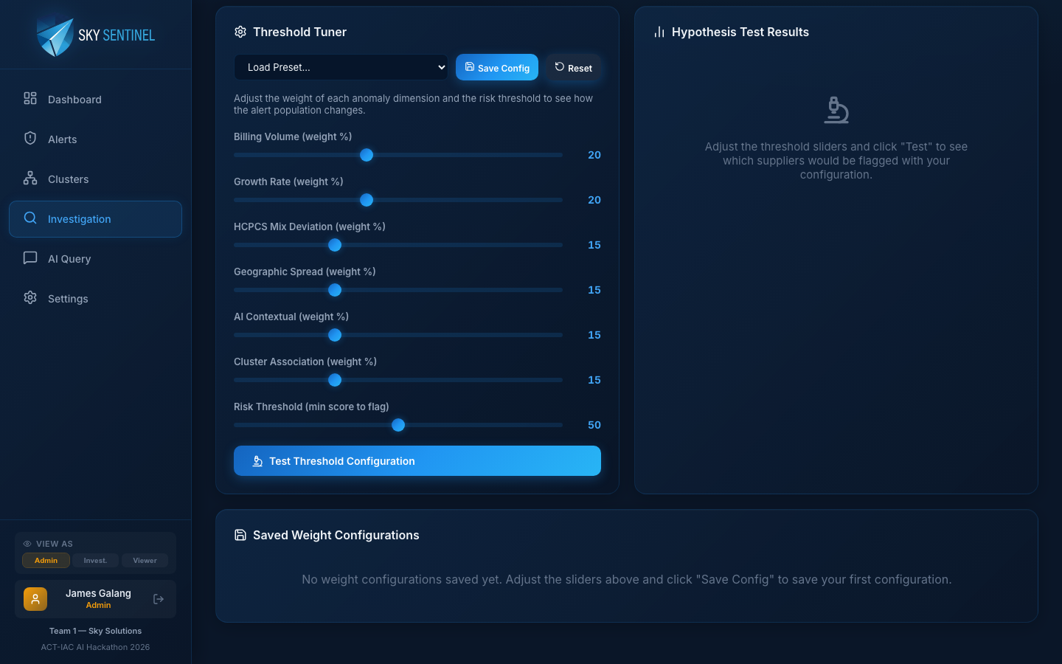
Human-in-the-Loop: You Shape the Model

Slide 7
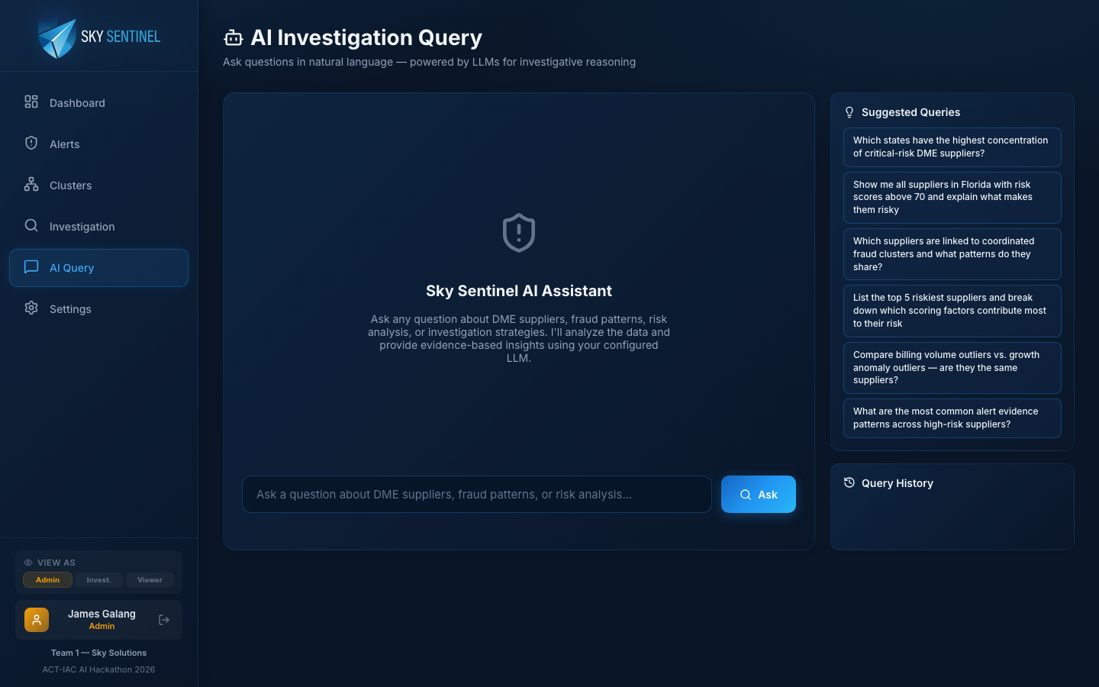
Natural Language Investigation

Slide 8
Ready to go beyond traditional fraud detection?
Stop by for a live investigation demo!

