Slide 1


Slide 2

ALSO KNOWN AS DEPENDENT T TEST. IT IS A STATISTICAL TECHNIQUE THAT IS USED TO COMPARES THE MEANS OF TWO MEASUREMENTS TAKEN FROM THE SAME INDIVIDUAL, OBJECT, OR RELATED UNITS.

Slide 3
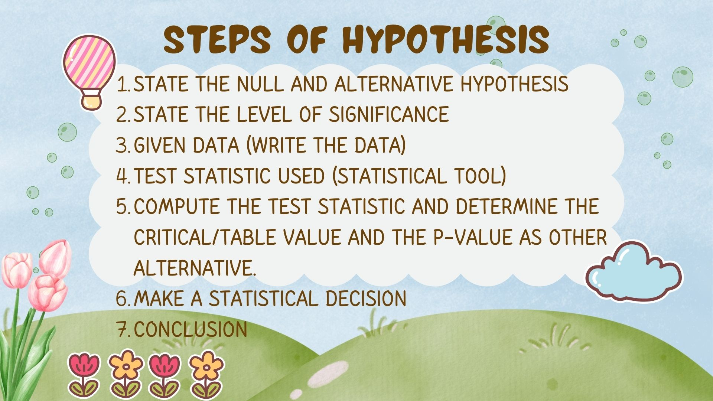

Slide 4


Slide 5
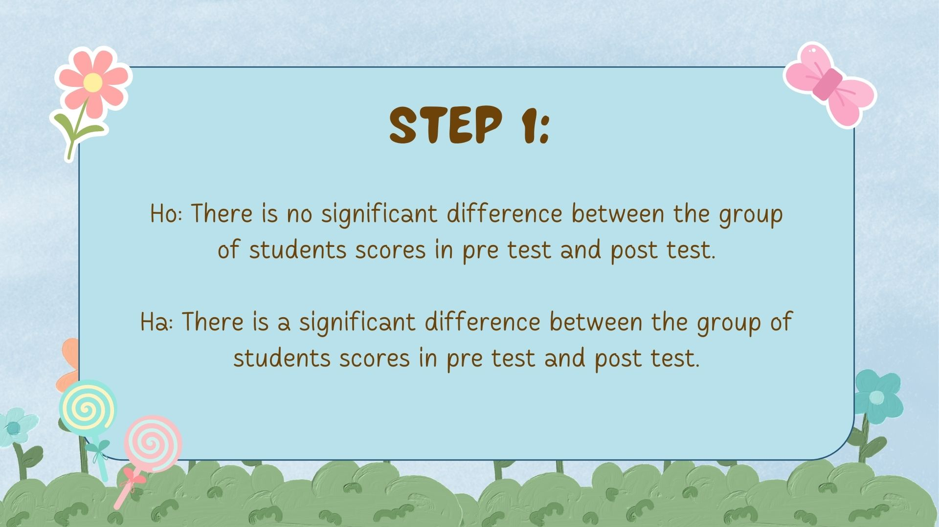

Slide 6

STEP 2
a = 0.05
LEVEL OF SIGNIFICANCE

Slide 7

STEP 3
PRE-TEST | POST TEST
23 | 35
25 | 40
32 | 30
38 | 28
26 | 41
40 | 22
35 | 33
40 | 36

Slide 8

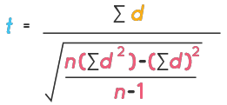
STEP 4
PAIRED T TEST FORMULA:
Degrees of freedom:
df = n - 1
d : difference per paired value
n : number of samples
n : total number of pairs

Slide 9

STEP 5
PRE-TEST | POST TEST
23 | 35
25 | 40
32 | 30
38 | 28
26 | 41
40 | 22
25 | 33
40 | 36
D
D²
-12
144
-15
225
2
10
-15
18
-8
4
4
100
225
324
64
16
∑ = -16
∑ = 1,102

Slide 10
CONTINUATION OF STEP 5
D: ∑ = -16
D² : ∑ = 1,102
df= 8-1 = 7
Tvalue = -0.458
Tcritical = 2.365

Slide 11
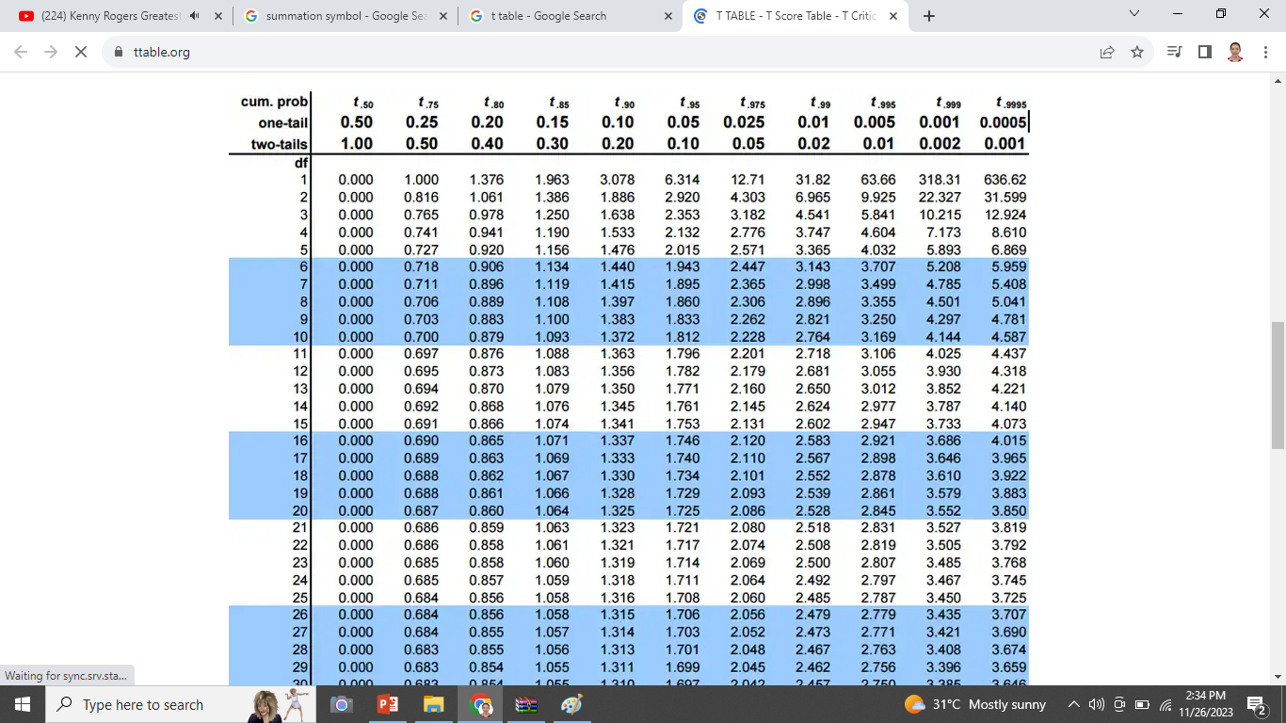

Slide 12

STEP 6
SINCE Tcomputed (-0.458) IS LESS THAN Tcritical (2.365) SO ACCEPT THE NULL HYPOTHESIS

Slide 13
STEP 7
AT a=0.05 THERE IS NO SIGNIFICANCE difference BETWEEN THE GROUP OF STUDENTS SCORES IN PRE TEST AND POST TEST. Therefore we know that there is a problem for the teaching methods or the group of students did not listen to the discussion of the teacher.

Slide 14

INDEPENDENT T TEST
Is used to compare two sample means from unrelated groups. This means that there are different people providing scores for each group. The purpose of this test is to determine if the samples are different from each other.

Slide 15

STEPS OF HYPOTHESIS
STATE THE NULL AND ALTERNATIVE HYPOTHESIS
STATE THE LEVEL OF SIGNIFICANCE
WRITE THE DATA
TEST STATISTIC TOOLS (STATISTICAL TOOLS)
COMPUTE THE TEST STATISTIC AND DETERMINE THE CRITICAL/TABLE VALUE AND THE P-VALUE
MAKE A STATISTICAL DECISION
CONCLUSION

Slide 16

THE PROBLEM
MRS. SANTOS DETERMINE THE SCORES BETWEEN THE MALE AND FEMALE STUDENT DURING THERE FINAL EXAM
MALE (x₁) | FEMALE (x₂)
14 | 12
18 | 9
17 | 11
16 | 5
4 | 10
14 | 3
12 | 7
10 | 2
9 | 6
17 | 13

Slide 17

STEP 1
Ho : THERE IS NO SIGNIFICANT DIFFERENCE BETWEEN THE SCORES OF MALE AND FEMALE STUDENTS IN THEIR FINAL EXAM. x̄₁ = x̄₂
Ha : THERE IS A SIGNIFICANT DIFFERENECE BETWEEN THE SCORES OF MALE AND FEMALE STUDENTS IN THEIR FINAL EXAM. x̄₁ ≠ x̄₂

Slide 18
STEP 2
a = 0.05
LEVEL OF SIGNIFICANCE

Slide 19

STEP 3
MALE (x₁) | FEMALE (x₂)
14 | 12
18 | 9
17 | 11
16 | 5
4 | 10
14 | 3
12 | 7
10 | 2
9 | 6
17 | 13

Slide 20
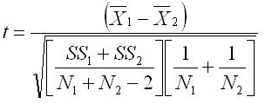
STEP 4
INDEPENDENT T TEST FORMULA :
df = N₁ + N₂ - 2
x̄₁
= mean of male
x̄₂
= mean of female
SS₁ = sum of squares of male
SS₂ = sum of squares of female
n₁= sample size for male
n₂= sample size for female

Slide 21

STEP 5
MALE (x₁)
14
18
17
16
4
14
12
10
9
17
FEMALE (x₂)
12
9
11
5
10
3
7
2
6
13
(X₁²)
(X₂²)
196
144
324
81
289
256
16
196
144
100
81
289
121
25
100
9
49
4
36
169
∑ x₁ = 131
n₁ = 10
x̄₁ = 13.1
∑ X₁² = 1891
∑ x₂ = 78
n₂ = 10
x̄₂ = 7.8
∑ X₂² = 738

Slide 22
CONTINUATION OF STEP 5
∑ X₁² = 1891
SS₁ = ∑ X₁² – (∑ X₁ )² / n₁
SS₁ = 1891 - (131)² / 10
SS₁ = 1891 – 1716.1
SS₁ = 174.9
SS₂ = ∑ X₂² – (∑ X₂ )² / n₂
∑ x₁ = 131
n₁ = 10
SS₂ = 738 – (78)² / 10
SS₂ = 738 – 608.4
SS₂ = 129.6
∑ X₂² = 738
∑ x₂ = 78
n₂ = 10

Slide 23
CONTINUATION OF STEP 5
Tcomputed = 2.88
x̄₁ = 13.1
df = N₁ + N₂ - 2
df = 10 + 10 – 2 = 18
x̄₂ = 7.8
SS₁ = 174.9
SS₂ = 129.6

Slide 24
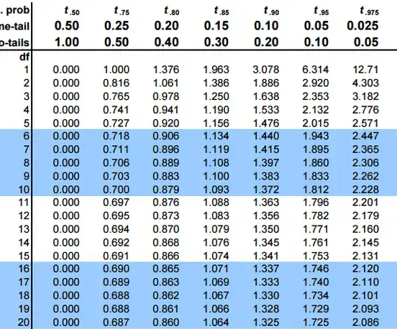

Slide 25
CONTINUATION OF STEP 5
x̄₁ = 13.1
df = N₁ + N₂ - 2
df = 10 + 10 – 2 = 18
x̄₂ = 7.8
SS₁ = 174.9
SS₂ = 129.6
Tcomputed = 2.88
Tcritical = 2.101

Slide 26
STEP 6
SINCE Tcomputed (2.88) IS greater THAN Tcritical (2.101) SO reject THE NULL HYPOTHESIS

Slide 27
STEP 7
AT a= 0.05 THERE IS SIGNIFICANCE difference BETWEEN THE SCORES OF MALE AND FEMALE STUDENTS IN THEIR FINAL EXAM. Therefore the male is more prepared than female during the final exam.

Slide 28


