Slide 1
Data Mining Classification: Alternative Techniques
Lecture Notes for Chapter 4
Instance-Based Learning
Introduction to Data Mining , 2nd Edition
by
Tan, Steinbach, Karpatne, Kumar

Slide 2

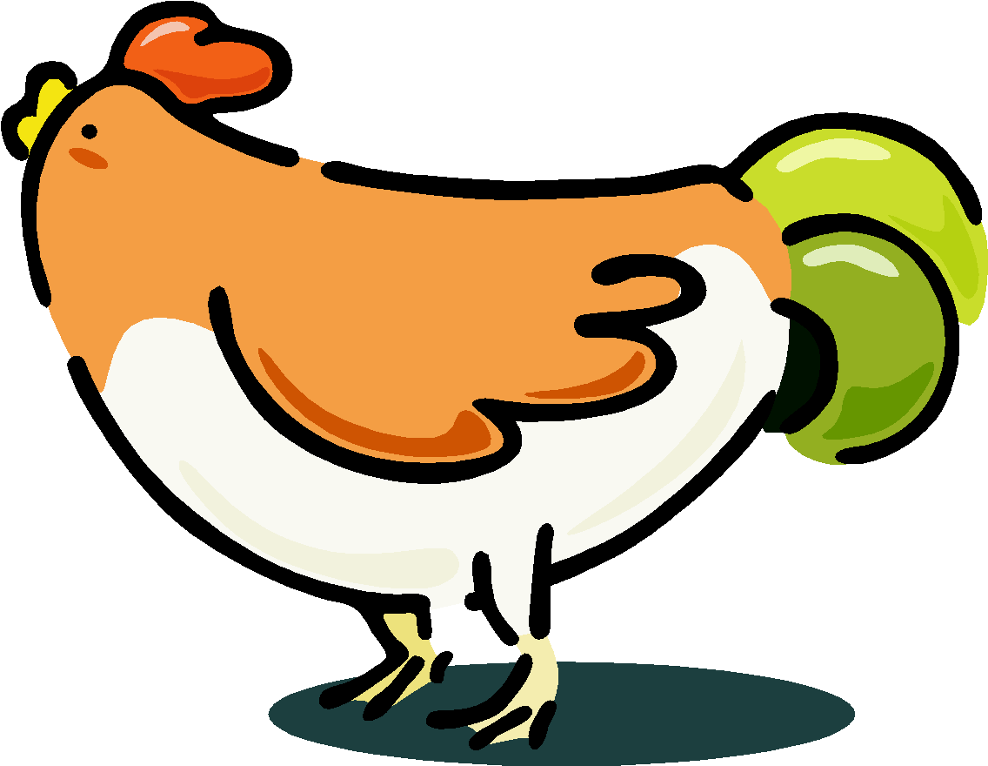


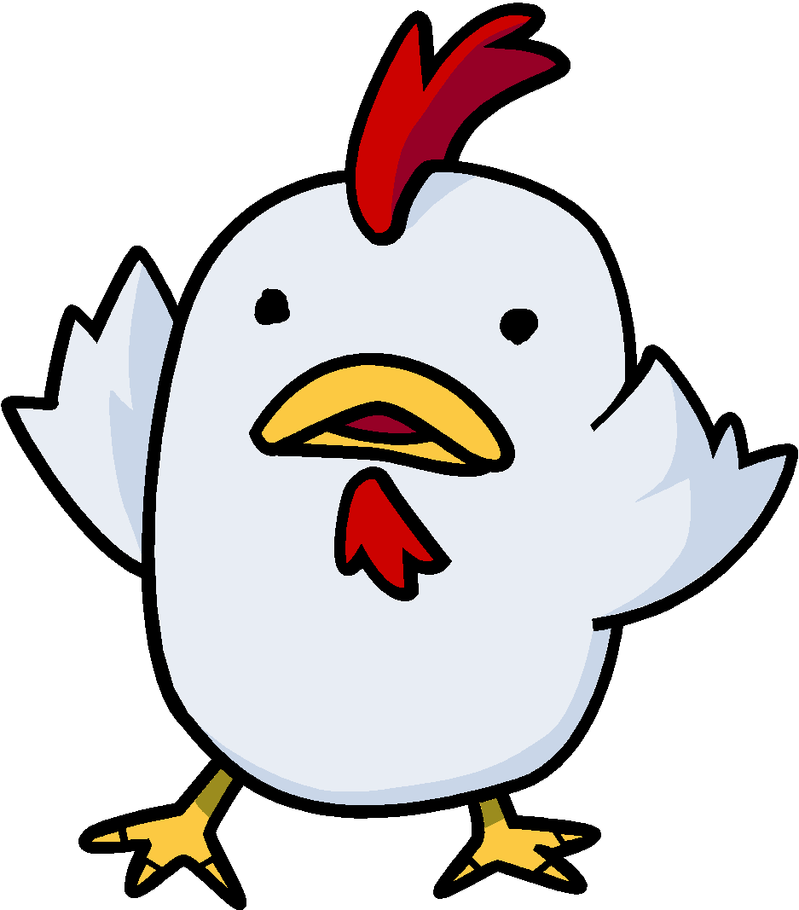

Nearest Neighbor Classifiers
Basic idea:
If it walks like a duck, quacks like a duck, then it’s probably a duck
Compute Distance
Test Record
Training Records
Choose k of the “nearest” records

Slide 3
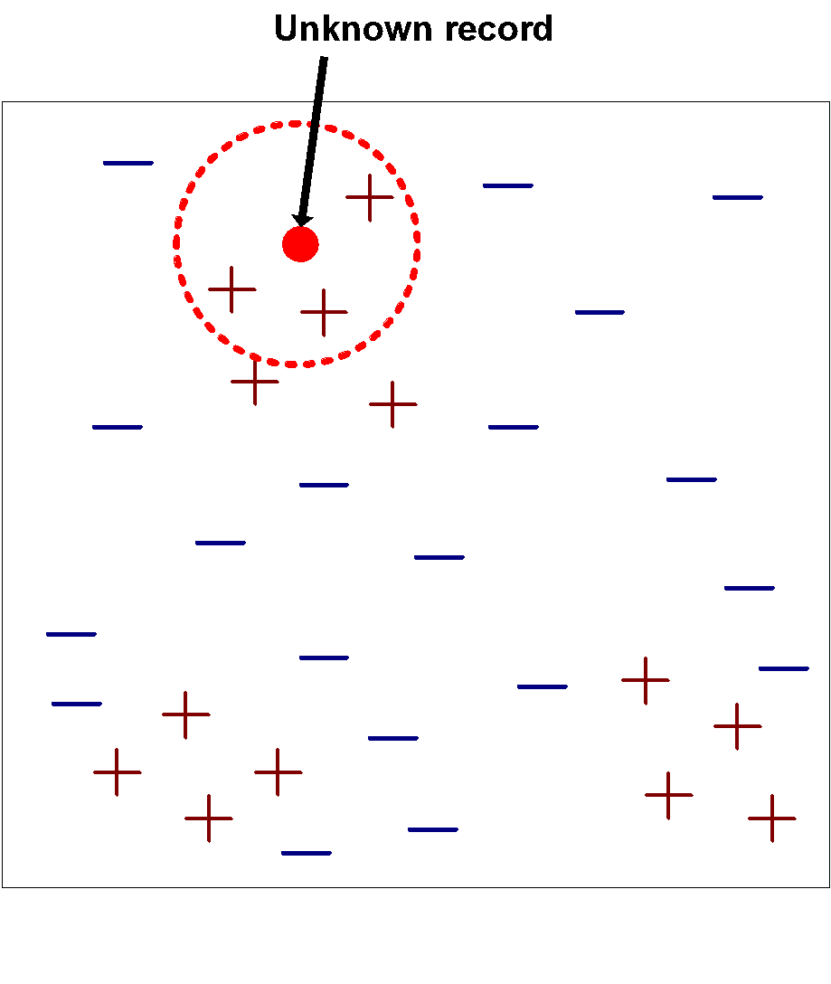
Nearest-Neighbor Classifiers
Requires the following:
A set of labeled records
Proximity metric to compute distance/similarity between a pair of records
e.g., Euclidean distance
The value of k, the number of nearest neighbors to retrieve
A method for using class labels of K nearest neighbors to determine the class label of unknown record (e.g., by taking majority vote)

Slide 4
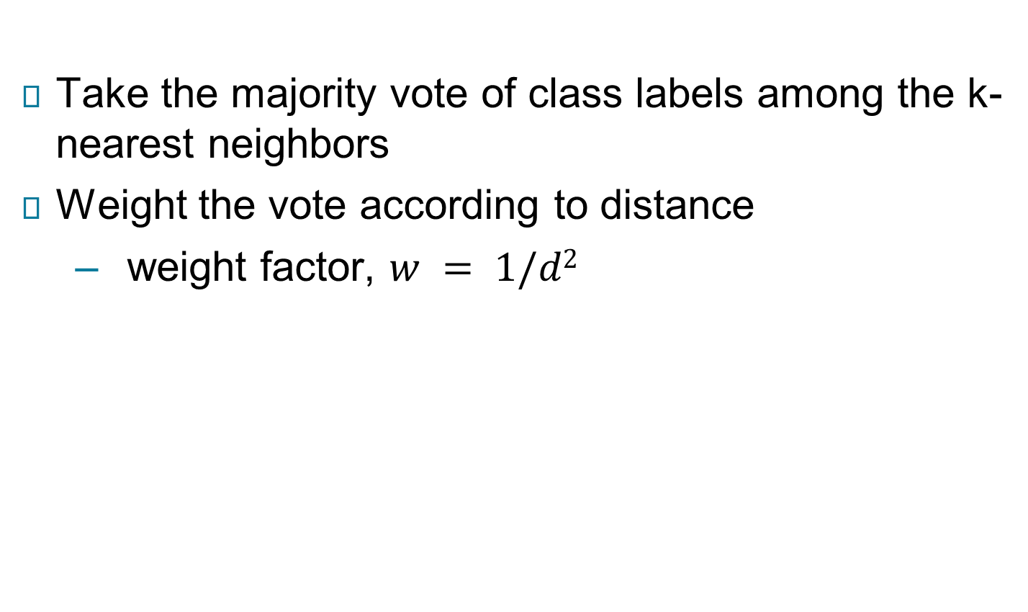
How to Determine the class label of a Test Sample?

Slide 5
Choice of proximity measure matters
For documents, cosine is better than correlation or Euclidean
1 1 1 1 1 1 1 1 1 1 1 0
0 0 0 0 0 0 0 0 0 0 0 1
vs
0 1 1 1 1 1 1 1 1 1 1 1
1 0 0 0 0 0 0 0 0 0 0 0
Euclidean distance = 1.4142 for both pairs, but the cosine similarity measure has different values for these pairs.

Slide 6
Nearest Neighbor Classification…
Data preprocessing is often required
Attributes may have to be scaled to prevent distance measures from being dominated by one of the attributes
Example:
height of a person may vary from 1.5m to 1.8m
weight of a person may vary from 90lb to 300lb
income of a person may vary from $10K to $1M
Time series are often standardized to have 0 means a standard deviation of 1

Slide 7
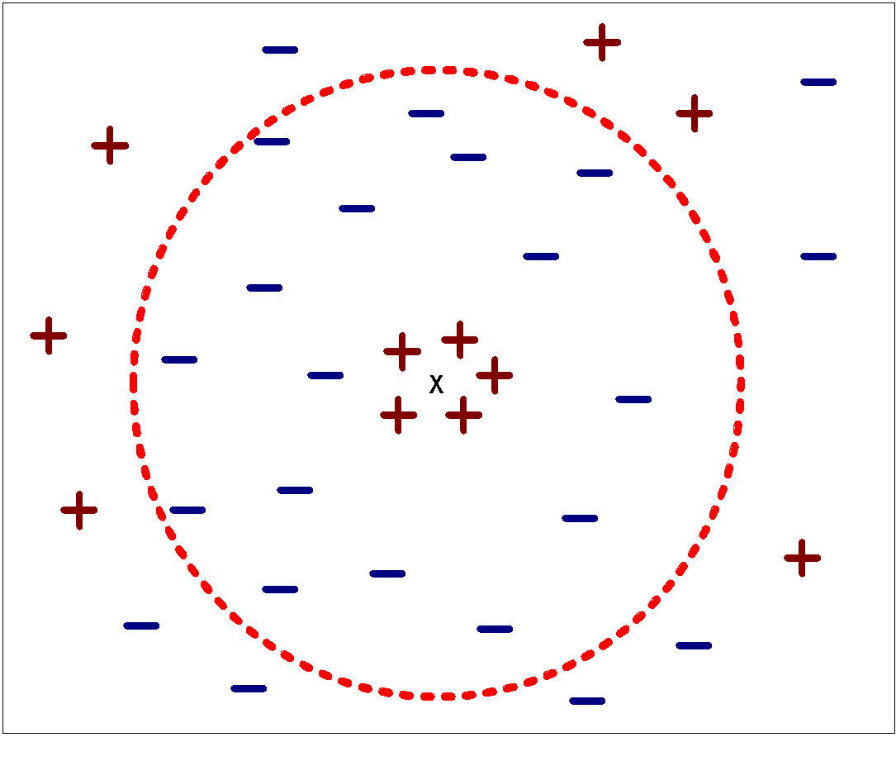
Nearest Neighbor Classification…
Choosing the value of k:
If k is too small, sensitive to noise points
If k is too large, neighborhood may include points from other classes

Slide 8
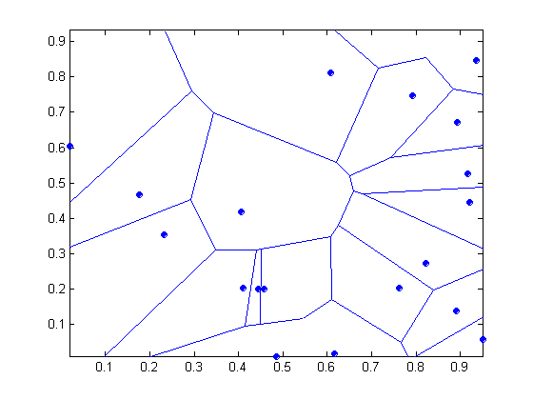
Nearest-neighbor classifiers
Nearest neighbor classifiers are local classifiers
They can produce decision boundaries of arbitrary shapes.
1-nn decision boundary is a Voronoi Diagram

Slide 9
Nearest Neighbor Classification…
How to handle missing values in training and test sets?
Proximity computations normally require the presence of all attributes
Some approaches use the subset of attributes present in two instances
This may not produce good results since it effectively uses different proximity measures for each pair of instances
Thus, proximities are not comparable

Slide 10
K-NN Classifiers…
Irrelevant attributes add noise to the proximity measure
Redundant attributes bias the proximity measure towards certain attributes
Handling attributes that are interacting

Slide 11
Improving KNN Efficiency
Avoid having to compute distance to all objects in the training set
Multi-dimensional access methods (k-d trees)
Fast approximate similarity search
Locality Sensitive Hashing (LSH)
Condensing
Determine a smaller set of objects that give the same performance
Editing
Remove objects to improve efficiency

Slide 12
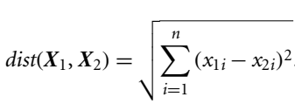
Instance-based Classification: k-Nearest-Neighbor
Nearest-neighbor classifiers compare a given test tuple with training tuples that are similar to it.
k-nearest-neighbor classifier searches the pattern space for the k training tuples that are closest to the unknown (or test) tuple.
These k training tuples are the k nearest neighbors of the unknown tuple.
Closeness is defined in terms of a distance metric, such as Euclidean distance. The Euclidean distance between two points or tuples:
X₁ =(x₁₁, x₁₂,…, x_{1n}) and X₂ =(x₂₁, x₂₂,…, x_{2n})

Slide 13
Instance-based Classification: k-Nearest-Neighbor
For k-nearest-neighbor classification, the unknown tuple is assigned the most common class among its k-nearest neighbors.
When k = 1, the unknown tuple is assigned the class of the training tuple that is closest to it in pattern space.
Nearest-neighbor classifiers can also be used for numeric prediction, that is, to return a real-valued prediction for a given unknown tuple.
In this case, the classifier returns the average value of the real-valued labels associated with the k-nearest neighbors of the unknown tuple.

Slide 14
Instance-based Classification: k-Nearest-Neighbor
Applicant | Cibil Score | Income | Loan Approved | Euclidean Distance
A | 700 | 50000 | Y | 25000.02
B | 800 | 40000 | Y | 15000.133
C | 750 | 30000 | Y | 5000.249
D | 400 | 10000 | N | 15000.133
E | 850 | 8000 | Y | 17001.84
F | 600 | 20000 | N | 5000.00
G | 700 | 35000 | Y | 10000.50
H | 750 | 100000 | Y | 75000.00667
I | 500 | 150000 | N | 125000.004
J | 650 | 18000 | N | 7000.178
Applicant | Cibil Score | Income | Loan Approved
A | 700 | 50000 | Y
B | 800 | 40000 | Y
C | 750 | 30000 | Y
D | 400 | 10000 | N
E | 850 | 8000 | Y
F | 600 | 20000 | N
G | 700 | 35000 | Y
H | 750 | 100000 | Y
I | 500 | 150000 | N
J | 650 | 18000 | N
k=3
X | 600 | 25000
X | 600 | 25000 | ?
$$x=\sqrt[2]{\left(700−600\right)2+\left(50000−25000\right)2}=25000.02$$

Slide 15
Instance-based Classification: k-Nearest-Neighbor
Applicant | Cibil Score | Income | Loan Approved
A | 700 | 50000 | Y
B | 800 | 40000 | Y
C | 750 | 30000 | Y
D | 400 | 10000 | N
E | 850 | 8000 | Y
F | 600 | 20000 | N
G | 700 | 35000 | Y
H | 750 | 100000 | Y
I | 500 | 150000 | N
J | 650 | 18000 | N
Applicant | Cibil Score | Income | Loan Approved | Euclidean Distance
A | 700 | 50000 | Y | 25000.02
B | 800 | 40000 | Y | 15000.133
C | 750 | 30000 | Y | 5000.249
D | 400 | 10000 | N | 15000.133
E | 850 | 8000 | Y | 17001.84
F | 600 | 20000 | N | 5000.00
G | 700 | 35000 | Y | 10000.50
H | 750 | 100000 | Y | 75000.00667
I | 500 | 150000 | N | 125000.004
J | 650 | 18000 | N | 7000.178
k=3
X | 600 | 25000 | N
X | 600 | 25000 | N

