Slide 1
Clustering Techniques

Slide 2
What is Cluster Analysis?
Given a set of objects, place them in groups such that the objects in a group are similar (or related) to one another and different from (or unrelated to) the objects in other groups
Inter-cluster distances are maximized
Intra-cluster distances are minimized

Slide 3
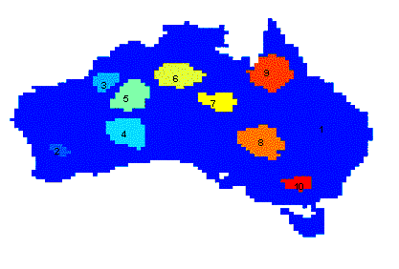
Applications of Cluster Analysis
Understanding
Group related documents for browsing, group genes and proteins that have similar functionality, or group stocks with similar price fluctuations
Summarization
Reduce the size of large data sets
Clustering precipitation in Australia

Slide 4
Examples of Clustering Applications
Marketing: Help marketers discover distinct groups in their customer bases, and then use this knowledge to develop targeted marketing programs
Land use: Identification of areas of similar land use in an earth observation database
Insurance: Identifying groups of motor insurance policy holders with a high average claim cost
City-planning: Identifying groups of houses according to their house type, value, and geographical location
Earth-quake studies: Observed earth quake epicenters should be clustered along continent faults

Slide 5
Requirements of Clustering in Data Mining
Scalability
Ability to deal with different types of attributes
Discovery of clusters with arbitrary shape
Minimal requirements for domain knowledge to determine input parameters
Able to deal with noise and outliers
Insensitive to order of input records
High dimensionality
Incorporation of user-specified constraints
Interpretability and usability

Slide 6
Notion of a Cluster can be Ambiguous
How many clusters?
Six Clusters
Two Clusters
Four Clusters

Slide 7
Types of Clustering
A clustering is a set of clusters
Important distinction between hierarchical and partitional sets of clusters
Partitional Clustering
A division of data objects into non-overlapping subsets (clusters)
Hierarchical clustering
A set of nested clusters organized as a hierarchical tree

Slide 8
Partitional Clustering
Original Points
A Partitional Clustering

Slide 9
Hierarchical Clustering
Traditional Hierarchical Clustering
Traditional Dendrogram
Non-traditional Hierarchical Clustering
Non-traditional Dendrogram

Slide 10
Other Distinctions Between Sets of Clusters
Exclusive versus non-exclusive
In non-exclusive clusterings, points may belong to multiple clusters.
Can belong to multiple classes or could be ‘border’ points
Fuzzy clustering (one type of non-exclusive)
In fuzzy clustering, a point belongs to every cluster with some weight between 0 and 1
Weights must sum to 1
Probabilistic clustering has similar characteristics
Partial versus complete
In some cases, we only want to cluster some of the data

Slide 11
Types of Clusters
Well-separated clusters
Prototype-based clusters
Contiguity-based clusters
Density-based clusters
Described by an Objective Function

Slide 12
Types of Clusters: Well-Separated
Well-Separated Clusters:
A cluster is a set of points such that any point in a cluster is closer (or more similar) to every other point in the cluster than to any point not in the cluster.
3 well-separated clusters

Slide 13
Types of Clusters: Prototype-Based
Prototype-based
A cluster is a set of objects such that an object in a cluster is closer (more similar) to the prototype or “center” of a cluster, than to the center of any other cluster
The center of a cluster is often a centroid, the average of all the points in the cluster, or a medoid, the most “representative” point of a cluster
4 center-based clusters

Slide 14
Types of Clusters: Contiguity-Based
Contiguous Cluster (Nearest neighbor or Transitive)
A cluster is a set of points such that a point in a cluster is closer (or more similar) to one or more other points in the cluster than to any point not in the cluster.
8 contiguous clusters

Slide 15
Types of Clusters: Density-Based
Density-based
A cluster is a dense region of points, which is separated by low-density regions, from other regions of high density.
Used when the clusters are irregular or intertwined, and when noise and outliers are present.
6 density-based clusters

Slide 16
Types of Clusters: Objective Function
Clusters Defined by an Objective Function
Finds clusters that minimize or maximize an objective function.
Enumerate all possible ways of dividing the points into clusters and evaluate the `goodness' of each potential set of clusters by using the given objective function. (NP Hard)
Can have global or local objectives.
Hierarchical clustering algorithms typically have local objectives
Partitional algorithms typically have global objectives
A variation of the global objective function approach is to fit the data to a parameterized model.
Parameters for the model are determined from the data.
Mixture models assume that the data is a ‘mixture' of a number of statistical distributions.

Slide 17
Characteristics of the Input Data Are Important
Type of proximity or density measure
Central to clustering
Depends on data and application
Data characteristics that affect proximity and/or density are
Dimensionality
Sparseness
Attribute type
Special relationships in the data
For example, autocorrelation
Distribution of the data
Noise and Outliers
Often interfere with the operation of the clustering algorithm
Clusters of differing sizes, densities, and shapes

Slide 18
What Is Good Clustering?
A good clustering method will produce high quality clusters with
high intra-class similarity
low inter-class similarity
The quality of a clustering result depends on both the similarity measure used by the method and its implementation.

Slide 19
Clustering Algorithms
K-means and its variants
Hierarchical clustering
Density-based clustering

Slide 20

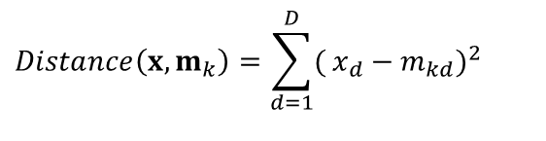
Partitioning Clustering Approach
Partitioning algorithms construct partition of a database of N objects into a set of K clusters.
The partitioning clustering algorithm usually adopts the Iterative Optimization paradigm.
It starts with an initial partition and uses an iterative control strategy.
It tries swapping data points to see if such a swapping improves the quality of clustering.
When swapping does not yield any improvements in clustering, it finds a locally optimal partitioning
in principle, optimal partition achieved via minimizing the sum of squared distance to its “representative object” in each cluster
$$E=Σ_{k=1}^{K}Σ_{x∈C_{k}}Distance(x,m_{k})$$
$$Distance\left(x,m_{k}\right)=\sum_{d=1}^{D}{(}x_{d}−m_{kd})^{2}$$
e.g., Euclidean distance

Slide 21
K-means algorithm
Given the cluster number K, the K-means algorithm is carried out in three steps after initialization:
Initialization: set seed points (randomly)
Assign each object to the cluster of the nearest seed point measured with a specific distance metric
Compute new seed points as the centroids of the clusters of the current partition (the centroid is the centre, i.e., mean point, of the cluster)
Go back to Step 1), stop when no more new assignment (i.e., membership in each cluster no longer changes)

Slide 22
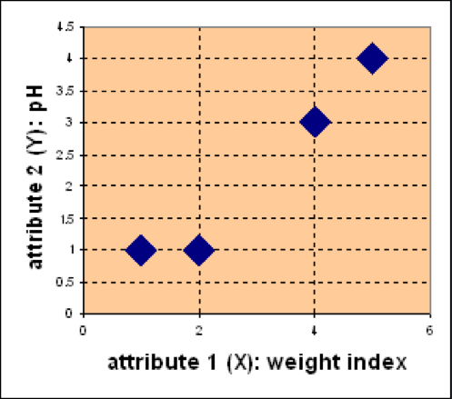
K-means - Example
1. Partitioning Methods: k-Means
Problem:
Suppose we have 4 types of medicines and each has two attributes (pH and weight index). Our goal is to group these objects into K=2 group of medicine.
Medicine | Weight | pH-Index
A | 1 | 1
B | 2 | 1
C | 4 | 3
D | 5 | 4
D
C
A
B

Slide 23
Phale 1st and 2nd row ko ek cluster bana lange
Phir unse saare rows ke point ka eculidian distance nikalege
Jasse A ka phale eculidian distance A,B,C,D se phir B ka A,B,C,D se phir jo ecludian distance kam aaya A se nikalne par B ke bajaye usko A me dal dange or jo ecludian distance kam aaya B se nikalne par A ke bajaye usko B me dal dange
Phir jis bhi cluster me 1 se zyada values h uska centroid nikal lange table ki values se .to hamare cluser ke naye centroid aa jyeage
Phir un centroid se dobara A,B,C,D ka ecludian distance nikalange or yahi process jab tak repeate karange jab tak cluser change hona band na ho jaye

Slide 24
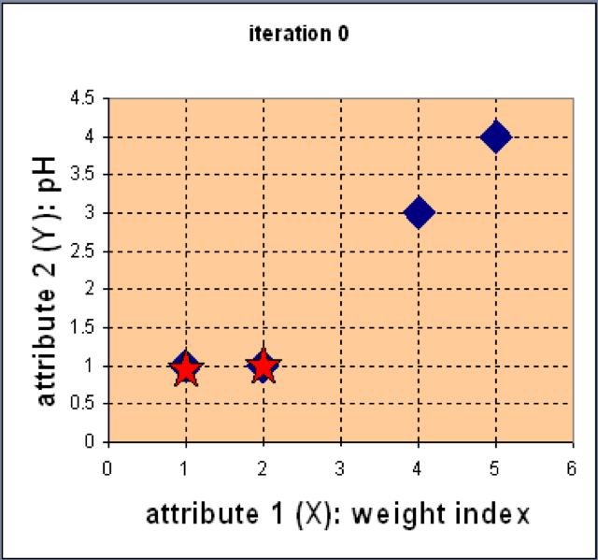
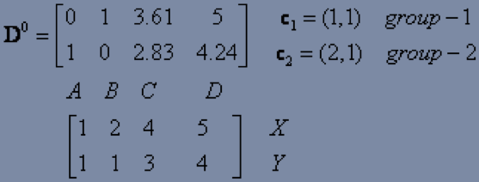
K-means - Example
1. Partitioning Methods: k-Means
Step 1: Use initial seed points for partitioning
Assign each object to the cluster
with the nearest seed point
After seen min distance in matrix
Clusters are
C1=A
C2=B,C,D

Slide 25
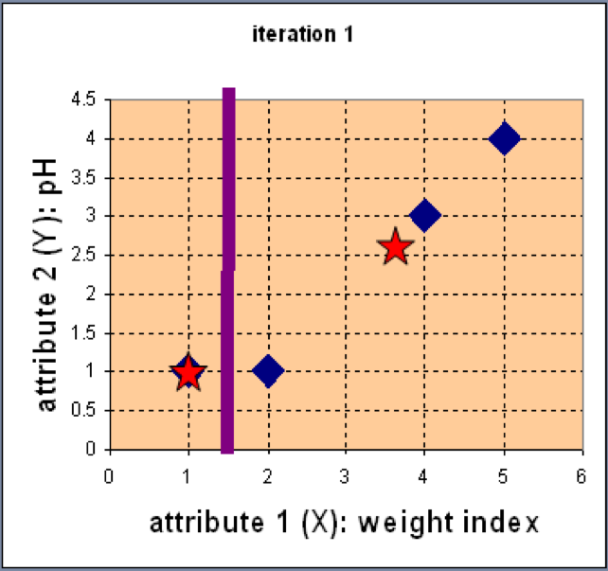
K-means - Example
1. Partitioning Methods: k-Means
Step 2: Compute new centroids of the current partition
Knowing the members of each cluster, now we compute the new centroid of each group based on these new memberships.

Slide 26
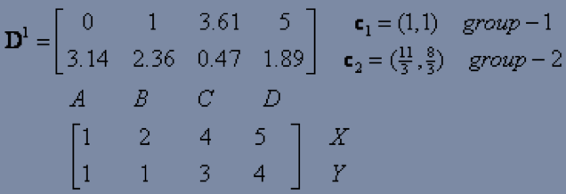
K-means - Example
1. Partitioning Methods: k-Means
Step 2: Renew membership based on new centroids
Compute the distance of all objects to the new centroids
Assign the membership to objects
After seen min distance in matrix
Clusters are
C1=A,B
C2=B,C

Slide 27
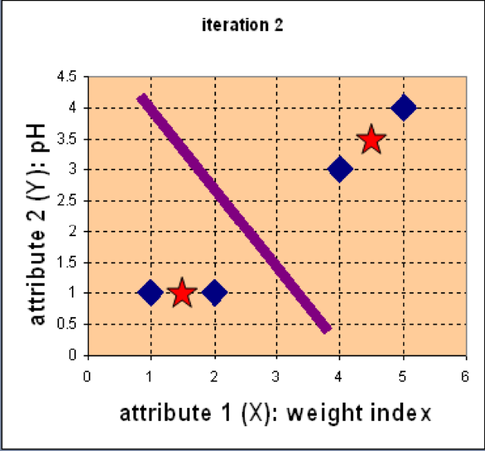
K-means - Example
1. Partitioning Methods: k-Means
Step 3: Repeat the first two steps until its convergence
Knowing the members of each cluster, now we compute the new centroid of each group based on these new memberships.

Slide 28
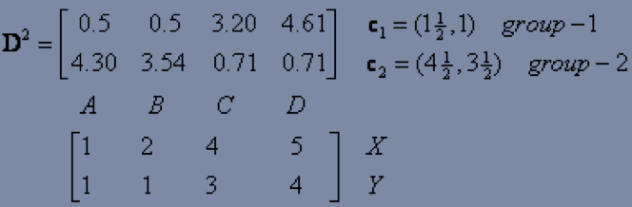
K-means - Example
1. Partitioning Methods: k-Means
Step 3: Repeat the first two steps until its convergence
Compute the distance of all objects to the new centroids
Stop due to no new assignment
Membership in each cluster no longer change
So,here we see clusters not change in this step so we stop here
So,C1=(3/2,1)
C2=(9/2,7/2)
After seen min distance in matrix
Clusters are
C1=A,B
C2=B,C

Slide 29
Strengths of k-means
Strengths:
Simple: easy to understand and to implement
Efficient: Time complexity: O(tkn), where n is the number of data points, k is the number of clusters, and t is the number of iterations.

Slide 30
Weaknesses of k-means
The algorithm is only applicable if the mean is defined.
The user needs to specify k.
The algorithm is sensitive to outliers
Outliers are data points that are very far away from other data points.
Outliers could be errors in the data recording or some special data points with very different values.

Slide 31
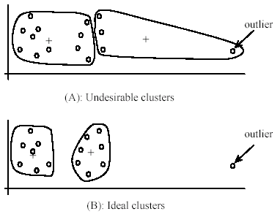
Weaknesses of k-means: Problems with outliers

Slide 32
Weaknesses of k-means: To deal with outliers
One method is to remove some data points in the clustering process that are much further away from the centroids than other data points.
To be safe, we may want to monitor these possible outliers over a few iterations and then decide to remove them.
Another method is to perform random sampling. Since in sampling we only choose a small subset of the data points, the chance of selecting an outlier is very small.
Assign the rest of the data points to the clusters by distance or similarity comparison, or classification

Slide 33
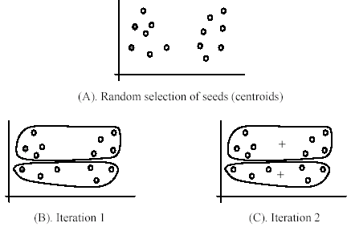
Weaknesses of k-means
The algorithm is sensitive to initial seeds.

Slide 34
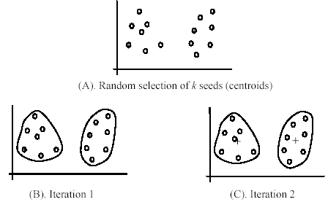
Weaknesses of k-means
If we use different seeds: good results
There are some methods to help choose good seeds

Slide 35
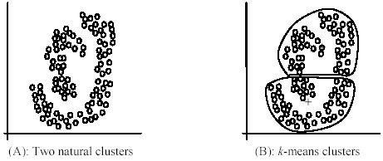
Weaknesses of k-means
The k-means algorithm is not suitable for discovering clusters that are not hyper-ellipsoids (or hyper-spheres).

Slide 36
The K-Medoids Clustering Method
Find representative objects, called medoids, in clusters
PAM (Partitioning Around Medoids)
The algorithm is intended to find a sequence of objects called medoids that are centrally located in clusters
The goal of the algorithm is to minimize the average dissimilarity of objects to their closest selected object.
PAM works effectively for small data sets, but does not scale well for large data sets
CLARA
CLARANS

Slide 37
PAM Partition Around Medoids
Pick a number, k, of random data items as medoids
Calculate
If TC_{mn} < 0, replace m by n and go back to 2
Assign every item to its nearest medoid
The pair (n,m) of medoid/non-medoid
with the smallest impact on clustering quality

Slide 38
Swapping Cost
For each pair of a medoid m and a non-medoid object h, measure whether h is better than m as a medoid
For example, we can use the squared-error criterion
Compute E_{h}-E_{m}
Negative: swapping brings benefit
Choose the minimum swapping cost

Slide 39
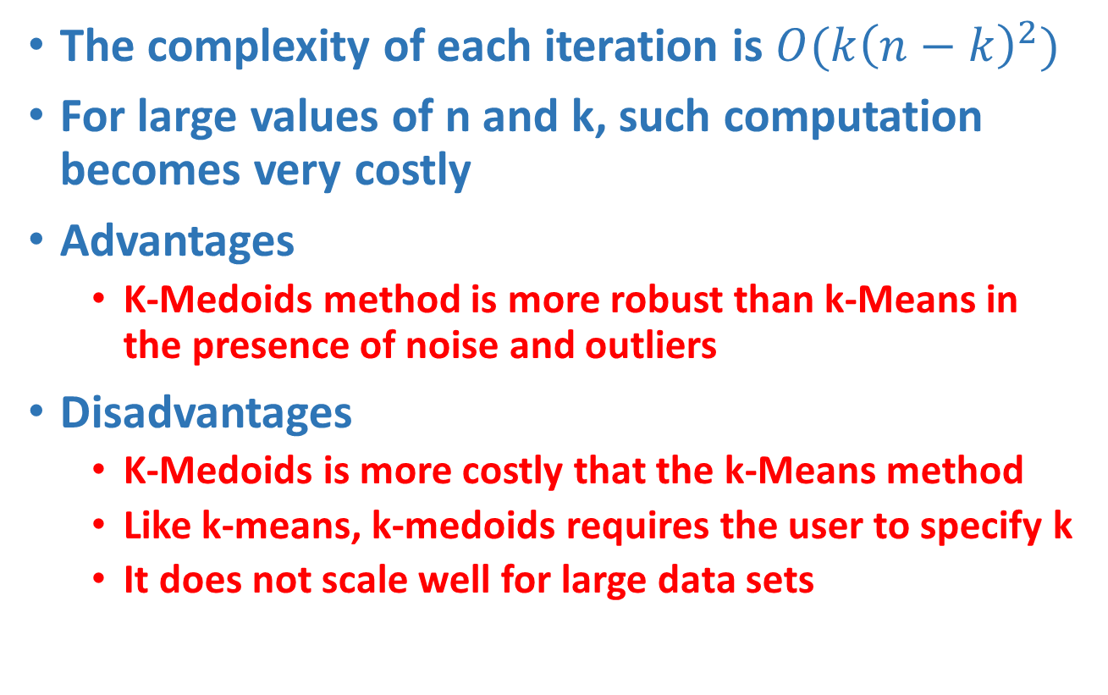
K-medoids Properties
The complexity of each iteration is $O(k{\left(n−k\right)}^{2})$
For large values of n and k, such computation becomes very costly
Advantages
K-Medoids method is more robust than k-Means in the presence of noise and outliers
Disadvantages
K-Medoids is more costly that the k-Means method
Like k-means, k-medoids requires the user to specify k
It does not scale well for large data sets

Slide 40
K-medoids Example
1. Partitioning Methods: k-Medoids
Distances | to X5 | to X9
X1 | 8 | 7
X2 | 5 | 6
X3 | 9 | 8
X4 | 7 | 6
X5 | 0 | 5
X6 | 2 | 3
X7 | 2 | 3
X8 | 3 | 2
X9 | 5 | 0
x10 | 5 | 2
Cost is | 9 | 25
Total cost is 34
X1 | 2 | 6
X2 | 3 | 4
X3 | 3 | 8
X4 | 5 | 7
X5 | 6 | 2
X6 | 6 | 4
X7 | 7 | 3
X8 | 7 | 4
X9 | 8 | 5
x10 | 7 | 6
Assume k=2
Select X5 and X9 as medoids
Here we use Manhattan distance:-|x₂-x₁|+|y₂-y₁|
Those distances are smaller while measure with medoids that make cluster with that medoids
Current clustering: {X2,X5,X6,X7},{X1,X3,X4,X8,X9,X10}

Slide 41
Find manhattan distance of x5 with x2,x6,x7 and x9 with x1,x3,x4,x8,x10
Total cost=5+2+2+7+8+5+2+2=33

Slide 42
K-medoids Example
1. Partitioning Methods: k-Medoids
So, now let us choose some other point to be a medoids from the cluster any of the cluster lets choose cluster 1 instead of X5 (6, 2). Let us randomly choose X1 (2, 6). At one time change only one medoids
Note the new medoid set is: X1(2, 6) and X9(8, 5). Now repeating the same task as earlier:
Replace X5 by X1 | Before( Smallest points) | to X1 | To X9 | Change
X1 | 7 | 0 | 7 | -7
X2 | 5 | 3 | 6 | -2
X3 | 8 | 3 | 8 | -5
X4 | 6 | 4 | 6 | -2
X5 | 0 | 8 | 5 | 5
X6 | 2 | 6 | 3 | 1
X7 | 2 | 8 | 3 | 1
X8 | 2 | 7 | 2 | 0
X9 | 0 | 7 | 0 | 0
x10 | 2 | 5 | 2 | 0
cost |  |  |  | -9
X1 | 2 | 6
X2 | 3 | 4
X3 | 3 | 8
X4 | 5 | 7
X5 | 6 | 2
X6 | 6 | 4
X7 | 7 | 3
X8 | 7 | 4
X9 | 8 | 5
x10 | 7 | 6
Here our cluster is change some points goes first cluster to second and some goes
second to first New cluster after changing medoids
Current clustering: {X1,X2,X3,X4},{X5,X6,X7,X8,X9,X10}

Slide 43
Find manhattan distance of x1 with x2,x3,x4 and x9 with x5,x6,x7,x8,x10
Total cost=3+3+4+5+3+3+2+2=25
Cost of Swapping of medoids x5 with x1
S=Current Total Cost- Previous Total Cost
S=25-33=-8<0
Hence Swapping X5 with x1 is a good idea.
Final Medoids:-{X1},{X9}
C1={X1,X2,X3,X4}
C2={X5,X6,X7,X8,X9,X10}

Slide 44
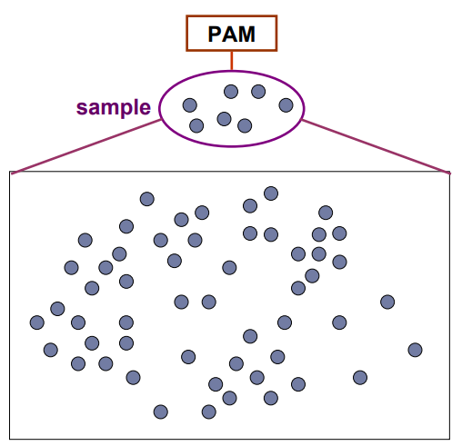
CLARA (Clustering Large Applications)
CLARA (Clustering Large Applications) uses a sampling-based method to deal with large data sets
A random sample should closely represent the original data
The chosen medoids will likely be similar to what would have been chosen from the whole data set

Slide 45
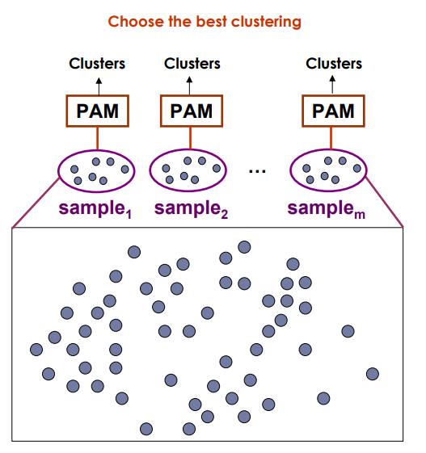
CLARA (Clustering Large Applications)
Draw multiple samples of the data set
Apply PAM to each sample
Return the best clustering

Slide 46
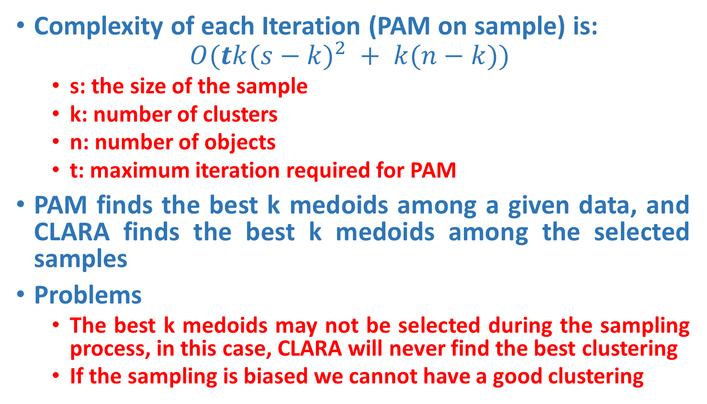
CLARA Properties
Complexity of each Iteration (PAM on sample) is:
$$O(tk({s−k)}^{2} + k(n−k))$$
s: the size of the sample
k: number of clusters
n: number of objects
t: maximum iteration required for PAM
PAM finds the best k medoids among a given data, and CLARA finds the best k medoids among the selected samples
Problems
The best k medoids may not be selected during the sampling process, in this case, CLARA will never find the best clustering
If the sampling is biased we cannot have a good clustering

Slide 47
CLARA - Algorithm
Set mincost to MAXIMUM;
Repeat q times // draws q samples
Create S by drawing s objects randomly from D;
Generate the set of medoids K from S by applying the PAM algorithm;
Compute cost(K,D)
If cost(K, D)<mincost
Mincost = cost(K, D);
Bestset = K;
Endif;
Endrepeat;
Return Bestset;

Slide 48
Complexity of CLARA
Set mincost to MAXIMUM;
Repeat q times
Create S by drawing s objects randomly from D;
Generate the set of medoids K from S by applying the PAM algorithm;
Compute cost(K,D)
If cost(K, D)<mincost
Mincost = cost(K, D);
Bestset = K;
Endif;
Endrepeat;
Return Bestset;
O(1)
O(t(s-k)²*k+(n-k)*k)
O(1)
O(t(s-k)²*k)
O((n-k)*k)
O(1)

Slide 49
CLARANS (“Randomized” CLARA)
CLARANS (A Clustering Algorithm based on Randomized Search)
The clustering process can be presented as searching a graph where every node is a potential solution, that is, a set of k medoids
Two nodes are neighbours if their sets differ by only one medoid
Each node can be assigned a cost that is defined to be the total dissimilarity between every object and the medoid of its cluster
The problem corresponds to search for a minimum on the graph
At each step, all neighbours of current node node are searched; the neighbour which corresponds to the deepest descent in cost is chosen as the next solution

Slide 50
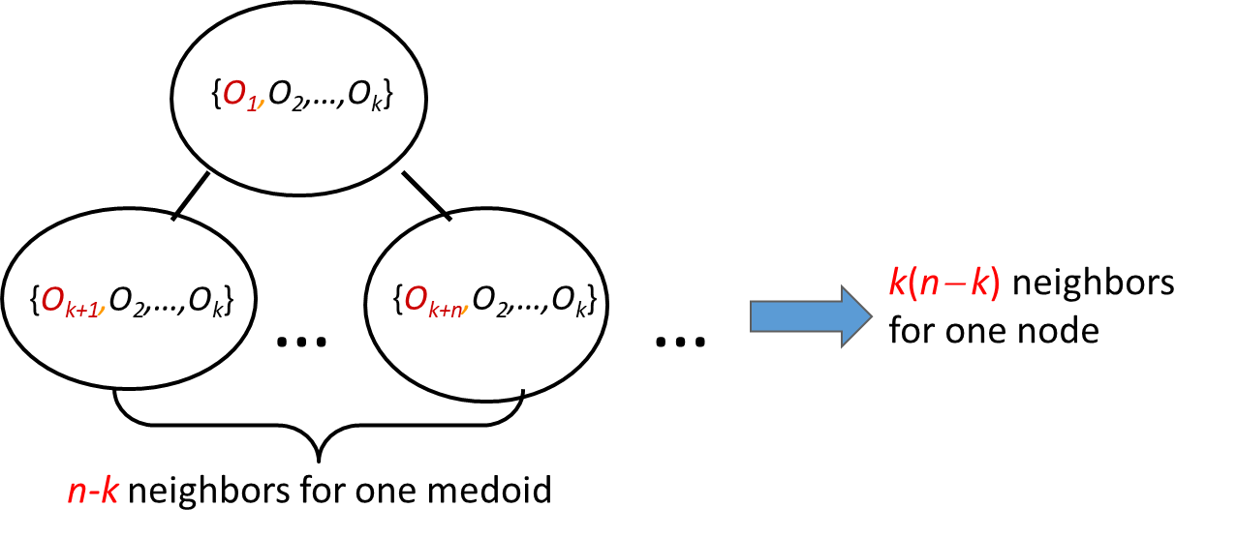
CLARANS (“Randomized” CLARA)
CLARANS (A Clustering Algorithm based on Randomized Search)
The clustering process can be presented as searching a graph where every node is a potential solution, that is, a set of k medoids
Graph Abstraction
Every node is a potential solution (k-medoid)
Two nodes are adjacent if they differ by one medoid
Every node has k(n−k) adjacent nodes

Slide 51
CLARANS (“Randomized” CLARA)
For large values of n and k, examining k(n‐k) neighbours is time consuming.
At each step, CLARANS draws sample of neighbours to examine.
Note that CLARA draws a sample of nodes at the beginning of search; therefore, CLARANS has the benefit of not confining the search to a restricted area.
If the local optimum is found, CLARANS starts with a new randomly selected node in search for a new local optimum. The number of local optimums to search for is a parameter.
It is more efficient and scalable than both PAM and CLARA; returns higher quality clusters.

Slide 52
CLARANS
Compare no more than maxneighbor times
N
C
N
…
<
Local minimum
N
N
C
N
N
…
numlocal
Local minimum
…
Local minimum
…
Best Node
Local minimum

Slide 53
CLARANS - Algorithm
Set mincost to MAXIMUM;
For i=1 to h do // find h local optimum
Randomly select a node as the current node C in the graph;
J = 1; // counter of neighbors
Repeat
Randomly select a neighbor N of C;
If Cost(N,D)<Cost(C,D)
Assign N as the current node C;
J = 1;
Else J++;
Endif;
Until J > m
Update mincost with Cost(C,D) if applicableEnd for;
End For
Return bestnode;

Slide 54
Hierarchical Clustering
Hierarchical Clustering Approach
A typical clustering analysis approach via partitioning data set sequentially
Construct nested partitions layer by layer via grouping objects into a tree of clusters (without the need to know the number of clusters in advance)
Use (generalised) distance matrix as clustering criteria
Agglomerative vs Divisive
Two sequential clustering strategies for constructing a tree of clusters
Agglomerative: a bottom-up strategy
Initially each data object is in its own (atomic) cluster
Then merge these atomic clusters into larger and larger clusters
Divisive: a top-down strategy
Initially all objects are in one single cluster
Then the cluster is subdivided into smaller and smaller clusters

Slide 55
Hierarchical Clustering
Agglomerative approach
Initialization:
Each object is a cluster
Iteration:
Merge two clusters which are
most similar to each other;
Until all objects are merged
into a single cluster
a
a b
b
a b c d e
c
c d e
d
d e
e
Step 0
Step 1
Step 2
Step 3
Step 4
bottom-up

Slide 56
Hierarchical Clustering
Divisive Approaches
Initialization:
All objects stay in one cluster
Iteration:
Select a cluster and split it into
two sub clusters
Until each leaf cluster contains
only one object
a
a b
b
a b c d e
c
c d e
d
d e
e
Step 4
Step 3
Step 2
Step 1
Step 0
Top-down

Slide 57
Dendrogram
A binary tree that shows how clusters are merged/split hierarchically
Each node on the tree is a cluster; each leaf node is a singleton cluster

Slide 58
Dendrogram
A clustering of the data objects is obtained by cutting the dendrogram at the desired level, then each connected component forms a cluster

Slide 59
Dendrogram
A clustering of the data objects is obtained by cutting the dendrogram at the desired level, then each connected component forms a cluster

Slide 60
How to Merge Clusters?
How to measure the distance between clusters?
Single-link
Complete-link
Average-link
Centroid distance
Distance?
Hint: Distance between clusters is usually defined on the basis of distance between objects.

Slide 61
How to Define Inter-Cluster Distance
Single-link
Complete-link
Average-link
Centroid distance
The distance between two clusters is represented by the distance of the closest pair of data objects belonging to different clusters.

Slide 62
How to Define Inter-Cluster Distance
Single-link
Complete-link
Average-link
Centroid distance
The distance between two clusters is represented by the distance of the farthest pair of data objects belonging to different clusters.

Slide 63
How to Define Inter-Cluster Distance
Single-link
Complete-link
Average-link
Centroid distance
The distance between two clusters is represented by the average distance of all pairs of data objects belonging to different clusters.

Slide 64
How to Define Inter-Cluster Distance
×
×
m_{i},m_{j} are the means of C_{i}, C_{j},
Single-link
Complete-link
Average-link
Centroid distance
The distance between two clusters is represented by the distance between the means of the cluters.

Slide 65
Cluster Distance Measures
Example: Given a data set of five objects characterized by a single continuous feature, assume that there are two clusters: C1: {a, b} and C2: {c, d, e}.
1. Calculate the distance matrix. 2. Calculate three cluster distances between C1 and C2.
a | b | c | d | e
1 | 2 | 4 | 5 | 6
Single link
Complete link
Average
 | a | b | c | d | e
a | 0 | 1 | 3 | 4 | 5
b | 1 | 0 | 2 | 3 | 4
c | 3 | 2 | 0 | 1 | 2
d | 4 | 3 | 1 | 0 | 1
e | 5 | 4 | 2 | 1 | 0

Slide 66
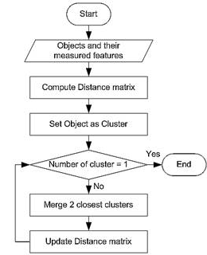
Agglomerative Algorithm
The Agglomerative algorithm is carried out in three steps:
Convert all object features into a distance matrix
Set each object as a cluster (thus if we have N objects, we will have N clusters at the beginning)
Repeat until number of cluster is one (or known # of clusters)
Merge two closest clusters
Update “distance matrix”

Slide 67
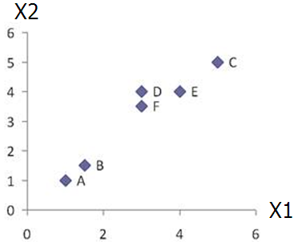
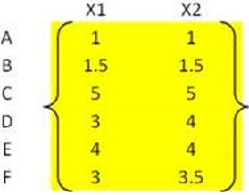
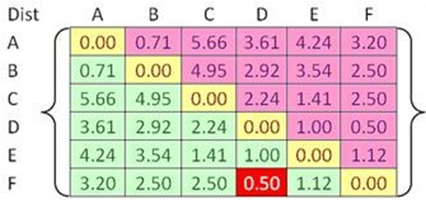


Example
Problem: clustering analysis with agglomerative algorithm
data matrix
Euclidean distance
distance matrix

Slide 68
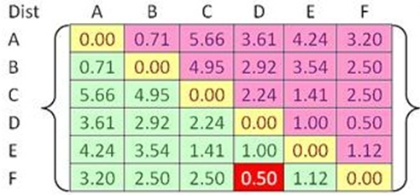
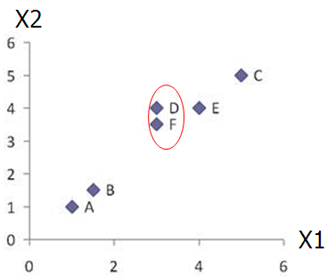
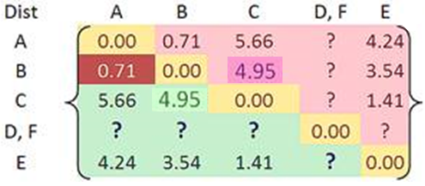

Example
Merge two closest clusters (iteration 1)

Slide 69
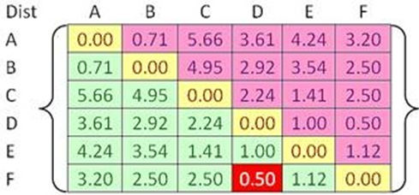

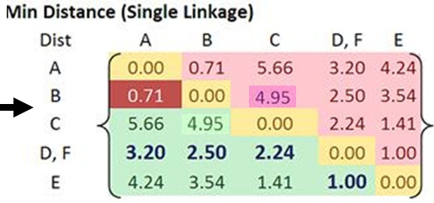
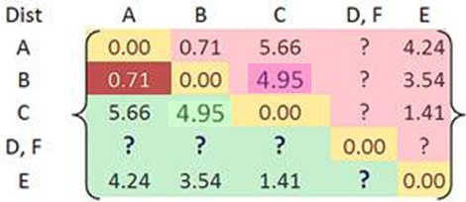
Example
Update distance matrix (iteration 1)

Slide 70
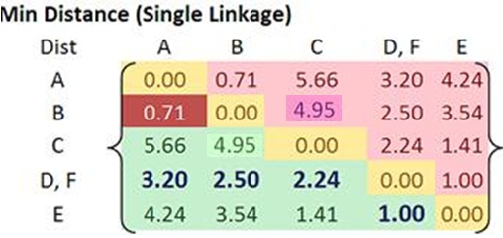
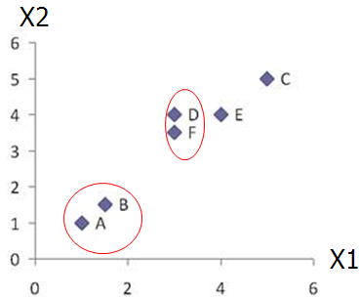
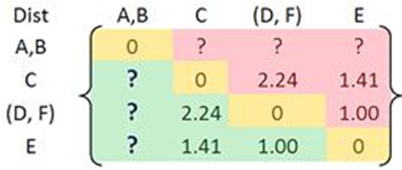
Example
Merge two closest clusters (iteration 2)

Slide 71
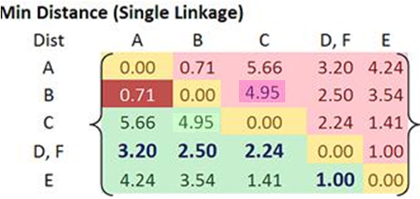
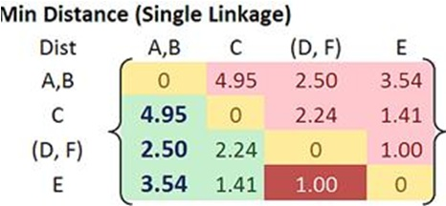

Example
Update distance matrix (iteration 2)

Slide 72
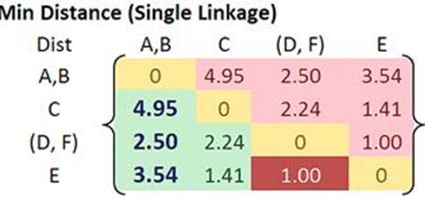
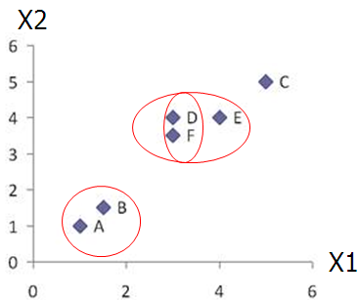
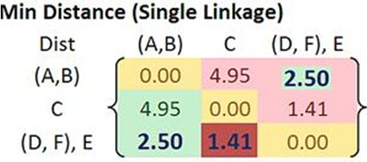

Example
Merge two closest clusters/update distance matrix (iteration 3)

Slide 73
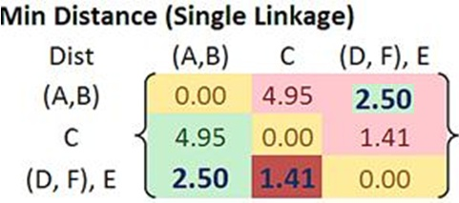
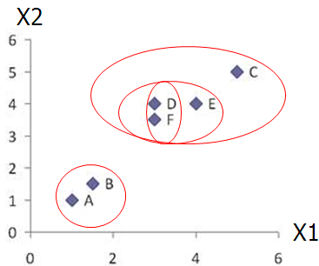
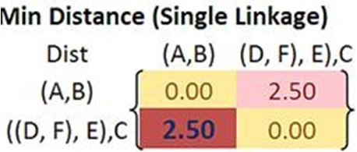

Example
Merge two closest clusters/update distance matrix (iteration 4)

Slide 74
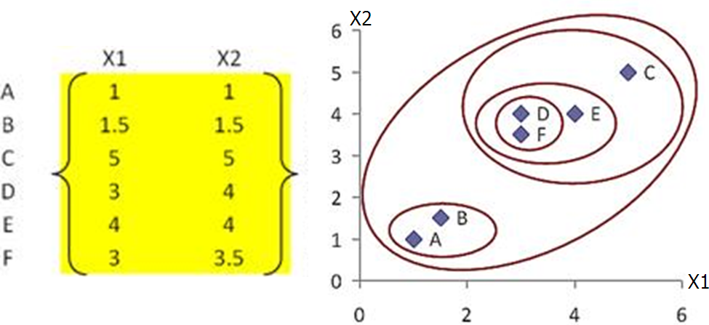
Example
Final result (meeting termination condition)

Slide 75
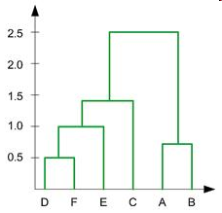
Example
Dendrogram tree representation
In the beginning we have 6
clusters: A, B, C, D, E and F
We merge clusters D and F into
cluster (D, F) at distance 0.50
We merge cluster A and cluster B
into (A, B) at distance 0.71
We merge clusters E and (D, F)
into ((D, F), E) at distance 1.00
We merge clusters ((D, F), E) and C
into (((D, F), E), C) at distance 1.41
We merge clusters (((D, F), E), C)
and (A, B) into ((((D, F), E), C), (A, B))
at distance 2.50
The last cluster contain all the objects,
thus conclude the computation
6
lifetime
5
4
3
2
object

Slide 76
Example
Dendrogram tree representation
For a dendrogram tree, its horizontal axis indexes all objects in a given data set, while its vertical axis expresses the lifetime of all possible cluster formation.
The lifetime of a cluster (individual cluster) in the dendrogram is defined as a distance interval from the moment that the cluster is created to the moment that it disappears by merging with other clusters.
6
lifetime
5
4
3
2
object

Slide 77
Hierarchical Clustering: Comparison
5
1
4
1
3
2
5
5
5
2
1
MIN
2
MAX
2
3
6
3
3
6
1
4
4
4
5
1
2
5
2
3
6
Group Average
3
1
4
4

Slide 78
Which Distance Measure is Better?
Each method has both advantages and disadvantages; application-dependent, single-link and complete-link are the most common methods
Single-link
Can find irregular-shaped clusters
Sensitive to outliers, suffers the so-called chaining effects
In order to merge two groups, only need one pair of points to be close, irrespective of all others. Therefore clusters can be too spread out, and not compact enough
Average-link, and Centroid distance
Robust to outliers
Tend to break large clusters

Slide 79
AGNES
AGNES : Agglomerative Nesting
Use single-link method
Merge nodes that have the least dissimilarity
Eventually all objects belong to the same cluster

Slide 80
UPGMA
UPGMA: Un-weighted Pair-Group Method Average.
Merge Strategy:
Average-link approach
The distance between two clusters is measured by the average distance between two objects belonging to different clusters.
1
∑
∑
d
(
C
,
C
)
=
d
(
p
,
q
)
avg
i
j
n
n
i
j
p
∈
C
i
q
∈
C
j
Average
distance
n_{i},n_{j}: the number of objects in cluster C_{i}, C_{j}.

Slide 81
DIANA
DIANA: Divisive Analysis
First, all of the objects form one cluster.
The cluster is split according to some principle, such as the minimum Euclidean distance between the closest neighboring objects in the cluster.
The cluster splitting process repeats until, eventually, each new cluster contains a single object, or a termination condition is met.

Slide 82
Splitting Process of DIANA
C
C2
C1
Choose the object O_{h} which is most dissimilar to other objects in C.
Let C1={O_{h}}, C2=C-C1.
For each object O_{i} in C2, tell whether it is more close to C1 or to other objects in C2
Choose the object O_{k} with greatest D score.
If D_{k}>0, move O_{k} from C2 to C1, and repeat 3-5.
Otherwise, stop splitting process.
C2
C1
C2
C1
C2
C1
……
C2
C1

