Slide 1
Greedy Algorithms
Often when trying to find the optimal solution to some problem you need to consider all your possible choices and how they might interact with other choices down the line.
But sometimes you don’t. Sometimes you can just take what looks like the best option for now and repeat.

Slide 2
Greedy Algorithms
General Algorithmic Technique:
Find decision criterion
Make best choice according to criterion
Repeat until done
Surprisingly, this sometimes works.
Greed choice property:
a sequence of locally optimal (greedy) choices
⇒ an optimal solution

Slide 3
Interval Scheduling
Problem: Given a collection C of intervals, find a subset S ⊆ C so that:
No two intervals in S overlap.
Subject to (1), |S| is as large as possible.

Slide 4
Interval Scheduling
Interval scheduling.
  Job j starts at s_{j} and finishes at f_{j}.
  Two jobs are compatible if they don't overlap.
  Goal: find maximum subset of mutually compatible jobs.
a
b
c
d
e
f
g
h
Time
0
1
2
3
4
5
6
7
8
9
10
11
Notes:
Activity selection = interval scheduling OPT = b, e, h
Note: smallest job (c) is not in any optimal solution, job that starts first (a) is not in any optimal solution.
Minimum conflicts: OPT is not a counter example. {b, d, e, a/c/f?} vs {b, c, d, e}
-------a---------
---b--- ----c---- -----d--- -----e-----
--g-- ------f------

Slide 5
Interval Scheduling: Greedy Algorithms
Greedy template. Consider jobs in some order. Take each job provided it's compatible with the ones already taken.
  [Earliest start time]
  Consider jobs in ascending order of start time s_{j}.
  [Shortest interval]
  Consider jobs in ascending order of interval length f_{j} - s_{j}.
  [Fewest conflicts]
  For each job, count the number of conflicting jobs c_{j}. Schedule in ascending order of conflicts c_{j}.
  [Earliest finish time]
    Consider jobs in ascending order of finish time f_{j}.
Notes:
Earliest start time – so more jobs can be accommodated (but large number of jobs can be reduced)
by starting early and resource can be kept busy
Shortest interval – more can be fitted (but can create bad conflicts)
Fewest conflicts – more can be considered (but can create critical conflicts)
--------------Proof technique--------------:
Give counter example to show something does not work
Demonstrate for all cases to show something works

Slide 6
Interval Scheduling: Greedy Algorithms
Greedy template. Consider jobs in some order. Take each job provided it's compatible with the ones already taken.
breaks earliest start time
breaks shortest interval
breaks fewest conflicts
Notes:
Max 4 but scheduled 1
Max 2 but scheduled 1
Max 4 but scheduled 3
===============================
Observe specifically how the “local” intuition and criterion is not globally sound.

Slide 7
Interval Scheduling: Greedy Algorithm
Greedy algorithm. Consider jobs in increasing order of finish time. Take each job provided it's compatible with the ones already taken.
Implementation. O(n log n).
  Remember job j* that was added last to A.
  Job j is compatible with A if s_{j} ≥ f_{j*}.
Sort jobs by finish times so that f₁ ≤ f₂ ≤ ... ≤ f_{n}.
A ← φ
for j = 1 to n {
if (job j compatible with A)
A ← A ∪ {j}
}
return A
jobs selected
Notes:
Preprocessing sort requires n logn. The loop is linear
Because we can keep track of the largest finish time for compatibility check.
================
IMPORTANT PROBLEM: Can we also show this result if we
consider jobs in the DECREASING order of START time?
--------------- -------
This may construct a different solution when two jobs with
same highest start time have different end times, but
will not schedule a larger number of jobs.
------------
The optimal jobs are also ordered by starting time
Since these jobs are compatible, there are no overlapping intervals,
hence the order of the finish time is the same as the order of the starting time.
------------
Can we derive a solution based on finish-time heuristic from start-time heuristic?
No, because they may be different solutions though with same number of jobs.
E.g., For jobs, [1,3] [1,4] [5,6][5,8], the two differing choices are
[1,3] [5,6] vs [5,8], [1,4]
E.g., For jobs, [1,3] [1,4] [5,6][5,8], [6, 7] the two differing choices are
[1,3] [5,6] [6,7] vs [6,7] 5,6], [1,4]
We can prove optimality separately but cannot transform one into another!!!!!!

Slide 8
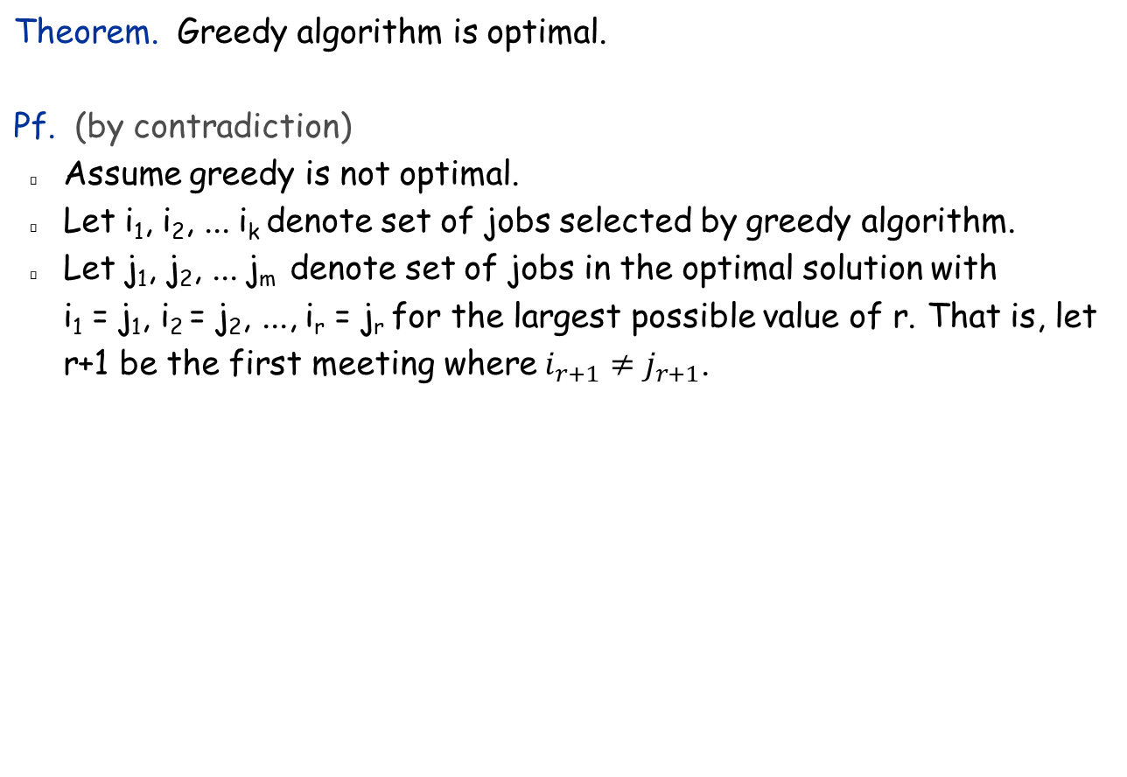
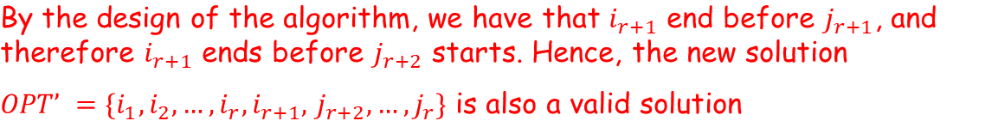
Interval Scheduling: Analysis
job i_{r+1} finishes before j_{r+1}
Greedy:
i₁
i₁
i_{r}
i_{r+1}
OPT:
j₁
j₂
j_{r}
j_{r+1}
. . .
Notes:
OPT picks a job that finishes later.
Optimal Suffix can be reused and the possible slack may enable
a new short job to be squeezed or an entirely different longer sequence installed.

Slide 9
Remarks
We assumed that all requests were known to the scheduling algorithm when it was choosing the compatible subset.
    Online Algorithm : The scheduler needs to make decisions about accepting or rejecting certain requests before knowing about the full set of requests?

Slide 10
Remarks
In the Interval Scheduling Problem, there is a single resource and many requests in the form of time intervals, so we must choose which requests to accept and which to reject.
A related problem arises if we have many identical resources available and we wish to schedule all the requests using as few resources as possible. Because the goal here is to partition all intervals across multiple resources, we will refer to this as the Interval Partitioning Problem

Slide 11
Interval Partitioning
Interval partitioning.
  Lecture j starts at s_{j} and finishes at f_{j}.
  Goal: find minimum number of classrooms to schedule all lectures so that no two occur at the same time in the same room.
Ex: This schedule uses 4 classrooms to schedule 10 lectures.
e
j
c
d
g
b
h
a
f
i
9
9:30
10
10:30
11
11:30
12
12:30
1
1:30
2
3
3:30
4
4:30
Time

Slide 12
Interval Partitioning
Interval partitioning.
  Lecture j starts at s_{j} and finishes at f_{j}.
  Goal: find minimum number of classrooms to schedule all lectures so that no two occur at the same time in the same room.
Ex: This schedule uses only 3 classrooms.
c
d
f
j
b
g
i
a
e
h
9
9:30
10
10:30
11
11:30
12
12:30
1
1:30
2
3
3:30
4
4:30
Time
Notes:
Another allocation:
c d f i
b g j
a e h
Note that there are 8 different solutions with the same optimal classrooms.

Slide 13
Interval Partitioning: Greedy Algorithms
Greedy template.
  [Earliest finish time]
    Consider jobs in ascending order of finish time f_{j}.
  [Shortest interval]
  Consider jobs in ascending order of interval length f_{j} - s_{j}.
  [Fewest conflicts]
  For each job, count the number of conflicting jobs c_{j}. Schedule in ascending order of conflicts c_{j}.
  [Earliest start time]
  Consider jobs in ascending order of start time s_{j}.
Notes:
Earliest start time – so more jobs can be accommodated (but large number of jobs can be reduced)
by starting early and resource can be kept busy
Shortest interval – more can be fitted (but can create bad conflicts)
Fewest conflicts – more can be considered (but can create critical conflicts)
--------------Proof technique--------------:
Give counter example to show something does not work
Demonstrate for all cases to show something works

Slide 14
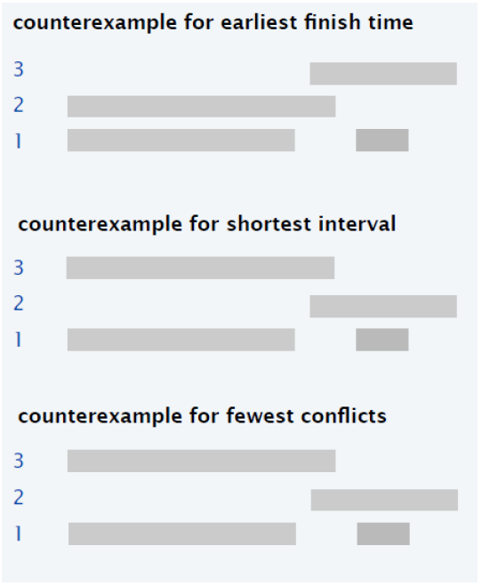
Interval Partitioning

Slide 15
Interval Partitioning: Lower Bound on Optimal Solution
Def. The depth of a set of open intervals is the maximum number of intervals that contain any given time.
Key observation. Number of classrooms needed ≥ depth.
Ex: Depth of schedule below = 3 ⇒ schedule below is optimal.
Q. Does there always exist a schedule equal to the depth of intervals?
a, b, c all contain 9:30
c
d
f
j
b
g
i
a
e
h
9
9:30
10
10:30
11
11:30
12
12:30
1
1:30
2
3
3:30
4
4:30
Time
Notes:
Depth = number of overlapping intervals.
Depth number of rooms necessary. Is it also sufficient?
Depth bound is achievable as shown by the following algorithm!

Slide 16
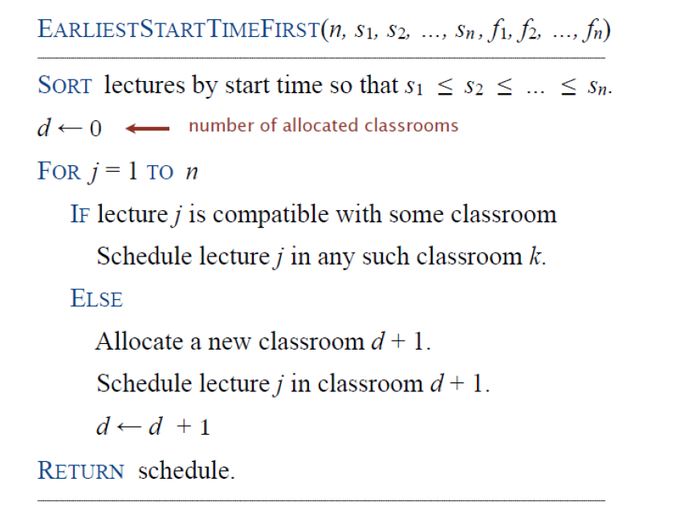
Interval Partitioning

Slide 17
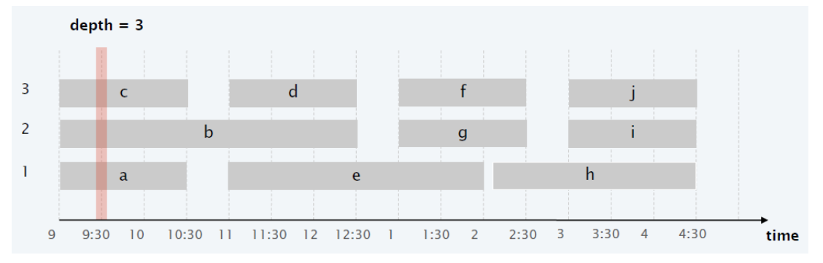
Interval Partitioning
Proof of optimality (lower bound)
#classrooms needed ≥ maximum “depth” at any point
    depth = number of lectures running at that time
We now show that our greedy algorithm uses only these many classrooms!

Slide 18
Interval Partitioning: Greedy Analysis
Observation. Greedy algorithm never schedules two incompatible lectures in the same classroom.
Theorem. Greedy algorithm is optimal.
Pf.
  Let d = number of classrooms that the greedy algorithm allocates.
  Classroom d is opened because we needed to schedule a job, say j, that is incompatible with all
  d-1 other classrooms.
  Since we sorted by start time, all these incompatibilities are caused by lectures that start no later than s_{j}.
  Thus, we have d lectures overlapping at time s_{j} + ε.
  Key observation ⇒
  all schedules use ≥ d classrooms. ▪
Notes:
Observation follows because we maintain the finish time for the last job to check the start time of the incoming lecture against.
“Since we sorted by start time, all these incompatibilities are caused by lectures that start no later than s_{j}.”
Note that in this statement there is no reference to which classrooms these are assigned to, only that they exist in the collection of lectures.
New classroom demonstrates its need by exhibiting the required overlap.

Slide 19
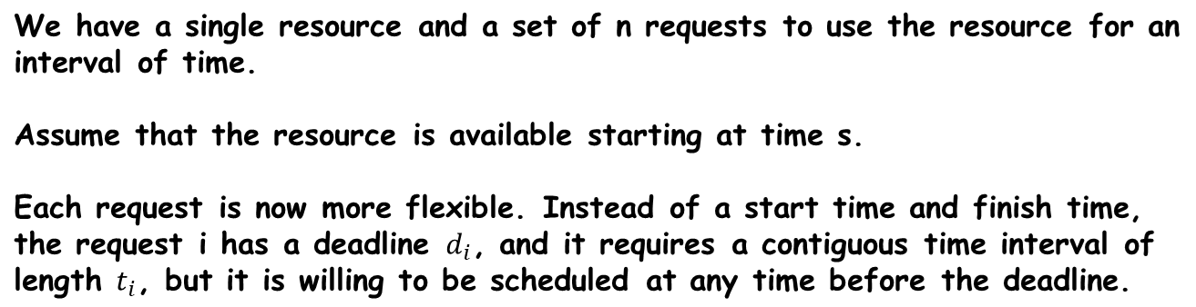
Scheduling to Minimize Lateness
Notes:
Now we look at a problem where jobs must be completed and resources are limited ---
In that case, things can get delayed and we want to minimize max lateness.
Schedule is a sequence of jobs and their start times.

Slide 20
Scheduling to Minimize Lateness
Minimizing lateness problem.
  Single resource processes one job at a time.
  Job j requires t_{j} units of processing time and is due at time d_{j}.
  If j starts at time s_{j}, it finishes at time f_{j} = s_{j} + t_{j}.
  Lateness: _{j} = max { 0, f_{j} - d_{j} }.
  Goal: schedule all jobs to minimize maximum lateness L = max _{j}.
Ex:
1
2
3
4
5
6
t_{j}
3
2
1
4
3
2
d_{j}
6
8
9
9
14
15
lateness = 2
lateness = 0
max lateness = 6
d₃ = 9
d₂ = 8
d₆ = 15
d₁ = 6
d₅ = 14
d₄ = 9
0
1
2
3
4
5
6
7
8
9
10
11
12
13
14
15
Notes:
Ts < Ds
Need to schedule jobs by determining their starting times – finish time and lateness (delay) automatically determined.
Note: finding a maximal size subset of jobs that meet deadline is NP-hard.
We are also not minimizing cumulative lateness, only max lateness.
Schedule: 3, 2, 6, 1, 5, 4 Max lateness incurred for d4 the last job scheduled
(by switching d4 and d5, we can reduce max lateness to 2, and now it will be incurred by both d4 and d1)
------------------------------------------------
Optimal lateness schedule 1,2,3,4,5,6 max lateness = 1
-------------------------------------------------
Lateness 2, 2, 3, 3 worse than 1, 6
Minimize max lateness, not cumulative lateness => will latter get minimized if the former is minimized?
No: In general, “minimizing total tardiness” is NP-Hard for arbitrary job durations and deadlines
(including unrealistic deadlines).

Slide 21
Minimizing Lateness: Greedy Algorithms
Greedy template. Consider jobs in some order.
  [Shortest processing time first] Consider jobs in ascending order of processing time t_{j}.
  [Smallest slack] Consider jobs in ascending order of slack d_{j} - t_{j}.
  [Earliest deadline first] Consider jobs in ascending order of deadline d_{j}.
Notes:
Get short ones done … Unfortunately, longer jobs may have tighter deadlines ☹
Just in time scheduling …
The optimal solution does not involve length of the job!

Slide 22
Minimizing Lateness: Greedy Algorithms
Greedy template. Consider jobs in some order.
  [Shortest processing time first] Consider jobs in ascending order of processing time t_{j}.
  [Smallest slack] Consider jobs in ascending order of slack d_{j} - t_{j}.
1
2
t_{j}
1
10
counterexample
d_{j}
100
10
1
2
t_{j}
1
10
counterexample
d_{j}
2
10
Notes:
[1] Proposed Schedule: 1, 2 lateness 1 (11-10) optimal: 2, 1 lateness 0
[2] Proposed Schedule: 2, 1 lateness 9 (11-02) optimal: 1, 2 lateness 1
===============================
Observe specifically how the “local” intuition and criterion
is not globally sound.
===================
Note also that three can be multiple optimal solutions when deadlines are lax.

Slide 23
Minimizing Lateness: Greedy Algorithm
Greedy algorithm. Earliest deadline first.
Sort n jobs by deadline so that d₁ ≤ d₂ ≤ … ≤ d_{n}
t ← 0
for j = 1 to n
Assign job j to interval [t, t + t_{j}]
s_{j} ← t, f_{j} ← t + t_{j}
t ← t + t_{j}
output intervals [s_{j}, f_{j}]
max lateness = 1
d₁ = 6
d₂ = 8
d₃ = 9
d₄ = 9
d₅ = 14
d₆ = 15
0
1
2
3
4
5
6
7
8
9
10
11
12
13
14
15
Notes:
<TAB> output interval [sj, fj]
Actual schedule: [0, t1] [t1, t1+t2], [t1+t2, t1+t2+t3]…[t1+…+tn-1, t1+…+tn]
-------------------
WHY DO WE NEED FORMAL PROOFS?
There are several solutions that all give optimal schedule
and we want to make sure that the chosen one is not
Inferior to any of them. E.g., in the current solution,
We can exchange 1 and 2 without hurting optimality,
Similarly, we can reverse initial segment to 3, 2, 1
and not regret it. The proof will ensure this fact.

Slide 24
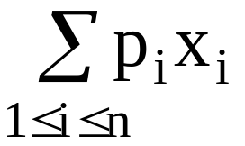
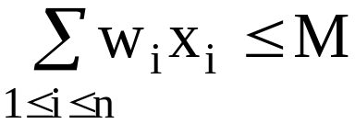
The knapsack problem
n objects, each with a weight w_{i} > 0
a profit p_{i} > 0
capacity of knapsack: M
Maximize
Subject to
0 ≤ x_{i} ≤ 1, 1 ≤ i ≤ n
3 -<number>

Slide 25
The knapsack algorithm
The greedy algorithm:
Step 1: Sort p_{i}/w_{i} into nonincreasing order.
Step 2: Put the objects into the knapsack according
to the sorted sequence as possible as we can.
e. g.
  n = 3, M = 20, (p₁, p₂, p₃) = (25, 24, 15)
  (w₁, w₂, w₃) = (18, 15, 10)
  Sol: p₁/w₁ = 25/18 = 1.39
  p₂/w₂ = 24/15 = 1.6
  p₃/w₃ = 15/10 = 1.5
  Optimal solution: x₁ = 0, x₂ = 1, x₃ = 1/2
total profit = 24 + 7.5 = 31.5
3 -<number>

Slide 26
The 2-way merging problem
# of comparisons required for the linear 2-way merge algorithm (Each merge step involved margining of two files) is m₁+ m₂ -1 where m₁ and m₂ are the lengths of the two sorted lists respectively.
  2-way merging example
2 3 5 6
1 4 7 8
The problem: There are n sorted lists, each of length m_{i}. What is the optimal sequence of merging process to merge these n lists into one sorted list ?
3 -<number>

Slide 27
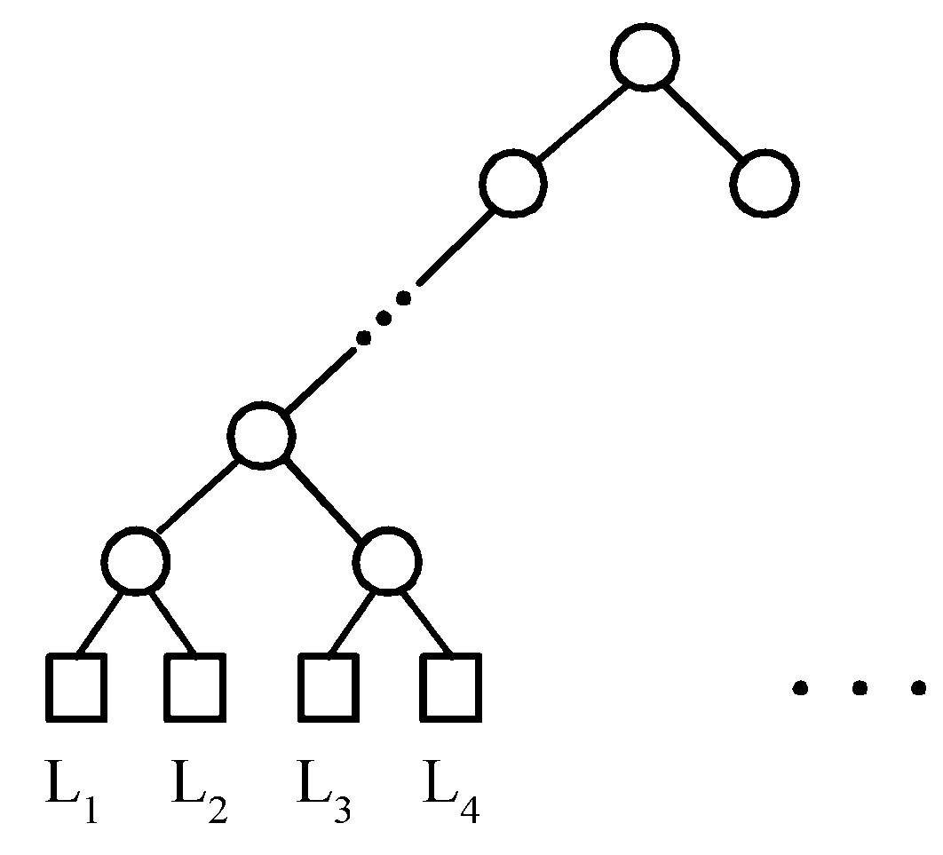
Extended binary trees
Two-way merge pattern can be represented by a binary merge pattern tree
Files
3 -<number>

Slide 28
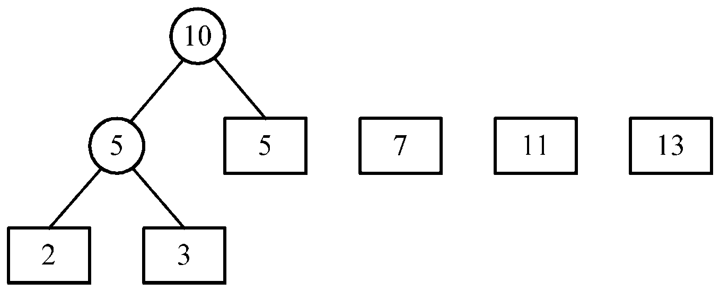
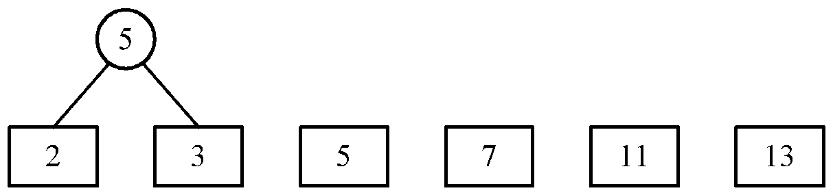
An example of 2-way merging
Example: 6 sorted lists with lengths 2, 3, 5, 7, 11 and 13.
3 -<number>

Slide 29
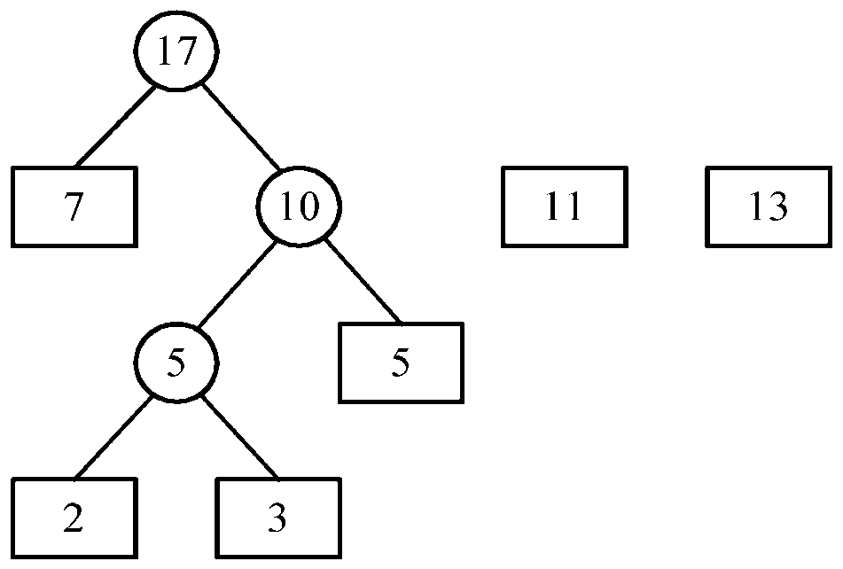
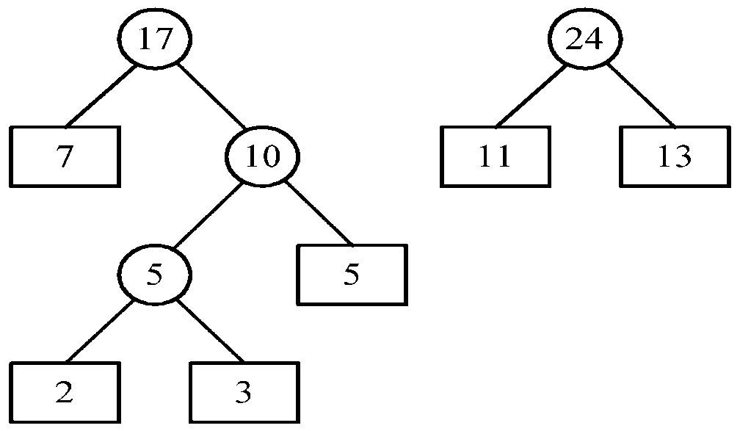
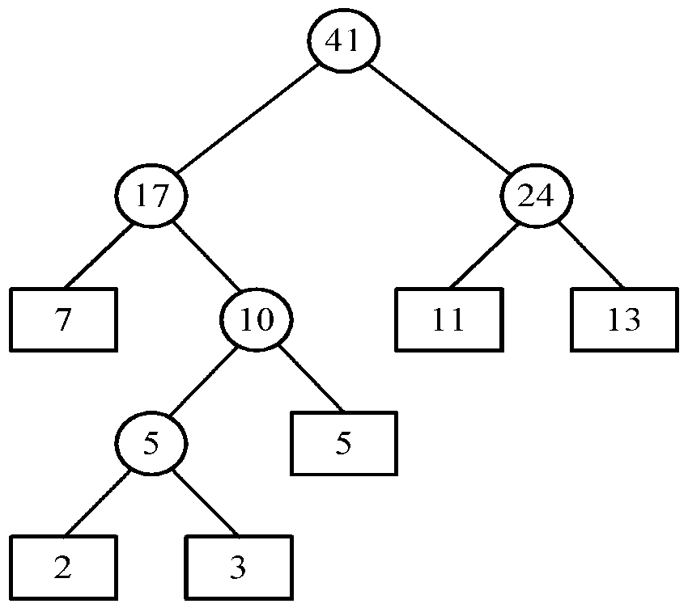
Time complexity for generating an optimal extended binary tree:O(n log n)
Using min-heap
3 -<number>

Slide 30
Huffman codes
In telecommunication, how do we represent a set of messages, each with an access frequency, by a sequence of 0’s and 1’s?
To minimize the transmission and decoding costs, we may use short strings to represent more frequently used messages.
This problem can by solved by using an extended binary tree which is used in the 2-way merging problem.
3 -<number>

Slide 31
Huffman Code Problem
Huffman’s algorithm achieves data compression by finding the best variable length binary encoding scheme for the symbols that occur in the file to be compressed.

Slide 32
Huffman Code Problem
The more frequent a symbol occurs, the shorter should be the Huffman binary word representing it.
The Huffman code is a prefix-free code.
  No prefix of a code word is equal to another codeword.

Slide 33
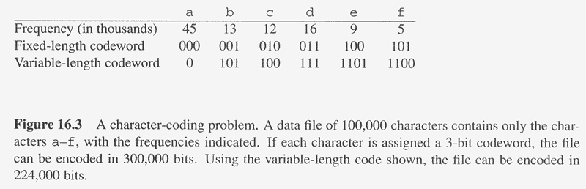
Overview
Huffman codes: compressing data (savings of 20% to 90%)
Huffman’s greedy algorithm uses a table of the frequencies of occurrence of each character to build up an optimal way of representing each character as a binary string
C: Alphabet

Slide 34
Example
Assume we are given a data file that contains only 6 symbols, namely a, b, c, d, e, f With the following frequency table:
Find a variable length prefix-free encoding scheme that compresses this data file as much as possible?

Slide 35
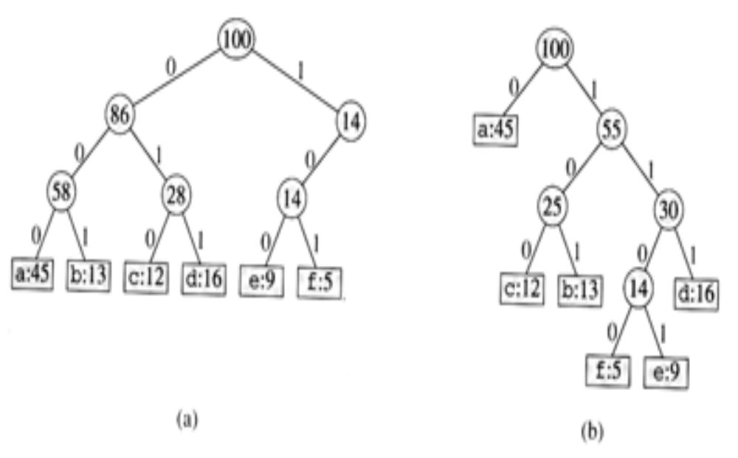
Huffman Code Problem
Left tree represents a fixed length encoding scheme
Right tree represents a Huffman encoding scheme

Slide 36
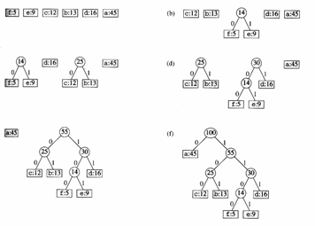
Example

Slide 37
Constructing A Huffman Code
H = new Heap()
for each w_{i}
T = new Tree(w_{i})
H.Insert(T)
while H.Size() > 1
T₁ = H.DeleteMin()
T₂ = H.DeleteMin()
T₃ = Merge(T₁, T₂)
H.Insert(T₃)

Slide 38
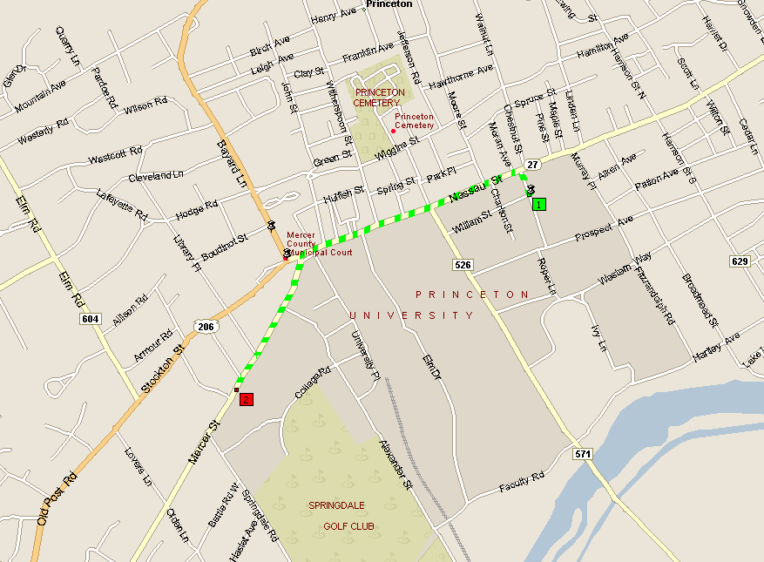
4.4 Shortest Paths in a Graph
shortest path from Princeton CS department to Einstein's house
Notes:
map from Microsoft Streets and Trips

Slide 39
Shortest Path Problem
Shortest path network.
  Directed graph G = (V, E).
  Source s, destination t.
  Length _{e} = length of edge e.
Shortest path problem: find shortest directed path from s to t.
cost of path = sum of edge costs in path
2
23
3
9
s
18
Cost of path s-2-3-5-t
= 9 + 23 + 2 + 16
= 48.
14
2
6
6
30
4
19
15
5
11
5
6
20
16
7
t
44
Notes:
Directed paths
(2) Cost of each edge – non-negative
(3) Complexity wise: shortest path from a source node to a destination node
~ shortest paths from a source node to all nodes
(cf. computes directed spanning tree eventually)
(4) Explores nodes in the increasing order of its distance from the start node
=======================
A great example of algorithm development:
Important Applications (message routing, transportation, largest flow capacity)
Proof of correctness critical (why not choose just “least cost edges”, tacit assumption about non-negative weights)
Data Structure design critical for efficiency (Priority queue)

Slide 40

Dijkstra's Algorithm
Dijkstra's algorithm.
  Maintain a set of explored nodes S for which we have determined the shortest path distance d(u) from s to u.
  Initialize S = { s }, d(s) = 0.
  Repeatedly choose unexplored node v (i.e., v ∉ S) that minimizes
  add v to S, and set d(v) = π(v).
shortest path to some u in explored part, followed by a single edge (u, v)
_{e}
v
d(u)
u
S
s
Notes:
Optimal substructure property: optimal paths contain optimal subpaths …
(best way to reach from s to y via v is to reach from s to v and v to t in best ways.)
(S contains the initial SHORTEST shortest paths.)
---------------------------------------------------------------------------------------------
Use of invariants
Minimize over all edges that go out of S and find the closest node v to s
CAUTION re: scoping of variables: v in pi(v) is global -- v under min is local

Slide 41
Dijkstra's Algorithm
Dijkstra's algorithm.
  Maintain a set of explored nodes S for which we have determined the shortest path distance d(u) from s to u.
  Initialize S = { s }, d(s) = 0.
  Repeatedly choose unexplored node v which minimizes
  add v to S, and set d(v) = π(v).
shortest path to some u in explored part, followed by a single edge (u, v)
_{e}
v
d(u)
u
S
s
Notes:
S is only needed for the proof of correctness, not the algorithm itself
-----------
GREED: consider nodes only in S, even if edges from v to nodes outside S are of small lengths.
From next slide, even if length(vy) = 0 and other edges to v have length of 100, this still works!

Slide 42
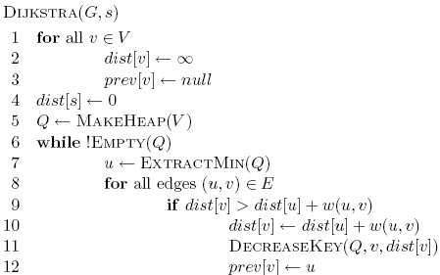
3
B
D
3
1
A
1
2
1
C
E
4

Slide 43
∞
∞
3
B
D
3
∞
1
A
1
2
∞
1
C
E
∞
4

Slide 44
Heap
A 0
B ∞
C ∞
D ∞
E ∞
∞
∞
3
B
D
3
0
1
A
1
2
∞
1
C
E
∞
4

Slide 45
Heap
B ∞
C ∞
D ∞
E ∞
∞
∞
3
B
D
3
0
1
A
1
2
∞
1
C
E
∞
4

Slide 46
Heap
B ∞
C ∞
D ∞
E ∞
∞
∞
3
B
D
3
0
1
A
1
2
∞
1
C
E
∞
4

Slide 47
Heap
C 1
B ∞
D ∞
E ∞
∞
∞
3
B
D
3
0
1
A
1
2
1
1
C
E
∞
4

Slide 48
Heap
C 1
B ∞
D ∞
E ∞
∞
∞
3
B
D
3
0
1
A
1
2
1
1
C
E
∞
4

Slide 49
Heap
C 1
B 3
D ∞
E ∞
3
∞
3
B
D
3
0
1
A
1
2
1
1
C
E
∞
4

Slide 50
Heap
C 1
B 3
D ∞
E ∞
3
∞
3
B
D
3
0
1
A
1
2
1
1
C
E
∞
4

Slide 51
Heap
B 3
D ∞
E ∞
3
∞
3
B
D
3
0
1
A
1
2
1
1
C
E
∞
4

Slide 52
Heap
B 3
D ∞
E ∞
3
∞
3
B
D
3
0
1
A
1
2
1
1
C
E
∞
4

Slide 53
Heap
B 3
D ∞
E ∞
3
∞
3
B
D
3
0
1
A
1
2
1
1
C
E
∞
4

Slide 54
Heap
B 2
D ∞
E ∞
2
∞
3
B
D
3
0
1
A
1
2
1
1
C
E
∞
4

Slide 55
Heap
B 2
D ∞
E ∞
2
∞
3
B
D
3
0
1
A
1
2
1
1
C
E
∞
4

Slide 56
Heap
B 2
E 5
D ∞
2
∞
3
B
D
3
0
1
A
1
2
1
1
C
E
5
4

Slide 57
Heap
E 3
D 5
2
5
3
B
D
3
0
1
A
1
2
1
1
C
E
3
4

Slide 58
Heap
D 5
2
5
3
B
D
3
0
1
A
1
2
1
1
C
E
3
4

Slide 59
Heap
2
5
3
B
D
3
0
1
A
1
2
1
1
C
E
3
4

Slide 60
Heap
2
5
3
B
D
0
1
A
1
1
1
C
E
3

Slide 61
Running time?

Slide 62
Running time?
1 call to MakeHeap

Slide 63
Running time?
|V| iterations

Slide 64
Running time?
|V| calls

Slide 65
Running time?
O(|E|) calls

Slide 66
Running time?
Depends on the heap implementation
1 MakeHeap
|V| ExtractMin
|E| DecreaseKey
Total
Array
O(|V|)
O(|V|²)
O(|E|)
O(|V|²)
Bin heap
O(|V|)
O(|V| log |V|)
O(|E| log |V|)
O((|V|+|E|) log |V|)
O(|E| log |V|)

Slide 67
Running time?
Depends on the heap implementation
1 MakeHeap
|V| ExtractMin
|E| DecreaseKey
Total
Array
O(|V|)
O(|V|²)
O(|E|)
O(|V|²)
Bin heap
O(|V|)
O(|V| log |V|)
O(|E| log |V|)
O((|V|+|E|) log |V|)
O(|E| log |V|)

Slide 68
What about Dijkstra’s on…?
1
1
B
D
A
5
10
-10
C
E

Slide 69
What about Dijkstra’s on…?
Dijkstra’s algorithm only works for positive edge weights
1
1
B
D
A
5
10
C
E

Slide 70
Dijkstra's Algorithm: Proof of Correctness
Invariant. For each node u ∈ S, d(u) is the length of the shortest s-u path.
Pf. (by induction on |S|)
Base case: |S| = 1 is trivial.
Inductive hypothesis: Assume true for |S| = k ≥ 1.
  Let v be the next node added to S, and let u-v be the chosen edge.
  The shortest s-u path plus (u, v) is an s-v path of length π(v).
  Consider any s-v path P. Show that it is no shorter than π(v).
  Let x-y be the first edge in P that leaves S,
  and let P' be the subpath to x.
  P is already too long as soon as it leaves S
  and path y-v has positive weight.
  (Boundary Case: P has same length with len(y-v) = 0.)
P
P'
x
y
s
S
u
● (P) ≥  (P') +  (x,y) ≥ d(x) +  (x, y) ≥ π(y) ≥ π(v)
v
nonnegative
weights (lengths)
inductive
hypothesis
defn of π(y)
Dijkstra’s algorithm
chose v instead of y
Notes:
HIGHLIGHT : >= is for the whole chain. Locally, d(x) +  (x, y) = π(y)
Consider any path P from s to v. It is already at least as long as π(v) by the time it leaves S.
[Two possibilities: (i) y = v and we did not choose P’-x-v because that length was >= s-u-v,
(ii) P’-x-y-v has length no less than s-u-v because P’-x-y >= s-u-v even if y-v is 0.)
And P is longer than that because the edge weights are non-negative.
Some ambiguity if the nodes x and y are equidistant and y-v is 0 length path.
● (P) ≥  (P') +  (x,y) ≥ d(x) +  (x, y) ≥ π(y) ≥ π(v)
● (P) ≥  (P') +  (x,y) (because l(y,v) >= 0)
● (P') = d(x) (optimal substructure property)
d(x) +  (x, y) = π(y)
π(y) ≥ π(v)
Hence, d(v) = π(v)
=================
(P) =  (P') +  (x,y) +  (v,y)
=================
Also discuss how does it break down for negative weights

Slide 71
Minimum Spanning Trees

Slide 72
Problem: Laying Telephone Wire
Central office

Slide 73
Wiring: Naive Approach
Central office
Expensive!

Slide 74
Wiring: Better Approach
Central office
Minimize the total length of wire connecting the customers

Slide 75
Minimum-cost spanning trees
Suppose you have a connected undirected graph with a weight (or cost) associated with each edge
The cost of a spanning tree would be the sum of the costs of its edges
A minimum-cost spanning tree is a spanning tree that has the lowest cost
16
16
A
B
A
B
21
11
6
11
6
19
5
5
F
C
F
C
33
14
10
E
18
D
E
18
D
A connected, undirected graph
A minimum-cost spanning tree

Slide 76
Minimum Spanning Tree (MST)
A minimum spanning tree is a subgraph of an undirected weighted graph G, such that
it is a tree (i.e., it is acyclic)
it covers all the vertices V
  contains |V| - 1 edges
the total cost associated with tree edges is the minimum among all possible spanning trees
not necessarily unique

Slide 77
Applications of MST
Any time you want to visit all vertices in a graph at minimum cost (e.g., wire routing on printed circuit boards, sewer pipe layout, road planning…)
Internet content distribution
  $$$, also a hot research topic
  Idea: publisher produces web pages, content distribution network replicates web pages to many locations so consumers can access at higher speed
  MST may not be good enough!
    content distribution on minimum cost tree may take a long time!
Provides a heuristic for traveling salesman problems. The optimum traveling salesman tour is at most twice the length of the minimum spanning tree (why??)

Slide 78
How Can We Generate a MST?
9
b
9
b
a
2
6
a
2
6
d
d
4
5
4
5
5
4
5
4
5
e
5
e
c
c

Slide 79
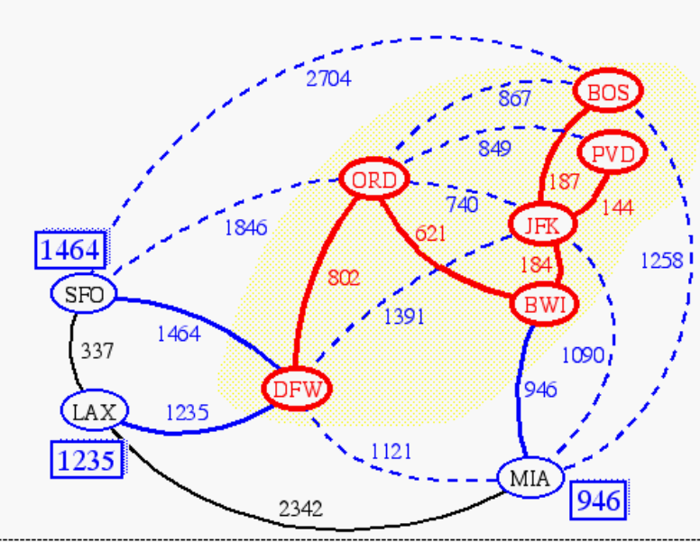
Prim(-Jarnik)’s Algorithm
Similar to Dijkstra’s algorithm (for a connected graph)
We pick an arbitrary vertex s and we grow the MST as a cloud of vertices, starting from s
We store with each vertex v a label d(v) = the smallest weight of an edge connecting v to a vertex in the cloud
At each step:
  We add to the cloud the vertex u outside the cloud with the smallest distance label
  We update the labels of the vertices adjacent to u

Slide 80
Prim’s algorithm
T = a spanning tree containing a single node s;
E = set of edges adjacent to s;
while T does not contain all the nodes {
  remove an edge (v, w) of lowest cost from E
  if w is already in T then discard edge (v, w)
  else {
    add edge (v, w) and node w to T
    add to E the edges adjacent to w
  }
}
An edge of lowest cost can be found with a priority queue
Testing for a cycle is automatic
  Hence, Prim’s algorithm is far simpler to implement than Kruskal’s algorithm (presented below)

Slide 81
Example
∞
7
2
7
D
2
7
D
B
4
B
4
8
9
∞
5
9
∞
2
5
F
2
5
F
C
8
C
8
8
3
8
3
E
E
A
7
7
A
7
7
0
0
7
7
2
7
D
7
D
B
4
2
B
4
5
9
∞
9
4
2
5
F
5
5
C
2
F
8
C
8
8
3
3
E
8
A
7
E
0
7
A
7
7
0

Slide 82
Example (contd.)
7
2
7
D
B
4
5
9
4
2
5
F
C
8
8
3
E
A
7
3
7
0
7
D
2
B
4
5
9
4
2
5
F
C
8
8
3
E
A
7
3
0

Slide 83
Prim’s algorithm
Vertex Parent
e -
b -
c -
d -
e
d
b
c
a
0
∞
∞
∞
∞
9
b
a
2
6
d
4
5
Vertex Parent
e -
b e
c e
d e
5
4
d
b
c
a
5
e
c
4
5
5
∞
The MST initially consists of the vertex e, and we update
the distances and parent for its adjacent vertices

Slide 84
Prim’s algorithm
Vertex Parent
e -
b e
c e
d e
d
b
c
a
4
5
5
∞
9
b
a
2
6
d
4
5
5
4
Vertex Parent
e -
b e
c d
d e
a d
5
e
c
a
c
b
2
4
5

Slide 85
Prim’s algorithm
Vertex Parent
e -
b e
c d
d e
a d
a
c
b
2
4
5
9
b
a
2
6
d
4
5
5
4
5
e
c
Vertex Parent
e -
b e
c d
d e
a d
c
b
4
5

Slide 86
Prim’s algorithm
Vertex Parent
e -
b e
c d
d e
a d
c
b
9
b
4
5
a
2
6
d
4
5
5
4
5
e
Vertex Parent
e -
b e
c d
d e
a d
c
b
5

Slide 87
Prim’s algorithm
Vertex Parent
e -
b e
c d
d e
a d
b
5
9
b
a
2
6
d
4
5
5
4
5
e
c
Vertex Parent
e -
b e
c d
d e
a d
The final minimum spanning tree

Slide 88
Another Approach
Create a forest of trees from the vertices
Repeatedly merge trees by adding “safe edges” until only one tree remains
A “safe edge” is an edge of minimum weight which does not create a cycle
9
b
a
2
6
d
forest: {a}, {b}, {c}, {d}, {e}
4
5
5
4
5
e
c

Slide 89
Kruskal’s algorithm
T = empty spanning tree;
E = set of edges;
N = number of nodes in graph;
while T has fewer than N - 1 edges {
  remove an edge (v, w) of lowest cost from E
  if adding (v, w) to T would create a cycle
    then discard (v, w)
    else add (v, w) to T
}
Finding an edge of lowest cost can be done just by sorting the edges
Testing for a cycle: Efficient testing for a cycle requires a additional algorithm (UNION-FIND) which we don’t cover in this course. The main idea: If both nodes v, w are in the same component of T, then adding (v, w) to T would result in a cycle.

Slide 90
Kruskal Example
2704
867
BOS
849
PVD
ORD
187
740
144
1846
621
JFK
184
1258
802
SFO
BWI
1391
1464
337
1090
DFW
946
LAX
1235
1121
MIA
2342

Slide 91
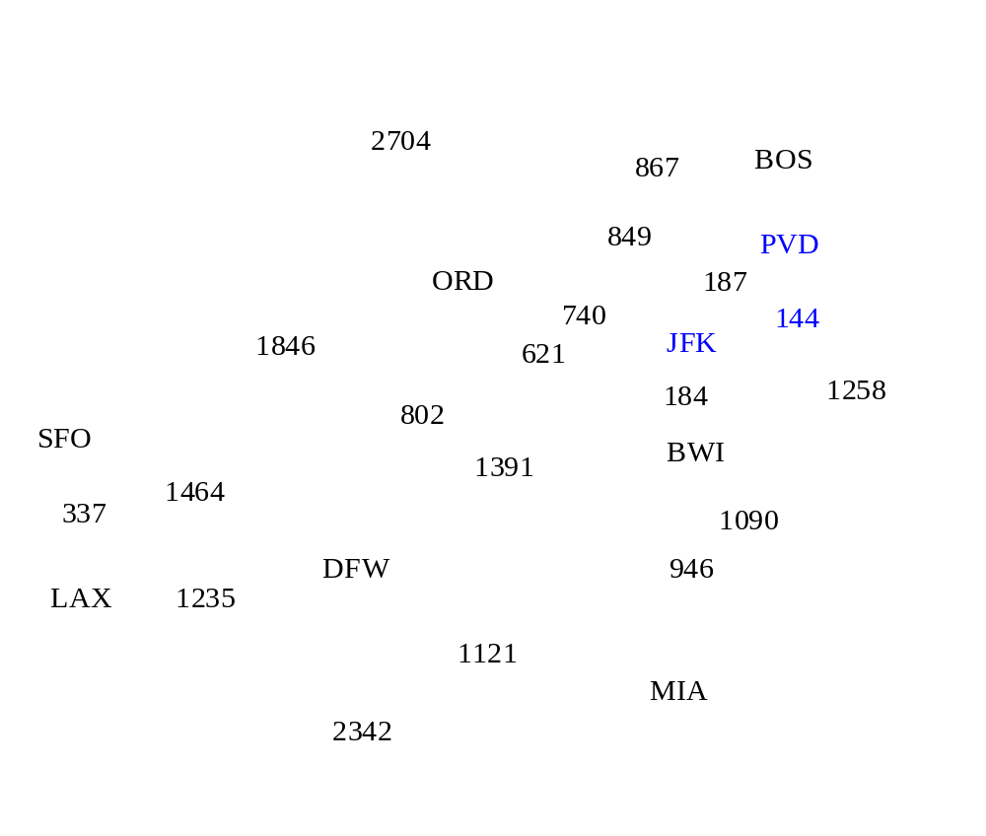
Example

Slide 92
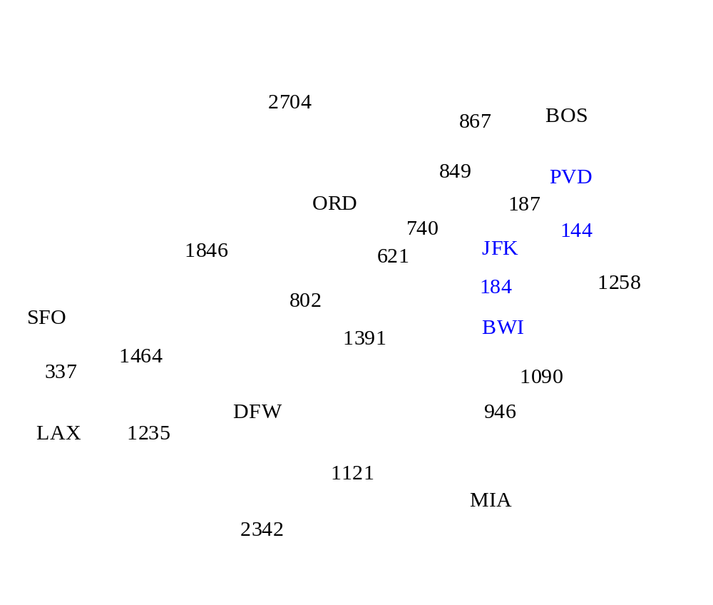
Example

Slide 93
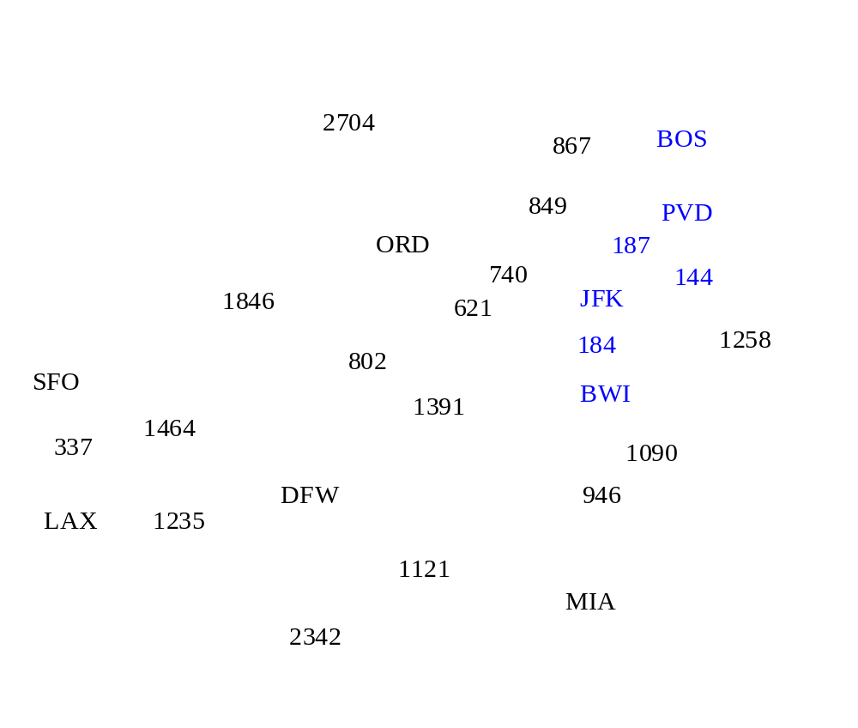
Example

Slide 94
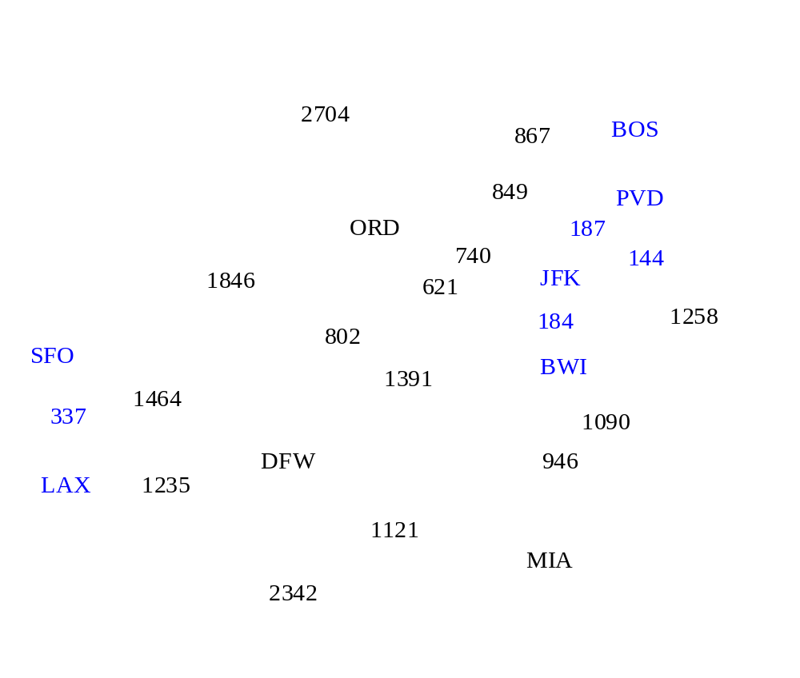
Example

Slide 95
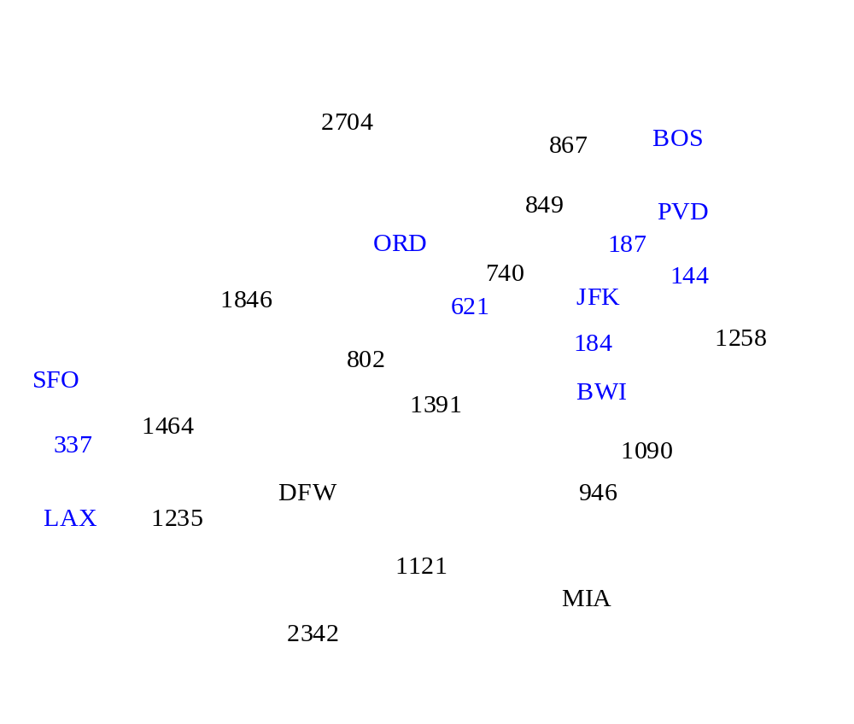
Example

Slide 96
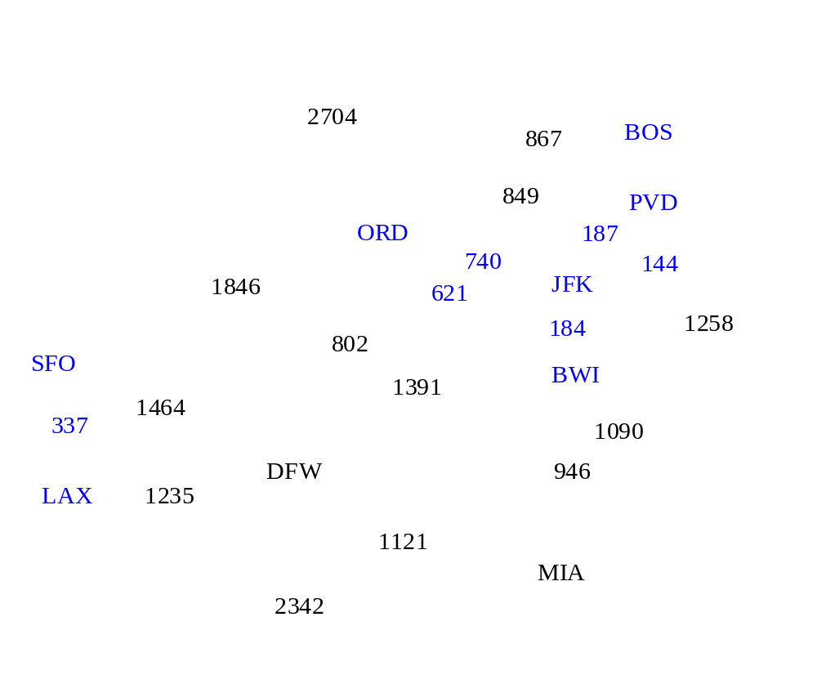
Example

Slide 97
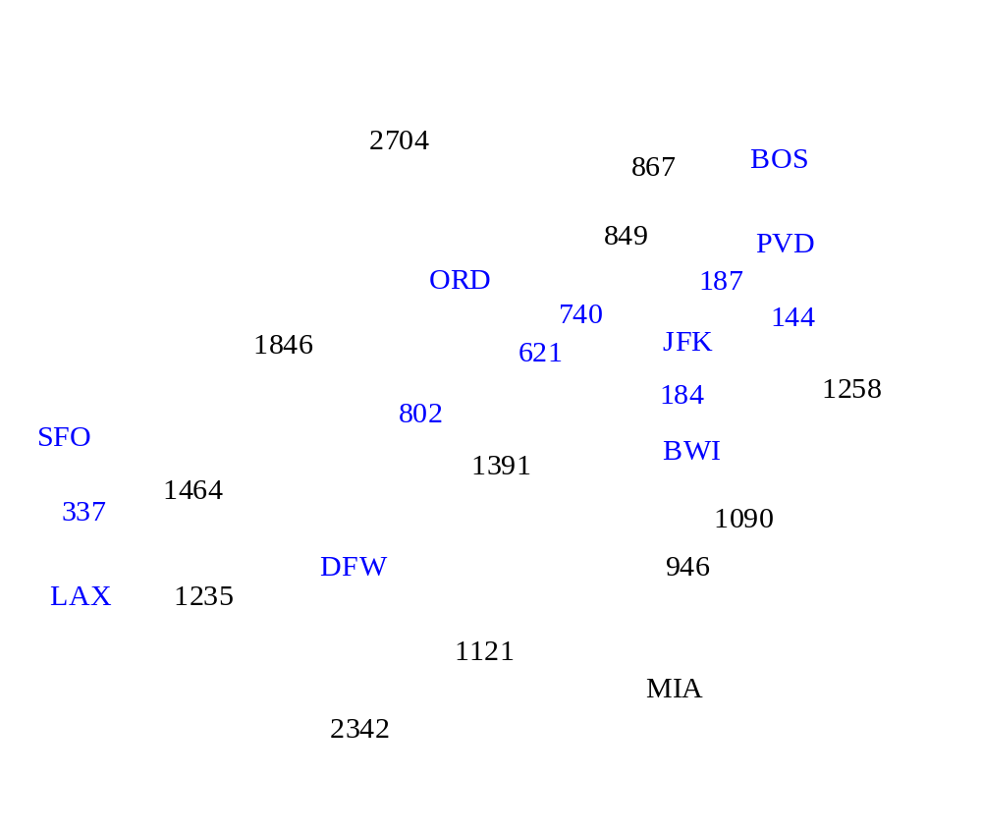
Example

Slide 98
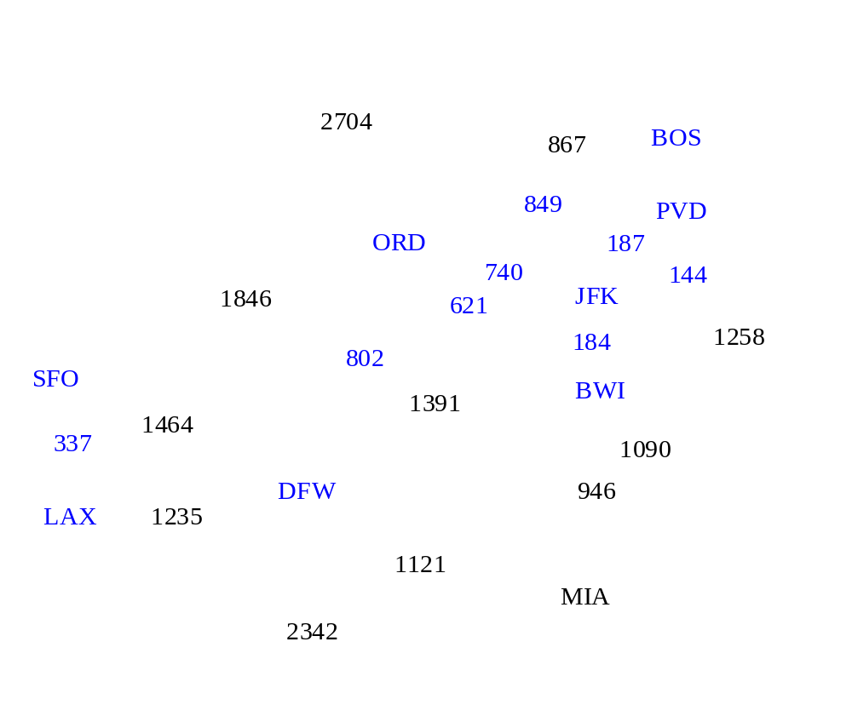
Example

Slide 99
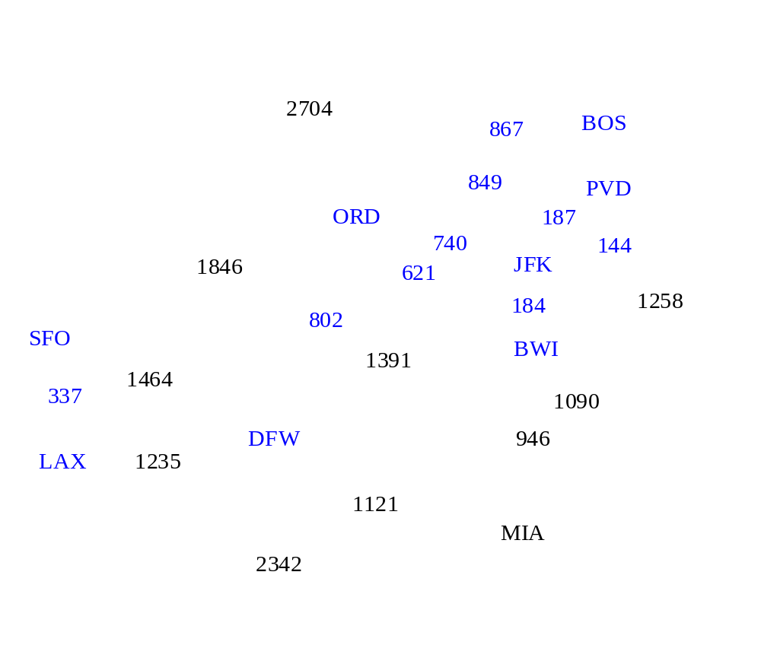
Example

Slide 100

Example

Slide 101
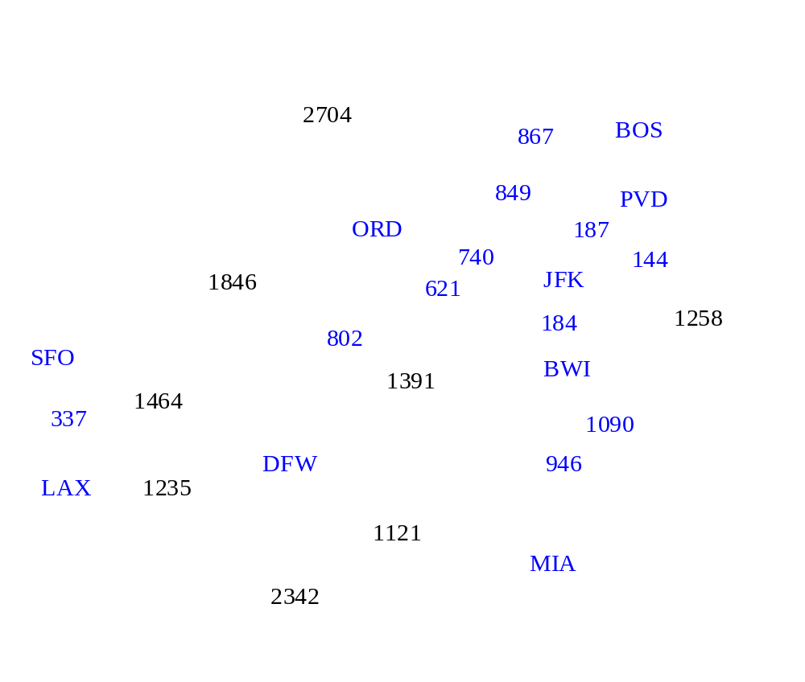
Example

Slide 102

Example

Slide 103
Example
2704
867
BOS
849
PVD
ORD
187
740
144
1846
621
JFK
184
1258
802
SFO
BWI
1391
1464
337
1090
DFW
946
LAX
1235
1121
MIA
2342

Slide 104
Time Compexity
Let v be number of vertices and e the number of edges of a given graph.
Kruskal’s algorithm: O(e log e)
Prim’s algorithm: O( e log v)
Kruskal’s algorithm is preferable on sparse graphs, i.e., where e is very small compared to the total number of possible edges: C(v, 2) = v(v-1)/2.

Slide 105
MST with Prim’s and Kruskal algorithm
4
a
2
b
3
c
5
5
4
2
1
2
d
e
f
3
3
1
3
g
7
h
5
i
4

