Slide 1
OPERATING SYSTEMS
Unix modes and system calls

Slide 2
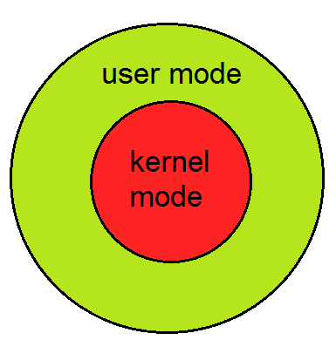
Syllabus
Almost all the modern computers have at least two modes of execution:
User mode (with the fewest privileges) and
Privileged mode (with the most).
Generally, there are three ways to execute in kernel mode:
Traps
System Calls
Interrupts

Slide 3
Syllabus
Traps are the general means for invoking the kernel from user code.
For page faults: the operating system determines the status of the faulted page and takes appropriate action (such as fetching it from secondary storage).
For programming errors: what happens depends upon what the program has previously set up. If nothing, then the program is immediately terminated. A program may establish a handler to be invoked in response to the error; the handler might clean up after the error and then terminate the process, or perhaps perform some sort of corrective action and continue with normal execution.
Signals

Slide 4
Syllabus
Traps are the general means for invoking the kernel from user code.
We usually think of a trap as an unintended request for kernel service, say that caused by a programming error such as using a bad address or dividing by zero.
For page faults: the operating system determines the status of the faulted page and takes appropriate action (such as fetching it from secondary storage).
For programming errors: what happens depends upon what the program has previously set up. If nothing, then the program is immediately terminated. A program may establish a handler to be invoked in response to the error; the handler might clean up after the error and then terminate the process, or perhaps perform some sort of corrective action and continue with normal execution.

Slide 5
Suggested Books
Silberschatz, Galvin,and Gagne, Operating Systems concepts, Wiley
Gary Nutt, Nabendu Chaki, Sarmistha Neogy, Operating Systems: A Modern Approach, Addison Wesley
D.M. Dhamdhere, Operating Systems: A Concept Based Approach, Tata McGrawHill

