Slide 1
(Instruction Codes, Registers, Common bus system,
Computer Instructions, Control Unit with Timing and
Instruction Cycle,)
Basic Computer Organization

Slide 2
Instruction Codes
The organization of the computer is defined by its internal registers, the timing and control structure, and the set of instructions that it uses.
The Internal organization of a digital system is defined by the sequence of micro-operations it performs on data stored in its registers.
The user of a computer can control the process by means of a program.
A program is a set of instructions that specify the operations, operands, and the processing sequence.

Slide 3
Instruction Codes
A computer instruction is a binary code that specifies a sequence of micro-operations for the computer. Each computer has its unique instruction set.
Instruction codes and data are stored in memory.
The computer reads each instruction from memory and places it in a control register.
The control unit interprets the binary code of the instruction and proceeds to execute it by issuing a sequence of micro-operations.

Slide 4
Instruction Codes
An Instruction code is a group of bits that instructs the computer to perform a specific operation.
The most basic part of an instruction code is its operation code part.
The operation code of an instruction is a group of bits that defines certain operations such as add, subtract, shift, and complement.

Slide 5
Instruction Codes
The number of bits required for the operation code depends on the total number of operations available in the computer.
2^{n} (or little less) distinct operations
n bit operation code

Slide 6
Instruction Codes
An operation must be performed on some data stored in processor registers or in memory.
An instruction code must therefore specify not only the operation, but also the location of the operands (in registers or in the memory), and where the result will be stored (registers/memory)

Slide 7

Instruction Codes
An instruction code is usually divided into operation code, operand address and addressing mode.
The simplest way to organize a computer is to have one processor register (Accumulator AC) and an instruction code format with two parts (op code, address)

Slide 8
Stored Program Organization
0
Memory 4096x16
15
12
11
Opcode
Address
15
0
Instruction Format
Instructions (program)
15
0
Binary Operand
15
0
Operands (data)
Processor register (Accumulator AC)

Slide 9
Indirect Address
There are three Addressing Modes used for address portion of the instruction code:
  Immediate: the operand is given in the address portion.
  Direct: the address points to the operand stored in the memory.
  Indirect: the address points to the pointer (another address) stored in the memory that references the operand in memory.
One bit of the instruction code can be used to distinguish between direct & indirect addresses

Slide 10
Indirect Address
Instruction Format
15
14
12
11
0
I
Opcode
Address
Direct Address
Indirect address
22
0
ADD
457
35
1
ADD
300
300
1350
457
Operand
1350
Operand
+
+
AC
AC

Slide 11
Indirect Address
Effective address: the address of the operand in a computation-type instruction or the target address in a branch-type instruction
The pointer can be placed in a processor register instead of memory.

Slide 12
Computer Registers
Computer instructions are normally stored in consecutive memory locations and executed sequentially one at a time.
The control reads an instruction from a specific address in memory and executes it.
This type of sequencing needs a counter to calculate the address of the next instruction after execution of the current instruction is completed.
It is also necessary to provide a register in the control unit for storing the instruction code after it is read from memory.
The computer needs processor registers for manipulating data and a register for holding a memory address.

Slide 13
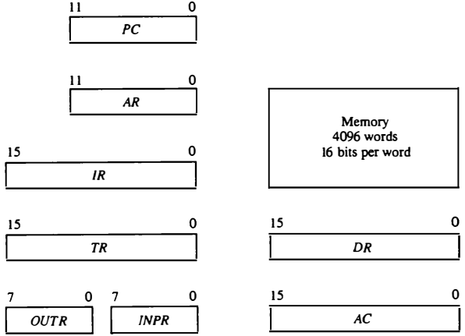
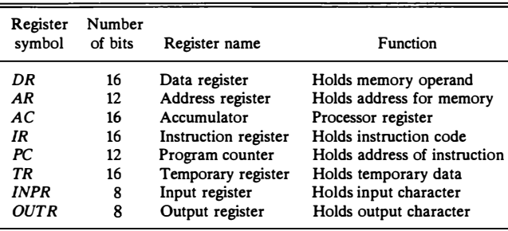
Registers for the Basic Computer

Slide 14
Computer Registers
The memory unit has a capacity of 4096 words and each word contains 16 bits.
12 bits of an instruction word are needed to specify the address of an operand.
This leaves three bits for the operation part of the instruction and a bit to specify a direct or indirect address.
The data register (DR) holds the operand read from memory.
The accumulator (AC) register is a general-purpose processing register.
The instruction read from memory is placed in the instruction register (IR).

Slide 15
Computer Registers
The temporary register (TR) is used for holding temporary data during the processing.
The memory address register (AR) has 12 bits since this is the width of a memory address.
The program counter (PC) also has 12 bits and it holds the address of the next instruction to be read from memory after the current instruction is executed.
The PC goes through a counting sequence and causes the computer to read sequential instructions previously stored in memory.
Instruction words are read and executed in sequence unless a branch instruction is encountered.

Slide 16
Computer Registers
Two registers are used for input and output.
The input register (INPR) receives an 8-bit character from an input device.
The output register (OUTR) holds an 8-bit character for an output device.

Slide 17
Common Bus System
The basic computer has eight registers, a memory unit, and a control unit
Path must be provided to transfer information form one register to another register and between memory and registers.
The number of wires will be excessive if connections are made between the outputs of each register and the inputs of the other registers.
A more efficient scheme for transferring information in a system with many registers is to use a common bus system.
A common bus can be constructed using multiplexers or three-state-buffer gates.

Slide 18
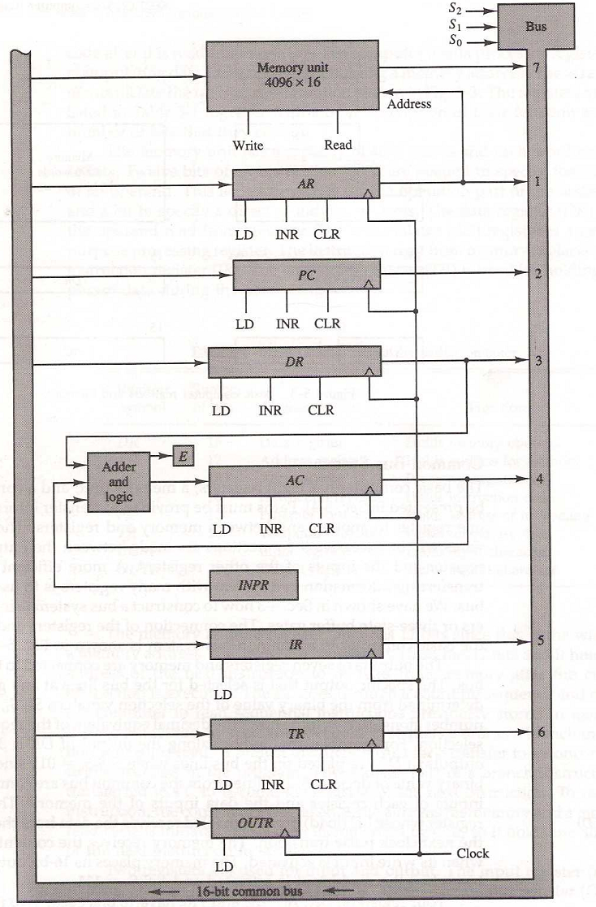
Basic computer registers connected to a common bus

Slide 19
Common Bus System
S₂S₁S₀: Selects the register/memory that would use the bus.
LD (load): When enabled, the particular register receives the data from the bus during the next clock pulse transition.
The memory receives the contents of the bus when its write input is activated.

Slide 20
Common Bus System
The memory places its 16-bit output onto the bus when the read input is activated and S₂S₁S₀=111.
DR, AC, IR, and TR have 16 bits each.
AR and PC: have 12 bits each since they hold a memory address

Slide 21
Common Bus System
When the contents of AR or PC are applied to the 16-bit common bus, the four most significant bits are set to zeros.
When AR or PC receives information from the bus, only the 12 least significant bits are transferred into the register.

Slide 22
Common Bus System
INPR and OUTR: communicate with the eight least significant bits in the bus.
INPR: Receives a character from the input device (keyboard,…etc) which is then transferred to AC.
OUTR: Receives a character from AC and delivers it to an output device (say a Monitor).

Slide 23
Common Bus System
The common bus receive information from six registers and the memory unit. The bus lines are connected to the inputs of six registers and the memory.
Five registers have three control inputs: LD (load), INR (increment), and CLR (clear). This type of register is equivalent to a binary counter with parallel load and synchronous clear.

Slide 24
Common Bus System
The increment operation is achieved by enabling the count input of the counter.
Two registers have only a LD input.

Slide 25
Common Bus System
The input data and output data of the memory are connected to the common bus.
But the memory address is connected to AR.

Slide 26
Common Bus System
Therefore, AR must always be used to specify a memory address.
By using a single register for the address, we eliminate the need for an address bus that would have been needed otherwise.

Slide 27
Common Bus System
Register → Memory: Write operation
Memory → Register: Read operation (note that AC cannot directly read from memory)
The 16-bit inputs of AC come from an adder and logic circuit. The circuit has three sets of inputs.

Slide 28
Common Bus System
One set of 16-bit inputs come from the outputs of AC.
They are used to implement register micro-operations such as complement AC and shift AC.
The inputs from DR and AC are used for arithmetic and logic micro-operations, such as add DR to AC, etc.

Slide 29
Common Bus System
The result of an addition is transferred to AC and the end carry-out of the addition is transferred to flip-flop E (extended AC bit).
The third set of 8-bit inputs come from the input register INPR.

Slide 30
Common Bus System
The content of any register can be applied onto the bus and an operation can be performed in the adder and logic circuit during the same clock cycle

Slide 31
Computer Instructions
An Instruction is a group of bits that instructs the computer to perform a specific operation.
The most basic part of an instruction is its operation code part.
The operation code of an instruction is a group of bits that defines certain operations such as add, subtract, shift, and complement.

Slide 32
Computer Instructions
The number of bits required for the operation code depends on the total number of operations available in the computer.
2^{n} (or little less) distinct operations
n bit operation code

Slide 33
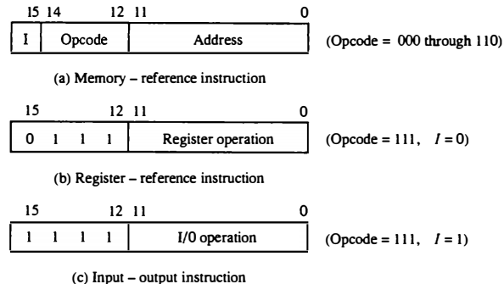
Computer Instructions
The basic computer has three instruction code formats
Each format has 16 bits.
Fig: Basic computer instruction formats

Slide 34
Computer Instructions
A memory-reference instruction uses one bit to specify the addressing mode I. I = 0 for direct, 1=Indirect
Fig: Basic computer instruction formats

Slide 35
Computer Instructions
A register-reference instruction specifies an operation on AC, other 12 bits are used to specify the operation
Fig: Basic computer instruction formats

Slide 36
Computer Instructions
An IO instruction does not need a reference to memory, remaining 12 bits are used to specify the type of IO operation
Fig: Basic computer instruction formats

Slide 37
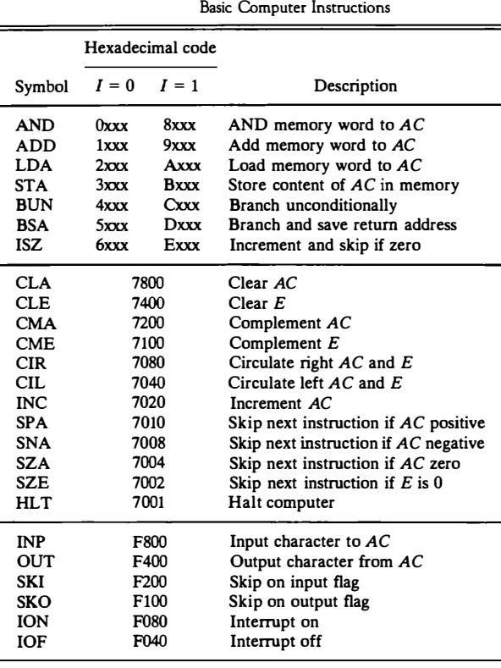
Basic computer instructions

Slide 38
Basic Computer Instructions
The 16 bits of an instruction code is reduced to equivalent four digits hexadecimal digits.
Memory-reference: the address part is denoted by three x’s and stand for the three hexadecimal digits.
Register-reference: The leftmost four bits are always 0111, which is equivalent to hexadecimal 7.
Input-output: The last four bits are always 1111, equivalent to hexadecimal F.

Slide 39
Control Unit with Timing
The timing for all registers in the basic computer is controlled by a master clock generator.
The clock pulses are applied to all flip-flops and registers in the system, including the flip-flops and registers in the control unit.
The clock pulses do not change the state of a register unless the register is enabled by a control signal (i.e., Load)

Slide 40
Control Unit with Timing
The control signals are generated in the control unit and provide control inputs for the multiplexers in the common bus, control inputs in processor registers, and micro-operations for the accumulator
There are two major types of control organization:
  Hardwired control
  Micro-programmed control

Slide 41
Control Unit with Timing
Hardwired Organization: the control logic is implemented with gates, flip-flops, decoders, and other digital circuits.
Micro-programmed Organization: the control information is stored in a control memory (if the design is modified, the micro-program in control memory has to be updated)

Slide 42
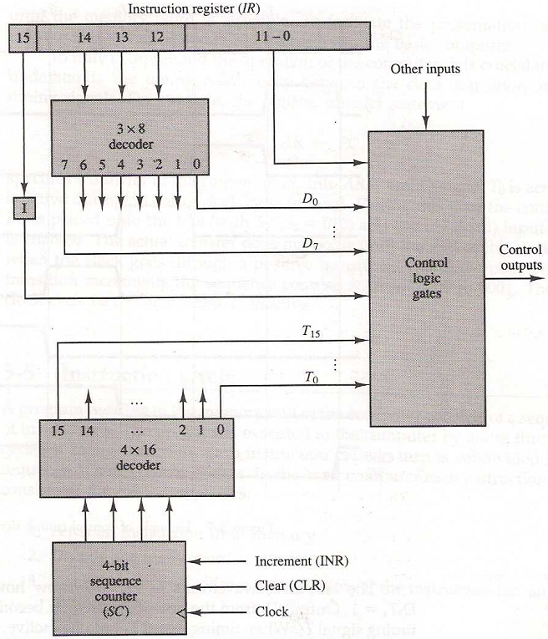
Control Unit of basic computer
Fig: Block diagram of the hardwired control unit

Slide 43
Control Unit of basic computer
It consists of two decoders, a sequence counter, and a number of control logic gates.
An instruction read from memory is placed in the instruction register (IR)
Fig: Block diagram of the hardwired control unit

Slide 44
Control Unit of basic computer
The opcode in bits are decoded with a 3 x 8 decoder. The eight outputs of the decoder are designated by the symbols D₀ through D₇.
Bit 15 of the instruction is transferred to a flip-flop I.
Bits 0 through 11 are applied to the control logic gates.
Fig: Block diagram of the hardwired control unit

Slide 45
Control Unit of basic computer
The 4-bit sequence counter can count in binary from 0 through 15.
The outputs of the counter are decoded into 16 timing signals T₀ through T₁₅.
The sequence counter SC can be incremented or cleared synchronously.
Fig: Block diagram of the hardwired control unit

Slide 46
Control Unit of basic computer
The counter is incremented to provide the sequence of timing signals out of the 4 x 16 decoder.
Fig: Block diagram of the hardwired control unit

Slide 47
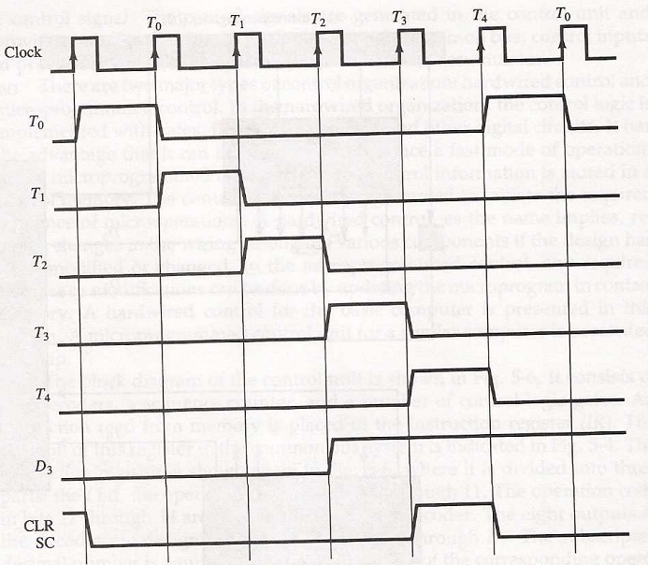
Control Timing Signals

Slide 48
Control Timing Signals
The timing diagram shows the time relationship of the control signals.
The sequence counter SC responds to the positive transition of the clock.
Fig: Diagram of Control Timing Signals

Slide 49
Control Timing Signals
Initially, the CLR input of SC is active. The first positive transition of the clock clears SC to 0, which in turn activates the timing signal T₀ out of the decoder. T₀ is active during one clock cycle.
Fig: Diagram of Control Timing Signals

Slide 50
Control Timing Signals
SC is incremented with every positive clock transition, unless its CLR input is active.
This produces the sequence of timing signals T₀, T₁, T₂, T₃, T₄ and so on, as shown in the diagram.
Fig: Diagram of Control Timing Signals

Slide 51
Control Timing Signals
The last three waveforms in diagram show how SC is cleared when D₃T₄ = 1.
Output D₃ from the operation decoder becomes active at the end of timing signal T₂.
Fig: Diagram of Control Timing Signals

Slide 52
Control Timing Signals
When timing signal T₄ becomes active, the output of the AND gate that implements the control function D₃T₄ becomes active.
This signal is applied to the CLR input of SC. On the next positive clock transition (the one marked T₄ in the diagram) the counter is cleared to 0.
Fig: Diagram of Control Timing Signals

Slide 53
Control Timing Signals
This causes the timing signal T₀ to become active instead of T₅ that would have been active if SC were incremented instead of cleared.
Fig: Diagram of Control Timing Signals

Slide 54
Instruction Cycle
A program is a sequence of instructions stored in memory.
The program is executed in the computer by going through a cycle for each instruction (in most cases).
Each instruction in turn is subdivided into a sequence of sub-cycles or phases.

Slide 55
Instruction Cycle Phases
In the basic computer each instruction cycle consists of the following phases:
  1- Fetch an instruction from memory
  2- Decode the instruction
  3- Read the effective address from memory if the instruction has an indirect address
  4- Execute the instruction
This cycle repeats indefinitely unless a HALT instruction is encountered

Slide 56
Fetch and Decode
Initially, the Program Counter (PC) is loaded with the address of the first instruction in the program.
The sequence counter SC is cleared to 0, providing a decoded timing signal T₀.
After each clock pulse, SC is incremented by one, so that the timing signals go through a sequence T₀, T₁, T₂, and so on.

Slide 57
Fetch and Decode
  T₀: AR←PC (this is essential!!)
  The address of the instruction is moved to AR.
  T₁: IR←M[AR], PC←PC+1
  The instruction is fetched from the memory to IR ,
  and the PC is incremented.
  T₂: D₀,…, D₇←Decode IR(12-14), AR←IR(0-11), I←IR(15)

Slide 58
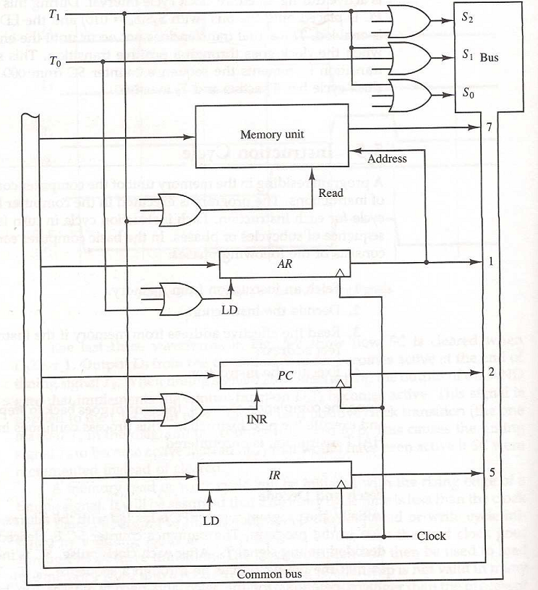
Register transfer for the fetch phase
Fig: Register transfer for the fetch phase.

Slide 59
Register transfer for the fetch phase
Figure shows how the first two register transfer statements are implemented in the bus system.
Fig: Register transfer for the fetch phase.

Slide 60
Register transfer for the fetch phase
T₀. (T₀: AR←PC)
To transfer the from PC to AR we must apply timing signal
Place the content of PC onto the bus by making the bus selection inputs S₂, S₁, S₀ equal to 010.
Transfer the content of the bus to AR by enabling the LD input of AR.
Fig: Register transfer for the fetch phase.

Slide 61
Register transfer for the fetch phase
T₁: IR←M[AR], PC←PC+1
To implement the second statement, we need timing signal T₁.
Enable the read input of memory.
Place the content of memory onto the bus by making S₂S₁S₀=111.
Fig: Register transfer for the fetch phase.

Slide 62
Register transfer for the fetch phase
Transfer the content of the bus to IR by enabling the LD input of IR.
Increment PC by enabling the INR input of PC.
Fig: Register transfer for the fetch phase.

Slide 63
Register transfer for the fetch phase
The bus system shows how T0 and T1 are connected to the control inputs of the registers, the memory, and the bus selection inputs.
Multiple input OR gates are included because there are other control functions that will initiate similar operations.
Fig: Register transfer for the fetch phase.

Slide 64
Determine the Type of Instruction
How the control determines the instruction cycle type after the decoding.

Slide 65
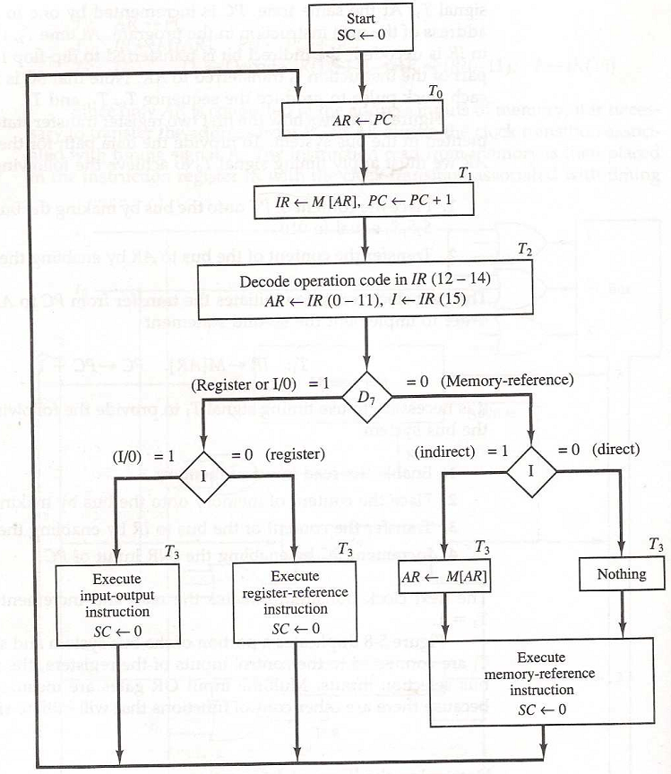
Determine the Type of Instruction
The flowchart shows the initial configurations for the instruction cycle and also how the control determines the instruction cycle type after the decoding.
Fig: Flowchart for instruction cycle

Slide 66
Determine the Type of Instruction
The timing signal that is active after the decoding is T₃.
During time T₃, the control unit determine the type of instruction that was read from the memory.
Fig: Flowchart for instruction cycle

Slide 67
Determine the Type of Instruction
If D₇=1, the instruction must be a register-reference or input-output type.
If D₇ = 0, the instruction must be a memory-reference instruction.
Fig: Flowchart for instruction cycle

Slide 68
Determine the Type of Instruction
when D₇ = 0, the operation code must be one of the other seven values 000 through 110.
Fig: Flowchart for instruction cycle

Slide 69
Determine the Type of Instruction
Control then inspects the value of the first bit of the instruction, which is now available in flip-flop I.
Fig: Flowchart for instruction cycle

Slide 70
Determine the Type of Instruction
If D₇ = 0 and I = 1, indicates a memory-reference instruction with an indirect address. So it is then necessary to read the effective address from memory.
Fig: Flowchart for instruction cycle

Slide 71
Determine the Type of Instruction
If D₇ = 0 and I = 0, indicates a memory-reference instruction with a direct address.
Fig: Flowchart for instruction cycle

Slide 72
Determine the Type of Instruction
If D₇ = 1 and I = 0, indicates a register-reference instruction.
If D₇ = 1and I = 1, indicates an input-output instruction.
Fig: Flowchart for instruction cycle

Slide 73
Determine the Type of Instruction
The three instruction types are subdivided into four separate paths.
The selected operation is activated with the clock transition associated with timing signal T₃.
Fig: Flowchart for instruction cycle

Slide 74
Determine the Type of Instruction
Symbolized:-
D'7IT3: AR ← M[AR]
D'7I'T3: Nothing
D7I'T3: Execute a register-reference instr.
D7IT3: Execute an input-output instr.
Fig: Flowchart for instruction cycle

Slide 75
Determine the Type of Instruction
A register-reference or input-output instruction can be executed with the clock associated with timing signal T₃.
Fig: Flowchart for instruction cycle

Slide 76
Determine the Type of Instruction
The execution of the memory-reference instruction can be continued with timing variable T₄, when instruction with I=0.
Fig: Flowchart for instruction cycle

Slide 77
Determine the Type of Instruction
After the instruction is executed, SC is cleared to 0 and control returns to the fetch phase with T₀=1.

Slide 78
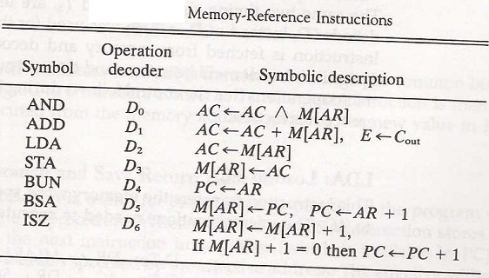
Memory-reference instruction

Slide 79
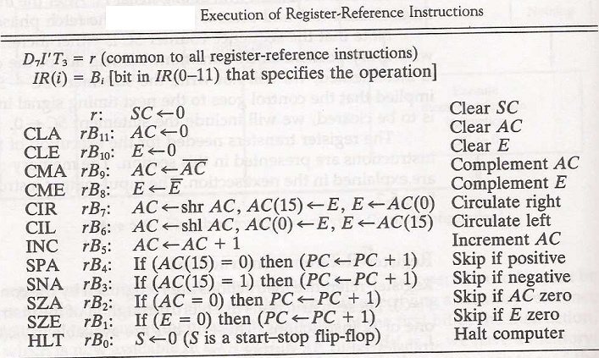
Register-reference instruction

Slide 80
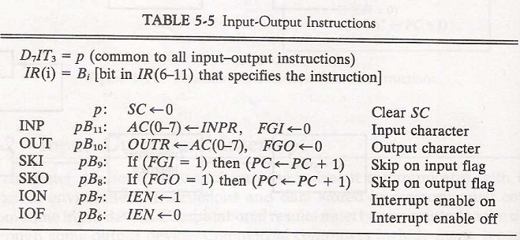
Input-output instruction

