Slide 1
B Tree

Slide 2
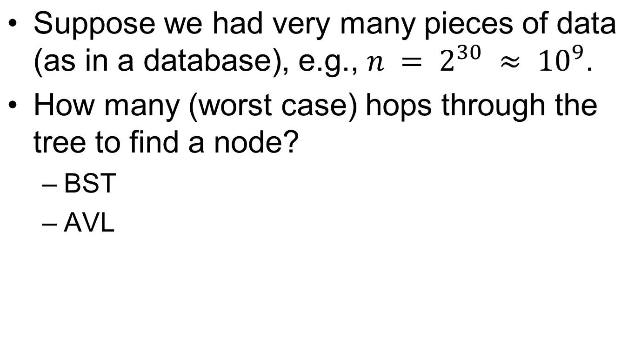
Traversing very large datasets

Slide 3
Memory considerations
What is in a tree node? In an object?
  Node:
    Object obj;
    Node left;
    Node right;
    Node parent;
  Object:
    Key key;
    …data…
Suppose the data is 1KB. How much space does the tree take? How much of the data can live in 1GB of RAM?

Slide 4
Minimizing random disk access
In our example, almost all of our data structure is on disk.
Thus, hopping through a tree amounts to random accesses to disk.
How can we address this problem?

Slide 5
M-ary Search Tree
Maximum branching factor of M
Complete tree has depth = log_{M}N
Each internal node in a complete tree has
M - 1 keys
Notes:
So, we’ll try to solve this problem as we did with heaps.
Here’s the general idea. We create a search tree with a branching factor of M.
Each node has M-1 keys and we search between them.
What’s the runtime?
O(log_{M}n)?
That’s a nice thought, and it’s the best case. What about the worst case?
Is the tree guaranteed to be balanced?
Is it guaranteed to be complete?
Might it just end up being a binary tree?

Slide 6
B-Tree Properties
Properties
  maximum branching factor of M
  the root has between 2 and M children or at most L keys
  other internal nodes have between ⎡M/2⎤ and M children
  internal nodes contain only search keys (no data)
  smallest datum between search keys x and y equals x
  each (non-root) leaf contains between ⎡L/2⎤ and L keys
  all leaves are at the same depth
Result
  tree is Θ(log_{M} n) deep
  all operations run in Θ(log_{M} n) time
  operations pull in about M/2 or L/2 items at a time
Notes:
The result of all this is that the tree in the worst case is log n deep.
In particular, it’s about log_{M/2}n deep.
Does this matter asymptotically?
No.
What about practically?
YES!
Since M and L are considered constants, all operations run in log n time.
Each operation pulls in at most M search keys or L items at a time.
So, we can tune L and M to the size of a disk block!

Slide 7
Basic operation on B-tree
B-TREE-SEARCH :-Searching in B Tree
B-TREE-INSERT :-Inserting key in B Tree
B-TREE-CREATE :-Creating a B Tree
B-TREE-DELETE :- Deleting a key from B
Tree

Slide 8
Constructing a B-tree
Suppose we start with an empty B-tree and keys arrive in the following order:1 12 8 2 25 6 14 28 17 7 52 16 48 68 3 26 29 53 55 45
We want to construct a B-tree of degree 3
The first four items go into the root:
To put the fifth item in the root would violate condition
Therefore, when 25 arrives, pick the middle key to make a new root
1
2
8
12

Slide 9
Constructing a B-tree
Add 6 to the tree
Exceeds Order. Promote middle and split.
1
2
8
12
25
1 12 8 2 25 6 14 28 17 7 52 16 48 68 3 26 29 53 55 45

Slide 10
Constructing a B-tree (contd.)
8
1
2
12
25
6, 14, 28 get added to the leaf nodes:
8
1 12 8 2 25 6 14 28 17 7 52 16 48 68 3 26 29 53 55 45
1
2
6
14
28
1
2
12
25

Slide 11
Constructing a B-tree (contd.)
Adding 17 to the right leaf node would over-fill it, so we take the middle key, promote it (to the root) and split the leaf
8
25
28
28
1
2
6
17
2
12
14
1 12 8 2 25 6 14 28 17 7 52 16 48 68 3 26 29 53 55 45
1 12 8 2 25 6 14 28 17 7 52 16 48 68 3 26 29 53 55 45

Slide 12
Constructing a B-tree (contd.)
7, 52, 16, 48 get added to the leaf nodes
8
17
7
25
28
48
1
2
6
12
14
52
1 12 8 2 25 6 14 28 17 7 52 16 48 68 3 26 29 53 55 45
16

Slide 13
Constructing a B-tree (contd.)
Adding 68 causes us to split the right most leaf, promoting 48 to the root
8
17
1 12 8 2 25 6 14 28 17 7 52 16 48 68 3 26 29 53 55 45
1
2
6
7
12
14
16
25
28
48
52
68

Slide 14
Constructing a B-tree (contd.)
Adding 3 causes us to split the left most leaf
8
17
48
7
2
6
7
12
14
16
1
3
25
28
52
68
1 12 8 2 25 6 14 28 17 7 52 16 48 68 3 26 29 53 55 45

Slide 15
Constructing a B-tree (contd.)
Add 26, 29, 53, 55 then go into the leaves
3
8
17
48
1
2
6
7
12
14
16
25
26
28
52
53
68
55
29
1 12 8 2 25 6 14 28 17 7 52 16 48 68 3 26 29 53 55 45

Slide 16
Constructing a B-tree (contd.)
Add 45 increases the trees level
Exceeds Order. Promote middle and split.
Exceeds Order. Promote middle and split.
3
8
17
48
1 12 8 2 25 6 14 28 17 7 52 16 48 68 3 26 29 53 55 45
1
2
6
7
12
14
16
25
26
28
29
45
52
53
55
68

Slide 17
Deleting from B-Trees

Slide 18
The Concept
You can delete a key entry from any node.
->Therefore, you must ensure that before/after deletion, the B-Tree maintains its properties.
When deleting, you have to ensure that a node doesn’t get too small (minimum node size is T – 1). We prevent this by combining nodes together.

Slide 19
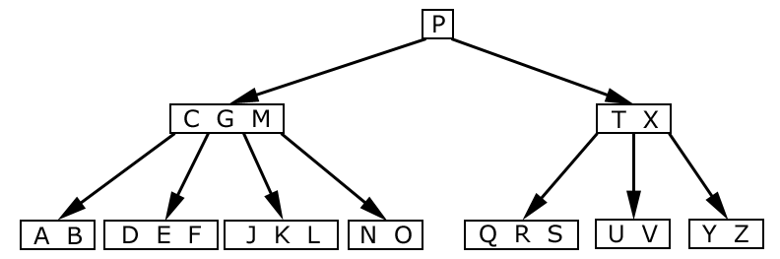
Lets look at an example:
We’re given this valid B-Tree
Note: T = 3
Source: Introduction to Algorithms, Thomas H. Cormen

Slide 20
Deletion Cases
Case 1: If the key k is in node x and x is a leaf node having atleast t keys - then delete k from x.
x
x
… k …
leaf
… …
≥ t keys
≥ t–1 keys

Slide 21
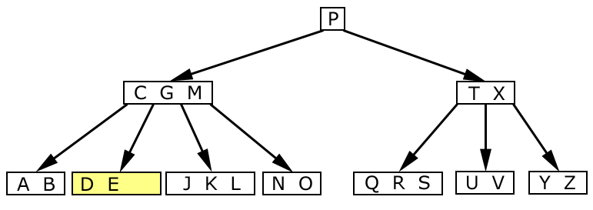
Simple Deletion
Case 1: We delete “F”
Result: We remove “F” from the leaf node. No further action needed.
F
Source: Introduction to Algorithms, Thomas H. Cormen

Slide 22
Deletion Cases (Continued)
Case 2: If the child key k is in node x and x is an internal node, do the following:
x
not a leaf
… k …
y
z

Slide 23
Deletion Cases (Continued)
Subcase a: If the child y that precedes k has at least t keys then find predecessor k´ of k in subtree rooted at y, recursively delete k´ and replace k by k´ in x.
x
x
not a leaf
… k …
… k´…
y
y
≥ t keys
≥ t keys
pred
of k
k´

Slide 24
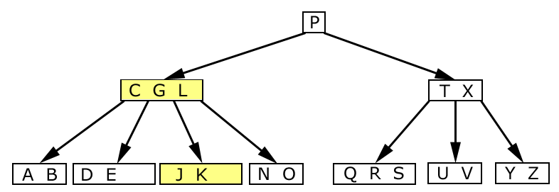
Deleting and shifting
Case 2a: We deleted “M”
Result: We remove “M” from the parent node. Since there are four nodes and two letters, we move “L” to replace “M”. Now, the “N O” node has a parent again.
M
L
Source: Introduction to Algorithms, Thomas H. Cormen

Slide 25
Deletion Cases (Continued)
Subcase B: Symmetrically, if the child z that follows k in node x has at least t keys then find successor k´ of k in subtree rooted at z, recursively delete k´and replace k by k´ in x.
x
x
not a leaf
… k …
… k´…
z
z
≥ t keys
≥ t keys
succ
of k
k´
B-Trees - <number>

Slide 26
Deletion Cases (Continued)
Subcase C: y and z both have t–1 keys -- merge k and z into y, free z, recursively delete k from y.
x
x
not a leaf
… k …
not a leaf
… …
y
z
y
y’s keys, k, z’s keys
t–1 keys
t–1 keys
2t–1 keys

Slide 27
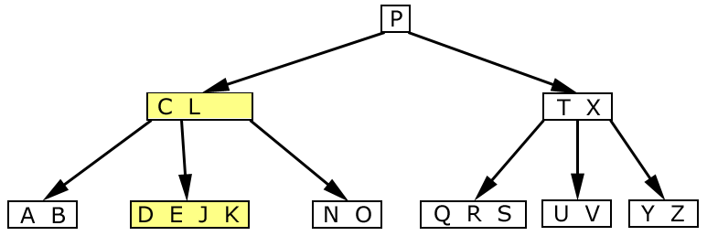
Combining and Deleting
Case 2c: Now, we delete “G”
Result: First, we combine nodes “DE” and “JK”. Then, we push down “G” into the “DEJK” node and delete it as a leaf.
Source: Introduction to Algorithms, Thomas H. Cormen

Slide 28
Combining and Deleting
Case 2c: Now, we delete “G”
Result: First, we combine nodes “DE” and “JK”. Then, we push down “G” into the “DEJK” node and delete it as a leaf.
C L
D E J K
G
Source: Introduction to Algorithms, Thomas H. Cormen

Slide 29
Deletion Cases (Continued)
Case 3: k not in internal node. Let c_{i}[x] be the root of the
subtree that must contain k, if k is in the tree.
If c_{i}[x] has at least t keys, then recursively descend;
otherwise, execute 3.A and 3.B as necessary.

Slide 30
Deletion Cases (Continued)
Subcase A: c_{i}[x] has t–1 keys, some sibling has at least t keys.
recursively
descend
x
x
not a leaf
k1
k2
… …
… …
c_{i}[x]
k2
c_{i}[x]
k1
…
…
t–1 keys
t keys
k
k
Comp 750, Fall 2009

Slide 31
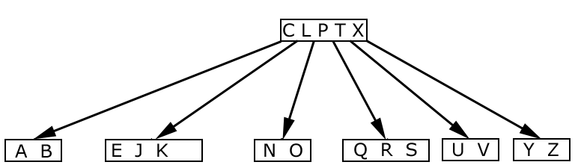
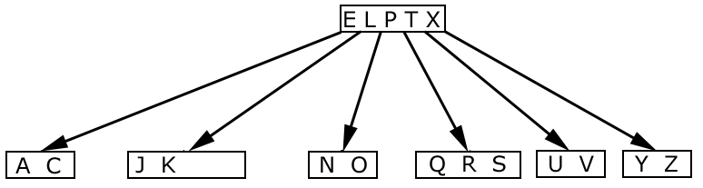
Deleting “B”
Before:
After: Deleted “B”, Demoted “C”, Promoted “E”

Slide 32
Deletion Cases (Continued)
Subcase B: c_{i}[x] and sibling both have t–1 keys.
recursively
descend
x
x
not a leaf
k1
… …
… …
c_{i}[x]
c_{i}[x]
k1
c_{i+1}[x]
c_{i}[x]’s keys, , c_{i+1}[x]’s keys
t–1 keys
t–1 keys
2t–1 keys
k
k
Comp 750, Fall 2009
B-Trees - <number>

Slide 33
Combining and Deleting
Case 3b: Now, we delete “D”
Result: First, we combine nodes “DE” and “JK”. Then, we push down “G” into the “DEJK” node and delete “D” as a leaf.
C L
E G J K
D
Source: Introduction to Algorithms, Thomas H. Cormen

Slide 34
Type #1: Simple leaf deletion
Assuming a 5-way
B-Tree, as before...
12
29
52
2
7
9
15
22
31
43
56
69
72
Delete 2: Since there are enough
keys in the node, just delete it
Note when printed: this slide is animated
CSCI 2720

Slide 35
Type #2: Simple non-leaf deletion
12
29
52
Delete 52
56
7
9
15
22
31
43
56
69
72
Borrow the predecessor
or (in this case) successor
Note when printed: this slide is animated
CSCI 2720

Slide 36
Type #4: Too few keys in node and its siblings
12
29
56
Join back together
7
9
15
22
31
43
69
72
Too few keys!
Delete 72
Note when printed: this slide is animated
CSCI 2720

Slide 37
Type #4: Too few keys in node and its siblings
12
29
7
9
15
22
31
43
56
69
Note when printed: this slide is animated
CSCI 2720

Slide 38
Type #3: Enough siblings
12
29
Demote root key and
promote leaf key
7
9
15
22
31
43
56
69
Delete 22
Note when printed: this slide is animated
CSCI 2720

Slide 39
Type #3: Enough siblings
12
31
7
9
15
29
43
56
69
Note when printed: this slide is animated
CSCI 2720

