Slide 1
Security at Network Layer

Slide 2
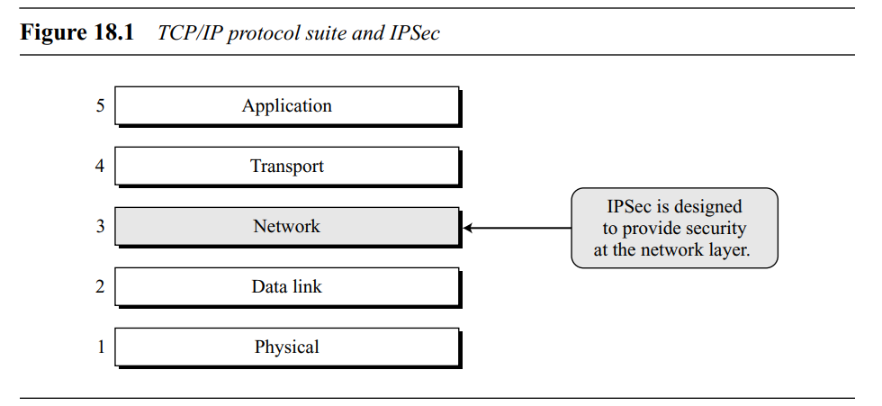
IPSec
To Provide security at Network layer, we use IPSec protocol
IP Security (IPSec) is a collection of protocols designed by the Internet Engineering Task Force (IETF) to provide security for a packet at the network level.
IPSec helps create authenticated and confidential packets for the IP layer

Slide 3
Why IPSec is used?
It can enhance the security of those client/server programs, such as electronic mail, that use their own security protocols. (Security at Application layer)
It can enhance the security of those client/ server programs, such as HTTP, that use the security services provided at the transport layer. (Security at Transport Layer)
It can provide security for those client/server programs that do not use the security services provided at the transport layer.(No Security provided at previous layers)

Slide 4
Two Modes
IPSec operates in one of two different modes:
Transport mode
Tunnel mode

Slide 5
Transport Mode
In transport mode, IPSec protects what is delivered from the transport layer to the network layer. In other words, transport mode protects the network layer payload, the payload to be encapsulated in the network layer.
Transport layer
Transport Layer Payload
IPSec layer
IPSec-H
Transport Layer Payload
IPSec-T
H-header
T-trailer
Network layer
IP-Header
IP payload
H-header
IPSec in transport Mode

Slide 6
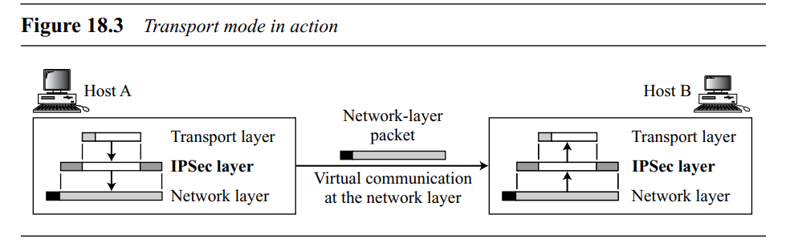
IPSec in transport mode does not protect the IP header; it only protects the information coming from the transport layer.
In this mode, the IPSec header (and trailer) are added to the information coming from the transport layer. The IP header is added later.
Transport mode is normally used when we need host-to-host (end-to-end) protection of data.
The sending host uses IPSec to authenticate and/or encrypt the payload delivered from the transport layer.
The receiving host uses IPSec to check the authentication and/or decrypt the IP packet and deliver it to the transport layer.

Slide 7
Tunnel Mode
In tunnel mode, IPSec protects the entire IP packet. It takes an IP packet, including the header, applies IPSec security methods to the entire packet, and then adds a new IP header
Network layer
IP-H
IP payload
IPSec layer
IPSec-H
IPSec-T
Network layer
IP-H
New IP payload
New header

Slide 8
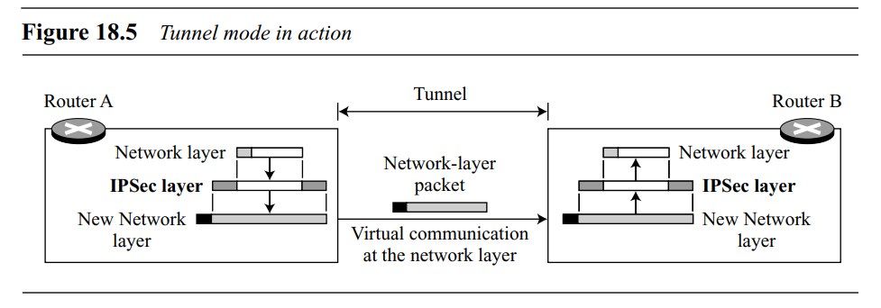
IPSec in tunnel mode protects the original IP header
The new IP header, as we will see shortly, has different information than the original IP header.
Tunnel mode is normally used between two routers, between a host and a router, or between a router and a host,
In other words, tunnel mode is used when either the sender or the receiver is not a host.

Slide 9
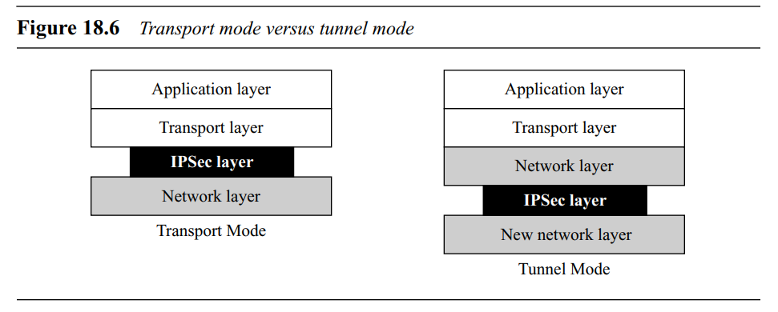
Comparison
In transport mode, the IPSec layer comes between the transport layer and the network layer.
In tunnel mode, the flow is from the network layer to the IPSec layer and then back to the network layer again

Slide 10
TWO SECURITY PROTOCOLS
IPSec defines two protocols:
Authentication Header (AH) Protocol
Encapsulating Security Payload (ESP) Protocol
to provide authentication and/or encryption for packets at the IP level.

Slide 11
Authentication Header (AH)
The Authentication Header (AH) Protocol is designed to authenticate the source host and to ensure the integrity of the payload carried in the IP packet.
The protocol uses a hash function and a symmetric key to create a message digest.
the digest is inserted in the authentication header.
The AH is then placed in the appropriate location, based on the mode (transport or tunnel).
The AH protocol provides source authentication and data integrity, but not privacy

Slide 12
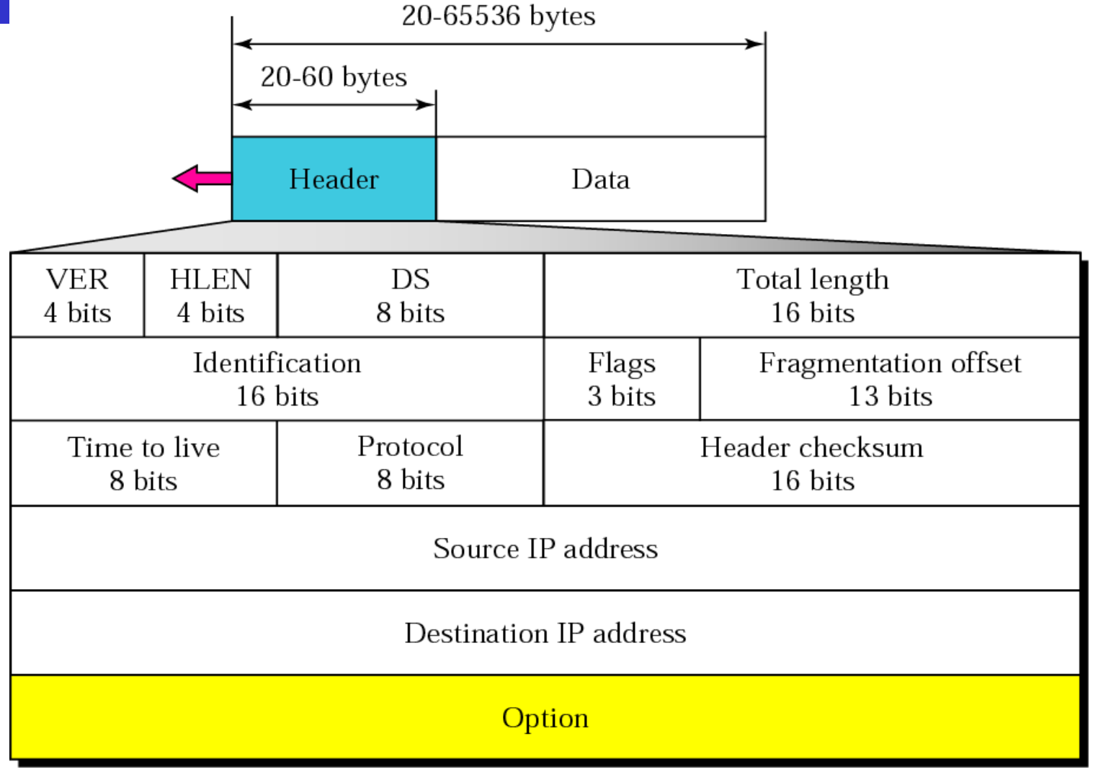
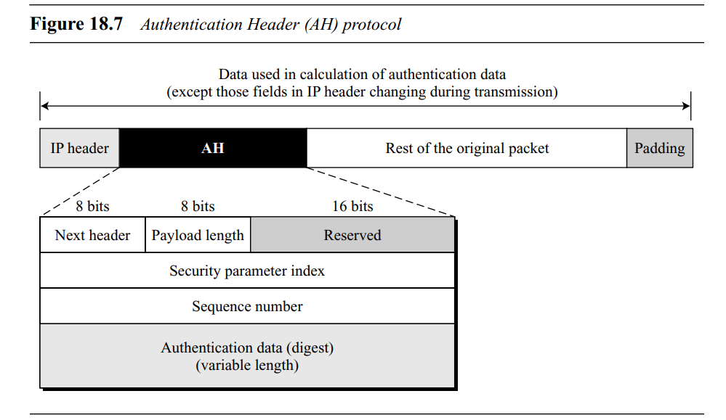
Authentication header-AH
IPV4 header
When an IP datagram carries an authentication header, the original value in the protocol field of the IP header is replaced by the value 51. A field inside the authentication header (the next header field) holds the original value of the protocol field (the type of payload being carried by the IP datagram)

Slide 13
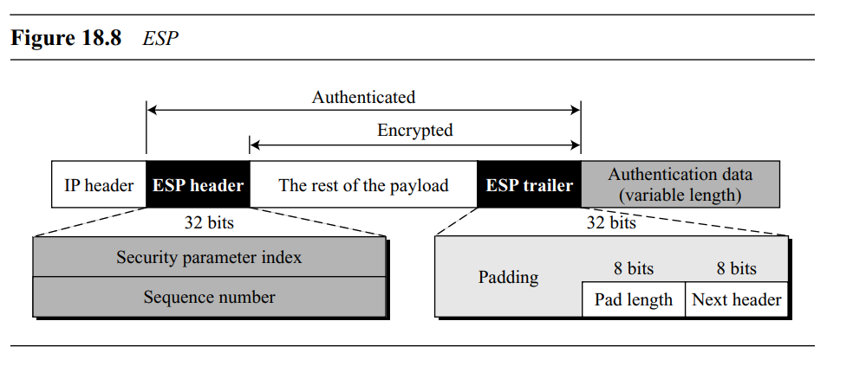
Encapsulating Security Payload (ESP)
The AH protocol does not provide privacy, only source authentication and data integrity. IPSec later defined an alternative protocol, Encapsulating Security Payload (ESP), that provides source authentication, integrity, and privacy.

Slide 14
ESP provides source authentication, data integrity, and privacy.
IPSec supports both IPv4 and IPv6.
When an IP datagram carries an ESP header and trailer, the value of the protocol field in the IP header is 50.
Note the difference between the authentication data in AH and ESP. In AH, part of the IP header is included in the calculation of the authentication data; in ESP, it is not.

Slide 15
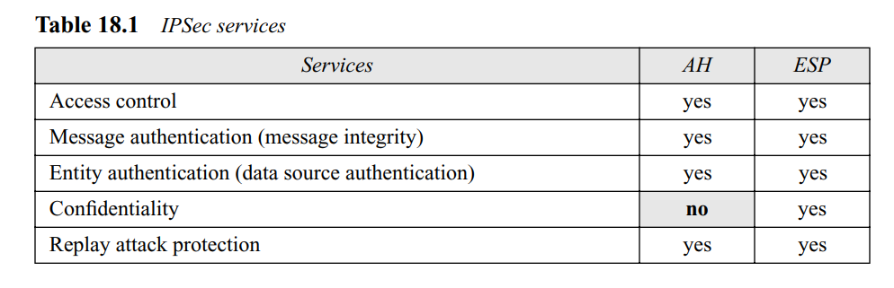
Services Provided by IPSec
List of services available for each protocol

Slide 16
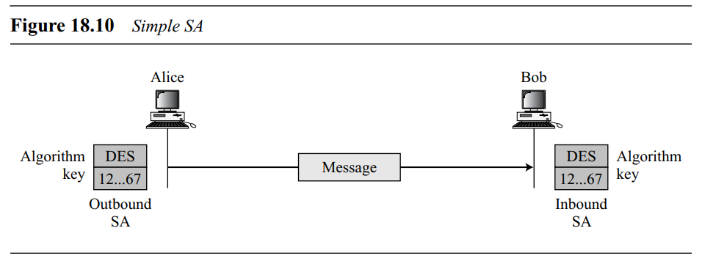
SECURITY ASSOCIATION
Idea of Security Association
IPSec requires a logical relationship, called a Security Association (SA), between two hosts.
A Security Association is a contract between two parties, it creates a secure channel between them.
In simpler terms, Security Association is a set of rules for secure transmission.

Slide 17
Security Association Database (SAD)
A Security Association can be very complex.
This is particularly true if Alice wants to send messages to many people and Bob needs to receive messages from many people.
In addition, each site needs to have both inbound and outbound SAs to allow bidirectional communication.
In other words, we need a set of SAs that can be collected into a database. This database is called the Security Association Database (SAD).
The database can be thought of as a two-dimensional table with each row defining a single SA.

Slide 18
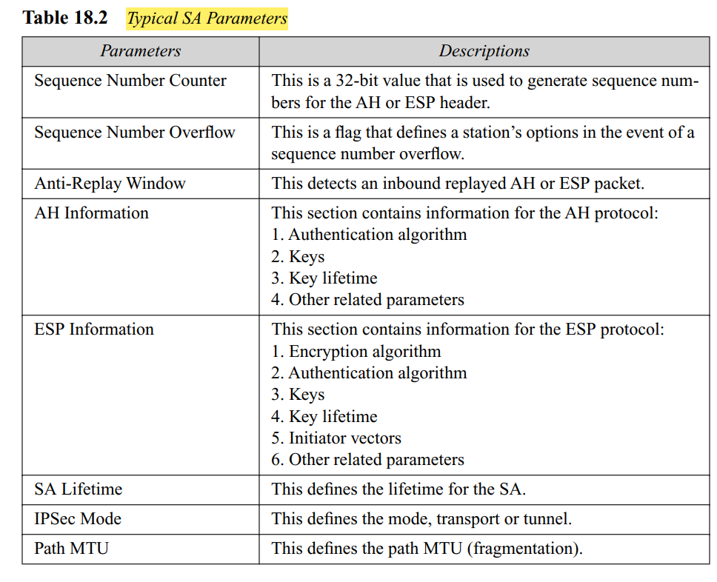
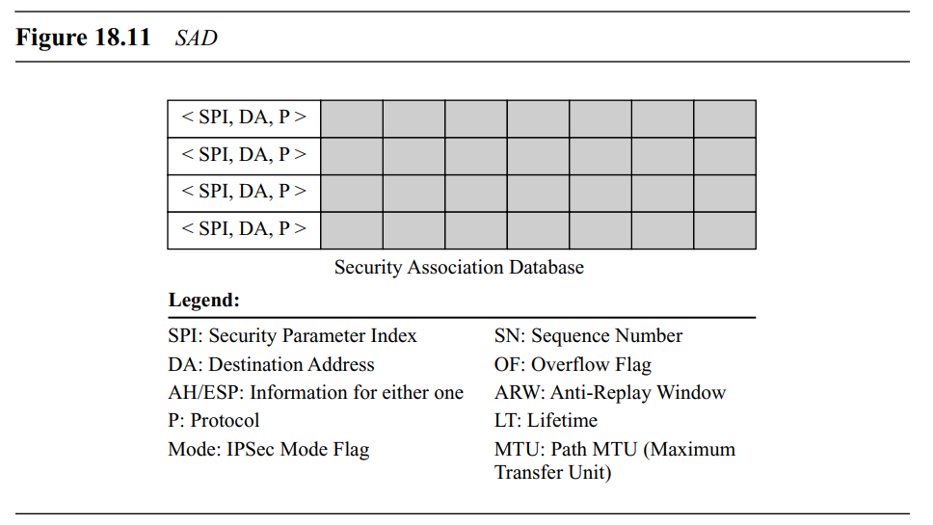
Each entry in an inbound SAD is selected using a triple index:
Security parameter index
Destination address
Protocol

Slide 19
SECURITY POLICY
Security Policy (SP), which defines the type of security applied to a packet when it is to be sent or when it has arrived.
Before using the SAD, a host must determine the predefined policy for the packet.

Slide 20
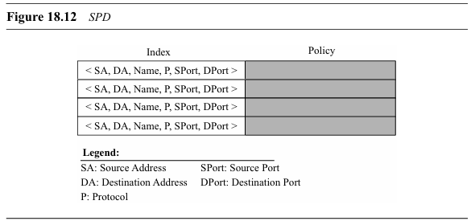
Security Policy Database
Each host that is using the IPSec protocol needs to keep a Security Policy Database (SPD).
Again, there is a need for an inbound SPD and an outbound SPD.
Each entry in the SPD can be accessed using a sixtuple index: source address, destination address, name, protocol, source port, and destination port,

Slide 21
Security Policy Database
Source and destination addresses can be unicast, multicast, or wildcard addresses.
The name usually defines a DNS entity.
The protocol is either AH or ESP.
The source and destination ports are the port addresses for the process running at the source and destination hosts.

Slide 22
Outbound SPD
When a packet is to be sent out, the outbound SPD is consulted
The input to the outbound SPD is the sixtuple index; the output is one of the three following cases:
DROP:-This means that the packet defined by the index cannot be sent; it is dropped.
BYPASS:- This means that there is no policy for the packet with this policy index; the packet is sent, bypassing the security header application.
APPLY:- In this case, the security header is applied. Two situations may occur

Slide 23
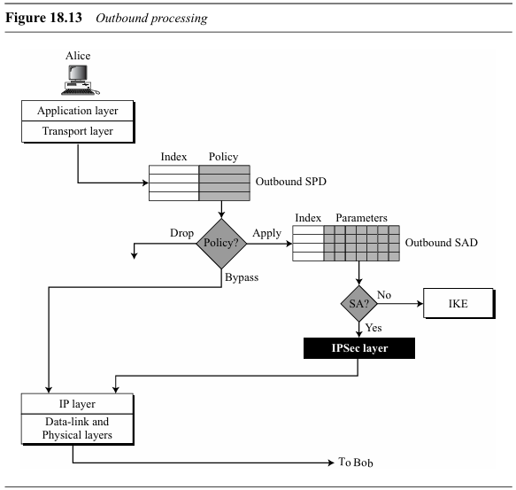

Slide 24
Inbound SPD
When a packet arrives, the inbound SPD is consulted.
Each entry in the inbound SPD is also accessed using the same sixtuple index.
The input to the inbound SPD is the sixtuple index; the output is one of the three following cases:
Discard. This means that the packet defined by that policy must be dropped.
Bypass. This means that there is no policy for a packet with this policy index; the packet is processed, ignoring the information from AH or ESP header. The packet is delivered to the transport layer.
Apply. In this case, the security header must be processed. Two situations may occur:

Slide 25
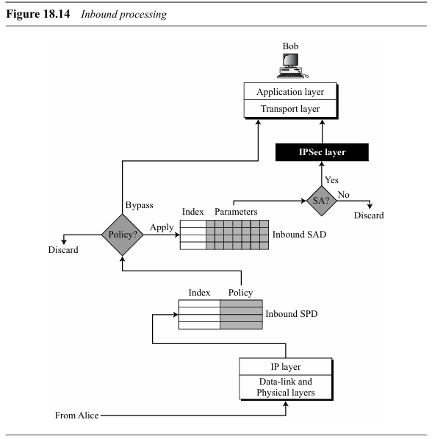

Slide 26
INTERNET KEY EXCHANGE (IKE)
The Internet Key Exchange (IKE) is a protocol designed to create both inbound and outbound Security Associations.
when a peer needs to send an IP packet, it consults the Security Policy Database (SPDB) to see if there is an SA for that type of traffic.
If there is no SA, IKE is called to establish one
IKE creates SAs for IPSec.

Slide 27
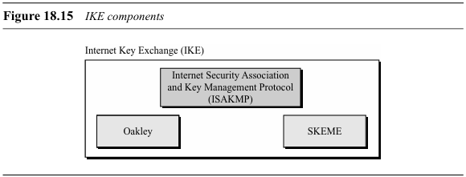
IKE is a complex protocol based on three other protocols: Oakley, SKEME, and ISAKMP

Slide 28
IKE components
The Oakley protocol was developed by Hilarie Orman. It is a key creation protocol based on the Diffie-Hellman key-exchange method, but with some improvements
SKEME, designed by Hugo Krawcyzk, is another protocol for key exchange. It uses public-key encryption for entity authentication in a key-exchange protocol.
Internet Security Association and Key Management Protocol (ISAKMP), It actually implements the exchanges defined in IKE.

Slide 29
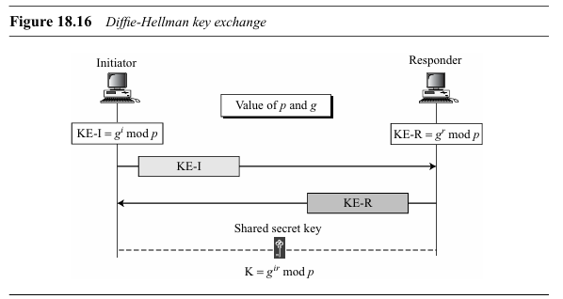
Improved Diffie-Hellman Key Exchange
The key-exchange idea in IKE is based on the Diffie-Hellman protocol. This protocol provides a session key between two peers without the need for the existence of any previous secret.

Slide 30
Attack Prevention
The Diffie-Hellman protocol has some weaknesses that need to be eliminated before it is suitable as an Internet key exchange.
Clogging attack or denial-of service attack - To prevent this clogging attack, we can add two extra messages to the protocol to force the two parties to send cookies.
Replay Attack - To protect against a replay attack, IKE uses nonces(number used once).
Man-In-The-Middle Attack - To protect against man-in-the-middle attack, IKE requires that each party shows that it possesses a secret.

Slide 31
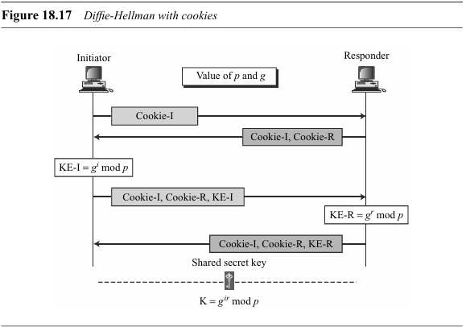
To protect against a clogging attack, IKE uses cookies.

Slide 32
IKE Phases
The designers of IKE divided IKE into two phases.
In phase I, IKE creates SAs for phase II.
In phase II, IKE creates SAs for IPSec or some other protocol.
Phase I is generic;
phase II is specific for the protocol.

Slide 33
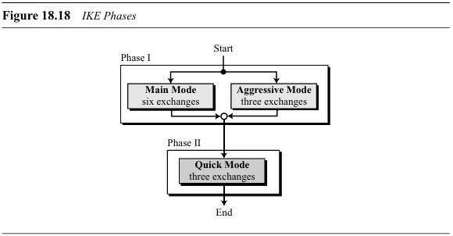
Phases and Modes
There are two modes for phase I: the main mode and the aggressive mode.
The only mode for phase II is the quick mode.

Slide 34
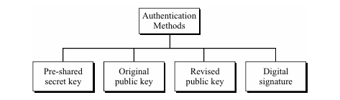
Authentication Methods
In Both phases we use different methods for exchanging information.

Slide 35
Pre-Shared secret key method :Both parties share a secret key in advance.During the IKE negotiation, they authenticate each other by proving they know the key.
Original public-key method :- The initiator encrypts a session key using the responder’s public key. The responder decrypts it using their private key. This method ensures that only the intended recipient (the responder) can decrypt the message.
Revised public-key method :- This method uses key exchange algorithms like Diffie-Hellman to securely establish a shared secret between the two parties over an unsecured channel.
Digital signature:-In this improved method, instead of directly encrypting a shared secret with the public key, both parties use digital signatures to authenticate. This is more efficient and secure than the original public-key method.

Slide 36
Phase I:
Main Mode(Pre-shared key)
In the main mode, the initiator(sender) and the responder(receiver) exchange six messages.

Slide 37
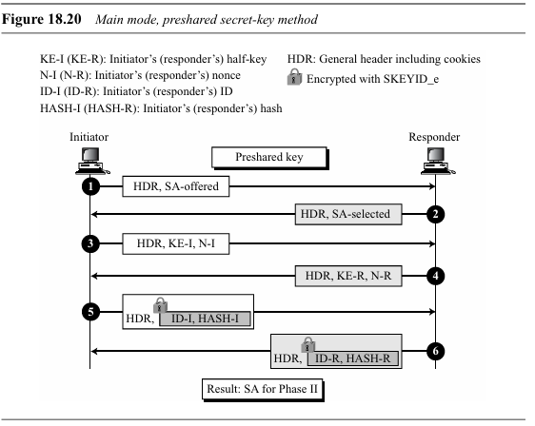

Slide 38
Steps in main mode:-
In the main mode, the initiator and the responder exchange six messages.
In the first two messages, they exchange cookies (to protect against a clogging attack) and negotiate the SA parameters.
In the third and fourth messages, the initiator and responder usually exchange their half-keys (gi and gr of the Diffie-Hellman method) and their nonces (for replay protection).

Slide 39
In the fifth and sixth messages, the two parties exchange the created hashes and their IDs.
The initiator sends HASH-I to the responder as proof that she is Alice. Only Alice knows the authentication secret and only she can calculate HASH-I. If the HASH-I then calculated by Bob matches the HASH-I sent by Alice, she is authenticated. In the same way, Bob can authenticate himself to Alice by sending HASH-R.

Slide 40
Aggressive Mode(Pre-shared key)
Aggressive mode is a compressed version of the corresponding main mode. Instead of six messages, only three are exchanged.
Messages 1 and 3 are combined to make the first message.
Messages 2, 4, and 6 are combined to make the second message.
Message 5 is sent as the third message.
The idea is the same

Slide 41
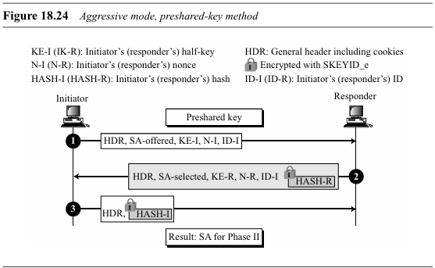

Slide 42
Phase II: Quick Mode
After SAs have been created in either the main mode or the aggressive mode, phase II can be started.
There is only one mode defined for phase II so far, the quick mode. This mode is under the supervision of the IKE SAs created by phase I.
The quick mode uses IKE SAs to create IPSec SAs

Slide 43
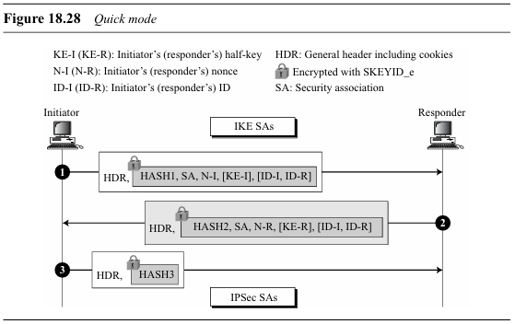

Slide 44
The initiator sends the first message, which includes
HASH1
the entire SA created in phase I
a new nonce (N-I)
optional new Diffie-Hellman half-key (KE-I)
optional IDs of both parties
In the second message ,responder sends
HASH2
the entire SA created in phase I
Responder nonce (N-R)
optional new Diffie-Hellman half-key (KE-R)
optional IDs of both parties
The third message contains only the HASH3.
The messages are authenticated using three : HASH1, HASH2, and HASH3.

