Slide 1
Data Mining Classification: Alternative Techniques
Lecture Notes for Chapter 4
Instance-Based Learning
Introduction to Data Mining , 2nd Edition
by
Tan, Steinbach, Karpatne, Kumar

Slide 2

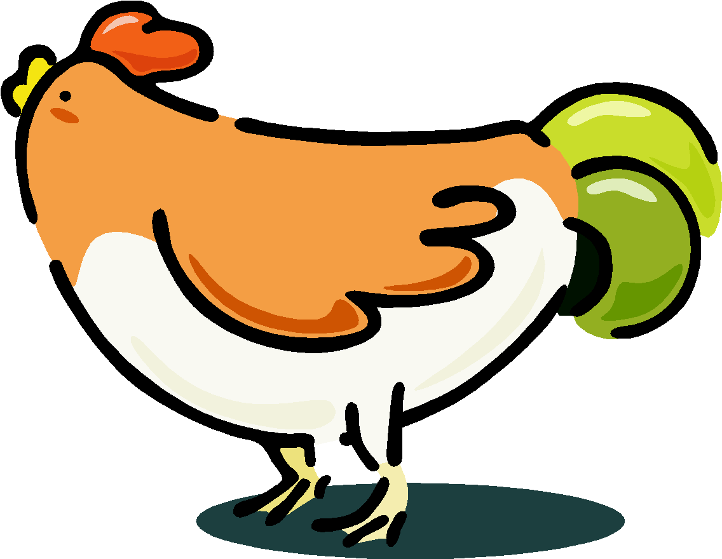


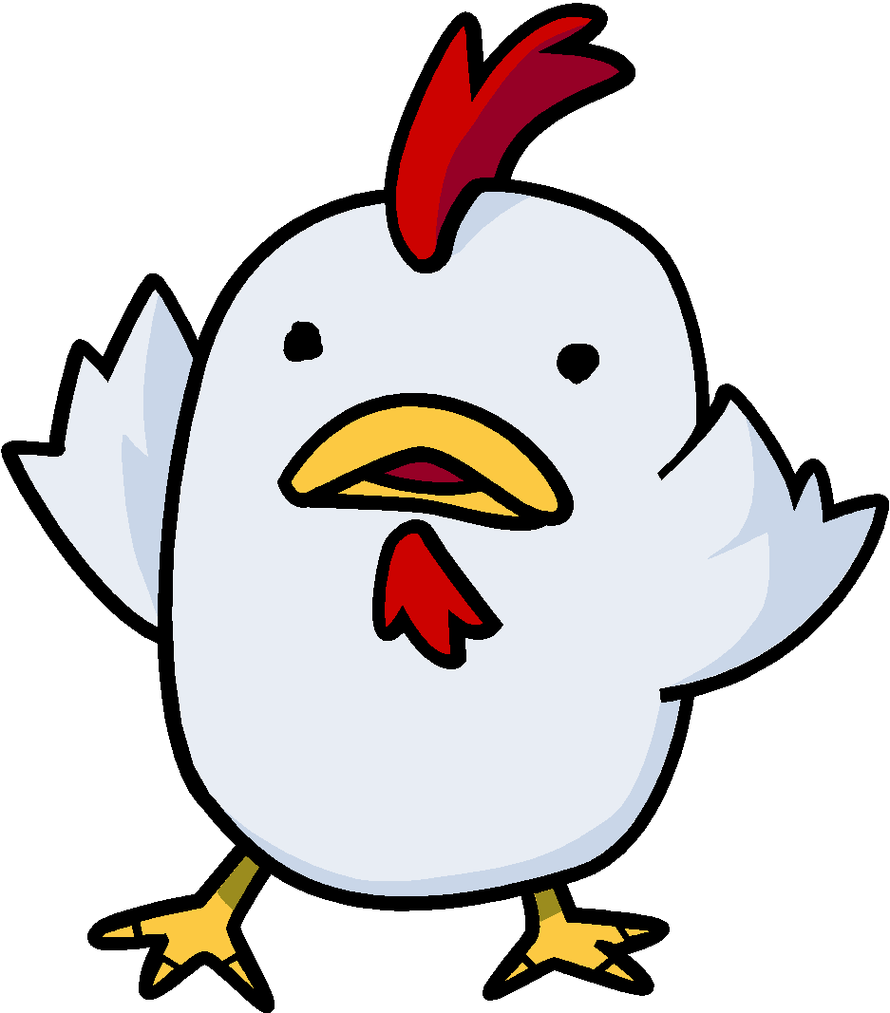

Nearest Neighbor Classifiers
Basic idea:
If it walks like a duck, quacks like a duck, then it’s probably a duck
Compute Distance
Test Record
Training Records
Choose k of the “nearest” records

Slide 3
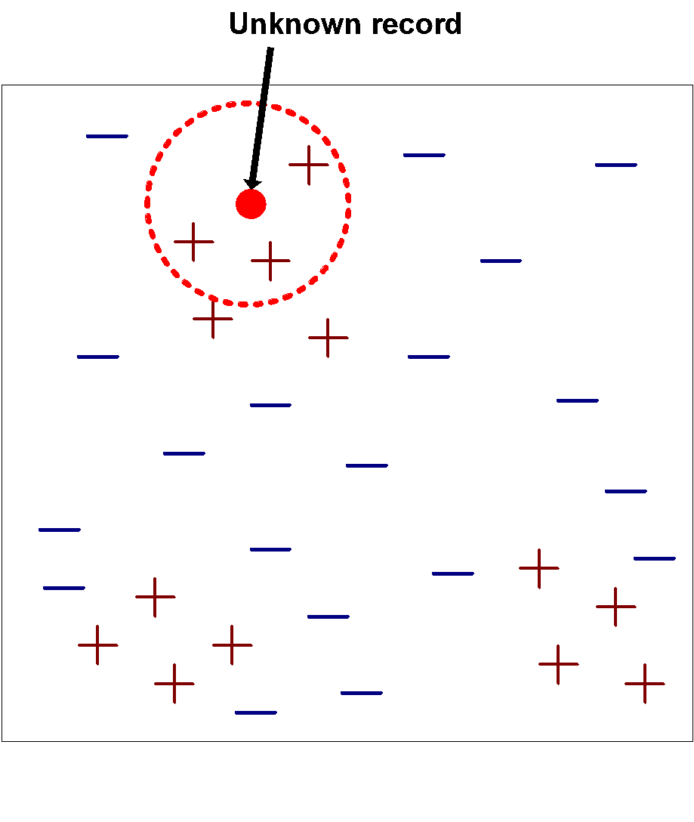
Nearest-Neighbor Classifiers
Requires the following:
A set of labeled records
Proximity metric to compute distance/similarity between a pair of records
e.g., Euclidean distance
The value of k, the number of nearest neighbors to retrieve
A method for using class labels of K nearest neighbors to determine the class label of unknown record (e.g., by taking majority vote)

Slide 4
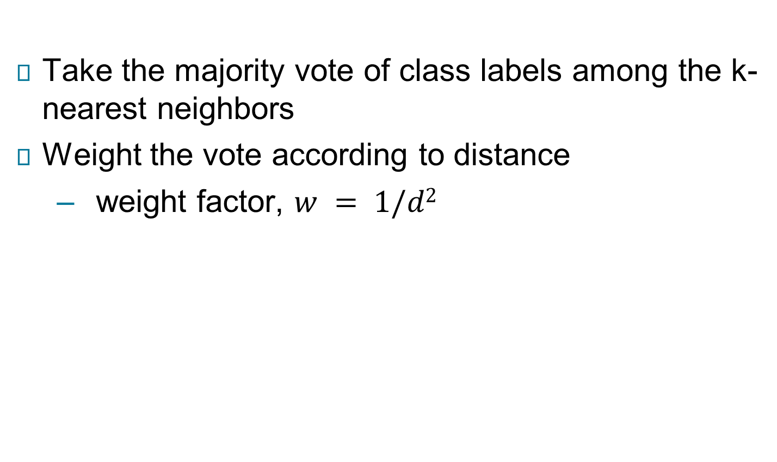
How to Determine the class label of a Test Sample?

Slide 5
Choice of proximity measure matters
For documents, cosine is better than correlation or Euclidean
1 1 1 1 1 1 1 1 1 1 1 0
0 0 0 0 0 0 0 0 0 0 0 1
vs
0 1 1 1 1 1 1 1 1 1 1 1
1 0 0 0 0 0 0 0 0 0 0 0
Euclidean distance = 1.4142 for both pairs, but the cosine similarity measure has different values for these pairs.

Slide 6
Nearest Neighbor Classification…
Data preprocessing is often required
Attributes may have to be scaled to prevent distance measures from being dominated by one of the attributes
Example:
height of a person may vary from 1.5m to 1.8m
weight of a person may vary from 90lb to 300lb
income of a person may vary from $10K to $1M
Time series are often standardized to have 0 means a standard deviation of 1

Slide 7
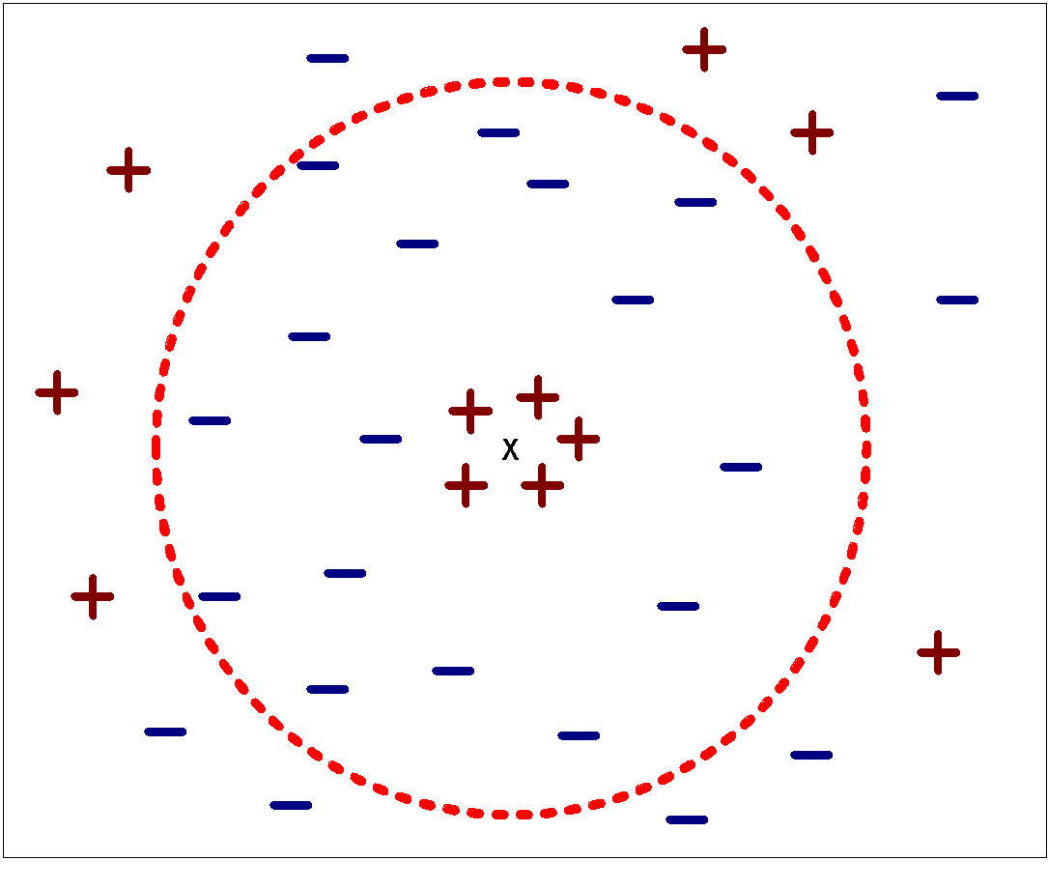
Nearest Neighbor Classification…
Choosing the value of k:
If k is too small, sensitive to noise points
If k is too large, neighborhood may include points from other classes

Slide 8
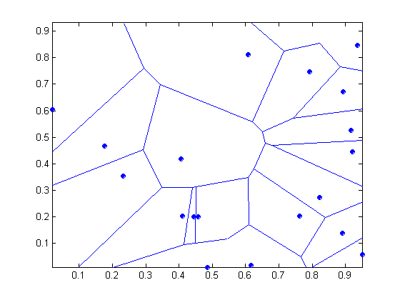
Nearest-neighbor classifiers
Nearest neighbor classifiers are local classifiers
They can produce decision boundaries of arbitrary shapes.
1-nn decision boundary is a Voronoi Diagram

Slide 9
Nearest Neighbor Classification…
How to handle missing values in training and test sets?
Proximity computations normally require the presence of all attributes
Some approaches use the subset of attributes present in two instances
This may not produce good results since it effectively uses different proximity measures for each pair of instances
Thus, proximities are not comparable

Slide 10
K-NN Classifiers…
Irrelevant attributes add noise to the proximity measure
Redundant attributes bias the proximity measure towards certain attributes
Handling attributes that are interacting

Slide 11
Improving KNN Efficiency
Avoid having to compute distance to all objects in the training set
Multi-dimensional access methods (k-d trees)
Fast approximate similarity search
Locality Sensitive Hashing (LSH)
Condensing
Determine a smaller set of objects that give the same performance
Editing
Remove objects to improve efficiency

