Slide 1
Copyright © 2017 Pearson India Education Services Pvt. Ltd
CHAPTER 1
Databases and Database Users

Slide 2
Database-System Applications
Banking and Finance
Banking
Credit card transactions
Finance
Universities
Airlines
Telecommunication
Copyright © 2017 Pearson India Education Services Pvt. Ltd

Slide 3
Traditional File-processing System
Operating System stores permanent records in various files
Needs different application programs to extract records from, and add records to, the appropriate files
Disadvantages:
Data redundancy
Difficulty in accessing data
Data Isolation
Integrity Problems
Atomicity Problems
Concurrent-access Anomalies
Security Problems
Copyright © 2017 Pearson India Education Services Pvt. Ltd

Slide 4
Recent Developments (1)
Social Networks started capturing a information about people and
lot of
Copyright © 2017 Pearson India Education Services Pvt. Ltd
about communications among people-posts, tweets,
photos, videos in systems such as:
Facebook
X (Formerly Twitter)
Linked-In
All of the above constitutes data
Search Engines- Google, Bing, Yahoo : collect their own repository of web pages for searching purposes

Slide 5
Recent Developments (2)
New Technologies are emerging from the so- called non-database software vendors to manage vast amounts of data generated on the web:
Big Data storage systems involving large clusters of distributed computers (Chapter 25)
NOSQL (Not Only SQL) systems (Chapter 24)
A large amount of data now resides on the “cloud” which means it is in huge data centers using thousands of machines.
Copyright © 2017 Pearson India Education Services Pvt. Ltd

Slide 6
Basic Definitions
Database:
A collection of related data.
Data:
Known facts that can be recorded and have an implicit meaning.
Mini-world:
Some part of the real world about which data is stored in a database. For example, student grades and transcripts at a university.
Database Management System (DBMS):
A software package/ system to facilitate the creation and maintenance of a computerized database.
Database System:
The DBMS software together with the data itself. Sometimes, the
applications are also included.
Copyright © 2017 Pearson India Education Services Pvt. Ltd

Slide 7
Impact of Databases and Database Technology
Businesses: Banking, Insurance, Retail, Transportation, Healthcare, Manufacturing
Service Industries: Financial, Real-estate, Legal, Electronic Commerce, Small businesses
Education : Resources for content and Delivery
More recently: Social Networks, Environmental and Scientific Applications, Medicine and
Copyright © 2017 Pearson India Education Services Pvt. Ltd
Genetics
Personalized mobile devices
Applications: based on smart

Slide 8
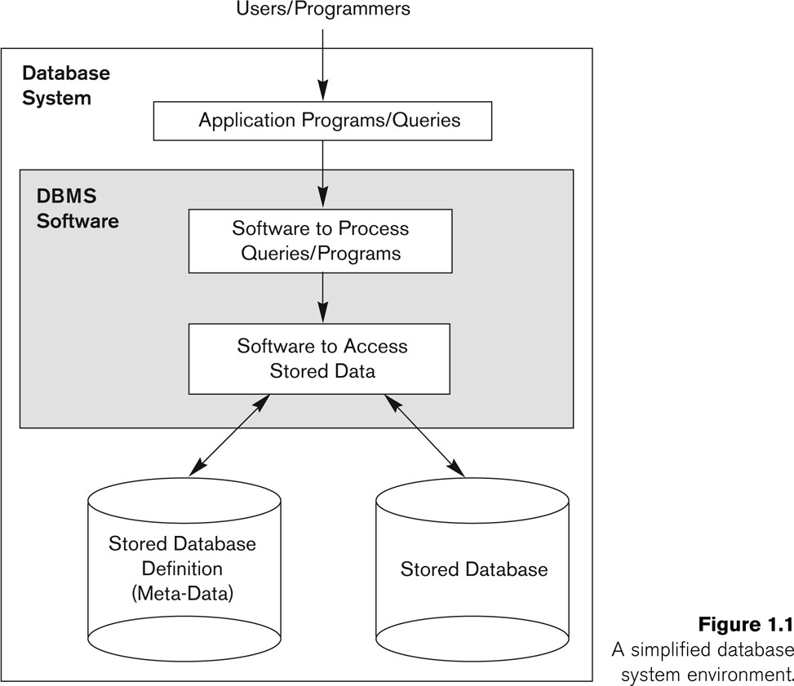
Simplified database system environment
Copyright © 2017 Pearson India Education Services Pvt. Ltd

Slide 9
Typical DBMS Functionality
Define a particular database in terms of its data types, structures, and constraints
Construct the initial database contents on a secondary storage medium(data ko copy karna kisi another storage me recovery ke lyea)
Manipulating the database:(with queries)
Retrieval: Querying, generating reports
Modification: Insertions, deletions and updates to its content
Accessing the database through Web applications
Processing and Sharing by a set of concurrent users and application programs – yet, keeping all data valid and consistent
Copyright © 2017 Pearson India Education Services Pvt. Ltd

Slide 10
Application Activities
Applications interact with a database by generating
Queries: that access different parts of data and formulate the result of a request
Transactions: that may read some data and “update” certain values or generate new data and store that in the database
Applications must not allow unauthorized users to access data
Applications must keep up with changing user requirements
Copyright © 2017 Pearson India Education Services Pvt. Ltd

Slide 11
Additional DBMS Functionality
DBMS may additionally provide:
Protection or Security measures to prevent unauthorized access
“Active” processing to take internal actions on data
Presentation and Visualization of data
Maintenance of the database and associated programs over the lifetime of the database application
Copyright © 2017 Pearson India Education Services Pvt. Ltd

Slide 12
Example of a Database
(with a Conceptual Data Model)
Mini-world for the example:
Part of a UNIVERSITY environment.
Some mini-world entities:
STUDENTs
COURSEs
SECTIONs (of COURSEs)
(academic) DEPARTMENTs
INSTRUCTORs
Copyright © 2017 Pearson India Education Services Pvt. Ltd

Slide 13
Example of a Database
(with a Conceptual Data Model)
Some mini-world relationships:
SECTIONs are of specific COURSEs
STUDENTs take SECTIONs
COURSEs have prerequisite COURSEs
INSTRUCTORs teach SECTIONs
COURSEs are offered by DEPARTMENTs
STUDENTs major in DEPARTMENTs
Note: The above entities and relationships are typically expressed in a conceptual data model, such as the ENTITY-RELATIONSHIP data model (see Chapters 3, 4)
Copyright © 2017 Pearson India Education Services Pvt. Ltd

Slide 14
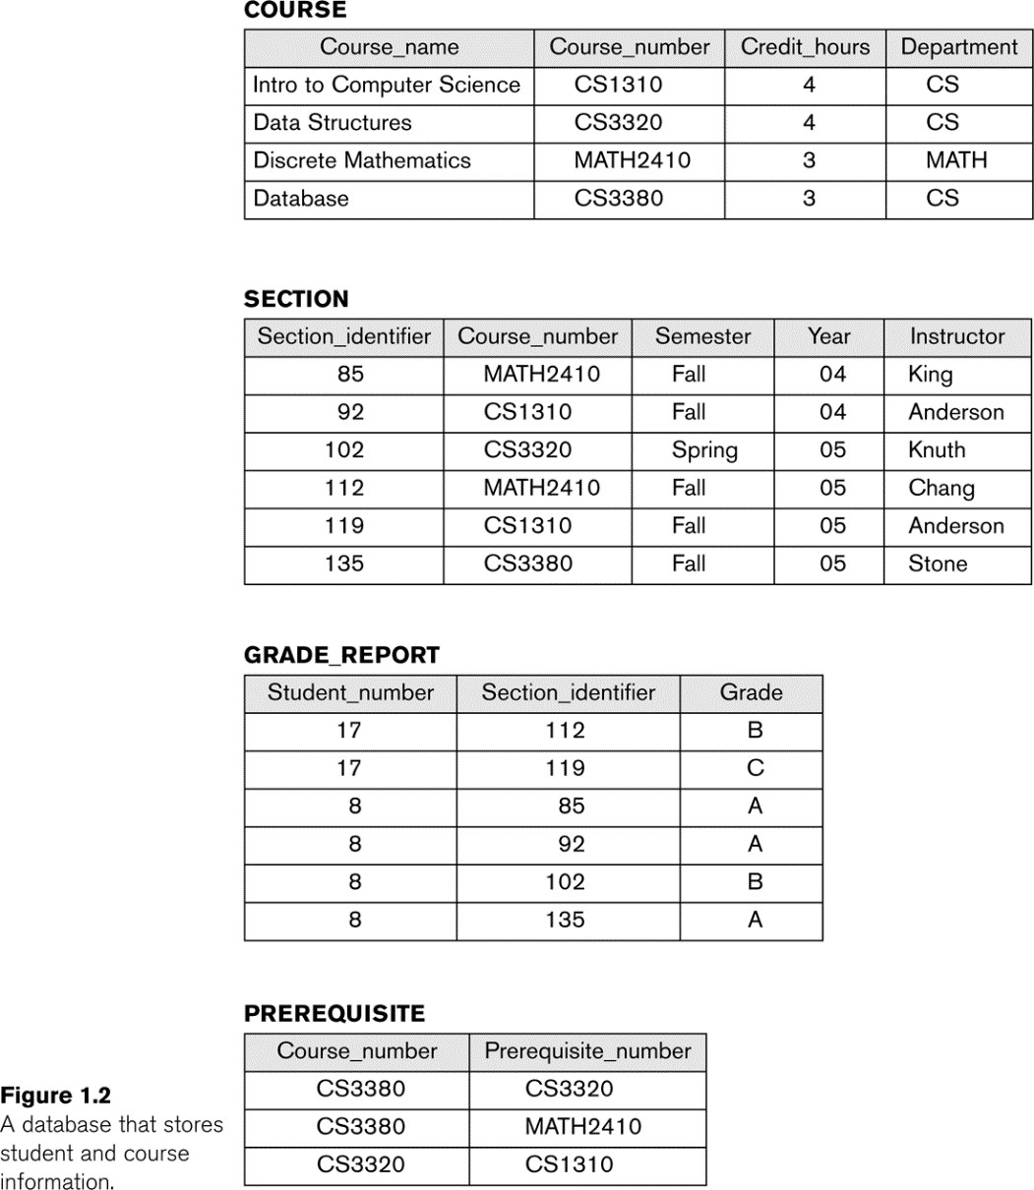
Example of a simple database
Copyright © 2017 Pearson India Education Services Pvt. Ltd

Slide 15
Main Characteristics of the Database Approach
Self-describing nature of a database system:
A DBMS catalog stores the description of a particular
database (e.g. data structures, types, and constraints)
The description is called meta-data*.
Insulation between programs and data:
Called program-data independence.
Allows changing data structures and storage organization without having to change the DBMS access programs.
* Some newer systems such as a few NOSQL systems need no meta-data: they store the data definition within its structure making it self describing
Copyright © 2017 Pearson India Education Services Pvt. Ltd

Slide 16
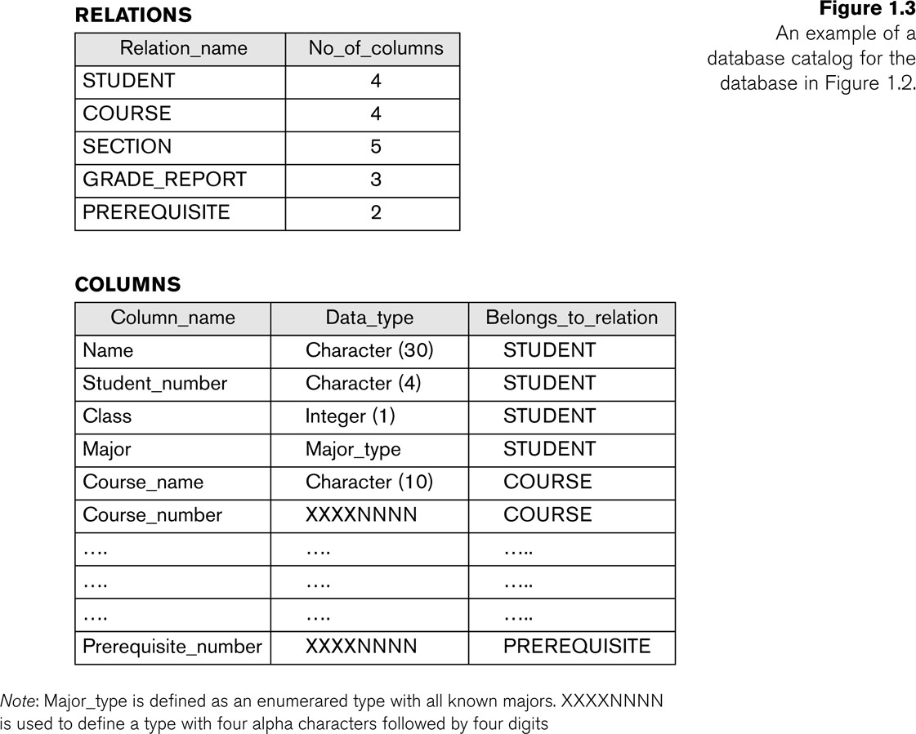
Example of a simplified database catalog
Copyright © 2017 Pearson India Education Services Pvt. Ltd

Slide 17
Main Characteristics of the Database Approach (continued)
Data Abstraction:
A data model is used to hide storage details and present the users with a conceptual view of the database.
Programs refer to the data model constructs rather than data storage details
Support of multiple views of the data:
Each user may see a different view of the database, which describes only the data of interest to that user.
Copyright © 2017 Pearson India Education Services Pvt. Ltd

Slide 18
Main Characteristics of the Database Approach (continued)
Sharing of data and multi-user transaction processing:
Allowing a set of concurrent users to retrieve from and to
update the database.
Concurrency control within the DBMS guarantees that each
transaction is correctly executed or aborted
Recovery subsystem ensures each completed transaction
has its effect permanently recorded in the database
OLTP (Online Transaction Processing) is a major part of database applications. This allows hundreds of concurrent transactions to execute per second.
Copyright © 2017 Pearson India Education Services Pvt. Ltd

Slide 19
Database Users
Users may be divided into
Those who actually use and control the database content, and those who design, develop and maintain database applications (called “Actors on the Scene”), and
Those who design and develop the DBMS software and related tools, and the computer systems operators (called “Workers Behind the Scene”).
Copyright © 2017 Pearson India Education Services Pvt. Ltd

Slide 20
Database Users – Actors on the Scene
Actors on the scene
Database administrators:
Responsible for authorizing access to the database, for coordinating and monitoring its use, acquiring software and hardware resources, controlling its use and monitoring efficiency of operations.
Database Designers:
Responsible to define the content, the structure, the constraints, and functions or transactions against the database. They must communicate with the
end-users and understand their needs.
Copyright © 2017 Pearson India Education Services Pvt. Ltd

Slide 21
Database End Users
Actors on the scene (continued)
End-users: They use the data for queries, reports and some of them update the database content. End-users can be categorized into:
Casual: access database occasionally when needed
Naïve or Parametric: they make up a large section of the end-user population.
Users of Mobile Apps mostly fall in this category
Bank-tellers or reservation clerks are parametric users who do this activity for an entire shift of operations.
Social Media Users post and read information from
websites
Copyright © 2017 Pearson India Education Services Pvt. Ltd

Slide 22
Database End Users (continued)
Sophisticated:
These include business analysts, scientists, engineers, others thoroughly familiar with the system capabilities.
Many use tools in the form of software packages that work closely with the stored database.
Stand-alone:
Mostly maintain personal databases using ready-to-use packaged applications.
An example is the user of a tax program that creates its own internal database.
Another example is a user that maintains a database of personal photos and videos.
Copyright © 2017 Pearson India Education Services Pvt. Ltd

Slide 23
Database Users – Actors on the Scene (continued)
System Analysts and Application Developers
This category currently accounts for a very large proportion of the IT work force.
System Analysts: They understand the user requirements of naïve and sophisticated users and design applications including canned transactions to meet those requirements.
Application Programmers: Implement the specifications developed by analysts and test and debug them before deployment.
Business Analysts: There is an increasing need for such people who can analyze vast amounts of business data and real-time data (“Big Data”) for better decision making related to planning, advertising, marketing etc.
Copyright © 2017 Pearson India Education Services Pvt. Ltd

Slide 24
Database Users – Actors behind the Scene
Copyright © 2017 Pearson India Education Services Pvt. Ltd
System Designers and Implementors: Design and implement DBMS packages in the form of modules and interfaces and test and debug them. The DBMS must interface with applications, language compilers, operating system components, etc.
Tool Developers: Design and implement software systems called tools for modeling and designing databases, performance monitoring, prototyping, test data generation, user interface creation, simulation etc. that facilitate building of applications and allow using database effectively.
Operators and Maintenance Personnel: They manage the actual running and maintenance of the database system hardware and software environment.

Slide 25
Advantages of Using the Database Approach
Controlling redundancy in data storage and in development and maintenance efforts.
Sharing of data among multiple users.
Restricting unauthorized access to data. Only the DBA
staff uses privileged commands and facilities.
Providing optimization of queries for efficient processing.
Providing backup and recovery services.
Representing complex relationships among data.
Enforcing integrity constraints on the database.
Copyright © 2017 Pearson India Education Services Pvt. Ltd

Slide 26
Review Questions
1.1. Define the following terms: data, database, DBMS, database system, database catalog, program-data independence, user view, DBA, end user, canned
transaction, deductive database system, persistent object, meta-data, and transaction-processing application.
1.2. What four main types of actions involve databases? Briefly discuss each.
1.3. Discuss the main characteristics of the database approach and how it differs from traditional file systems.
1.4. What are the responsibilities of the DBA and the database designers?

Slide 27
1.5. What are the different types of database end users? Discuss the main activities of each.
1.6. Discuss the capabilities that should be provided by a DBMS.
1.7. Discuss the differences between database systems and information retrieval systems.
Exercise
1.8. Identify some informal queries and update operations that you would expect to apply to the database shown in Figure 1.2.
1.9. What is the difference between controlled and uncontrolled redundancy? Illustrate with examples.
1.10. Specify all the relationships among the records of the database shown in Figure 1.2.

Slide 28
1.11. Give some additional views that may be needed by other user groups for the database shown in Figure 1.2.
1.12. Cite some examples of integrity constraints that you think can apply to the database shown in Figure 1.2.
1.13. Give examples of systems in which it may make sense to use traditional file processing instead of a database approach.

Slide 29
1.14. Consider Figure 1.2.
a. If the name of the ‘CS’ (Computer Science) Department changes to ‘CSSE’
(Computer Science and Software Engineering) Department and the corresponding
prefix for the course number also changes, identify the columns in the database that would need to be updated.
b. Can you restructure the columns in the COURSE, SECTION, and PREREQUISITE tables so that only one column will need to be updated?

