Slide 1
CHAPTER 14
Copyright © 2017 Pearson India Education Services Pvt. Ltd
Basics of Functional Dependencies and Normalization for Relational Databases

Slide 2
1. Informal Design Guidelines for Relational Databases (1)
What is relational database design?
The grouping of attributes to form "good" relation schemas
Two levels of relation schemas
The logical "user view" level
The storage "base relation" level
Design is concerned mainly with base relations
What are the criteria for "good" base relations?
Copyright © 2017 Pearson India Education Services Pvt. Ltd

Slide 3
Informal Design Guidelines for Relational Databases (2)
We first discuss informal guidelines for good relational design
Then we discuss formal concepts of functional dependencies and normal forms
- 1NF (First Normal Form)
- 2NF (Second Normal Form)
- 3NF (Third Normal Form)
- BCNF (Boyce-Codd Normal Form)
Copyright © 2017 Pearson India Education Services Pvt. Ltd

Slide 4
1.1 Semantics of the Relational Attributes must be clear
GUIDELINE 1: Informally, each tuple in a relation should represent one entity or relationship instance. (Applies to individual relations and their attributes).
Attributes of different entities (EMPLOYEEs, DEPARTMENTs, PROJECTs) should not be mixed in the same relation
Only foreign keys should be used to refer to other entities
Entity and relationship attributes should be kept apart as much as possible.
Bottom Line: Design a schema that can be explained easily relation by relation. The semantics of attributes should be easy to interpret.
Copyright © 2017 Pearson India Education Services Pvt. Ltd

Slide 5
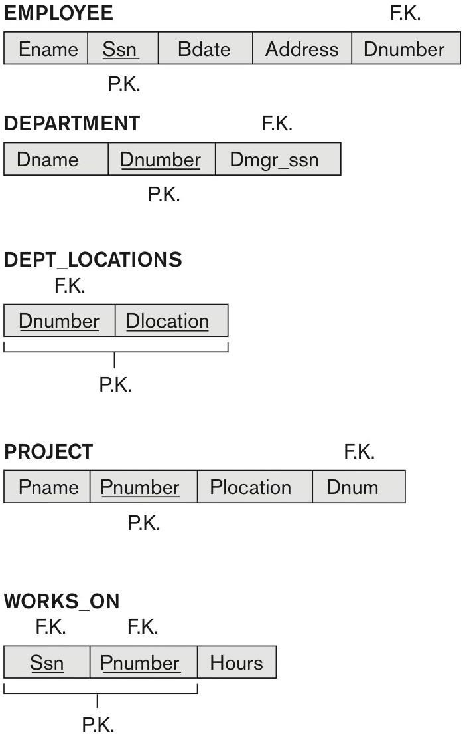
Figure 14.1 A simplified COMPANY relational database schema
Copyright © 2017 Pearson India Education Services Pvt. Ltd
Figure 14.1 A simplified COMPANY relational database schema.

Slide 6
1.2 Redundant Information in Tuples and Update Anomalies
Information is stored redundantly
Wastes storage
Causes problems with update anomalies
Insertion anomalies
Deletion anomalies
Modification anomalies
Copyright © 2017 Pearson India Education Services Pvt. Ltd

Slide 7
EXAMPLE OF AN UPDATE ANOMALY
Consider the relation:
EMP_PROJ(Emp#, Proj#, Ename, Pname, No_hours)
Update Anomaly:
Changing the name of project number P1 from “Billing” to “Customer-Accounting” may cause this update to be made for all 100 employees working on project P1.
Copyright © 2017 Pearson India Education Services Pvt. Ltd

Slide 8
EXAMPLE OF AN INSERT ANOMALY
Consider the relation:
EMP_PROJ(Emp#, Proj#, Ename, Pname, No_hours)
Insert Anomaly:
Cannot insert a project unless an employee is assigned to it.
Conversely
Cannot insert an employee unless an he/she is assigned to a project.
Copyright © 2017 Pearson India Education Services Pvt. Ltd

Slide 9
EXAMPLE OF A DELETE ANOMALY
Consider the relation:
EMP_PROJ(Emp#, Proj#, Ename, Pname, No_hours)
Delete Anomaly:
When a project is deleted, it will result in deleting all the employees who work on that project.
Alternately, if an employee is the sole employee on a project, deleting that employee would result in deleting the corresponding project.
Copyright © 2017 Pearson India Education Services Pvt. Ltd

Slide 10
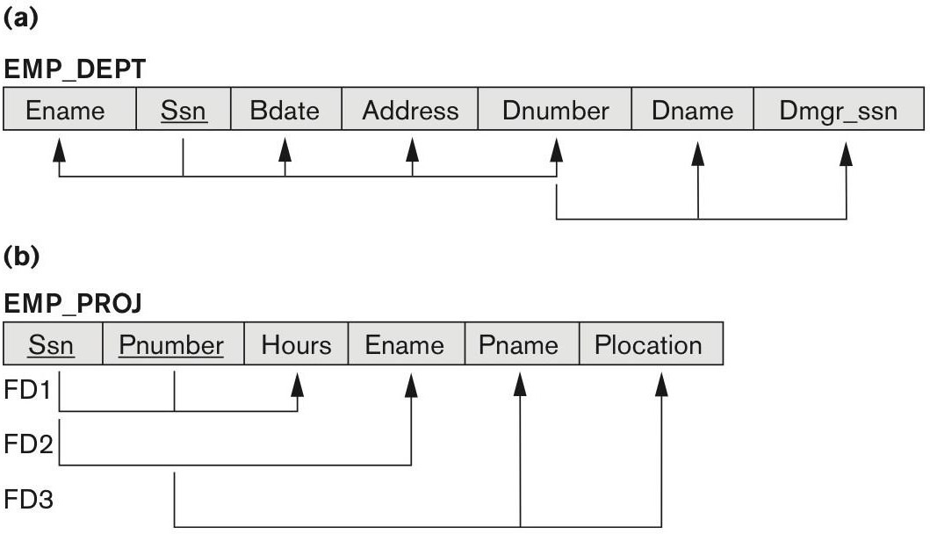
Figure 14.3 Two relation schemas suffering from update anomalies
Copyright © 2017 Pearson India Education Services Pvt. Ltd
Figure 14.3
Two relation schemas suffering from update anomalies. (a) EMP_DEPT and (b) EMP_PROJ.

Slide 11
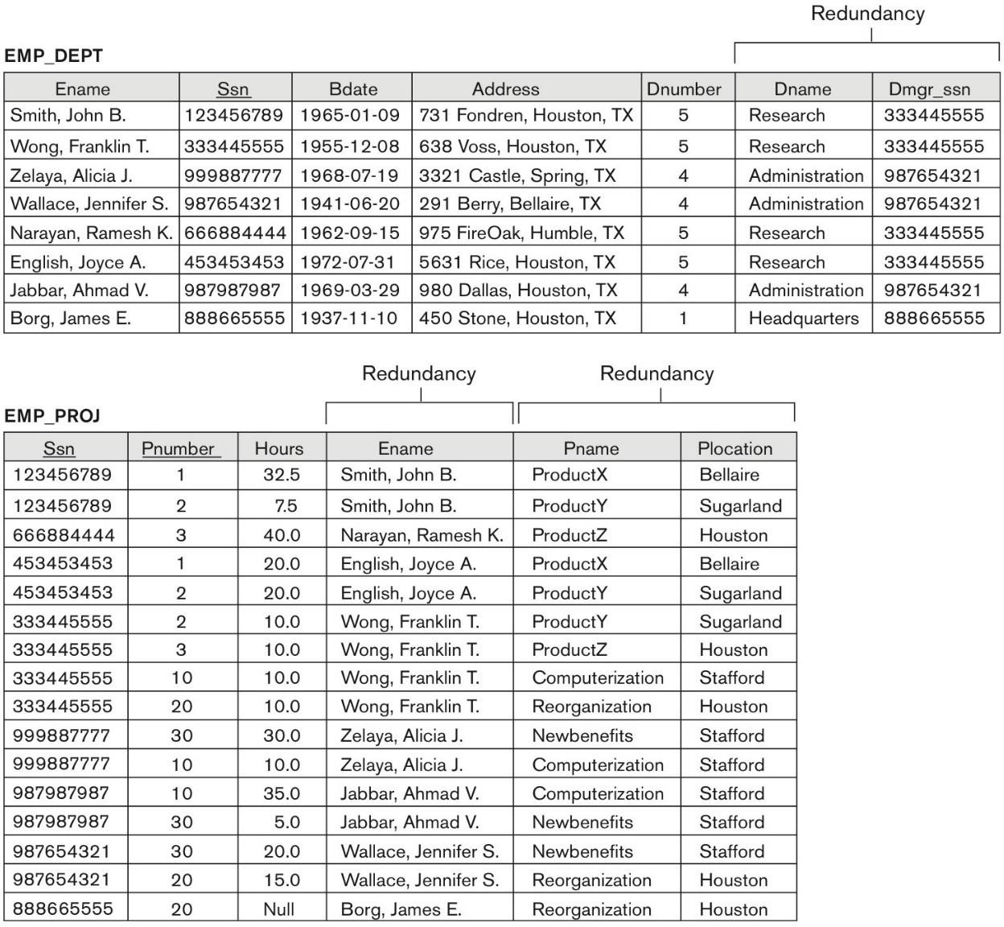
Figure 14.4 Sample states for EMP_DEPT and EMP_PROJ
Copyright © 2017 Pearson India Education Services Pvt. Ltd
Figure 14.4
Sample states for EMP_DEPT and EMP_PROJ resulting from applying NATURAL JOIN to the relations in Figure 14.2. These may be stored as base relations for performance reasons.

Slide 12
Guideline for Redundant Information in Tuples and Update Anomalies
GUIDELINE 2:
Design a schema that does not suffer from the insertion, deletion and update anomalies.
If there are any anomalies present, then note them so that applications can be made to take them into account.
Copyright © 2017 Pearson India Education Services Pvt. Ltd

Slide 13
1.3 Null Values in Tuples
GUIDELINE 3:
Relations should be designed such that their tuples will have as few NULL values as possible
Attributes that are NULL frequently could be placed in separate relations (with the primary key)
Reasons for nulls:
Attribute not applicable or invalid
Attribute value unknown (may exist)
Value known to exist, but unavailable
Copyright © 2017 Pearson India Education Services Pvt. Ltd

Slide 14
1.4 Generation of Spurious Tuples – avoid at any cost
Bad designs for a relational database may result in erroneous results for certain JOIN operations
The "lossless join" property is used to guarantee meaningful results for join operations
GUIDELINE 4:
The relations should be designed to satisfy the lossless join condition.
No spurious tuples should be generated by doing a natural-join of any relations.
Copyright © 2017 Pearson India Education Services Pvt. Ltd

Slide 15
2. Functional Dependencies
Functional dependencies (FDs)
Are used to specify formal measures of the "goodness" of relational designs
And keys are used to define normal forms for relations
Are constraints that are derived from the meaning
and interrelationships of the data attributes
A set of attributes X functionally determines a set of attributes Y if the value of X determines a unique value for Y
Eg:-we have dname and loc. dname is functionally determines loc so we get value of loc by dname.
Copyright © 2017 Pearson India Education Services Pvt. Ltd

Slide 16
2.1 Defining Functional Dependencies
X 🡒 Y holds if whenever two tuples have the same value for X, they must have the same value for Y
For any two tuples t1 and t2 in any relation instance r(R): If
t1[X]=t2[X], then t1[Y]=t2[Y]
X 🡒 Y in R specifies a constraint on all relation instances r(R)
Written as X 🡒 Y; can be displayed graphically on a
relation schema as in Figures. ( denoted by the arrow: ).
FDs are derived from the real-world constraints on the attributes
Copyright © 2017 Pearson India Education Services Pvt. Ltd

Slide 17
Examples of FD constraints (1)
Social security number determines employee name
SSN 🡒 ENAME
Project number determines project name and location
PNUMBER 🡒 {PNAME, PLOCATION}
Employee ssn and project number determines the hours per week that the employee works on the project
{SSN, PNUMBER} 🡒 HOURS
Copyright © 2017 Pearson India Education Services Pvt. Ltd

Slide 18
Examples of FD constraints (2)
An FD is a property of the attributes in the schema R
The constraint must hold on every relation instance r(R)
If K is a key of R, then K functionally determines all attributes in R
(since we never have two distinct tuples with t1[K]=t2[K])
Copyright © 2017 Pearson India Education Services Pvt. Ltd

Slide 19
Defining FDs from instances
Note that in order to define the FDs, we need to understand the meaning of the attributes involved and the relationship between them.
An FD is a property of the attributes in the schema R
Given the instance (population) of a relation, all we can conclude is that an FD may exist between certain attributes.
What we can definitely conclude is – that certain FDs do not exist because there are tuples that show a violation of those dependencies.
Copyright © 2017 Pearson India Education Services Pvt. Ltd

Slide 20
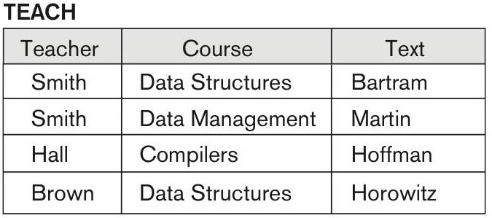
Figure 14.7 Ruling Out FDs
Note that given the state of the TEACH relation, we can say that the FD: Text → Course may exist. However, the FDs Teacher → Course, Teacher → Text and
Couse → Text are ruled out.
Copyright © 2017 Pearson India Education Services Pvt. Ltd

Slide 21
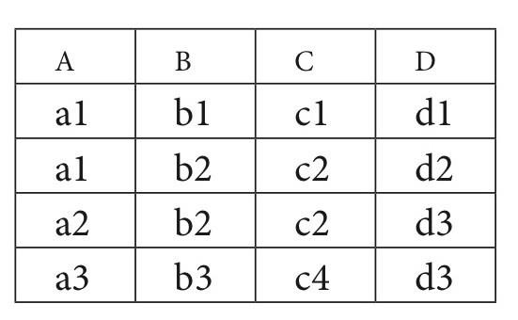
Figure 14.8 What FDs may exist?
A relation R(A, B, C, D) with its extension.
Which FDs may exist in this relation?
Copyright © 2017 Pearson India Education Services Pvt. Ltd
The FDs may hold B->C, C->B
The FDs do not hold A->B, B->A, D->C

Slide 22
3 Normal Forms Based on Primary Keys
3.1 Normalization of Relations
3.2 Practical Use of Normal Forms
3.3 Definitions of Keys and Attributes Participating in Keys
3.4 First Normal Form
3.5 Second Normal Form
3.6 Third Normal Form
Copyright © 2017 Pearson India Education Services Pvt. Ltd

Slide 23
3.1 Normalization of Relations (1)
Normalization:
The process of decomposing unsatisfactory "bad" relations by breaking up their attributes into smaller relations
Normal form:
Condition using keys and FDs of a relation to certify whether a relation schema is in a particular normal form
Copyright © 2017 Pearson India Education Services Pvt. Ltd

Slide 24
Normalization of Relations (2)
1NF
only attribute values permitted are single atomic
(or indivisible) values.
2NF, 3NF, BCNF
based on keys and FDs of a relation schema
4NF
based on keys, multi-valued dependencies : MVDs;
5NF
based on keys, join dependencies : JDs
Copyright © 2017 Pearson India Education Services Pvt. Ltd

Slide 25
3.2 Practical Use of Normal Forms
Normalization is carried out in practice so that the resulting designs are of high quality and meet the desirable properties
The practical utility of these normal forms becomes questionable when the constraints on which they are based are hard to understand or to detect
The database designers need not normalize to the highest possible normal form
(usually up to 3NF and BCNF. 4NF rarely used in practice.)
Denormalization:
The process of storing the join of higher normal form relations as a base relation—which is in a lower normal form
Copyright © 2017 Pearson India Education Services Pvt. Ltd

Slide 26
3.3 Definitions of Keys and Attributes Participating in Keys (1)
A superkey of a relation schema R = {A1, A2, ...., An} is a set of attributes S subset-of R with the property that no two tuples t1 and t2 in any legal relation state r of R will have t1[S] = t2[S]
A key K is a superkey with the additional property that removal of any attribute from K will cause K not to be a superkey any more.
Copyright © 2017 Pearson India Education Services Pvt. Ltd

Slide 27
Definitions of Keys and Attributes Participating in Keys (2)
If a relation schema has more than one key, each is called a candidate key.
One of the candidate keys is arbitrarily designated to be the primary key, and the others are called secondary keys.
A Prime attribute must be a member of some
candidate key
A Nonprime attribute is not a prime attribute— that is, it is not a member of any candidate key.
Copyright © 2017 Pearson India Education Services Pvt. Ltd

Slide 28
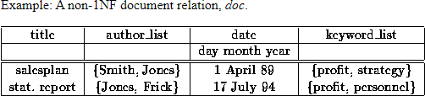
3.4 First Normal Form
Disallows
composite attributes
multivalued attributes
nested relations; attributes whose values for an
individual tuple are non-atomic
Copyright © 2017 Pearson India Education Services Pvt. Ltd
Most RDBMSs allow only those relations to be defined that are in First Normal Form

Slide 29
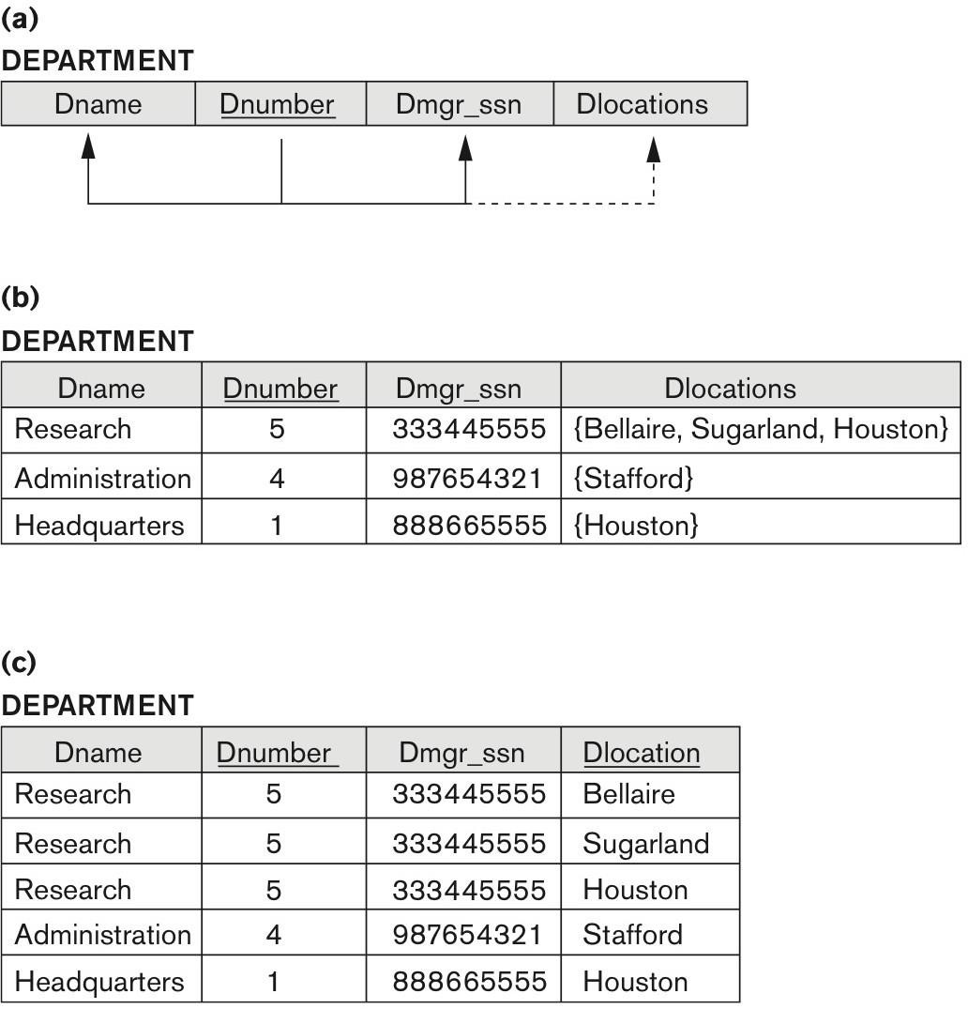
Figure 14.9 Normalization into 1NF
Figure 14.9 Normalization into 1NF. (a) A relation schema that is not in 1NF. (b) Sample state of relation DEPARTMENT. (c) 1NF version of the same relation with redundancy.
Copyright © 2017 Pearson India Education Services Pvt. Ltd
Agar hamare paas koi attribure composite ya multivalued aa jaae to vo relation 1NF me nahi h To use 1NF me banana ke lyea ham jo attribute composite ya multivalued h ya to uska ek neya relation bana dange ya ham uski values ko ek string me store karva lange

Slide 30

Figure 14.10 Normalizing nested relations into 1NF
Copyright © 2017 Pearson India Education Services Pvt. Ltd
Figure 14.10 Normalizing nested relations into 1NF. (a) Schema of the EMP_PROJ relation with a nested relation attribute PROJS. (b) Sample extension of the EMP_PROJ relation showing nested relations within each tuple. (c) Decomposition of EMP_PROJ into relations EMP_PROJ1 and EMP_PROJ2 by propagating the primary key.

Slide 31
3.5 Second Normal Form (1)
Uses the concepts of FDs, primary key
Definitions
Prime attribute: An attribute that is member of the primary
key K
Full functional dependency: a FD Y -> Z where removal of any attribute from Y means the FD does not hold any more
Examples:
{SSN, PNUMBER} -> HOURS is a full FD since neither SSN
-> HOURS nor PNUMBER -> HOURS hold
{SSN, PNUMBER} -> ENAME is not a full FD (it is called a
partial dependency ) since SSN -> ENAME also holds
Copyright © 2017 Pearson India Education Services Pvt. Ltd

Slide 32
Second Normal Form (2)
A relation schema R is in second normal form (2NF) if every non-prime attribute A in R is fully functionally dependent on the primary key
R can be decomposed into 2NF relations via the process of 2NF normalization or “second normalization”
Copyright © 2017 Pearson India Education Services Pvt. Ltd

Slide 33
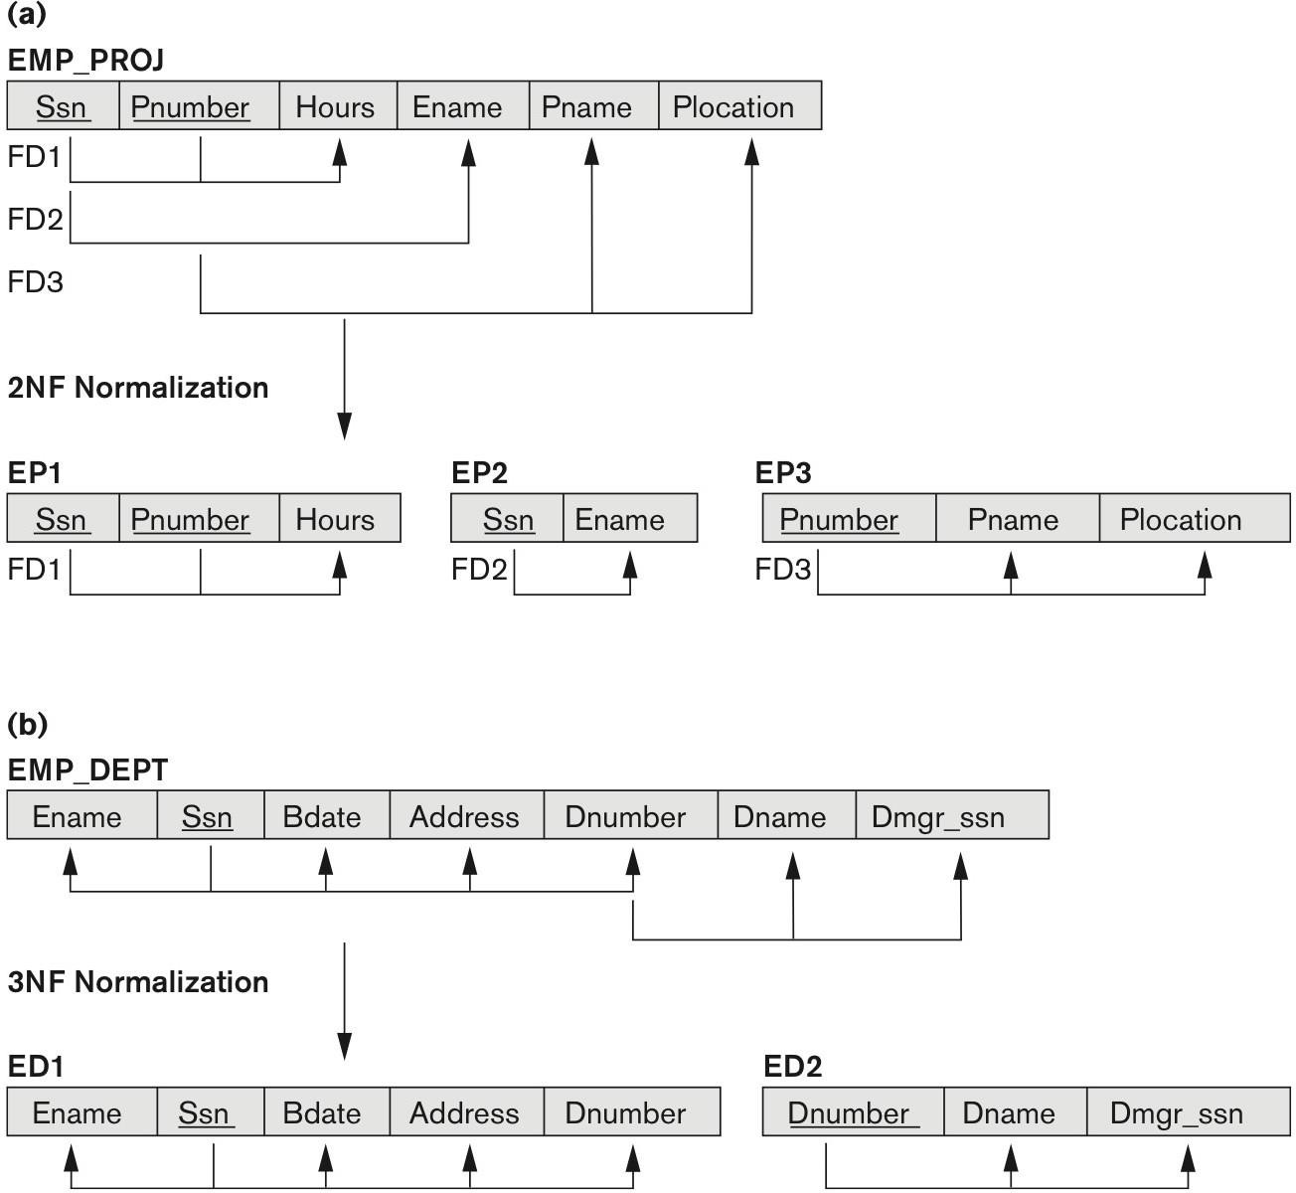
Figure 14.11 Normalizing into 2NF and 3NF
Copyright © 2017 Pearson India Education Services Pvt. Ltd
2NF me check karne k lyea agar koi 2 ya usse zyda primary(candidate key) h to vo dono kisi attriubes ko define kar sakti h agar koi akeli key kesi attribute ko define kare to vo galat h to us key or attribute ko alag se ek relation bana dange
Figure 14.11
Normalizing into 2NF and 3NF.
(a) Normalizing EMP_PROJ into 2NF relations. (b) Normalizing EMP_DEPT into 3NF relations.

Slide 34
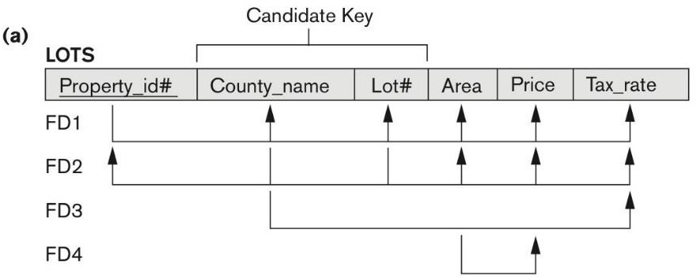
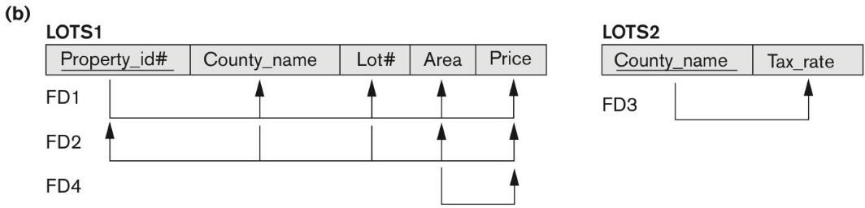
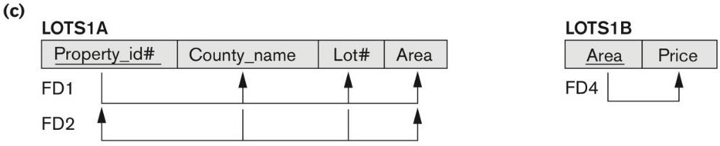
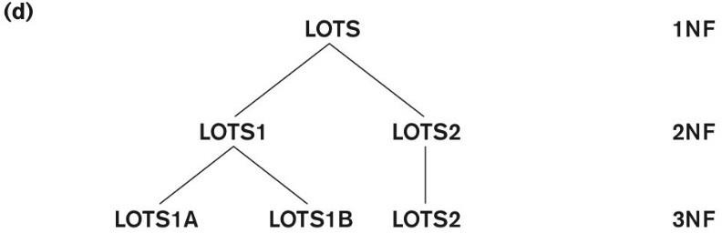
Figure 14.12 Normalization into 2NF and 3NF
Figure 14.12 Normalization into 2NF and 3NF. (a) The LOTS relation with its functional dependencies FD1 through FD4.
(b) Decomposing into the 2NF relations LOTS1 and LOTS2. (c) Decomposing LOTS1 into the 3NF relations LOTS1A and LOTS1B.
(d) Progressive normalization of LOTS into a 3NF design.
Copyright © 2017 Pearson India Education Services Pvt. Ltd
In 3NF we check firstly it is in 2NF or not then agar koi non prime attribute kesi non prime attribute ko bata reha h to us non prime attribute ko primary key banakar ek neya relation bana dange un atttibutes ke sath jinko vo btta pa reha tha

Slide 35
3.6 Third Normal Form (1)
Definition:
Transitive functional dependency: a FD X -> Z that can be derived from two FDs X -> Y and Y -> Z
Examples:
SSN -> DMGRSSN is a transitive FD
Since SSN -> DNUMBER and DNUMBER ->
DMGRSSN hold
SSN -> ENAME is non-transitive
Since there is no set of attributes X where SSN -> X
and X -> ENAME
Copyright © 2017 Pearson India Education Services Pvt. Ltd

Slide 36
Third Normal Form (2)
A relation schema R is in third normal form (3NF) if it is in 2NF and no non-prime attribute A in R is transitively dependent on the primary key
R can be decomposed into 3NF relations via the process
of 3NF normalization
NOTE:
In X -> Y and Y -> Z, with X as the primary key, we consider
this a problem only if Y is not a candidate key.
When Y is a candidate key, there is no problem with the transitive dependency .
E.g., Consider EMP (SSN, Emp#, Salary ).
Here, SSN -> Emp# -> Salary and Emp# is a candidate key.
Copyright © 2017 Pearson India Education Services Pvt. Ltd

Slide 37
Normal Forms Defined Informally
1st normal form
All attributes depend on the key
2nd normal form
All attributes depend on the whole key
3rd normal form
All attributes depend on nothing but the key
Copyright © 2017 Pearson India Education Services Pvt. Ltd

Slide 38
4. General Normal Form Definitions (For Multiple Keys) (1)
The above definitions consider the primary key only
The following more general definitions take into account relations with multiple candidate keys
Any attribute involved in a candidate key is a
prime attribute
All other attributes are called non-prime attributes.
Copyright © 2017 Pearson India Education Services Pvt. Ltd

Slide 39
4.1 General Definition of 2NF (For Multiple Candidate Keys)
Copyright © 2017 Pearson India Education Services Pvt. Ltd
A relation schema R is in second normal form (2NF) if every non-prime attribute A in R is fully functionally dependent on every key of R
In Figure 14.12 the FD
County_name → Tax_rate violates 2NF.
So second normalization converts LOTS into LOTS1 (Property_id#, County_name, Lot#, Area, Price) LOTS2 ( County_name, Tax_rate)

Slide 40
4.2 General Definition of Third Normal Form
Definition:
Superkey of relation schema R - a set of attributes S of R that contains a key of R(key is also a super key,superkey me kuch attributes vo bhi hote h jo key ke sath milkar relation ko define kar sakte h usme primary key hogi hi hogi agar koi attribute hata de to bhi vo super key agar vo relation ko define kar paae agar hatane ke baad relation ko define nahi kar paae to vo super key nahi hogi )
A relation schema R is in third normal form (3NF)
if whenever a FD X → A holds in R, then either:
(a) X is a superkey of R, or
(b) A is a prime attribute of R
LOTS1 relation violates 3NF because
Area → Price ; and Area is not a superkey in LOTS1. (see Figure 14.12).
Copyright © 2017 Pearson India Education Services Pvt. Ltd

Slide 41
4.3 Interpreting the General Definition of Third Normal Form
Consider the 2 conditions in the Definition of 3NF: A relation schema R is in third normal form (3NF) if whenever a FD X → A holds in R, then either:
(a) X is a superkey of R, or
(b) A is a prime attribute of R
Condition (a) catches two types of violations :
- one where a prime attribute functionally determines a non-prime attribute. This catches 2NF violations due to non-full functional dependencies.
-second, where a non-prime attribute functionally determines a non-prime attribute. This catches 3NF violations due to a transitive dependency.
Copyright © 2017 Pearson India Education Services Pvt. Ltd

Slide 42
4.3 Interpreting the General Definition of Third Normal Form (2)
Copyright © 2017 Pearson India Education Services Pvt. Ltd
ALTERNATIVE DEFINITION of 3NF: We can restate the definition
as:
A relation schema R is in third normal form (3NF) if every non-prime attribute in R meets both of these conditions:
It is fully functionally dependent on every key of R
It is non-transitively dependent on every key of R Note that stated this way, a relation in 3NF also meets the requirements for 2NF.
The condition (b) from the last slide takes care of the dependencies that “slip through” (are allowable to) 3NF but are “caught by” BCNF which we discuss next.

Slide 43
5. BCNF (Boyce-Codd Normal Form)
A relation schema R is in Boyce-Codd Normal Form (BCNF) if whenever an FD X → A holds in R, then X is a superkey of R
Each normal form is strictly stronger than the previous one
Every 2NF relation is in 1NF
Every 3NF relation is in 2NF
Every BCNF relation is in 3NF
There exist relations that are in 3NF but not in BCNF
Hence BCNF is considered a stronger form of 3NF
The goal is to have each relation in BCNF (or 3NF)
Copyright © 2017 Pearson India Education Services Pvt. Ltd

Slide 44
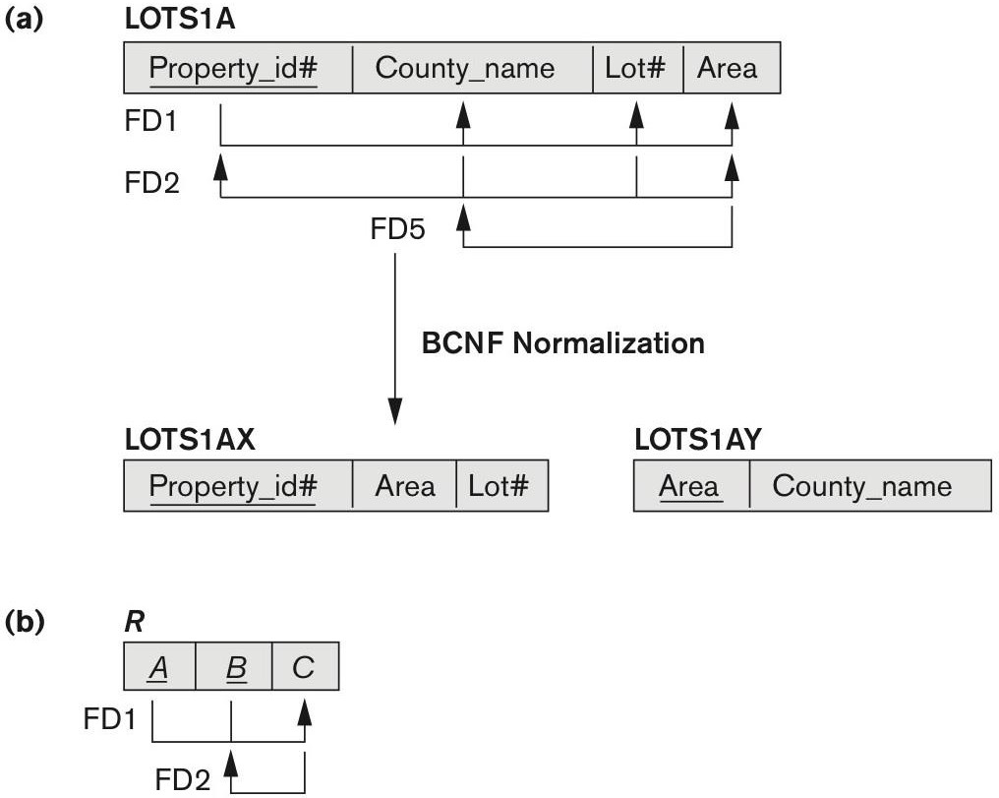
Figure 14.13 Boyce-Codd normal form
Copyright © 2017 Pearson India Education Services Pvt. Ltd
Figure 14.13 Boyce-Codd normal form. (a) BCNF normalization of LOTS1A with the functional dependency FD2 being lost in the decomposition. (b) A schematic relation with FDs; it is in 3NF, but not in BCNF due to the f.d. C → B.

Slide 45

Figure 14.14 A relation TEACH that is in 3NF but not in BCNF
Copyright © 2017 Pearson India Education Services Pvt. Ltd
Figure 14.14
A relation TEACH that is in 3NF
but not BCNF.

Slide 46
Achieving the BCNF by Decomposition (1)
Two FDs exist in the relation TEACH:
fd1: { student, course} -> instructor
fd2: instructor -> course
{student, course} is a candidate key for this relation and
that the dependencies shown follow the pattern in Figure
14.13 (b).
So this relation is in 3NF but not in BCNF
A relation NOT in BCNF should be decomposed so as to meet this property, while possibly forgoing the preservation of all functional dependencies in the decomposed relations.
Copyright © 2017 Pearson India Education Services Pvt. Ltd

Slide 47
Achieving the BCNF by Decomposition (2)
Three possible decompositions for relation TEACH
D1: {student, instructor} and {student, course}
D2: {course, instructor } and {course, student}
D3: {instructor, course } and {instructor, student} ✓
All three decompositions will lose fd1.
We have to settle for sacrificing the functional dependency preservation. But we cannot sacrifice the non-additivity property after decomposition.
Out of the above three, only the 3rd decomposition will not generate
spurious tuples after join.(and hence has the non-additivity property).
Copyright © 2017 Pearson India Education Services Pvt. Ltd

