Slide 1
Chapter 20
Introduction to Transaction Processing Concepts and Theory

Slide 2
Introduction to Transaction Processing
Transaction: An executing program (process) that includes one or more database access operations
Read operations (database retrieval, such as SQL SELECT)
Write operations (modify database, such as SQL INSERT, UPDATE, DELETE)
Transaction: A logical unit of database processing
Example: Bank balance transfer of $100 dollars from an account to a saving account in a BANK database
Note: Each execution of a program is a distinct
transaction with different parameters
Bank transfer program parameters: savings account number, checking account number, transfer amount

Slide 3
Introduction to Transaction Processing (cont.)
A transaction (set of operations) may be:
stand-alone, specified in a high-level language like
SQL submitted interactively, or
consist of database operations embedded within a program (most transactions)
Transaction boundaries: Begin and End transaction.
Note: An application program may contain several transactions separated by Begin and End transaction boundaries

Slide 4
Introduction to Transaction Processing (cont.)
Transaction Processing Systems: Large multi-user database systems supporting thousands of concurrent transactions (user processes) per minute
Two Modes of Concurrency
Interleaved processing: concurrent execution of processes is interleaved in a single CPU
Parallel processing: processes are concurrently executed in multiple CPUs (Figure 21.1)
Basic transaction processing theory assumes interleaved concurrency

Slide 5
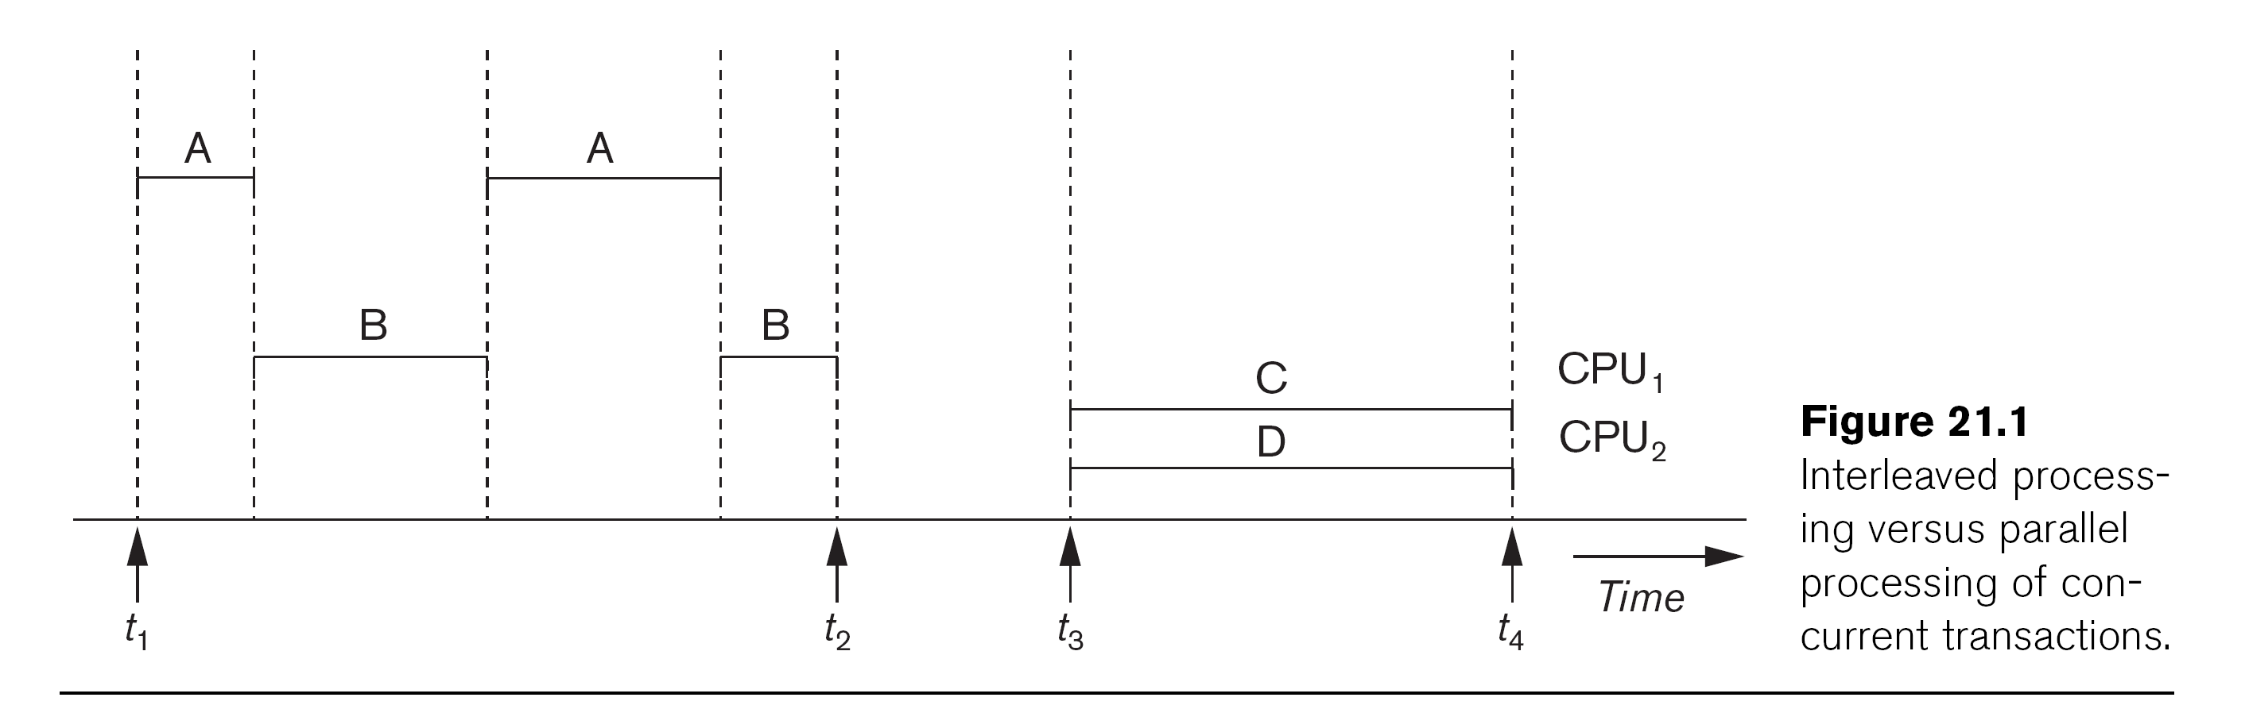

Slide 6
Introduction to Transaction Processing (cont.)
For transaction processing purposes, a simple database model is used:
A database - collection of named data items
Granularity (size) of a data item - a field (data item value), a record, or a whole disk block
TP concepts are independent of granularity
Basic operations on an item X:
read_item(X): Reads a database item named X into a program variable. To simplify our notation, we assume that the program variable is also named X.
write_item(X): Writes the value of program variable X into the database item named X.

Slide 7
Introduction to Transaction Processing (cont.)
READ AND WRITE OPERATIONS:
Basic unit of data transfer from the disk to the computer main memory is one disk block (or page). A data item X (what is read or written) will usually be the field of some record in the database, although it may be a larger unit such as a whole record or even a whole block.
read_item(X) command includes the following
steps:
Find the address of the disk block that contains item X.
Copy that disk block into a buffer in main memory (if that disk block is not already in some main memory buffer).
Copy item X from the buffer to the program variable named X.

Slide 8
Introduction to Transaction Processing (cont.)
READ AND WRITE OPERATIONS (cont.):
write_item(X) command includes the following steps:
Find the address of the disk block that contains
item X.
Copy that disk block into a buffer in main memory (if it is not already in some main memory buffer).
Copy item X from the program variable named X
into its correct location in the buffer.
Store the updated block from the buffer back to disk (either immediately or at some later point in time).

Slide 9
Transaction Notation
Figure 21.2 (next slide) shows two examples of transactions
Notation focuses on the read and write operations
Can also write in shorthand notation:
– T1: b1; r1(X); w1(X); r1(Y); w1(Y); e1;
– T2: b2; r2(Y); w2(Y); e2;
bi and ei specify transaction boundaries (begin and end)
i specifies a unique transaction identifier (TId)

Slide 10
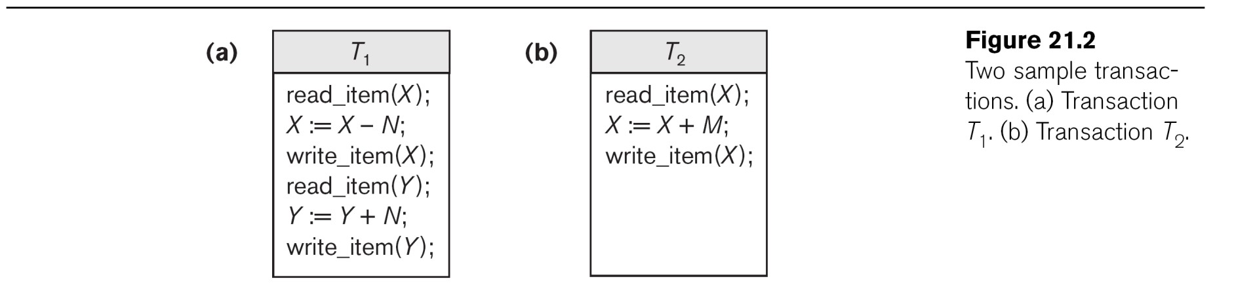

Slide 11
Why we need concurrency control
Without Concurrency Control, problems may occur with concurrent transactions:
Lost Update Problem.
Occurs when two transactions update the same data item, but both read the same original value before update
The Temporary Update (or Dirty Read) Problem.
This occurs when one transaction T1 updates a database item X, which is accessed (read) by another transaction T2; then T1 fails for some reason; X was (read) by T2 before its value is changed back (rolled back or UNDONE) after T1 fails

Slide 12
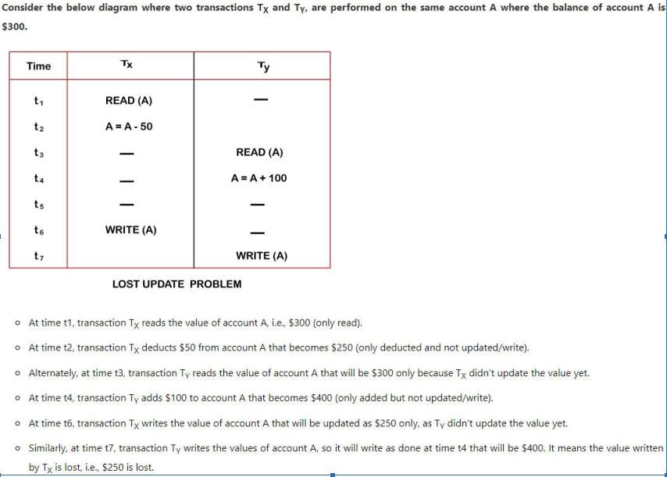

Slide 13
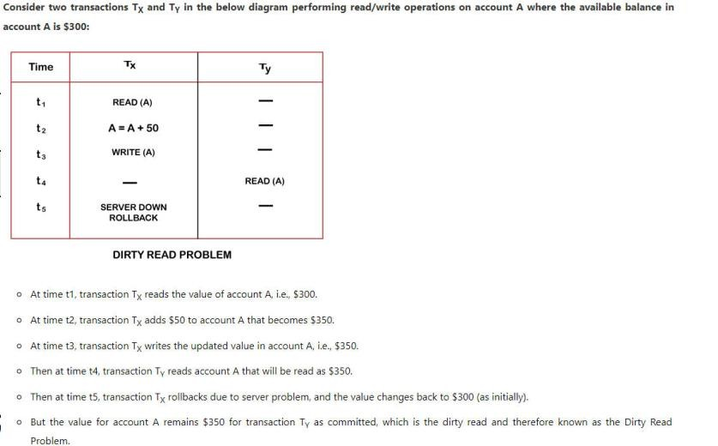

Slide 14
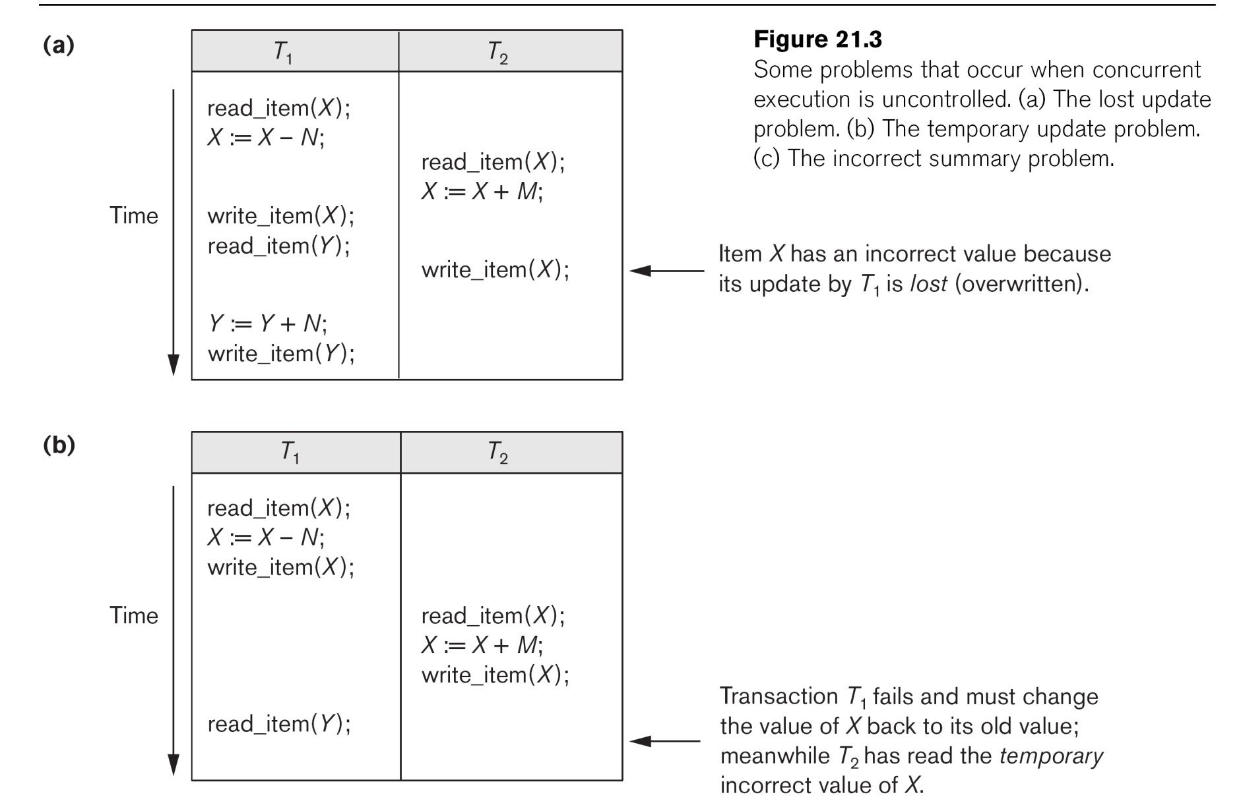

Slide 15
Why we need concurrency control (cont.)
The Incorrect Summary Problem .
One transaction is calculating an aggregate summary function on a number of records (for example, sum (total) of all bank account balances) while other transactions are updating some of these records (for example, transferring a large amount between two accounts, see Figure 21.3(c)); the aggregate function may read some values before they are updated and others after they are updated.

Slide 16
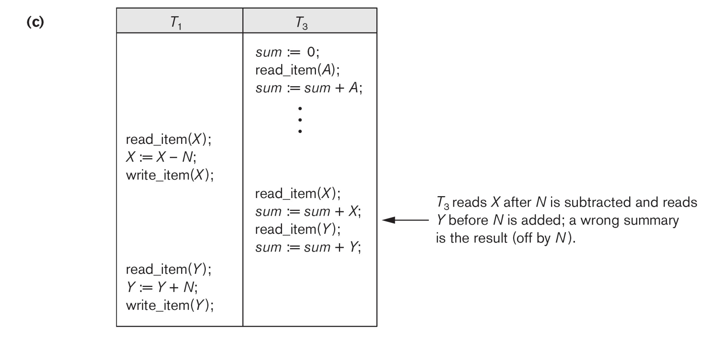

Slide 17
Why we need concurrency control (cont.)
The Unrepeatable Read Problem .
A transaction T1 may read an item (say, available seats on a flight); later, T1 may read the same item again and get a different value because another transaction T2 has updated the item (reserved seats on the flight) between the two reads by T1

Slide 18
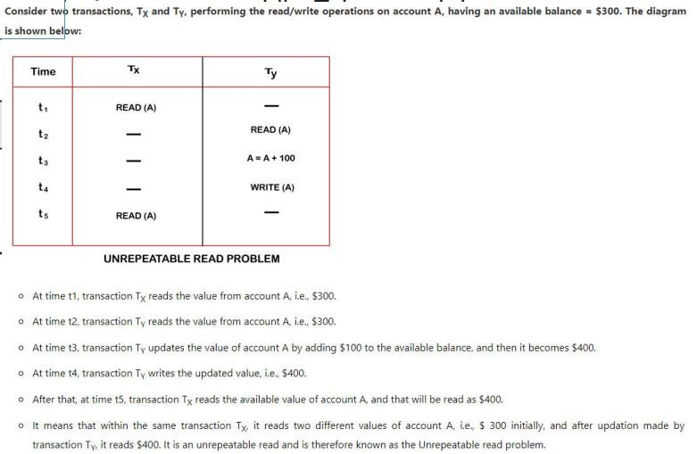

Slide 19
Why recovery is needed
Causes of transaction failure:
A computer failure (system crash): A hardware or software error occurs during transaction execution. If the hardware crashes, the contents of the computer’s internal main memory may be lost.
A transaction or system error : Some operation in the transaction may cause it to fail, such as integer overflow or division by zero. Transaction failure may also occur because of erroneous parameter values or because of a logical programming error. In addition, the user may interrupt the transaction during its execution.

Slide 20
Why recovery is needed (cont.)
Local errors or exception conditions detected by the transaction:
certain conditions necessitate cancellation of the transaction. For example, data for the transaction may not be found. A condition, such as insufficient account balance in a banking database, may cause a transaction, such as a fund withdrawal, to be canceled
a programmed abort causes the transaction to fail.
Concurrency control enforcement: The concurrency control method may decide to abort the transaction, to be restarted later, because it violates serializability or because several transactions are in a state of deadlock (see Chapter 22).

Slide 21
Why recovery is needed (cont.)
Disk failure: Some disk blocks may lose their data because of a read or write malfunction or because of a disk read/write head crash. This kind of failure and item 6 are more severe than items 1 through 4.
Physical problems and catastrophes: This refers to an endless list of problems that includes power or air- conditioning failure, fire, theft, sabotage, overwriting disks or tapes by mistake, and mounting of a wrong tape by the operator.

Slide 22
Transaction and System Concepts
A transaction is an atomic unit of work that is either completed in its entirety or not done at all. A transaction passes through several states (Figure 21.4, similar to process states in operating systems).
Transaction states:
Active state (executing read, write operations)
Partially committed state (ended but waiting for system checks to determine success or failure)
Committed state (transaction succeeded)
Failed state (transaction failed, must be rolled back)
Terminated State (transaction leaves system)

Slide 23
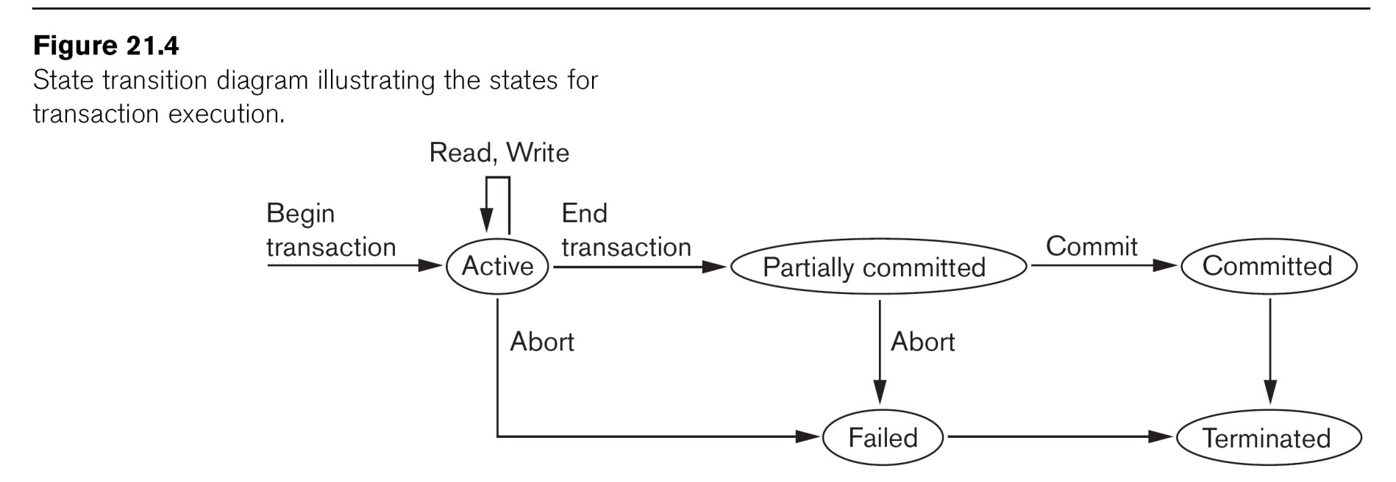

Slide 24
Transaction and System Concepts (cont.)
DBMS Recovery Manager needs system to keep track of the following operations (in the system log file):
begin_transaction: Start of transaction execution.
read or write: Read or write operations on the database items that are executed as part of a transaction.
end_transaction: Specifies end of read and write transaction operations have ended. System may still have to check whether the changes (writes) introduced by transaction can be permanently applied to the database (commit transaction); or whether the transaction has to be rolled back (abort transaction) because it violates concurrency control or for some other reason.

Slide 25
Transaction and System Concepts (cont.)
Recovery manager keeps track of the following operations (cont.):
commit_transaction: Signals successful end of transaction; any changes (writes) executed by transaction can be safely committed to the database and will not be undone.
abort_transaction (or rollback): Signals transaction has ended unsuccessfully; any changes or effects that the transaction may have applied to the database must be undone.

Slide 26
Transaction and System Concepts (cont.)
System operations used during recovery (see Chapter 23):
undo(X): Similar to rollback except that it applies to a single write operation rather than to a whole transaction.
redo(X): This specifies that a write operation of a committed transaction must be redone to ensure that it has been applied permanently to the database on disk.

Slide 27
Transaction and System Concepts (cont.)
Commit Point of a Transaction:
Definition: A transaction T reaches its commit point when all its operations that access the database have been executed successfully and the effect of all the transaction operations on the database has been recorded in the log file (on disk). The transaction is then said to be committed.

Slide 28
Desirable Properties of Transactions
Called ACID properties – Atomicity, Consistency, Isolation, Durability:
Atomicity: A transaction is an atomic unit of processing; it is either performed in its entirety or not performed at all.
Consistency preservation: A correct execution of the transaction must take the database from one consistent state to another.

Slide 29
Desirable Properties of Transactions (cont.)
ACID properties (cont.):
Isolation: Even though transactions are executing concurrently, they should appear to be executed in isolation – that is, their final effect should be as if each transaction was executed in isolation from start to finish.
Durability or permanency: Once a transaction is committed, its changes (writes) applied to the database must never be lost because of subsequent failure.

Slide 30
Desirable Properties of Transactions (cont.)
Atomicity: Enforced by the recovery protocol.
Consistency preservation: Specifies that each transaction does a correct action on the database on its own. Application programmers and DBMS constraint enforcement are responsible for this.
Isolation: Responsibility of the concurrency control protocol.
Durability or permanency: Enforced by the recovery
protocol.

Slide 31
Introduction to Transaction Support in SQL
A single SQL statement is always considered to be atomic. Either the statement completes execution without error, or it fails and leaves the database unchanged.
With SQL, there is no explicit Begin Transaction statement. Transaction initiation is done implicitly when particular SQL statements are encountered.
Every transaction must have an explicit end statement, which is either a COMMIT or ROLLBACK.

