Slide 1
Computer Networks - An Introduction

Slide 2
OBJECTIVE
Distinguish between circuit switching and packet switching
Understand the layered approach of OSI model and the function of each layer
Compare OSI and TCP/IP Model
Appreciate the advantages and disadvantages of different network topologies

Slide 3
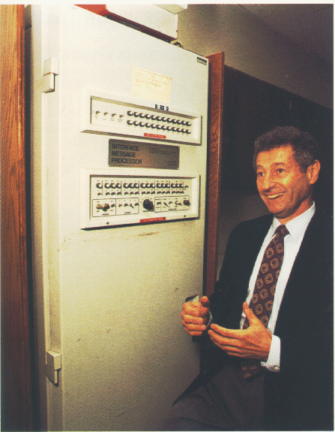
The Beginning
http://www.lk.cs.ucla.edu/personal_history.html

Slide 4
Circuit Switching
Features of circuit switched networks
  Resources needed for communication between end systems are reserved for the duration of the communication session.
  Additional overhead for reserving resources.

Slide 5
Circuit Switching
Communication is faster
Once, the resource is allocated, it remains with that user until the session is over, even if there is no data to be sent
More suitable for real time communication
e. g. Telephone network.

Slide 6
Packet Switching
Features of Packet Switching:
  Resources are not reserved
  Resources are allocated on demand
  Best effort delivery
  Communication via messages

Slide 7
Packet Switching
Packet switches usually use store-and-forward transmission. This introduces delay
Each link to a switch also has an output buffer, meant for output queue. This also introduces queuing delay
Messages may contain both control information and data
e. g. Internet

Slide 8
ARPANET
Packet-switched Network consisting of subnet and host computers
Subnet consisting of minicomputers called IMP (Interface Message Processor) connected by 56 kbps transmission lines
Each IMP connected to at least two other IMPs
Datagram subnet for rerouting the packet in case some lines or IMPs are destroyed
Each node of network consisting of an IMP and host connected by a short wire

Slide 9
Original ARPANET Design
Host-host protocol
Host
Host
Source IMP to destination IMP protocol
IMP
IMP-IMP protocol
Subnet

Slide 10
Human Communication
A Comparison
Computer Communication
Tacit Implications
Precise Coding
Redundancies
Clearly Specified Protocols
Explicit Layers
Hidden Layers

Slide 11
Layered Architecture
TELEPHONE
POSTAL
COMPUTER
Message Creation
Call Initiation
Composition
Application
Message Structuring
Placing in cover
Transport
Path allocation
Circuit Formation
Sorting
Network
Transmission
Voice Transmission
Mail bags
Data Link
+
Physical
Reception

Slide 12
Layers
In the sense of purpose and responsibility, each layer is separate and independent
Each layer has its own function, but also provides a service to those layers above and below itself
The model should be considered an aid to understanding the nature of communication on the network – and useful in sorting out troubles that might occur on a network
Layering allows both software engineers and hardware manufacturers ensure their products work together.

Slide 13
Two Basic Type of Services
Connection-Oriented Services
Establish, Use and Release connection
First-in First-out message pipe - Order maintained
Connectionless Services
Each message handled independently
No guarantee of maintaining order of messages

Slide 14
Connection-Oriented Transport
Reliable Transport Method – uses acknowledgement
Features are :
  Reliability
  Slower Communication
  Packets are re-transmitted if unrecognisable or not received
Once all the data is received successfully , the packet is re-assembled and the Transport Layer passes it to the Session Layer

Slide 15
Connectionless Transport
In this mode the transmitting device does not require acknowledgements from the receiver, and continues to transmit on the assumption that the data was received
Features are:
  Little or No Reliability
  Faster Transmission
  Packets are not Re-transmitted

Slide 16
A NETWORK
When one computer is connected to another
  To share resources: Hardware, software, files etc.
Communicate via a protocol
  Agreed upon method of initiating and ending communication, verifying errors, etc.
When one network is connected to another
  Intranets, internet.

Slide 17
What is a Network?
Three basic types of networks include:
Local Area Network (LAN)
Metropolitan Area Network (MAN)
Wide Area Network (WAN)

Slide 18
Protocol
A protocol is an agreement that standardizes the way communication will be handled.
Differing from the standard protocol may result in the other party not understanding the communication.

Slide 19
Protocol Hierarchies
Networks are organized as a stack of levels or layers
We build each layer on the one below it
Layers differ in number and function from one network to another
Each layer hides underlying details from the one above it – sort of like a virtual machine
Each layer talks to the ones above & below it

Slide 20
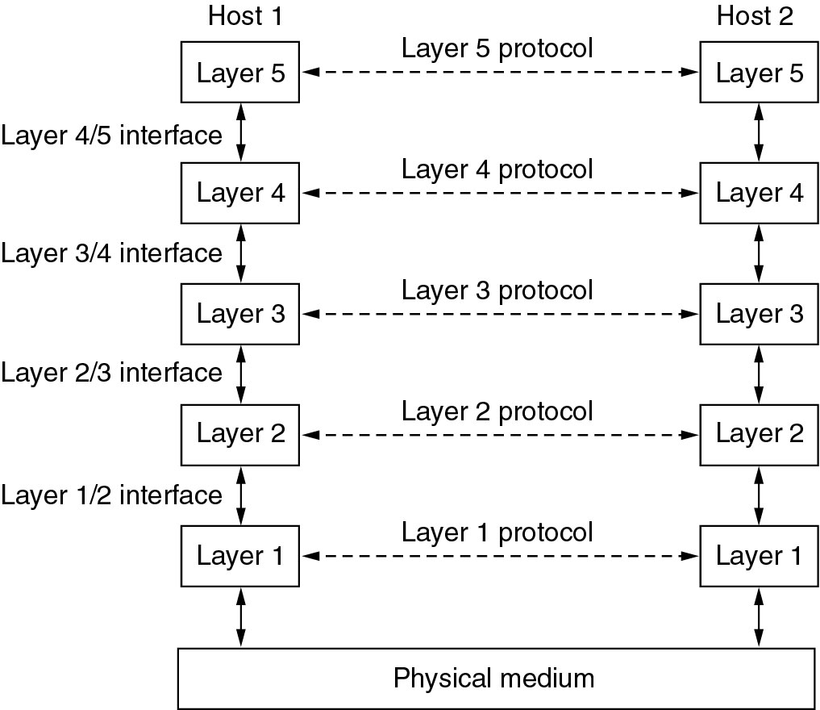
Example Hierarchy

Slide 21
Data Transfer
No data is transferred directly from one machine to another on that layer – the layers can only talk to the ones above or below them on their host.
A message from layer 5 will have to travel to layer 1, move across the physical medium, and then back up to layer 5 on the different machine.
Layer 1 is the only layer able to move data from one machine to another, through the physical medium.

Slide 22
OSI MODEL
The seven layers of OSI Model
Function of each layer
Process of communication between devices

Slide 23
What is the OSI model ?
Open Systems Interconnection model is fundamental to all communications between network devices.
Developed in 1974 by ISO after the American Department of Defence began using the TCP/IP suite of protocols.
Finally adopted in 1977. It is now the theoretical model for how communication takes place between network devices.

Slide 24
The seven layers
Layer 7
Application
Layer 6
Presentation
Layer 5
Session
Layer 4
Transport
Layer 3
Network
Data Link
Layer 2
Physical
Layer 1

Slide 25
The Layers at Work
When communicating, each OSI layer talks with the same layer in the other device
e.g. the Application Layer of Device A communicates with the Application Layer of Device B, by passing the data through the other layers
The Application Layer of each device is not concerned with how the other layers are functioning, but it does rely on them to do their job

Slide 26
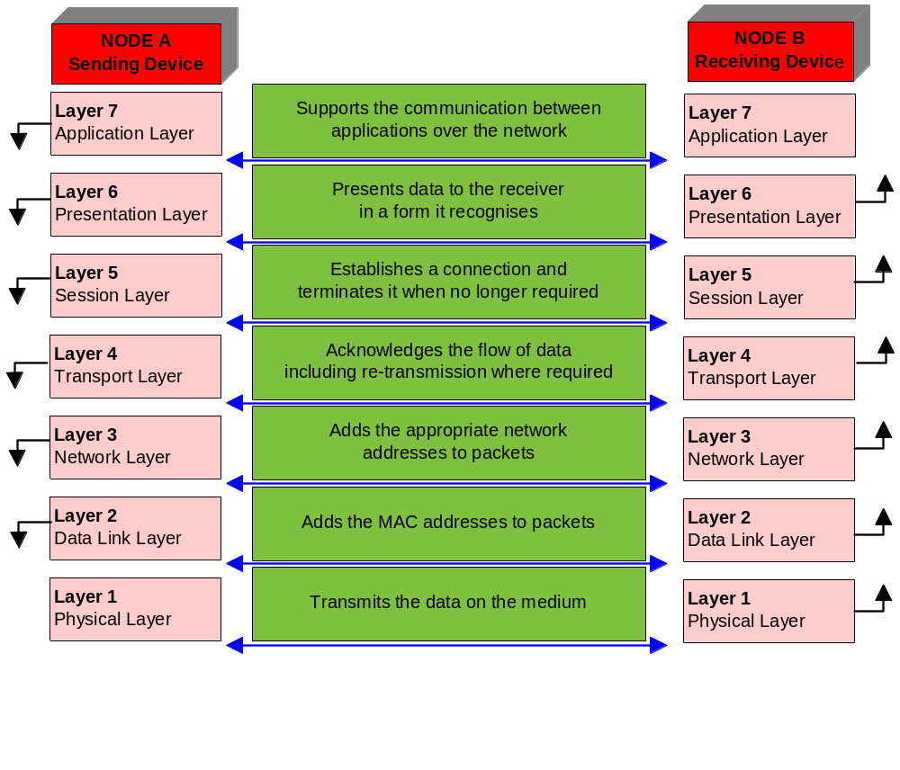
The layers at Work

Slide 27
How does data flow ? ( Encapsulation)
Application
DATA
Presentation
Presentation Header
PH
DATA
Session
Session Header
SH
PH
DATA
Transport
Transport Header
TH
SH
PH
DATA
Network
Network Header
NH
TH
SH
PH
DATA
Data Link
Data Link Header
DLH
NH
TH
SH
PH
DATA
DLT
Data Link Trailer
Physical
Bits
To Destination Device

Slide 28
Application Layer
‘Closest’ layer to the user
Clicking on a link on a web page issues a command for the browser to retrieve the relevant information from the Internet
In this example your computer is the source, and the host of the web site information is the destination
The application completes your request and delivers the information to your computer

Slide 29
Application Services
File Services
Electronic-mail Services
Network-printing Services
Application Services
Database Services

Slide 30
Presentation Layer
This layer has three fundamental functions
1) Data Presentation :
Enables receiving device to understand the information sent from the source
Converts data from native format (abstract syntax) to a common format (transfer syntax), e.g. ASCII

Slide 31
Presentation Layer
2) Data Compression:
By reducing the volume of data, transfers can take place in less time
Packets are examined and such things as spaces in text removed
The destination device returns the data to its original format before passing to the Application Layer

Slide 32
Presentation Layer
3) Data Encryption :
Allows data to be converted to a form which hides its meaning, apart from those you wish to see it
Not all data is encrypted on its journey across the network
In order for decryption to occur at the destination device a ‘key’ is required

Slide 33
Session Layer
Primarily responsible for handling the session between devices (beginning, maintaining and finishing)
Enforces order in the communication between devices
Regulates the flow of data
It takes responsibility for the following

Slide 34
Session Services
The following services are provided:
Establishing a Connection
Maintaining the Session
Ending the Connection
Dialogue Control
Dialogue Separation

Slide 35
Session Services
Handshaking – SYN and ACK packets
‘Keep alive messages’
Session must be terminated (otherwise one device will be still transmitting without any device actually listening)
Dialogue Control (simplex, half-duplex, full-duplex)
Dialogue Separation – checkpoints within the transmission which allow the detection of lost packets, and subsequent re-transmission

Slide 36
Transport Layer
Ensures reliable transport of packets from source to destination.
Also manages the speed of transmission – flow control.
There are two types of transmission :
Connection-Oriented Transmissions (TCP)
Connectionless Transmissions (UDP)

Slide 37
Network Layer
Responsible for the correct addressing and delivery of packets of data known as datagrams
Uses the network address ( this is a logical address – and does not depend upon any hardware in the device, or the device’s physical location)

Slide 38
Network Layer
Adds the address to the packet (encapsulation)
Determines the best path for the packet (routing)
Ensures that the packet is in the correct format for the destination

Slide 39
How does Network Layer Work ?
Encapsulation at the Transport Layer involves adding the address of the sender and the destination to the datagram
If a packet must move to another network, a routing protocol is required
If different packet lengths are used on the different networks, the Network Layer formats the data accordingly
The primary piece of hardware which works on this layer is the router
Notes:
An example of Transport and Network Layer
IPX and SPX are networking protocols used primarily on networks using the Novell NetWare operating systems.
IPX is a network layer protocol (layer 3 of the OSI Model), while SPX is a transport layer protocol (layer 4 of the OSI Model). The SPX layer sits on top of the IPX layer and provides connection-oriented services between two nodes on the network.

Slide 40
Data Link Layer
Has two sub layers of its own:
  Logical Link Control (LLC)
  Media Access Control (MAC)
LLC acts between protocols such as Internet Protocol (IP) and the MAC method.
MAC is responsible for the connection to the physical media (eg: cable)

Slide 41
Data Link Layer
MAC
  Each NIC has a unique number hard coded in to the card – its physical address
  It is a 48 bit address.
When the MAC address is added to the packet it is known as a frame
It has all the information required to travel from the source to the destination

Slide 42
Physical Layer
Responsible for the physical connection between devices
The NIC converts the data (bits) in to transmission signals.
Transmissions may be analogue or digital
Responsible for the rate of transmission
Includes all components such as the type of connector (RJ-45, Token Ring, BNC, SC connector)
Devices at this level include NICs, repeaters, hubs and concentrators

Slide 43
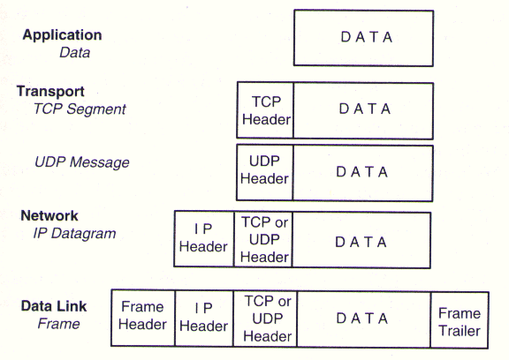
Entity exchanged at each Layer

Slide 44
TCP/IP Model
Layers of TCP/IP Model
Function of each layer
Comparison with OSI Model

Slide 45
TCP/IP Layers
OSI
TCP / IP
Application (Layer7)
Application (Telnet ,FTP)
Presentation (Layer6)
Outside OS
Session (Layer 5)
Transport (Layer 4)
Transport(TCP,UDP)
Inside OS
Network (Layer 3)
Internet(IP.ICMP,IGMP)
Data Link (Layer 2)
Link Layer(device driver and interface card)
Physical (Layer 1)
Outside OS

Slide 46
The Application Layer
OSI - FTAM,VT,MHS,DS
TCP/IP - FTP,SMTP,TELNET,DNS,SNMP
Note
  FTAM (File Transfer , Access , Management)
  VT (Virtual Terminal)
  MHS(Message Handling System)
  DS (Directory Services)

Slide 47
Transport for both Models
The TCP/IP and OSI architecture models both employ all connection and connectionless models at transport layer. However, the internet architecture refers to the two models in TCP/IP as simply “connections” and datagrams.
But the OSI reference model, with its penchant for “precise” terminology, uses the terms connection-mode and connection-oriented for the connection model and the term connectionless-mode for the connectionless model.

Slide 48
Network vs. Internet
Like all the other OSI Layers, the network layer provides both connectionless and connection-oriented services
As for the TCP/IP architecture, the internet layer is exclusively connectionless
X.25 Packet Level Protocol – OSI’s Connection-oriented Network Protocol
OSI’s CLNP (ISO/IEC 8473: 1993) is functionally identical to the Internet’s IP (RFC 791). Both CLNP and IP are best-effort-delivery network protocols

Slide 49
General Comparison
Focus of Reliability Control
Roles of Host System

Slide 50
Focus of Reliability Control
Implementation of the OSI model places emphasis on providing a reliable data transfer service, while the TCP/IP model treats reliability as an end-to-end problem.
Each layer of the OSI model detects and handles errors, all data transmitted includes checksums. The transport layer of the OSI model checks source-to-destination reliability.
In the TCP/IP model, reliability control is concentrated at the transport layer. The transport layer handles all error detection and recovery. The TCP/IP transport layer uses checksums, acknowledgments, and timeouts to control transmissions and provides end-to-end verification

Slide 51
Roles of Host System
Hosts on OSI implementations do not handle network operations (simple terminal), but TCP/IP hosts participate in most network protocols.
TCP/IP hosts carry out such functions as end-to-end verification, routing, and network control. The TCP/IP internet can be viewed as a data stream delivery system involving intelligent hosts

Slide 52
A Critique of TCP/IP
As opposed to OSI, TCP/IP makes no differentiation between specification and implementation
Does not give any effective model and is hence poorly suited to describing any other protocol stack
Host-to-network layer is not really a layer but an interface between network and data link layers
No distinction between physical and data link layers
All protocols other than TCP and IP are ad hoc
Nevertheless, TCP/IP protocols are widely used, whereas the OSI model is useful only for discussing computer networks.

Slide 53
Devices for Interconnecting Networks
Repeater - Connects two LANs at the Physical layer level
Hub - Multi-port Repeater, i.e. connects multiple LANs
Bridge - Connects LANs at the Data Link layer level
Router - Connects networks at the Network layer level
Gateway - Connects networks at Transport or higher layers
  The demarcation between Routers and Gateways has become fuzzy, as many sophisticated Routers involve protocols pertaining to Transport or even higher layer.
Switch - Implementation of a Bridge/Router/Gateway in silicon - as a Layer 2 / Layer 3 / Layer 4…... Switch

Slide 54
Repeater
Copies every bit arriving through one LAN to the other LAN. Thus the traffic is the same on both sides of a Repeater. All LANs interconnected by a Hub also carry the same traffic.
Connects LAN segments where the physical level protocols are identical
Receives, Amplifies, and Retransmits signals in both directions
Also acts as Active Repeaters for Optical Networks

Slide 55
Bridge
Store and Forward device
Accepts an entire frame, can make minor changes to the frame such as addition and deletion of header and then forward it to physical layer after verifying the checksum.
Can connect different LANs and transfer data between two networks when necessary
Keeps local traffic in the local area

Slide 56
Router
Sets up the path to be followed by a packet from the source node to the destination node on the basis of the Network layer Header of the packet and the router’s own database.
Optimizes metrics such as delay, throughput, number of hops etc.
Should provide simple, optimal and efficient routing
Should use a fair, robust and correct algorithm

Slide 57
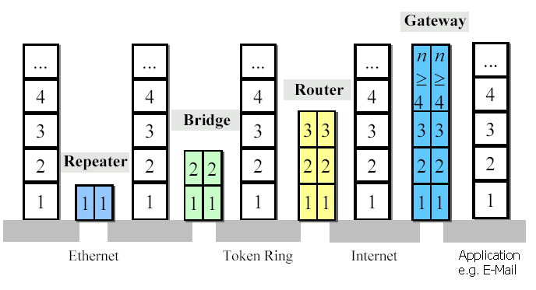
Devices at different layers
Notes:
Note : Explain where each node will be used. Why are they best suited for their position in the network and how are they different from each other. Also explain switch.

Slide 58
Topologies
Network configuration in terms of the interconnection between the nodes of the network
Bus (IEEE 802.3, Ethernet, Arcnet, IEEE 802.4, Token Bus):
  Transmission by one node can be received by others, i.e. broadcast
  Only one packet at a time
  Reliable and simple to implement
Ring (IEEE 802.5, Token Ring, FDDI):
  Point-to-point links
  Multiple packets possible at a time
  Broadcast

Slide 59
Topologies (continued)
Star
    Useful when most communication is to/from the central node
    Not broadcast
    Central-node is the single point of failure
    Maintenance easy as any node can be isolated from central node
Mesh
    Most flexible
    Multiple simultaneous packets possible
    Not broadcast
    Requires routing
    Commonly used in WANs

Slide 60
Need for Protocols
Medium Access Control
Error Control
Flow Control
Routing
Congestion Control
Internetworking
Sequencing
Addressing

Slide 61
Medium Access Protocols
Analogy: group of people in a room
  All hear everything broadcast
  Need access control
Unruly Group (Aloha)
  Speak whenever you must
  Works with a few nodes, else chaos
Polite Group (CSMA/CD)
  Listen before starting to speak
  Speak only when the floor (medium) is free
  Listen while speaking and back off for some time if collision occurs
Group with a leader (Token based )
  Seek permission from the leader to speak
  Speak only after receiving permission from the leader
  Leader can assign priorities

Slide 62

Thank You

Slide 63
Disclaimer
Aricent makes no representations or warranties with respect to contents of these slides and the same are being provided “as is”. The content/materials in the slides are of a general nature and are not intended to address the specific circumstances of any particular individual or entity. The material may provide links to internet sites (for the convenience of users) over which Aricent has no control and for which Aricent assumes no responsibility for the availability or content of these external sites. While the attempt has been to acknowledge sources of materials wherever traceable to an individual or an institution; any materials not specifically acknowledged is purely unintentional

