Slide 1
Processes

Slide 2
Process Concept
An operating system executes a variety of programs that run as a process.
Process – a program in execution
Process execution must progress in sequential fashion. No parallel execution of instructions of a single process
Multiple parts
The program code, also called text section
Current activity including program counter, processor registers
Stack containing temporary data
Function parameters, return addresses, local variables
Data section containing global variables
Heap containing memory dynamically allocated during run time

Slide 3
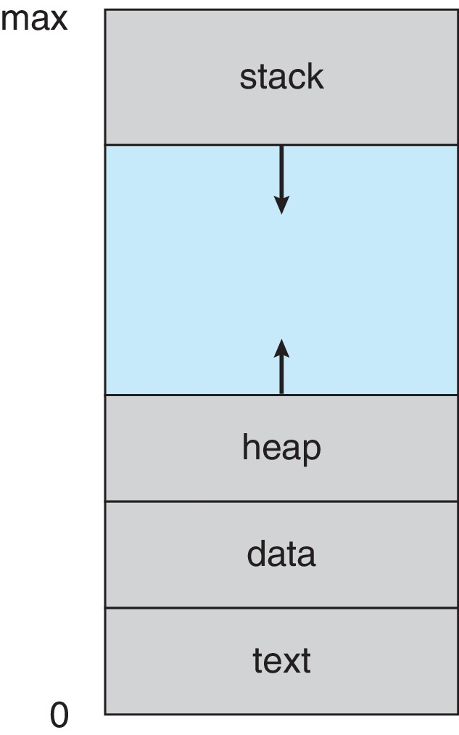
Process in Memory

Slide 4
Process Concept
Program is passive entity stored on disk (executable file);
Process is active
Program becomes process when an executable file is loaded into memory
Execution of program started via GUI mouse clicks, command line entry of its name, etc.
One program can be several processes
Consider multiple users executing the same program

Slide 5
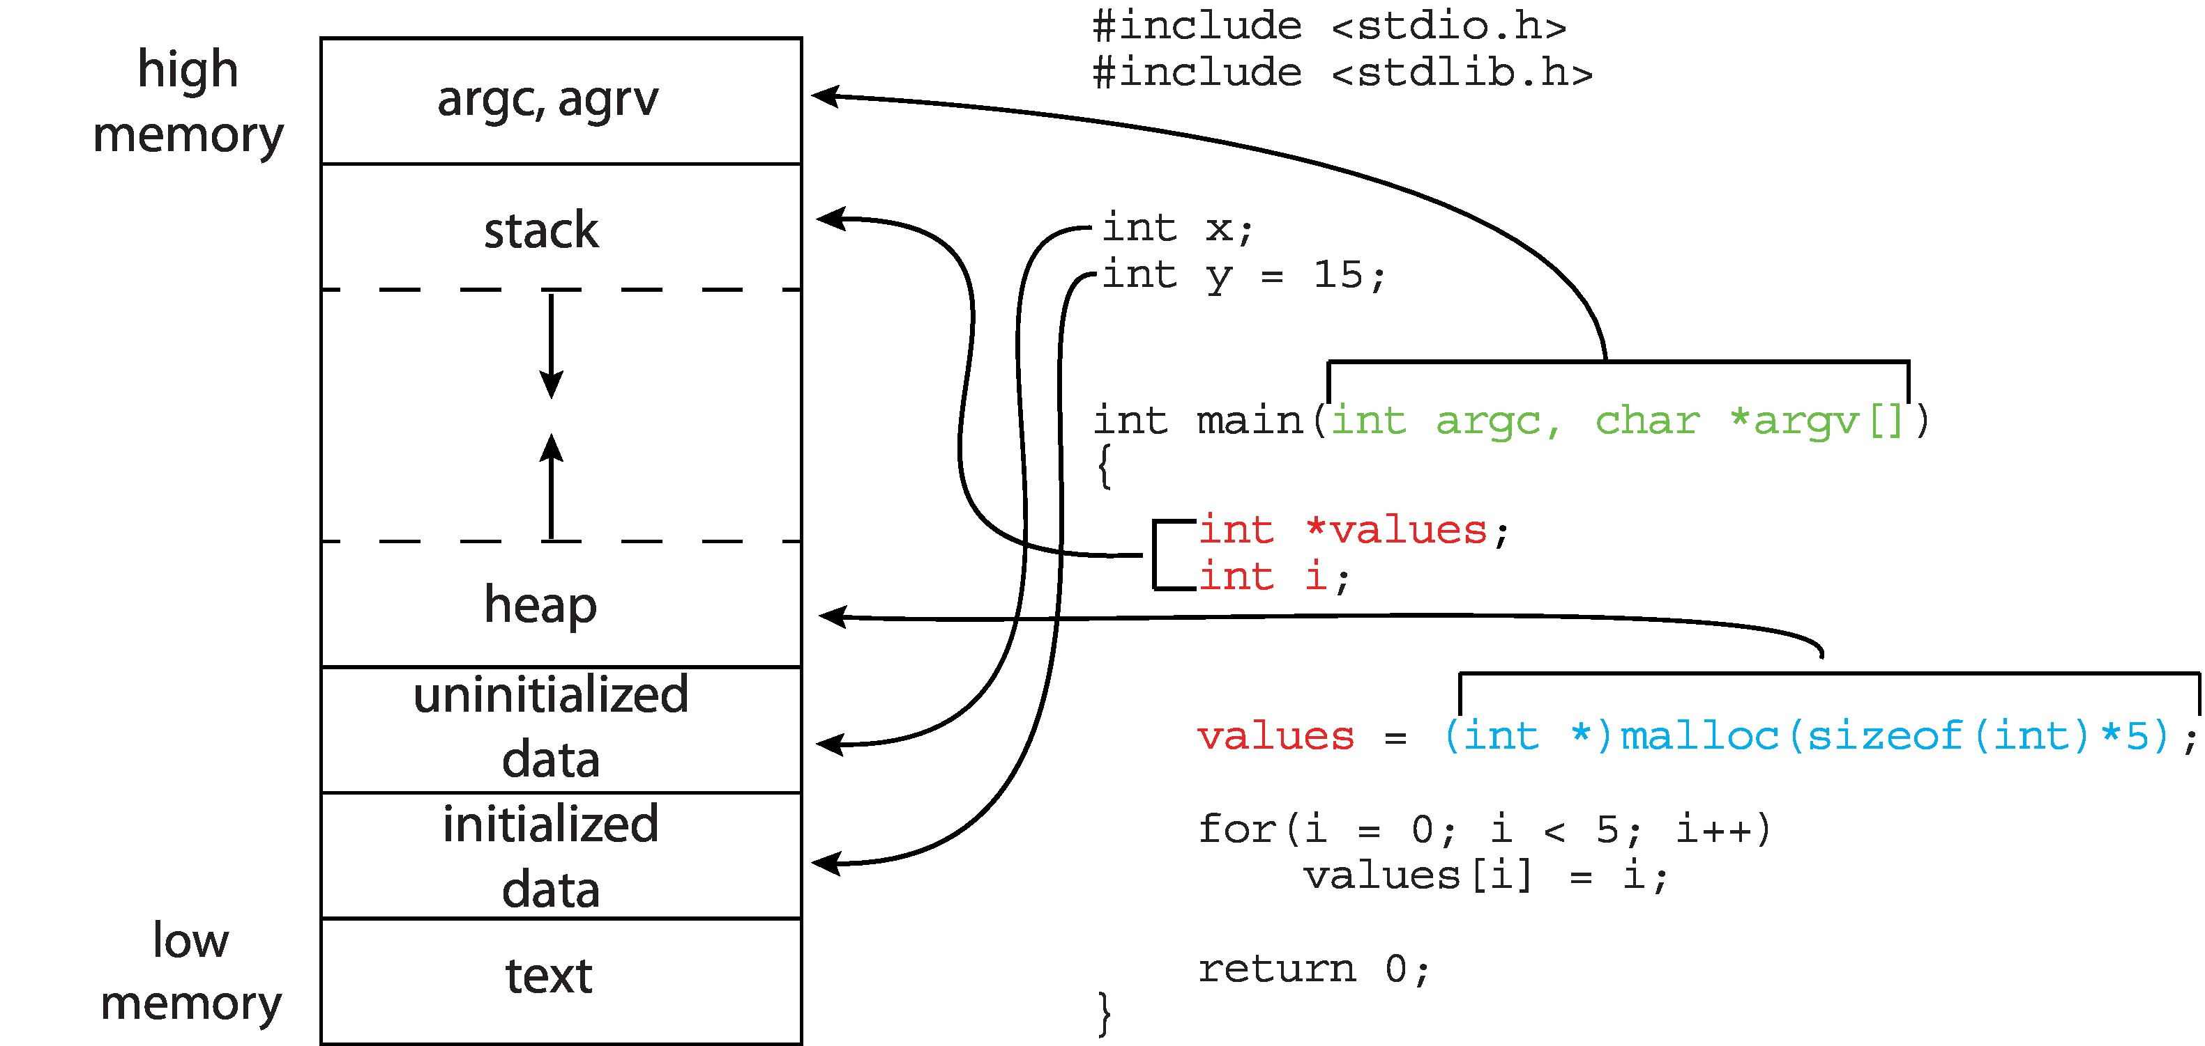
Memory Layout of a C Program

Slide 6
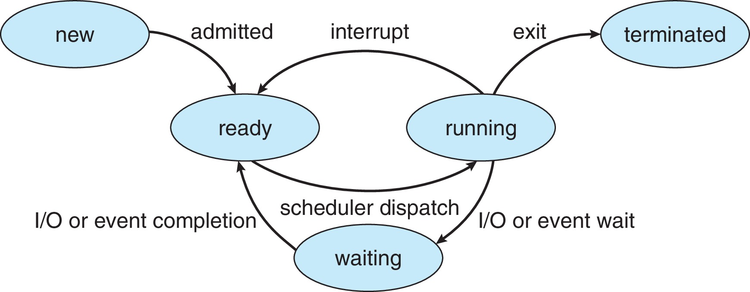
Process State
As a process executes, it changes state
New: The process is being created
Running: Instructions are being executed
Waiting: The process is waiting for some event to occur
Ready: The process is waiting to be assigned to a processor
Terminated: The process has finished execution

Slide 7
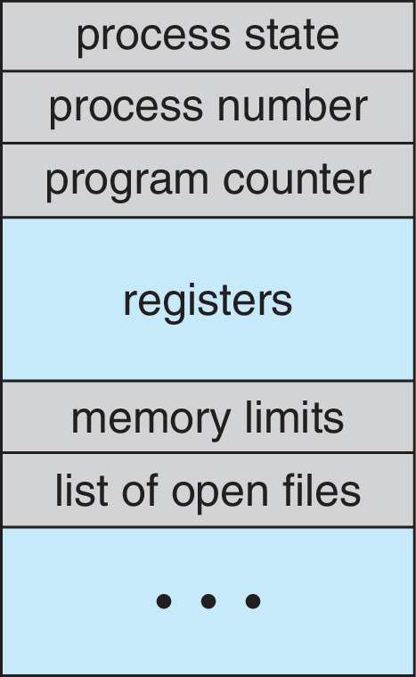
Process Control Block (PCB)
PCB contains Information associated with each process
Process state – running, waiting, etc.
Program counter – location of instruction to next execute
CPU registers – contents of all process-centric registers
CPU scheduling information- process priorities, scheduling queue pointers
Memory management information – memory allocated to the process
Accounting information – CPU used, clock time elapsed since start, time limits, process numbers.
I/O status information – I/O devices allocated to process, list of open files.

Slide 8
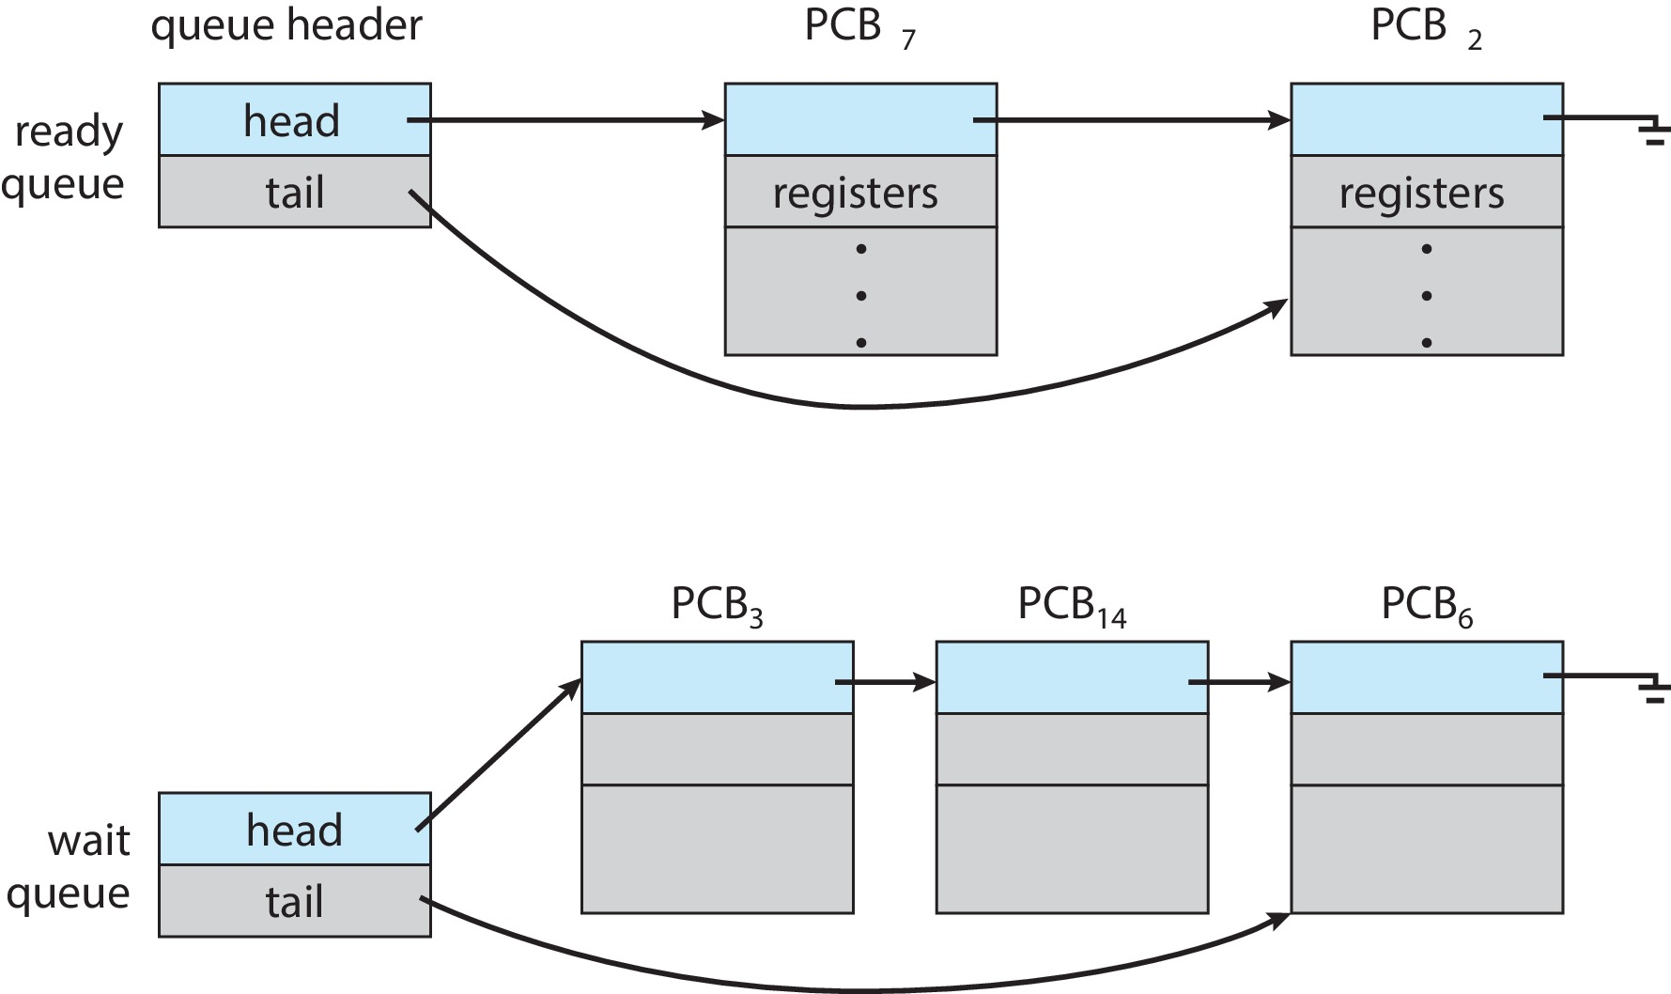
Process Scheduling
Process scheduler selects among available processes for next execution on CPU core.
Goal -- Maximize CPU use, quickly switch processes onto CPU core.
Maintains scheduling queues of processes.
Ready queue – set of all processes residing in main memory, ready and waiting to execute.
Wait queues – set of processes waiting for an event (i.e., I/O)
Processes migrate among the various queues.

Slide 9
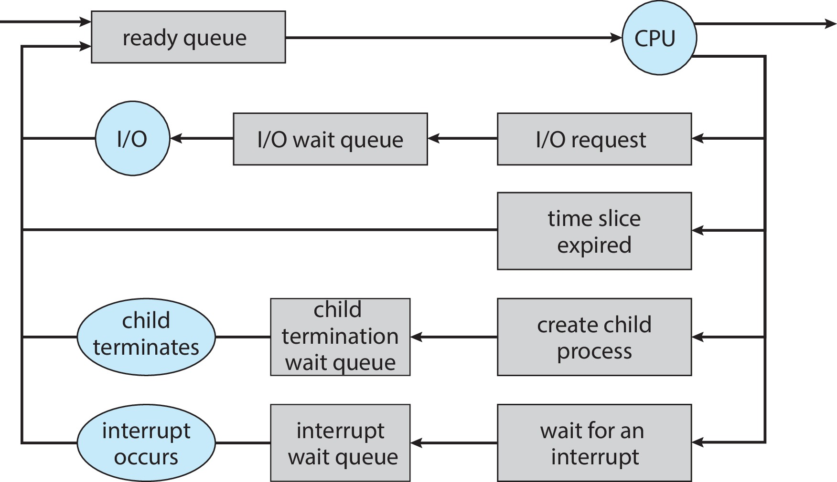
Representation of Process Scheduling

Slide 10
Context Switch
When CPU switches to another process, the system must save the state of the old process and load the saved state for the new process via a context switch.
Context of a process represented in the PCB.
Context-switch time is pure overhead; the system does no useful work while switching.
The more complex the OS and the PCB -- the longer the context switch.
Time dependent on hardware support.
Some hardware provides multiple sets of registers per CPU -- multiple contexts loaded at once.

Slide 11
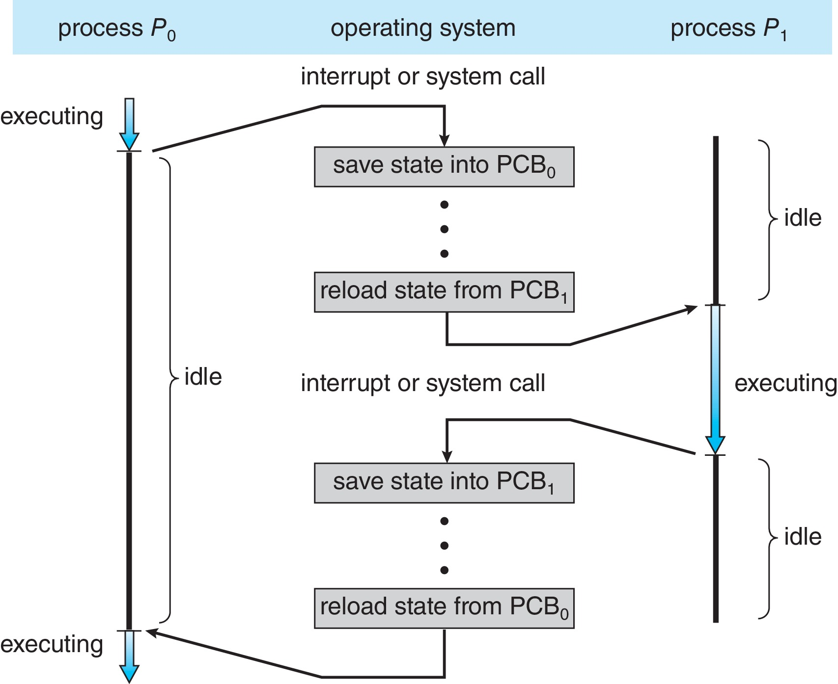
CPU Switch From Process to Process
A context switch occurs when the CPU switches from one process to another.
Waste of time

Slide 12
Multitasking in Mobile Systems
Some mobile systems (e.g., early version of iOS) allow only one process to run, others suspended
Due to screen real estate, user interface limits iOS provides for a
Single foreground process- controlled via user interface
Multiple background processes– in memory, running, but not on the display, and with limits
Limits include single, short task, receiving notification of events, specific long-running tasks like audio playback
Android runs foreground and background, with fewer limits
Background process uses a service to perform tasks
Service can keep running even if background process is suspended
Service has no user interface, small memory use

Slide 13
Operations on Processes
System must provide mechanisms for:
Process creation
Process termination

Slide 14
Process Creation
Parent process create children processes, which, in turn create other processes, forming a tree of processes
Generally, process identified and managed via a process identifier (pid)
Resource sharing options
A child process may be able to obtain its resources directly from OS
Children share subset of parent’s resources
Execution options
Parent and children execute concurrently
Parent waits until children terminate

Slide 15
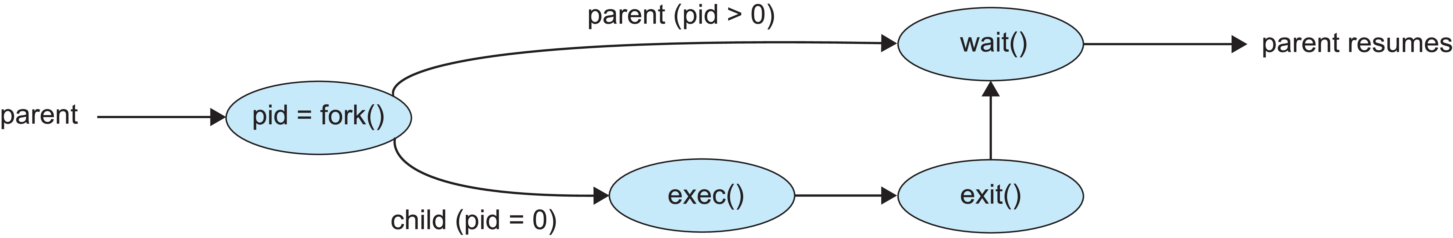
Process Creation
Address space
Child duplicate of parent
Child has a program loaded into it
UNIX examples
fork() system call creates new process (child process)
exec() system call used after a fork() to replace the process’ memory space with a new program
Parent process calls wait()waiting for the child to terminate

Slide 16
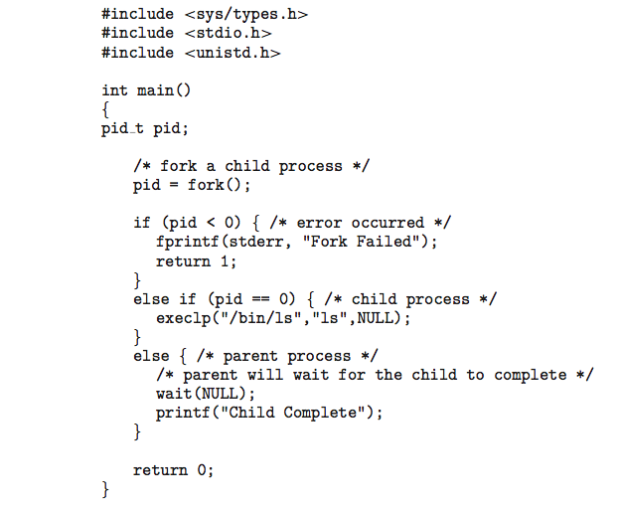
C Program Forking Separate Process

Slide 17
Process Termination
Process executes last statement and then asks the operating system to delete it using the exit() system call.
Returns status data from child to parent (via wait())
Process’ resources are deallocated by operating system
Parent may terminate the execution of children processes using the abort() system call. Some reasons for doing so:
Child has exceeded allocated resources
Task assigned to child is no longer required
The parent is exiting, and the operating systems does not allow a child to continue if its parent terminates

Slide 18
Process Termination
Some operating systems do not allow child to exists if its parent has terminated.
If a process terminates (either normally or abnormally), then all its children must also be terminated.
cascading termination. All children, grandchildren, etc., are terminated.
The termination is initiated by the operating system.
We can terminate a process by using the exit() system call, providing an exit status as a parameter:
exit(1);
In fact, under normal termination, exit() will be called either directly (exit(1)) or
indirectly, as the C run-time library will include a call to exit() by default.

Slide 19
Process Termination
The parent process may wait for termination of a child process by using the wait()system call.
This system call also returns the process identifier of the terminated child so that the parent can tell which of its children has terminated.
pid = wait(&status);
When a process terminates, its resources are deallocated by the operating system.
However, its entry in the process table must remain there until the parent calls wait(), because the process table contains the process’s exit status.
A process that has terminated, but whose parent has not yet called wait(), is known as a zombie process.
if a parent did not invoke wait() and instead terminated, leaving its child processes as orphans.
Waitpid(pid,&status,flag)

Slide 20

Multiprocess Architecture – Chrome Browser
Many web browsers ran as single process (some still do)
If one web site causes trouble, entire browser can hang or crash
Google Chrome Browser is multiprocess with 3 different types of processes:
Browser process manages user interface, disk and network I/O
Renderer process renders web pages, deals with HTML, Javascript. A new renderer created for each website opened
Plug-in process for each type of plug-in

Slide 21
Interprocess Communication
Processes executing concurrently in the operating system may be either independent or cooperating.
Independent process cannot affect or be affected by the other processes executing in the system.
A process is independent if it does not share data with any other processes executing in the system.
Cooperating process can affect or be affected by other processes executing in the system.
Any process that shares data with other processes is a cooperating process.

Slide 22
Interprocess Communication
There are several reasons for providing an environment that allows process cooperation:
Information sharing: Since several applications may be interested in the same piece of information, we must provide an environment to allow concurrent access to such information.
Computation speedup: If we want a particular task to run faster, we must break it into subtasks, each of which will be executing in parallel with the others.
Modularity: To construct the system in a modular fashion, dividing the system functions into separate processes or threads.

Slide 23
Interprocess Communication
Cooperating processes require an interprocess communication (IPC) mechanism that will allow them to exchange data— that is, send data to and receive data from each other.
Two fundamental models of interprocess communication:
Shared memory
Message passing

Slide 24
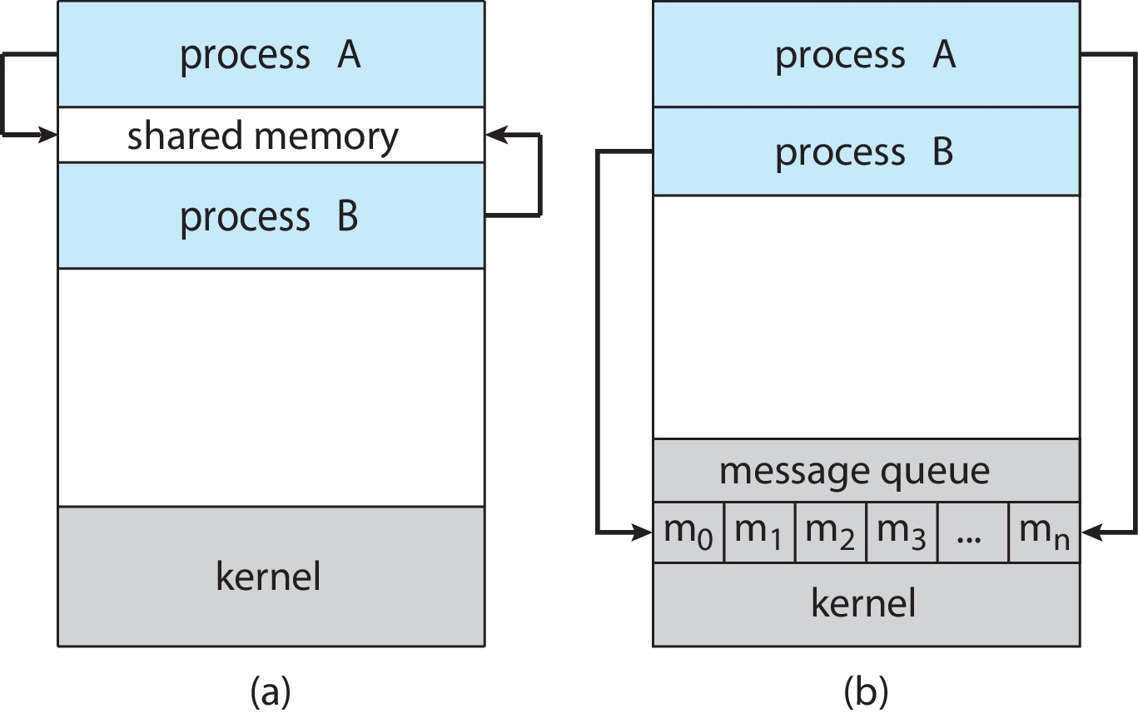
Communications Models
Shared-memory model: A region of memory that is shared by the cooperating processes is established. Processes can then exchange information by reading and writing data to the shared region.
Fig: (a) Shared memory. (b) Message passing
Message-passing model: communication takes place by means of messages exchanged between the cooperating processes.

Slide 25
Communications Models
Message passing is useful for exchanging smaller amounts of data.
Message passing is also easier to implement in a distributed system than shared memory.
Fig: (a) Shared memory. (b) Message passing

Slide 26
Communications Models
Shared memory can be faster than message passing, since message-passing systems are implemented using system calls, and thus require the more time-consuming task of kernel intervention.
Fig: (a) Shared memory. (b) Message passing
In shared-memory systems, system calls are required only to establish shared memory regions. Once shared memory is established, all accesses are treated as routine memory accesses, and no assistance from the kernel is required.

Slide 27
Communications Models
Message passing: For example, an Internet chat program could be designed so that chat participants communicate with one another by exchanging messages.
IPC facility provides two operations:
send(message)
receive(message)
The message size is either fixed or variable

Slide 28
Producer–consumer problem
To illustrate the concept of cooperating processes, let’s consider the producer–consumer problem, which is a common paradigm for cooperating processes.
Exchange information by reading and writing data in the shared areas.
To allow producer and consumer processes to run concurrently, we must have available a buffer of items that can be filled by the producer and emptied by the consumer.
This buffer will reside in a region of memory that is shared by the producer and consumer processes.

Slide 29
Producer–consumer problem
The producer and consumer must be synchronized, so that the consumer does not try to consume an item that has not yet been produced.
Two types of buffers can be used:
Unbounded-buffer places no practical limit on the size of the buffer:
Producer never waits
Consumer waits if there is no buffer to consume
Bounded-buffer assumes, there is a fixed buffer size
Producer must wait if all buffers are full
Consumer waits if there is no buffer to consume

Slide 30
Bounded-Buffer – Shared-Memory Solution
Shared data
#define BUFFER_SIZE 10
typedef struct {
. . .
} item;
item buffer[BUFFER_SIZE];
int in = 0;
int out = 0;
The shared buffer is implemented as a circular array with two logical pointers: in and out.

Slide 31
Bounded-Buffer – Shared-Memory Solution
item next_produced;
while (true) {
/* produce an item in next produced */
while (((in + 1) % BUFFER_SIZE) == out)
; /* do nothing */
buffer[in] = next_produced;
in = (in + 1) % BUFFER_SIZE;
}
The variable in points to the next free position in the buffer; out points to the first full position in the buffer.
item next_consumed; while (true) { while (in == out)
; /* do nothing */ next_consumed = buffer[out];
out = (out + 1) % BUFFER_SIZE; /* consume the item in next consumed */
}
The buffer is empty when in == out;
the buffer is full when ((in + 1) % BUFFER SIZE) == out.

Slide 32
Bounded-Buffer – Shared-Memory Solution
Solution is correct, but can only use BUFFER_SIZE-1 elements.

Slide 33
Bounded-Buffer – Shared-Memory Solution
our original solution allowed at most BUFFER SIZE − 1 items in the buffer at the same time.
One possibility to overcome this deficiency, is to add an integer variable, count, initialized to 0.
count is incremented every time we add a new item to the buffer and is decremented every time we remove one item from the buffer.

Slide 34
Bounded-Buffer – Shared-Memory Solution
while (true) { /* produce an item in next produced */
while (count == BUFFER_SIZE)
; /* do nothing */
buffer[in] = next_produced;
in = (in + 1) % BUFFER_SIZE;
count++;
} ______________________________________________________
while (true) {
while (count == 0)
; /* do nothing */
next_consumed = buffer[out];
out = (out + 1) % BUFFER_SIZE;
count--;
/* consume the item in next consumed */
}

Slide 35
Bounded-Buffer – Shared-Memory Solution
Although the producer and consumer routines shown are correct separately, they may not function correctly when executed concurrently.
Suppose that the value of the variable count is currently 5 and that the producer and consumer processes concurrently execute the statements count++ and count—.
Following the execution of these two statements, the value of the variable count may be 4, 5, or 6! The only correct result, though, is count == 5

Slide 36
Bounded-Buffer – Shared-Memory Solution
count++ could be implemented as (Producer ) register₁ = count register₁ = register₁ + 1 count = register₁
count-- could be implemented as (Consumer ) register₂ = count register₂ = register₂ - 1 count = register₂
Consider this execution interleaving with “count = 5” initially:
S₀: producer execute register₁ = count {register₁ = 5} S₁: producer execute register₁ = register₁ + 1 {register₁ = 6} S₂: consumer execute register₂ = count {register₂ = 5} S₃: consumer execute register₂ = register₂ – 1 {register₂ = 4} S₄: producer execute count = register₁ {count = 6 } S₅: consumer execute count = register₂ {count = 4}
If, we reversed the order of the statements at S₄ and S₅, we would arrive at the incorrect state count= 6.

Slide 37
Race Condition
When two or more process cooperates with each other, manipulate the same data concurrently and the outcome of the execution depends on the particular order in which the access takes place, is called a race condition.
Such processes need to be synchronized so that their order of execution can be guaranteed.
The procedure involved in preserving the appropriate order of execution of cooperative processes is known as Process Synchronization.
There are various synchronization mechanisms that are used to synchronize the processes.

