Slide 1
PROCESS SCHEDULERS
Long Term scheduler, Short term scheduler
&
Medium-term scheduler

Slide 2
Process Scheduler
Process scheduling is an essential part of a Multiprogramming operating systems.
Operating systems allow more than one process to be loaded into the executable memory at a time and the loaded process shares the CPU using time multiplexing.
Schedulers are special system software which handle process scheduling.
Schedulers are of three types −
Long-Term Scheduler
Short-Term Scheduler
Medium-Term Scheduler

Slide 3
Long-Term Scheduler
Long-term scheduler also called job scheduler.
The long-term scheduler controls the degree of multiprogramming (the number of processes in memory).
In multiprogramming system, more processes are submitted than can be executed immediately.
These processes are spooled to a mass-storage device (typically a disk), where they are kept for later execution.
Job scheduler selects processes from this pool and loads them into memory for execution.
The long-term scheduler executes much less frequently.

Slide 4
Long-Term Scheduler(Put process in ready queue)
It is important that the long-term scheduler make a careful selection of both IO and CPU bound process.
IO bound tasks are which use much of their time in input and output operations
while CPU bound processes are which spend their time on CPU.
The job scheduler increases efficiency by maintaining a balance between the IO and CPU bound process.

Slide 5
Short-Term Scheduler
Short-term scheduler also called CPU scheduler.
The role of the CPU scheduler is to select from among the processes that are in the ready queue and allocate a CPU core to one of them.
The CPU scheduler is responsible for ensuring there is no starvation owing to high burst time processes.
Short-term scheduler only selects the process to schedule it doesn’t load the process on running.
Dispatcher is responsible for loading the process selected by Short-term scheduler on the CPU.
Short-term schedulers are faster than long-term schedulers.

Slide 6
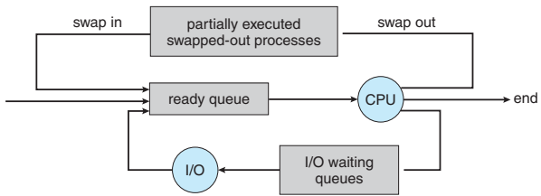
Medium-Term Scheduler
Some operating systems, such as time-sharing systems, may introduce an additional, intermediate level of scheduling.
The key idea behind a medium-term scheduler is that sometimes it can be advantageous to remove processes from memory (and from active contention for the CPU) and thus reduce the degree of multiprogramming.
Later, the process can be reintroduced into memory, and its execution can be continued where it left off. This scheme is called swapping.

Slide 7
Medium-Term Scheduler
The process is swapped out, and is later swapped in, by the medium-term scheduler.
It is responsible for suspending and resuming the process.
Swapping may be necessary to improve the process mix or because a change in memory requirements has overcommitted available memory, requiring memory to be freed up.

Slide 8
Schedulers
Long-Term Scheduler | Short-Term Scheduler | Medium-Term Scheduler
It is a job scheduler | It is a CPU scheduler | It is a process swapping scheduler.
Speed is lesser than short term scheduler | Speed is fastest among other two | Speed is in between both short and long term scheduler.
It controls the degree of multiprogramming | It provides lesser control over degree of multiprogramming | It reduces the degree of multiprogramming.
It is almost absent or minimal in time sharing system | It is also minimal in time sharing system | It is a part of Time sharing systems.
It selects processes from pool and loads them into memory for execution | It selects those processes which are ready to execute | It can re-introduce the process into memory and execution can be continued.

