Slide 1
Memory Management

Slide 2
Introduction
A typical instruction-execution cycle,
First fetches an instruction from memory.
The instruction is then decoded
Read of an Effective Address (operands to be fetched from memory).
Executing of Instruction and then the instruction has been executed on the operands, results may be stored back in memory.
Program (set of instructions) is permanently kept on backing store (disk)
For a program to be run it must be brought from backing store(disk) into memory and placed within a process

Slide 3
Introduction
Main memory and registers are the only storage devices the CPU can access directly.
Memory unit only sees a stream of:
addresses + read requests, or
address + data and write requests
Register access is done in one CPU clock (or less)
Main memory can take many cycles
Cache sits between main memory and CPU registers
Protection of memory is required to ensure correct operation.

Slide 4
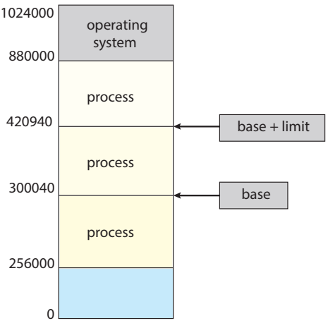
Introduction
Need to ensure that a process can access only those addresses in it address space.
We can provide this protection by using a pair of base and limit registers define the logical address space of a process
Base + Limit-1
Relocation register

Slide 5
Introduction
The base register holds the smallest legal physical memory address.
The limit register specifies the size of the range.
For example, if the base register holds 300040 and the limit register is 120900
Then the program can legally access all addresses from 300040 through 420939 (inclusive).

Slide 6
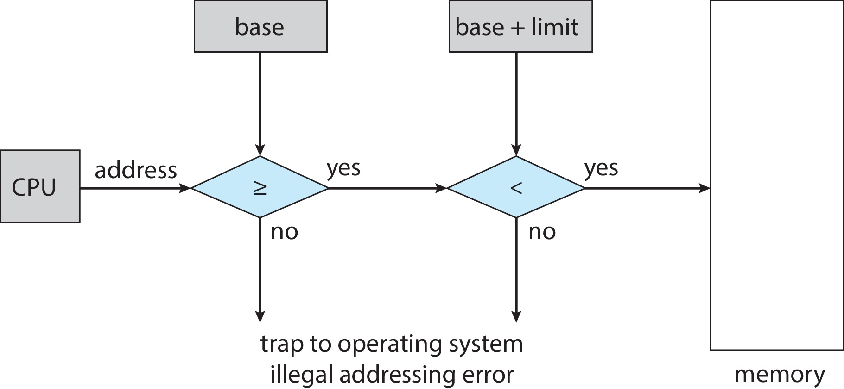
Hardware Address Protection
CPU must check every memory access generated in user mode to be sure it is between base and limit for that user.
The instructions to loading the base and limit registers are privileged.

Slide 7
Address Binding
Programs on disk, ready to be brought into memory to execute, are placed in an input queue
Without support, must be loaded into address 0000
Inconvenient to have first user process physical address always at 0000
Addresses represented in different ways at different stages of a program’s life
Source code addresses are usually symbolic.
Compiled code addresses bind to relocatable addresses
Linker or loader will bind relocatable addresses to absolute addresses
Each binding maps one address space to another.

Slide 8
Binding of Instructions and Data to Memory
Address binding of instructions and data to memory addresses can happen at three different stages:
Compile time: If memory location known a priori, absolute code can be generated; must recompile code if starting location changes.
Load time: Must generate relocatable code if memory location is not known at compile time.
Execution time: Binding delayed until run time if the process can be moved during its execution from one memory segment to another
Need hardware support for address maps (e.g., base and limit registers)

Slide 9
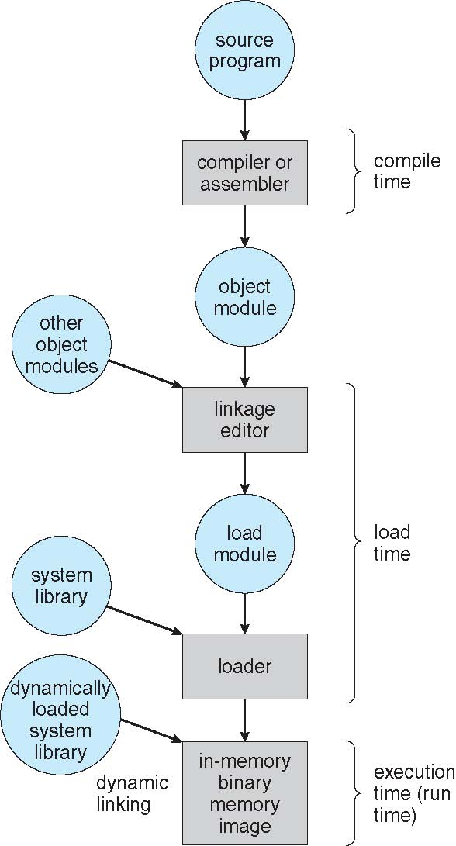
Multistep Processing of a User Program

Slide 10
Logical vs. Physical Address Space
The concept of a logical address space that is bound to a separate physical address space is central to proper memory management.
Logical address – generated by the CPU; also referred to as virtual address.
Physical address – address seen by the memory unit.
Logical and physical addresses are the same in compile-time and load-time address-binding schemes;
Logical (virtual) and physical addresses differ in execution-time address-binding scheme
Logical address space is the set of all logical addresses generated by a program.
Physical address space is the set of all physical addresses corresponding to these logical addresses.

Slide 11
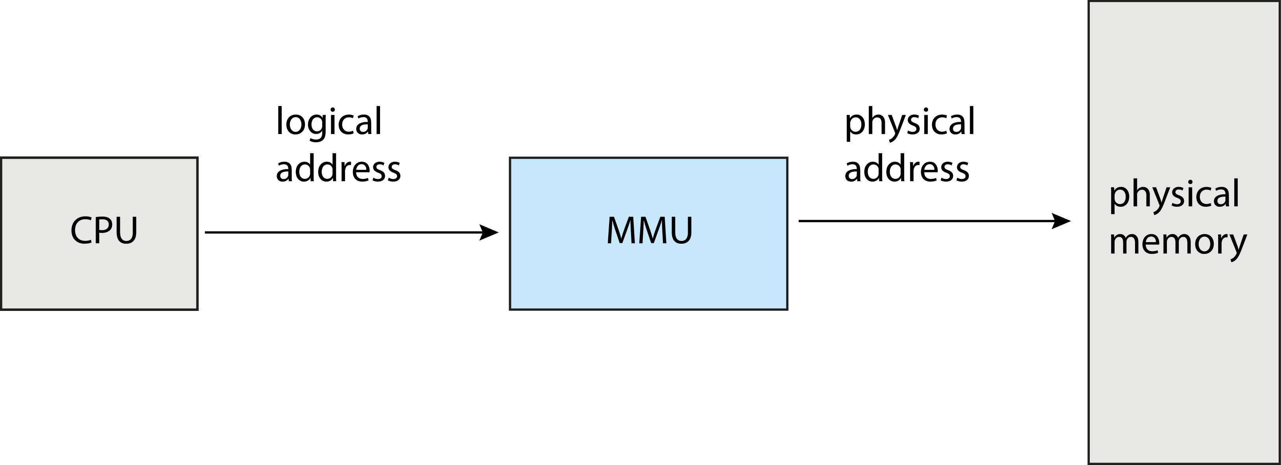
Memory-Management Unit (MMU)
Hardware device that at run-time maps logical address to physical address.
Many methods possible, covered in the rest of this ppt.

Slide 12
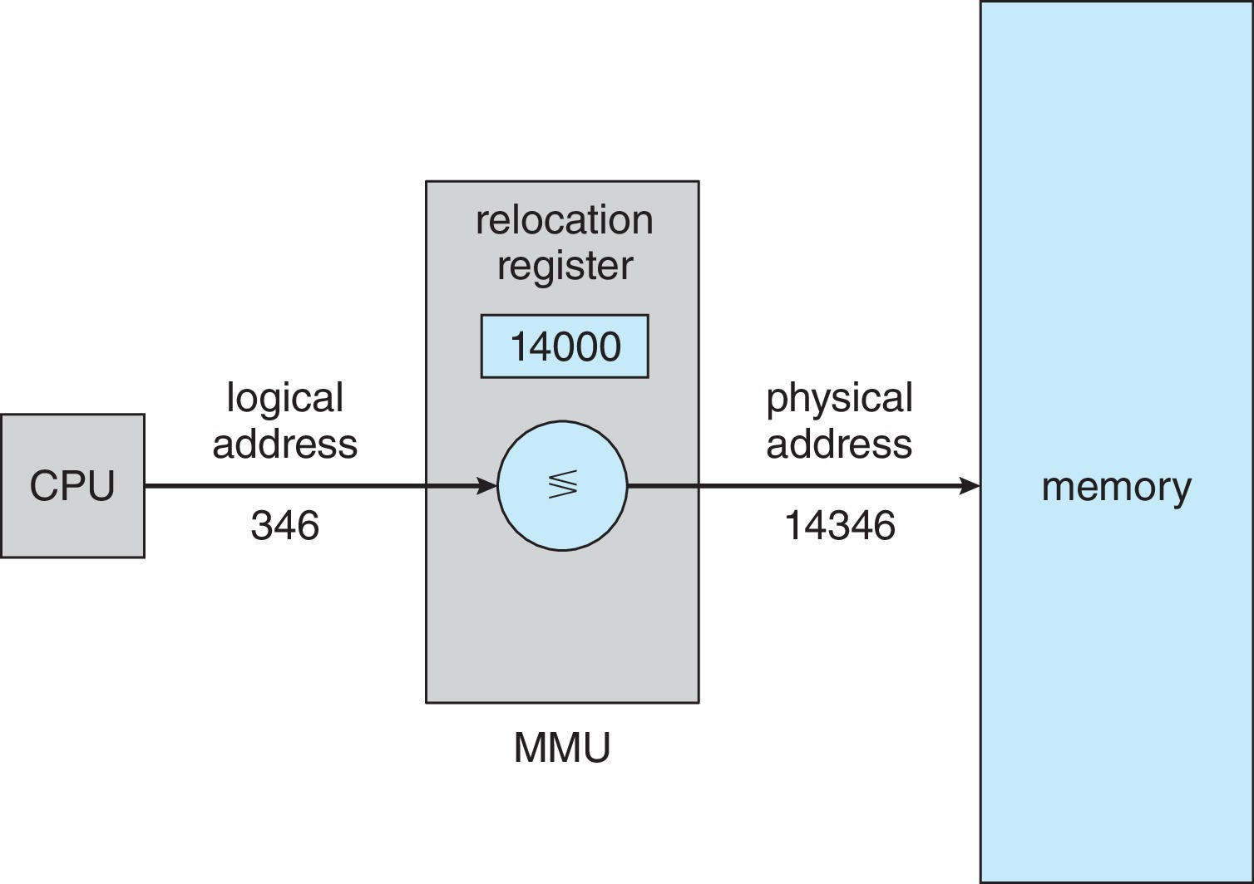
Relocation Register
Consider simple scheme. which is a generalization of the base-register scheme.
The base register now called relocation register.
The value in the relocation register is added to every address generated by a user process at the time it is sent to memory.

Slide 13
Relocation Register
The user program deals with logical addresses; it never sees the real physical addresses.
Execution-time binding occurs when reference is made to location in memory
Logical address bound to physical addresses

Slide 14
Dynamic Loading
To obtain better memory-space utilization, we can use dynamic loading.
The program consist of main part and a number of routines.
With dynamic loading, a routine is not loaded until it is called.
All routines are kept on disk in a relocatable load format.
The main program is loaded into memory and is executed.

Slide 15
Dynamic Loading
When a routine needs to call another routine, the calling routine first checks to see whether the other routine has been loaded.
If it has not, the relocatable linking loader is called to load the desired routine into memory.
Then control is passed to the newly loaded routine.
The advantage of dynamic loading is that a routine is loaded only when it is needed.

Slide 16
Dynamic Linking
Static linking – system libraries and program code combined by the loader into the binary program image
Dynamic linking –linking postponed until execution time.
Dynamic linking, in contrast, is similar to dynamic loading.
Dynamically linked libraries (DLLs) are system libraries that are linked to user programs when the programs are run.
DLLs are also known as shared libraries.
DLLs libraries can be shared among multiple processes, so that only one instance of the DLL in main memory.

Slide 17
Memory Allocation
Main memory must support both OS and user processes
Limited resource, must allocate efficiently
Contiguous allocation is one early method.
In contiguous memory allocation, each process is contained in a single section of memory that is contiguous to the section containing the next process.
Main memory usually into two partitions:
one for the operating system, and
one for the user processes.
We can place the operating system in either low memory addresses or high memory addresses.

Slide 18
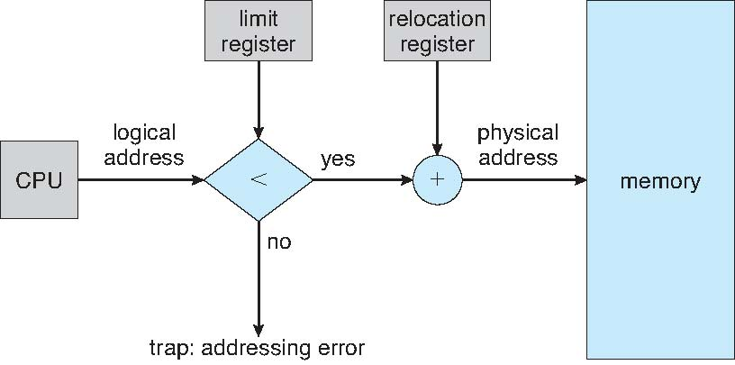
Contiguous Allocation
Relocation registers used to protect user processes from each other, and from changing operating-system code and data.
Base register contains value of smallest physical address
Limit register contains range of logical addresses – each logical address must be less than the limit register
MMU maps logical address dynamically

Slide 19
Memory Allocation
Degree of multiprogramming limited by number of partitions
Fixed-size partition
Variable-partition sizes for efficiency (sized to a given process’ needs)
Each partition may contain exactly one process.
Hole – block of available memory; holes of various size are scattered throughout memory.
When a process arrives, it is allocated memory from a hole large enough to accommodate it.
Process exiting frees its partition, adjacent free partitions combined.
Operating system maintains information about:
(a) allocated partitions
(b) free partitions (hole)

Slide 20
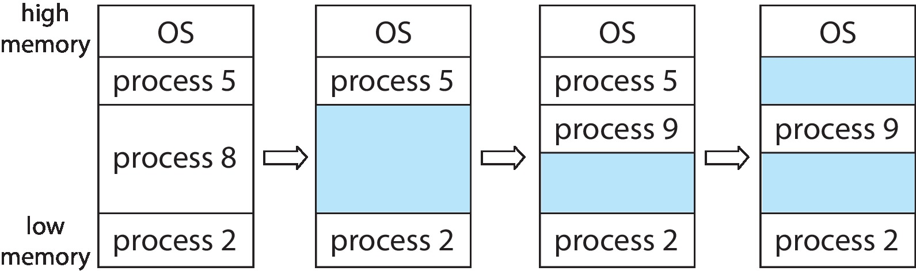
Variable Partition Allocation
When a process arrives and needs memory, the system searches the set for a hole that is large enough for this process.
If the hole is too large, it is split into two parts.
One part is allocated to the arriving process; the other is returned to the set of holes.
When a process terminates, it releases its block of memory, which is then placed back in the set of holes.
If the new hole is adjacent to other holes, these adjacent holes are merged to form one larger hole.

Slide 21
Dynamic Storage-Allocation Problem
How to satisfy a request of size n from a list of free holes?
First-fit: Allocate the first hole that is big enough
Best-fit: Allocate the smallest hole that is big enough; must search entire list, unless ordered by size
Produces the smallest leftover hole
Worst-fit: Allocate the largest hole; must also search entire list
Produces the largest leftover hole
First-fit and best-fit better than worst-fit in terms of speed and storage utilization

Slide 22
Fragmentation
External Fragmentation – total memory space exists to satisfy a request, but it is not contiguous
Internal Fragmentation – allocated memory may be slightly larger than requested memory; this size difference is memory internal to a partition, but not being used

Slide 23
Internal fragmentation | External fragmentation
In internal fragmentation fixed-sized memory, blocks square measure appointed to process. | In external fragmentation, variable-sized memory blocks square measure appointed to method.
The solution of internal fragmentation is best-fit block. | Solution of external fragmentation is compaction, paging and segmentation.
Internal fragmentation occurs when memory is divided into fixed sized partitions. | External fragmentation occurs when memory is divided into variable size partitions based on the size of processes.
The difference between memory allocated and required space or memory is called Internal fragmentation. | The unused spaces formed between non-contiguous memory fragments are too small to serve a new process, is called External fragmentation .

Slide 24
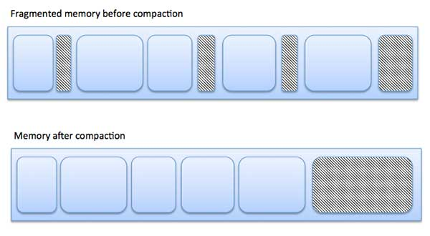
Fragmentation
Reduce external fragmentation by compaction
Shuffle memory contents to place all free memory together in one large block
Compaction is possible only if relocation is dynamic, and is done at execution time
Depending on the total amount of memory storage and the average process size, external fragmentation may be a minor or a major problem.

Slide 25
Fragmentation
Statistical analysis of first fit, for instance, reveals that, even with some optimization, given N allocated blocks, another 0.5 N blocks will be lost to fragmentation.
That is, one-third of memory may be unusable! This property is known as the 50-percent rule.
Now consider that backing store(virtual memory) has same fragmentation problems

Slide 26
Fragmentation
Another possible solution to the external-fragmentation problem is to permit the logical address space of processes to be noncontiguous, thus allowing a process to be allocated physical memory wherever such memory is available.
This is the strategy used in paging, the most common memory-management technique for computer systems.

Slide 27
Segmentation
Memory-management scheme that supports user view of memory
A program is a collection of segments
A segment is a logical unit such as:
main program
procedure
function
method
object
local variables, global variables
common block
stack
symbol table
arrays

Slide 28
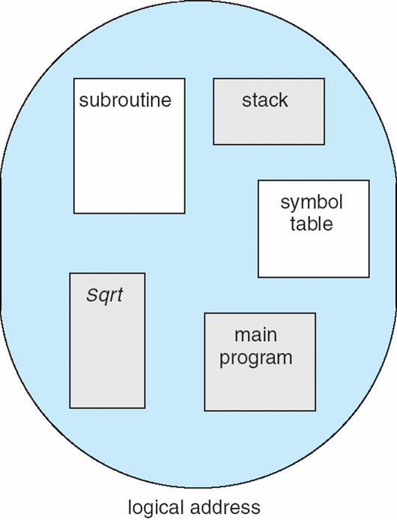
User’s View of a Program

Slide 29
Logical View of Segmentation
1
4
1
2
3
4
2
3
user space
physical memory space

Slide 30
Segmentation Architecture
Logical address consists of a two tuple:
<segment-number(total no of bits to represent total no of pages), offset(page size)>
Segment table – maps two-dimensional physical addresses; each table entry has:
base – contains the starting physical address where the segments reside in memory
limit – specifies the length of the segment
Segment-table base register (STBR) points to the segment table’s location in memory
Segment-table length register (STLR) indicates number of segments used by a program
Segment number s is legal if s < STLR

Slide 31
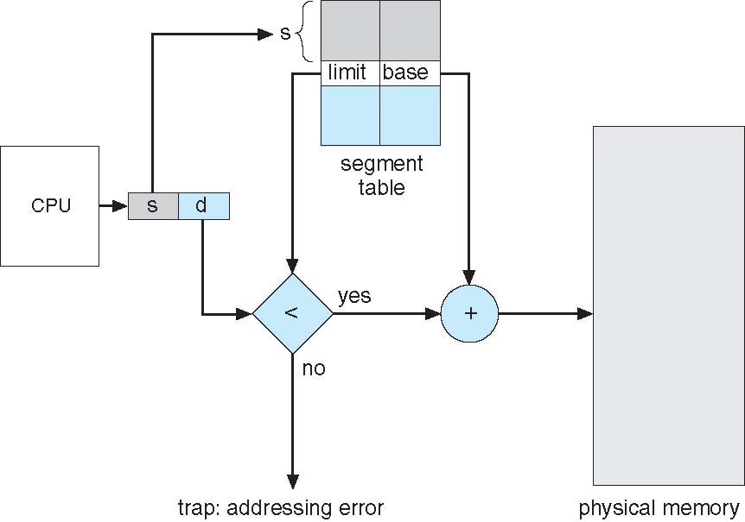
Segmentation Hardware
Here we have a
frame no
that we search in
the
segmentation table
For data
Here we have offset no
to find data in particular
frame

Slide 32
Paging
Physical address space of a process can be noncontiguous; process is allocated physical memory whenever the latter is available
Avoids external fragmentation
Avoids problem of varying sized memory chunks
Divide physical memory into fixed-sized blocks called frames
Divide logical memory into blocks of same size called pages
Keep track of all free frames
To run a program of size N pages, need to find N free frames and load program.
Set up a page table to translate logical to physical addresses
Backing store likewise split into pages
Still have Internal fragmentation

Slide 33

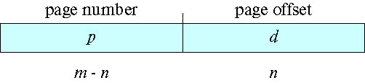
Address Translation Scheme
Address generated by CPU is divided into:
Page number (p) – used as an index into a page table which contains base address of each page in physical memory
Page offset (d) – combined with base address to define the physical memory address that is sent to the memory unit
For given logical address space 2^{m} and page size 2^{n}

Slide 34
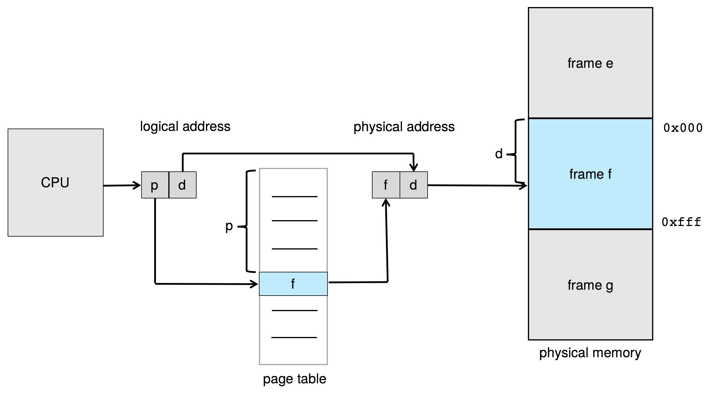
Paging Hardware

Slide 35
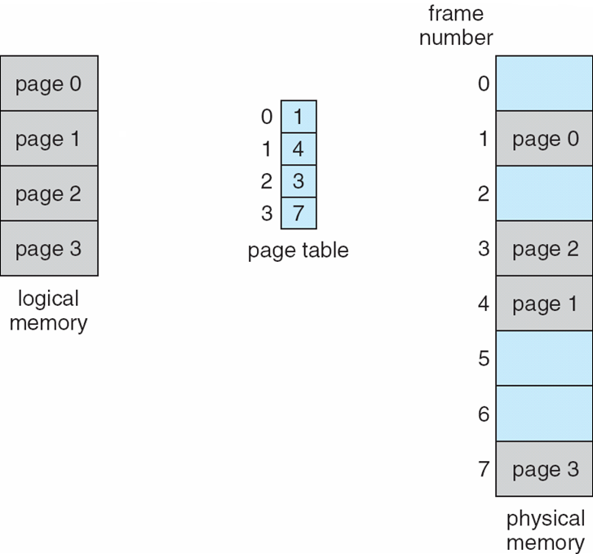
Paging Model of Logical & Physical Memory

Slide 36
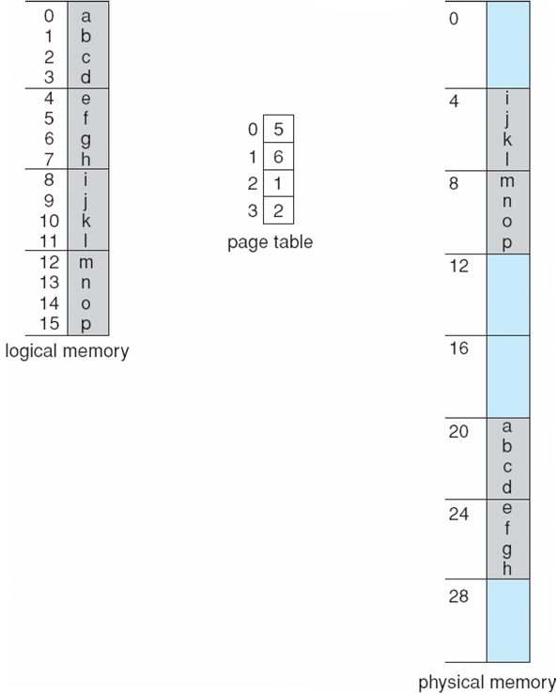
Paging Example
Logical address: n = 2 and m = 4. Using a page size of 4 bytes and a physical memory of 32 bytes (8 pages)

Slide 37
Paging -- Calculating internal fragmentation
Page size = 2,048 bytes
Process size = 72,766 bytes
35 pages + 1,086 bytes
Internal fragmentation of 2,048 - 1,086 = 962 bytes
Worst case fragmentation = 1 frame – 1 byte
On average fragmentation = 1 / 2 frame size
So small frame sizes desirable?
But each page table entry takes memory to track
Page sizes growing over time
Solaris supports two page sizes – 8 KB and 4 MB

Slide 38
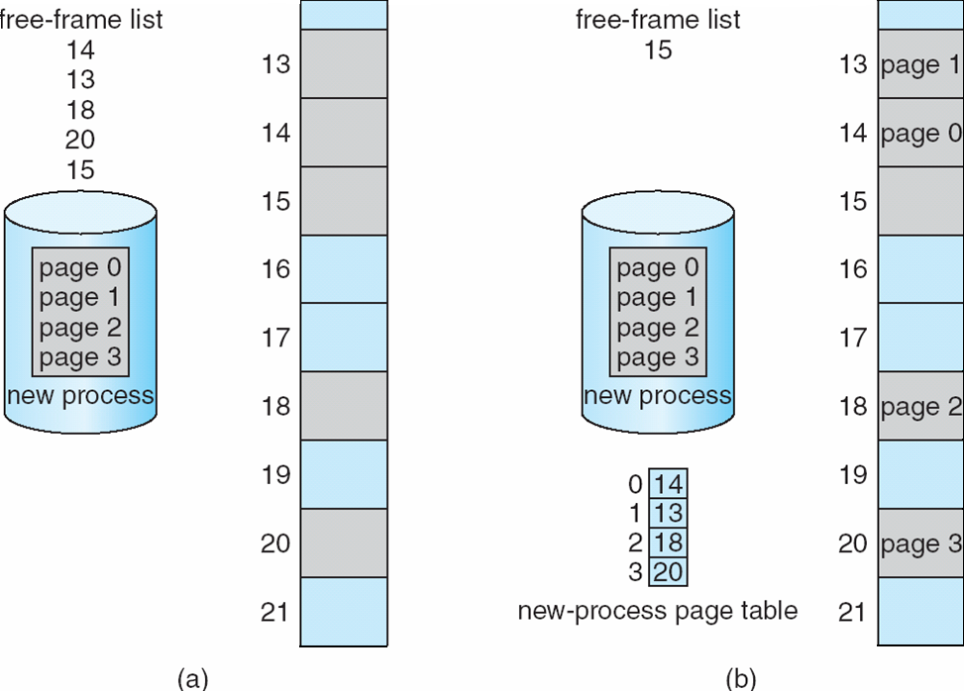
Free Frames
Before allocation
After allocation

Slide 39
Implementation of Page Table
Page table is kept in main memory
Page-table base register (PTBR) points to the page table
Page-table length register (PTLR) indicates size of the page table
In this scheme every data/instruction access requires two memory accesses
One for the page table and one for the data / instruction
The two-memory access problem can be solved by the use of a special fast-lookup hardware cache called translation look-aside buffers (TLBs) (also called associative memory).

Slide 40
Translation Look-Aside Buffer
TLBs typically small (64 to 1,024 entries)
On a TLB miss, value is loaded into the TLB for faster access next time
Replacement policies must be considered
Some entries can be wired down for permanent fast access
Some TLBs store address-space identifiers (ASIDs) in each TLB entry – uniquely identifies each process to provide address-space protection for that process
Otherwise need to flush the TLB at every context switch

Slide 41
Hardware
Associative memory – parallel search
Address translation (p, d)
If p is in associative register, get frame # out
Otherwise get frame # from page table in memory

Slide 42
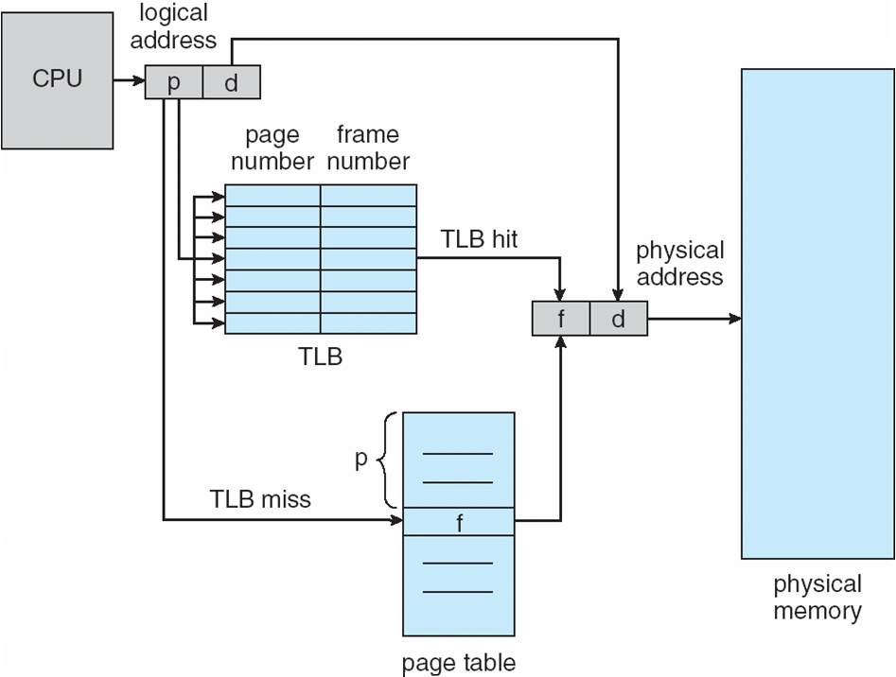
Paging Hardware With TLB

Slide 43
Memory Protection
Memory protection implemented by associating protection bit with each frame to indicate if access is allowed
Valid-invalid bit attached to each entry in the page table:
“valid” indicates that the associated page is in the process’ logical address space, and is thus a legal page
“invalid” indicates that the page is not in the process’ logical address space
Or use page-table length register (PTLR)
Any violations result in a trap to the kernel
Can also add more bits to indicate if read-only, read-write, execute-only is allowed.

Slide 44
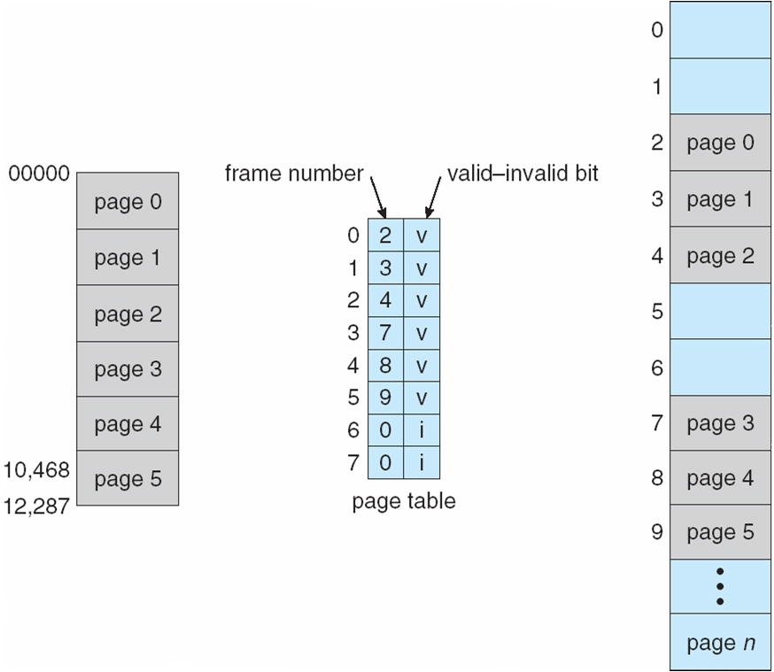
Valid (v) or Invalid (i) Bit In A Page Table

Slide 45
Shared Pages
Shared code
One copy of read-only (reentrant) code shared among processes (i.e., text editors, compilers, window systems)
Similar to multiple threads sharing the same process space
Also useful for interprocess communication if sharing of read-write pages is allowed
Private code and data
Each process keeps a separate copy of the code and data
The pages for the private code and data can appear anywhere in the logical address space

Slide 46
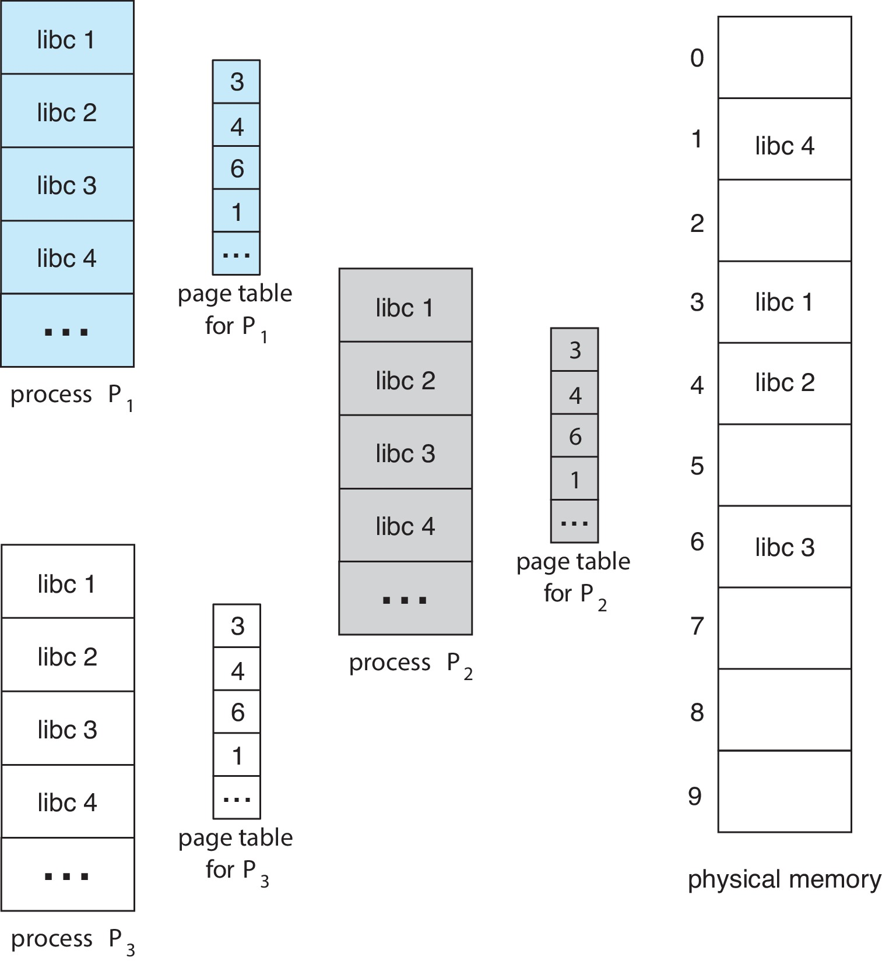
Shared Pages Example

Slide 47
Structure of the Page Table
Memory structures for paging can get huge using straight-forward methods
Consider a 32-bit logical address space as on modern computers
Page size of 1 KB (2¹⁰)
Page table would have 1 million entries (2³² / 2¹⁰)
If each entry is 4 bytes ➔ each process requires 16 MB of physical address space for the page table alone
Don’t want to allocate that contiguously in main memory
One simple solution is to divide the page table into smaller units
Hierarchical Paging
Hashed Page Tables
Inverted Page Tables

Slide 48
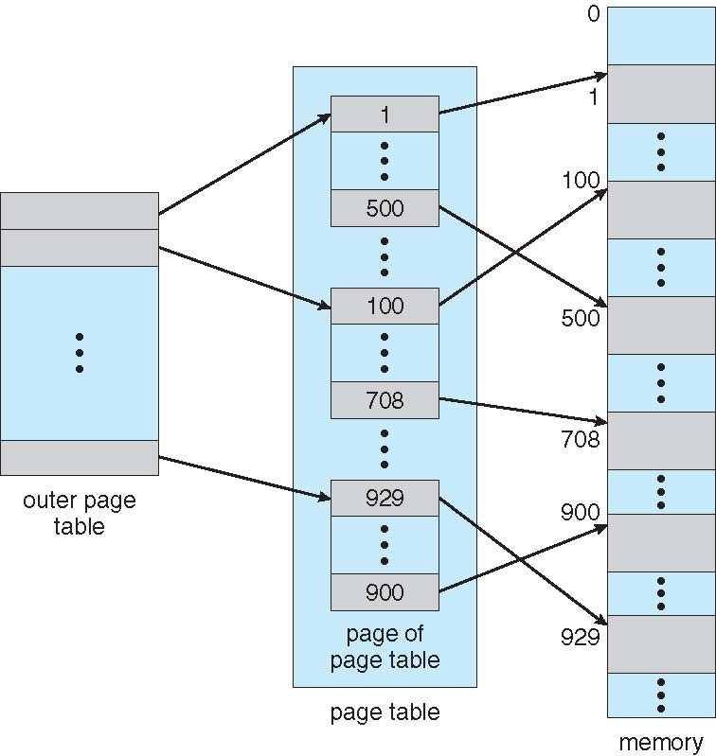
Hierarchical Page Tables
Break up the logical address space into multiple page tables
A simple technique is a two-level page table
We then page the page table

Slide 49
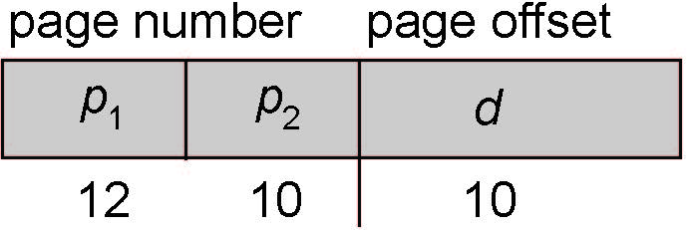
Two-Level Paging Example
A logical address (on 32-bit machine with 1K page size) is divided into:
a page number consisting of 22 bits
a page offset consisting of 10 bits
Since the page table is paged, the page number is further divided into:
a 12-bit page number
a 10-bit page offset
Thus, a logical address is as follows:
where p₁ is an index into the outer page table, and p₂ is the displacement within the page of the inner page table

Slide 50
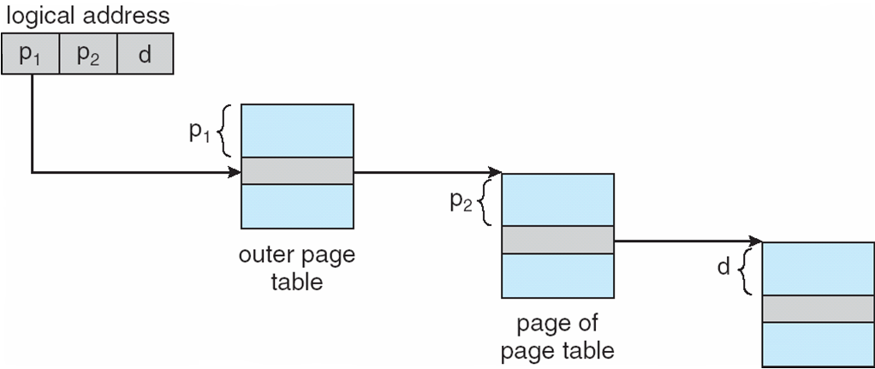
Address-Translation Scheme

Slide 51
Hashed Page Tables
Used in architecture with address spaces > 32 bits
The virtual page number is hashed into a page table
This page table contains a chain of elements hashing to the same location
Each element contains
The virtual page number
The value of the mapped page frame
A pointer to the next element
Virtual page numbers are compared in this chain searching for a match
If a match is found, the corresponding physical frame is extracted

Slide 52
Hashed Page Tables
Variation for 64-bit addresses is clustered page tables
Similar to hashed but each entry refers to several pages (such as 16) rather than 1
Especially useful for sparse address spaces (where memory references are non-contiguous and scattered)

Slide 53
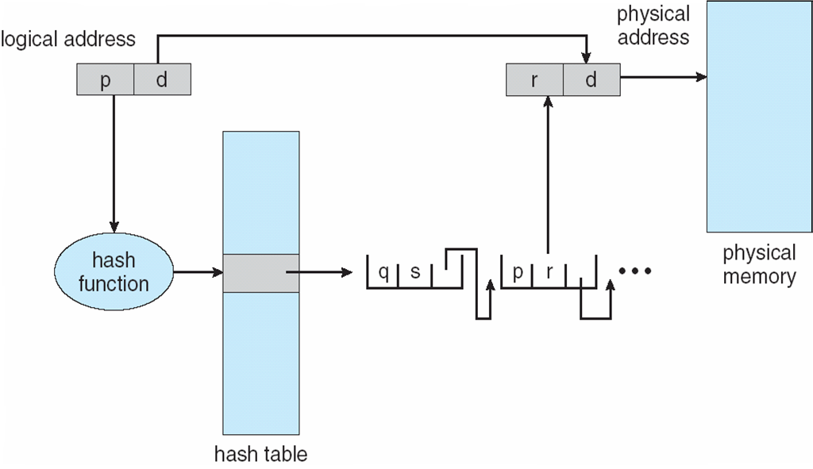
Hashed Page Table

Slide 54
Inverted Page Table
Rather than having each process keep a page table & track of all possible logical pages, track all physical pages
One entry for each real page of memory
Entry consists of the virtual address of the page stored in that real memory location, with information about the process that owns that page
Decreases memory needed to store each page table, but increases time needed to search the table when a page reference occurs
Use hash table to limit the search to one (or at most a few) page-table entries
TLB can accelerate access
But how to implement shared memory?
One mapping of a virtual address to the shared physical address

Slide 55
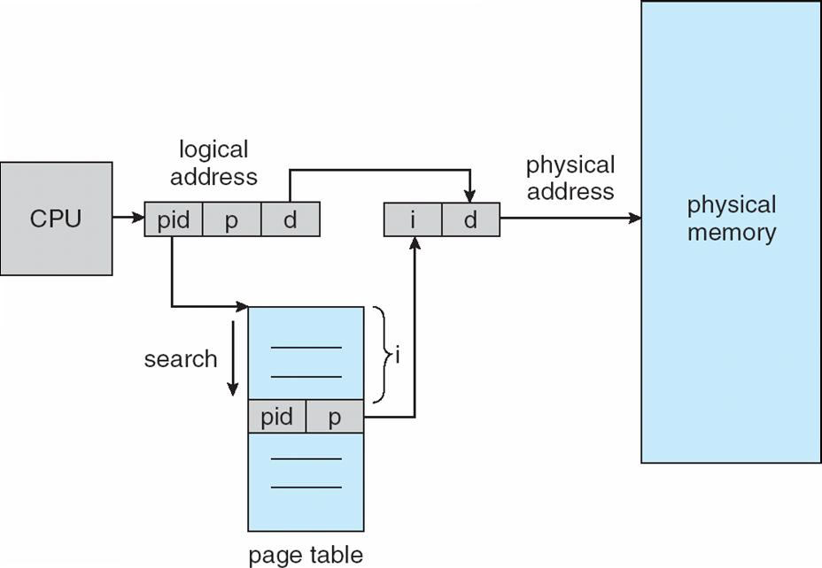
Inverted Page Table Architecture

Slide 56
Swapping
A process can be swapped temporarily out of memory to a backing store, and then brought back into memory for continued execution
Total physical memory space of processes can exceed physical memory
Roll out, roll in – swapping variant used for priority-based scheduling algorithms; lower-priority process is swapped out so higher-priority process can be loaded and executed
Major part of swap time is transfer time; total transfer time is directly proportional to the amount of memory swapped
System maintains a ready queue of ready-to-run processes which have memory images on disk

Slide 57
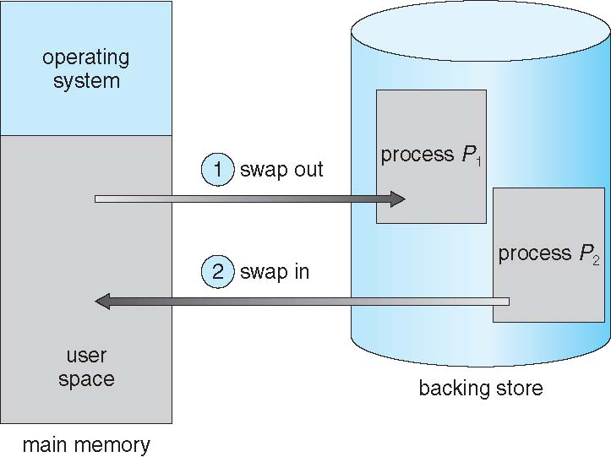
Schematic View of Swapping

