Slide 1
Bakery Algorithm
Lamport’s Bakery Algorithm

Slide 2
Bakery Algorithm
Analogy
Bakery With A Numbering Machine
Each Customer Receives Unique Number
Numbers Increase By One As Customers Enter
Global Counter Displays Number Of Customer Being Served Currently
All Others Wait In Queue
After Baker Is Done Serving Customer The Next Number Is Displayed
Served Customer Leaves

Slide 3
Bakery Algorithm
threads and bakery analogy
when thread wants to enter critical section it has to make sure it has the smallest number.
however, with threads it may not be true that only one thread gets the same number
– e.g., if number operation is non-atomic
if more that one thread has the smallest number then the thread with lowest id can enter
use pair (number, ID)
– In this context (a,b) < (c,d) is equivalent to
– (a<c) or ((a==c) and (b<d))

Slide 4
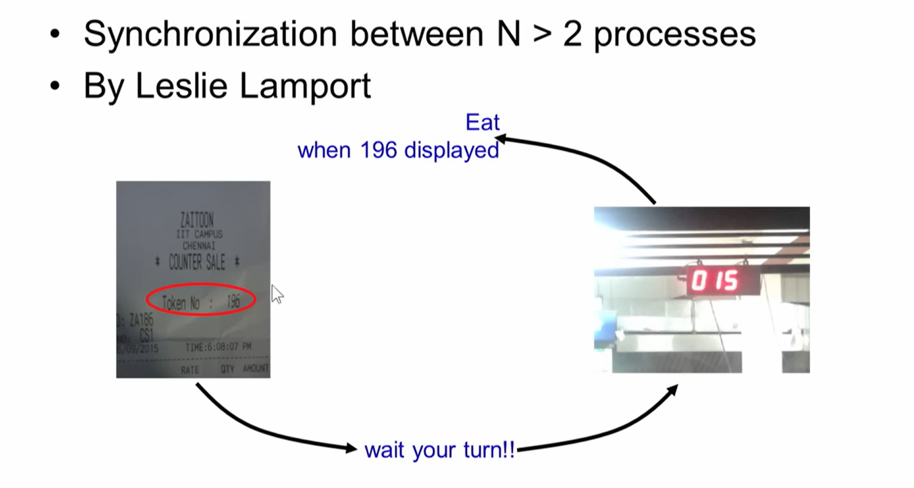
Bakery Algorithm

Slide 5
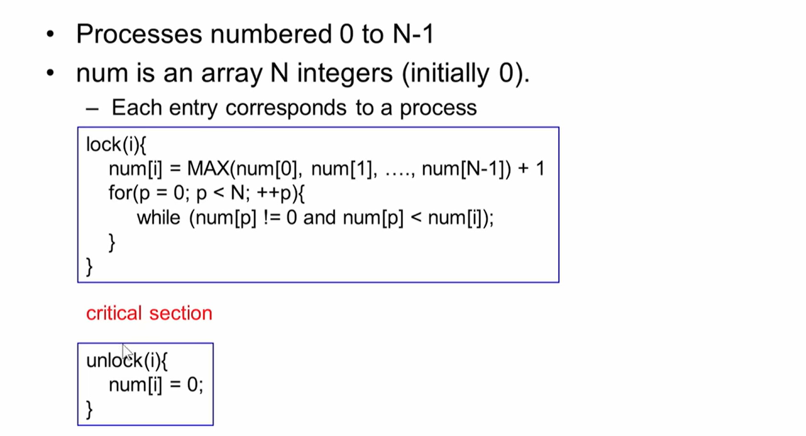
Simplified Bakery Algorithm

Slide 6
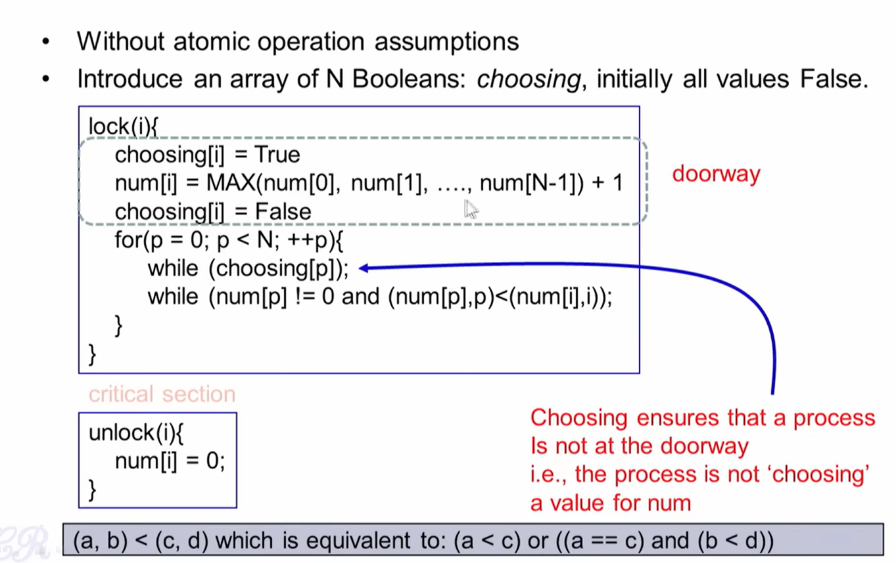
Original Bakery Algorithm

Slide 7
Refernces
https://lamport.azurewebsites.net/pubs/bakery.pdf
https://www.cs.colostate.edu/~cs551/CourseNotes/BakeryAlg.html
https://nptel.ac.in/courses/106106144
https://en.wikipedia.org/wiki/Lamport%27s_bakery_algorithm

