Slide 1
Condition Variables

Slide 2
Another type of sychronization
Locks allow one type of synchronization between threads – mutual exclusion
Another common requirement in multi-threaded applications – waiting and signaling
-> E.g., Thread T1 wants to continue only after T2 has finished some task
Can accomplish this by busy-waiting on some variable, but inefficient
Need a new synchronization primitive: condition variables

Slide 3
Condition Variables
A condition variable (CV) is a queue that a thread can put itself into when waiting on some condition
Another thread that makes the condition true can signal the CV to wake up a waiting thread
Pthreads provides CV for user programs
–> OS has a similar functionality of wait/signal for kernel threads
Signal wakes up one thread, signal broadcast wakes up all waiting threads

Slide 4
Condition Variables
Condition variables allow threads to wait in a race-free way for arbitrary conditions to occur.
The condition itself is protected by a mutex. A thread must first lock the mutex to change the condition state.
int pthread_cond_init(pthread_cond_t *cond, const pthread_condattr_t *attr);
int pthread_cond_destroy(pthread_cond_t *cond);
pthread_cond_t cond = PTHREAD_COND_INITIALIZER;
If successful, the pthread_cond_init() and pthread_cond_destroy() functions return zero.
Otherwise, an error number is returned to indicate the error.

Slide 5
Condition Variables
int pthread_cond_wait(pthread_cond_t *cond, pthread_mutex_t *mutex);
int pthread_cond_timedwait(pthread_cond_t *cond, pthread_mutex_t *mutex, const struct timespec *abstime);
The pthread_cond_wait() and pthread_cond_timedwait() functions are used to block on a condition variable.
They are called with mutex locked by the calling thread.
Upon successful completion, a value of zero is returned.
Otherwise, an error number is returned to indicate the error.

Slide 6
Condition Variables
int pthread_cond_signal(pthread_cond_t *cond);
int pthread_cond_broadcast(pthread_cond_t *cond);
These two functions are used to unblock threads blocked on a condition variable.
The pthread_cond_signal() call unblocks at least one of the threads that are blocked on the specified condition variable cond (if any threads are blocked on cond).
The pthread_cond_broadcast() call unblocks all threads currently blocked on the specified condition variable cond.
If successful, the pthread_cond_signal() and pthread_cond_broadcast() functions return zero. Otherwise, an error number is returned to indicate the error.

Slide 7
Condition Variables: parent waits for child
int done
pthread_mutex_t m = PTHREAD_MUTEX_INITIALIZER;
pthread_cond_t c = PTHREAD_COND_INITIALIZER;
void thr_exit() {
pthread_mutex_lock (&m);
done = 1;
pthread_cond_signal (&C),;
pthread_mutex_unlock (&m);
}
void child (void *arg) {
printf("child\n");
thr_exit();
return NULL;
}
void thr_join() {
pthread_mutex_lock (&m);
while (done == 0)
pthread_cond_wait(&c, &m);
pthread_mutex_unlock (&m);
}
int main() {
printf("parent: begin\n");
pthread_t p;
Pthread_create(&p, NULL, child, NULL);
thr_join();
printf("parent: end\n");
return 0;
}

Slide 8
Why check condition in while loop?
In the example code, why do we check condition before calling wait?
In case the child has already run and done is true, then no need to wait
Why check condition with “while” loop and not “if”?
To avoid corner cases of thread being woken up even when condition not true (may be an issue with some implementations)
﻿
if (condition)
wait (condvar)
//small chance that condition may be false when wait returns
while (condition)
wait (condvar)
//condition guaranteed to be true since we check in while-loop

Slide 9
Why use lock when calling wait?
What if no lock is held when calling wait/signal?
Race condition: missed wakeup
Parent checks done to be 0, decides to sleep, interrupted
Child runs, sets done to 0, signals, but no one sleeping yet
Parent now resumes and goes to sleep forever
Lock must be held when calling wait and signal with CV
The wait function releases the lock before putting thread to sleep, so lock is available for signaling thread﻿
﻿void thr_exit() {
done = 1;
pthread_cond_signal (&c);
}
void thr_join () {
if (done ==0)
pthread_cond_wait (&c);
}

Slide 10
Example: Producer/Consumer problem
A common pattern in multi-threaded programs
Example: in a multi-threaded web server, one thread accepts requests from the network and puts them in a queue. Worker threads get requests from this queue and process them.
Setup: one or more producer threads, one or more consumer threads, a shared buffer of bounded size.

Slide 11
Producer/Consumer with 2 CVs
﻿pthread_cond_t empty, fill;
﻿pthread_mutex_t mutex;
void *producer (void *arg) {
int i;
for (i = 0; i < loops; i++) {
pthread_mutex_lock(&mutex);
while (count == MAX)
pthread_cond_wait(&empty, &mutex);
put (i);
thread_cond_signal(&fill);
pthread_mutex_unlock(&mutex);
}
}
void consumer(void *arg) {
int i; for (i=0; i <loops; i++) {
pthread_mutex_lock(&mutex);
while (count ==0)
pthread_cond_wait(&fill, &mytex);
int tmp=get ();
pthread_cond_signal(&empty)
pthread_mutex_unlock(&mutex);
printf("%d\n", tmp);
}
}

Slide 12
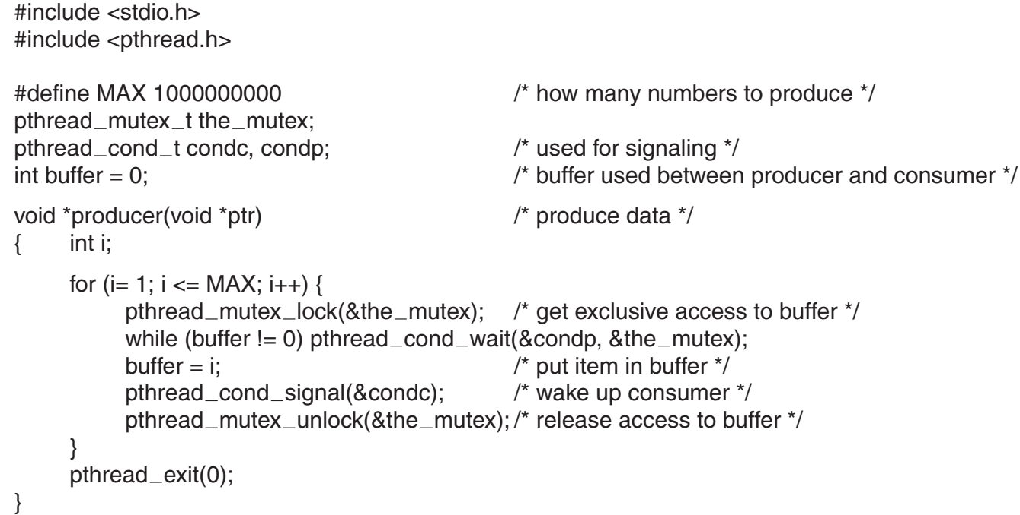
Producer Consumer with Condition Variables

Slide 13
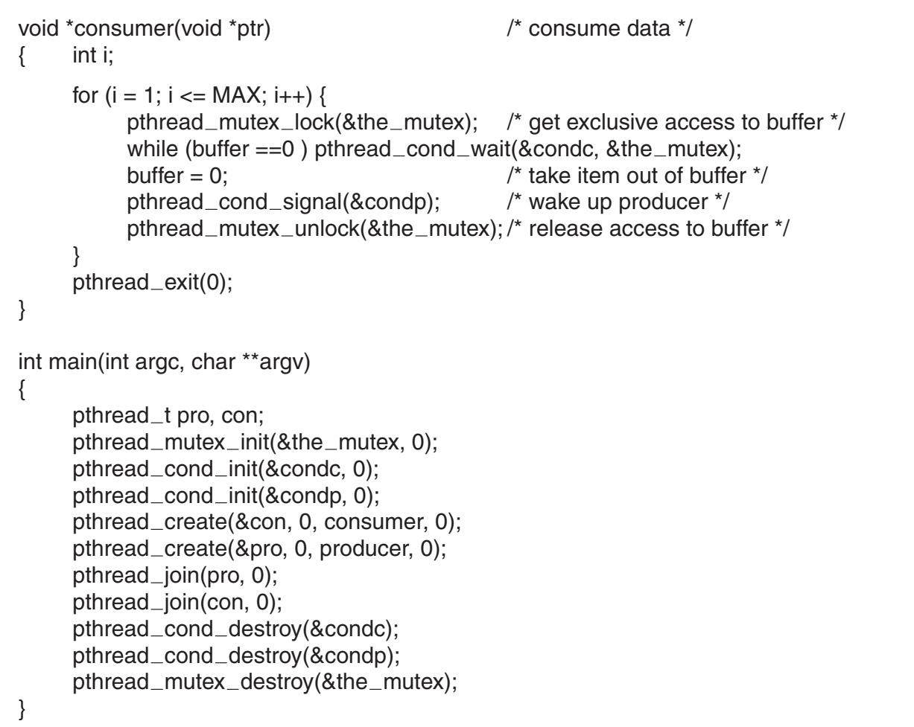
Producer Consumer with Condition Variables

Slide 14
References
https://www.cse.iitb.ac.in/~mythili/os/

