Slide 1
Pipe
pipe
&
fifo

Slide 2
pipe
Pipe is a connection between two processes, such that the standard output from one process becomes the standard input of the other process.
pipe() is a system call that facilitates inter-process communication. It opens a pipe, which is an area of main memory that is treated as a "virtual file".
The pipe can be used by the process, as well as all its child processes, for reading and writing.
One process can write to this "virtual file" or pipe and another related process can read from it.
If a process tries to read before something is written to the pipe, the process is suspended until something is written.
The pipe system call finds the first two available positions in the process's open file table and allocates them for the read and write ends of the pipe.
Recall that the open system call allocates only one position in the open file table.

Slide 3
pipe
#include <unistd.h>
int pipe(int fildes[2]);
The pipe() function will create a pipe and place two file descriptors, one each into the arguments fildes[0] and fildes[1].
fildes[0] is a file descriptor used to read from the pipe.
fildes[1] is a file descriptor used to write to the pipe.
A read on the file descriptor fildes[0] will access data written to file descriptor fildes[1] on a first-in-first-out basis.
Upon successful completion, 0 is returned. Otherwise, -1 is returned.
The system call places two integers into this array. These integers are the file descriptors of the first two available locations in the open file table.

Slide 4
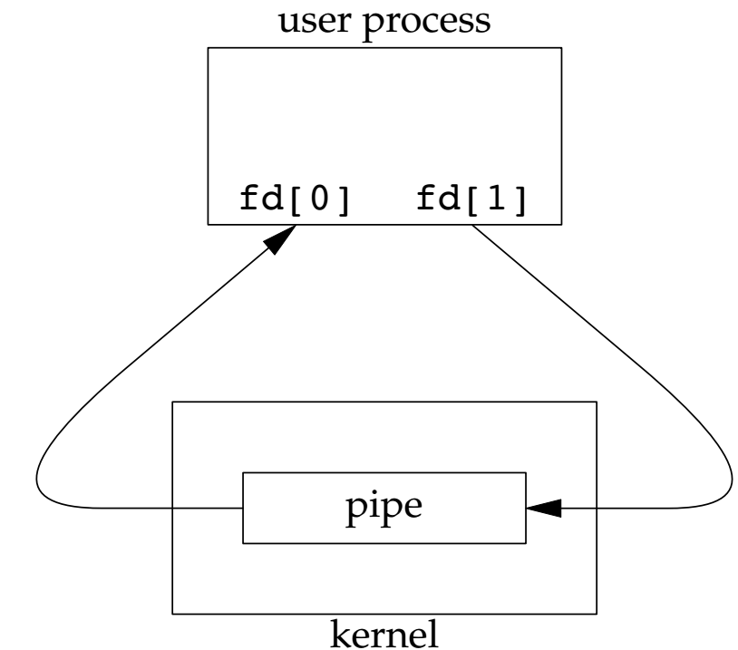
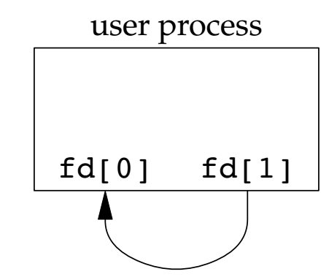
Two ways to view a pipe
Below figure shows the two ends of the pipe connected in a single process.
The Above figure emphasizes that the data in the pipe flows through the kernel.

Slide 5
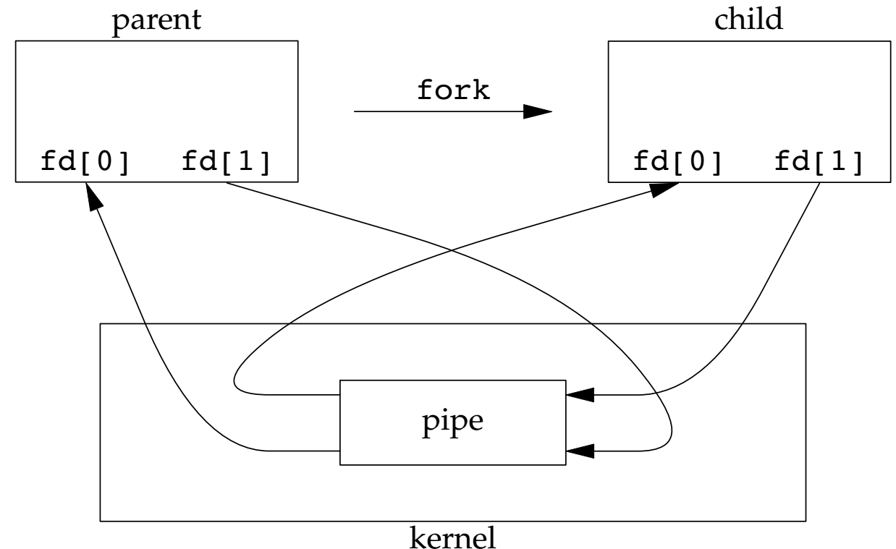
pipe
A pipe in a single process is next to useless.
Normally, the process that calls pipe then calls fork, creating an IPC channel from the parent to the child, or vice versa.

Slide 6
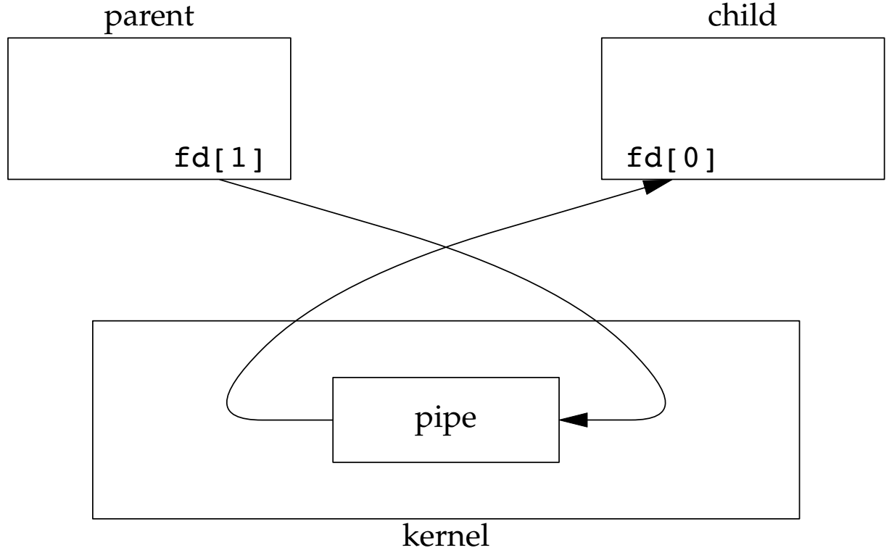
pipe
What happens after the fork depends on which direction of data flow we want.
For a pipe from the parent to the child, the parent closes the read end of the pipe (fd[0]), and the child closes the write end (fd[1]).

Slide 7
pipe
When one end of a pipe is closed, two rules apply.
If we read from a pipe whose write end has been closed, read returns 0 to indicate an end of file after all the data has been read.
If we write to a pipe whose read end has been closed, the signal SIGPIPE is generated. If we either ignore the signal or catch it and return from the signal handler, write returns −1 with errno set to EPIPE.

Slide 8
Pipe with parent and child process
#include <stdio.h>
#include <stdlib.h>
#include <string.h>
#include <unistd.h>
#include <sys/types.h>
#include <sys/wait.h>
#include <errno.h>
int main(int argc, char* argv[]) {
int fd[2];
if (pipe(fd) == -1) {
printf("An error ocurred with opening the pipe\n");
return 1;
}
int id = fork();
if (id == -1) {
printf("An error ocurred with fork\n");
return 2;
}
if (id == 0) {
// Child process
close(fd[0]);
int x;
printf("Input a number: ");
scanf("%d", &x);
write(fd[1], &x, sizeof(int));
close(fd[1]);
} else {
// Parent process
close(fd[1]);
int y;
read(fd[0], &y, sizeof(int)) == -1)
printf("Got from child process %d\n", y);
printf("Result is %d\n", y);
close(fd[0]);
}
return 0;
}

Slide 9
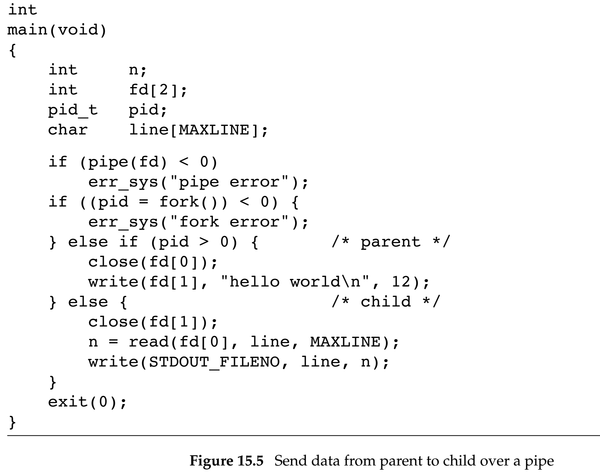
Example: Send data from parent to child over a pipe

Slide 10
FIFO
FIFOs are sometimes called named pipes.
Unnamed pipes can be used only between related processes when a common ancestor has created the pipe.
Creating a FIFO is similar to creating a file.
There are two uses for FIFOs.
FIFOs are used by shell commands to pass data from one shell pipeline to another without creating intermediate temporary files.
FIFOs are used as rendezvous points in client–server applications to pass data between the clients and the servers.

Slide 11
FIFO
#include <sys/stat.h>
int mkfifo(const char *path, mode_t mode);
The mkfifo() function creates a new FIFO special file named by the pathname pointed to by path.
The file permission bits of the new FIFO are initialised from mode.
The specification of the mode argument is the same as for the open function.
It is common to have multiple writers for a given FIFO.

Slide 12
fifo
#include <stdio.h>
#include <unistd.h>
#include <sys/types.h>
#include <sys/wait.h>
#include <fcntl.h>
int main(int argc, char* argv[]) {
mkfifo("myfifo1", 0777)
printf("Opening...\n");
int fd = open("myfifo1", O_WRONLY);
printf("Opened\n");
int x = 97;
write(fd, &x, sizeof(x)
printf("Written\n");
close(fd);
printf("Closed\n");
return 0;
}

Slide 13
References
https://www2.cs.uregina.ca/~hamilton/courses/330/notes/unix/pipes/pipes.html
Advanced Programming in the UNIX Environment by W. Richard Stevens, Stephen A. Rago (Addison-Wesle), 2013 .

