Slide 1
Semaphore

Slide 2
Semaphore
A semaphore is fundamentally an integer whose value is never allowed to fall below 0.
There are two operations on a semaphore: wait and post. The post operation increment the semaphore by 1, and
the wait operations does the following:
If the semaphore has a value > 0, the semaphore is decremented by 1.
If the semaphore has value 0, the caller will be blocked (busy-waiting or more likely on a queue) until the semaphore has a value larger than 0, and then it is decremented by 1.
We declare a semaphore as:
sem_t sem;
#include<semaphore.h>

Slide 3
Semaphore
int sem_init(sem_t * sem, int pshared, unsigned int value);
#include <semaphore.h>
This initializes the semaphore *sem. The initial value of the semaphore will be value.
If the pshared argument has a non-zero value, then the semaphore is shared between processes.
If the pshared argument is zero, then the semaphore is shared between threads of the process
On success, the return value is 0, and on failure, the return value is -1.
An attempt to initialize a semaphore that has already been initialized results in undefined behavior.

Slide 4
Semaphore
int sem_wait(sem_t *sem);
int sem_trywait(sem_t *sem);
The sem_wait() function locks the semaphore only if the semaphore is currently not locked and its value is non-zero.
If the semaphore value is currently zero, then the calling thread will not return from the call to sem_wait() until it either locks the semaphore or the call is interrupted by a signal.
The sem_trywait() function locks the semaphore referenced by sem only if the semaphore is currently not locked; that is, if the semaphore value is currently positive. Otherwise, it does not lock the semaphore.
On success, the return value is 0, and on failure, the return value is -1.

Slide 5
Semaphore
int sem_post(sem_t *sem);
The sem_post() function unlocks the semaphore and the semaphore value is simply incremented.
If successful, the sem_post() function returns zero; otherwise the function returns -1.

Slide 6
Semaphore
int sem_destroy(sem_t *sem);
The sem_destroy() function is used to destroy semaphore indicated by sem.
It is safe to destroy an initialised semaphore upon which no threads are currently blocked. The effect of destroying a semaphore upon which other threads are currently blocked is undefined.
Upon successful completion, a value of zero is returned. Otherwise, a value of -1 is returned.

Slide 7
Semaphore
int sem_getvalue(sem_t *sem, int *sval);
The sem_getvalue() function updates the location referenced by the sval argument to have the value of the semaphore referenced by sem without affecting the state of the semaphore.
Upon successful completion, the function returns a value of zero. Otherwise, the function returns a value of -1.

Slide 8
Example: Thread printing its name
#include <pthread.h>
#include <stdio.h>
#include <stdlib.h>
#include <unistd.h>
#include <string.h>
#include <semaphore.h>
#define THREAD_NUM 4
sem_t semaphore;
void* routine(void* args) {
sem_wait(&semaphore);
sleep(1);
printf(“Thread %d\n", (int)args);
sem_post(&semaphore);
free(args);
}
int main(int argc, char *argv[]) {
pthread_t th[THREAD_NUM];
sem_init(&semaphore, 0, 4);
int i;
for (i = 0; i < THREAD_NUM; i++) {
int* a = malloc(sizeof(int));
*a = i;
if(pthread_create(&th[i], NULL, &routine, a)!=0) {
perror("Failed to create thread");
}
}
for (i = 0; i < THREAD_NUM; i++) {
if (pthread_join(th[i], NULL) != 0) {
perror("Failed to join thread");
}
}
sem_destroy(&semaphore);
return 0;
}

Slide 9
Example: Semaphores for ordering
#include <pthread.h>
#include <stdio.h>
#include <stdlib.h>
#include <unistd.h>
#include <semaphore.h>
﻿sem_t s;
void * child (void *arg)
{
printf("child\n");
sem_post(&s); // signal here: child is done
return NULL;
}
int main(int argc, char *argv[]) {
sem_init(&s, 0,x); // what should X be?
printf("parent: begin\n");
pthread_t c;
Pthread_create(&c, NULL, child, NULL);
sem_wait (&s); // wait here for child
printf("parent: end\n");
return 0;
}

Slide 10
Example: Producer-Consumer
#include <pthread.h>
#include <stdio.h>
#include <stdlib.h>
#include <unistd.h>
#include <semaphore.h>
sem_t empty;
sem_t full;
sem_t mutex;
void* producer (void *arg)
{
int i;
for (i=0; i < loops; i++) {
sem_wait (& empty);
sem_wait (&mutex);
put (i);
sem_post (&mutex);
sem_post (&full);
}
Void* consumer (void *arg)
{
int i;
for (i=0; i < loops; i++) {
sem wait (&full);
sem_wait(&mutex);
int tmp get ();
sem_post(&mutex);
sem_post(& empty);
printf("%d\n", tmp);
}
}

Slide 11
Producer-Consumer:
void* consumer(void* args) {
while (1) {
int y;
// Remove from the buffer
sem_wait(&semFull);
pthread_mutex_lock(&mutexBuffer);
y = buffer[count - 1];
count--;
pthread_mutex_unlock(&mutexBuffer);
sem_post(&semEmpty);
// Consume
printf("Got %d\n", y);
sleep(1);
}
}
int main(int argc, char* argv[]) {
srand(time(NULL));
pthread_t th[THREAD_NUM];
pthread_mutex_init(&mutexBuffer, NULL);
sem_init(&semEmpty, 0, 10);
sem_init(&semFull, 0, 0);
int i;
for (i = 0; i < THREAD_NUM; i++) {
if (i > 0) {
if (pthread_create(&th[i], NULL, &producer, NULL) != 0) {
perror("Failed to create thread");
}
} else {
if (pthread_create(&th[i], NULL, &consumer, NULL) != 0) {
perror("Failed to create thread");
}
}
}
for (i = 0; i < THREAD_NUM; i++) {
if (pthread_join(th[i], NULL) != 0) {
perror("Failed to join thread");
}
}
sem_destroy(&semEmpty);
sem_destroy(&semFull);
pthread_mutex_destroy(&mutexBuffer);
return 0;
}
#define THREAD_NUM 8
sem_t semEmpty;
sem_t semFull;
pthread_mutex_t mutexBuffer;
int buffer[10];
int count = 0;
void* producer(void* args) {
while (1) {
// Produce
int x = rand() % 100;
sleep(1);
// Add to the buffer
sem_wait(&semEmpty);
pthread_mutex_lock(&mutexBuffer);
buffer[count] = x;
count++; pthread_mutex_unlock(&mutexBuffer);
sem_post(&semFull);
}
}

Slide 12
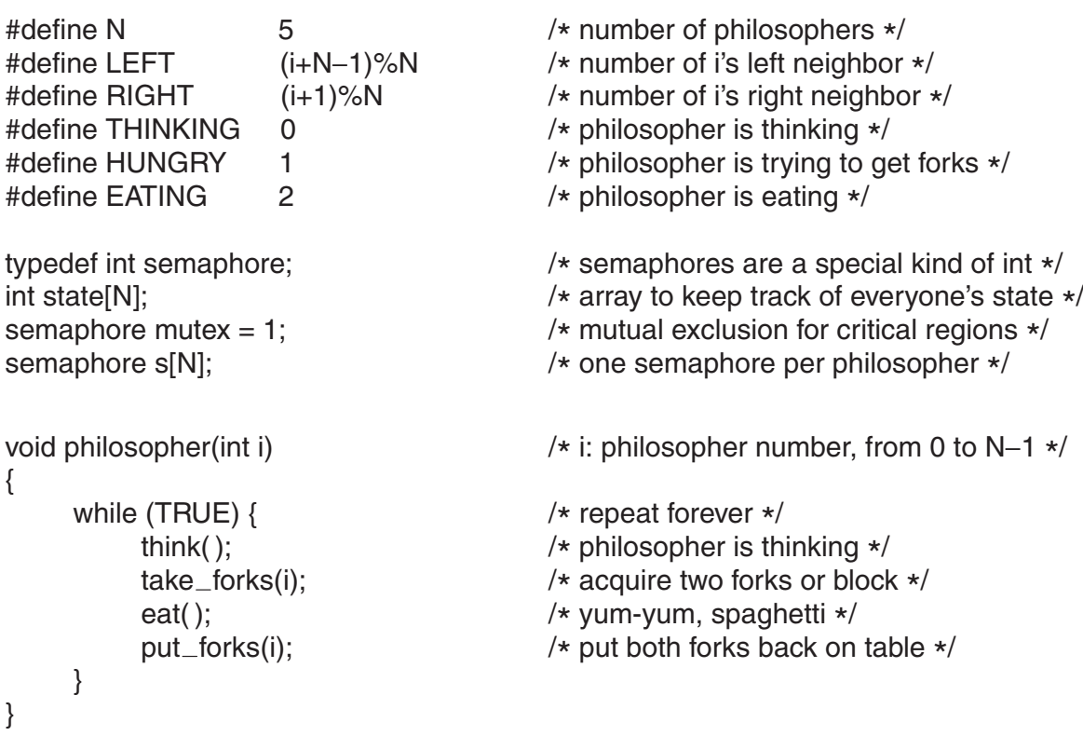
Dining philosophers problem:

Slide 13
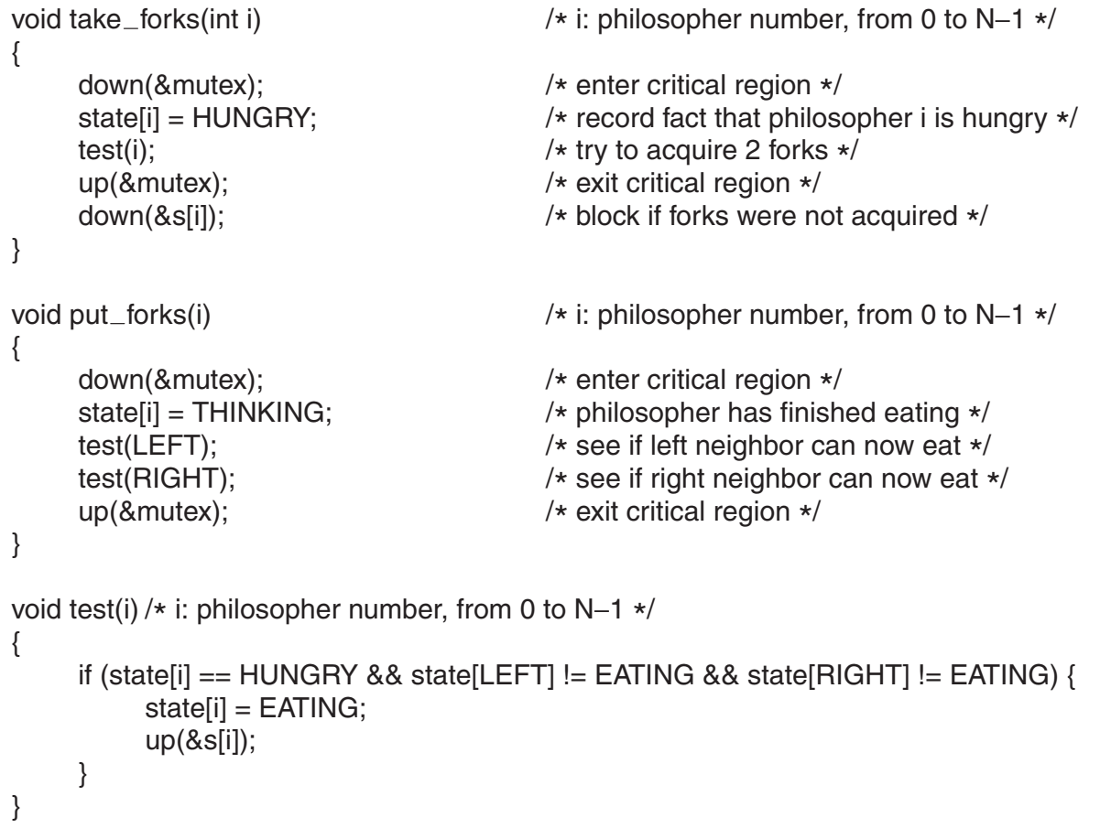
Dining philosophers problem:

