Slide 1
MS 101: Algorithms
Instructor
Neelima Gupta
ngupta@cs.du.ac.in

Slide 2
Table of Contents
NP -- Completeness

Slide 3
NP-Completeness
Some problems are intractable:
as they grow large, we are unable to solve them in reasonable time
What constitutes reasonable time? Standard working definition: polynomial time
  On an input of size n the worst-case running time is O(n^{k}) for some constant k
  Polynomial time: O(n²), O(n³), O(1), O(n lg n)
  Not in polynomial time: O(2^{n}), O(n^{n}), O(n!)

Slide 4
Polynomial-Time Algorithms
Are some problems solvable in polynomial time?
  Of course: every algorithm we’ve studied provides polynomial-time solution to some problem
  We define P to be the class of problems solvable in polynomial time
Are all problems solvable in polynomial time?
  No: Turing’s “Halting Problem” is not solvable by any computer, no matter how much time is given
  Such problems are clearly intractable, not in P

Slide 5
Hamiltonian Cycle Problem
  A hamiltonian cycle of an undirected graph is a simple cycle that contains every vertex
  The hamiltonian-cycle problem: given a graph G, find a hamiltonian cycle in it?
  We’ll see later the problem is recast differently.

Slide 6
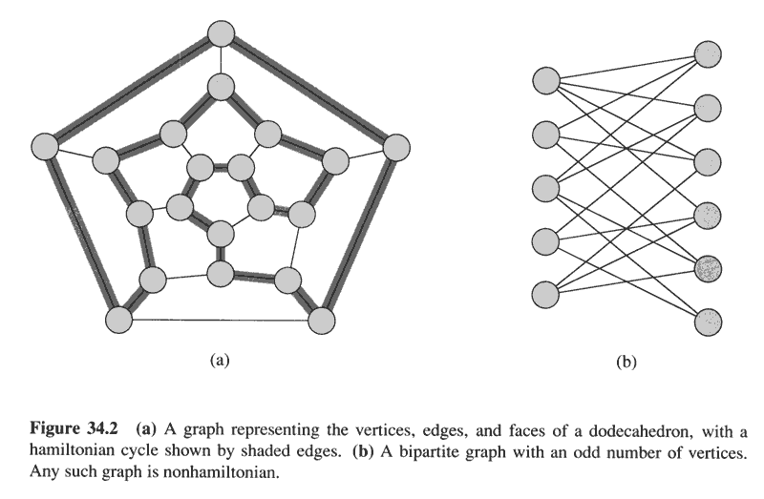
Copyright © The McGraw-Hill Companies, Inc. Permission required for reproduction or display.

Slide 7
A naïve algorithm
List all permutations of the vertices and see if it forms a HC.
What is its Running time?

Slide 8
P and NP
As mentioned, P is set of problems that can be solved in polynomial time
NP (nondeterministic polynomial time) is the set of problems that can be solved in polynomial time by a nondeterministic computer
  What the hell is that?

Slide 9
Nondeterminism
Think of a non-deterministic computer as a computer that magically “guesses” a solution, then has to verify that it is correct
  If a solution exists, computer always guesses it
  One way to imagine it: a parallel computer that can freely spawn an infinite number of processes
    Have one processor work on each possible solution
    All processors attempt to verify that their solution works
    If a processor finds it has a working solution
  So: NP = problems verifiable in polynomial time
  We’ll define this notion more formally later.

Slide 10
HCP
Solution is verifiable in Polynomial Time.
Given sloution : a sequence of vertices ..let it be : v1,v2,…vn,v1…for all I = 1,n check whether there is an edge (vi, vi+1)
  With adjacency list representation this takes O(V) time for each edge ..total O(VE) – polynomial
  With incidency matrix, this takes O(1) time for each edge ..total O(E) – polynomial
  Hence HCP is in NP

Slide 11
Decision Problems Vs Optimization Problem
Most of the problems in NP are either decision problems or optimization problems.
In fact, most of the optimization problems can be recast as decision problems and it can be shown that optimization problems are at least as hard as their decision counter-part.

Slide 12
Example : SHORTEST-PATH problem
SHORTEST-PATH problem : Given a pair of vertices u and v, in an unweighted, undirected graph, find a shortest path between them.
Its decision problem is :
  PATH(G,u,v,k) : Does there exist a path of length less than or equal to k between u and v in G?
  Clearly, if we can solve the optimization problem in polynomial time, then we can solve the decision problem in polynomial time by asking :Is the shortest path of length <= k? Clearly, answer to this Q is “yes” iff answer to the PATH problem is “yes”.

Slide 13
Example : SHORTEST-PATH problem contd..
  But the converse may not be true (in general). This shows that the optimization problem is harder (or at least as hard as ) than the decision problem.
Hence, if we can show that PATH is hard, it follows that SHORTEST-PATH is hard.

Slide 14
Other Examples :
HCP : Given a graph G, does it have a HC in it?
Clique :
  OPT : find the largest Clique in a given graph
  CLIQUE(G,k) : Given G, does there exist a clique of size equal to k in G?
Vertex Cover : A VC of an undirected graph is a subset V’ of V such for all edges (u,v) either u or v or both are in V’.. Informally all the edges are covered by the subset V’.
  OPT : find a VC of minimum size.
  VERTEX-COVER(G,k) : Does G contain a VC of size k?

Slide 15
Summarize
Optimization problems are harder than (at least as hard as ) their decision counter-part.

Slide 16
Abstract formulation of a problem
An abstract problem Q is a relation on a set I of instances and a set S of solutions.
For eg : SHOREST PATHS(G,u,v)
  I : instance set : set of triplets (G,u,v)
  S : set of shortest paths between u and v in G.

Slide 17
An Aside: Terminology
What is the difference between a problem and an instance of that problem?
To formalize things, we will express instances of problems as strings
  How can we express a instance of the hamiltonian cycle problem as a string?
  We will see how do we do this a little while later.
To simplify things, we will worry only about decision problems with a yes/no answer

Slide 18
Abstract formulation of a decision problem
This formulation is more general than required..it is for OPT problems. For the decision problems S = {0,1} or {No, Yes}.
For Eg. PATH(G,u,v,k)
  For an instance i = (G,u,v,k), PATH(i) = Yes if there is a path between u and v, of length <= k in G, else PATH(i) = No.

Slide 19
Formal Language framework
We say that an algorithm A accepts a string over {0,1} if, given input x, the algorithm’s output on x, denoted by A(x), is 1.
The language accepted by an algorithm A is the set of strings
  L = {x over {0,1} : A(x) = 1),
  That is the set of strings that A accepts.
  Note A need not reject a string if x is not in L.

Slide 20
Formal Language framework
A language L is decided by an algorithm A if every string in L is accepted by A and every string not in A is rejected by A.
A language L is accepted in polynomial time by an algorithm A if, there exists a constant k such that, for every string x in L, of length(binary length) n, A accepts x in O(n^k) time.
Similarly, define decidability.

Slide 21
Formal Language framework
HCP = {<G> : G is Hamiltonian} : The language consists of the strings representing graphs that are Hamiltonian. The length of the string is Omega(|V| + |E|).
  Any algorithm to accept HCP that runs in time polynomial in max{|V|, |E|} will be polynomial in the length of the string.
PATH = {<G,u,v,k> : G has a path of length <= k between u and v}. The length of the input string is Omega(|V| + |E| + log u + log v + log k)
  Any algorithm to accept PATH that runs in time polynomial in max{|V|, |E|} will be polynomial in the length of the string.

Slide 22
Eg: Polynomial time acceptance
HCP
PATH
LATER

Slide 23
Verification Algorithm
A Verification Algorithm is defined to be a two-argument (say, x and y) algorithm A where x is an input string (or an instance of a problem) and y is another string called the certificate, y is used by A to verify x.
Example :
  HCP : x = <G> , if G is indeed Hamiltonian then there is a a sequence of vertices that forms a HC in G … y is this sequence. Given y(such a sequence), it can be verified in linear time whether it forms a HC..i.e. this sequence can be used to verify that x is in HCP.
  Big Questions: Who gives me this certificate?
  If I know this certificate, haven’t I already solved the problem?

Slide 24
Class NP redefined
Answer to the 2nd Q : Yes, Indeed.
A language belongs to NP iff there exists a 2-input polynomial time algorithm A and constant c such that
L = {x over {0,1} : there exists a certificate y with |y| = O(|x|^c) such that A(x,y) = 1}
We say that the algorithm A verifies language L in polynomial time.
Hence HCP is in NP.

Slide 25
Another Example
PATH : verifiable in polynomial time, hence is in NP.

Slide 26
Discussion on complexity classes

Slide 27
Tractibility
Some problems are undecidable: no computer can solve them
  E.g., Turing’s “Halting Problem”
  We don’t care about such problems here; take a theory class
Other problems are decidable, but intractable:
as they grow large, we are unable to solve them in reasonable time
  What constitutes “reasonable time”?

Slide 28
Review: P
Some problems are provably decidable in polynomial time on an ordinary computer
  We say such problems belong to the set P
  Technically, a computer with unlimited memory
  How do we typically prove a problem ∈ P?

Slide 29
Review: NP
Some problems are provably decidable in polynomial time on a nondeterministic computer
  We say such problems belong to the set NP
  Can think of a nondeterministic computer as a parallel machine that can freely spawn an infinite number of processes
  How do we typically prove a problem ∈ NP?
Is P ⊆ NP? Why or why not?

Slide 30
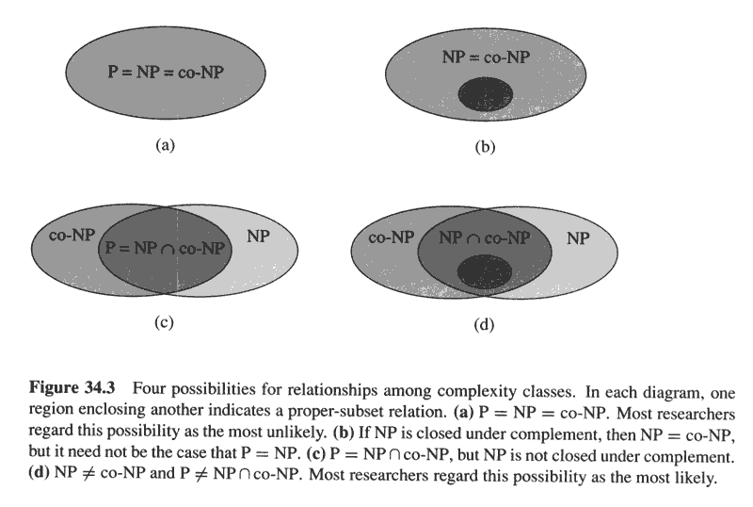
Copyright © The McGraw-Hill Companies, Inc. Permission required for reproduction or display.

Slide 31
NP - Completeness
The aim to study this class is not to solve a problem but to see how hard is a problem?

Slide 32
NP-Complete Problems
The NP-Complete problems are an interesting class of problems whose status is unknown
  No polynomial-time algorithm has been discovered for an NP-Complete problem
  No supra-polynomial lower bound has been proved for any NP-Complete problem, either
We call this the P = NP question
  The biggest open problem in CS

Slide 33
NP-completeness
The theory of NP_completeness restricts its attention to decision problems only.

Slide 34
Reduction
The crux of NP-Completeness is reducibility
  Informally, a problem P can be reduced to another problem Q if any instance of P can be “easily rephrased” as an instance of Q, the solution to which provides a solution to the instance of P
    What do you suppose “easily” means?
    This rephrasing is called transformation or reduction
  Intuitively: If P reduces to Q, then if one can solve Q then one can solve P also, i.e. P is “no harder to solve” than Q or Q is at least as hard as P.

Slide 35
Reducibility
An example:
  P: Given a set of Booleans, is at least one TRUE?
  Q: Given a set of integers, is their sum positive?
  Transformation: (x₁, x₂, …, x_{n}) = (y₁, y₂, …, y_{n}) where y_{i} = 1 if x_{i} = TRUE, y_{i} = 0 if x_{i} = FALSE
Another example:
  Solving linear equations is reducible to solving quadratic equations
    How can we easily use a quadratic-equation solver to solve linear equations?

Slide 36
Reducibility
Formally, We say a language L1 (say corresponding to problem P) is polynomial time reducible to language L2 (say corresponding to problem Q) denoted by L1 ≤_{p} L2, if there exists a polynomial time computable function f : {0,1}* → {0,1}* such that for all x in {0,1}*
x is in L1 iff f(x) is in L2.
The function f is called the reduction function and a polynomial time algorithm F that computes f is called a reduction algorithm.

Slide 37
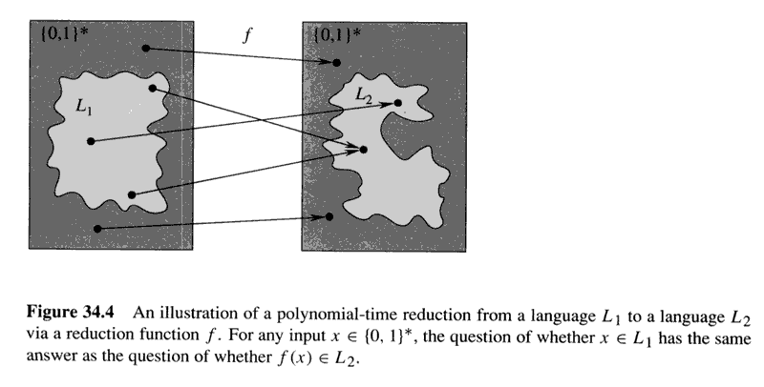

Slide 38
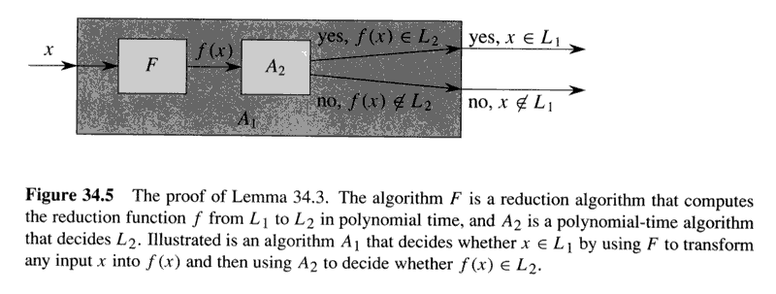
L1 ≤_{p} L2 and L2 in P implies L1 is in P

Slide 39
NP - Complete
Problem P is said to be NPC if
P ∈ NP, and
Q ≤_{p} P ∀ Q ∈ NP
That is, the problem is in NP and every other problem in NP is polynomial time reducible to P so that P is at least as hard as any other problem in NP.

Slide 40
NP-Hard and NP-Complete
If P is polynomial-time reducible to Q, we denote this P ≤_{p} Q
Definition of NP-Hard and NP-Complete:
  If all problems R ∈ NP are reducible to P, then P is NP-Hard
  We say P is NP-Complete if P is NP-Hard
  and P ∈ NP
If P ≤_{p} Q and P is NP-Complete, Q is also
NP- Complete ---- Very Important

Slide 41
Why Prove NP-Completeness?
Though nobody has proven that P != NP, if you prove a problem NP-Complete, most people accept that it is probably intractable
Therefore it can be important to prove that a problem is NP-Complete
  Don’t need to come up with an efficient algorithm
  Can instead work on approximation algorithms

Slide 42
Proving NP-Completeness
What steps do we have to take to prove a problem P is NP-Complete?
  Pick a known NP-Complete problem Q
  Reduce Q to P
    Describe a transformation that maps instances of Q to instances of P, s.t. “yes” for P = “yes” for Q
    Prove the transformation works
    Prove it runs in polynomial time
  Oh yeah, prove P ∈ NP (What if you can’t?)

Slide 43
The SAT Problem
One of the first problems to be proved NP-Complete was satisfiability (SAT):
  Given a Boolean expression on n variables, can we assign values such that the expression is TRUE?
  Ex: ((x₁ →x₂) ∨ ¬((¬x₁ ↔ x₃) ∨ x₄)) ∧¬x₂
  Cook’s Theorem: The satisfiability problem is NP-Complete
    Note: Argue from first principles, not reduction
    Proof: not here

Slide 44
Conjunctive Normal Form
Even if the form of the Boolean expression is simplified, the problem may be NP-Complete
  Literal: an occurrence of a Boolean or its negation
  A Boolean formula is in conjunctive normal form, or CNF, if it is an AND of clauses, each of which is an OR of literals
    Ex: (x₁ ∨ ¬x₂) ∧ (¬x₁ ∨ x₃ ∨ x₄) ∧ (¬x₅)
  3-CNF: each clause has exactly 3 distinct literals
    Ex: (x₁ ∨ ¬x₂ ∨ ¬x₃) ∧ (¬x₁ ∨ x₃ ∨ x₄) ∧ (¬x₅ ∨ x₃ ∨ x₄)
    Notice: true if at least one literal in each clause is true

Slide 45
The 3-CNF Problem
Thm 36.10: Satisfiability of Boolean formulas in 3-CNF form (the 3-CNF Problem) is NP-Complete
  Proof: Nope
The reason we care about the 3-CNF problem is that it is relatively easy to reduce to others
  Thus by proving 3-CNF NP-Complete we can prove many seemingly unrelated problems
  NP-Complete

Slide 46
3-CNF → Clique
What is a clique of a graph G?
A: a subset of vertices fully connected to each other, i.e. a complete subgraph of G
The clique problem: how large is the maximum-size clique in a graph?
Can we turn this into a decision problem?
A: Yes, we call this the k-clique problem
Is the k-clique problem within NP?

Slide 47
Clique is in NP
CLIQUE = {<G,k>: G has a clique of size k}
For x = <G,k> in CLIQUE, does there exist a certificate y: |y| = polynomial in the length of x and a polynomial time algorithm that can use y to verify that x is in CLIQUE?
  Show the existence of y,
  Show that |y| = polynomial in the length of |x|,
  Give an algorithm that verifies x using y,
  Show that the algorithm runs in polynomial time in |y| and |x| and hence in polynomial time in the length of |x|.
  SO, FOUR STEPS TO SHOW THAT A PROBLEM IS IN NP

Slide 48
CLIQUE is in NPC
2nd step to show that CLIQUE is in NPC is
Pick up a problem known to be NPC and
  Transform (reduce) the known problem to CLIQUE
    Show that under the transformation : solution of known problem is yes => solution to CLIQUE is yes.
    Show that under the transformation : solution of CLIQUE is yes => solution of the known problem is yes.
    Show that the transformation can be done in time polynomial in the length of an instance of CLIQUE
    SO, THREE STEPS TO REDUCE A KNOWN PROBLEM TO CLIQUE.

Slide 49
3-CNF → Clique
What should the reduction do?
A: Transform a 3-CNF formula to a graph, for which a k-clique will exist (for some k) iff the 3-CNF formula is satisfiable

Slide 50
3-CNF → Clique
The reduction:
  Let B = C₁ ∧ C₂ ∧ … ∧ C_{k} be a 3-CNF formula with k clauses, each of which has 3 distinct literals
  For each clause put a triple of vertices in the graph, one for each literal
  Put an edge between two vertices if they are in different triples and their literals are consistent, meaning not each other’s negation
  Run an example:
  B = (x ∨ ¬y ∨ ¬z) ∧ (¬x ∨ y ∨ z ) ∧ (x ∨ y ∨ z )

Slide 51
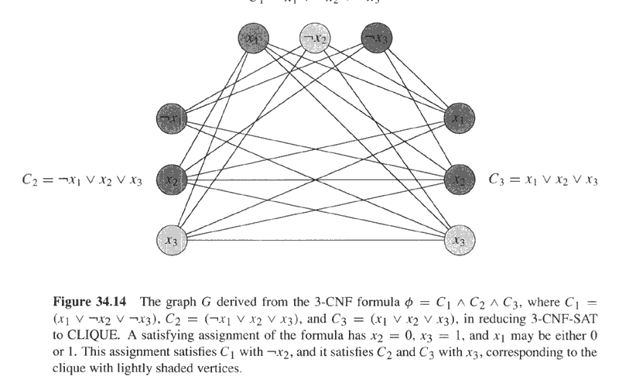
Copyright © The McGraw-Hill Companies, Inc. Permission required for reproduction or display.

Slide 52
3-CNF → Clique
Prove the reduction works:
  If B has a satisfying assignment, then each clause has at least one literal (vertex) that evaluates to 1
  Picking one such “true” literal from each clause gives a set V’ of k vertices. V’ is a clique (Why?)
  If G has a clique V’ of size k, it must contain one vertex in each triple (clause) (Why?)
  We can assign 1 to each literal corresponding with a vertex in V’, without fear of contradiction

Slide 53
Reduction takes polynomial time
Let there be n variables in the 3-CNF with k clauses
Then, the input size is at least(>=) B = max{k,n}
Any algorithm at most(<=) polynomial in B is polynomial in the input size.
Creating 3k vertices with no more than k^2 edges with n variables takes no more than max{k^2 max{log 3k, log n}, n log n} time …a polynomial in n and k and hence in B.

Slide 54
Make life simpler with an assumption for future
From now on we understand that a graph G with |V| vertices and |E| edges can be created and represented in time polynomial in |V| and |E|.
Hence in future we’ll just show that |V| and |E| are polynomial in the input size of …..
You can use this in the exam.

Slide 55
Vertex Cover Problem
A vertex cover for a graph G is a set of vertices incident to every edge in G
The vertex cover problem: what is the minimum size vertex cover in G?
Restated as a decision problem: does a vertex cover of size k exist in G?
Thm 36.12: vertex cover is NP-Complete

Slide 56
VC is in NP
How?
Four steps
--- Show the existence of y,
  Show that |y| = polynomial in the length of |x|,
  Give an algorithm that verifies x using y,
  Show that the algorithm runs in polynomial time in |y| and |x| and hence in polynomial time in the length of |x|.

Slide 57
Pick up a problem known in NPC
  CLIQUE

Slide 58
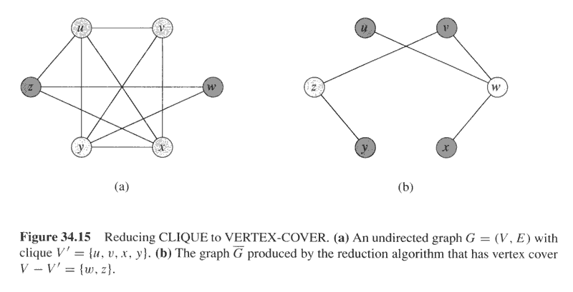
Copyright © The McGraw-Hill Companies, Inc. Permission required for reproduction or display.
Clique → Vertex Cover

Slide 59
Clique → Vertex Cover
Reduce k-clique to vertex cover
  The complement G_{C} of a graph G contains exactly those edges not in G
  Compute G_{C} in polynomial time
  G has a clique of size k iff G_{C} has a vertex cover of size |V| - k

Slide 60
Clique → Vertex Cover
Claim: If G has a clique of size k, G_{C} has a vertex cover of size |V| - k
  Let V’ be the k-clique
  Then V - V’ is a vertex cover in G_{C}
    Let (u,v) be any edge in G_{C}
    Then u and v cannot both be in V’ (Why?)
    Thus at least one of u or v is in V-V’ (why?), so
    edge (u, v) is covered by V-V’
    Since true for any edge in G_{C}, V-V’ is a vertex cover

Slide 61
Clique → Vertex Cover
Claim: If G_{C} has a vertex cover V’ ⊆ V, with |V’| = |V| - k, then G has a clique of size k
  For all u,v ∈ V, if (u,v) ∈ G_{C} then u ∈ V’ or
  v ∈ V’ or both (Why?)
  Contrapositive: if u ∉ V’ and v ∉ V’, then
  (u,v) ∈ E
  In other words, all vertices in V-V’ are connected by an edge, thus V-V’ is a clique
  Since |V| - |V’| = k, the size of the clique is k

Slide 62
Vertex Cover → HCP

Slide 63
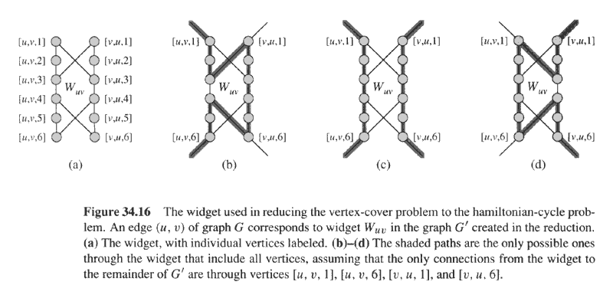
Copyright © The McGraw-Hill Companies, Inc. Permission required for reproduction or display.

Slide 64
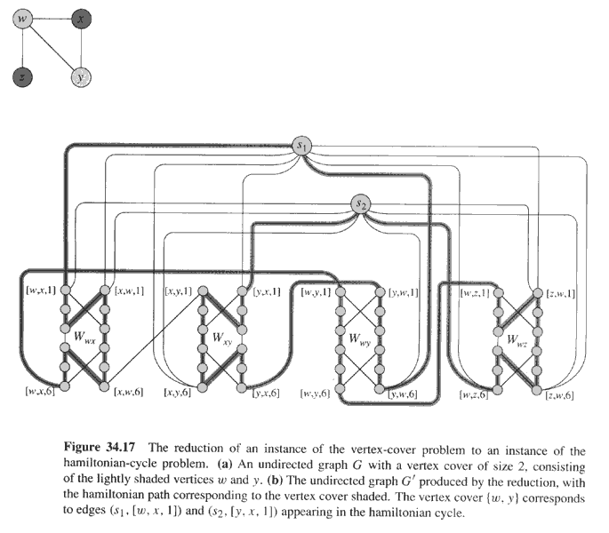
Copyright © The McGraw-Hill Companies, Inc. Permission required for reproduction or display.

Slide 65
General Comments
Literally hundreds of problems have been shown to be NP-Complete
Some reductions are profound, some are comparatively easy, many are easy once the key insight is given
You can expect a simple NP-Completeness proof on the final

Slide 66
Other NP-Complete Problems
Subset-sum: Given a set of integers, does there exist a subset that adds up to some target T?
0-1 knapsack: when weights not just integers
Hamiltonian path: Obvious
Graph coloring: can a given graph be colored with k colors such that no adjacent vertices are the same color?
Etc…

Slide 67
The End

