Slide 1
Computer Networks – Internet Protocol

Slide 2
OBJECTIVE
Discuss Internet Protocol (IP) in the Internetwork context
Understand classful IPv4 addressing
Discuss IPv4 Datagram format
Understand IP Fragmentation and reassembly
Distinguish between routing and forwarding
Introduce routing protocols used in the Internet i.e. OSPF and BGP

Slide 3
Internetworking
H1
H2
H3
H4
Ethernet
H5
R1
Routers
R2
H6
Ethernet
Ethernet
H7
H8
H9

Slide 4
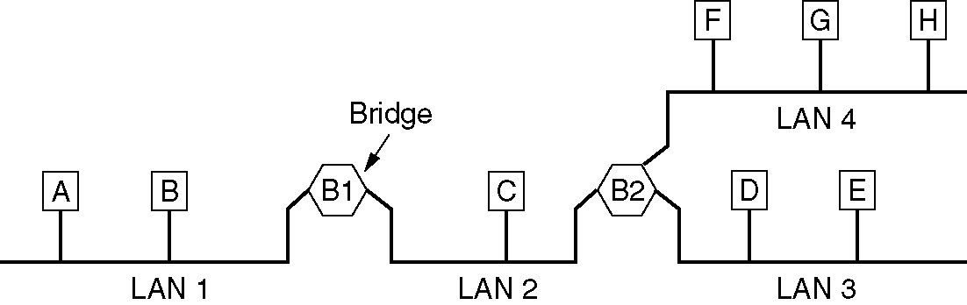
Local Internetworking
A configuration with four LANs and two bridges.
Picture courtesy: Andrew S. Tanenbaum, “Computer Networks”, 4/e, PHI, 2004

Slide 5
Internet Architecture
Autonomous networks connected by routers/gateways
User views the Internet as a single unified network
IP provides internetworking support
UDP and TCP are the transport protocols over IP
Protocols for conversion between IP and MAC addresses
Protocol for conversion between name and IP address
Applications use TCP/UDP support

Slide 6
Internet Protocol Suite
Network Layer - IP
Control Message - ICMP
Multicast Groups - IGMP
Address resolution - ARP, RARP
Booting and Configuration - BOOTP, DHCP
Transport Layer - TCP, UDP
Name-Address mapping - DNS

Slide 7
Internet Service Model
Connectionless Packet Delivery
  IP datagrams are forwarded without any explicit connection, possibly via several Routers
Unreliable Service
  Packets may be lost, corrupted, duplicated or delivered out of order
  Packets can be delayed for long time
Best Effort
  Packets not discarded capriciously, delivery failure not necessarily reported

Slide 8
Internet Protocol(IP)
Internet Protocol
  Is a network Layer Protocol
  Transmits blocks of data called datagrams from sources to destinations, where sources and destinations are hosts identified by fixed length addresses (IP Addresses

Slide 9
What IP does not provide ?
IP does not provide a reliable communication facility
  No acknowledgement either end to end or hop-by-hop.
  No error control for data, only a header checksum
  No retransmission
  No flow control

Slide 10
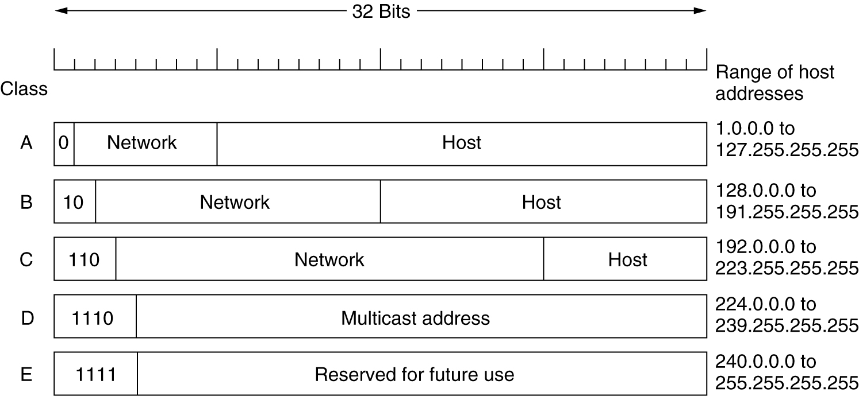
IPv4 Addresses
IP address formats.
Picture courtesy: Andrew S. Tanenbaum, “Computer Networks”, 4/e, PHI, 2004

Slide 11
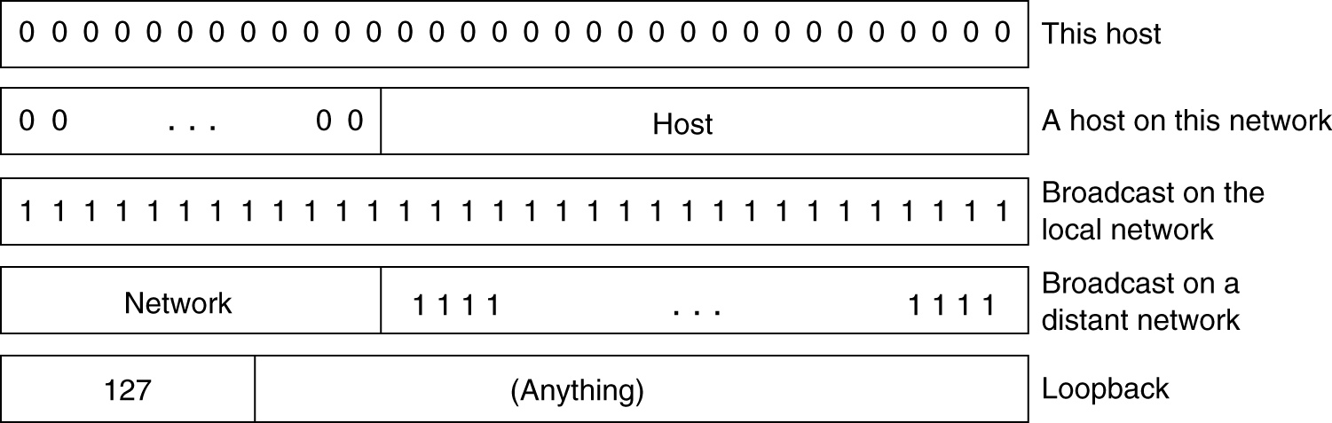
IP Addresses (2)
Special IP addresses
Picture courtesy: Andrew S. Tanenbaum, “Computer Networks”, 4/e, PHI, 2004

Slide 12
Anatomy of an IP Address
Every interface on an internet must have a unique Internet Address (also called an IP Address).
These are 32 bit numbers .
Not Flat , there is a structure to these addresses.
Normally written as four decimal numbers , one for each byte of the address
  E.g 140.252.13.33
Divided into a Network Id and Host Id

Slide 13
Class A Addresses
Maximum networks | 2⁷-2 | 126
Maximum usable networks | 2⁷-4 | 124
Hosts per network | 2²⁴-2 | 16,777,214
Private IP address | 10.0.0.0 | 1
Address range | 1.0.0.0 | 126.0.0.0
Notes:
Network address – all 0’s – same network
Network address – all 1’s – broadcast
Class A address – 127.anything – loopback address
Network address – 10 – private address
Hence, total available network address : 2⁷ – 4.

Slide 14
Class B Addresses
Maximum networks | 2¹⁴-2 | 16,382
Maximum usable networks | 2¹⁴-18 | 16,366
Hosts per network | 2¹⁶-2 | 65,534
Private IP address | 172.16.0.0 to 172.31.255.255 | 16
Address range | 128.0.0.0 | 191.255.0.0
Notes:
Network address cannot be all 0’s and all 1’s, so 2 addresses lost.
Bit 0 and 1 for identifying Class B address, so 14 bits left for network address.
172.16.0.0 to 172.31.255.255 i.e 16 network addresses for private addresses
Hence, total addresses available : 2 ¹⁴ – (2+16)

Slide 15
Class C Addresses
Maximum networks | 2²¹-2 | 2,097,150
Maximum usable networks | 2²¹-258 | 2,096,894
Hosts per network | 2⁸-2 | 254
Private IP address | 192.168.0.0 to 192.168.255.255 | 256
Address range | 192.0.0.0 | 223.255.255.255
Notes:
Number of bits required for address class identification – 3
Number of bits left for class C network address – (24-3) = 21
All 0’s and all 1’s not possible (same network and broadcast address), hence 2 combinations lost.
192.168.0.0 to 192.168.255.255 i.e 256 network address lost – private address.
Hence, total number of class C networks = 2 ²¹ – (2+256)

Slide 16
Assignment
Find out the IP address of your machine.
Identify its CLASS
Identify its category – Private or Public

Slide 17
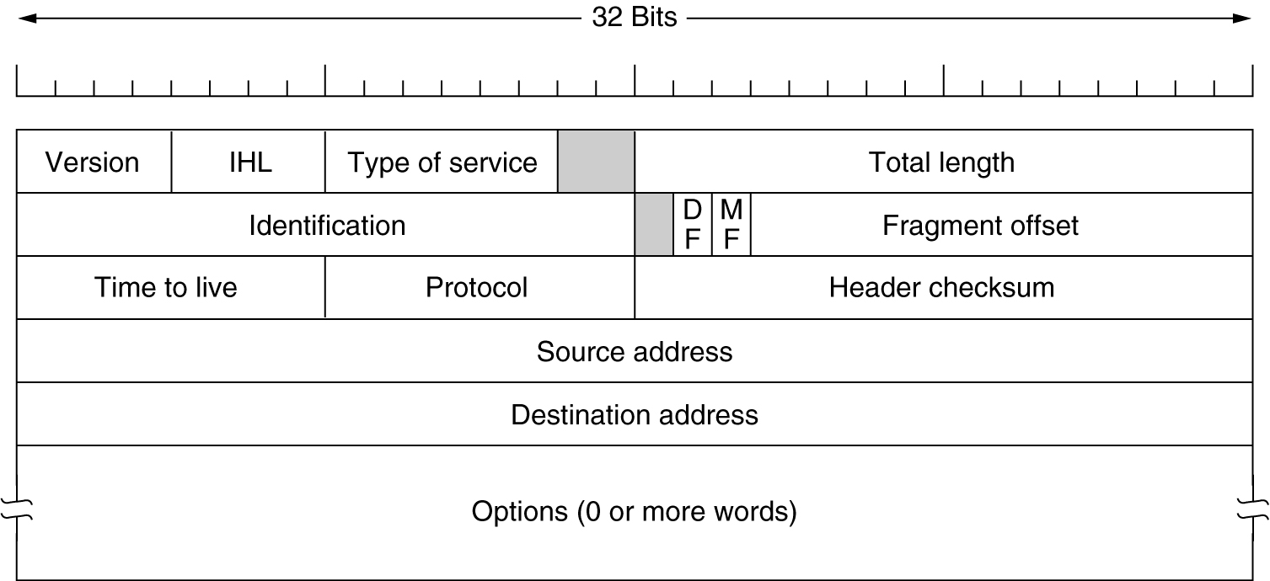
IPv4 Packet
Picture courtesy: Andrew S. Tanenbaum, “Computer Networks”, 4/e, PHI

Slide 18
Header Fields
TOS: Type-Of-Service = Precedence/D/T/R/Unused
  Precedence (priority) (0 -7); 0 is minimum, 7 is maximum
  D for low-delay,T for high throughput, R for high reliability
  2 bits unused. Service type bits ignored by most routers
Total Length: Size of datagram including the header
  (Maximum size of IP packet is 64 KB)
TTL: Time-To-Live
  Decremented on each hop
  Datagram dropped when TTL becomes 0.
Protocol: Upper layer protocol (e.g., TCP)
Checksum: Verifies integrity of IP header
Options: Must add to multiple of 32-bits
  Record route, Timestamp, Source routing

Slide 19
IP Fragmentation and Reassembly
Every network has MTU
IP fragments the packet if MTU < datagrams
  More Fragments Flag; Don’t Fragment Flag
Fragmentation is harmful
  Try to avoid at Source host; Extra Work
  Lock up
Reassembly lockup
  Decrement timer and drop when it reaches 0
MTU discovery
  Send large packet with don’t fragment set
  If error, try smaller

Slide 20
Example of IP Fragmentation
length
=4000
ID
=x
fragflag
=0
offset
=0
Example
4000 byte datagram
MTU = 1500 bytes
One large datagram becomes
several smaller datagrams
length
=1500
ID
=x
fragflag
=1
offset
=0
1480 bytes in
data field
length
=1500
ID
=x
fragflag
=1
offset
=185
offset =
1480/8
length
=1040
ID
=x
fragflag
=0
offset
=370
Picture courtesy: Kurose and Ross, “Computer Networking: A Top Down Approach featuring the Internet”, 3/e, Chapter 4, Pearson Education, 2005

Slide 21
Reassembly Process
To assemble the fragments of an Internet datagram , an IP module combines internet datagrams that all have the same value for the following four fields:
(identification , source , destination ,protocol)
Data portion of the datagram is placed in the correct position from the fragmentation offset field.
First fragment is identified by fragmentation offset = 0 and the last fragment by MF bit = 0.

Slide 22
Internet Scaling Problems
Over the past years, the Internet has experienced 2 major scaling issues
  The eventual exhaustion of the IPv4 address space.
  The ability to route traffic between the ever increasing number of networks that compromse the Internet
  IPv4 defines a 32-bit address.
  2³² (4,294,967,296) adresses available.
Design problem
  Class C networks are too small (254 hosts per network)
  Next option is class B, which is too big (65,534 hosts per network)

Slide 23
Routing Protocols

Slide 24
Routing vs. Forwarding
forwarding: move packets from router’s input to appropriate router output
routing: determine route taken by packets from source to destination.
  Routing algorithms
analogy:
routing: process of planning trip from source to destination
forwarding: process of getting through single interchange

Slide 25
Routing and Forwarding
routing algorithm
Picture courtesy: Kurose and Ross, “Computer Networking: A Top Down Approach featuring the Internet”, 3/e, Chapter 4, Pearson Education, 2005
local forwarding table
header value
output link
0100
0101
0111
1001
3
2
2
1
value in arriving
packet’s header
0111
1
3
2

Slide 26
Different Types of Routing Algorithms
Static / dynamic
Flat / Hierarchical
Host intelligent / router intelligent
Link State/ Distance Vector
Notes:
In static routing, there are table mappings established by the network administrator before the beginning of routing. These mappings do not change unless the network administrator alters them.
Algorithms that use static routes are simple to design and work well in environments where network traffic is relatively predictable and where network design is relatively simple.
Static routing systems cannot react to network changes.
Static routing doesn't impose any overhead on the routers or the network links.
Dynamic routing algorithms, adjusts to changing network circumstances by analyzing incoming routing update messages. If the message indicates that a network change has occurred, the routing software recalculates routes and sends out new routing update messages. These messages permeate the network, stimulating routers to rerun their algorithms and change their routing tables accordingly.
Dynamic routing algorithms can be supplemented with static routes where appropriate. A router of last resort (a router to which all unroutable packets are sent), for example, can be designated to act as a repository for all unroutable packets, ensuring that all messages are at least handled in some way
In a flat routing system, the routers are peers of all others.
In a hierarchical routing system, some routers form what amounts to a routing backbone.
In hierarchical routing system, packets from nonbackbone routers travel to the backbone routers, where they are sent through the backbone until they reach the general area of the destination. At this point, they travel from the last backbone router through one or more nonbackbone routers to the final destination.
In flat routing system, a packet can move from any router to any router depending on the cost of the path.
Some routing algorithms assume that the source end node will determine the entire route. This is usually referred to as source routing. In source-routing systems, routers merely act as store-and-forward devices, mindlessly sending the packet to the next stop.
Other algorithms assume that hosts know nothing about routes. In these algorithms, routers determine the path through the internetwork based on their own calculations. In the first system, the hosts have the routing intelligence. In the latter system, routers have the routing intelligence.

Slide 27
Routing Metrics
Path Length
Reliability
Delay
Bandwidth
Load
Communication Cost
Notes:
Reference Cisco Routing Basics
Path length is the most common routing metric. Some routing protocols allow network administrators to
assign arbitrary costs to each network link. In this case, path length is the sum of the costs associated
with each link traversed. Other routing protocols define hop count, a metric that specifies the number of
passes through internetworking products, such as routers, that a packet must take en route from a source
to a destination.
Reliability, in the context of routing algorithms, refers to the dependability (usually described in terms
of the bit-error rate) of each network link. Some network links might go down more often than others.
After a network fails, certain network links might be repaired more easily or more quickly than other
links. Any reliability factors can be taken into account in the assignment of the reliability ratings, which
are arbitrary numeric values usually assigned to network links by network administrators.
Routing delay refers to the length of time required to move a packet from source to destination through
the internetwork. Delay depends on many factors, including the bandwidth of intermediate network
links, the port queues at each router along the way, network congestion on all intermediate network links,
and the physical distance to be traveled. Because delay is a conglomeration of several important
variables, it is a common and useful metric.
Bandwidth refers to the available traffic capacity of a link. All other things being equal, a 10-Mbps
Ethernet link would be preferable to a 64-kbps leased line. Although bandwidth is a rating of the
maximum attainable throughput on a link, routes through links with greater bandwidth do not necessarily
provide better routes than routes through slower links. For example, if a faster link is busier, the actual
time required to send a packet to the destination could be greater.
Load refers to the degree to which a network resource, such as a router, is busy. Load can be calculated
in a variety of ways, including CPU utilization and packets processed per second. Monitoring these
parameters on a continual basis can be resource-intensive itself.
Communication cost is another important metric, especially because some companies may not care about
performance as much as they care about operating expenditures. Although line delay may be longer, they
will send packets over their own lines rather than through the public lines that cost money for usage time.

Slide 28
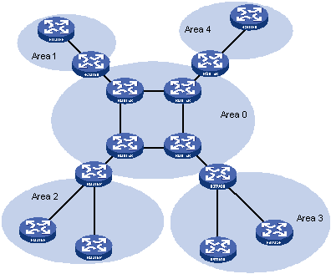
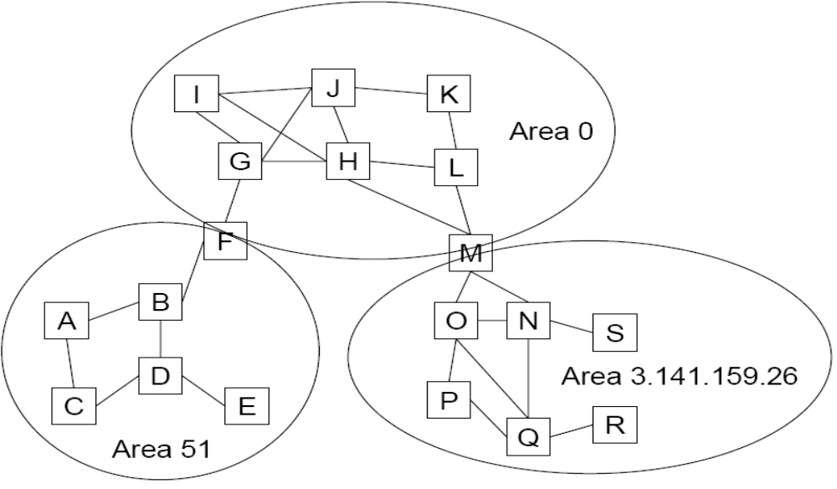
Autonomous System (divided into areas)
Autonomous System

Slide 29
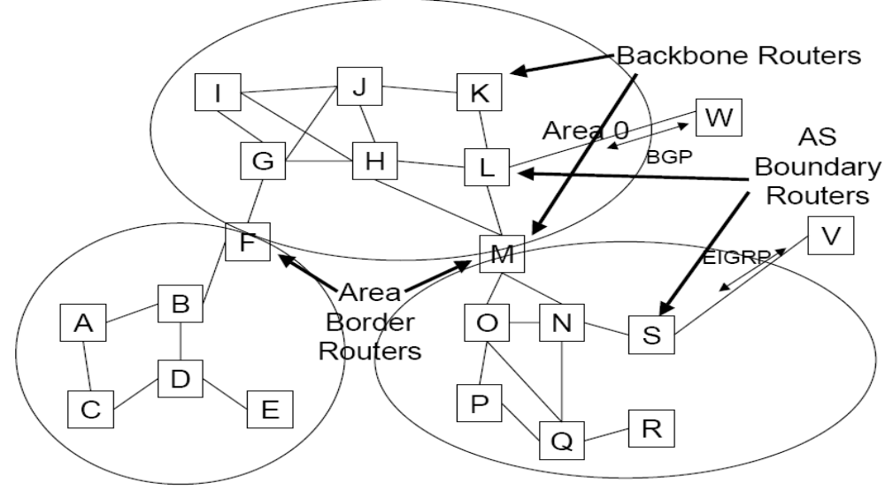
Router Types
Notes:
Area Border Routers – A router that attaches to multiple areas .
Back Bone routers – In this diagram , routers with all interfaces connected to backbone are shown as Back Bone Routers
Internal Routers – A router with all directly connected networks belonging to the same area.
AS Boundary Routers – Routers that exchange routing information with routers belonging to other autonomous systems.
Note – AS Boundary Routers may be internal Routers or Area Border Routers and may or may not participate in backbone.

Slide 30
OSPF
It is an intra domain routing protocol.
Usually used within an autonomous system.
Autonomous system is a collection of networks governed by common administrative policies .The routing policy within an autonomous system will be the same.
An autonomous system is identified by an AS number.
Typically an ISP is an autonomous system.

Slide 31
OSPF
It is a hierarchical Routing Protocol.
The ISP is divided into areas.
Communication takes place within each area and between areas.
Backbone area is called as Area0.
Each router maintains a database.
Database of a router belonging to the same area is same.
The routers are categorized depending on the job they are supposed to do , accordingly their database differs ( like routers within an area does a specific job, routers belonging to backbone area have a different job etc. )

Slide 32
EGP
What Is an EGP?
  Exterior gateway Protocol
  Used to convey routing information between Autonomous Systems
  Decoupled from the IGP
Current EGP is BGP (Border Gateway Protocol)
Why Do We Need an EGP?
Scaling to large network
  Hierarchy
  Limit scope of failure
Policy
  Control reachability to prefixes

Slide 33

Router Architecture Overview
Two key router functions:
run routing algorithms/protocol (RIP, OSPF, BGP)
forwarding datagrams from incoming to outgoing link
Picture courtesy: Kurose and Ross, “Computer Networking: A Top Down Approach featuring the Internet”, 3/e, Chapter 4, Pearson Education, 2005

Slide 34

Thank You

Slide 35
Disclaimer
Aricent makes no representations or warranties with respect to contents of these slides and the same are being provided “as is”. The content/materials in the slides are of a general nature and are not intended to address the specific circumstances of any particular individual or entity. The material may provide links to internet sites (for the convenience of users) over which Aricent has no control and for which Aricent assumes no responsibility for the availability or content of these external sites. While the attempt has been to acknowledge sources of materials wherever traceable to an individual or an institution; any materials not specifically acknowledged is purely unintentional

