Slide 1
Computer Networks – ARP, DHCP, DNS

Slide 2
OBJECTIVE
Appreciate the purpose / utility / role of ARP, DHCP, and DNS in end-to-end routing

Slide 3
ARP

Slide 4

How ARP ?
ARP uses two kinds of messages for address resolution.
  ARP REQUEST
  ARP REPLY
I do!! My MAC address is
00:00:00:00:00:03
Does anyone have IP 10.0.0.3? If so, tell me your MAC address!
ARP REQ
ARP REP

Slide 5


ARP REQUEST
Sender broadcasts an ARP request to all stations on the network
MAC address of the destination is FF.FF.FF.FF.FF.FF
My Computer 129.119.10.42
Who has 129.119.103.2

Slide 6
ARP REPLY
Receiver unicast an ARP REPLY to sender who requested the MAC address
MAC address of the destination is MAC address of the sender which is got from ARP REQUEST packet.
My Computer 129.119.10.42
I have 129.119.103.2
My MAC is [AE-08-12-47-A8-0E]

Slide 7
DHCP

Slide 8
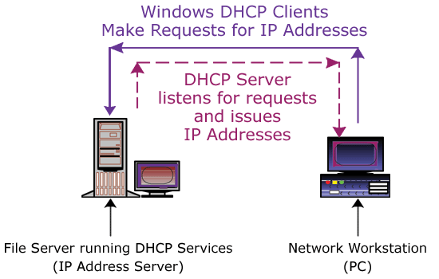
DHCP

Slide 9
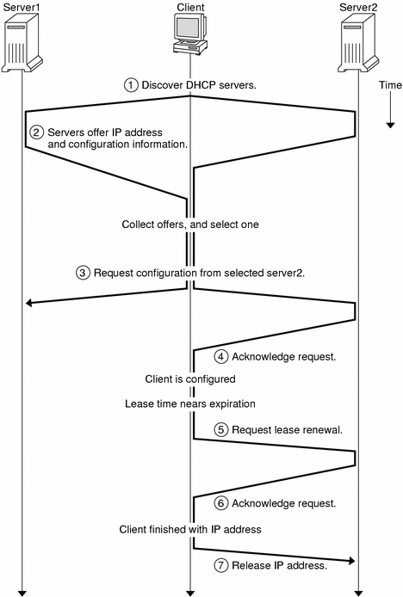
Notes:
Why more than one servers ???
Both servers will have same set of IP addresses in their pool ?

Slide 10
DNS

Slide 11
Domain Name System
Hierarchical, domain-based naming scheme
Distributed database of name-address mappings (and other information)
Specifies a tree-structured name space.
Data is associated with each node in this tree.
A query specifies domain name (node in the tree) and type of resource information.
Name servers hold information for name space.
Resolvers get information from a name server.

Slide 12
A brief history of DNS
HOSTS.TXT file at NIC
  All host names were recorded in this file
  Hosts copied this file by FTP
  No structure in names
  Provided only one information - IP Address
/etc/hosts file in Linux box
Several proposals for distributed hierarchical database were submitted during 1983-86.
DNS RFC issued in 1987 (RFC-1034 & 1035).

Slide 13
Design Goals
General purpose facility. Should support several types of information.
Should be independent of network layer protocol.
Database size is proportional to number of hosts.
Most data changes slowly, but few parts may change rapidly.
Information access is more important than updates and consistency.

Slide 14
Elements of DNS
Domain Name Space
Resource Records
Name Servers
Resolvers

Slide 15
Domain Name Space
Node refers to internal nodes and leaves of the domain name space.
Each node has a label (max 64 octets); Root has no label.
Domain Name of a node is a list of labels on the path from node to root e.g. dts009.asian.ad.aricent.com
Comparisons are case-insensitive.
Length of a domain name < = 255 octets.
Relative domain names consists of few starting labels, e.g., dts009, dts009.asian, dts009.asian.ad.

Slide 16
The Structure of DNS name space
Generic
Countries
Unnamed root “ ”
…..
int
com
edu
gov
mil
org
net
us
nl
in
127
aricent
yale
gtld
ieee
ernet
ac
gov
eng
cs
eng
iitd
iitm
upsc
ai
india
ee
cs
Aricent Engineering Dept - eng.aricent.com.
robot

Slide 17
Top Level Domains
.com
.edu
.org
.mil
.gov
.net
Each country has a unique 2-character code as its top level domain e.g. .in for India. Standard sub-domain nomenclature like .ac, .co, .res etc. have now evolved.

Slide 18
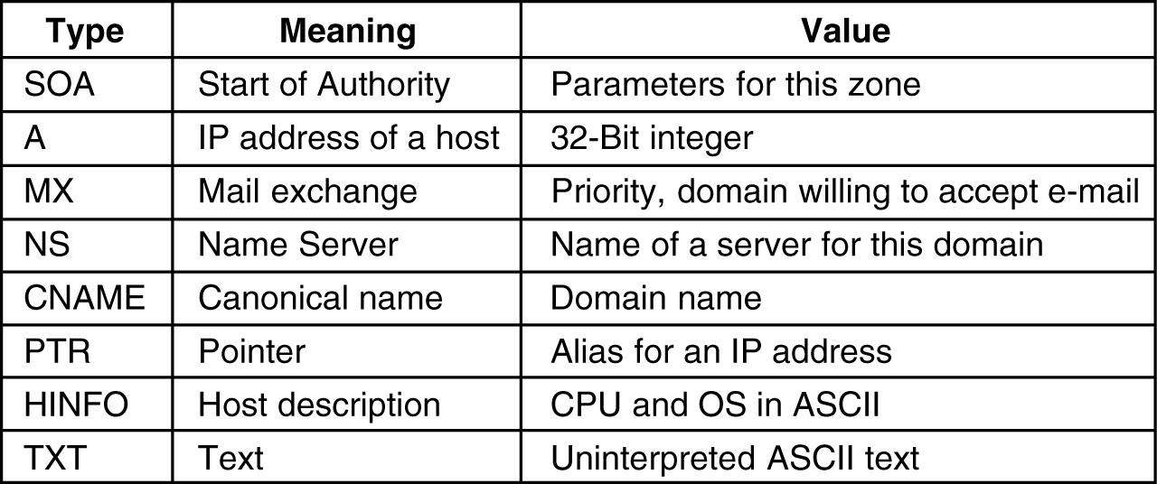
Resource Records
The principal DNS resource records types.
Table courtesy: Andrew S. Tanenbaum, “Computer Networks”, 4/e, PHI

Slide 19
Resource Records
Each node has a set of Resource Records (RR). A resource record consists of five fields:
  Domain name to which this RR applies: primary search key
  Time-to-live of the record: 32-bit integer
  Type: defines the kind of record, the most important ones being
    Start Of Authority (SOA) - parameters for this zone
    IP Address of the host (A)
    Mail exchange (MX) - domain prepared to accept e-mail for this domain
    Name Server (NS) - name of an authoritative name server for this domain
    Canonical name (CNAME) - allows aliases to be created for this domain name
    Pointer (PTR) - DNS data type; generally associates a name with an IP address
    Host information (HINFO) - information about the host machine
    Text (TXT) - information about the domain for the sake of user convenience
    Class - Protocol family (e.g. IN = Internet)
  Data: Type/Class dependent information

Slide 20
DNS Queries
Types of Queries:
  Recursive: If the server does not have the requested information, it finds it from other servers and reports back
  Iterative: Query fails if the requested information is not available locally, but the name of the next server along the line that may have the information is returned.
Query consists of 3 parts:
  Query Name
  Query Type
  Query Class
All RRs that match these 3 fields are to be returned.

Slide 21
Name Servers
Each domain must have at least two name servers Each name server must have either
  complete information on the sub-tree
  information about other servers for the sub-tree
Each name server must know of at least 1 server at higher level (except those serving root domain)
Example: aricent is a sub-domain of com; users within Aricent are served by the local name server having the (private) IP address 10.203.142.16 and 10.203.142.103

Slide 22
DNS Quiz
Where is the DNS server located ?
How will a DNS server handle large number of requests ?
Will successive access to same resource from the same client generate multiple queries ?
DNS is which layer protocol ?

Slide 23
DNS (Answers to the quiz)
The organization should have multiple local name servers. If the local name servers do not know the answer they need to contact other name servers in the internet. This is basically a distributed database .
Suitable use of distributed architecture . Additional redundant servers may be used for balancing the workload.
No . A fundamental property of DNS is caching. When a name server receives information about a mapping it caches that information so that a later query for the same mapping can use the cached result and not result in additional queries to other servers.
DNS is an application which can be built over both TCP and UDP

Slide 24

Thank You

Slide 25
Disclaimer
Aricent makes no representations or warranties with respect to contents of these slides and the same are being provided “as is”. The content/materials in the slides are of a general nature and are not intended to address the specific circumstances of any particular individual or entity. The material may provide links to internet sites (for the convenience of users) over which Aricent has no control and for which Aricent assumes no responsibility for the availability or content of these external sites. While the attempt has been to acknowledge sources of materials wherever traceable to an individual or an institution; any materials not specifically acknowledged is purely unintentional

