Slide 1
Computer Networks – Socket Programming

Slide 2
TOC
TCP/IP 4-Layer Model
Connection-Oriented vs. Connectionless Service
Client-Server Model
Berkley Sockets
Socket Address Structures
Socket Programming - Function calls
Byte Ordering
Client-Server pseudo code
I/O Models in Unix
Pitfalls of Socket Programming

Slide 3
TCP/IP 4-Layer Model
User process
User process
Application Layer
TCP
UDP
Transport Layer
IP
Network Layer
H/W Intf.
Physical Layer

Slide 4
Connection-Oriented vs. Connectionless Service
A connection-oriented service includes the establishment of a logical connection between 2 processes -
  Establish logical connection
  Transfer data
  Terminate connection .
Connectionless services may have the following features -
  Application programs send messages to other programs with a minimum of protocol mechanism .
  The device at one end of the communication transmits data to the other, without first ensuring that the recipient is available and ready to receive the data.
  Usually described as stateless since the endpoints have no protocol-defined way to remember where they are in a "conversation" of message exchanges .

Slide 5
Client-Server Model
A server is a process not a machine !
A server waits for a request from a client .
A client is a process that sends a request to an existing server and (usually) waits for a reply .

Slide 6
Client-Server Model (contd…)
Servers are generally more complex – Why ?
2 Basic types of servers:
  Iterative - Server handles one client at a time
  Concurrent - Server handles many clients at a time
    Single Process concurrent server - uses threads to achieve this.
    Multiple Process concurrent server - uses fork system call to achieve this.
  Note: Most TCP servers are concurrent and most UDP servers are iterative .

Slide 7
Client-Server Model (contd…)
Server and Client exchange messages over the network through a common Socket API.
Server
Clients
user
space
ports
TCP/UDP
TCP/UDP
Socket API
kernel
space
IP
IP
Ethernet Adapter
Ethernet Adapter
hardware

Slide 8
Berkley Sockets

Slide 9
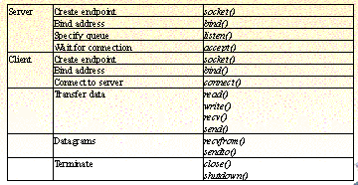
Berkley Sockets

Slide 10
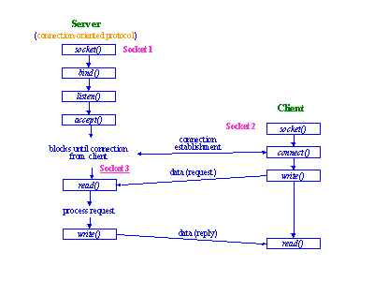
Connection Oriented communication
Notes:
Mention socket1 is the listening socket in the server , which normally exists throughout the lifetime of the server ,
And socket 3 is the connection socket for each client

Slide 11
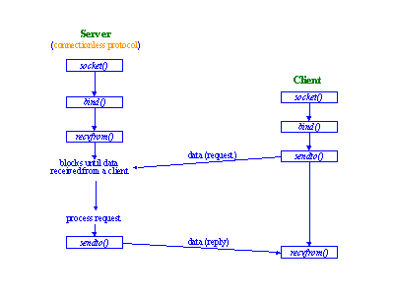
Connection less communication

Slide 12
Socket Address Structures
For most of the socket functions , a socket address structure( begins with sockaddr_ and ends with a unique suffix for each protocol) is required.
  Note: A pointer to the socket address structure , and the length is passed to the functions.
There are different socket address structures depending upon various protocols (like IPv4, IPv6, Unix domain, datalink ).
Notes:
Problem , if there are different address structures , how can a pointer be passed to a function ? (It should have a single prototype).
ANSI solution use (void*) – generic pointer .
But socket functions , coded before ANSI standard .
So , a generic socket address structure was defined .

Slide 13
IPv4 Socket Address Structure
struct sockaddr_in {
uint8_t sin_len;
sa_family_t sin_family, /* AF_INET */
in_port_t sin_port,
struct in_addr sin_addr,
char sin_zero[8],
};
struct in_addr {
in_addr_t s_addr;
};
Note: Header file <netinet/in.h> needs to be included for definition of the above structures.
Notes:
POSIX requires the three members as shown in different color.
Note the port & address are in network byte order.
Sin_zero[8] member is added to make the structure at least 16 bytes.
Even if a length field is present , normally its is not set or examined.
For description of the datatypes refer Stevens UNP, Page 69,vol1 3rd edn.
Struct in_addrt
{
In_addr_t s_addr;
}
Is the 32 bit IPV4 address in Network Byte Ordered.

Slide 14
Generic Socket Address Structure
struct sockaddr {
uint8_t sa_len;
u_short sa_family;
char sa_data[14];
};
e.g. : ANSI C prototype for bind function
int bind (int , struct sockaddr * , socklen_t );
Code :
struct sockaddr_in serv;
//fill in serv
bind(sockfd , ( struct sockaddr*)&serv, sizeof(serv));
Notes:
Generic socket address structure is shown above .
The socket functions are defined as taking a pointer to the generic socket address structure
Omitting the cast , C Compiler generates a warning.
From an application programmer’s view point this casting is the only use of the generic structure

Slide 15
The ‘socket’ call
int socket (int family, int type, int protocol)
where,
family - AF_INET (IPv4 Protocols), AF_INET6, AF_UNIX
type - SOCK_STREAM, SOCK_DGRAM, SOCK_RAW
protocol (Combination of protocol and type) - Typically set to 0 (system’s default is chosen for the given combination of family and type) for most applications.
Note: On success, the ‘socket’ function returns a small non negative integer value called a socket descriptor, similar to file descriptor.
Notes:
Refer Page 97 ( socket function ) UNP –Stevens , Fenner , Rago , 3rd Edn , PHI

Slide 16
Socket functions – Common format
<function_name> (socket descriptor, pointer to an address structure,
length of the structure or a pointer)
  Above shows a general format of functions like connect, bind, accept (details to be followed).
  1st argument is the socket descriptor .
  2nd argument is the address of a structure, which may be specific for specific families like IPv4, IPv6.
  3rd argument is the length of the address structure (argument 2).
Notes:
Refer arg 2
A cast to a pointer to a generic address struct sockaddr is required.
Refer arg 3
It can also be a pointer to a memory which will be updated by the number of bytes , returned in the structure ( eg accept function)

Slide 17
Socket Functions (connect)
The ‘connect()’ system call is used by a TCP client to establish a connection with a TCP Server
int connect (int sockfd, const struct sockaddr *servaddr, socklen_t addrlen);
where,
servaddr: Pointer to a protocol specific address structure.
addrlen: Size of the above address structure.
In case of TCP, ‘connect’ initiates TCP’s three way handshake.
The function returns only when the connection is established, or an error occurs
Note: The client need not call bind before calling connect. The kernel will choose both an ephemeral port & the source IP address if necessary.

Slide 18
Socket Functions (bind)
The bind() system call is used to assign a local protocol address
(combination of IPv4/IPv6 address & port no) to an existing socket .
int bind (int sockfd, struct sockaddr *myaddr, socklen_t addrlen);
where,
myaddr: Pointer to a protocol specific address structure.
addrlen: Size of the above address structure.
Calling ‘bind()’ allows a process to specify half of an association <local address, local port>. This function is common for a server process, since servers are commonly known by their well known ports.

Slide 19
Socket Functions (listen)
The listen() function is called by a TCP server and it converts an
unconnected socket into a passive socket , indicating that the kernel should accept incoming connection requests directed to this socket
int listen (int sockfd, int backlog);
where,
backlog: specifies how many connection requests can be queued by the system while it waits for the server to execute the accept system call
Notes:
Note : Two queues are maintained ( Completed Connection queue ( Three way handshake completed) and
Incomplete Connection Queue( SYN RECEIVED).
Sum of both queues cannot exceed backlog . Normally in texts value of backlog is shown to be 5. A large
Value can be specified . The kernel may truncate it to the maximum value supported.
Refer Stevens for detailed explanation.

Slide 20
Socket Functions (accept)
The accept() is called by a TCP server to return the next completed connection from the front of the completed connection queue. If the completed connection queue is empty the process is put to sleep (default blocking socket).
int accept (int sockfd, struct sockaddr *cliaddr, socklen_t *addrlen)
If accept is successful, it’s return value is a brand new descriptor , automatically created by the kernel. (This descriptor refers to the TCP connection with the client)
Notes:
So , Normally a server creates two sockets for a particular client connection.
( listening socket , which was passed in the arguments to the bind , listen ,
accept and it exists for the lifetime of the server , and one connection socket for each connection)
The client protocol address is populated in the structure pointed by cliaddr , and the number of bytes written in the
structure is also updated in the variable pointed by addrlen.

Slide 21
Socket I/O Functions
Functions for TCP sockets -
  read/write
    Arguments – (fd, buf, count)
  recv/send
    Arguments – (fd, buf, count, flags)
    Using flags, various options can be specified like non-blocking operation for the I/O, wait for all of data to be available in read, etc.
Functions for UDP sockets -
  recvfrom
    Arguments - (sockfd, buff, nbytes, flags, from, addrlen)
  sendto
    Arguments - (sockfd, buff, nbytes, flags, to, addrlen)
Notes:
While discussing the slide , the man page should be referred for the detailed description of the argument types.

Slide 22
Things to remember while sending/receiving data
TCP is a connection oriented protocol , sends data in segments .So there are no record boundaries . The number of send calls in the sender may not match the number of receive calls in the receiver
While sending, make sure all of the data is sent by repeatedly calling send() if required and also, repeatedly call recv() to receive all data
Normally the calls are blocking in nature.
Read call may block for receipt of the end of connection from the other side
Take appropriate actions if return value of the calls indicate error

Slide 23
Discarding sockets – close()
int close (int sockfd);
Close decrements the reference count for the socket descriptor and if the reference count becomes zero (0), then the FIN (for connection termination) is also sent
This is very important as the process in the other side may be sitting inside a read call & get blocked for ever if the FIN is not received
If the FIN is received then only read returns 0 & the process can continue. Moreover close terminates both directions of data transfer
Notes:
Solution for the above scenario:
shutdown function may be used which can close a connection half way (selectively reading & writing ) and initiate TCP’S normal termination sequence , even if the socket descriptor reference count is not 0.
eg : shutdown(sockfd , SHUT_WR) – write half is closed and process cannot issue any of the write functions on the socket.

Slide 24
Byte Ordering
Different computer architectures use different byte ordering to represent multibyte values
Little-Endian
IBM 80x86
DEC VAX
DEC PDP-11
Big-Endian
IBM 370
Motorola 68000
Sun
Low Byte
High Byte
High Byte
Low Byte
Addr A
Addr A+1
Addr A
Addr A+1

Slide 25
Network Byte Order
There is no standard between the two byte orderings and we may encounter systems that use both formats
Networking protocols must specify a network bye order
  Note: Internet protocols use big endian
Concern is therefore converting between host byte order and network byte order

Slide 26
Byte Ordering Functions
Following functions are used for conversion between network and host byte order :
uint32_t htonl (uint32_t host32bitvalue);
uint16_t htons (uint16_t host16bitvalue);
uint32_t ntohl (uint32_t net32bitvalue);
uint16_t ntons (uint16_t net16bitvalu);
where, the alphabets denote the following:
  h: host
  n: network
  s: 16bit value(like TCP/UDP PortNo)
  l: 32-bit value (like an IPv4 address )
The header file <netinet/in.h> needs to be included for accessing these functions.

Slide 27
Pseudo code for a simple Iterative Client Server
Server Code
get a listening socket (socket , specify TCP).
bind the socket (Bind) (populated server address structure and the socket descriptor are the parameter)
listen (Specify Queue Length)
for (;;) {
  Block till received connection from client ( Accept ).
  Send / Receive data .
  Close the client connection socket.
}

Slide 28
Pseudo code for a simple Iterative Client Server
Client Code
Get a active socket (socket , specify TCP)
Connect to the server (connect , need server’s IP address and port)
If successful in connect
  Send / Receive data
Close the client connection

Slide 29
Pseudo code for a simple concurrent Server
Server Code
Get a listening socket ( socket , specify TCP).
Bind the socket ( Bind) ( populated server address structure and the socket descriptor are the parameter).
Listen ( Specify Queue Length).
For (;;) {
  Block till received connection from client ( Accept ).
  Fork a child ( Serving a particular client ).
    Close the listening socket .
    Send / Receive data .
    Close the client connection socket .
  Close the client connection socket .
}

Slide 30
Pseudo code for a threaded Server.
Server Code
Get a listening socket ( socket , specify TCP)
Bind the socket ( Bind) ( populated server address structure and the socket descriptor are the parameter)
Listen ( Specify Queue Length)
For (;;) {
  Block till received connection from client ( Accept )
  Create a thread (Serving a particular client)
    pthread_create(&th1,NULL,doit,(void*)connfd);
}
Note – doit is the function for serving a client .
connfd is the connection socket returned from accept .

Slide 31
Pseudo code for a simple Iterative Server -UDP
Server Code
Get a listening socket ( socket , specify UDP).
Bind the socket ( Bind) ( populated server address structure and the socket descriptor are the parameter).
//Listen Not used with UDP Socket
For (;;) {
  Block till received data from client ( recvfrom )
  //Accept not used with datagram socket
    Send data (sendto)
    }
Notes:
What change should be there in the client Code ?
( The client may not use connect call as there is no connection concept in UDP)

Slide 32
I/O Models (Available in Unix)
Blocking I/O
Non Blocking I/O
I/O Multiplexing
Signal Driven I/O
Asynchronous I/O
Notes:
Need to discuss all the models briefly

Slide 33
I/O Multiplexing
In developing applications, the ‘select()’ call can be used to multiplex I/O
requests among multiple sockets and/or files.
int select (int maxfds, fd_set *readfds, fd_set *writefds, fd_set *exceptfds, struct timeval *timeout);
where,
maxfds: maximum number of descriptors to be tested .
readfds: specify descriptor to be checked for reading .
writefds: specify descriptor to be checked for writing .
exceptfds: specify descriptor to be checked for exception conditions.
timeout: time to wait for one of the specified descriptors to become ready. (If NULL, wait forever).

Slide 34
I/O Multiplexing (contd….)
fd_set is a bit map
before select()
0 | 1 | 2 | 3 | 4 | 5 | 6
 |  |  | V | V | V
after select()
0 | 1 | 2 | 3 | 4 | 5 | 6
 |  |  | V |  | V
fd_zero(fd_set *fds) : To clear the FD set (bit map).
fd_set(int fd, fd_set *fds) : To set a particular file descriptor.
fd_clr(int fd, fd_set *fds) : To unset a particular file descriptor.
fd_isset(int fd, fd_set *fds) : To determine whether a file descriptor is ready for read or write.

Slide 35
I/O Models – I/O Multiplexing - An Example
void str_cli(
FILE *fp, /*Here to be used as stdin as argument*/
int sockfd) /*Connection Socket */
int maxdes,written,byteswritten,n;
fd_set rset;
char sendbuf[1024] , recvbuf[1024];
FD_ZERO(&rset);
maxdes=(sockfd>fileno(fp)?sockfd+1:fileno(fp)+1);
for(;;){
FD_SET(fileno(fp) , &rset);
FD_SET(sockfd , &rset);
select(maxdes,&rset,NULL,NULL,NULL);
if(FD_ISSET(sockfd , & rset))
{
//Read Data from socket
}
if(FD_ISSET(fileno(fp) , & rset))
{
fgets(sendbuf,1024,fp);
}
}
}
Notes:
Briefly explain the code / Show the demo.

Slide 36
Some Pitfalls of socket programming
Ignoring Return Status of the functions
Peer Socket Closure
Address in Use Error
Sending structured data
Framing Assumptions in TCP
Notes:
Briefly explain each of the mentioned pitfalls.

Slide 37
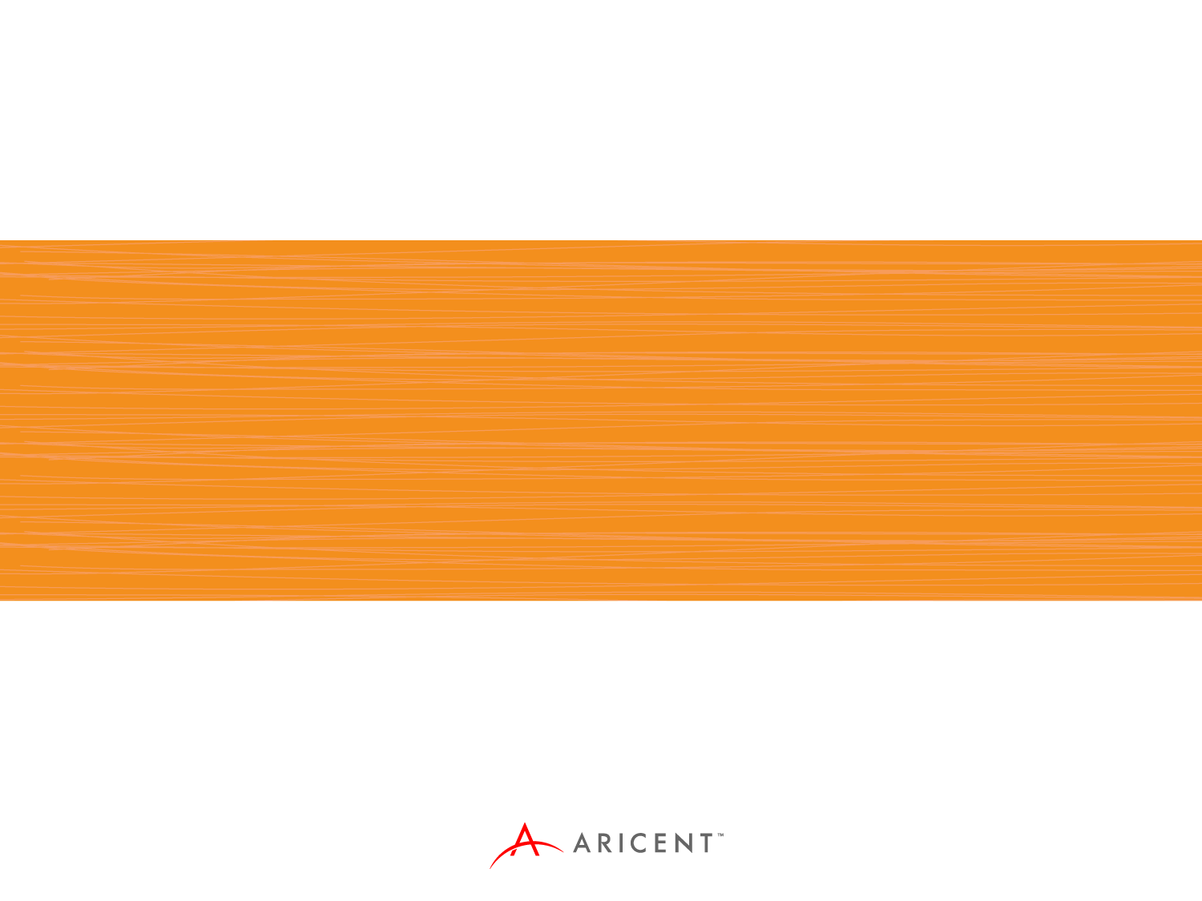
Thank You

Slide 38
Disclaimer
Aricent makes no representations or warranties with respect to contents of these slides and the same are being provided “as is”. The content/materials in the slides are of a general nature and are not intended to address the specific circumstances of any particular individual or entity. The material may provide links to internet sites (for the convenience of users) over which Aricent has no control and for which Aricent assumes no responsibility for the availability or content of these external sites. While the attempt has been to acknowledge sources of materials wherever traceable to an individual or an institution; any materials not specifically acknowledged is purely unintentional

