Slide 1
Algorithm Analysis

Slide 2
Algorithm
An algorithm is a finite set of instructions that, if followed, accomplishes a particular task. In addition, all algorithms must satisfy the following criteria:
Input: Zero or more quantities are externally supplied.
Output: At least one quantity is produced.
Definiteness: Each instruction is clear and unambiguous.
Finiteness: If we trace out the instructions of an algorithm, then for all cases, the algorithm terminates after a finite number of steps.
Effectiveness: Every instruction must be very basic so that it can be carried out, in principle, by a person using only pencil and paper. It is not enough that each operation be definite as in criterion3; it also must be feasible

Slide 3
Design and Analysis of Algorithms
Analysis: predict the cost of an algorithm in terms of resources and performance
Design: design algorithms which minimize the cost

Slide 4
Algorithmic Performance
There are two aspects of algorithmic performance:
Time
Instructions take time.
How fast does the algorithm perform?
What affects its runtime?
Space
Data structures take space
What kind of data structures can be used?
How does choice of data structure affect the runtime?

Slide 5
Why study algorithms and performance?
Algorithms help us to understand scalability.
Performance often draws the line between what is feasible and what is impossible.
Algorithmic mathematics provides a language for talking about program behavior.
Performance is the currency of computing.
The lessons of program performance generalize to other computing resources.

Slide 6
The Execution Time of Algorithms
Each operation in an algorithm (or a program) has a cost.
Each operation takes a certain of time.
count = count + 1; // take a certain amount of time, but it is constant
A sequence of operations:
count = count + 1; Cost: c₁
sum = sum + count; Cost: c₂
Total Cost = c₁ + c₂

Slide 7
The Execution Time of Algorithms
Example: Simple If-Statement
Cost Times
if (n < 0) c1 1
absval = -n c2 1
else
absval = n; c3 1
Total Cost <= c1 + max(c2,c3)

Slide 8
The Execution Time of Algorithms
Example: Simple Loop
Cost Times
i = 1; c1 1
sum = 0; c2 1
while (i <= n) { c3 n+1
i = i + 1; c4 n
sum = sum + i;c5 n
}
Total Cost = c1 + c2 + (n+1)*c3 + n*c4 + n*c5
The time required for this algorithm is proportional to n

Slide 9
The Execution Time of Algorithms
Example: Nested Loop
Cost Times
i=1; c1 1
sum = 0; c2 1
while (i <= n) { c3 n+1
j=1; c4 n
while (j <= n) { c5 n*(n+1)
sum = sum + i;c6 n*n
j = j + 1; c7 n*n
}
i = i + 1; c8 n
}
Total Cost = c1 + c2 + (n+1)*c3 + n*c4 + n*(n+1)*c5+n*n*c6+n*n*c7+n*c8
The time required for this algorithm is proportional to n²

Slide 10
General Rules for Estimation
Loops
The running time of a loop is at most the running time of the statements inside of that loop times the number of iterations.
Nested Loops
Running time of a nested loop containing a statement in the inner most loop is the running time of statement multiplied by the product of the sized of all loops.
Consecutive Statements
Just add the running times of those consecutive statements.
If/Else
Never more than the running time of the test plus the larger of running times of S1 and S2.

Slide 11
Algorithm Growth Rates
We measure an algorithm’s time requirement as a function of the problem size.
Problem size depends on the application: e.g. number of elements in a list for a sorting algorithm, the number users for a social network search.
So, for instance, we say that (if the problem size is n)
Algorithm A requires 5*n² time units to solve a problem of size n.
Algorithm B requires 7*n time units to solve a problem of size n.
The most important thing to learn is how quickly the algorithm’s time requirement grows as a function of the problem size.
Algorithm A requires time proportional to n².
Algorithm B requires time proportional to n.
An algorithm’s proportional time requirement is known as growth rate.
We can compare the efficiency of two algorithms by comparing their growth rates.

Slide 12
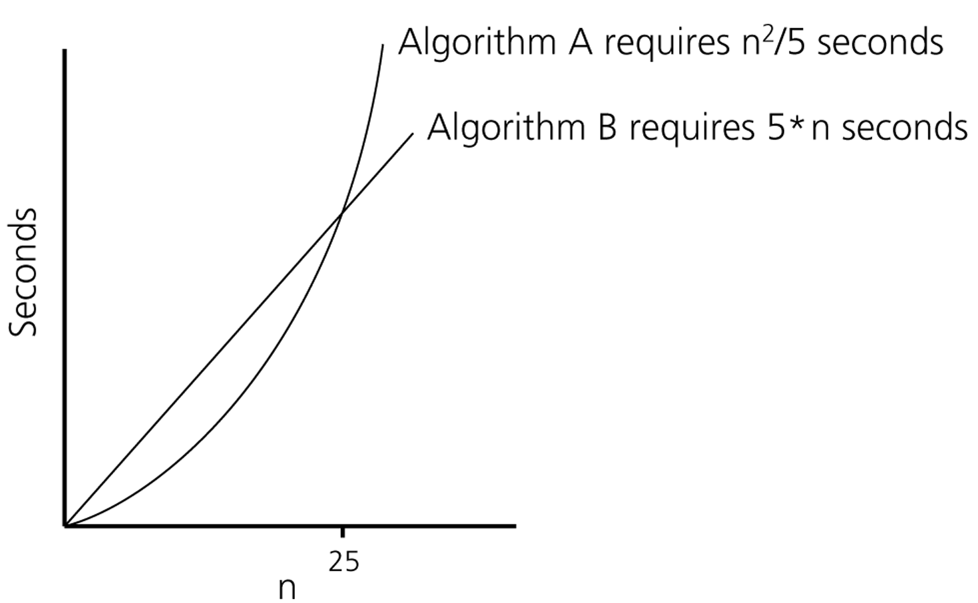
Algorithm Growth Rates
Time requirements as a function
of the problem size n

Slide 13
Common Growth Rates
Function | Growth Rate Name
c | Constant
log N | Logarithmic
log² N | Log-squared
N | Linear
N log N | Log-linear
N² | Quadratic
N³ | Cubic
2^{N} | Exponential

Slide 14
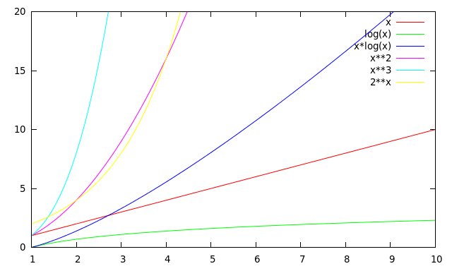
Running Times for Small Inputs
Input size (x = n)

Slide 15
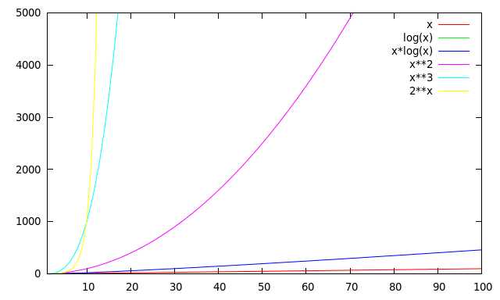
Running Times for Large Inputs
Running time
Input size (x = n)

Slide 16
Order-of-Magnitude Analysis and Big O Notation
If Algorithm A requires time proportional to g(n), Algorithm A is said to be order g(n), and it is denoted as O(g(n)).
The function g(n) is called the algorithm’s growth-rate function.
Since the capital O is used in the notation, this notation is called the Big O notation.
If Algorithm A requires time proportional to n², it is O(n²).
If Algorithm A requires time proportional to n, it is O(n).

Slide 17
Definition of the Order of an Algorithm
Definition:
Algorithm A is order g(n) – denoted as O(g(n)) – if constants k and n₀ exist such that A requires no more than k*g(n) time units to solve a problem of size n ≥ n₀. ➔ f(n) ≤ k*g(n) for all n ≥ n₀
The requirement of n ≥ n₀ in the definition of O(f(n)) formalizes the notion of sufficiently large problems.
In general, many values of k and n can satisfy this definition.

Slide 18
Order of an Algorithm
If an algorithm requires f(n) = n²–3*n+10 seconds to solve a problem size n. If constants k and n₀ exist such that
k*n² ≥ n²–3*n+10 for all n ≥ n₀ .
the algorithm is order n² (In fact, k is 3 and n₀ is 2)
3*n² ≥ n²–3*n+10 for all n ≥ 2 .
Thus, the algorithm requires no more than k*n² time units for n ≥ n₀ ,
So it is O(n²)

Slide 19
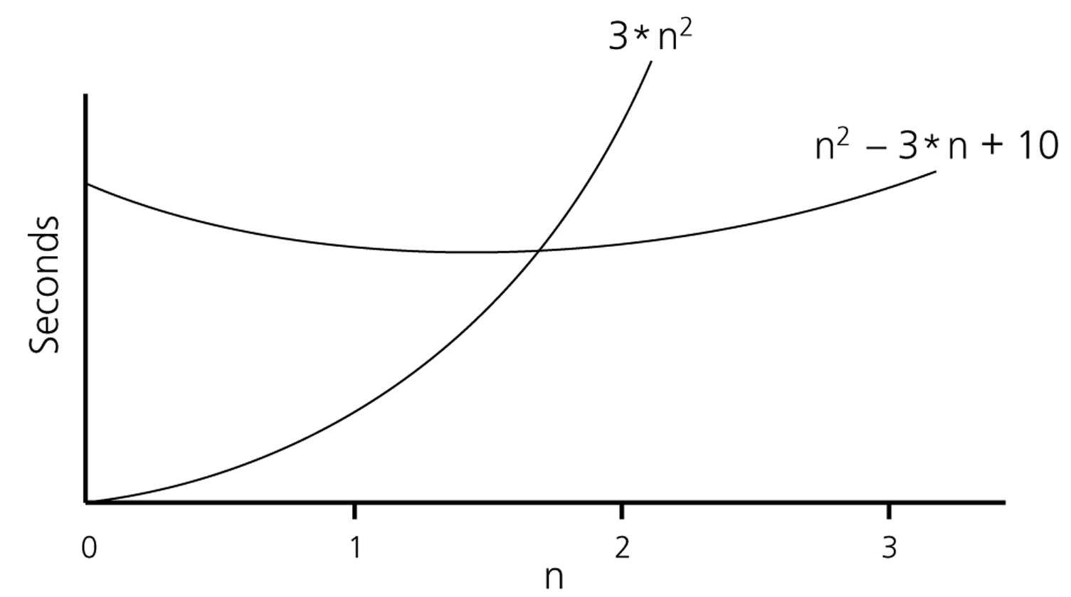
Order of an Algorithm

Slide 20
Order of an Algorithm
Show 2^{x} + 17 is O(2^{x})
2^{x} + 17 ≤ 2^{x} + 2^{x} = 2*2^{x} for x > 5
Hence k = 2 and n₀ = 5

Slide 21
Order of an Algorithm
Show 2^{x} + 17 is O(3^{x})
2^{x} + 17 ≤ k3^{x}
Easy to see that rhs grows faster than lhs over time → k=1
However when x is small 17 will still dominate → skip over some smaller values of x by using n₀ = 2
Hence k = 1 and n₀ = 2

Slide 22
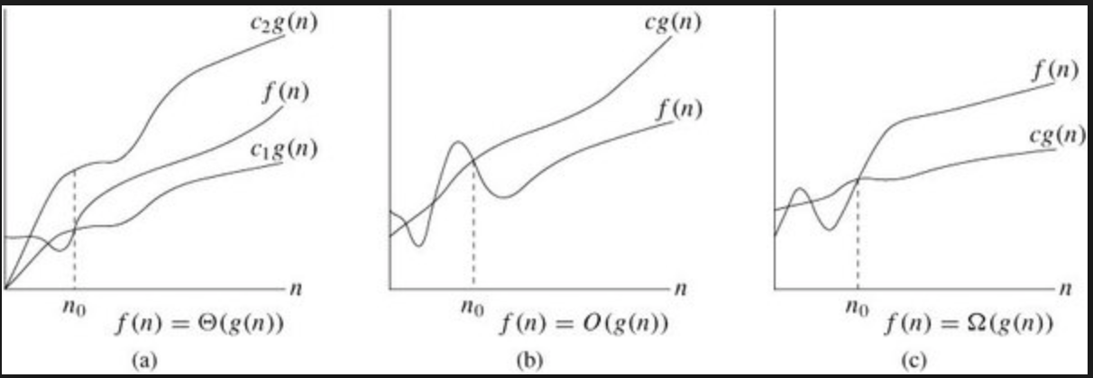
Definition of the Order of an Algorithm
Definition:
Algorithm A is omega g(n) – denoted as Ω(g(n)) – if constants k and n₀ exist such that A requires more than k*g(n) time units to solve a problem of size n ≥ n₀. ➔ f(n) ≥ k*g(n) for all n ≥ n₀

Slide 23
Definition of the Order of an Algorithm
Definition: The function f(n) = Θ(g(n)) if and only if there exist positive constants c1, c2, n0 such that c1g(n) ≤ f(n) ≤ c2g(n), ∀n ≥ n0. Theta can be used to denote tight bounds of an algorithm. i.e., g(n) is a lower bound as well as an upper bound for f(n).
Note that f(n) = Θ(g(n)) if and only if f(n) = Ω(g(n)) and f(n) = O(g(n)).
23

Slide 24

Order of an Algorithm
Show f(n) = 7n² + 1 is 𝚹(n²)
You need to show f(n) is O(n²) and f(n) is Ω(n²)
f(n) is O(n²) because 7n² + 1 ≤ 7n² + n² ∀n ≥ 1 ➔ k₂ = 8 n₀ = 1
f(n) is Ω (n²) because 7n² + 1 ≥ 7n² ∀n ≥ 0 ➔ k₁ = 7 n₀ = 0
Pick the largest n₀ to satisfy both conditions naturally ➔ k₁ = 8, k₂ = 7, n₀ = 1

Slide 25
Growth-Rate Functions
O(1) Time requirement is constant, and it is independent of the problem’s size.
O(log₂n) Time requirement for a logarithmic algorithm increases increases slowly
as the problem size increases.
O(n) Time requirement for a linear algorithm increases directly with the size
of the problem.
O(n*log₂n) Time requirement for a n*log₂n algorithm increases more rapidly than
a linear algorithm.
O(n²) Time requirement for a quadratic algorithm increases rapidly with the
size of the problem.
O(n³) Time requirement for a cubic algorithm increases more rapidly with the
size of the problem than the time requirement for a quadratic algorithm.
O(2^{n}) As the size of the problem increases, the time requirement for an
exponential algorithm increases too rapidly to be practical.
25

Slide 26
Properties of Growth-Rate Functions
We can ignore low-order terms in an algorithm’s growth-rate function.
If an algorithm is O(n³+4n²+3n), it is also O(n³).
We only use the higher-order term as algorithm’s growth-rate function.
We can ignore a multiplicative constant in the higher-order term of an algorithm’s growth-rate function.
If an algorithm is O(5n³), it is also O(n³).
O(f(n)) + O(g(n)) = O(f(n)+g(n))
We can combine growth-rate functions.
If an algorithm is O(n³) + O(4n), it is also O(n³ +4n²) ➔ So, it is O(n³).
Similar rules hold for multiplication.

Slide 27
Growth-Rate Functions – Example1
Cost Times
i = 1; c1 1
sum = 0; c2 1
while (i <= n) { c3 n+1
i = i + 1; c4 n
sum = sum + i; c5 n
}
T(n) = c1 + c2 + (n+1)*c3 + n*c4 + n*c5
= (c3+c4+c5)*n + (c1+c2+c3)
= a*n + b
➔ So, the growth-rate function for this algorithm is O(n)
27

Slide 28
Growth-Rate Functions – Example2
Cost Times
i=1; c1 1
sum = 0; c2 1
while (i <= n) { c3 n+1
j=1; c4 n
while (j <= n) { c5 n*(n+1)
sum = sum + i; c6 n*n
j = j + 1; c7 n*n
}
i = i +1; c8 n
}
T(n) = c1 + c2 + (n+1)*c3 + n*c4 + n*(n+1)*c5+n*n*c6+n*n*c7+n*c8
= (c5+c6+c7)*n² + (c3+c4+c5+c8)*n + (c1+c2+c3)
= a*n² + b*n + c
➔ So, the growth-rate function for this algorithm is O(n²)
28

Slide 29
Growth-Rate Functions Recursive Algorithms
int fact(int n) {
if (n ==0)
return (1);
else
return (n * fact(n-1));
}
T(n) = T(n-1) + c
= (T(n-2) + c) + c
= (T(n-3) + c) + c + c
= (T(n-i) + i*c)
when i=n → T(0) + n*c ➔ T(n) = O(n)

Slide 30
Tracing the call fact (3)
N = 3 if (N==0) false return (3*fact(2))
After original call
N = 2 if (N==0) false return (2*fact(1))
N = 3 if (N==0) false return (3*fact(2))
After 1st call
N = 1 if (N==0) false return (1*fact(0))
N = 2 if (N==0) false return (2*fact(1))
N = 3 if (N==0) false return (3*fact(2))
After 2nd call
N = 0 if (N==0) true return (1)
N = 1 if (N==0) false return (1*fact(0))
N = 2 if (N==0) false return (2*fact(1))
N = 3 if (N==0) false return (3*fact(2))
After 3rd call

Slide 31
Tracing the call fact (3)
N = 1 if (N==0) false return (1* 1)
N = 2 if (N==0) false return (2*fact(1))
N = 3 if (N==0) false return (3*fact(2))
After return from 3rd call
N = 2 if (N==0) false return (2* 1)
N = 3 if (N==0) false return (3*fact(2))
After return from 2nd call
N = 3 if (N==0) false return (3* 2)
After return from 1st call
return 6

Slide 32
Sequential Search
int sequentialSearch(const int a[], int item, int n){
for (int i = 0; i < n && a[i]!= item; i++);
if (i == n)
return –1;
return i;
}
Unsuccessful Search: ➔ O(n)
Successful Search:
Best-Case: item is in the first location of the array ➔O(1)
Worst-Case: item is in the last location of the array ➔O(n)
Average-Case: The number of key comparisons 1, 2, ..., n
➔ O(n)

Slide 33
Binary Search
We can do binary search if the array is sorted:
int binarySearch(int a[], int size, int x) {
int low =0;
int high = size –1;
int mid; // mid will be the index of
// target when it’s found.
while (low <= high) {
mid = (low + high)/2;
if (a[mid] < x)
low = mid + 1;
else if (a[mid] > x)
high = mid – 1;
else
return mid;
}
return –1;
}
33

Slide 34
Binary Search – Analysis
For an unsuccessful search:
The number of iterations in the loop is ⎣log₂n⎦ + 1
➔ O(log₂n)
For a successful search:
Best-Case: The number of iterations is 1. ➔ O(1)
Worst-Case: The number of iterations is ⎣log₂n⎦ +1 ➔ O(log₂n)
Average-Case: The avg. # of iterations < log₂n ➔ O(log₂n)
0 1 2 3 4 5 6 ← an array with size 7
3 2 3 1 3 2 3 ← # of iterations
The average # of iterations = 17/7 = 2.4285 < log₂7
34

Slide 35
References
Data Structure and Algorithms for Electrical Engineering by Yung Yi
CENG707 - Data Structures and Algorithms by Yusuf Sahillioğlu

