Slide 1
Sorting Algorithms

Slide 2
Sorting – The Task
Given an array
x[0], x[1], … , x[size-1]
reorder entries so that
x[0] <= x[1] <= . . . <= x[size-1]
Here, List is in non-decreasing order.
We can also sort a list of elements in non-increasing order.

Slide 3
Sorting – Example
Original list:
10, 30, 20, 80, 70, 10, 60, 40, 70
Sorted in non-decreasing order:
10, 10, 20, 30, 40, 60, 70, 70, 80
Sorted in non-increasing order:
80, 70, 70, 60, 40, 30, 20, 10, 10

Slide 4
Sorting Problem
What do we want :
- Data to be sorted in order
0
size-1
x:
Unsorted list
Sorted list

Slide 5
Issues in Sorting
Many issues are there in sorting techniques
How to rearrange a given set of data?
Which data structures are more suitable to store data prior to their sorting?
How fast the sorting can be achieved?
How sorting can be done in a memory constraint situation?
How to sort various types of data?

Slide 6
Sorting Algorithms

Slide 7
Sorting by Comparison
Basic operation involved in this type of sorting technique is comparison. A data item is compared with other items in the list of items in order to find its place in the sorted list.
Insertion
Selection
Exchange
Enumeration

Slide 8
Sorting by Comparison
Sorting by comparison – Insertion:
From a given list of items, one item is considered at a time. The item chosen is then inserted into an appropriate position relative to the previously sorted items. The item can be inserted into the same list or to a different list.
e.g.: Insertion sort
Sorting by comparison – Selection:
First the smallest (or largest) item is located and it is separated from the rest; then the next smallest (or next largest) is selected and so on until all item are separated.
e.g.: Selection sort, Heap sort

Slide 9
Sorting by Comparison
Sorting by comparison – Exchange:
If two items are found to be out of order, they are interchanged. The process is repeated until no more exchange is required.
e.g.: Bubble sort, Shell Sort, Quick Sort
Sorting by comparison – Enumeration:
Two or more input lists are merged into an output list and while merging the items, an input list is chosen following the required sorting order.
e.g.: Merge sort

Slide 10
Sorting by Distribution
No key comparison takes place
All items under sorting are distributed over an auxiliary storage space based on the constituent element in each and then grouped them together to get the sorted list.
Distributions of items based on the following choices
Radix - An item is placed in a space decided by the bases (or radix) of its components with which it is composed of.
Counting - Items are sorted based on their relative counts.
Hashing - Items are hashed, that is, dispersed into a list based on a hash function.

Slide 11
Insertion Sort

Slide 12
Insertion Sort
General situation :
0
i
size-1
x:
smallest elements, sorted
remainder, unsorted
i
Compare and
Shift till x[i] is
larger.
i
0
j
size-1

Slide 13
Insertion Sort
void insertionSort (int list[], int size)
{
int i,j,item;
for (i=1; i<size; i++)
{
item = list[i] ;
/* Move elements of list[0..i-1], that are greater than item, to one position ahead of their current position */
for (j=i-1; (j>=0)&& (list[j] > item); j--)
list[j+1] = list[j];
list[j+1] = item ;
}
}

Slide 14
Insertion Sort
int main()
{
int x[ ]={-45,89,-65,87,0,3,-23,19,56,21,76,-50};
int i;
for(i=0;i<12;i++)
printf("%d ",x[i]);
printf("\n");
insertionSort(x,12);
for(i=0;i<12;i++)
printf("%d ",x[i]);
printf("\n");
}
OUTPUT
-45 89 -65 87 0 3 -23 19 56 21 76 -50
-65 -50 -45 -23 0 3 19 21 56 76 87 89

Slide 15
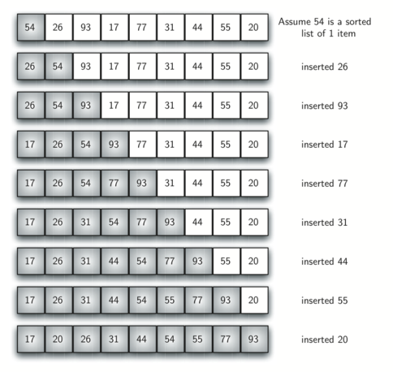
Insertion Sort - Example

Slide 16

Insertion Sort: Complexity Analysis
Case 1: If the input list is already in sorted order
Number of comparisons: Number of comparison in each iteration is 1.
Number of movement: No data movement takes place in any iteration.
$$M\left(n\right)=0$$
$C\left(n\right)=1+1+1+…+1$upto (n-1)^{th} iteration.

Slide 17
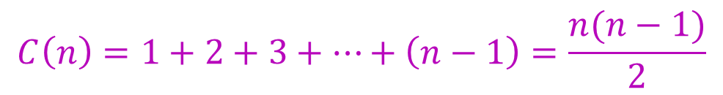

Insertion Sort: Complexity analysis
Case 2: If the input list is sorted but in reverse order
Number of comparisons: Number of comparison in each iteration is 1.
Number of movement: Number of movements takes place in any i^{th} iteration is i.
$$M\left(n\right)=1+2+3+…+\left(n−1\right)=\frac{n(n−1)}{2}$$
$$C\left(n\right)=1+2+3+…+\left(n−1\right)=\frac{n(n−1)}{2}$$

Slide 18

Insertion Sort: Complexity analysis
Case 3: If the input list is in random order
Let $p_{j}$be the probability that the key will go to the $jth$ location
$(1≤j≤i+1)$. Then the number of comparisons will be ${j∙p}_{j}$.
The average number of comparisons in the $(i+1)th$ iteration is
$$A_{i+1}=\sum_{j=1}^{i+1}{j∙p_{j}}$$
Assume that all keys are distinct and all permutations of keys are equally likely.
$$p_{1}=p_{2}=p_{3}=…=p_{i+1}=\frac{1}{i+1}$$

Slide 19

Insertion Sort: Complexity analysis
Case 3: Number of comparisons
Therefore, the average number of comparisons in the $(i+1)th$ iteration
$$A_{i+1}=\frac{1}{i+1}\sum_{j=1}^{i+1}{j}=\frac{1}{i+1}∙\frac{\left(i+1\right)∙\left(i+2\right)}{2}=\frac{i+2}{2}$$
Total number of comparisons for all $(n−1)$iterations is
$$C\left(n\right)=\sum_{i=0}^{n−1}{A_{i+1}}=\frac{1}{2}∙\frac{n\left(n−1\right)}{2}+(n−1)$$

Slide 20

Insertion Sort: Complexity analysis
Case 3: Number of Movements
On the average, number of movements in the $ith$ iteration
$$M_{i}=\frac{i+\left(i−1\right)+\left(i−2\right)+…+2+1}{i}=\frac{i+1}{2}$$
Total number of movements
$$M\left(n\right)=\sum_{i=1}^{n−1}{M_{i}}=\frac{1}{2}∙\frac{n\left(n−1\right)}{2}+\frac{n−1}{2}$$

Slide 21
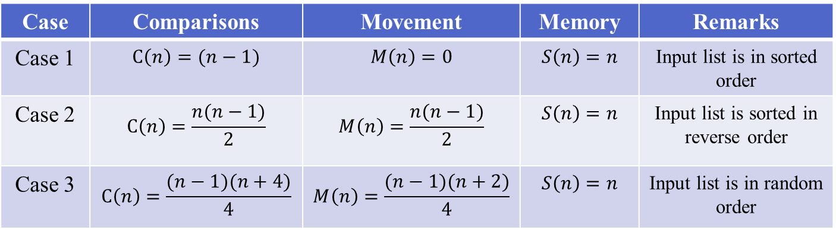
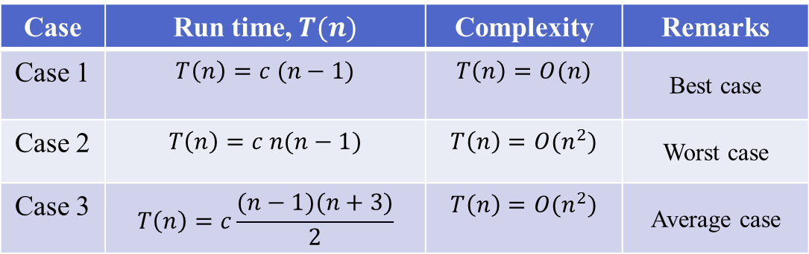
Insertion Sort: Summary of Complexity Analysis
Case | Comparisons | Movement | Memory | Remarks
Case 1 | $$C\left(n\right)=(n−1)$$ | $$M\left(n\right)=0$$ | $$S\left(n\right)=n$$ | Input list is in sorted order
Case 2 | $$C\left(n\right)=\frac{n(n−1)}{2}$$ | $$M\left(n\right)=\frac{n(n−1)}{2}$$ | $$S\left(n\right)=n$$ | Input list is sorted in reverse order
Case 3 | $$C\left(n\right)=\frac{(n−1)(n+4)}{4}$$ | $$M\left(n\right)=\frac{(n−1)(n+2)}{4}$$ | $$S\left(n\right)=n$$ | Input list is in random order
Case | Run time, $T(n)$ | Complexity | Remarks
Case 1 | $$T\left(n\right)=c (n−1)$$ | $$T\left(n\right)=O(n)$$ | Best case
Case 2 | $$T\left(n\right)=c n(n−1)$$ | $$T\left(n\right)=O(n^{2})$$ | Worst case
Case 3 | $$T\left(n\right)=c\frac{(n−1)(n+3)}{2}$$ | $$T\left(n\right)=O(n^{2})$$ | Average case

Slide 22
Selection Sort

Slide 23
Selection Sort
General situation :
0
k
size-1
x:
smallest elements, sorted
remainder, unsorted
Steps :
Find smallest element, mval, in x[k…size-1]
Swap smallest element with x[k], then increase k.
0
k
mval
size-1
x:
swap

Slide 24
Selection Sort
/* Yield location of smallest element in
x[k .. size-1];*/
int findMinLloc (int x[ ], int k, int size)
{
int j, pos; /* x[pos] is the smallest element found so far */
pos = k;
for (j=k+1; j<size; j++)
if (x[j] < x[pos])
pos = j;
return pos;
}

Slide 25
Selection Sort
/* The main sorting function */
/* Sort x[0..size-1] in non-decreasing order */
int selectionSort (int x[], int size)
{ int k, m;
for (k=0; k<size-1; k++)
{
m = findMinLoc(x, k, size);
temp = a[k];
a[k] = a[m];
a[m] = temp;
}
}

Slide 26
Selection Sort - Example
x:
3
12
-5
6
142
21
-17
45
x:
-17
-5
3
6
12
21
142
45
x:
-17
12
-5
6
142
21
3
45
x:
-17
-5
3
6
12
21
45
142
x:
-17
-5
12
6
142
21
3
45
x:
-17
-5
3
6
12
21
45
142
x:
-17
-5
3
6
142
21
12
45
x:
-17
-5
3
6
142
21
12
45
x:
-17
-5
3
6
12
21
142
45

Slide 27

Selection Sort: Complexity Analysis
Case 1: If the input list is already in sorted order
Number of comparisons:
$$C\left(n\right)=\sum_{i=1}^{n−1}{\left(n−i\right)= }\frac{n(n−1)}{2}$$
Number of movement: no data movement takes place in any iteration.
$$M\left(n\right)=0$$

Slide 28

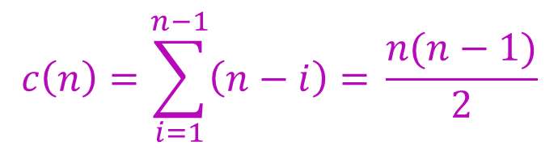
Selection Sort: Complexity Analysis
Case 2: If the input list is sorted but in reverse order
Number of comparisons:
Number of movements:
$$M\left(n\right)=\frac{3}{2}(n−1)$$
$$c\left(n\right)=\sum_{i=1}^{n−1}{\left(n−i\right)= }\frac{n(n−1)}{2}$$

Slide 29

Selection Sort: Complexity Analysis
Case 3: If the input list is in random order
Number of comparisons:
$$C\left(n\right)=\frac{n(n−1)}{2}$$
Let $p_{i}$be the probability that the $ith$ smallest element is in the $ith$ position. Number of total swap operations $=(1−p_{i})×(n−1)$
where $p_{1}=p_{2}=p_{3}=…=p_{n}=\frac{1}{n}$
Total number of movements
$$M\left(n\right)=\left(1−\frac{1}{n}\right)×\left(n−1\right)×3=\frac{3(n−1)(n−1)}{n}$$

Slide 30
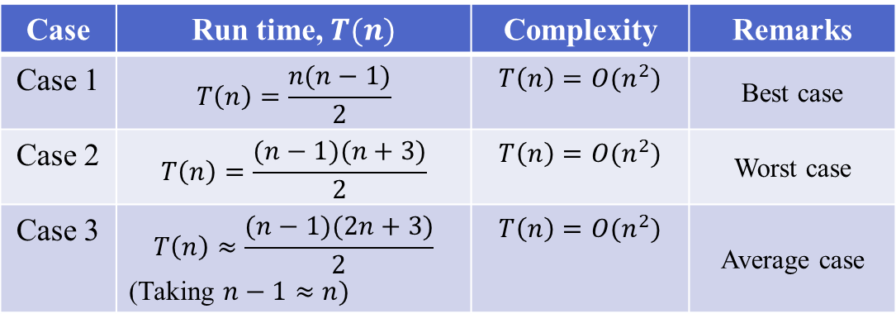
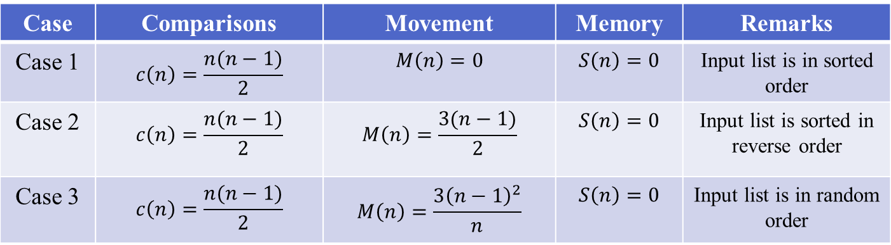
Selection Sort: Summary of Complexity analysis
Case | Comparisons | Movement | Memory | Remarks
Case 1 | $$c\left(n\right)=\frac{n(n−1)}{2}$$ | $$M\left(n\right)=0$$ | $$S\left(n\right)=0$$ | Input list is in sorted order
Case 2 | $$c\left(n\right)=\frac{n(n−1)}{2}$$ | $$M\left(n\right)=\frac{3(n−1)}{2}$$ | $$S\left(n\right)=0$$ | Input list is sorted in reverse order
Case 3 | $$c\left(n\right)=\frac{n(n−1)}{2}$$ | $$M\left(n\right)=\frac{{3\left(n−1\right)}^{2}}{n}$$ | $$S\left(n\right)=0$$ | Input list is in random order
Case | Run time, $T(n)$ | Complexity | Remarks
Case 1 | $$T\left(n\right)=\frac{n(n−1)}{2}$$ | $$T\left(n\right)=O(n^{2})$$ | Best case
Case 2 | $$T\left(n\right)=\frac{(n−1)(n+3)}{2}$$ | $$T\left(n\right)=O(n^{2})$$ | Worst case
Case 3 | $$T\left(n\right)≈\frac{(n−1)(2n+3)}{2}$$ (Taking $n−1≈n)$ | $$T\left(n\right)=O(n^{2})$$ | Average case

Slide 31
Bubble Sort

Slide 32
Bubble Sort
In every iteration heaviest element drops at the bottom.
The sorting process proceeds in several passes.
In every pass we go on comparing neighbouring pairs, and swap them if out of order.
In every pass, the largest of the elements under considering will bubble to the top (i.e., the right).
The bottom moves upward.

Slide 33
Bubble Sort
How the passes proceed?
In pass 1, we consider index 0 to n-1.
In pass 2, we consider index 0 to n-2.
In pass 3, we consider index 0 to n-3.
……
……
In pass n-1, we consider index 0 to 1.

Slide 34
Bubble Sort - Example
Pass: 1
x:
3
12
-5
6
72
21
-7
45
x:
3
-5
6
12
72
21
-7
45
x:
3
12
-5
6
72
21
-7
45
x:
3
-5
6
12
21
72
-7
45
x:
3
-5
12
6
72
21
-7
45
x:
3
-5
6
12
21
-7
72
45
x:
3
-5
6
12
72
21
-7
45
x:
3
-5
6
12
21
-7
45
72

Slide 35
Bubble Sort - Example
Pass: 2
x:
3
-5
6
12
21
-7
45
72
x:
-5
3
6
12
21
-7
45
72
x:
-5
3
6
12
21
-7
45
72
x:
-5
3
6
12
-7
21
45
72
x:
-5
3
6
12
21
-7
45
72
x:
-5
3
6
12
-7
21
45
72
x:
-5
3
6
12
21
-7
45
72

Slide 36
Bubble Sort
void swap(int *x, int *y)
{
int tmp = *x;
*x = *y;
*y = tmp;
}
void bubble_sort(int x[], int n)
{
int i,j;
for (i=n-1; i>0; i--)
for (j=0; j<i; j++)
if (x[j] > x[j+1])
swap(&x[j],&x[j+1]);
}

Slide 37
Bubble Sort
int main()
{
int x[ ]={-45,89,-65,87,0,3,-23,19,56,21,76,-50};
int i;
for(i=0;i<12;i++)
printf("%d ",x[i]);
printf("\n");
bubble_sort(x,12);
for(i=0;i<12;i++)
printf("%d ",x[i]);
printf("\n");
}
OUTPUT
-45 89 -65 87 0 3 -23 19 56 21 76 -50
-65 -50 -45 -23 0 3 19 21 56 76 87 89

Slide 38

Bubble Sort: Complexity analysis
Case 1: If the input list is already in sorted order
Number of comparisons:
$$C\left(n\right)=\frac{n(n−1)}{2}$$
Number of movements:
$$M\left(n\right)=0$$

Slide 39
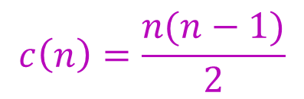

Bubble Sort: Complexity analysis
Case 2: If the input list is sorted but in reverse order
Number of comparisons:
Number of movements:
$$M\left(n\right)=\frac{n(n−1)}{2}$$
$$c\left(n\right)=\frac{n(n−1)}{2}$$

Slide 40

Bubble Sort: Complexity analysis
Case 3: If the input list is in random order
Number of comparisons:
$$C\left(n\right)=\frac{n(n−1)}{2}$$
Number of movements:
Let $p_{j}$be the probability that the largest element is in the unsorted part is in $jth$ $(1≤j≤n−i+1)$ location.
The average number of swaps in the $ith$ pass is
$$=\sum_{j=1}^{n−i+1}{\left(\overline{n−i+1}−j\right)}∙p_{j}$$

Slide 41

Bubble Sort: Complexity analysis
Case 3: If the input list is in random order
Number of movements:
$p_{1}=p_{2}=p_{n−i+1}=\frac{1}{n−i+1}$
Therefore, the average number of swaps in the $ith$ pass is
$$=\sum_{j=1}^{n−i+1}{\frac{1}{n−i+1}∙\left(\overline{n−i+1}−j\right)}=\frac{n−i}{2}$$
The average number of movements
$$M(n)=\sum_{i=1}^{n−1}{\frac{n−i}{2}=\frac{n(n−1)}{4}}$$

Slide 42
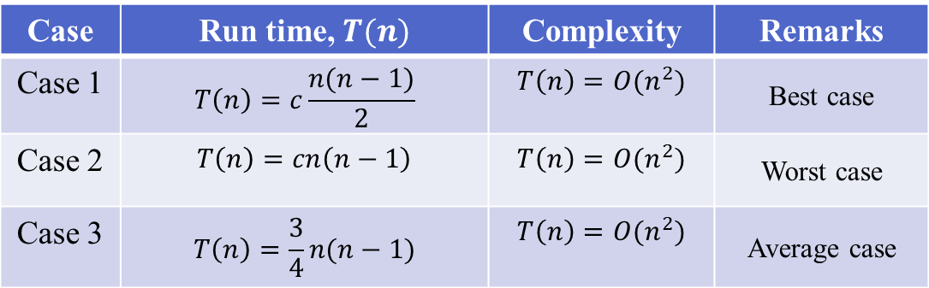
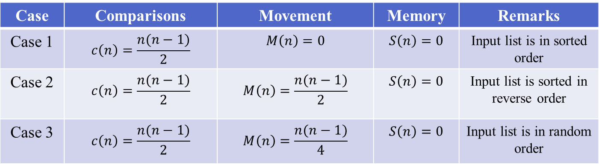
Bubble Sort: Summary of Complexity analysis
Case | Comparisons | Movement | Memory | Remarks
Case 1 | $$c\left(n\right)=\frac{n(n−1)}{2}$$ | $$M\left(n\right)=0$$ | $$S\left(n\right)=0$$ | Input list is in sorted order
Case 2 | $$c\left(n\right)=\frac{n(n−1)}{2}$$ | $$M\left(n\right)=\frac{n(n−1)}{2}$$ | $$S\left(n\right)=0$$ | Input list is sorted in reverse order
Case 3 | $$c\left(n\right)=\frac{n(n−1)}{2}$$ | $$M\left(n\right)=\frac{n(n−1)}{4}$$ | $$S\left(n\right)=0$$ | Input list is in random order
Case | Run time, $T(n)$ | Complexity | Remarks
Case 1 | $$T\left(n\right)=c\frac{n(n−1)}{2}$$ | $$T\left(n\right)=O(n^{2})$$ | Best case
Case 2 | $$T\left(n\right)=cn\left(n−1\right)$$ | $$T\left(n\right)=O(n^{2})$$ | Worst case
Case 3 | $$T\left(n\right)=\frac{3}{4}n(n−1)$$ | $$T\left(n\right)=O(n^{2})$$ | Average case

Slide 43
Bubble Sort
How do you make best case with (n-1) comparisons only?
By maintaining a variable flag, to check if there has been any swaps in a given pass.
If not, the array is already sorted.

Slide 44
Bubble Sort
void bubble_sort(int x[], int n)
{
int i,j;
int flag = 0;
for (i=n-1; i>0; i--)
{
for (j=0; j<i; j++)
if (x[j] > x[j+1])
{
swap(&x[j],&x[j+1]);
flag = 1;
}
if (flag == 0) return;
}
}

Slide 45
What is Divide and Conquer?
Divide-and conquer is a general algorithm design paradigm:
Divide: divide the input data S in two or more disjoint subsets S₁, S₂, …
Recur: solve the subproblems recursively
Conquer: combine the solutions for S₁, S₂, …, into a solution for S
The base case for the recursion are subproblems of constant size
Analysis can be done using recurrence equations

Slide 46
Efficient Sorting algorithms
Two of the most popular sorting algorithms are based on divide-and-conquer approach.
Quick sort
Merge sort
Basic concept of divide-and-conquer method:
sort (list)
{
if the list has length greater than 1
{
Partition the list into lowlist and highlist;
sort (lowlist);
sort (highlist);
combine (lowlist, highlist);
}
}

Slide 47
Quick Sort

Slide 48
Quick Sort – How it Works?
At every step, we select a pivot element in the list (usually the first element).
We put the pivot element in the final position of the sorted list.
All the elements less than or equal to the pivot element are to the left.
All the elements greater than the pivot element are to the right.

Slide 49
Quick Sort Partitioning
0
size-1
x:
pivot
Values smaller
Values greater
Perform
partitioning
Perform
partitioning

Slide 50
Quick Sort
#include <stdio.h>
void quickSort( int[], int, int);
int partition( int[], int, int);
void main()
{
int i,a[] = { 7, 12, 1, -2, 0, 15, 4, 11, 9};
printf("\n\nUnsorted array is: ");
for(i = 0; i < 9; ++i)
printf(" %d ", a[i]);
quickSort( a, 0, 8);
printf("\n\nSorted array is: ");
for(i = 0; i < 9; ++i)
printf(" %d ", a[i]);
}
void quickSort( int a[], int l, int r)
{
int j;
if( l < r ) { // divide and conquer
j = partition( a, l, r);
quickSort( a, l, j-1);
quickSort( a, j+1, r);
}
}

Slide 51
Quick Sort
int partition( int a[], int l, int r)
{
int pivot, i, j, t;
pivot = a[l];
i = l;
j = r+1;
while( 1) {
do {
++i;
} while(a[i]<=pivot && i<=r);
do {
--j;
} while( a[j] > pivot );
if( i >= j ) break;
t = a[i];
a[i] = a[j];
a[j] = t;
}
t = a[l];
a[l] = a[j];
a[j] = t;
return j;
}

Slide 52
Example
We are given array of n integers to sort:
40
20
10
80
60
50
7
30
100

Slide 53
Pick Pivot Element
There are a number of ways to pick the pivot element. In this example, we will use the first element in the array:
40
20
10
80
60
50
7
30
100

Slide 54
pivot_index = 0
40
20
10
80
60
50
7
30
100
[0] [1] [2] [3] [4] [5] [6] [7] [8]
i
j

Slide 55
pivot_index = 0
40
20
10
80
60
50
7
30
100
[0] [1] [2] [3] [4] [5] [6] [7] [8]
i
j

Slide 56
pivot_index = 0
40
20
10
80
60
50
7
30
100
[0] [1] [2] [3] [4] [5] [6] [7] [8]
i
j

Slide 57
pivot_index = 0
40
20
10
80
60
50
7
30
100
[0] [1] [2] [3] [4] [5] [6] [7] [8]
i
j

Slide 58
pivot_index = 0
40
20
10
80
60
50
7
30
100
[0] [1] [2] [3] [4] [5] [6] [7] [8]
i
j

Slide 59
pivot_index = 0
40
20
10
30
60
50
7
80
100
[0] [1] [2] [3] [4] [5] [6] [7] [8]
i
j

Slide 60
pivot_index = 0
40
20
10
30
60
50
7
80
100
[0] [1] [2] [3] [4] [5] [6] [7] [8]
i
j

Slide 61
pivot_index = 0
40
20
10
30
60
50
7
80
100
[0] [1] [2] [3] [4] [5] [6] [7] [8]
i
j

Slide 62
pivot_index = 0
40
20
10
30
60
50
7
80
100
[0] [1] [2] [3] [4] [5] [6] [7] [8]
o
j

Slide 63
pivot_index = 0
40
20
10
30
60
50
7
80
100
[0] [1] [2] [3] [4] [5] [6] [7] [8]
i
j

Slide 64
pivot_index = 0
40
20
10
30
60
50
7
80
100
[0] [1] [2] [3] [4] [5] [6] [7] [8]
i
j

Slide 65
pivot_index = 0
40
20
10
30
60
50
7
80
100
[0] [1] [2] [3] [4] [5] [6] [7] [8]
i
j

Slide 66
pivot_index = 0
40
20
10
30
7
50
60
80
100
[0] [1] [2] [3] [4] [5] [6] [7] [8]
i
j

Slide 67
pivot_index = 0
40
20
10
30
7
50
60
80
100
[0] [1] [2] [3] [4] [5] [6] [7] [8]
i
j

Slide 68
pivot_index = 0
40
20
10
30
7
50
60
80
100
[0] [1] [2] [3] [4] [5] [6] [7] [8]
i
j

Slide 69
pivot_index = 0
40
20
10
30
7
50
60
80
100
[0] [1] [2] [3] [4] [5] [6] [7] [8]
i
j

Slide 70
pivot_index = 0
40
20
10
30
7
50
60
80
100
[0] [1] [2] [3] [4] [5] [6] [7] [8]
i
j

Slide 71
pivot_index = 0
40
20
10
30
7
50
60
80
100
[0] [1] [2] [3] [4] [5] [6] [7] [8]
i
j

Slide 72
pivot_index = 0
40
20
10
30
7
50
60
80
100
[0] [1] [2] [3] [4] [5] [6] [7] [8]
i
j

Slide 73
pivot_index = 0
40
20
10
30
7
50
60
80
100
[0] [1] [2] [3] [4] [5] [6] [7] [8]
j
i

Slide 74
Partition Result
7
20
10
30
40
50
60
80
100
[0] [1] [2] [3] [4] [5] [6] [7] [8]
<= data[pivot]
> data[pivot]

Slide 75
Recursion: Quicksort Sub-arrays
7
20
10
30
40
50
60
80
100
[0] [1] [2] [3] [4] [5] [6] [7] [8]
<= data[pivot]
> data[pivot]

Slide 76

Quick Sort: Complexity analysis
Memory requirement:
Size of the stack is:
$$S\left(n\right)=\left\lceil \log_{2 }n\right\rceil +1$$
Number of comparisons:
Let, $T(n)$represents total time to sort n elements and $P(n)$represents the time for perform a partition of a list of $n$elements.
$T\left(n\right)=P\left(n\right)+T\left(n_{l}\right)+T\left(n_{r}\right)$, with $T\left(1\right)=T\left(0\right)=0$
where, $n_{l}$ = number of elements in the left sub list
$n_{r}$ = number of elements in the right sub list and $0 ≤ n_{l}$, $n_{r}<n$

Slide 77
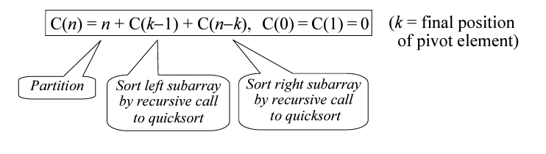
Quick Sort: Complexity analysis

Slide 78

Quick Sort: Complexity analysis
Case 1: Elements in the list are in ascending order
Number of comparisons:
$C\left(n\right)=n−1+C\left(n−1\right),$ with $C\left(1\right)=$ $C\left(0\right)=0$
$$C\left(n\right)=\left(n−1\right)+\left(n−2\right)+\left(n−3\right)+…+2+1$$
$$C\left(n\right)=\frac{n(n−1)}{2}$$
Number of movements:
$$M\left(n\right)=0$$

Slide 79
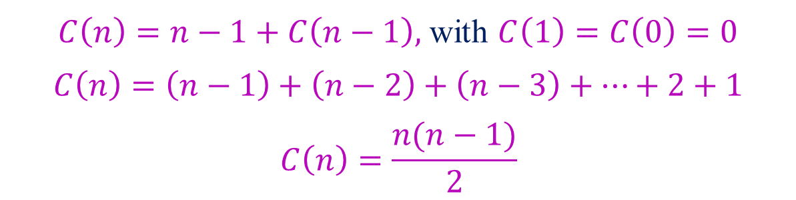

Quick Sort: Complexity analysis
Case 2: Elements in the list are in reverse order
Number of comparisons:
Number of movements:
$$M\left(n\right)=\left\{\begin{aligned}\frac{n−1}{2}, if n is odd \\ \frac{n}{2}, if n is even \end{aligned}\right.$$
$C\left(n\right)=n−1+C\left(n−1\right),$ with $C\left(1\right)=$ $C\left(0\right)=0$
$$C\left(n\right)=\left(n−1\right)+\left(n−2\right)+\left(n−3\right)+…+2+1$$
$$C\left(n\right)=\frac{n(n−1)}{2}$$

Slide 80

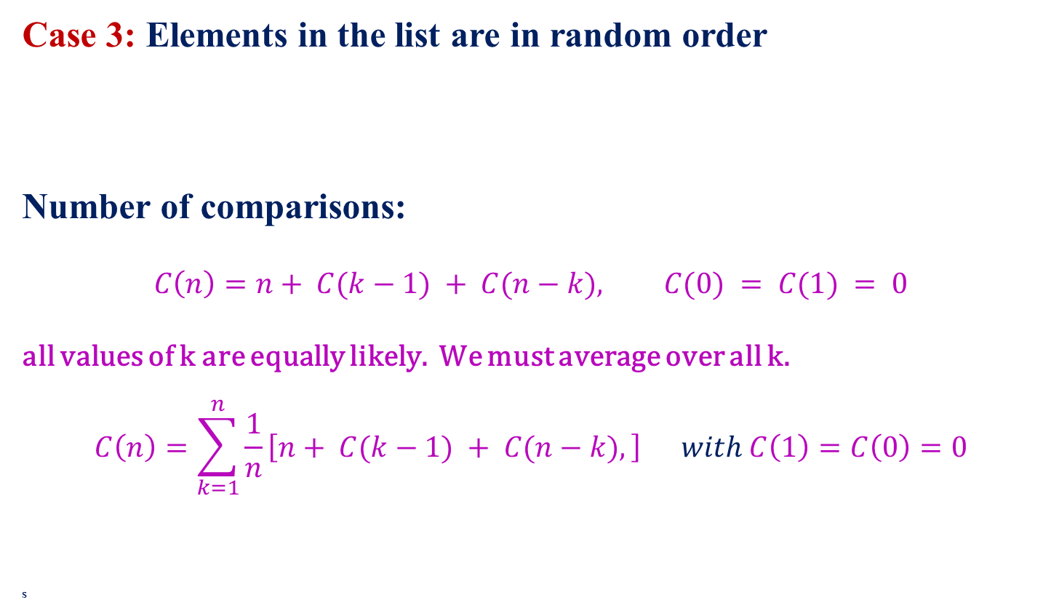
Quick Sort: Complexity analysis
Case 3: Elements in the list are in random order
Number of comparisons:
$$C\left(n\right)=n+ C(k−1) + C(n−k), C(0) = C(1) = 0$$
all values of k are equally likely. We must average over all k.
$$C\left(n\right)=\sum_{k=1}^{n}{\frac{1}{n}}\left[n+ C(k−1) + C(n−k),\right] with C\left(1\right)=C\left(0\right)=0$$
s
$ith$ location
(i-1)
(n-i)

Slide 81
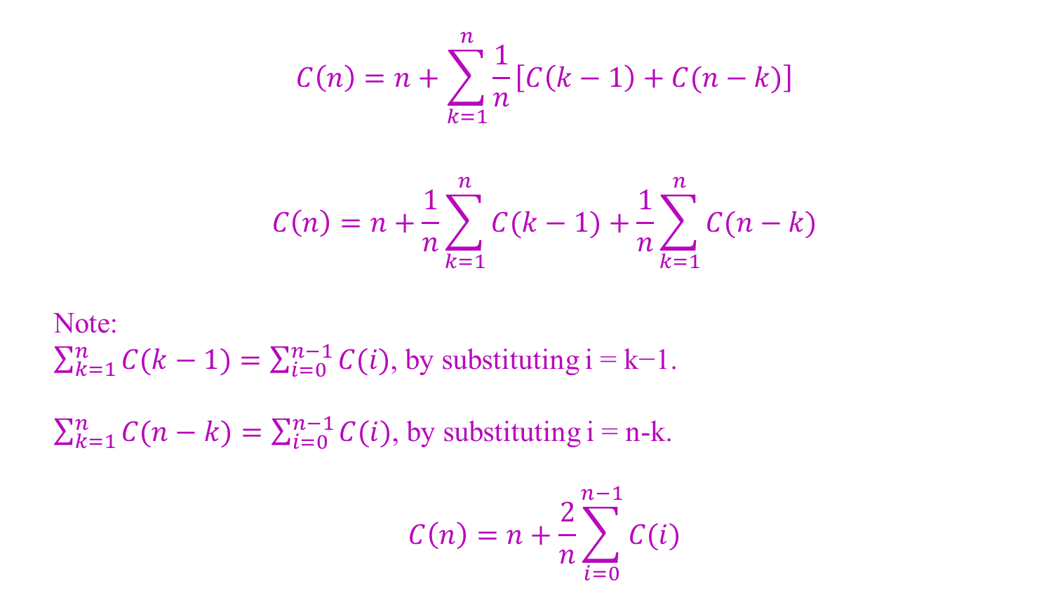
Quick Sort: Complexity analysis
$$C\left(n\right)=n+\sum_{k=1}^{n}{\frac{1}{n}}\left[C\left(k−1\right)+C(n−k)\right]$$
$$C\left(n\right)=n+\frac{1}{n}\sum_{k=1}^{n}{C(k−1)}+\frac{1}{n}\sum_{k=1}^{n}{C(n−k)}$$
Note:
$\sum_{k=1}^{n}{C(k−1)}=\sum_{i=0}^{n−1}{C(i)}$, by substituting i = k−1.
$\sum_{k=1}^{n}{C(n−k)}=\sum_{i=0}^{n−1}{C(i)}$, by substituting i = n-k.
$$C\left(n\right)=n+\frac{2}{n}\sum_{i=0}^{n−1}{C(i)}$$

Slide 82

Quick Sort: Complexity analysis
$$C\left(n\right)=n+\frac{2}{n}\sum_{i=0}^{n−1}{C(i)}$$
$$nC\left(n\right)=n^{2}+2\sum_{i=0}^{n−1}{C\left(i\right)}…..(1)$$
Writing down the same recurrence with n−1 replacing n, we get
$$(n−1)C\left(n−1\right)={\left(n−1\right)}^{2}+2\sum_{i=0}^{n−2}{C(i)………….(2)}$$
– (2)
$$nC\left(n\right)−\left(n−1\right)C\left(n−1\right)=n^{2}−{\left(n−1\right)}^{2}+2C\left(n−1\right)$$
$$nC\left(n\right)=2n−1+\left(n+1\right)C\left(n−1\right)$$
1.39n lg(n)/6 ≈ 0.23 n lg(n) exchanges.

Slide 83

Quick Sort: Complexity analysis
$$\frac{C\left(n\right)}{n+1}=\frac{2cn}{n(n+1)}+\frac{C\left(n−1\right)}{n}$$
$$\frac{C\left(n\right)}{n+1}=\frac{2c}{(n+1)}+\frac{C\left(n−1\right)}{n}$$

Slide 84
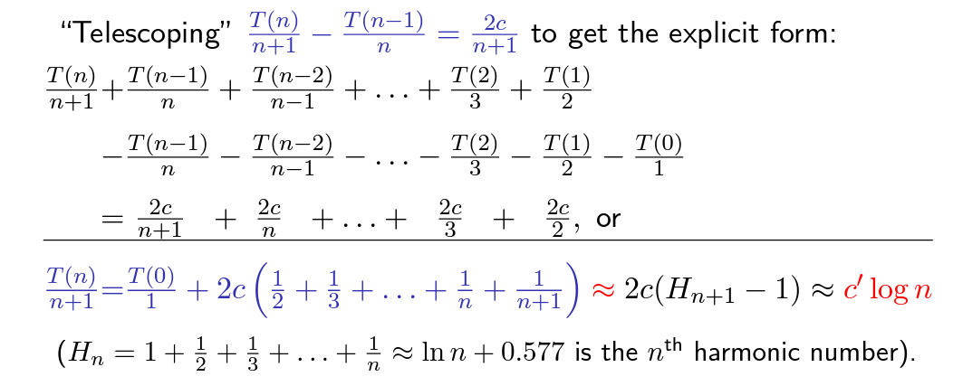

Quick Sort: Complexity analysis
$$\frac{C\left(n\right)}{n+1}=\frac{2c}{(n+1)}+\frac{C\left(n−1\right)}{n}$$

Slide 85

Quick Sort: Complexity analysis
Case 3: Elements in the list are in random order
Number of movements:
$$M\left(n\right)=\frac{1}{n}\sum_{i=1}^{n}{\left[\left(i−1\right)+M\left(i−1\right)+M(n−i)\right]}$$
$$M\left(n\right)=\frac{n−1}{2}+\frac{2}{n}\sum_{i=1}^{n−1}{M(i)}$$
$$M\left(n\right)=2\left(n+1\right)\left(\log_{e}n+0.577\right)−4n$$

Slide 86
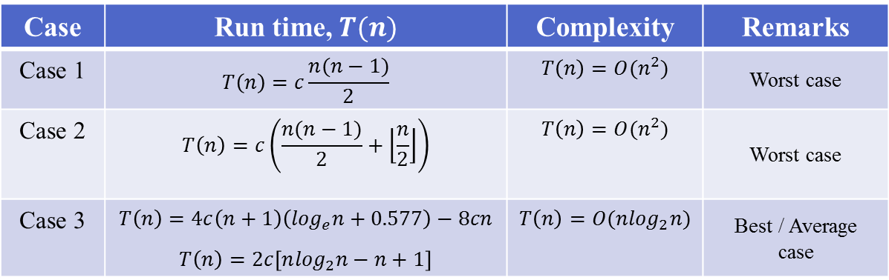
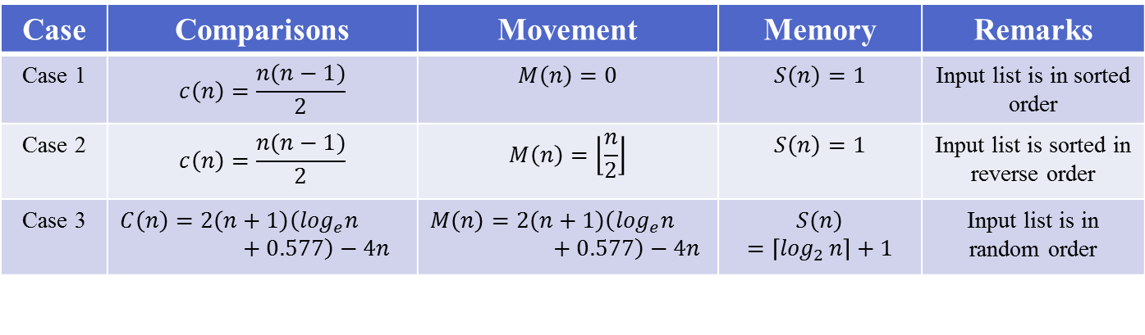
Quick Sort: Summary of Complexity analysis
Case | Comparisons | Movement | Memory | Remarks
Case 1 | $$c\left(n\right)=\frac{n(n−1)}{2}$$ | $$M\left(n\right)=0$$ | $$S\left(n\right)=1$$ | Input list is in sorted order
Case 2 | $$c\left(n\right)=\frac{n(n−1)}{2}$$ | $$M\left(n\right)=\left\lfloor \frac{n}{2}\right\rfloor$$ | $$S\left(n\right)=1$$ | Input list is sorted in reverse order
Case 3 | $$C\left(n\right)=2\left(n+1\right)\left(\log_{e}n+0.577\right)−4n$$ | $$M\left(n\right)=2\left(n+1\right)\left(\log_{e}n+0.577\right)−4n$$ | $$S\left(n\right)=\left\lceil \log_{2 }n\right\rceil +1$$ | Input list is in random order
Case | Run time, $T(n)$ | Complexity | Remarks
Case 1 | $$T\left(n\right)=c\frac{n(n−1)}{2}$$ | $$T\left(n\right)=O(n^{2})$$ | Worst case
Case 2 | $$T\left(n\right)=c\left(\frac{n(n−1)}{2}+\left\lfloor \frac{n}{2}\right\rfloor \right)$$ | $$T\left(n\right)=O(n^{2})$$ | Worst case
Case 3 | $$T\left(n\right)=4c\left(n+1\right)\left(\log_{e}n+0.577\right)−8cn$$ $$T\left(n\right)=2c\left[n\log_{2}n−n+1\right]$$ | $$T\left(n\right)=O(n\log_{2}n)$$ | Best / Average case

Slide 87
Merge Sort

Slide 88
Merge Sort – How it Works?
Input Array
Part-I
Part-II
Part-I
Part-II
Part-I
Part-II
Merge
Sorted arrays
Split

Slide 89



Merging two Sorted arrays
$$Pa$$
$$Pb$$
a:
Sorted Array
b:
Sorted Array
0
l
0
m
c:
Merged sorted array
0
l+m-1
Move and copy elements pointed by $Pa$ if its value is smaller
than the element pointed by $Pb$ in $(l+m−1)$operations and otherwise.

Slide 90
Merge Sort – Example
x:
3
12
-5
6
72
21
-7
45
Splitting arrays
3
12
-5
6
72
21
-7
45
3
12
-5
6
72
21
-7
45
3
12
-5
6
72
21
-7
45
Merging two
sorted arrays
3
12
-5
6
21
72
-7
45
-5
3
6
12
-7
21
45
72
-7
-7
-5
-5
3
3
6
12
21
45
72

Slide 91
Merge Sort Program
#include<stdio.h>
void mergesort(int a[],int i,int j);
void merge(int a[],int i1,int j1,int i2,int j2);
int main()
{
int a[30],n,i;
printf("Enter no of elements:");
scanf("%d",&n);
printf("Enter array elements:");
for(i=0;i<n;i++)
scanf("%d",&a[i]);
mergesort(a,0,n-1);
printf("\nSorted array is :");
for(i=0;i<n;i++)
printf("%d ",a[i]);
return 0;
}

Slide 92
Merge Sort Program
void mergesort(int a[],int i,int j)
{
int mid;
if(i<j) {
mid=(i+j)/2;
/* left recursion */
mergesort(a,i,mid);
/* right recursion */
mergesort(a,mid+1,j);
/* merging of two sorted sub-arrays */
merge(a,i,mid,mid+1,j);
}
}

Slide 93
Merge Sort Program
void merge(int a[],int i1,int i2,int j1,int j2)
{
int temp[50]; //array used for merging
int i=i1,j=j1,k=0;
while(i<=i2 && j<=j2) //while elements in both lists
{
if(a[i]<a[j])
temp[k++]=a[i++];
else
temp[k++]=a[j++];
}
while(i<=i2) //copy remaining elements of the first list
temp[k++]=a[i++];
while(j<=j2) //copy remaining elements of the second list
temp[k++]=a[j++];
for(i=i1,j=0;i<=j2;i++,j++)
a[i]=temp[j]; //Transfer elements from temp[] back to a[]
}

Slide 94
Merge Sort – Splitting Trace
-56 23 43 -5 -3 0 123 -35 87 56 75 80
-56 23 43 -5 -3 0
123 -35 87 56 75 80
-56 23 43
-5 -3 0
123 -35 87
56 75 80
23 43
-3 0
123
-35 87
56
75 80
-56
-5
23
43
-3
0
-35
87
75
80
Output: -56 -35 -5 -3 0 23 43 56 75 80 87 123
Space Complexity??
Worst Case: O(n.log(n))

Slide 95

Merge Sort: Complexity analysis
Time Complexity:
$T\left(n\right)=D\left(n\right)+T\left(\left\lfloor \frac{n}{2}\right\rfloor \right)+T\left(\left\lceil \frac{n}{2}\right\rceil \right)+C\left(n\right) if n>1$
$T\left(n\right)=c_{1} if n=1$
For simplicity of calculation
$T\left(\left\lfloor \frac{n}{2}\right\rfloor \right)=T\left(\left\lceil \frac{n}{2}\right\rceil \right)=T\left(\frac{n}{2}\right)$
$T\left(n\right)=c_{1} if n=1$
$T\left(n\right)=c_{2}+2T\left(\frac{n}{2}\right)+\left(n−1\right) if n>1$
$T\left(n\right)=n∙c_{1}+n\log_{2}n+\left(c_{2}−1\right)\left(n−1\right) Assuming n=2^{k}$

Slide 96
Quick Sort vs. Merge Sort
Quick sort
hard division, easy combination
partition in the divide step of the divide-and-conquer framework
hence combine step does nothing
Merge sort
easy division, hard combination
merge in the combine step
the divide step in this framework does one simple calculation only

Slide 97
Quick Sort vs. Merge Sort
Both the algorithms divide the problem into two sub problems.
Merge sort:
two sub problems are of almost equal size always.
Quick sort:
an equal sub division is not guaranteed.
This difference between the two sorting methods appears as the deciding factor of their run time performances.

