Slide 1
Counting Sort

Slide 2

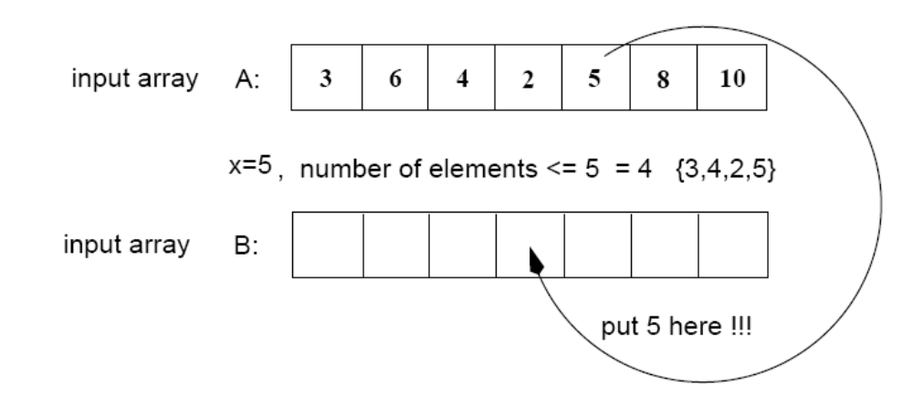
Counting Sort
Assumptions:
  Sort n integers which are in the range [0 ... r]
  r is in the order of n, that is, r=O(n)
Idea:
  For each element x, find the number of elements x
  Place x into its correct position in the output array
output array

Slide 3
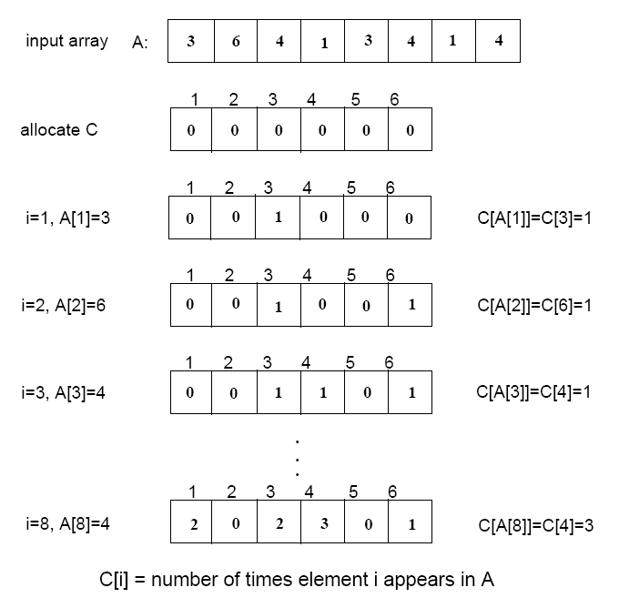
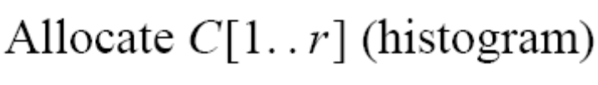

Step 1
(i.e., frequencies)

Slide 4
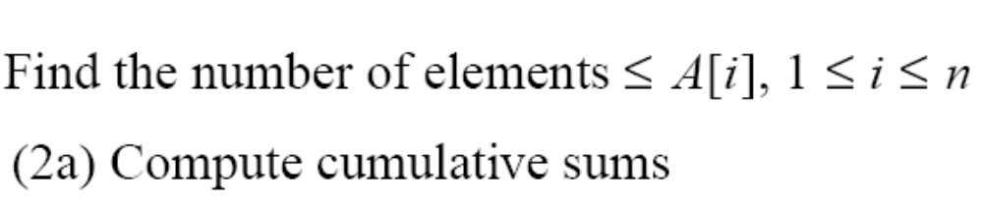
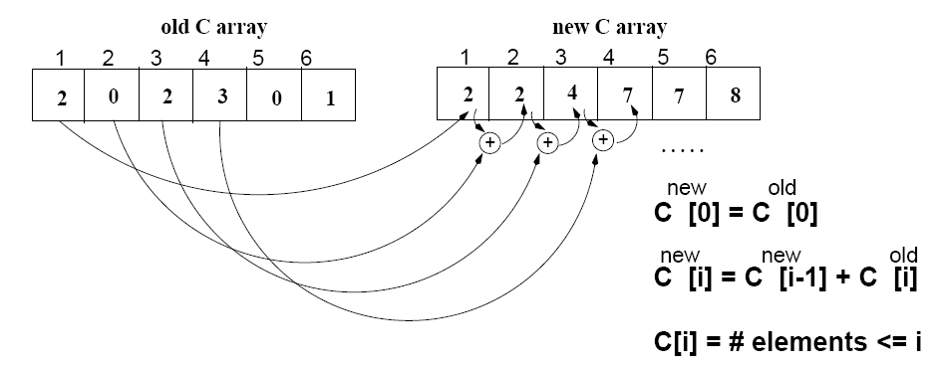
Step 2
(i.e., cumulative sums)

Slide 5
Algorithm
Start from the last element of A
Place A[i] at its correct place in the output array
Decrease C[A[i]] by one

Slide 6
Example
1
2
3
4
5
6
7
8
0
1
2
3
4
5
A
2
5
3
0
2
3
0
3
C
2
2
4
7
7
8
0
1
2
3
4
5
(cumulative sums)
C
2
0
2
3
0
1
(frequencies)
1
2
3
4
5
6
7
8
1
2
3
4
5
6
7
8
B
3
B
0
3
0
1
2
3
4
5
0
1
2
3
4
5
C
2
2
4
6
7
8
C
1
2
4
6
7
8
1
2
3
4
5
6
7
8
1
2
3
4
5
6
7
8
B
0
3
3
B
0
2
3
3
0
1
2
3
4
5
0
1
2
3
4
5
C
1
2
4
5
7
8
C
1
2
3
5
7
8

Slide 7
Example (cont.)
1
2
3
4
5
6
7
8
A
2
5
3
0
2
3
0
3
1
2
3
4
5
6
7
8
1
2
3
4
5
6
7
8
B
0
0
2
3
3
B
0
0
2
3
3
3
5
0
1
2
3
4
5
0
1
2
3
4
5
C
0
2
3
5
7
8
C
0
2
3
4
7
7
1
2
3
4
5
6
7
8
1
2
3
4
5
6
7
8
B
0
0
2
3
3
3
B
0
0
2
2
3
3
3
5
0
1
2
3
4
5
C
0
2
3
4
7
8

Slide 8
COUNTING-SORT
1
j
n
A
  Alg.: COUNTING-SORT(A, B, n, k)
  for i ← 0 to r
  do C[ i ] ← 0
  for j ← 1 to n
  do C[A[ j ]] ← C[A[ j ]] + 1
  C[i] contains the number of elements equal to i
  for i ← 1 to r
  do C[ i ] ← C[ i ] + C[i -1]
  C[i] contains the number of elements ≤ i
  for j ← n downto 1
  do B[C[A[ j ]]] ← A[ j ]
  C[A[ j ]] ← C[A[ j ]] - 1
0
k
C
1
n
B

Slide 9
Analysis of Counting Sort
  Alg.: COUNTING-SORT(A, B, n, k)
  for i ← 0 to r
  do C[ i ] ← 0
  for j ← 1 to n
  do C[A[ j ]] ← C[A[ j ]] + 1
  C[i] contains the number of elements equal to i
  for i ← 1 to r
  do C[ i ] ← C[ i ] + C[i -1]
  C[i] contains the number of elements ≤ i
  for j ← n downto 1
  do B[C[A[ j ]]] ← A[ j ]
  C[A[ j ]] ← C[A[ j ]] - 1
Θ(r)
Θ(n)
Θ(r)
Θ(n)
Overall time: Θ(n + r)

Slide 10
Analysis of Counting Sort
Overall time: Θ(n + r)
In practice we use COUNTING sort when r = O(n)
⇒ running time is Θ(n)
Counting sort is stable
Counting sort is not in place sort

Slide 11
Bucket Sort
Assumption:
  the input is generated by a random process that distributes elements uniformly over [0, 1)
Idea:
  Divide [0, 1) into n equal-sized buckets
  Distribute the n input values into the buckets
  Sort each bucket (e.g., using quicksort)
  Go through the buckets in order, listing elements in each one
Input: A[1 . . n], where 0 ≤ A[i] < 1 for all i
Output: elements A[i] sorted
Auxiliary array: B[0 . . n - 1] of linked lists, each list initially empty

Slide 12
Example - Bucket Sort
A
1
.78
.17
.39
.26
.72
.94
.21
.12
.23
.68
B
0
/
2
1
.17
.12 /
3
2
.26
.21
.23 /
4
3
.39 /
5
4
/
6
5
/
7
6
.68 /
8
7
.78
.72 /
9
8
/
10
9
.94 /

Slide 13
Example - Bucket Sort
.12
.17
.21
.23
.26
.39
.68
.72
.78
.94 /
0
/
1
.12
.17 /
2
.21
.23
.26 /
3
.39 /
4
/
5
/
6
.68 /
7
.72
.78 /
Concatenate the lists from
0 to n – 1 together, in order
8
/
9
.94 /

Slide 14
Correctness of Bucket Sort
Consider two elements A[i], A[ j]
Assume without loss of generality that A[i] ≤ A[j]
Then ⎣nA[i]⎦ ≤ ⎣nA[j]⎦
  A[i] belongs to the same bucket as A[j] or to a bucket with a lower index than that of A[j]
If A[i], A[j] belong to the same bucket:
  sorting puts them in the proper order
If A[i], A[j] are put in different buckets:
  concatenation of the lists puts them in the proper order

Slide 15
Analysis of Bucket Sort
Alg.: BUCKET-SORT(A, n)
for i ← 1 to n
do insert A[i] into list B[⎣nA[i]⎦]
for i ← 0 to n - 1
do sort list B[i] with quicksort sort
concatenate lists B[0], B[1], . . . , B[n -1] together in order
return the concatenated lists
O(n)
Θ(n)
O(n)
Θ(n)

