Slide 1
Dynamic Programming

Slide 2
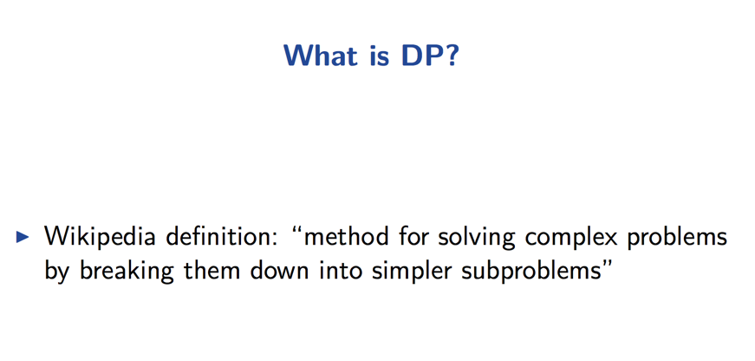

Slide 3
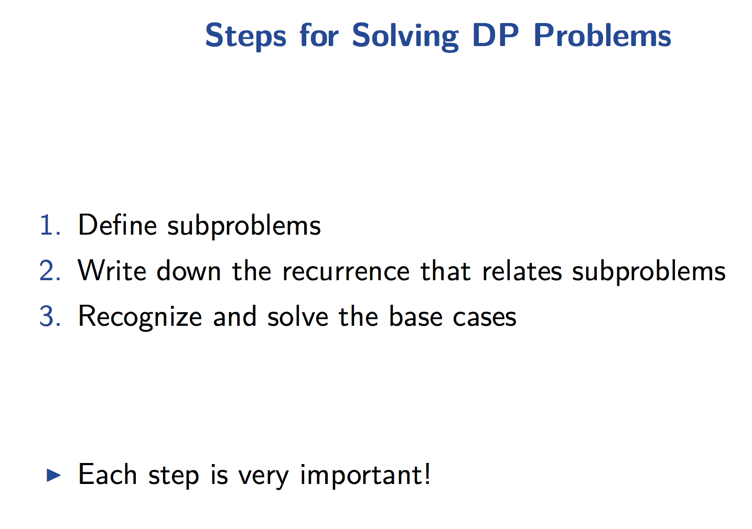

Slide 4
Greedy Algorithms
Greedy algorithms focus on making the best local choice at each decision point.
For example, a natural way to compute a shortest path from x to y might be to walk out of x, repeatedly following the cheapest edge until we get to y. WRONG!
In the absence of a correctness proof greedy algorithms are very likely to fail.

Slide 5
Recall Divide & Conquer
Five pillars of Divide and Conquer algorithms:
How to divide into sub-problems?
Conquer through recursion
How to recombine sub-results?
When to stop dividing?
Analysis using Master Theorem or Recurrence Relations

Slide 6
Dynamic Programming: Computing View
Not every sub-problem is new.
Save time: retain prior results.

Slide 7
Dynamic Programming: Computing View
A
B
C
B
E
F
G
E
G
H
E
F
G
Notes:
note the extensive repetition of sub problems. We solve e and g several times. Even worse, we solve b twice. DP trades memory for time by saving intermediate results.

Slide 8
Dynamic Programming: Computing View
A
B
C
B
E
F
G
E
G
H
E
F
G
start solving sub-problems at the bottom.
Notes:
this is the bottom up approach to DP. It works well with the tables we’ll be drawing later. We solve sub problems first.

Slide 9
Dynamic Programming: Computing View
A
E solution_{E}
F solution_{F}
G solution_{G}
B
C
B
E
F
G
E
G
H
E
F
G
Build a table of results as you go
Notes:
strictly speaking, we should have solved all the leaves before proceeding upward.

Slide 10
Dynamic Programming
A
E solution_{E}
F solution_{F}
G solution_{G}
B solution_{B}
B
C
B
E
F
G
E
G
H
E
F
G
Avoid recomputing intermediate results

Slide 11
Dynamic Programming:
A
A
B
C
B
B
C
E
F
G
E
G
H
E
F
G
E
F
G
H
Notes:
the second tree shows the work that actually gets done using a memory function.

Slide 12
Problem:
Let’s consider the calculation of Fibonacci numbers:
F(n) = F(n-2) + F(n-1)
with seed values F(1) = 1, F(2) = 1
or F(0) = 0, F(1) = 1
What would a series look like:
0, 1, 1, 2, 3, 4, 5, 8, 13, 21, 34, 55, 89, 144, …

Slide 13
Recursive Algorithm:
Fib(n)
{
if (n == 0)
return 0;
if (n == 1)
return 1;
Return Fib(n-1)+Fib(n-2)
}

Slide 14
Recursive Algorithm:
Fib(n)
{
if (n == 0)
return 0;
if (n == 1)
return 1;
Return Fib(n-1)+Fib(n-2)
}
It has a serious issue!

Slide 15
Recursion tree
What’s the problem?

Slide 16
Memoization:
Fib(n)
{
if (n == 0)
return M[0];
if (n == 1)
return M[1];
if (Fib(n-2) is not already calculated)
call Fib(n-2);
if(Fib(n-1) is already calculated)
call Fib(n-1);
//Store the ${n}^{th}$ Fibonacci no. in memory & use previous results.
M[n] = M[n-1] + M[n-2]
Return M[n];
}

Slide 17
already calculated …

Slide 18
Dynamic programming
- Main approach: recursive, holds answers to a sub problem in a
table, can be used without recomputing.
Can be formulated both via recursion and saving results in a
table (memoization). Typically, we first formulate the recursive
solution and then turn it into recursion plus dynamic
programming via memoization or bottom-up.
-”programming” as in tabular not programming code

Slide 19
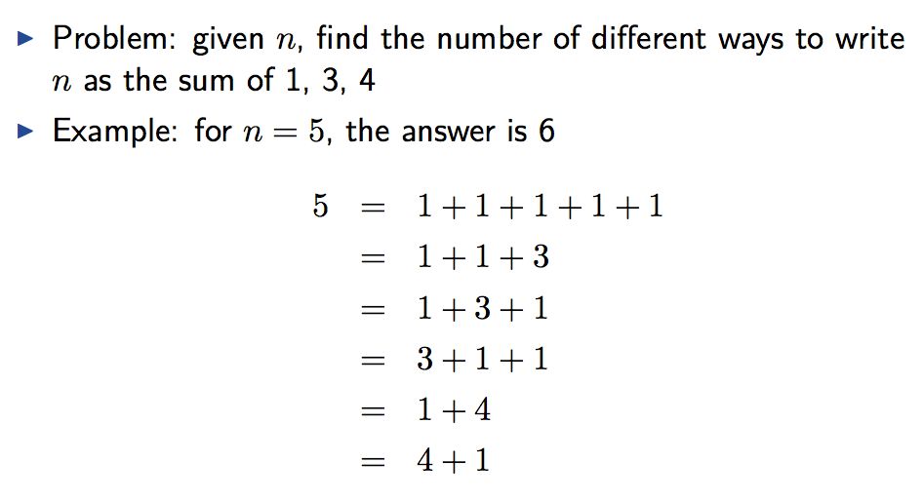
1-dimensional DP Problem

Slide 20
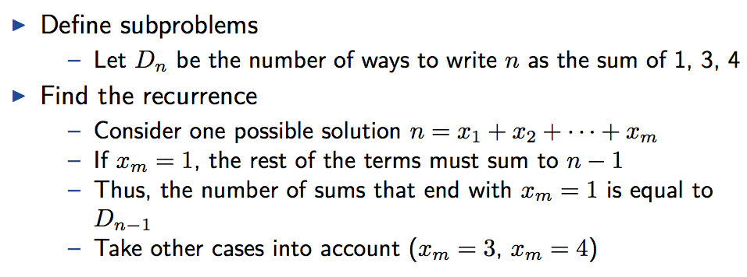
1-dimensional DP Problem

Slide 21
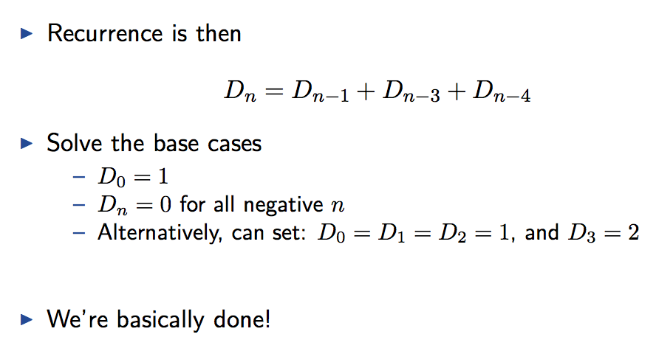
1-dimensional DP Problem

Slide 22
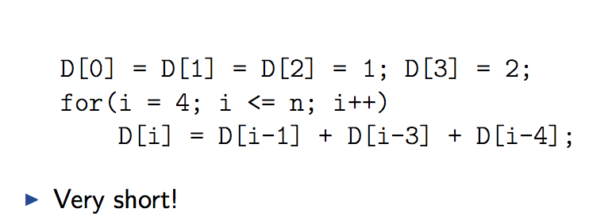
1-dimensional DP Problem

Slide 23
What happens when n is extremely large?

Slide 24
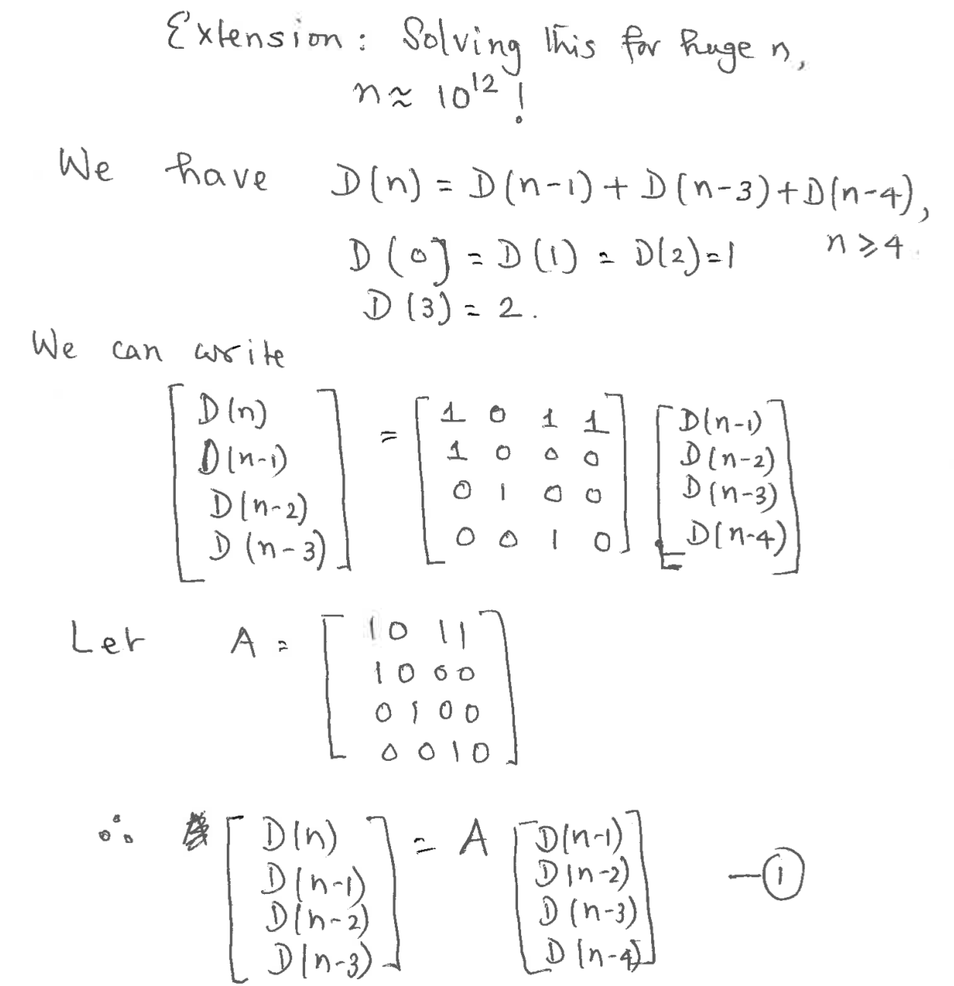

Slide 25
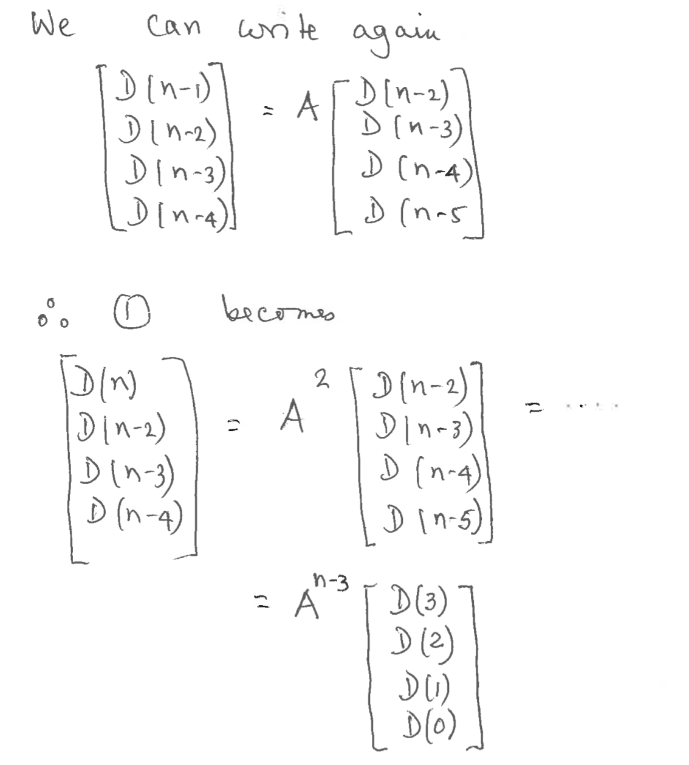

Slide 26
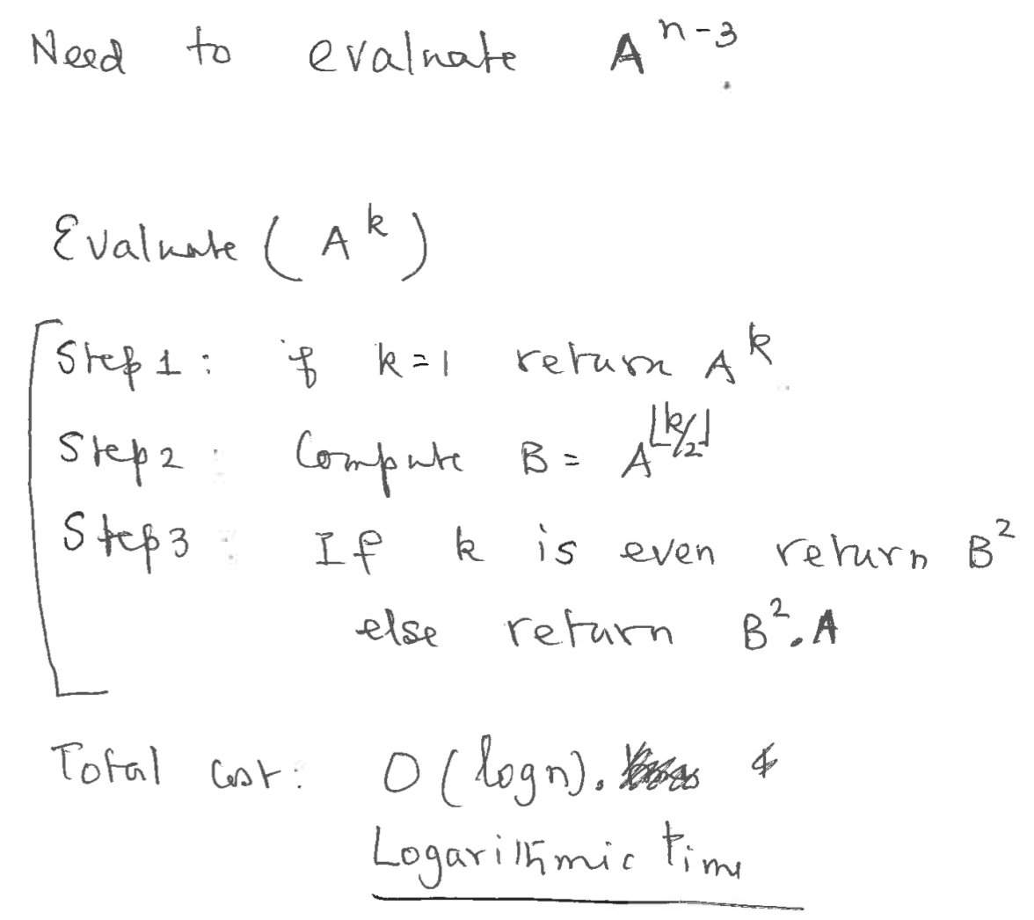

Slide 27
Dynamic Programming
Dynamic Programming is an algorithm design technique for optimization problems: often minimizing or maximizing.
Like divide and conquer, DP solves problems by combining solutions to subproblems.
Unlike divide and conquer, subproblems are not independent.
Subproblems may share subsubproblems,
However, solution to one subproblem may not affect the solutions to other subproblems of the same problem. (More on this later.)
DP reduces computation by
Solving subproblems in a bottom-up fashion.
Storing solution to a subproblem the first time it is solved.
Looking up the solution when subproblem is encountered again.
Key: determine structure of optimal solutions

Slide 28
Steps in Dynamic Programming
Characterize structure of an optimal solution.
Define value of optimal solution recursively.
Compute optimal solution values either top-down with caching or bottom-up in a table.
Construct an optimal solution from computed values.

Slide 29
Longest Common Subsequence
Problem: Given 2 sequences, X = ⟨x₁,...,x_{m}⟩ and Y = ⟨y₁,...,y_{n}⟩, find a common subsequence whose length is maximum.
springtime ncaa tournament
printing north carolina
Subsequence need not be consecutive, but must be in order.

Slide 30
Naïve Algorithm
For every subsequence of X, check whether it’s a subsequence of Y .
Time: Θ(n2^{m}).
2^{m} subsequences of X to check.
Each subsequence takes Θ(n) time to check: scan Y for first letter, for second, and so on.

Slide 31
Optimal Substructure
Theorem
Let Z = ⟨z₁, . . . , z_{k}⟩ be any LCS of X and Y .
1. If x_{m} = y_{n}, then z_{k} = x_{m} = y_{n} and Z_{k-1} is an LCS of X_{m-1} and Y_{n-1}.
2. If x_{m} ≠ y_{n}, then either z_{k} ≠ x_{m} and Z is an LCS of X_{m-1} and Y .
3. or z_{k} ≠ y_{n} and Z is an LCS of X and Y_{n-1}.
Notation:
prefix X_{i} = ⟨x₁,...,x_{i}⟩ is the first i letters of X.

Slide 32
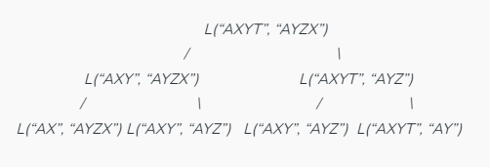
Overlapping Subproblem

Slide 33
Recursive Solution
Define c[i, j] = length of LCS of X_{i} and Y_{j} .
We want c[m,n].
This gives a recursive algorithm and solves the problem. But does it solve it well?

Slide 34
Recursive Solution
c[springtime, printing]
c[springtim, printing] c[springtime, printin]
[springti, printing] [springtim, printin] [springtim, printin] [springtime, printi]
[springt, printing] [springti, printin] [springtim, printi] [springtime, print]

Slide 35
Recursive Solution
Keep track of c[α,β] in a table of nm entries:
top/down
bottom/up

Slide 36
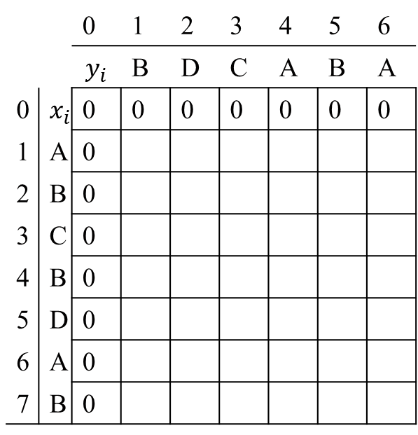
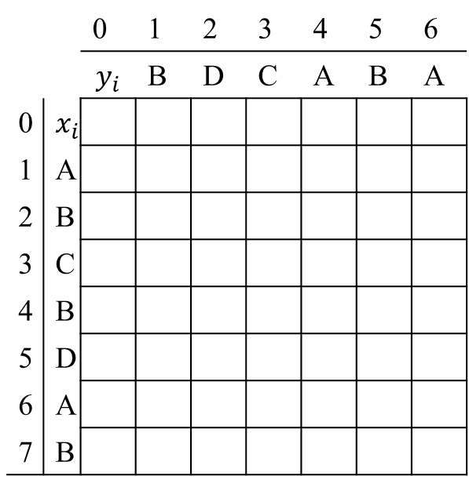
Computing the length of an LCS
LCS-LENGTH (X, Y)
m ← length[X]
n ← length[Y]
for i ← 1 to m
do c[i, 0] ← 0
for j ← 0 to n
do c[0, j ] ← 0
for i ← 1 to m
do for j ← 1 to n
do if x_{i} = y_{j}
then c[i, j ] ← c[i−1, j−1] + 1
b[i, j ] ← “ ”
else if c[i−1, j ] ≥ c[i, j−1]
then c[i, j ] ← c[i− 1, j ]
b[i, j ] ← “↑”
else c[i, j ] ← c[i, j−1]
b[i, j ] ← “←”
return c and b
b[i, j ] points to table entry whose subproblem we used in solving LCS of X_{i} and Y_{j}.
c[m,n] contains the length of an LCS of X and Y.
 |  | 0 | 1 | 2 | 3 | 4 | 5 | 6
 |  | $$y_{i}$$ | B | D | C | A | B | A
0 | $$x_{i}$$ | 0 | 0 | 0 | 0 | 0 | 0 | 0
1 | A | 0
2 | B | 0
3 | C | 0
4 | B | 0
5 | D | 0
6 | A | 0
7 | B | 0
 |  | 0 | 1 | 2 | 3 | 4 | 5 | 6
 |  | $$y_{i}$$ | B | D | C | A | B | A
0 | $$x_{i}$$
1 | A
2 | B
3 | C
4 | B
5 | D
6 | A
7 | B
0
↑
0
↑
0
↑
1
↖
1
←
1
↖
1
↖
1
←
1
←
1
↑
2
↖
2
←
Time: O(mn)

Slide 37
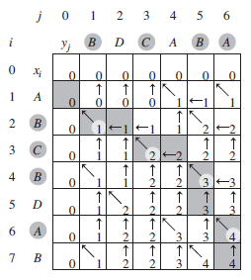
Constructing an LCS
PRINT-LCS (b, X, i, j)
if i = 0 or j = 0
then return
if b[i, j ] = “ ”
then PRINT-LCS(b, X, i−1, j−1)
print x_{i}
elseif b[i, j ] = “↑”
then PRINT-LCS(b, X, i−1, j)
else PRINT-LCS(b, X, i, j−1)
Initial call is PRINT-LCS (b, X,m, n).
When b[i, j ] = , we have extended LCS by one character. So LCS = entries with in them.
Time: O(m+n)

Slide 38
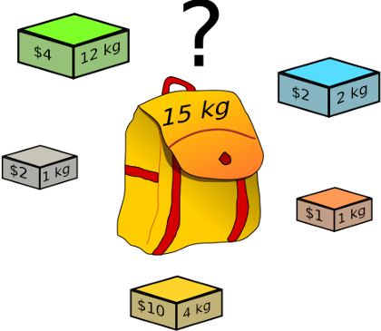
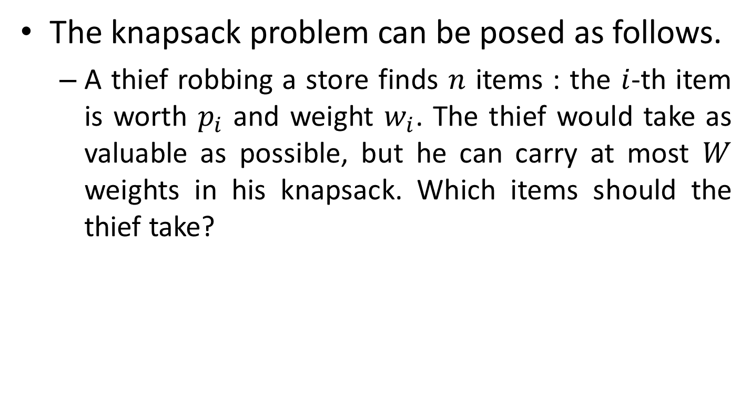
Knapsack Problem
The knapsack problem can be posed as follows.
A thief robbing a store finds $n$ items : the $i$-th item is worth $p_{i}$ and weight $w_{i}$. The thief would take as valuable as possible, but he can carry at most $W$ weights in his knapsack. Which items should the thief take?

Slide 39
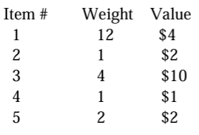
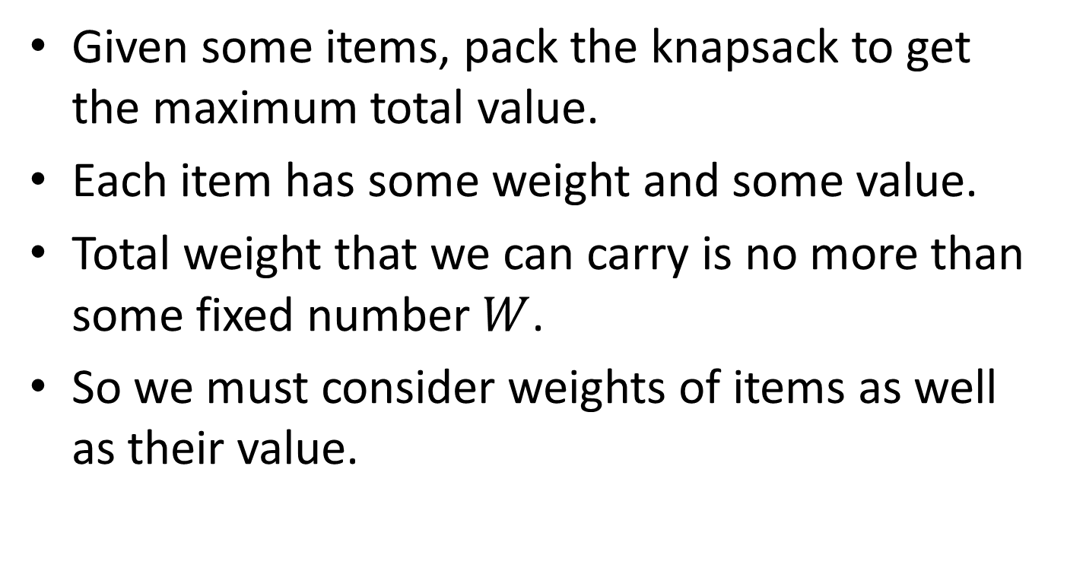
Knapsack Problem
Given some items, pack the knapsack to get the maximum total value.
Each item has some weight and some value.
Total weight that we can carry is no more than some fixed number $W$.
So we must consider weights of items as well as their value.

Slide 40
0/1 Knapsack problem
It's called "0/1" because each item is either all in, or all out. There is no possibility to put some portion of the item in the knapsack.

Slide 41
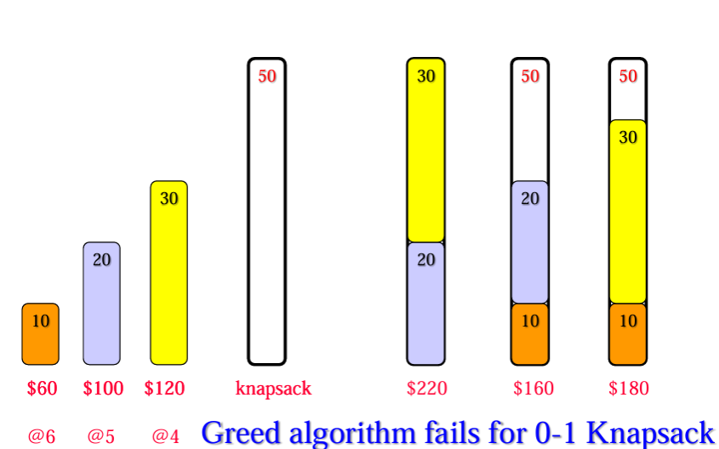
The Greedy method does not work for the 0/1 Knapsack Problem!

Slide 42
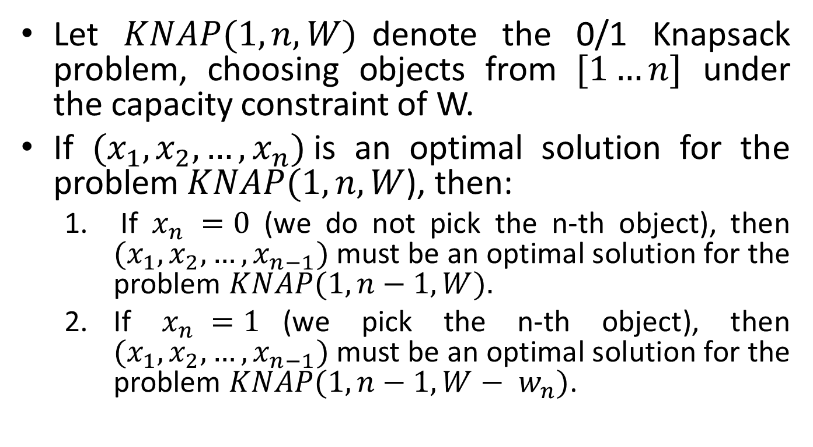
0/1 Knapsack problem
Let $KNAP(1, n, W)$denote the 0/1 Knapsack problem, choosing objects from $[1…n]$ under the capacity constraint of W.
If $(x_{1},x_{2},…,x_{n})$is an optimal solution for the problem $KNAP(1, n, W$), then:
If $x_{n} =0$ (we do not pick the n-th object), then $(x_{1},x_{2},…,x_{n−1})$must be an optimal solution for the problem $KNAP(1, n−1, W).$
If $x_{n} =1$(we pick the n-th object), then $(x_{1},x_{2},…,x_{n−1})$must be an optimal solution for the problem $KNAP(1, n−1, W− w_{n})$.

Slide 43
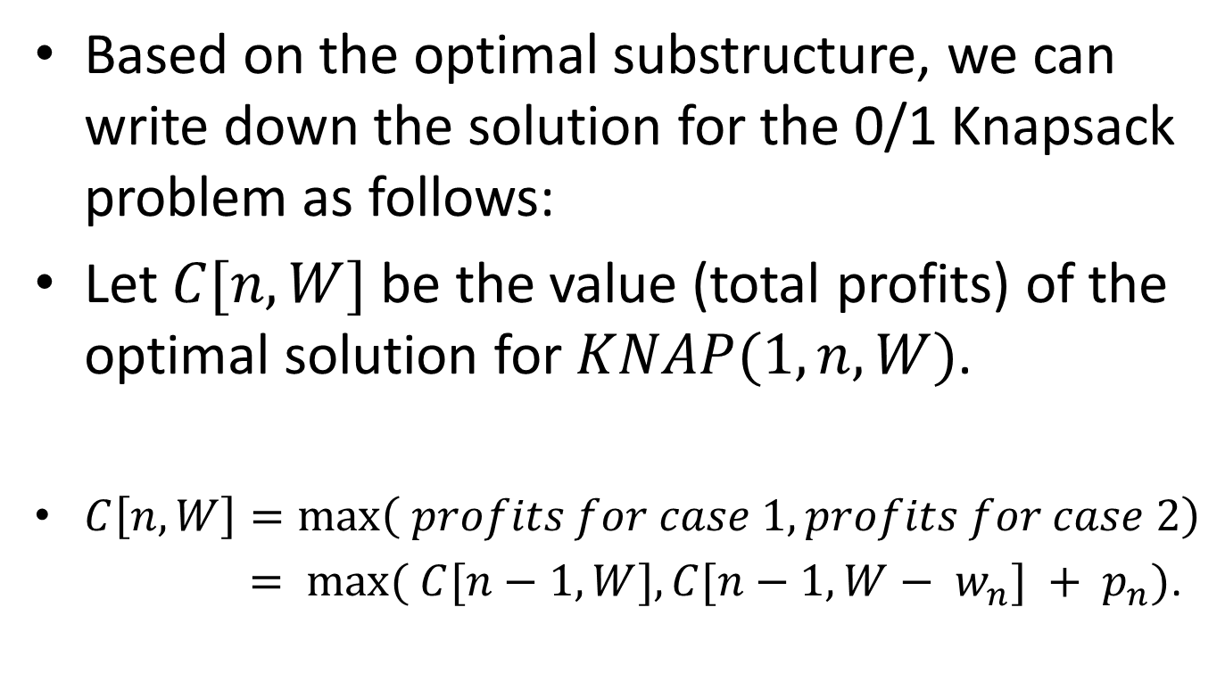
Solution in terms of subproblems
Based on the optimal substructure, we can write down the solution for the 0/1 Knapsack problem as follows:
Let $C[n, W]$be the value (total profits) of the optimal solution for $KNAP(1, n, W)$.
$C\left[n, W\right]=\max\left( profits for case 1, profits for case 2\right)$
$= max⁡( C[n−1, W], C[n−1, W− w_{n}] + p_{n})$.

Slide 44
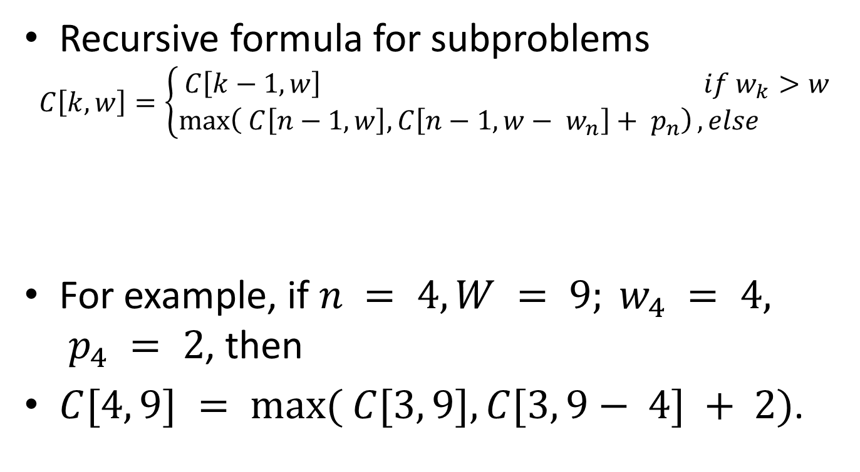
Solution in terms of subproblems
Recursive formula for subproblems
$$C\left[k,w\right]=\left\{\begin{aligned}C\left[k−1,w\right] if w_{k}>w \\ \max\left( C\left[n−1, w\right], C\left[n−1, w− w_{n}\right]+ p_{n}\right), else \end{aligned}\right.$$
For example, if $n = 4, W = 9; w_{4} = 4, p_{4} = 2$, then
$C[4, 9] = max⁡( C[3, 9], C[3, 9− 4] + 2)$.

Slide 45
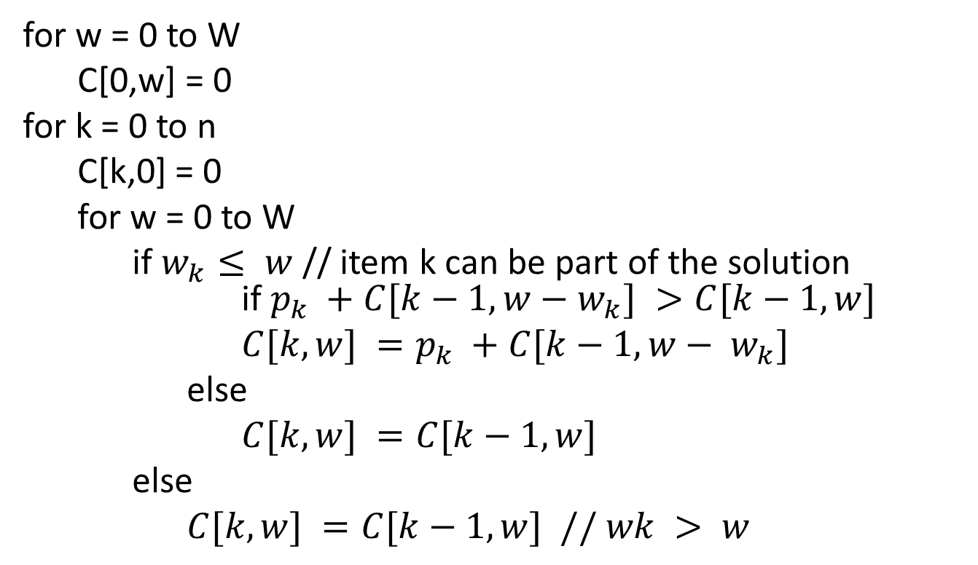
0-1 Knapsack DP Algorithm
for w = 0 to W
C[0,w] = 0
for k = 0 to n
C[k,0] = 0
for w = 0 to W
if $w_{k}≤ w$// item k can be part of the solution if $p_{k} +C[k−1,w−w_{k}] >C[k−1,w]$
$C[k,w] =p_{k} +C[k−1,w− w_{k}]$
else
$C[k,w] =C[k−1,w]$
else
$C[k,w] =C[k−1,w] // wk > w$

Slide 46
Example
n = 4 (# of elements)
W = 5 (max weight)
Elements (weight, benefit):
(2,3), (3,4), (4,5), (5,6)

Slide 47
Example (3)
w
 | 0 | 1 | 2 | 3 | 4 | 5
0
1
2
3
4
 | 0 | 1 | 2 | 3 | 4 | 5
0 | 0 | 0 | 0 | 0 | 0 | 0
1 | 0
2 | 0
3 | 0
4 | 0
i

Slide 48
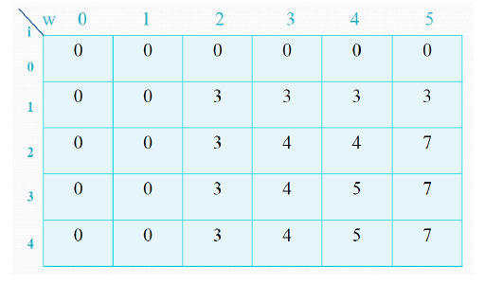
Example

Slide 49
Matrix-chain Multiplication
Suppose we have a sequence or chain A₁, A₂, …, A_{n} of n matrices to be multiplied
That is, we want to compute the product A₁A₂…A_{n}
There are many possible ways (parenthesizations) to compute the product

Slide 50
Matrix-chain Multiplication …contd
Example: consider the chain A₁, A₂, A₃, A₄ of 4 matrices
Let us compute the product A₁A₂A₃A₄
There are 5 possible ways:
(A₁(A₂(A₃A₄)))
(A₁((A₂A₃)A₄))
((A₁A₂)(A₃A₄))
((A₁(A₂A₃))A₄)
(((A₁A₂)A₃)A₄)

Slide 51
Matrix-chain Multiplication …contd
To compute the number of scalar multiplications necessary, we must know:
Algorithm to multiply two matrices
Matrix dimensions

Slide 52
Algorithm to Multiply 2 Matrices
Input: Matrices A_{p×q} and B_{q×r} (with dimensions p×q and q×r)
Result: Matrix C_{p×r} resulting from the product A·B
MATRIX-MULTIPLY(A_{p×q} , B_{q×r})
1. for i ← 1 to p
2. for j ← 1 to r
3. C[i, j] ← 0
4. for k ← 1 to q
5. C[i, j] ← C[i, j] + A[i, k] · B[k, j]
6. return C
Scalar multiplication in line 5 dominates time to compute CNumber of scalar multiplications = pqr

Slide 53
Matrix-chain Multiplication …contd
Example: Consider three matrices A_{10×100}, B_{100×5}, and C_{5×50}
There are 2 ways to parenthesize
((AB)C) = D_{10×5} · C_{5×50}
AB ⇒ 10·100·5=5,000 scalar multiplications
DC ⇒ 10·5·50 =2,500 scalar multiplications
(A(BC)) = A_{10×100} · E_{100×50}
BC ⇒ 100·5·50=25,000 scalar multiplications
AE ⇒ 10·100·50 =50,000 scalar multiplications
Total: 7,500
Total: 75,000

Slide 54
Matrix-chain Multiplication …contd
Matrix-chain multiplication problem
Given a chain A₁, A₂, …, A_{n} of n matrices, where for i=1, 2, …, n, matrix A_{i} has dimension p_{i-1}×p_{i}
Parenthesize the product A₁A₂…A_{n} such that the total number of scalar multiplications is minimized
Brute force method of exhaustive search takes time exponential in n

Slide 55
Dynamic Programming Approach
The structure of an optimal solution
Let us use the notation A_{i..j} for the matrix that results from the product A_{i} A_{i+1} … A_{j}
An optimal parenthesization of the product A₁A₂…A_{n} splits the product between A_{k} and A_{k+1} for some integer k where1 ≤ k < n
First compute matrices A_{1..k} and A_{k+1..n} ; then multiply them to get the final matrix A_{1..n}

Slide 56
Dynamic Programming Approach …contd
Key observation: parenthesizations of the subchains A₁A₂…A_{k} and A_{k+1}A_{k+2}…A_{n} must also be optimal if the parenthesization of the chain A₁A₂…A_{n} is optimal (why?)
That is, the optimal solution to the problem contains within it the optimal solution to subproblems

Slide 57
Dynamic Programming Approach …contd
Recursive definition of the value of an optimal solution
Let m[i, j] be the minimum number of scalar multiplications necessary to compute A_{i..j}
Minimum cost to compute A_{1..n} is m[1, n]
Suppose the optimal parenthesization of A_{i..j} splits the product between A_{k} and A_{k+1} for some integer k where i ≤ k < j

Slide 58
Dynamic Programming Approach …contd
A_{i..j} = (A_{i} A_{i+1}…A_{k})·(A_{k+1}A_{k+2}…A_{j})= A_{i..k} · A_{k+1..j}
Cost of computing A_{i..j} = cost of computing A_{i..k} + cost of computing A_{k+1..j} + cost of multiplying A_{i..k} and A_{k+1..j}
Cost of multiplying A_{i..k} and A_{k+1..j} is p_{i-1}p_{k} p_{j}
m[i, j ] = m[i, k] + m[k+1, j ] + p_{i-1}p_{k} p_{j} for i ≤ k < j
m[i, i ] = 0 for i=1,2,…,n

Slide 59
Dynamic Programming Approach …contd
But… optimal parenthesization occurs at one value of k among all possible i ≤ k < j
Check all these and select the best one
0 if i=j
m[i, j ] =
min {m[i, k] + m[k+1, j ] + p_{i-1}p_{k} p_{j} } if i<j
i ≤ k< j

Slide 60
Dynamic Programming Approach …contd
To keep track of how to construct an optimal solution, we use a table C
C[i, j ] = value of k at which A_{i} A_{i+1} … A_{j} is split for optimal parenthesization
Algorithm: next slide
First computes costs for chains of length l=1
Then for chains of length l=2,3, … and so on
Computes the optimal cost bottom-up

Slide 61
Algorithm to Compute Optimal Cost
Input: Array p[0…n] containing matrix dimensions and n
Result: Minimum-cost table C and split table s
MATRIX-CHAIN-ORDER(p[ ], n)
for i ← 1 to n
C[i, i] ← 0
for l ← 2 to n
for i ← 1 to n-l+1
j ← i+l-1
C[i, j] ← ∞
for k ← i to j-1
q ← C[i, k] + C[k+1, j] + p[i-1] p[k] p[j]
if q < C[i, j]
C[i, j] ← q
s[i, j] ← k
return m and s
Takes O(n³) time
Requires O(n²) space

Slide 62
Matrix chain multiplication
The algorithm takes O(n³) time and requires O(n²) space.
Example:
Consider the following six matrix problem.
The problem therefore can be phrased as one of filling in the following table representing the values m.
Matrix | A₁ | A₂ | A₃ | A₄ | A₅ | A₆
Dimensions | 10x20 | 20x5 | 5x15 | 15x50 | 50x10 | 10x15
i\j | 1 2 3 4 5 6
1 2 3 4 5 6
0
0
0
0
0
0

Slide 63
Matrix chain multiplication
Chains of length 2 are easy, as there is no minimization required, so
m[i, i+1] = p_{i-1}p_{i}p_{i+1}
m[1, 2] = 10x20x5 = 1000
m[2, 3] = 20x5x15 = 1500
m[3, 4] = 5x15x50 = 3750
m[4, 5] = 15x50x10 = 7500
m[5, 6] = 50x10x15 = 7500
i\j | 1 2 3 4 5 6
1 2 3 4 5 6
0
1000
0
1500
0
3750
0
7500
0
7500
0

Slide 64
Matrix chain multiplication
Chains of length 3 require some minimization – but only one each.
m[1,3]=min{(m[1,1]+m[2,3]+p₀p₁p₃),(m[1,2]+m[3,3]+p₀p₂p₃)}
= min{(0+1500+10x20x15), (1000+0+10x5x15)}
= min { 4500, 1750 } = 1750
m[2,4]=min{(m[2,2]+m[3,4]+p₁p₂p₄),(m[2,3]+m[4,4]+p₁p₃p₄)}
= min{(0+3750+20x5x50), (1500+0+20x15x50)}
= min { 8750, 16500 } = 8750
m[3,5]=min{(m[3,3]+m[4,5]+p₂p₃p₅),(m[3,4]+m[5,5]+p₂p₄p₅)}
= min{(0+7500+5x15x10), (3750+0+5x50x10)}
= min { 8250, 6250 } = 6250
m[4,6]=min{(m[4,4]+m[5,6]+p₃p₄p₆),(m[4,5]+m[6,6]+p₃p₅p₆)}
= min{(0+7500+15x50x15), (7500+0+15x10x15)}
= min { 18750, 9750 } = 9750

Slide 65
Matrix chain multiplication
i\j | 1 2 3 4 5 6
1 2 3 4 5 6
0
1000
1750
0
1500
8750
0
3750
6250
0
7500
9750
0
7500
0

Slide 66
Matrix chain multiplication
m[1,4]=min{(m[1,1]+m[2,4]+p₀p₁p₄),(m[1,2]+m[3,4]+p₀p₂p₄),
(m[1,3]+m[4,4]+p₀p₃p₄)}
= min{(0+8750+10x20x50), (1000+3750+10x5x50),
(1750+0+10x15x50)}
= min { 18750, 7250, 9250 } = 7250
m[2,5]=min{(m[2,2]+m[3,5]+p₁p₂p₅),(m[2,3]+m[4,5]+p₁p₃p₅),
(m[2,4]+m[5,5]+p₁p₄p₅)}
= min{(0+6250+20x5x10), (1500+7500+20x15x10),
(8750+0+20x50x10)}
= min { 7250, 12000, 18750 } = 7250
m[3,6]=min{(m[3,3]+m[4,6]+p₂p₃p₆),(m[3,4]+m[5,6]+p₂p₄p₆),
(m[3,5]+m[6,6]+p₂p₅p₆)}
= min{(0+9750+5x15x15), (3750+7500+5x50x15),
(6250+0+5x10x15)}
= min { 10875, 15000, 7000 } = 7000

Slide 67
Matrix chain multiplication
i\j | 1 2 3 4 5 6
1 2 3 4 5 6
0
1000
1750
7250
0
1500
8750
7250
0
3750
6250
7000
0
7500
9750
0
7500
0

Slide 68
Matrix chain multiplication
m[1,5]=min{(m[1,1]+m[2,5]+p₀p₁p₅),(m[1,2]+m[3,5]+p₀p₂p₅),
(m[1,3]+m[4,5]+p₀p₃p₅),(m[1,4]+m[5,5]+p₀p₄p₅)}
= min{(0+7250+10x20x10), (1000+6250+10x5x10),
(1750+7500+10x15x10), (7250+0+10x50x10)}
= min { 9250, 7750, 10750, 12250 } = 7750
m[2,6]=min{(m[2,2]+m[3,6]+p₁p₂p₆),(m[2,3]+m[4,6]+p₁p₃p₆),
(m[2,4]+m[5,6]+p₁p₄p₆),(m[2,5]+m[6,6]+p₁p₅p₆)}
= min{(0+7000+20x5x15), (1500+9750+20x15x15),
(8750+7500+20x50x15), (7250+0+20x10x15)}
= min { 8500, 15750, 31,250, 10250 } = 8500
m[1,6]=min{(m[1,1]+m[2,6]+p₀p₁p₆),(m[1,2]+m[3,6]+p₀p₂p₆),
(m[1,3]+m[4,6]+p₀p₃p₆),(m[1,4]+m[5,6]+p₀p₄p₆), (m[1,5]+m[6,6]+p₀p₅p₆)}
= min{(11500, 8750, 13750, 22250, 9250 } = 8750

Slide 69
Matrix chain multiplication
i\j | 1 2 3 4 5 6
1 2 3 4 5 6
0
1000
1750
7250
7750
8750
0
1500
8750
7250
8500
0
3750
6250
7000
0
7500
9750
0
7500
0

Slide 70
Matrix chain multiplication
Algorithm PrintOptimalPerens(s, i, j)
{ if (i=j) then
Print “A”_{i};
else
{ Print “(“;
PrintOptimalPerens(s, i, s[i,j]);
PrintOptimalPerens(s, s[i,j]+1, j);
Print “)”;
}
}
i\j | 1 2 3 4 5 6
1 2 3 4 5 6 | 1 1 2 2 2 2 2 2 2 2 2 3 3 4 5 4 4 5 5 5 6

Slide 71
Weighted Interval Scheduling
Weighted interval scheduling problem.
Job j starts at s_{j}, finishes at f_{j}, and has weight or value v_{j} .
Two jobs compatible if they don't overlap.
Goal: find maximum weight subset of mutually compatible jobs.
a
b
c
d
e
f
g
h
Time
0
1
2
3
4
5
6
7
8
9
10
11

Slide 72
Unweighted Interval Scheduling Review
Recall. Greedy algorithm works if all weights are 1.
Consider jobs in ascending order of finish time.
Add job to subset if it is compatible with previously chosen jobs.
Observation. Greedy algorithm can fail spectacularly if arbitrary weights are allowed.
weight = 999
b
weight = 1
a
Time
0
1
2
3
4
5
6
7
8
9
10
11

Slide 73
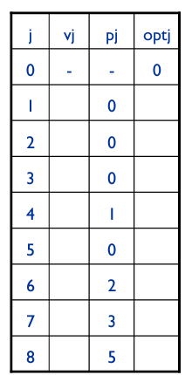
Weighted Interval Scheduling
Notation. Label jobs by finishing time: f₁ ≤ f₂ ≤ . . . ≤ f_{n} .
Def. p(j) = largest index i < j such that job i is compatible with job j.
Ex: p(8) = 5, p(7) = 3, p(2) = 0.
1
2
3
4
5
6
7
8
Time
0
1
2
3
4
5
6
7
8
9
10
11
Notes:
Ultimately the bottom-up approach builds the solution linearly checking if each job (considered in the order of increasing finishing times) is in the solution set or not and building an optimal solution.
-------------------------------------------------------------
p() = predecessor function?
INTUITION: If job j is in the final schedule, the largest prefix of jobs will contain at most job p(j).
Finish time of p(j) < Start time of j AND p(j) is the largest such value.

Slide 74
Dynamic Programming: Binary Choice
Notation. OPT(j) = value of optimal solution to the problem consisting of job requests 1, 2, ..., j.
Case 1: OPT selects job j.
can't use incompatible jobs { p(j) + 1, p(j) + 2, ..., j - 1 }
must include optimal solution to problem consisting of remaining compatible jobs 1, 2, ..., p(j)
Case 2: OPT does not select job j.
must include optimal solution to problem consisting of remaining compatible jobs 1, 2, ..., j-1
optimal substructure
Notes:
Follows from the definition of p(j)
Optimal subset of prefix

Slide 75
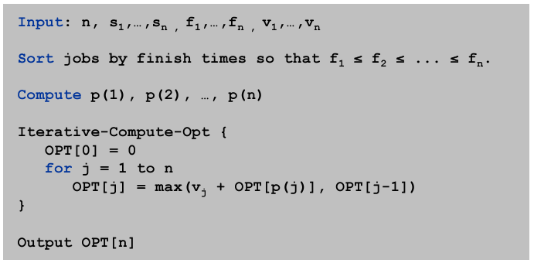
Weighted Interval Scheduling: Bottom-Up
Notes:
p(j) = max-k f_k <= s_j
Consider jobs in the order of their start times
Can perform binary search of s_j on sorted finish times array
Computing p’s requires o(n lg n) = n binary searches
of finish time using start-finish time array
-------
Recursive definition –> top-down approach

Slide 76
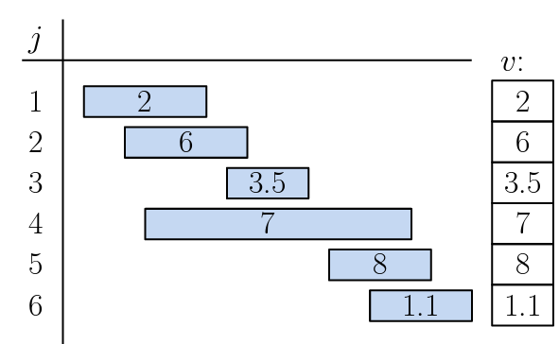

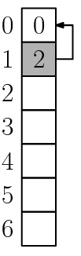





Example

Slide 77
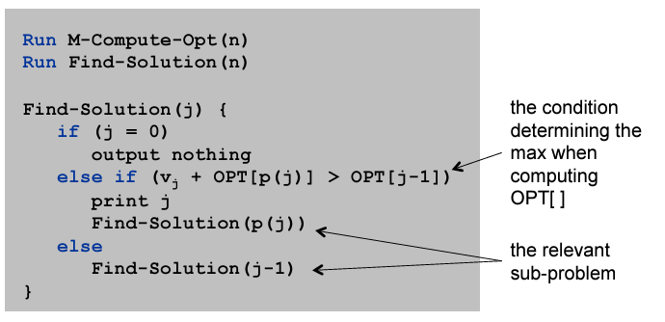
Weighted Interval Scheduling: Finding a Solution
Q. Dynamic programming algorithms computes optimal value. What if we want the solution itself?
A. Do some post-processing – “traceback”

Slide 78
All-Pair Shortest Path
Single Source Shortest Path
Optimal Binary Search Tree
Multistage Graph

Slide 79
Floyd’s Algorithm
All pairs shortest path

Slide 80
All pairs shortest path
The problem: find the shortest path between every pair of vertices of a graph
The graph: may contain negative edges but no negative cycles
A representation: a weight matrix where W(i,j)=0 if i=j. W(i,j)=∞ if there is no edge between i and j. W(i,j)=“weight of edge”
Principle of optimality applies to shortest path problems

Slide 81
The weight matrix and the graph
1
3
v₁
v₂
9
5
1
2
3
v₅
3
2
v₄
v₃
4

Slide 82
The subproblems
How can we define the shortest distance d_{i,j} in terms of “smaller” problems?
One way is to restrict the paths to only include vertices from a restricted subset.
Initially, the subset is empty.
Then, it is incrementally increased until it includes all the vertices.

Slide 83
The subproblems
Let D^{(k)}[i,j]=weight of a shortest path from v_{i} to v_{j} using only vertices from {v₁,v₂,…,v_{k}} as intermediate vertices in the path
D⁽⁰⁾=W
D^{(n)}=D which is the goal matrix
How do we compute D^{(k)} from D^{(k-1)} ?

Slide 84
The Recursive Definition:
Case 1: A shortest path from v_{i} to v_{j} restricted to using only vertices from {v₁,v₂,…,v_{k}} as intermediate vertices does not use v_{k}. Then D^{(k)}[i,j]= D^{(k-1)}[i,j].
Case 2: A shortest path from v_{i} to v_{j} restricted to using only vertices from {v₁,v₂,…,v_{k}} as intermediate vertices does use v_{k}. Then D^{(k)}[i,j]= D^{(k-1)}[i,k]+ D^{(k-1)}[k,j].
Shortest path using intermediate vertices {V₁, . . . V_{k} }
V_{k}
V_{j}
V_{i}
Shortest Path using intermediate vertices { V_{1, . . .} V_{k -1} }

Slide 85
The recursive definition
Since D^{(k)}[i,j]= D^{(k-1)}[i,j] or D^{(k)}[i,j]= D^{(k-1)}[i,k]+ D^{(k-1)}[k,j]. We conclude: D^{(k)}[i,j]= min{ D^{(k-1)}[i,j], D^{(k-1)}[i,k]+ D^{(k-1)}[k,j] }.
Shortest path using intermediate vertices {V₁, . . . V_{k} }
V_{k}
V_{j}
V_{i}
Shortest Path using intermediate vertices { V_{1, . . .} V_{k -1} }

Slide 86
The pointer array P
Used to enable finding a shortest path
Initially the array contains 0
Each time that a shorter path from i to j is found the k that provided the minimum is saved (highest index node on the path from i to j)
To print the intermediate nodes on the shortest path a recursive procedure that print the shortest paths from i and k, and from k to j can be used

Slide 87
Floyd's Algorithm Using n+1 D matrices
Floyd//Computes shortest distance between all pairs of //nodes, and saves P to enable finding shortest paths 1. D⁰ ← W // initialize D array to W [ ] 2. P ← 0 // initialize P array to [0] 3. for k ← 1 to n 4. do for i ← 1 to n 5. do for j ← 1 to n 6. if (D^{k-1}[ i, j ] > D^{k-1} [ i, k ] + D^{k-1} [ k, j ] ) 7. then D^{k}[ i, j ] ← D^{k-1} [ i, k ] + D^{k-1} [ k, j ] 8. P[ i, j ] ← k; 9. else D^{k}[ i, j ] ← D^{k-1} [ i, j ]

Slide 88
Example
1
2
3
1
0
4
5
W = D⁰ =
1
2
2
0
∞
5
3
∞
-3
0
4
2
3
1
2
3
2
-3
1
0
0
0
P =
2
0
0
0
3
0
0
0

Slide 89
k = 1 Vertex 1 can be intermediate node
1
1
2
3
5
D⁰ =
1
0
4
5
4
2
3
2
2
0
∞
2
-3
3
∞
-3
0
1
2
3
1
0
4
5
D¹[2,3] = min( D⁰[2,3], D⁰[2,1]+D⁰[1,3] )
= min (∝, 7)
= 7
D¹[3,2] = min( D⁰[3,2], D⁰[3,1]+D⁰[1,2] )
= min (-3,∝)
= -3
D¹ =
2
2
0
7
3
∞
-3
0
1
2
3
1
0
0
0
P =
2
0
0
1
3
0
0
0

Slide 90
k = 2 Vertices 1, 2 can be intermediate
1
2
3
1
5
D¹ =
1
0
4
5
4
2
3
2
2
0
7
2
-3
3
∞
-3
0
1
2
3
1
0
4
5
D²[1,3] = min( D¹[1,3], D¹[1,2]+D¹[2,3] )
= min (5, 4+7)
= 5
D²[3,1] = min( D¹[3,1], D¹[3,2]+D¹[2,1] )
= min (∝, -3+2)
= -1
D² =
2
2
0
7
3
-1
-3
0
1
2
3
1
0
0
0
P =
2
0
0
1
3
2
0
0

Slide 91
k = 3 Vertices 1, 2, 3 can be intermediate
1
1
2
3
5
D² =
1
0
4
5
3
4
2
2
2
0
7
2
-3
3
-1
-3
0
1
2
3
1
0
2
5
D³ =
D³[1,2] = min(D²[1,2], D²[1,3]+D²[3,2] )
= min (4, 5+(-3))
= 2
D³[2,1] = min(D²[2,1], D²[2,3]+D²[3,1] )
= min (2, 7+ (-1))
= 2
2
2
0
7
3
-1
-3
0
1
2
3
1
0
3
0
P =
2
0
0
1
3
2
0
0

Slide 92
Printing intermediate nodes on shortest path from q to r
path(index q, r)
if (P[ q, r ]!=0)
path(q, P[q, r])
println( “v”+ P[q, r])
path(P[q, r], r)
return;
//no intermediate nodes
else return
Before calling path check D[q, r] < ∞, and print node q, after the call to
path print node r
1
2
3
1
0
3
0
P =
2
0
0
1
3
2
0
0
1
5
4
2
3
2
-3

Slide 93
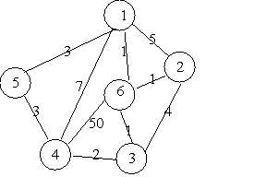
Example

Slide 94
Single Source Shortest paths
Shortest path problem. Given a digraph G = (V, E), with arbitrary edge weights or costs c_{vw}, find cheapest path from node s to node t.
Allow negative weights
1
-3
3
5
4
source s
0
12
-5
8
7
7
2
9
9
-1
1
11
5
5
-3
13
4
10
6
cost of the shown path s-t = 9 - 3 + 1 + 11 = 18 (min. cost = 11)
destination t
Notes:
Ex. Nodes represent agents in a financial setting and c_vw is cost of transaction in which we buy from agent v and sell immediately to agent w.

Slide 95
Shortest Paths: Failed Attempts
Dijkstra. Can fail if negative edge costs/weights are present.
Re-weighting. Adding a constant to every edge weight can fail.
u
2
3
s
v
1
-6
t
5
5
2
2
s
6
t
6
3
0
3
-3
Notes:
One can form cheaper paths using more expensive sub-paths, so nodes can be added non-monotonically w.r.t the length of their paths.
This is contrary to Dijsktra’s approach. E.g., one can have S->direct->T be cheaper than S->direct->U but with S->U->V->T, where V-Direct->T is very small, S->*->T cost can be smaller.
(2) Adding constant to every edge does not work because different path lengths will introduce different cost increments to the paths, modifying the original problem and path relationships.
Only weight transformations that preserve path weights are admissible.

Slide 96

Negative cycles
Def. A negative cycle is a directed cycle such that the sum of its edge weights is negative.
5
-3
-3
4
-4
a negative cycle W :
Notes:
‘Does a solution always exist?’ need to be explored before developing an efficient algorithm.
Well-founded problem definition requires absence of Negative cycles.

Slide 97
Shortest paths and negative cycles
Lemma 1. If some path from v to t contains a negative cycle, then there does not exist a cheapest path from v to t.
Pf. If there exists such a cycle W, then we can build a v↝t path of arbitrarily negative weight by detouring around the cycle as many times as desired. ▪
v
t
W
c(W) < 0
Notes:
Requirement for a solution to always exist: Absence of negative cycles.

Slide 98
Shortest paths and negative cycles
Lemma 2. If G has no negative cycle, then there exists a cheapest path from v to t that is simple (and that has ≤ n – 1 edges).
Pf.
Consider a cheapest v↝t path P that uses the fewest number of edges.
If P contains a cycle W, we can remove portion of P corresponding to W, obtaining a path with fewer edges, without increasing the cost. ▪
v
t
W
c(W) ≥ 0
Notes:
Algorithmic Implication: Explore paths of length (n-1) to get cheapest paths.
CONTRAPOSITIVE: If path of length n or greater is cheaper, then a negative cycle exists.
STRENTHENING: If G has no negative cycle from v to t, then there exists a cheapest path from v to t that is simple (and that has ≤ n – 1 edges).

Slide 99
Shortest path and negative cycle problems
Shortest path problem. Given a digraph G = (V, E) with edge weights c_{vw} and no negative cycles, find cheapest v↝t path for each node v.
Negative cycle problem. Given a digraph G = (V, E) with edge weights c_{vw}, find a negative cycle (if one exists).
1
5
4
2
-3
5
-3
-3
t
4
-4
shortest-paths tree
negative cycle
Notes:
Paths to target t (rather than paths from source s).
Negative cycle on a path to t vs any negative cycle in the entire graph.

Slide 100
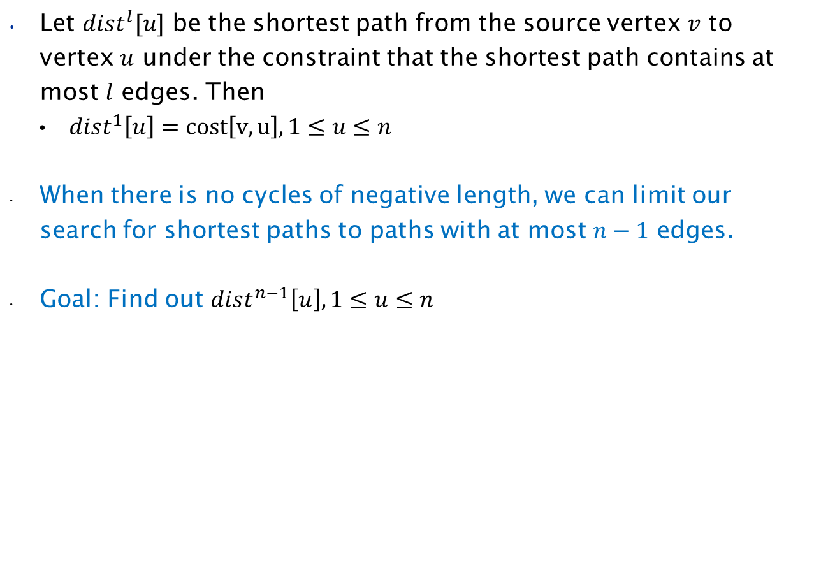
Shortest paths: dynamic programming
Let $dist^{l}[u]$ be the shortest path from the source vertex $v$ to vertex $u$ under the constraint that the shortest path contains at most $l$ edges. Then
$dist^{1}\left[u\right]=cost\left[v,u\right], 1≤u≤n$
When there is no cycles of negative length, we can limit our search for shortest paths to paths with at most $n−1$ edges.
Goal: Find out $dist^{n−1}\left[u\right],1≤u≤n$

Slide 101
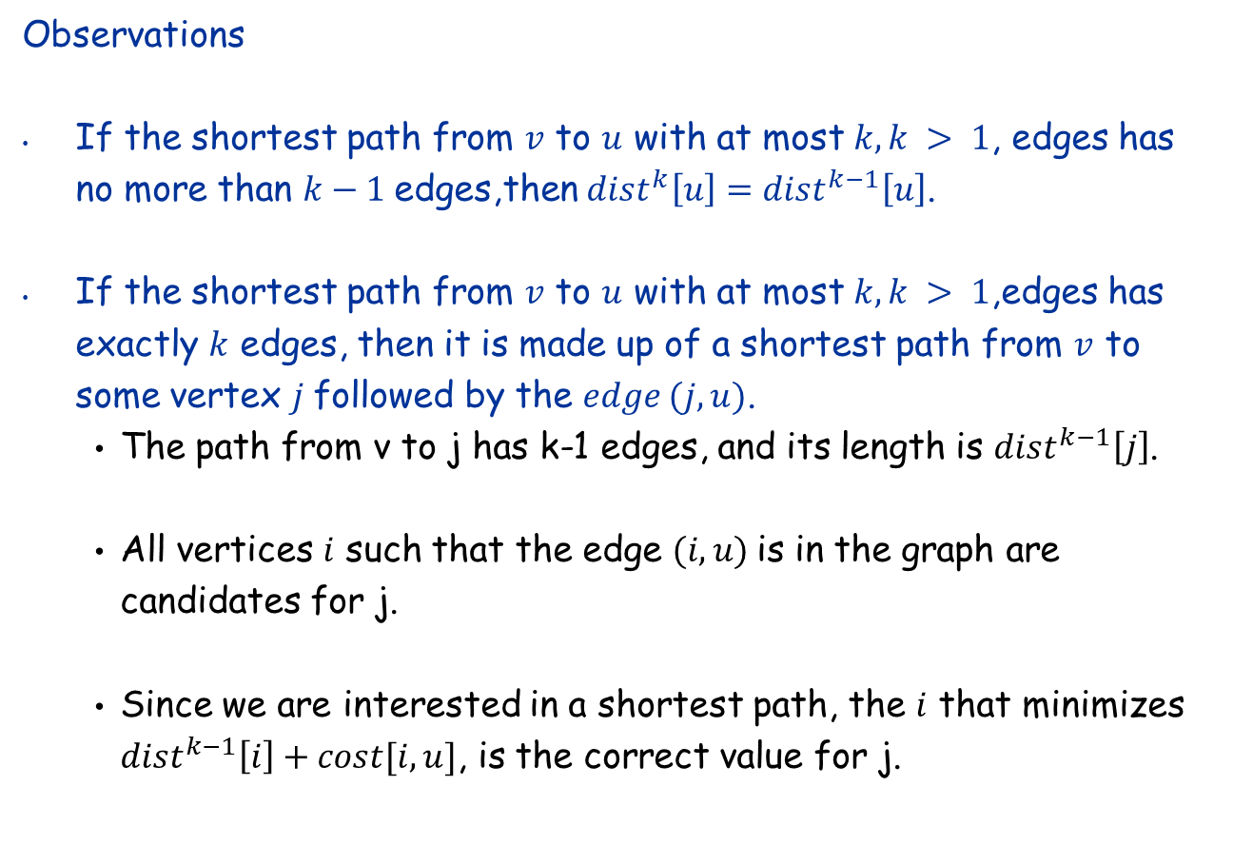
Shortest paths: dynamic programming
Observations
If the shortest path from $v$ to $u$ with at most $k, k > 1$, edges has no more than $k−1$edges,then $dist^{k}\left[u\right]=dist^{k−1}\left[u\right]$.
If the shortest path from $v$ to $u$ with at most $k, k > 1$,edges has exactly $k$ edges, then it is made up of a shortest path from $v$ to some vertex $j$followed by the $edge (j,u)$.
The path from v to j has k-1 edges, and its length is $dist^{k−1}\left[j\right]$.
All vertices $i$ such that the edge $(i,u)$is in the graph are candidates for j.
Since we are interested in a shortest path, the $i$ that minimizes $dist^{k−1}\left[i\right]+cost[i,u]$, is the correct value for j.

Slide 102

Shortest paths: dynamic programming
The observations result in the following recurrence for $dist$
$$dist^{k}\left[u\right]=\min\left\{dist^{k−1}\left[u\right],\min_{i}\left\{dist^{k−1}\left[i\right]+cost\left[i,u\right]\right\}\right\}$$
This recurrence can be used to compute $dist^{k}\left[u\right]$ from $dist^{k−1}\left[u\right]$, for $k = 2, 3, …, n−1$

Slide 103
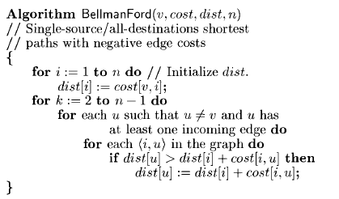
Bellman Ford Algorithm

Slide 104
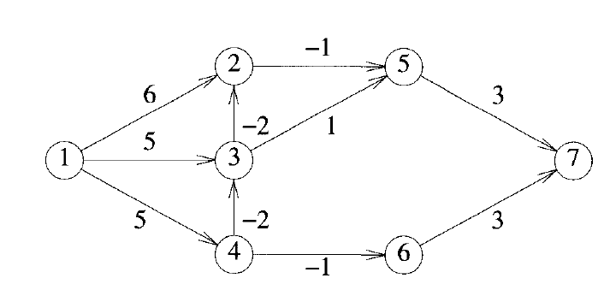



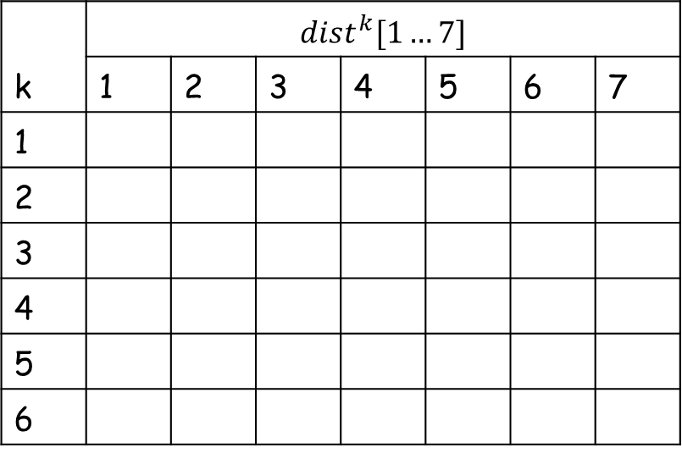















Example of Bellman-Ford
k | $$dist^{k}[1…7]$$
 | 1 | 2 | 3 | 4 | 5 | 6 | 7
1
2
3
4
5
6
0
6
5
5
$$∞$$
$$∞$$
$$∞$$
0
3
3
5
$$5$$
$$4$$
$$∞$$
0
1
3
5
$$2$$
$$4$$
$$7$$
0
1
3
5
$$0$$
$$4$$
$$5$$
0
1
3
5
$$0$$
$$4$$
$$3$$
0
1
3
5
$$0$$
$$4$$
$$3$$

Slide 105
String distance metrics: Levenshtein
Edit-distance metrics
Distance is shortest sequence of edit commands that transform s to t.
Simplest set of operations:
Copy character from s over to t
Delete a character in s (cost 1)
Insert a character in t (cost 1)
Substitute one character for another (cost 1)
This is “Levenshtein distance”

Slide 106
Levenshtein distance - example
distance(“William Cohen”, “Willliam Cohon”)
s
W | I | L | L | I | A | M | _ | C | O | H | E |  | N
W | I | L | L | L | I | A | M | _ | C | O | H | O | N
C | C | C | C | I | C | C | C | C | C | C | C | S | C
0 | 0 | 0 | 0 | 1 | 1 | 1 | 1 | 1 | 1 | 1 | 1 | 2 | 2
alignment
t
op
cost

Slide 107
Levenshtein distance - example
distance(“William Cohen”, “Willliam Cohon”)
s
W | I | L | L |  | I | A | M | _ | C | O | H | E | N
W | I | L | L | L | I | A | M | _ | C | O | H | O | N
C | C | C | C | I | C | C | C | C | C | C | C | S | C
0 | 0 | 0 | 0 | 1 | 1 | 1 | 1 | 1 | 1 | 1 | 1 | 2 | 2
gap
alignment
t
op
cost

Slide 108
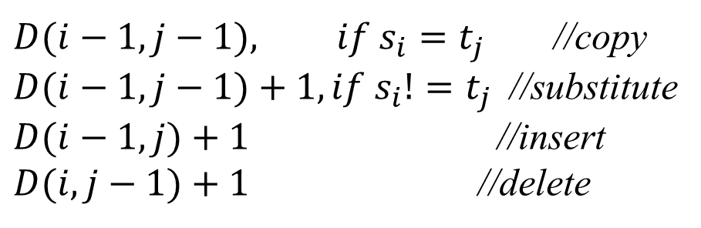
Computing Levenshtein distance - 1
D(i,j) = score of best alignment from $s_{1}…s_{i}$to $t_{1}…t_{j}$
$D(i−1,j−1), if s_{i}=t_{j}$//copy
$D(i−1,j−1)+1, if s_{i}!=t_{j}$//substitute
$D(i−1,j)+1$ //insert
$D(i,j−1)+1$ //delete
= min

Slide 109
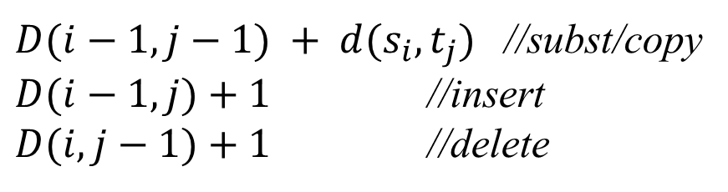
Computing Levenshtein distance - 2
D(i,j) = score of best alignment from s1..si to t1..tj
$D(i−1,j−1) + d(s_{i},t_{j})$//subst/copy
$D(i−1,j)+1$//insert
$D(i,j−1)+1$//delete
= min
(simplify by letting d(c,d)=0 if c=d, 1 else)
also let D(i,0)=i (for i inserts) and D(0,j)=j

Slide 110
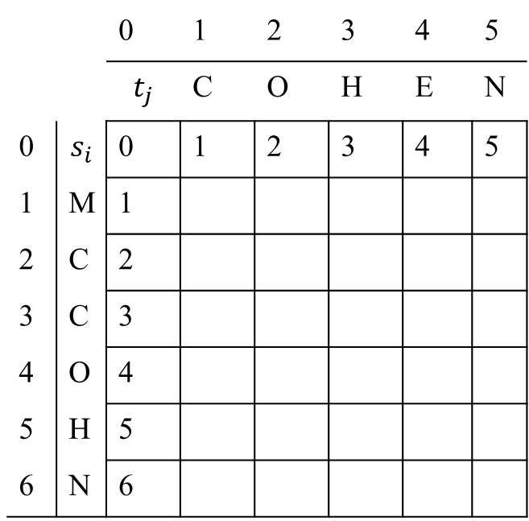
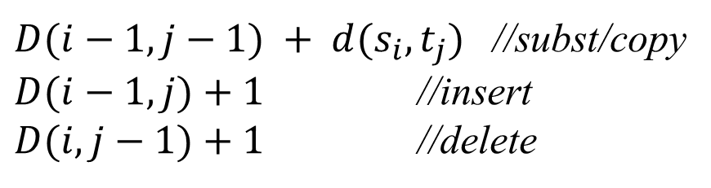
Computing Levenshtein distance - 3
$D(i−1,j−1) + d(s_{i},t_{j})$//subst/copy
$D(i−1,j)+1$//insert
$D(i,j−1)+1$//delete
D(i,j)= min
 |  | 0 | 1 | 2 | 3 | 4 | 5
 |  | $$t_{j}$$ | C | O | H | E | N
0 | $$s_{i}$$ | 0 | 1 | 2 | 3 | 4 | 5
1 | M | 1
2 | C | 2
3 | C | 3
4 | O | 4
5 | H | 5
6 | N | 6
1
2
3
4
5
1
2
3
4
5
2
2
3
4
5
3
2
3
4
5
4
3
2
3
4
5
4
3
3
3
= D(s,t)

Slide 111
Computing Levenshtein distance – 4
D(i-1,j-1) + d(si,tj) //subst/copy
D(i-1,j)+1 //insert
D(i,j-1)+1 //delete
D(i,j) = min
 |  | C | O |  | H | E | N
M |  | 1 | 2 |  | 3 | 4 | 5
C |  | 1 | 2 |  | 3 | 4 | 5
C |  | 2 | 3 |  | 3 | 4 | 5
O |  | 3 | 2 |  | 3 | 4 | 5
H |  | 4 | 3 |  | 2 | 3 | 4
N |  | 5 | 4 |  | 3 | 3 | 3
A trace indicates where the min value came from, and can be used to find edit operations and/or a best alignment (may be more than 1)

