Slide 1
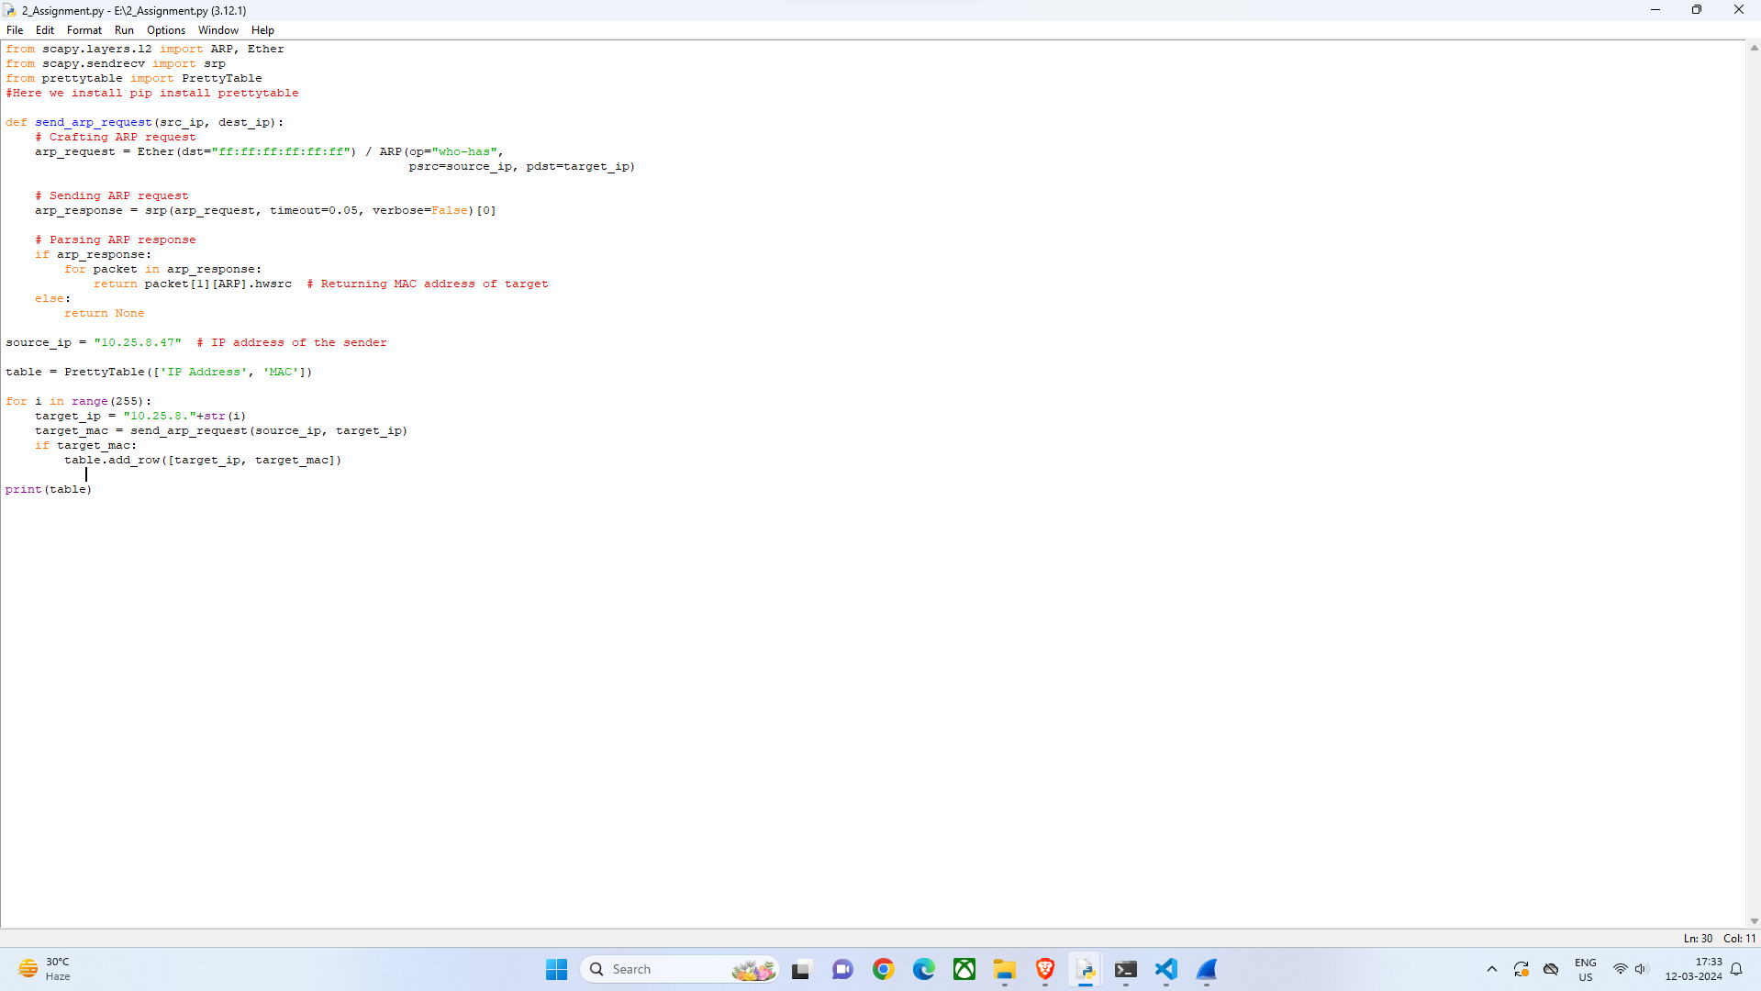
This is my python code

Slide 2
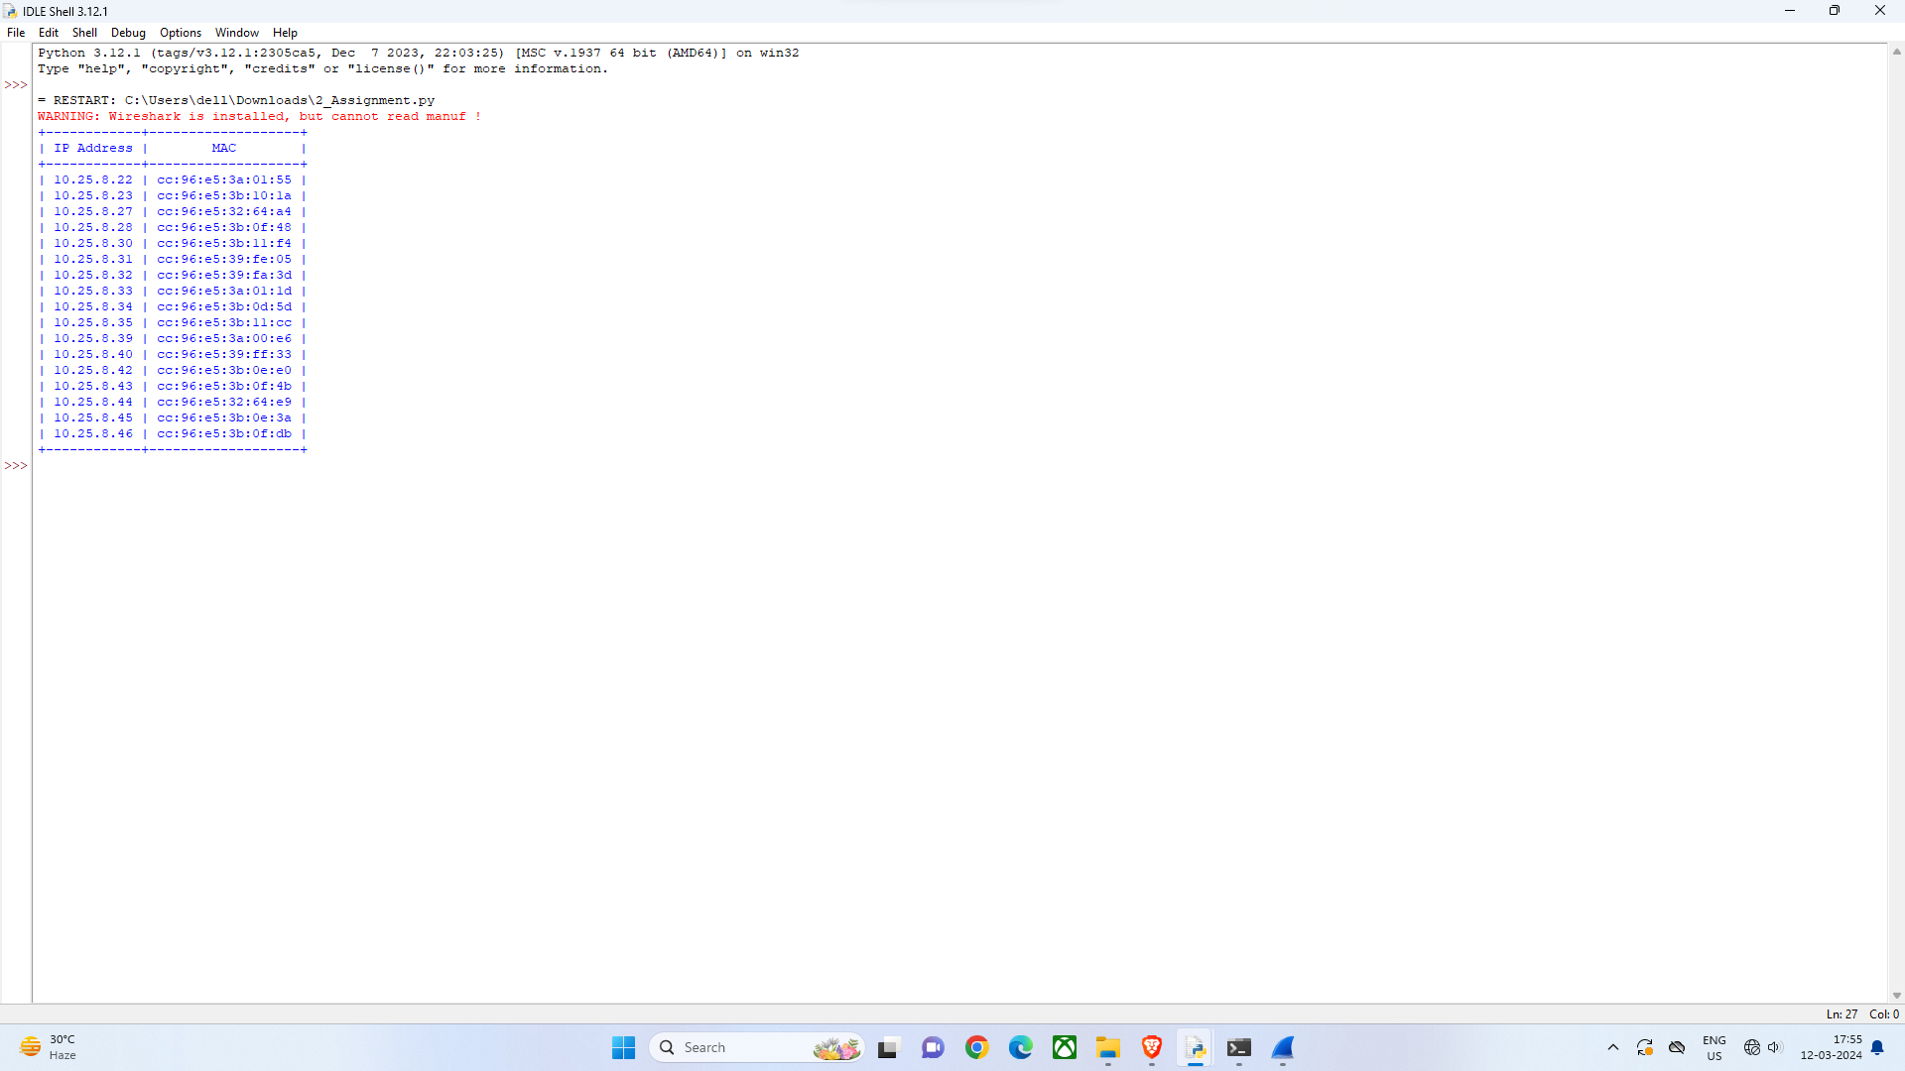
These are the ip address and Mac address that i recieved

Slide 3
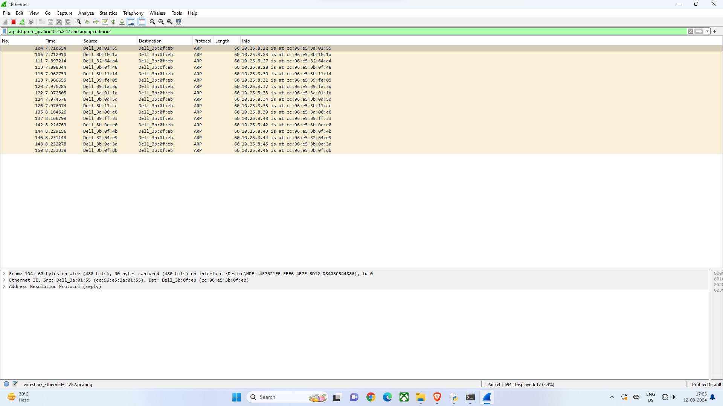
This is my Wireshark output

